Slide 2
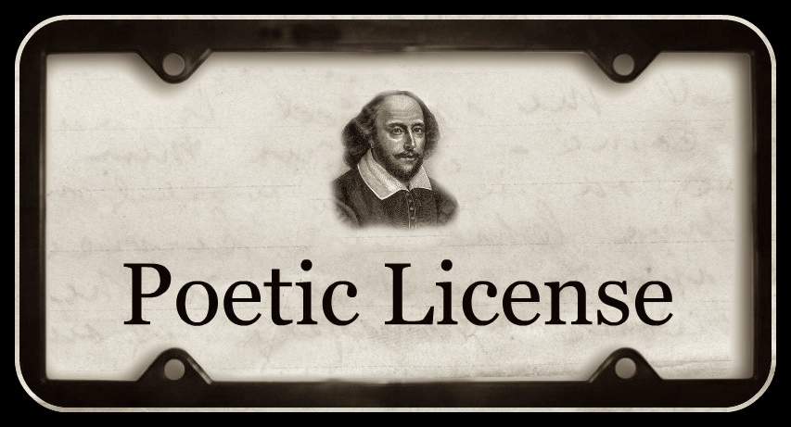
http://adelekenny.blogspot.com/2011/06/poetry-prompt-59-poetic-license.html

Slide 3
CATS.

Slide 4
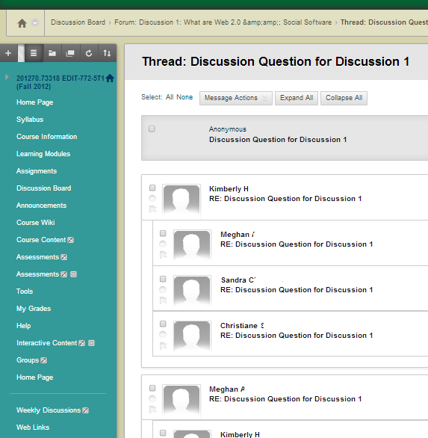

Slide 5
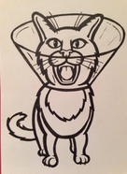
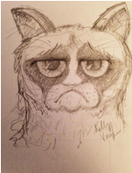
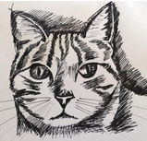
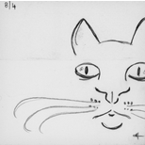
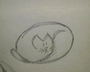
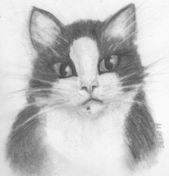
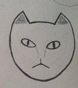
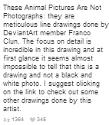
ACR324 Assignment 1: Draw a Cat

Slide 6
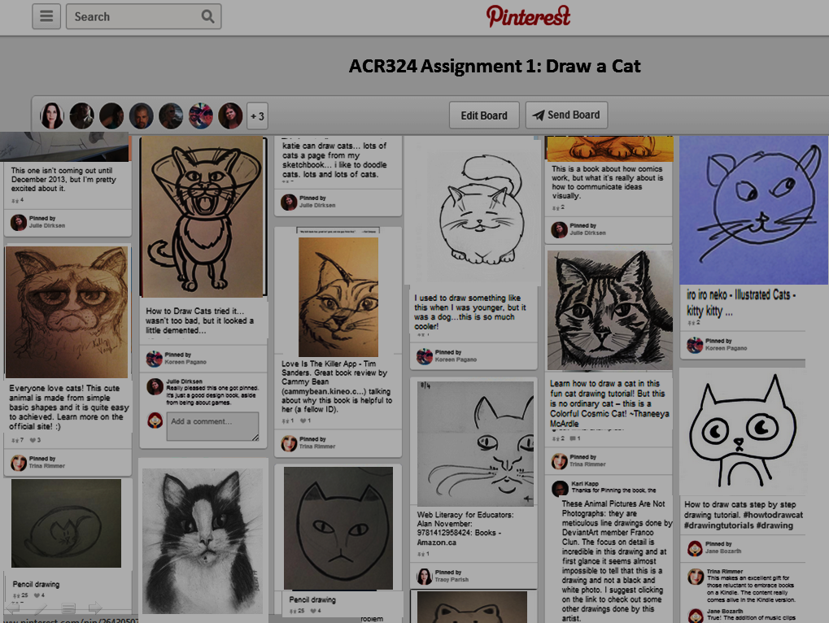
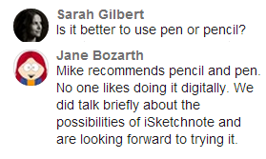
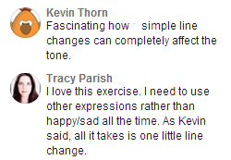

Slide 7
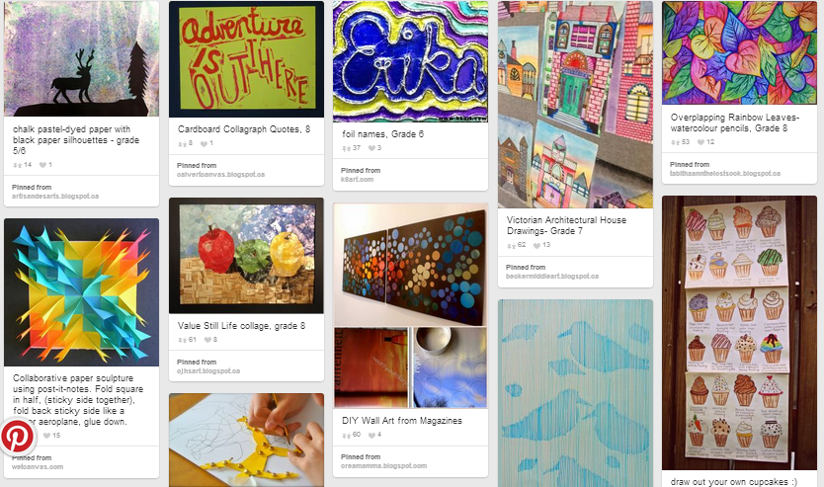
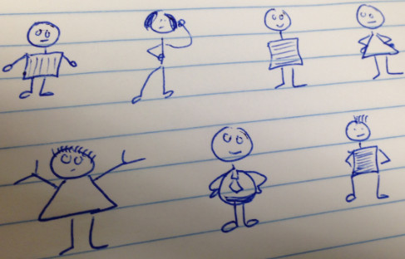
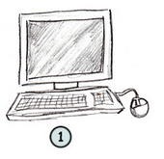
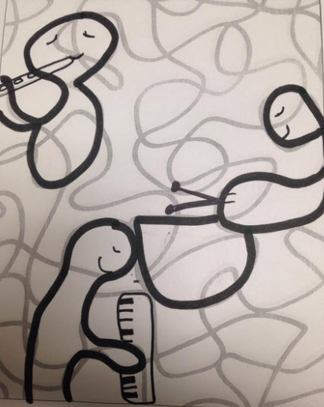
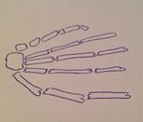
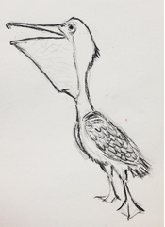
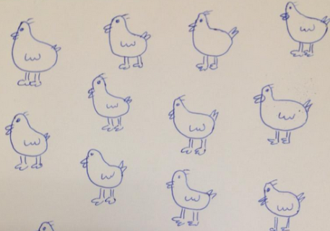
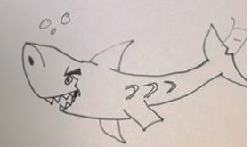
ACR324 Liza

Slide 8
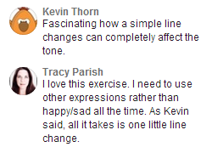
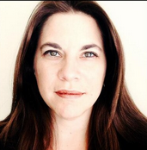
Tracy Parish I felt kind of silly drawing the same chicken over and over, but now I get the “Draw it 50 times to make it yours” rule. This helps to fix it in your brain. It also helps with confidence and speed.

Slide 9
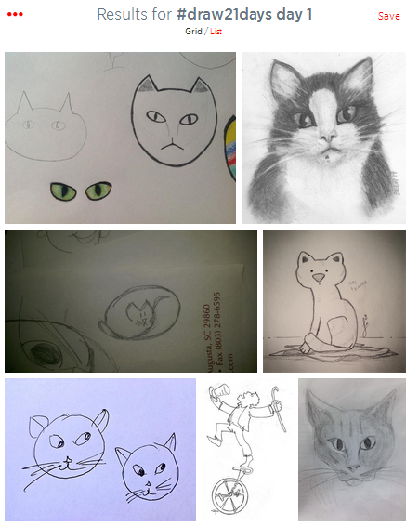
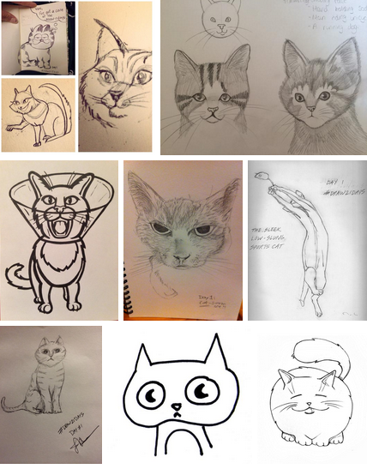
Results for #ACR324 Day 1

Slide 11
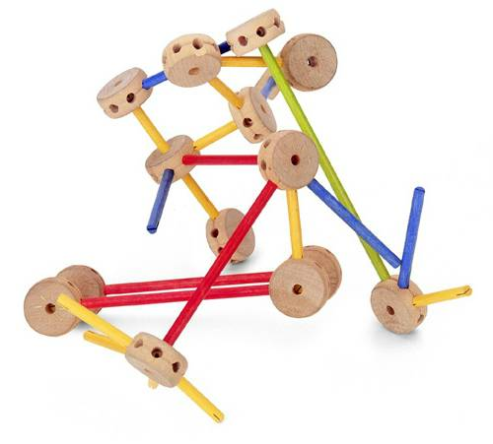
Toys
to
Tools
http://26.media.tumblr.com/tumblr_l6l0uagfyO1qczpamo1_500.jpg
Notes:
You may have heard that some organizations are opposed to the use of social media and other tools in the workplace. Often this is because they are perceived as toys, not tools. Let’s look at that perception and ways we can change it.

Slide 12
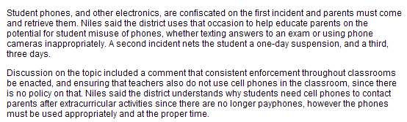
=
confiscated
enforcement
Notes:
Really? The TOP problem in a high school is cell phones? This is what the vice principal said:

Slide 13
“If it’s illegal to text while driving, then it should be illegal to do it while learning as well.”
Notes:
This is what the vice principal said. Meantime this is what a school across town figured out:

Slide 14
“They are classroom computers you can make phone calls on.”
Notes:
And this is what their vice principal said:

Slide 15
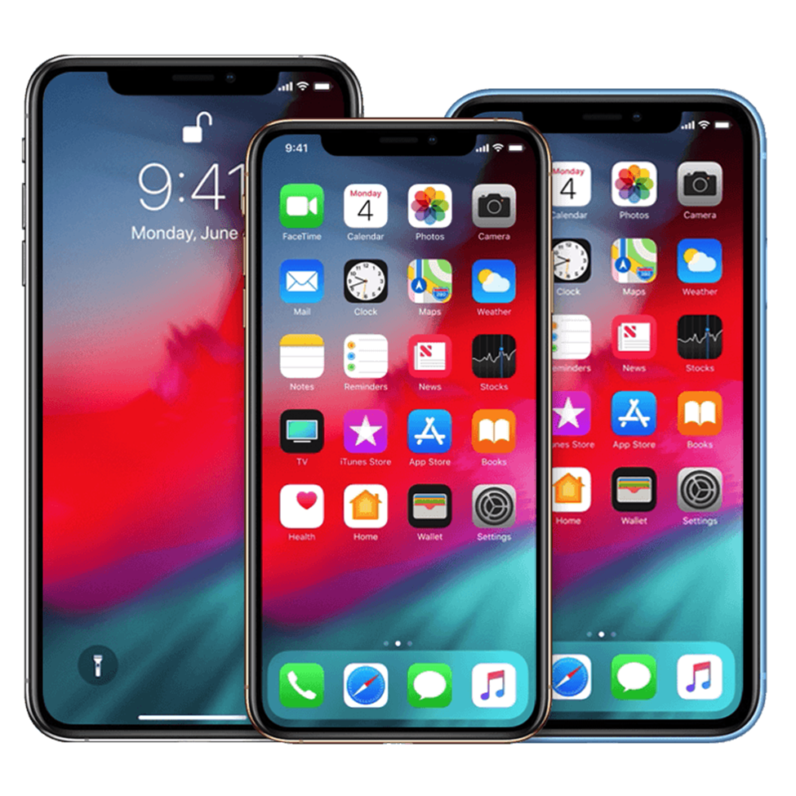
“They are classroom computers you can make phone calls on…
…and the parents are paying for them.”
http://www.yuckles.com/halloween-womens-clearance-costumes.html
Notes:
And the vice principal there realized something else

Slide 16
Are you introducing a tool… or facilitating a shift?

Slide 17
Notes:
Public perception is often that smartphones are just toys. Look at what the public said when the Army said it might give iPhones to soldiers:

Slide 18
Notes:
But look at what developers are doing using these tools as a platform. These won first prize in the Army’s app competition:

Slide 19
US ARMY apps
Movement Projection
Map-routing app for road navigation that allows soldiers to input obstacles and threats—and start, stop, and end points—and calculates the fastest route.
Naturepedia
Database on edible and harmful plants around the world as well as dangerous snake species in Afghanistan and nearby regions. Users can easily thumb through images with their device.
Disaster Relief Operations
Survey, dissemination and evaluation tool for searching, editing and creating maps viewable on Google Earth and Google Maps. Assists Army personnel working in humanitarian relief and civilian affairs operations.

Slide 21
Notes:
Don’t take everything so literally

Slide 22
https://thenextweb.com/augmented-reality/2017/07/18/the-nightmare-future-of-google-glass-2-0-in-the-workplace/
Notes:
Don’t take everything so literally.

Slide 23
Smart Hardhats
Daqri https://www.enr.com/ext/resources/Issues/National_Issues/2015/November/23-Nov/DAQRI_Smart_Helmet_Lifestyle_150_0001_ENRready.jpg
Notes:
Don’t take everything so literally.

Slide 24
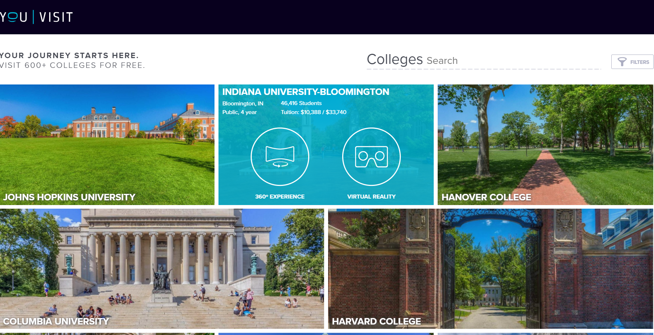

Slide 25
Examples
What problem are you trying to solve?

Slide 26
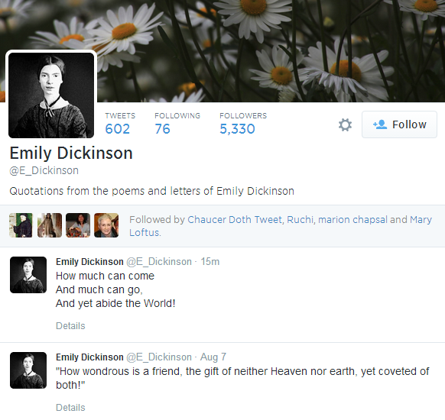

Slide 27
Accounting. Statistics. Chemistry. Medicine.

Slide 28
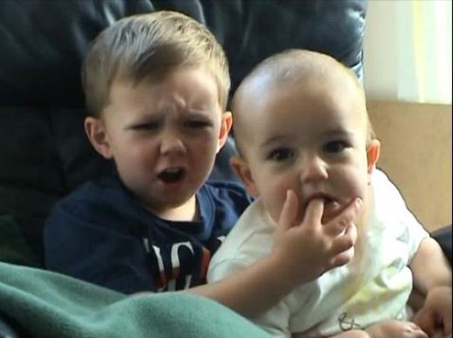

Slide 29
Notes:
I took the porn out of the comments.

Slide 30
Notes:
This is my favorite.

Slide 31
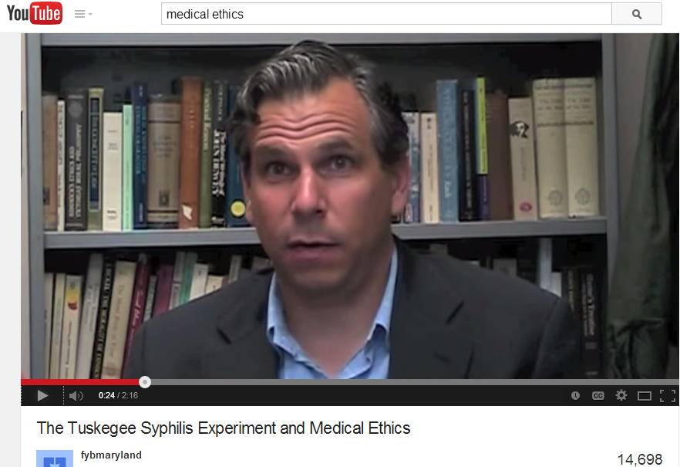

Slide 33
Notes:
But **I** go to YouTube and I find the Internet personality TonyaTKO, who’s figured out a way to leverage YouTube to engage with her audience:

Slide 34
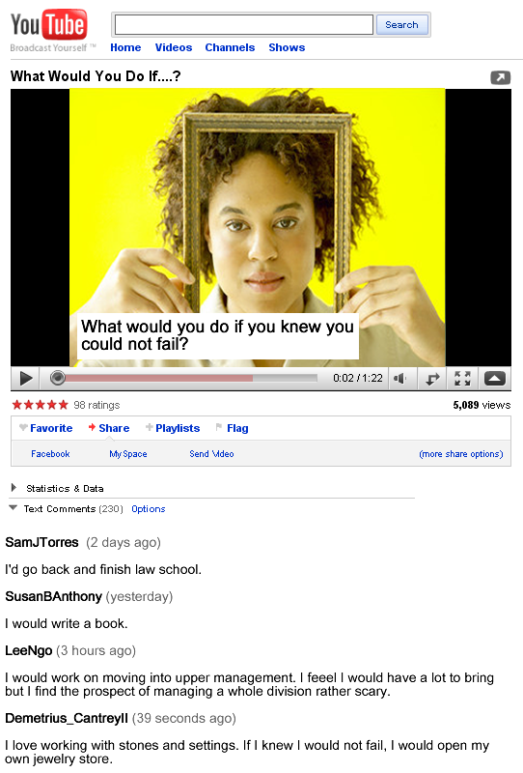
Notes:
She stands in front of a running camera and says, “What would you do if you knew you could not fail? Type your answer in the comments area below.” And then she just stands there, with the camera running, for 30 seconds.

Slide 35
Notes:
So far she’s had more than

Slide 36
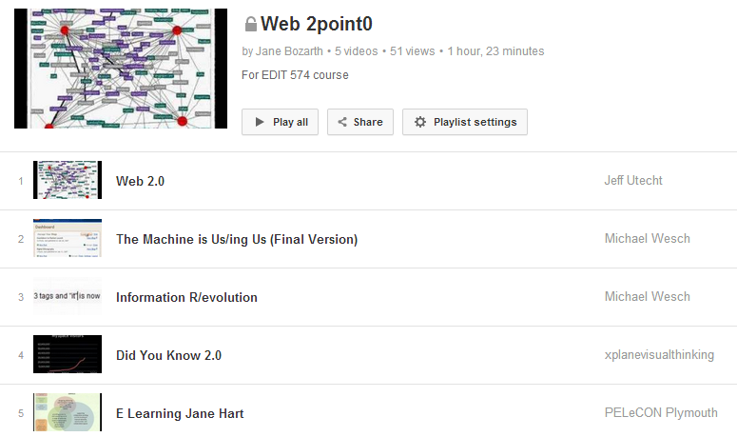
Notes:
But **I** go to YouTube and I find the Internet personality TonyaTKO, who’s figured out a way to leverage YouTube to engage with her audience:

Slide 37
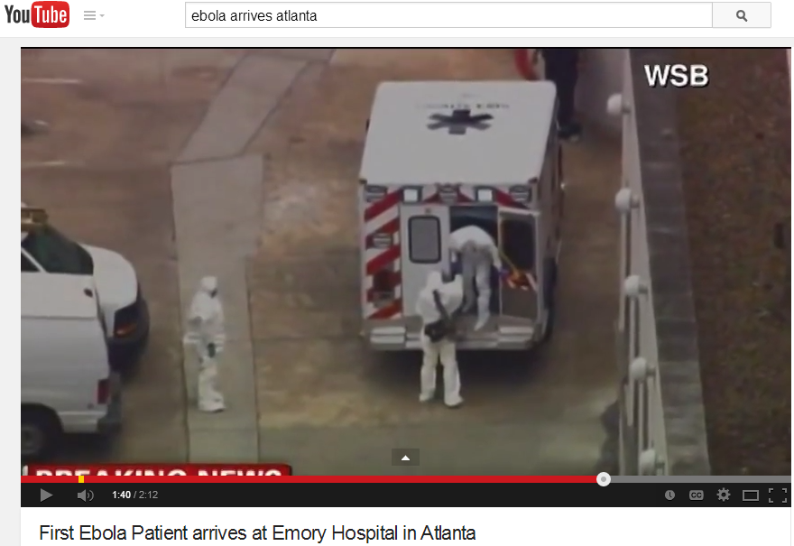
Notes:
But **I** go to YouTube and I find the Internet personality TonyaTKO, who’s figured out a way to leverage YouTube to engage with her audience:

Slide 38
1. Write script: YouTube video presenting concept in Organic Chemistry in a visual way
2. Two examples why content important
3. Check in with instructor
4. Create & upload video

Slide 39
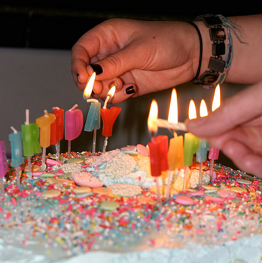

Slide 40
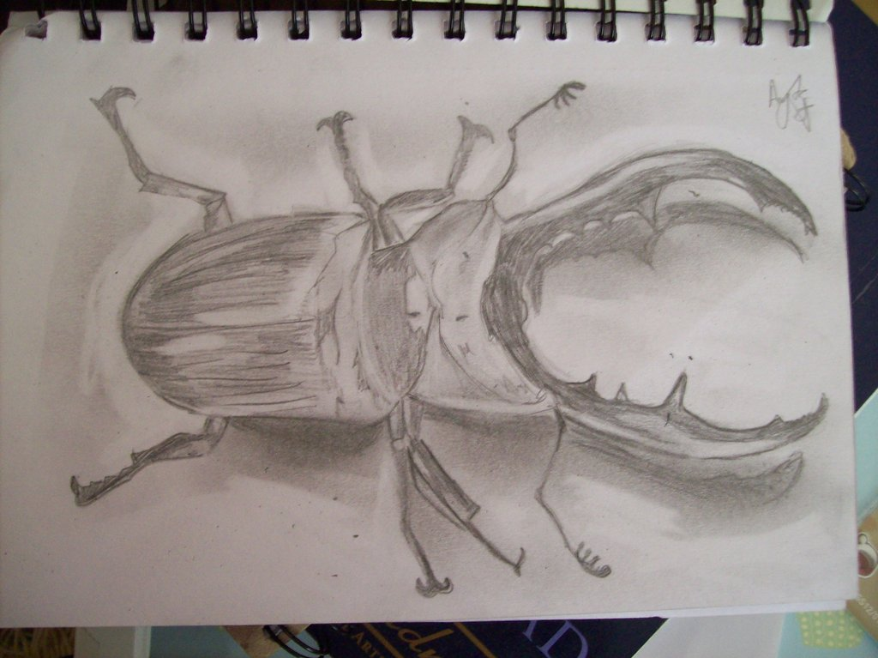
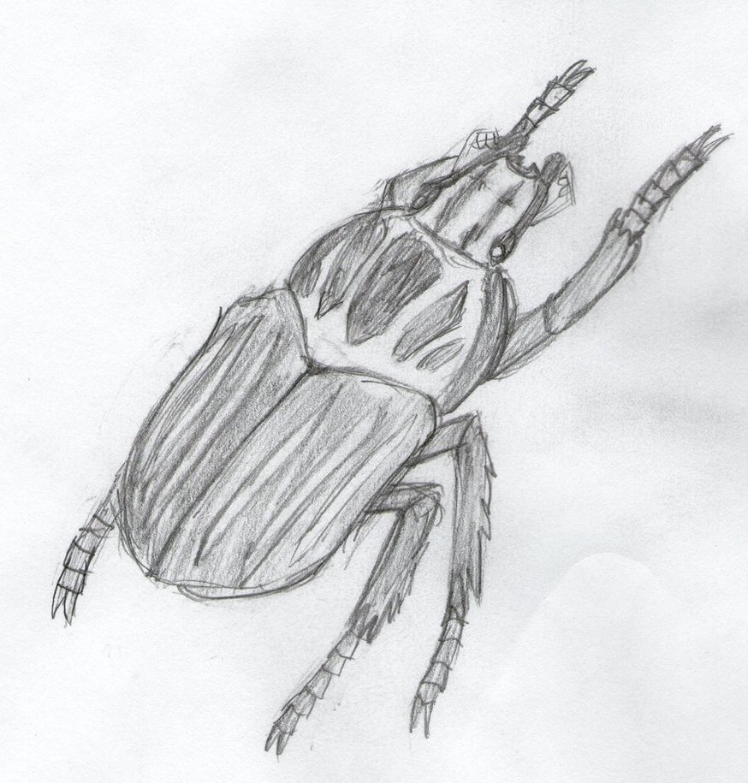
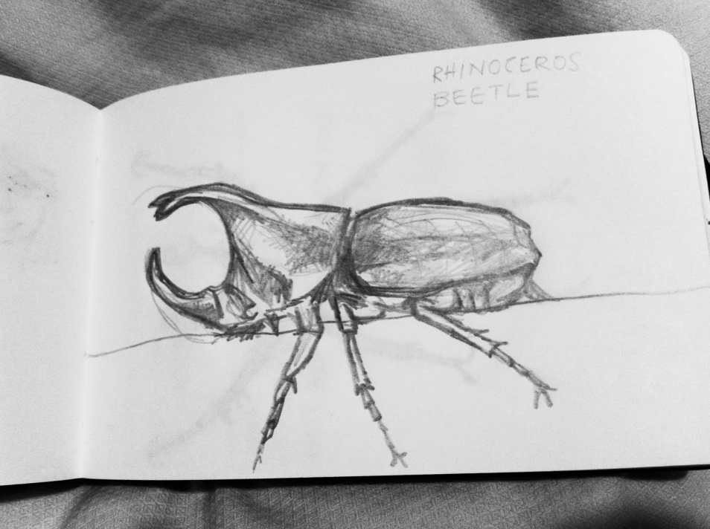

Slide 41
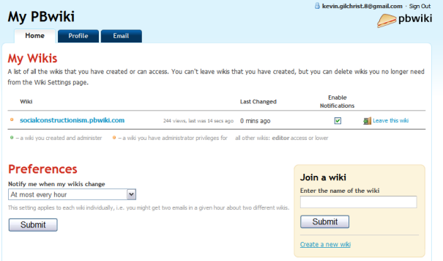
Undergrad Psychology Course
Teams take turns working collaboratively to create a wiki page on that week’s lecture topic.

Slide 42
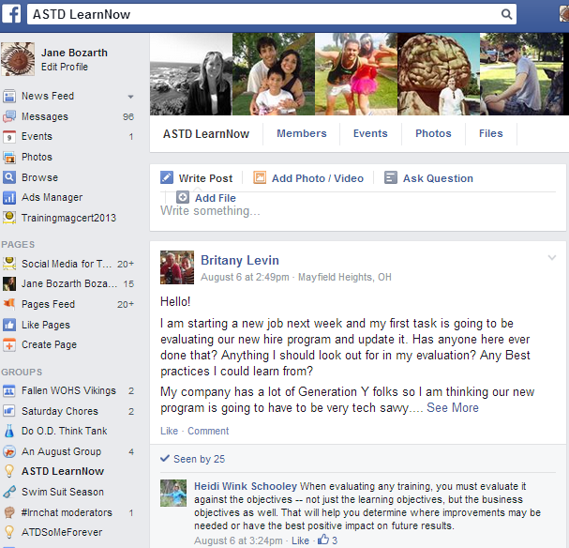
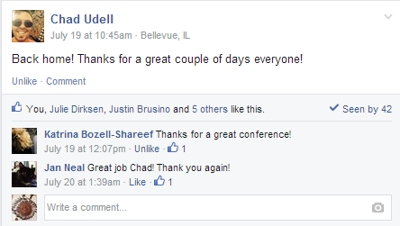
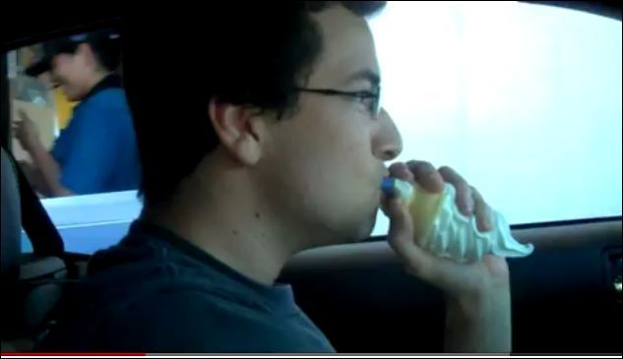
Baylor Sociology 214
QUESTION OF THE DAY: What are some factors that influence crime?
Socialization in childhood.
Level of education; issues with learning disabilities
Hilarious. Did you look
back to see the reaction?
Say more about socialization?
This is a good example of violating a
social norm in the name of a better solution.

Slide 43
Baylor Sociology 214
Hilarious. Did you look
back to see the reaction?
This is a good example of violating a
social norm in the name of a better solution.

Slide 44
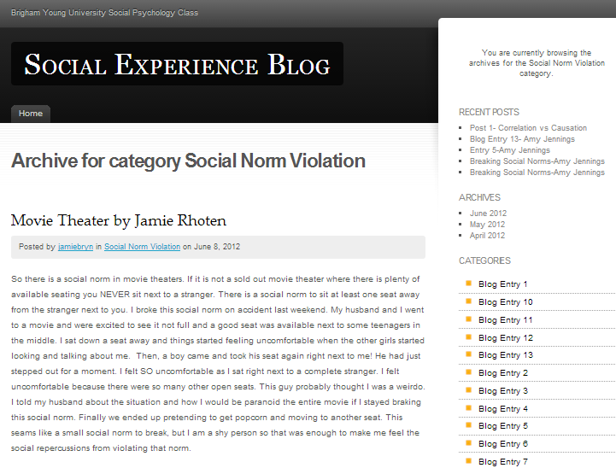
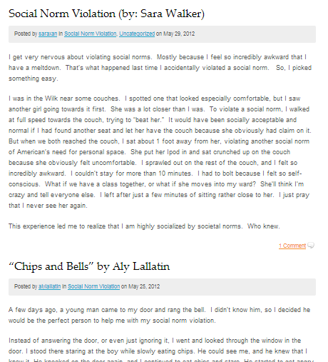

Slide 45
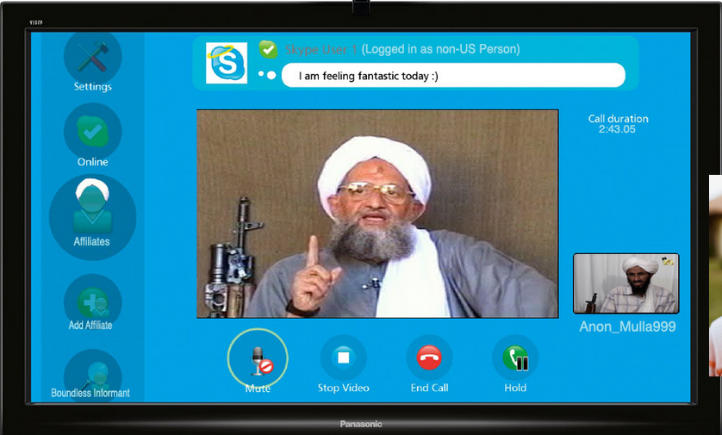
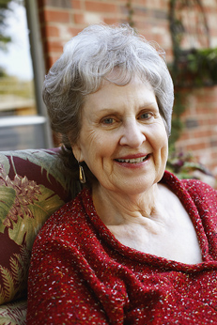

Slide 46
Not just courses…

Slide 47
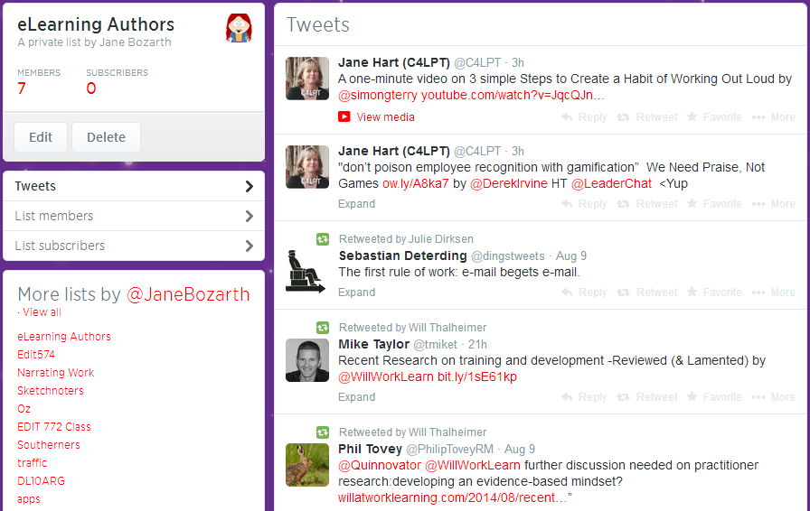

Slide 48
Chewing gum and calorie intake. Should we be concerned that Wrigley Science Foundation funded this? http://bit.ly/2PJ9Nm #ncpsy234

Slide 49
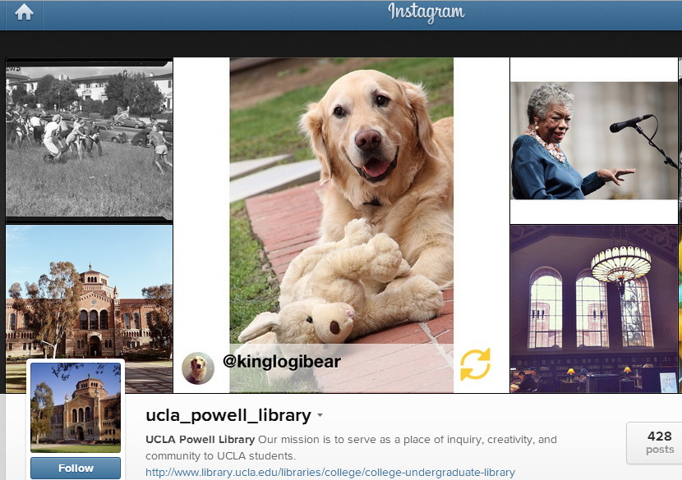

Slide 50
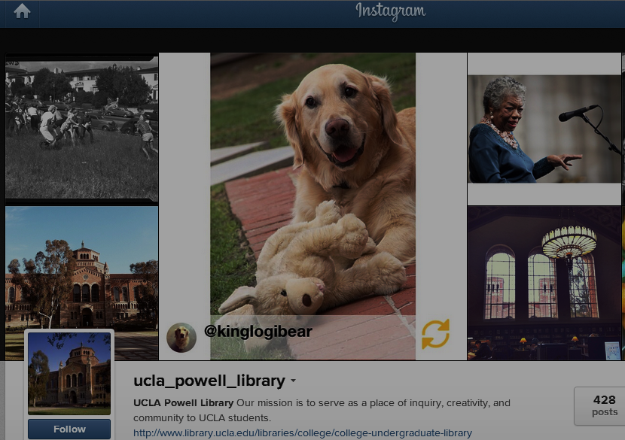
“We incorporate content that emerges from UCLA’s curriculum. By doing so, we seek to distribute to others in the community the knowledge that comes from one course.”

Slide 53
"Green Media“: media-studies course devoted to making media about making food
Composition Course: “Food and You”

Slide 60
https://www.cc.gatech.edu/news/609284/jill-watsons-terrific-twos

Slide 62
http://www.pinterest.com/tracyparish /id-elearning-books/

Slide 63
Notes:
Happen to see each other on Twitter I happened to read about ways of managing lit for qual dissertation

Slide 64
Linda Kirkman: HOW I WROTE MY THESIS.

Slide 65
https://www.teachingchannel.org/videos/when-lesson-plans-fail

Slide 66
Problems

Slide 69
2,000
photos !?!

Slide 70
Please Read Carefully
Teams A and B will post to Flickr on alternate Tuesdays starting next week but skipping election day and Tuesdays with “3” in them.
Notes:
“Students need to trust their learning environments” ~ Stone et al

Slide 71
Create a unique username including the year you were born with the last 2 digits reversed
Click here for live help during business hours. In Perth.
Create a password that includes a hyphen but no dash and pi to 6 places, backwards
FILES
See the red “files” link for more instructions about things that if you don’t get right will severely affect your grade. Not for the better.
You can upload a pdf but only in black and white. Convert color to grayscale and save in PPT 2003 before uploading as a PDF.
Your session will time out in 4:59.

Slide 72
We’re going to use MySpace because Facebook won’t let you have daguerreotype profile pictures.

Slide 73
Answers

Slide 74
http://www.smartwomensempowerment.org/start-your-business-with-the-end-in-mind/

Slide 75
The point is to enable more learning, not generate more work.

Slide 76
One mOne more point: THIS is what “technology” is about.

Slide 78
Jane Bozarth Director of Research eLearning Guild
www.bozarthzone.com

