Slide 1
Disruption to Design
Diana Oblinger
April 9, 2019

Slide 2
The mission of higher education does not change, but the context does.
Notes:
transition

Slide 3
Rather than being “disrupted,” we can use disruptions for design.

Slide 4
disruptions
Notes:
Overview of key disruptions

Slide 5
Professional work is being reconfigured.
Notes:
Because machines are getting smarter, they can do things we used to.

Slide 6
Smart Machines
AI solves problems but doesn’t replicate the thinking process of humans
Uses “brute force” computing enabled by massive processing power and memory
Applications span all disciplines
AI will contribute up to $15.7 trillion to the world economy by 2030
Global GDP may grow 14% as a result of AI
By 2020 algorithms will positively alter the behavior of over 1 billion workers
6.2 billion hours of worker productivity recovered by 2021
Notes:
AI will have a massive impact on jobs and the economy
https://www.flickr.com/photos/mikemacmarketing/30212411048
Gartner figures for 2020 and 2021 numbers; See https://www.gartner.com/newsroom/id/3482117 and https://www.gartner.com/newsroom/id/3837763
The Future of the Professions; p 165
AI Will Add $15.7 Trillion to Global Economy Bloomberg New June 28, 2017
https://www.bloomberg.com/news/articles/2017-06-28/ai-seen-adding-15-7-trillion-as-game-changer-for-global-economy
Image: https://www.google.com/search?q=IBM+watson&source=lnms&tbm=isch&sa=X&ved=0ahUKEwj6w_vCs7bUAhVh5oMKHVyYB2UQ_AUIDCgD&biw=1280&bih=574#imgrc=GZwin_0keNS_8M:

Slide 7
Occupations will evolve alongside increasingly capable machines.
Notes:
Because of the combination of human intelligence and AI, occupations will evolve.

Slide 8
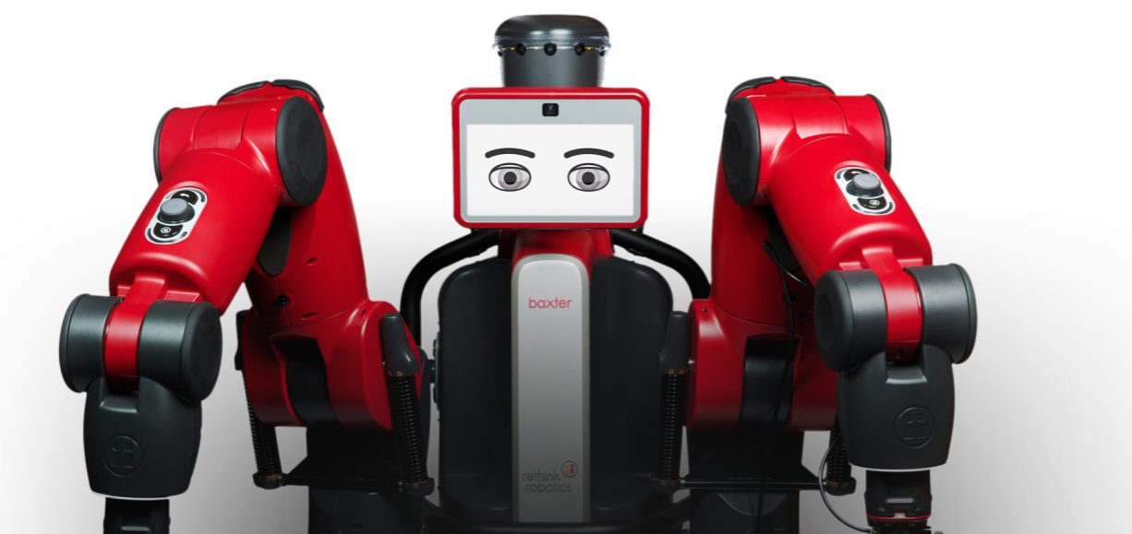
Jobs Changed
New technologies have spurred the creation of more jobs than they have destroyed
When tasks are automated, workers perform new tasks
New technologies have raised productivity growth
Jobs Gained, Changed and Lost by 2030
One-third of the workforce may need to learn new skills or occupations
8-9% of labor demand will be in new types of occupations
It will be a challenge to ensure professionals have the skills to support the transition to new positions
Notes:
Tasks change (e.g., automated) so we need to learn new skills. Workers are constantly being “promoted” by automation.
Replaces tasks, not entire jobs (e.g., DaVinci precision surgery)
Machines can:
Discern patterns, identify trends and make accurate predictions
Perform cognitive tasks that often required human intelligence
Interact with manual skill and dexterity in the physical world
Image: http://www.rethinkrobotics.com/baxt
McKinsey Global Institute: Jobs Lost, Job Gained: Workforce Transitions in a Time of Automation. December 2017. https://www.mckinsey.com/mgi/overview/2017-in-review/automation-and-the-future-of-work/jobs-lost-jobs-gained-workforce-transitions-in-a-time-of-automation
In 10 years robots have moved from making cars to driving them. (The Future of the Profession, p 167)
Text from above on page 168
Every year in manufacturing 200,000 industrial robots are installed, adding to an expected total of 1.5 million robots in 2015.

Slide 9
There will be a new division of labor between “man” and machine.
Notes:
One of the new ways to work will be with machines.

Slide 10
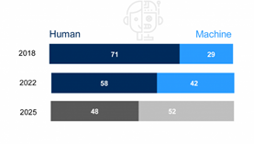
Learning New Skills
Tasks will shift from high-skilled workers to lower-skilled ones
Workers will need 101 days of retraining and upskilling by 2022
50% of organizations will lack sufficient AI and data literacy skills
Cross-functional and agile ways of work will increase
Work will be unbundled and re-bundled
The machine share of task hours will increase from 29% to 52% by 2025
Workers will need the right skills to complement new technologies
“Digital dexterity” and the ability to use information as a second language will be critical
Notes:
More tasks will be done by machines; people will need to work with machines, e.g., using information, coding. Example from Bosch in Germany.
Gartner suggests “digital dexterity” or the ability to use information, data, media and technology
https://www.weforum.org/agenda/2018/09/future-of-jobs-2018-things-to-know/
McKinsey. May 2018. Skill Shift: Automation and the future of the workforce page 36, 40; https://www.mckinsey.com/featured-insights/future-of-work/skill-shift-automation-and-the-future-of-the-workforce
Gartner: digital dexterity and information as a second language: see https://www.gartner.com/newsroom/id/3879581 (Singapore rated #6). “An organization with high digital dexterity has employees who have the cognitive ability and social practice to leverage and manipulate media, information and technology in unique and highly innovative ways.”

Slide 11
Sustainable career paths depend on transferable skills.

Slide 12
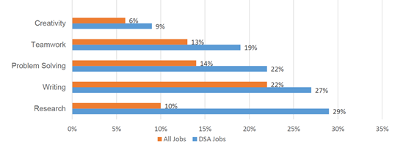
“Mobility Skills”
“Soft skills” are really employability or mobility skills
Critical thinking
Problem-solving
Communication
Collaboration
Planning and project delivery
Teamwork
Metacognition
These uniquely human skills transfer from domain to domain
Increase in hybrid jobs: every job is “digital”
Human+ skills combine technical skills with human skills such as
Programming + communication
Artificial intelligence + emotional intelligence
Logic + ethics
Notes:
Bridging the Gap Between Education and Occupation: Business Roundtable survey of 177 member companies on workforce talent. See https://www.asa.org/wp-content/uploads/2017/07/Education-and-Occupation-Whitepaper.pdf
Text from BHEF, IBM, Burning Glass presentation
Also WSJ, May 31, 2017 “Human Role in IT Evolves as Automation Gains Pace”
Michelle Weise presentation on Human+ skills
Also see https://www.bloomberg.com/graphics/2015-job-skills-report/ for more information about desired skills from MBA programs

Slide 13
A global skills marketplace is emerging.

Slide 14
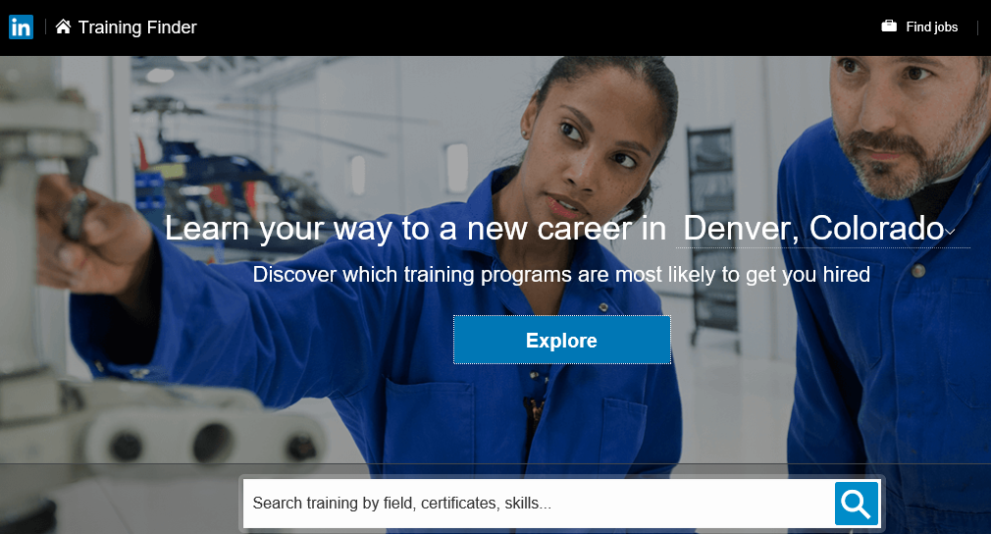
Talent Platforms
Online talent platforms help match job-seekers with skills and link to the labor market—a way of closing the skills gap
National programs, e.g., Singapore’s SkillsFuture, aim to grow skills
Talent development via a “60-year curriculum”
LinkedIn
Credential and competency clearinghouse, connecting and developing talent
562M registered members; 200 countries; 50M skills; 20M companies; 15M open positions; 60M schools
Signaling between sectors improves career readiness
Talent development guidance, e.g., LinkedIn Learning
Notes:
15 million active job postings
Skills gap, “market information” or matching problem?
Becoming the online resume of record
Vision: To own the ‘economic graph’ that connects talent with job opportunities on a massive scale
500+ million registered members worldwide
200 countries
24 languages
10 million active job postings
Becoming the online resume of record by default; also lots of job postings
Becoming a credential and competency clearinghouse
Doesn’t just match people; provides information to institutions, individuals, etc.
Acquisition of Lynda.com adds another dimension—possibly a massive “course catalog” that enables one to obtain relevant skills.
LinkedIn has partnered with Skillful, a Markle initiative, to help members discover better careers
Goal: create better information ecosystem so employers, educators and job aspirants can get in better alignment faster and more effectively
University pages: shows career paths of each institution’s graduates—helps students see themselves as going to someplace other than Harvard or Yale.
Another example: Viridis plays matchmaker between community colleges, students and employers

Slide 15
Courses & curricula

Slide 16
Digital skills will be required in all disciplines.

Slide 17
Medicine in the Digital Age
Medical students need key digital skills
Units include:
Social media
Digital physician-patient communication
Smart devices
Apps
Telemedicine
Virtual reality
Big data
Medicine in the Digital Age: Mainz, Germany
Premise: Doctors and patients have changed in the digital age, as has medical practice
Data and biobanks of patients can be analyzed (big data and predictive medicine)
Smart systems, digital remote systems and robotics can offer precision, personalized approaches
Physicians need information literacy to integrate digital medicine approaches and weight risks and benefits
Notes:
https://blog.der-digitale-patient.de/en/medicine-in-the-digital-age/
https://teach-different.com/_medizinstudium-4-0_/
Image from https://blog.der-digitale-patient.de/en/project/

Slide 18
You learn to do what you do.
Notes:
We don’t just want to learn about something—we want to learn to do things.
No point in wasting time to learn about something—learn to do it. It is faster and more engaging.

Slide 19
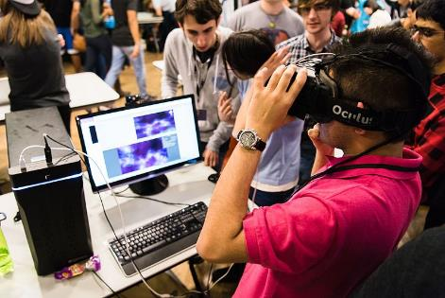
Experiential Learning
Learner engagement higher
Outcomes include greater ability to:
Innovate and take risks
Solve complex problems
Collaborate across differences
Think critically and reflect on learning
Augmented, virtual and mixed reality embed students in their learning, resulting in greater retention
Other forms of experiential learning include:
Simulations
Games
Haptics
Notes:
An example of how you can learn more, faster is experiential learning. Can be hands-on, VR, AR, etc.
Retention rates are 50-75% compared to traditional instruction (10%)
Time in training can be reduced (40%)
http://ivrtrain.com/ivrtrain/VR_Learn_Report-2017.pdf
https://www.shrm.org/resourcesandtools/hr-topics/technology/pages/why-virtual-reality-training-for-employees-is-catching-on.aspx
Image: https://commons.wikimedia.org/wiki/File:VR_at_HackIllinois_2016.jpg

Slide 20
Assessment will become continuous and a fundamental part of learning.

Slide 21
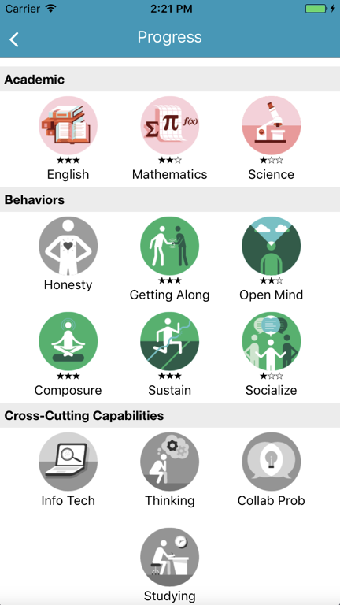
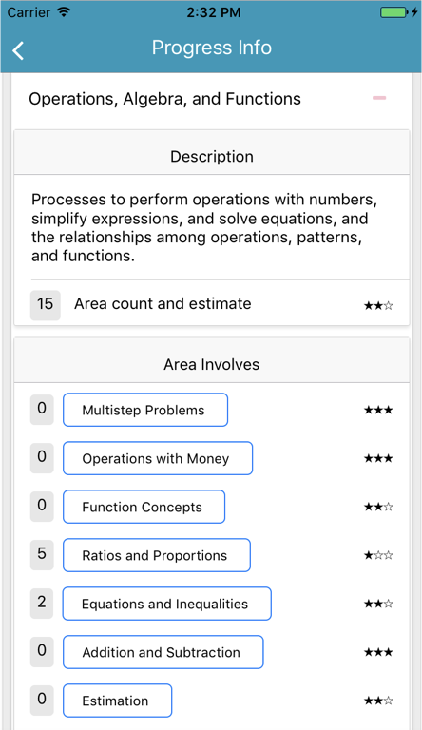
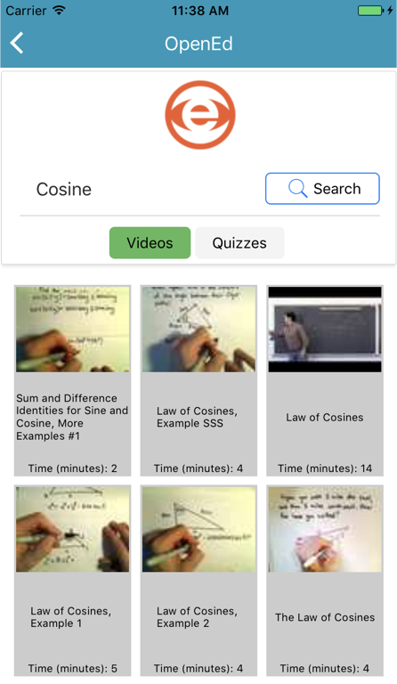
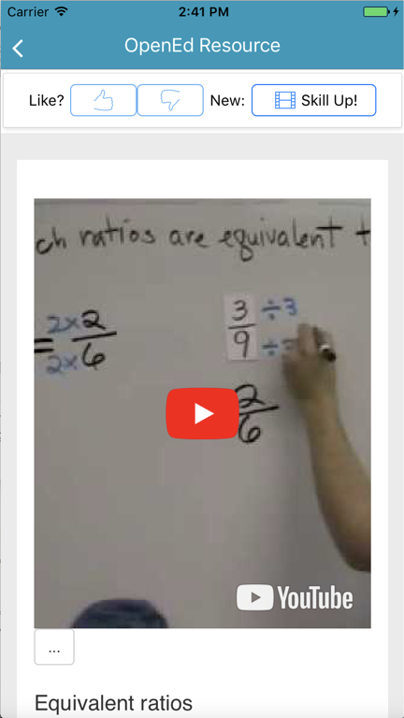
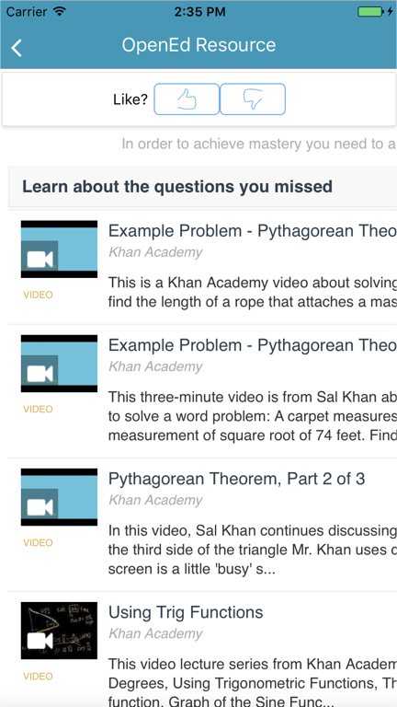
Self-Directed Pathways
Dynamic cognitive diagnostic models and machine learning algorithms personalize pathways
Useful for improving cognitive and social/emotional skills
Forms an infrastructure for personalized, holistic learning
Applicable in K-12, HE and workplace
Educational Companion App: ACTNext
Notes:
ACTNext

Slide 22
Virtual personal learning assistants can augment human capabilities.

Slide 23
Algorithms and Outcomes
Teacherbots as TAs (e.g., “Jill Watson” at Georgia Tech)
Georgia State University handled 200,000 calls during enrollment period with chatbot
Chatbots can be used to teach and assess collaboration
Genie (Deakin University)
Intelligent virtual assistant provides student advice
Genie is a platform, presented through a mobile application, comprised of chatbots, artificial intelligence, voice recognition, and a predictive analytics engine
Platform is integrated with LMS, library and Watson
Notes:
Image clipped from video at https://www.youtube.com/watch?v=zsRPuU53E74
https://www.itnews.com.au/news/meet-genie-deakin-unis-virtual-assistant-for-students-453230
Smart technologies don’t necessarily result in smart outcomes.
According to John Seely Brown: “The technology is the easy part. The hard part is figuring out the social and institutional structures around the technology.”

Slide 24
Nudges can guide learners to better outcomes.

Slide 25
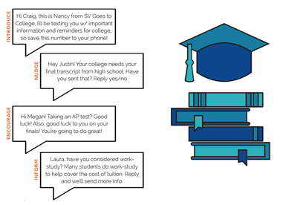
Influencing Behavior
Uses of nudges
Nudge theory: behavior can be influenced by small suggestions
97% of college students use texting as their primary means of communication
Used in admissions, financial aid, student success, courses, alumni relations
The cost of student attrition is estimated at $16.5 billion
Community college freshmen in financial aid campaign were 14 points more likely to persist; with an average enrollment of 12,000 students $2.9M would be saved in tuition/year
Students in another campaign completed more freshman credits; change was most pronounced for low-income students
Notes:
http://docs.house.gov/meetings/AP/AP07/20150318/103142/HHRG-114-AP07-Wstate-CastlemanB-20150318.pdf
https://curry.virginia.edu/sites/default/files/uploads/epw/43_West_Virginia_College_Success_Nudges.pdf
https://curry.virginia.edu/uploads/resourceLibrary/29_Freshman_Year_Financial_Aid_Nudges.pdf
https://www.mongooseresearch.com/blog/2017/10/12/five-novel-uses-of-texting-to-engage-students
Cost of attrition from Wyzant
Financial aid campaign: increased retention from 60% to 74%. Average community college size is 12,000 students
Nudge theory: behavior can be influenced by small suggestions and positive reinforcements. Noble Prize awarded to Richard Thaler for his work on nudges and behavioral economics.
Cost of Signal Vine texting campaign: $10 per student

Slide 26
Credentials & Careers

Slide 27
Learning will come in all sizes.
Notes:
Learning doesn’t have to be big to be effective.
https://www.edsurge.com/news/2017-11-06-as-corporate-world-moves-toward-curated-microlearning-higher-ed-must-adapt

Slide 28
Micro-learning
Microlearning: skill-based education using micro-content
Activities can be integrated into the learner’s daily routine
Immediate application of learning increases participation and knowledge
Google “Whisper” Courses
Microlearning is used to nudge managers to take action when they receive management survey results
Managers who receive whisper lessons improve on the attribute by 22-40%
95% of participants recommend the course
Notes:
Not everything needs to be a day-long or even hour-long course. Micro-learning can be very effective.
https://rework.withgoogle.com/blog/whisper-courses/

Slide 29
Certificates, diplomas, and informal learning are being integrated into online identities.
Notes:
We learn all the time. The learning isn’t random. It can be guided and integrated.
Think about pathways to accumulate that learning and use it to lead you to the next opportunity, learning experience.

Slide 30
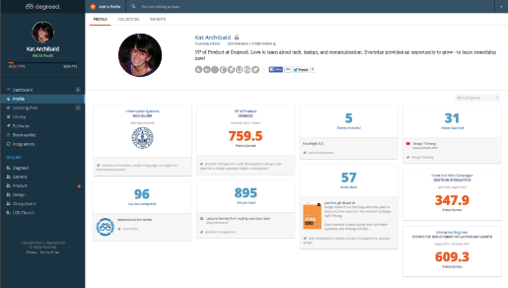
Continuous Learning
Online, updatable framework to track and score learning
Tools recommend, track, organize and validate online education (e.g., TED talks, MOOCs, Lynda.com, etc.)
Integrates academic, professional, and informal learning activities
Degreed
Skills framework creates data about what people can do and matches them to career opportunities
Skill Review
Individual Development Plan
Career Pathing
Creates a personalized learning profile and dashboard with a point system, similar to a FICO score
Notes:
In a world of continuous learning, we should be able to integrate digital credentials.
Image: https://cdn0.capterra-static.com/screenshots/2100281/12963.png
http://csc.gov.ky/sites/default/files/news/Degreed-Point-System.pdf
Degreed’s original mission: “to jailbreak the degree”—create “the world’s first digital lifelong diploma”
People are learning throughout life. Estimate of 700 hours of “personal learning projects” per person each year. Read a book. Take a course on Lynda.com or a module from Khan Academy.
New tools appearing that help individuals and organizations aggregate that information
Degreed is an example; they offer both corporate enterprise accounts and individual accounts
Companies use Degreed “to demystify and delineate the path to promotion or a move to another division. Employees may need to learn X, Y and Z skills, and they can demonstrate that through their Degreed profiles.” https://www.edsurge.com/news/2016-01-06-degreed-gets-to-work-collects-21m-in-second-fundraise-in-10-months/
“The future doesn’t care how you became an expert.” from Degreed website

Slide 31
Next generation assessments can discover talent.
Notes:
AI will allow us to do a lot of things differently—like hiring.
The best predictor of success is not necessarily a degree.

Slide 32
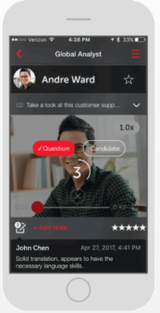
Data-Rich Assessments
Predictive assessments can evaluate job aptitude (emotional intelligence, personality traits, cognitive ability) in < 30 minutes
Video-based assessment
Game-based assessment
Data generated on candidate characteristics
HireVue
Digital interviews, e.g., 3 questions and business case
25,000 data points from 15-minute video interview
Game-based assessments, predictive of cognitive skill
Side-by-side comparison of interviews by reviewers
Unilever, for example, reduced time-to-hire from 6 months to 6 weeks with cost savings of over $1M/year
Notes:
Developing talent will be critical. The way you find it will be different, going past a credential to a skill.
It is also another example of a process impacted by new ways of working. Another implication is that a training certificate or degree may not continue to be the gold standard for getting a job or a promotion.
Verbal & non-verbal components of a 15-minute interview provide 25,000 data points compared to 100 from standard interview assessment
Use situational judgement questions, scenario-based simulations; past behavior questions in interviews
Company is able to cast a wider net because screening is more productive
Image: HireVue.com
HireVue “The Next Generation of Assessments, ” https://grow.hirevue.com/lp/offer/the-next-generation-of-assessments
NB: The best predictors of good hires are not degrees, GPA or university attended. Structured interview are better predictors. See Schmidt, Frank; Hunter, John. “The Validity and Utility of Selection Methods in Personnel Psychology: Practical and Theoretical Implications of 85 Years of Research Findings” 1998. American Psychological Association. http://psycnet.apa.org/buy/1998-10661-006.
Research Note: Quantifying HireVue’s Impact on Recruiting, Feb 2014. Nucleus Research
24% cost-per-hire
40% less time spent in interviews
13% more top performers hired
75% increased recruiter productivity
Case study on Recruiting Millennials: Unilever goes digital to transform its graduate hiring program: https://www.hirevue.com/customers/global-talent-acquisition-unilever-case-study
79% of recruiting & hiring managers believe AI will play a role in their jobs in the future. See
NB: Performance gap between internal movers and external hires is significant. External hires receive significantly lower performance evaluations for their first 2 years on the job yet are paid 18% more. Hires also have much higher rates of exit. Therefore, may be important to help companies improve internal hiring. (Email from Ike Bnnion, 10-5-18)
Add more details for talking points
Video on HireVue: https://www.youtube.com/watch?v=U-j3Ja8wTiA
For examples of how game-based assessments work, see videos from Revelian:
https://www.youtube.com/watch?v=iSaW9gw46RQ
https://www.youtube.com/watch?v=tjQWipFl_iw

Slide 33
Flipping the education-to-employment model holds promise.

Slide 34
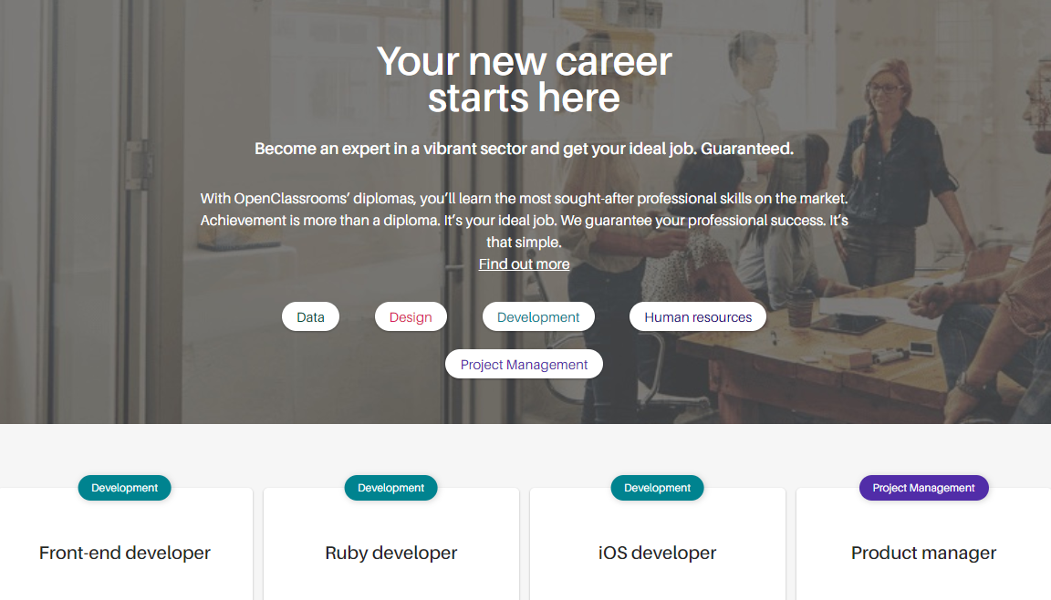
Hire-and-Train
Tech firms may spend $30K to find a new developer; a new nurse may cost $82K
The $200 billion in recruiting spend can be redirected to sourcing qualified candidates then training them
Intermediaries source and screen candidates, then educate them
OpenClassrooms & Capgemini
Skills-based program, online apprenticeship program
Learning is project-driven, designed to develop key skills
15-month program for software engineers and data scientists
3 months full-time training
12 months work-based learning (4 days work; 1 day training) on a client project
Individualized mentoring
Notes:
OpenClassrooms case study on Capgemini
Daniel Pianko, How to train 2 million American for high-skilled jobs for free: https://thehill.com/opinion/white-house/418934-how-to-train-2-million-americans-for-high-skilled-jobs-for-free
Image: https://openclassrooms.com/en/paths
MOOC facts: Inside Higher Education
OpenClassrooms: https://openclassrooms.com/en/
3 million students in 128 countries

Slide 35
Connections can be created between workplace learning and degrees.

Slide 36
Badges to Credentials
Provides pathway from workplace learning to academic degrees
IBM has issued more than 850,000 badges; more than half have been matched to NU’s academic portfolio
IBM developing joint badge programs (Wake Tech)
IBM Badges and Northeastern University
IBM badge credentials can be used towards Northeastern University professional master’s degrees:
Data analytics
Project management
Program and portfolio management
Converts industry knowledge to college credit
Notes:
“New collar” workers without a degree are moving from badges to masters degrees.
http://eddesignlab.org/2017/09/badges-change-game-hiring-ibm/
https://news.northeastern.edu/2017/09/northeastern-university-and-ibm-partnership-first-to-turn-digital-badges-into-academic-credentials-for-learners-worldwide/
Northeastern will look at 51 additional graduate degrees and 17 certificate programs to follow.
Add more detail from file:///C:/Users/doblinger/Downloads/open-badges-at-ibm-overview-for-external-21716-160217155708.pdf
Also see IBM slide decks
Under IBM’s “new collar” program, 15% of its skilled jobs are now held by workers without college degrees. Badges are seen as a way to build “competency stacks” toward those roles. IBM wants to create alternative pathways to develop skill and verify talent.
500,000 badges awarded to employees and product users
Other large employers that have recently announced badging programs for talent development or competency-based hiring: Microsoft and Ernst and Young.

Slide 37
Students want control of their own records.

Slide 38
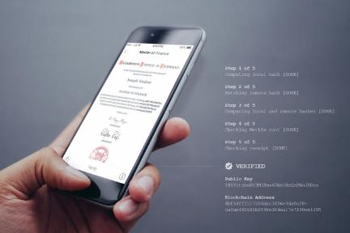
Block-Chain Records
Block-chain can allow students to have autonomy over their own records
In the future, stackable certificates may link credentials from different institutions
MIT Digital Diploma
Digital diploma can be instantly shared for free
Diploma can be verified by employers without going through an intermediary
Uses block-chain technology (Blockcerts)
The format cannot be faked
Notes:
Image: http://news.mit.edu/2017/mit-debuts-secure-digital-diploma-using-bitcoin-blockchain-technology-1017
http://news.mit.edu/2017/mit-debuts-secure-digital-diploma-using-bitcoin-blockchain-technology-1017

Slide 39
implications

Slide 40
For the next generation of education, consider:
The importance of “digital dexterity,” digital literacy or using information as a second language
The development of “human + skills” and “mobility skills”
Long-term learning relationships and talent development integrated with business and government
Assessment as a fundamental navigation tool for lifelong learning
Integrated, lifelong digital credentials

Slide 41
Diana Oblinger
doblinger@gmail.com
© 2019 All rights reserved

Slide 42
Citations
Slide 5: The Future of the Professions; page 164, quote from Patrick Winston, AI expert
Slide 6: https://www.bloomberg.com/news/articles/2017-06-28/ai-seen-adding-15-7-trillion-as-game-changer-for-global-economy; https://www.gartner.com/newsroom/id/3482117; https://www.gartner.com/newsroom/id/3837763. Image: https://www.flickr.com/photos/mikemacmarketing/30212411048
Slide 8: McKinsey Global Institute: Jobs Lost, Job Gained: Workforce Transitions in a Time of Automation. December 2017. https://www.mckinsey.com/mgi/overview/2017-in-review/automation-and-the-future-of-work/jobs-lost-jobs-gained-workforce-transitions-in-a-time-of-automation. Image: http://www.rethinkrobotics.com/baxt
Slide 10: https://www.weforum.org/agenda/2018/09/future-of-jobs-2018-things-to-know/; https://www.gartner.com/newsroom/id/3879581
Slide 12: https://www.asa.org/wp-content/uploads/2017/07/Education-and-Occupation-Whitepaper.pdf; https://www.bloomberg.com/graphics/2015-job-skills-report/
Slide 14: www.linkedin.com
Slide 17: https://blog.der-digitale-patient.de/en/medicine-in-the-digital-age/; https://teach-different.com/_medizinstudium-4-0_/. Image https://blog.der-digitale-patient.de/en/project/
Slide 19: http://ivrtrain.com/ivrtrain/VR_Learn_Report-2017.pdf; https://www.shrm.org/resourcesandtools/hr-topics/technology/pages/why-virtual-reality-training-for-employees-is-catching-on.aspx; Image: https://commons.wikimedia.org/wiki/File:VR_at_HackIllinois_2016.jpg
Slide 21: “The Evolution of Educational Testing,” Alina vonDavier, ACTNext, 2017. https://actnext.org/research-and-projects/the-evolution-of-educational-testing-from-summative-assessment-to-adaptive-learning-and-artificial-intelligence/
Slide 23: https://www.itnews.com.au/news/meet-genie-deakin-unis-virtual-assistant-for-students-453230. Image: https://www.youtube.com/watch?v=zsRPuU53E74
Slide 25: http://docs.house.gov/meetings/AP/AP07/20150318/103142/HHRG-114-AP07-Wstate-CastlemanB-20150318.pdf; https://www.mongooseresearch.com/blog/2017/10/12/five-novel-uses-of-texting-to-engage-students
Slide 28: https://rework.withgoogle.com/blog/whisper-courses/
Slide 30: http://csc.gov.ky/sites/default/files/news/Degreed-Point-System.pdf. Image: https://cdn0.capterra-static.com/screenshots/2100281/12963.png
Slide 32: https://grow.hirevue.com/lp/offer/the-next-generation-of-assessments; http://psycnet.apa.org/buy/1998-10661-006; https://www.hirevue.com/customers/global-talent-acquisition-unilever-case-study
Slide 34: https://thehill.com/opinion/white-house/418934-how-to-train-2-million-americans-for-high-skilled-jobs-for-free; https://openclassrooms.com/en/. Image: https://openclassrooms.com/en/paths
Slide 36: http://eddesignlab.org/2017/09/badges-change-game-hiring-ibm/; https://news.northeastern.edu/2017/09/northeastern-university-and-ibm-partnership-first-to-turn-digital-badges-into-academic-credentials-for-learners-worldwide/
Slide 38: http://news.mit.edu/2017/mit-debuts-secure-digital-diploma-using-bitcoin-blockchain-technogy-1017. Image from same site.

