Slide 1
Next Generation of Digital Learning:
It's Not Merely An Extension Of The Past
Presented at eLearning: Innovation for Tomorrow's Students, April 9, 2019
http://bit.ly/lahill19
Presented by: Phil Hill (@PhilOnEdTech)

Slide 2
Ch-ch-changes
2011 - 2019

Slide 4
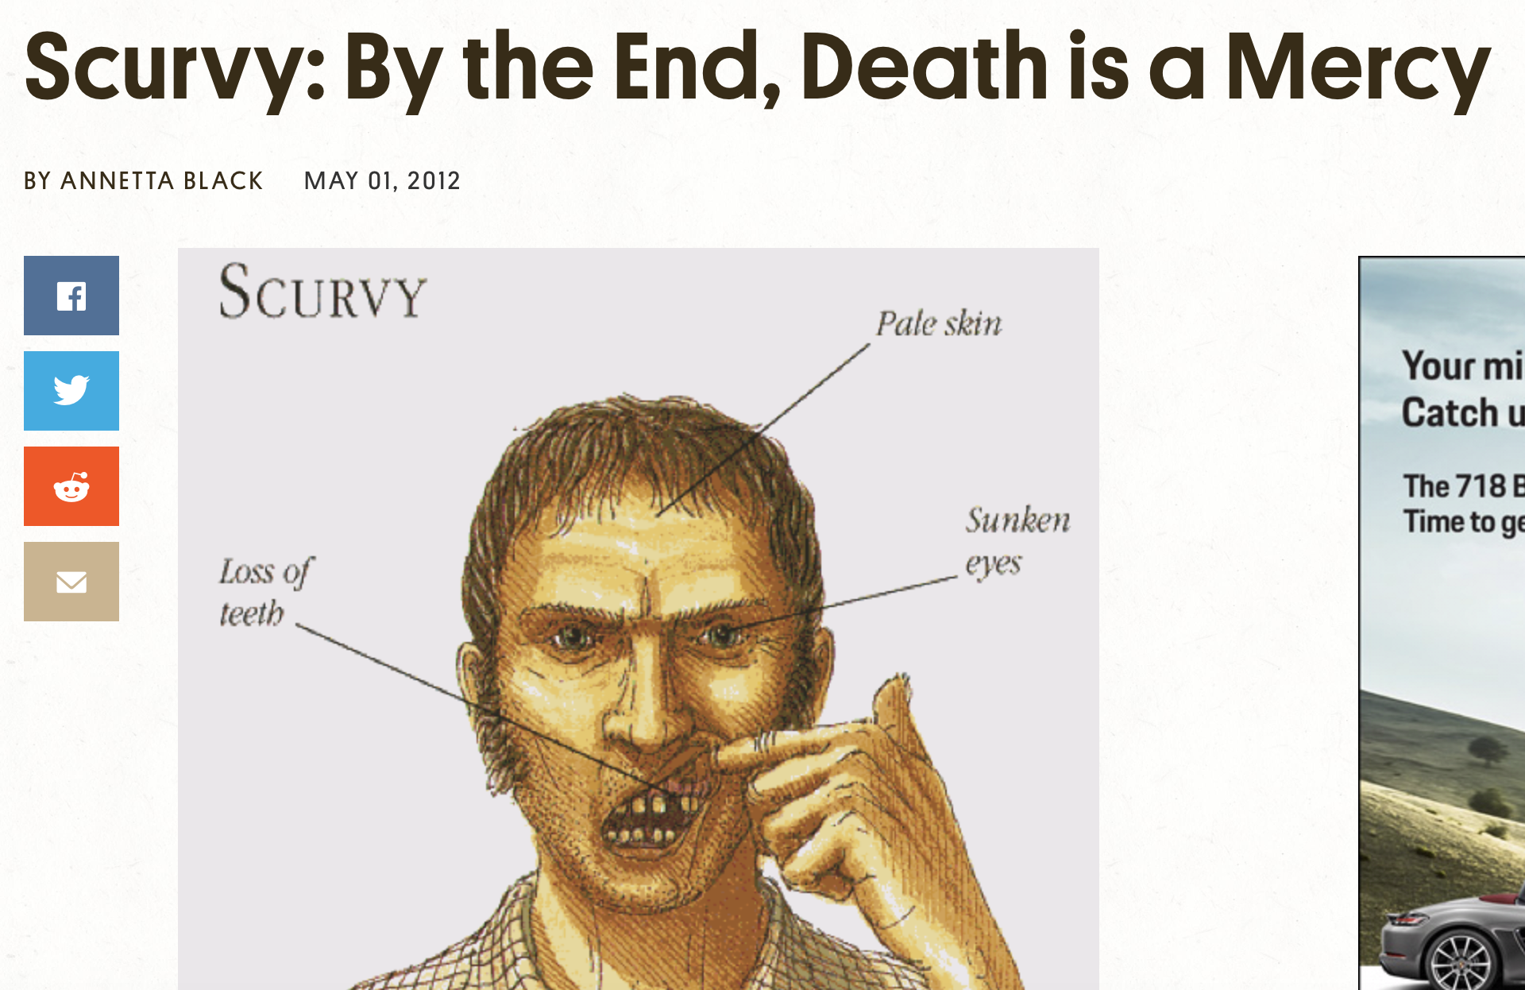
Source: https://www.atlasobscura.com/articles/scurvy

Slide 5
1497: da Gama; 100 out of 160 die of scurvy
1601: Lancaster; 3 tsp of citrus = no scurvy; control group 110 of 178 die
1747: Lind; citrus = cure scurvy in 3-4 days
1795: British Navy accepts citrus; scurvy wiped out
1865: Merchant Marine accepts citrus; scurvy wiped out
Source: Mosteller, 1981

Slide 6
1960s: Douglas Engelbart at SRI; hypertext documents
1971: Michael Hart a U Illinois; Declaration of Independence plain text
1993: BiblioBytes; sell ebook over Internet
2000: eBooks.com
2001: MIT Open Courseware
Source: Mosteller, 1981

Slide 7
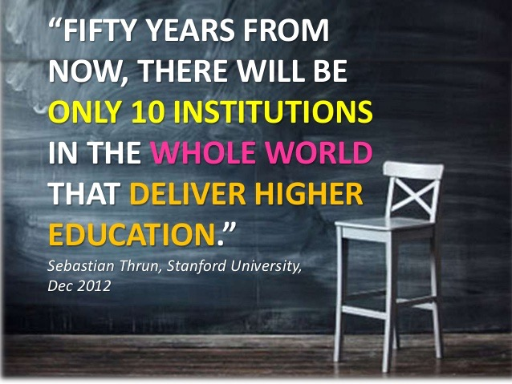

Slide 8
Still a landscape of ~5 LMS solutions
LMS Core Functions: Rosters, Grades, Assignments, Submissions, Class Messages / Discussions
What’s the big deal?
Source: https://vimeo.com/79954057

Slide 9
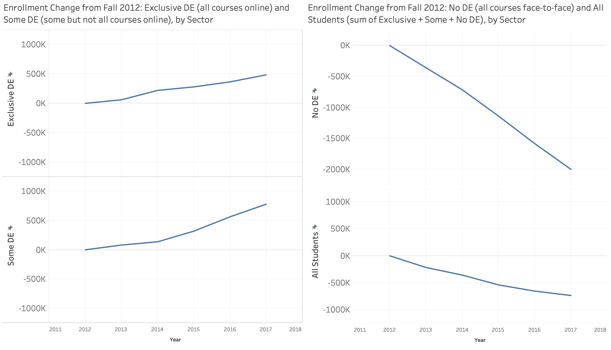
Meanwhile . . . more than 1 in 3 students in US take at least one online course per term

Slide 10
Playing in the corner
Photo Credit: www.mummymummymum.com

Slide 11
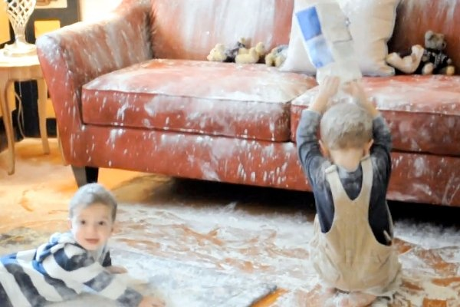
Now loose in the house
Photo Credit: http://www.youtube.com/user/mtmuzic

Slide 12
We are in the midst of an inflection point in higher education driven by mainstream adoption, different platform designs, and moving beyond the digitization of traditional classroom

Slide 13
Implications:
Adoption Patterns

Slide 14
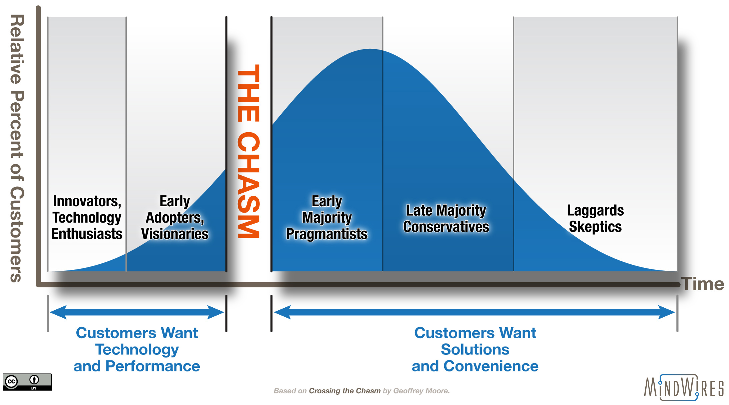

Slide 15
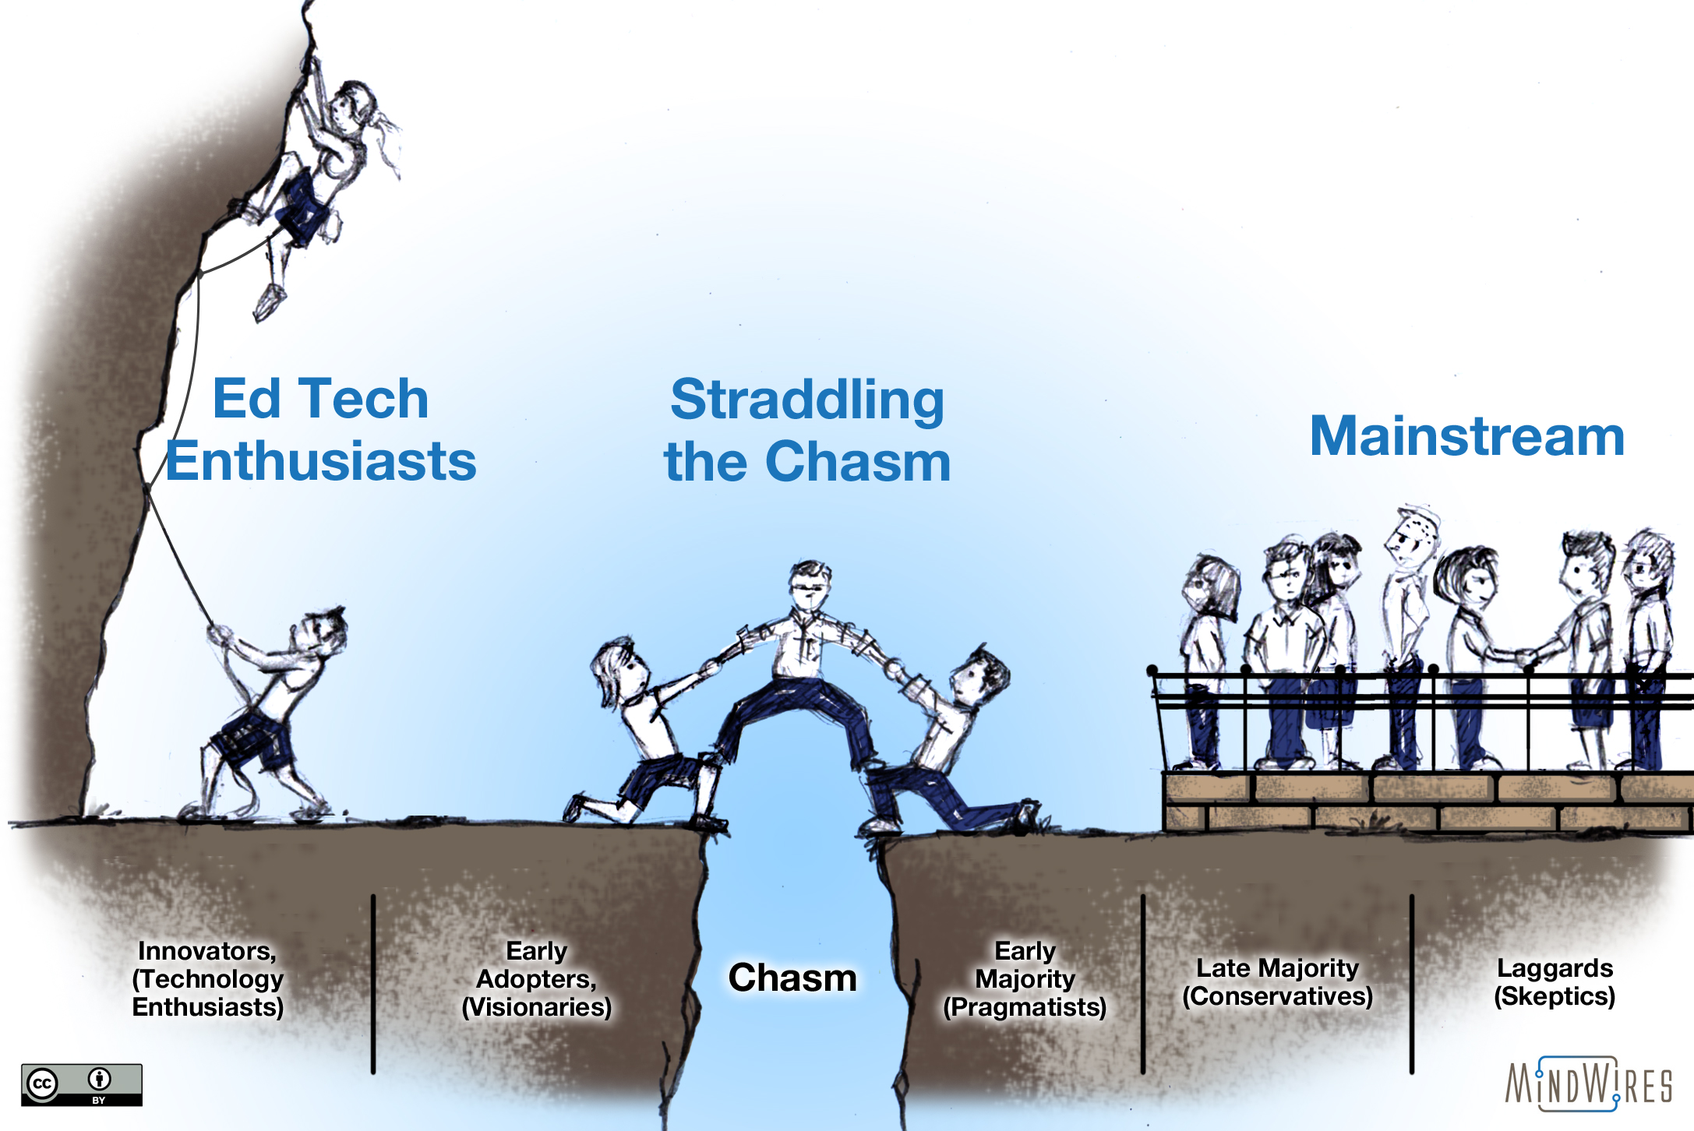

Slide 16
Implications:
Students are Individuals

Slide 17
“We think of it like a robot tutor in the sky that can semi-read your mind and figure out what your strengths and weaknesses are, down to the percentile.”
- J Ferreira, Knewton

Slide 19
source: https://www.youtube.com/watch?v=fxZ4YVw2_NI

Slide 20
Personalized Learning

Slide 21
Personalized learning is really just undepersonalized teaching.
But that doesn’t sound as cool.

Slide 22
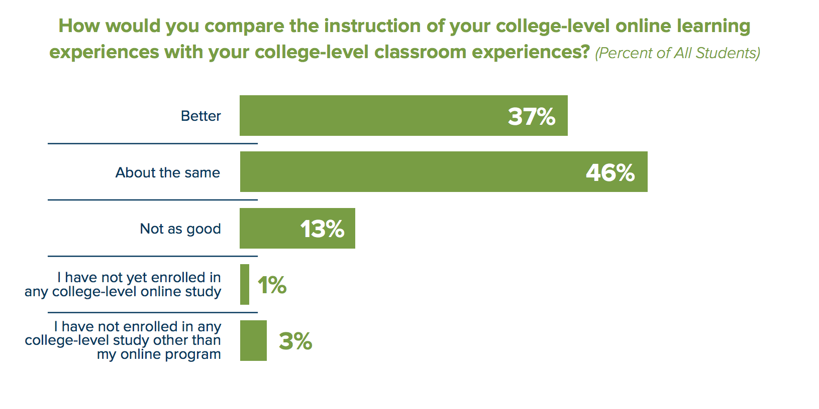
Source: https://www.learninghouse.com/ocs2017/

Slide 24
Still a landscape of ~5 LMS solutions
LMS Core Functions: Rosters, Grades, Assignments, Submissions, Class Messages / Discussions
What’s the big deal?
source: https://www.youtube.com/watch?v=fxZ4YVw2_NI

Slide 25
source: http://e-literate.tv/s3-e21/

Slide 26
Implications:
All Students

Slide 27
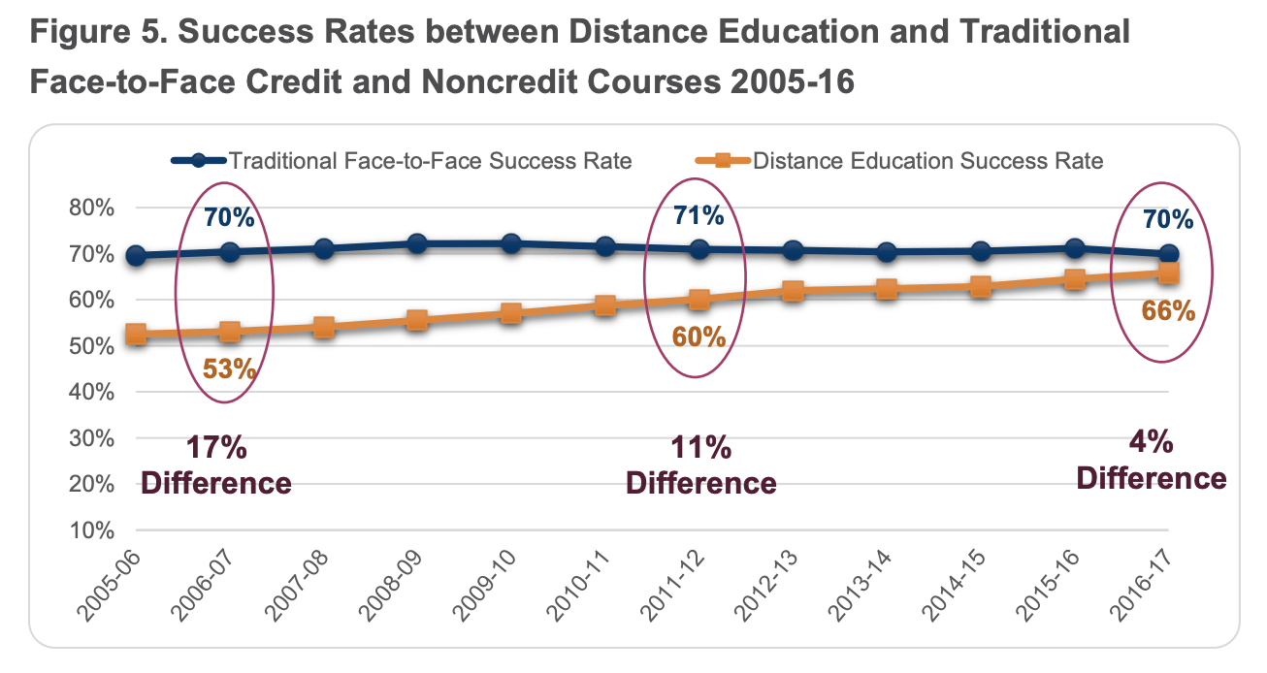
Source: http://californiacommunitycolleges.cccco.edu/Portals/0/Reports/2017-DE-Report-Final-ADA.pdf

Slide 28
“The point here is that ’online’ is a culture to young people. Yet to most colleges [and too many ed tech companies], it is a delivery method.”
Michelle Pacansky-Brock
Best Practices for Teaching with Emerging Technologies edited by Phil Hill

Slide 29
"Technology can support teachers in the application of the relevant principles across a group of students with high variability. In fact, technology can help tailor lessons to the situation in extremely powerful ways. “The instrumentation of the online learning environment to sense the student experience and the ability to customize content on a student-by-student basis may be the key to enabling teachers to provide differentiated instruction, informed by a solid foundation in cognitive science. Modern online courses and delivery platforms already implement some of these concepts, and provide a framework for others.”
Source: https://oepi.mit.edu/final-report

Slide 30
“The asynchronous, individualized nature of online learning allows differentiation of course content. Students can control a course’s pace to fit their learning styles and abilities.”
“Our research found that interactive course software that provides instantaneous feedback could be particularly effective in improving student performance in online courses. ”
PPIC, Successful Online
Courses in California’s
Community Colleges

Slide 31
Phil Hill: phil@mindwires.com
Twitter: @PhilOnEdTech

