Slide 1
P.R.E.P Initiative
Prepared. Resilient. Empowered. Professional.
Notes:
The idea for this kind of initiative came out of my own experience as a non-traditional student, as well as a need we saw as instructors at CLTCC. I personally knew the struggles of attending college as an adult learner with a family, and I had a special connection to my non-trads as an advisor in my previous job. We also had many struggling adult learners in our classes we were teaching and felt that we needed to do something more for them. Another motivation was to pursue this particular grant opportunity was the creation and use of OER materials. The whole team is very involved in promoting OER at our college, so it was a perfect fit.

Slide 2
Objective
To increase enrollment, retention, and graduation of adult learners, and to provide them with confidence to perform in academia and the workforce.
Notes:
We came up with the idea for the PREP initiative to help guide adult learners through their college experience with the objective: to increase enrollment, retention, and graduation of adult learners, and to provide them with the confidence to perform in academia and the workforce.

Slide 3
Overview
Admission/Enrollment
ORNT 1000
Mentoring
OER
Technology
Continued Mentoring
Credential & Placement
Notes:
The critical components of our initiative are to help adult learners from the very beginning of their college journey by assisting them through the process of admission and enrollment. We meet these students in person either in workshops, their campus visits, or pre-semester orientation. During orientation we give the students some basic supplies, like notebooks, binders, pens, and a flashdrive, to help cut their costs and get them to class prepared.
The bulk of the initiative is in the ORNT 1000 Freshman Seminar class, where non-traditional students who opt into the PREP initiative are assigned their own section. They are a community of adult learners who are very diverse, but share many common struggles with the demands on their time and energy. In this class they spared the cost of a textbook and use OER. They also meet in a computer lab and are introduced to technology they will continue to use in college and the workforce. The mentoring component is one of the most important pieces, I believe. We meet these students prior to the start of the course, so by the time we meet in class, we have already built a rapport. It is easier for them to approach us and ask questions. This first class was an A term class this spring and it was a very small class - 6 students ended up sticking it out. The small class size really made it easy for us to get to know each other. They formed some close ties that extended beyond the class, which is what we were really hoping for. I met with each student one on one throughout the semester and continue to do so now, after the class has concluded. I also send them emails every couple of weeks with inspirational words, videos, and reminders about important dates and events. I believe this helps to keep them connected to the college and each other as a community.
After their first semester, we plan to continue to meet, though not as often. The email communication will be maintained until they earn their credential and find a job. We also plan to reach out to any students who do not remain enrolled to try and recruit them back.

Slide 4
Outreach
Notes:
Outreach is a critical part of the initiative that can be a determining factor in its success, and to be quite honest, it’s been one of the biggest challenges, which we will discuss more later.

Slide 5
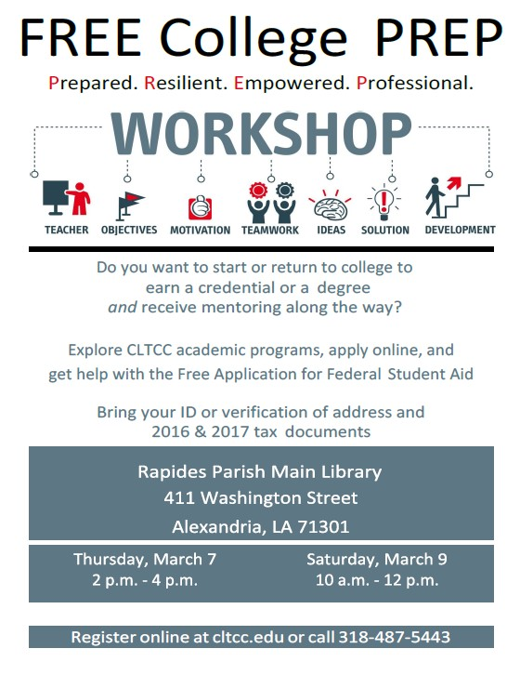
Library Partnership
P.R.E.P Workshops held twice a semester at a library branch
Assisted with
Admission/Enrollment
FAFSA
Program/Credential Offerings
Hi-Set Information
Notes:
Our first outreach project was to coordinate workshops each semester with the Rapides Parish Library. We offered a weekday workshop and a Saturday workshop each semester to try and fit the different schedules of potential students. We advertised on the radio, on our website, and on social media. Our first set of workshops in the fall did not go so well. The location, I believe, was not the most convenient, so we picked a different branch for the spring workshops, which turned out a larger crowd. We gained some contacts this spring, which are on an email and call list. At these workshops, we presented information about admission, enrollment, programs, financial aid, the Hi-Set, and the PREP initiative. We also assisted those who needed help filling out their application and FAFSA forms. Working with the library was amazing, and we really made some good connections with potential students. Overall, I believe we were successful, but we are working on ways to draw an even larger crowd for the next set of workshops.

Slide 6
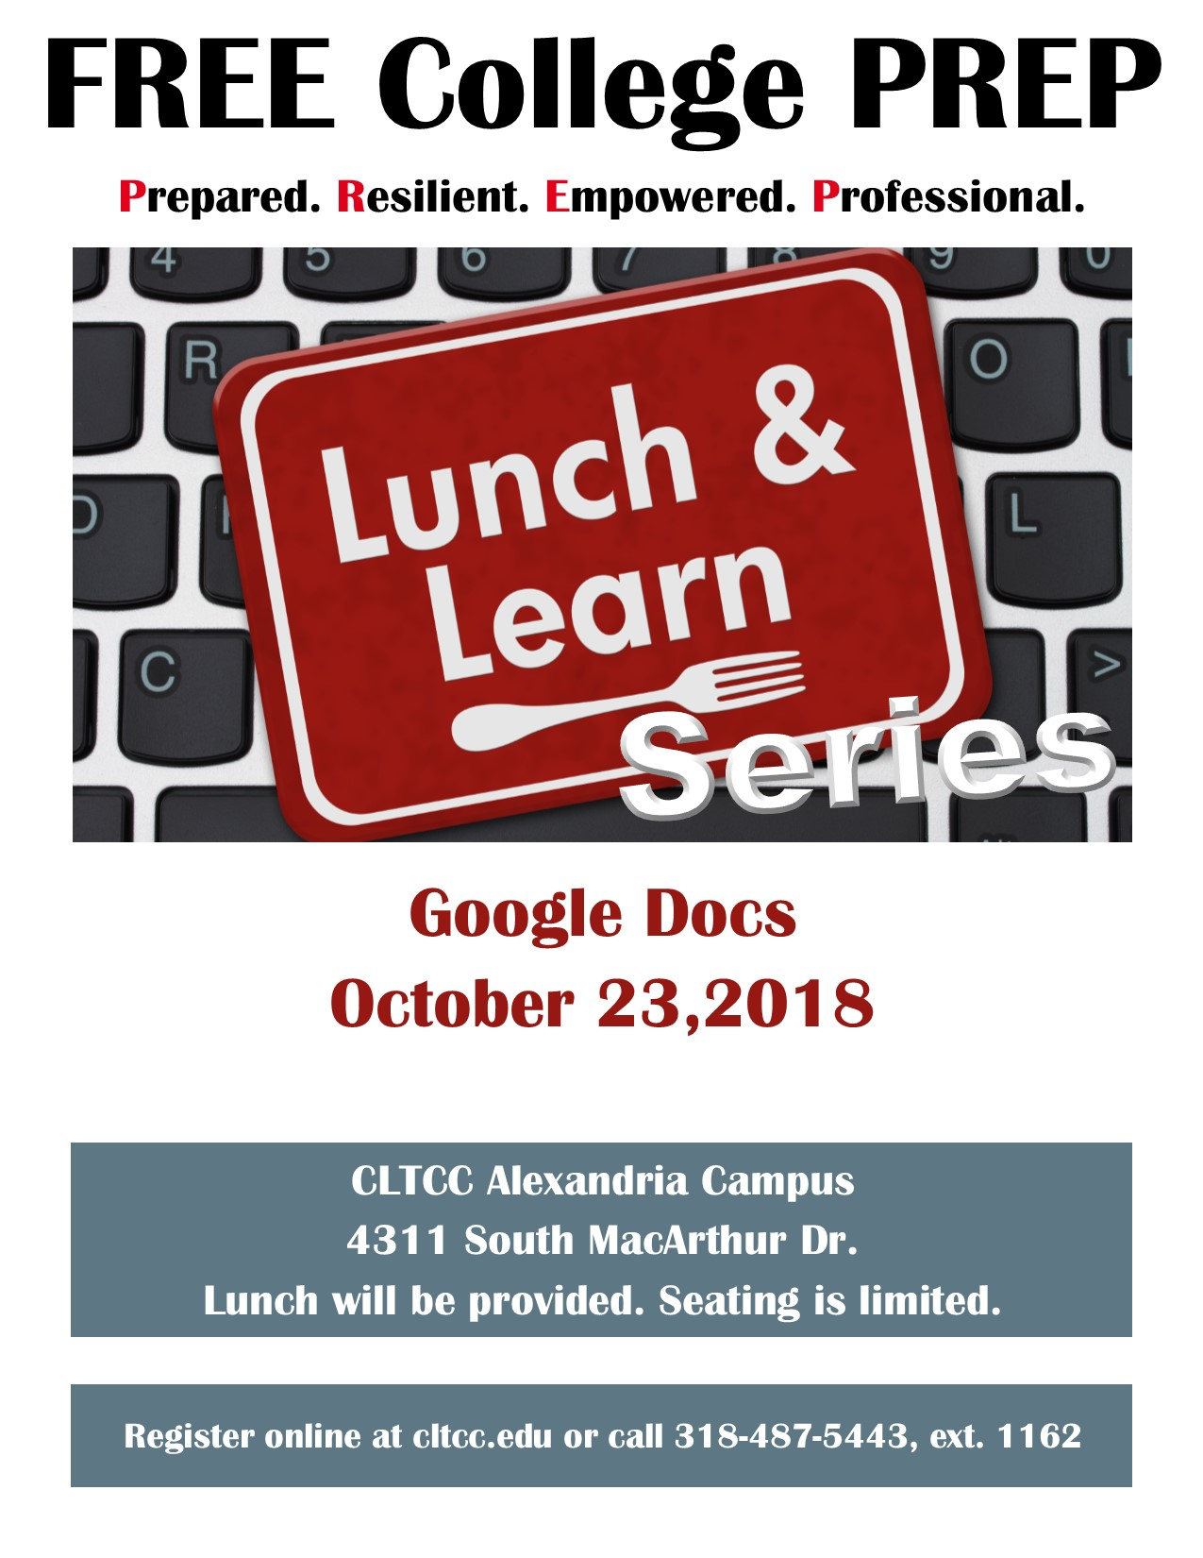
Lunch & Learn
Monthly topics on technology for the workforce
Google Apps and Services
GFC LearnFree Resources
Social Media Literacy
Identity Theft Protection
Notes:
We reach the workforce and members of the community with our monthly Lunch & Learn series on technology and technology related topics. These have been very successful, as our average attendance is 11, and we have many repeat attendees. They have opened Google accounts and learned how to send emails, add contacts, and start groups. They have also learned about Google Docs and will learn about Google Slides this month. We have had guest speakers cover topics like social media and identity theft. We have given certificates to those who have completed a checklist on Gmail accounts, and will give all who participated in any workshop a certificate of attendance. We usually start with lunch and a short lecture on a topic, then move to the computer lab for their hands on training. Mrs. Lisa Henton is the hero of this program. She has been coordinated workshops like this for many years, has so many contacts who will come and speak, and is a pro at coordinating everything. Our librarian, Mrs. Dani Vaughn-Tucker, and our IT Manager, Dr. sharon Laycock, have also been integral in preparing and presenting the curriculum.

Slide 7
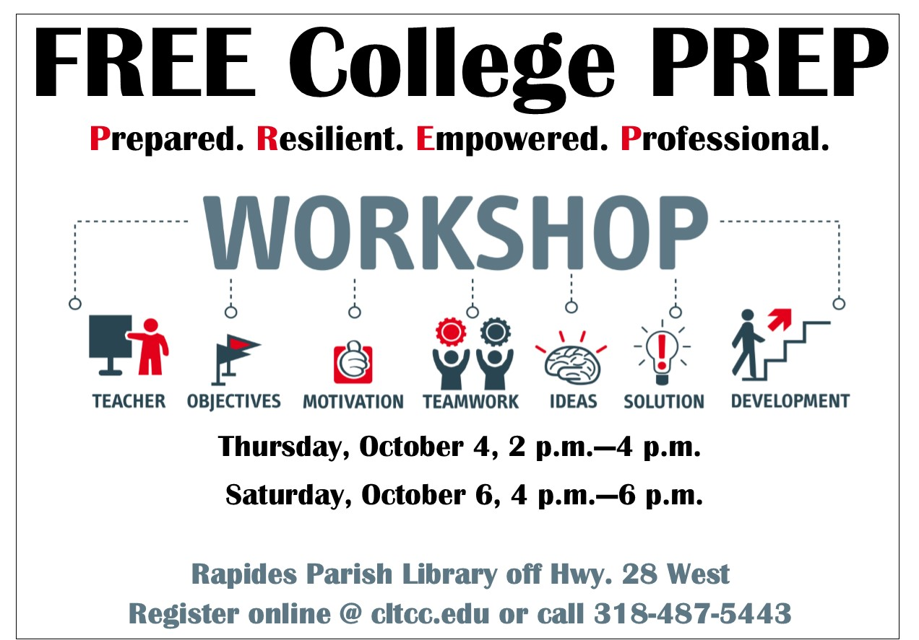
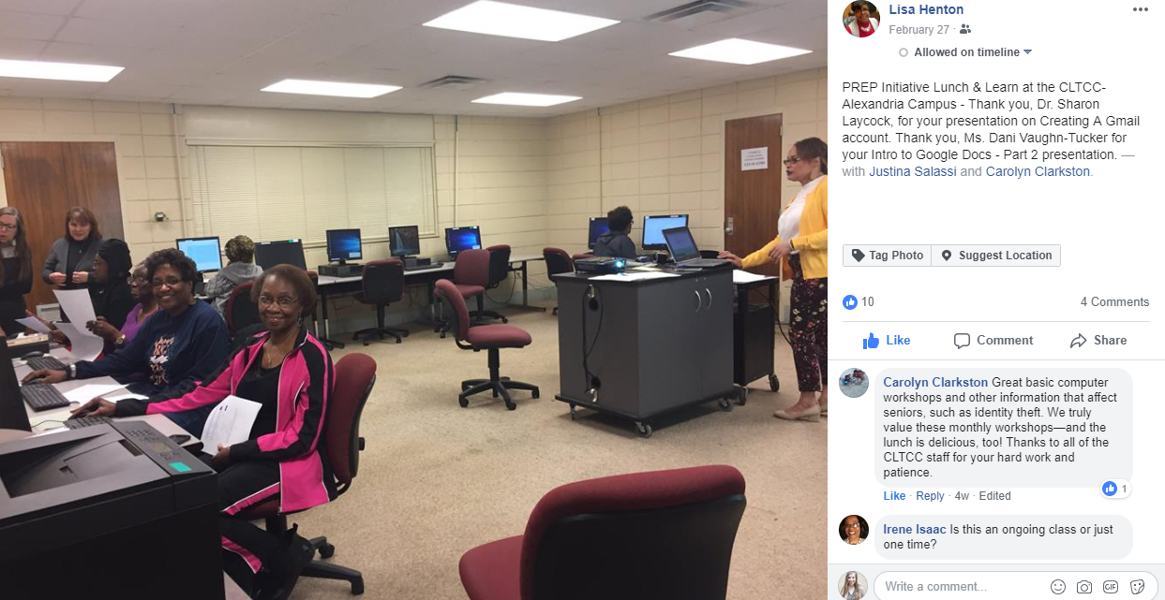
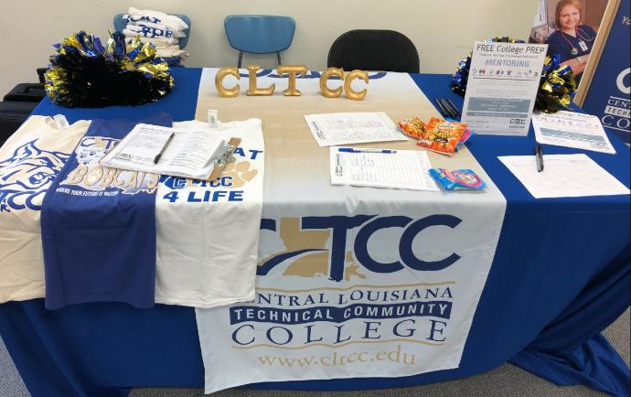
Other Marketing Efforts
Social Media
News Coverage
Radio Ads
Postcards
Notes:
Last semester we sent out postcards to students who had recently been through our adult education department and passed the Hi-Set, inviting them to the workshops. This semester, we plan to send postcards more widely promoting the initiative, not just the workshops. We post on social media, set up tables at school events, and have received news coverage.

Slide 8
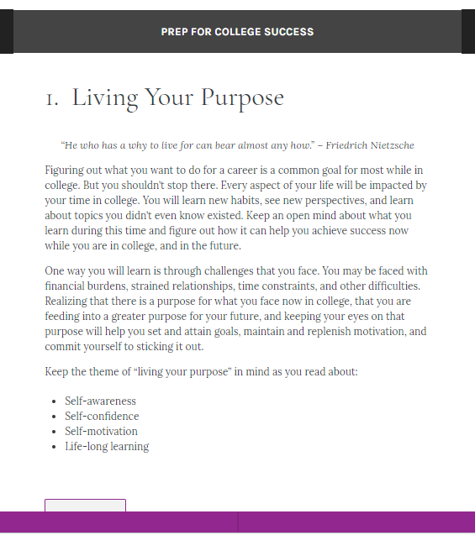
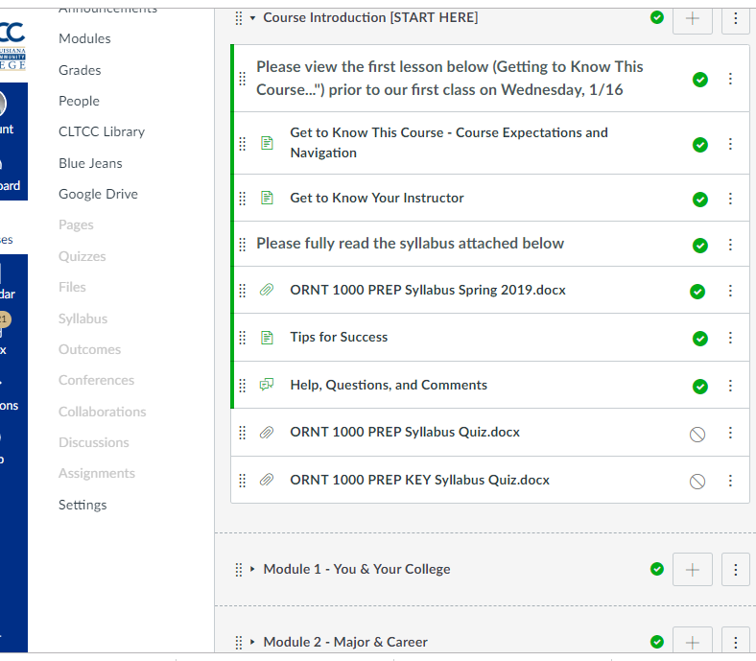
ORNT 1000
Open Course & Textbook
PREP Freshman Seminar is small and made up of only non-traditional adult learners, is hybrid, and taught in a computer lab to focus on developing technology skills.
Course and textbook are fully open and will be available in Canvas Commons after review.
Notes:
The course turned out to be so much fun. We designed it as a hybrid course and met only once per week during A term. They completed many assignments in Canvas. Here’s what one student had to say about the class.
The course and textbook will both be licensed with a Creative Commons CC-BY-NC license. The course includes lessons that were created in SoftChalk, an interactive lesson software, and we are still working on the textbook. We are using our free account through LOUIS to author this textbook in Pressbooks EDU. After the course and textbook are both completed, we will have them reviewed before posting them in the Canvas Commons.

Slide 9
Curriculum Highlights
Real world applications
SoftChalk Interactive lessons
Technology Skills
Transferable Skills
Community Building
Study Skills
Time and Money Management Skills
College Resources

Slide 10
Learning from the PREP Experience

Slide 11
Tracking the Cohort
1
2
3
4
Persistence & Retention
DFW & GPA
Graduation Rate
Job Placement
Assign an attribution to the cohort in Banner to track cohorts.
We will track semester and overall GPA and DFW rates of our cohorts.
Does the initiative impact graduation numbers for adult learners?
Programs already track this information. We will look at our cohorts, specifically.
Notes:
What we want to learn is how this initiative impacts the persistence and retention, grades, graduation rate, and job placement of our cohorts. We are hoping that good outcomes will provide an incentive to continue this initiative, or an improved version of it, after the grant period.

Slide 12
Challenges
Buy-in from other departments
Marketing
Reach
Notes:
Some of the challenges we have faced include buy-in and support from other departments, marketing, and reach. In trying to recruit and participate in college events, such as freshman orientation, we have to work closely with student services. We really have to educate them on what this initiative is and how we want them to help. Sometimes I think it’s difficult to remember this initiative and work with us. Similarly, we need to figure out how to help advisors remember that this ORNT 1000 class is an option for their non-traditional students. Advising should be the main conduit by which adult learners are sent to us. Also, a few of our majors do not send their students to college wide ORNT 1000 classes, but teach their own. Those programs include Welding and Allied Health majors, which make up a significant portion of the college. We would like to be able to offer some sort of initiative for students in those majors, as well. These are just a few things that we are thinking about and working to improve.

Slide 13
Thank You
Notes:
A big thank you to the Board of Regents. To Dr. Williams and those working on the eLearning Innovations Fund. Thanks to CLTCC for your support, to our Chancellor, Mr. Sawtelle, for encouraging us in this initiative, and a huge thank you to the Rapides Parish Library for being so helpful, accommodating, and invested in this initiative.

