Slide 1
Online Labs in Science Majors Courses ELearning Innovation Grants Program Dr. Clint Coleman, Dean of STEM Fletcher Technical Community College

Slide 2
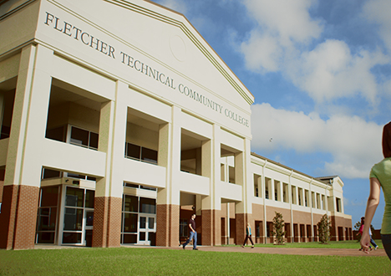
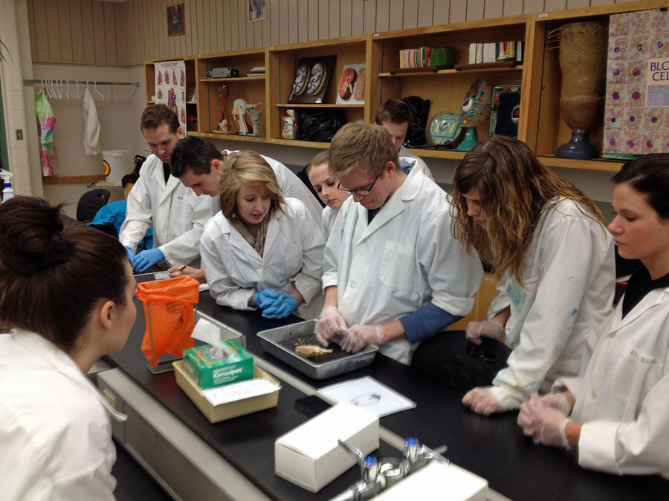
History
Fletcher serves a diverse population of 5000+ individuals
Many students can not commit to a traditional class, but several science courses require hands on/applied laboratories
Can ‘at home’ laboratory kits duplicate the ‘in class’ lab experience for the students?

Slide 3
Goals
Goal 1: offer students access to online biology labs
BIOL1150/1170 (Anatomy and Physiology 1 and 2) offered online
Hands on Labs was selected as the vendor for supplies
Goal 2: Expand the online biology lab options
BIOL 1150 (Fall 2018) provided with access codes to online components of Hands On Labs curriculum
BIOL 1170 (Spring 2019) provided with at home laboratory kits from Hands On Labs
Freshman natural and physical science for Majors courses are being considered for 2019-2020
Goal 3: Increase online biology enrollment
If the pilot study is successful, Fletcher could potentially reach more students online

Slide 4
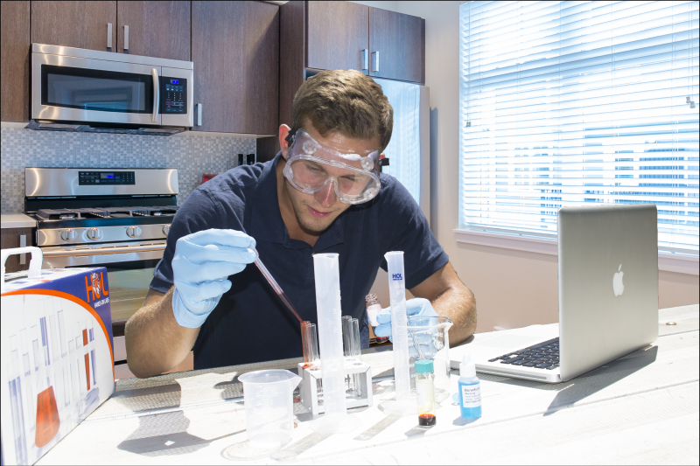
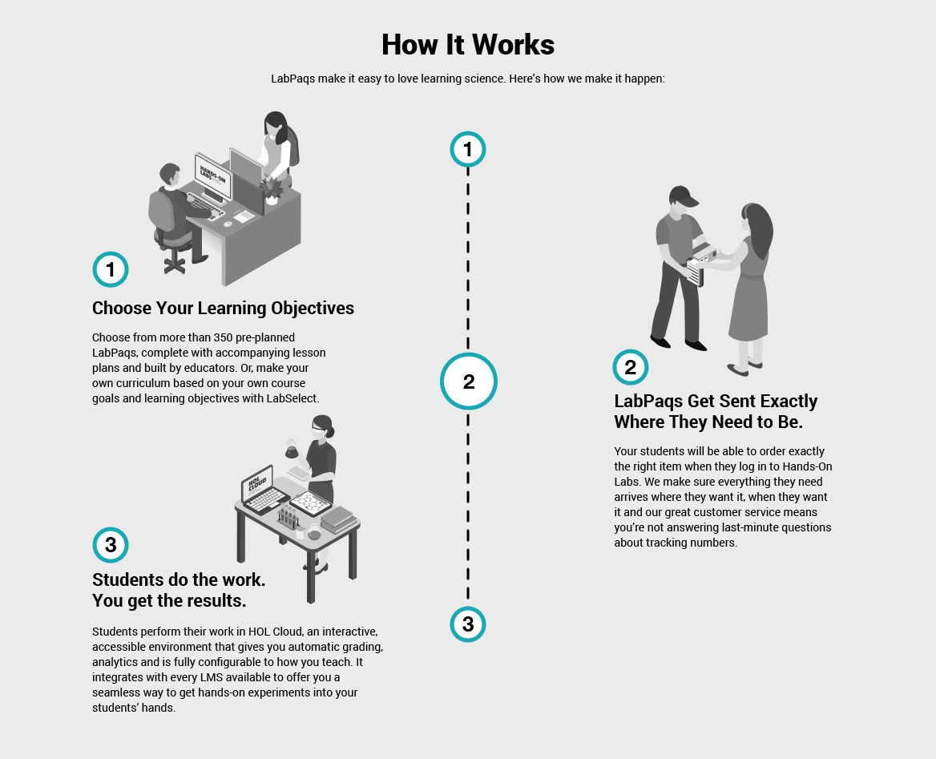
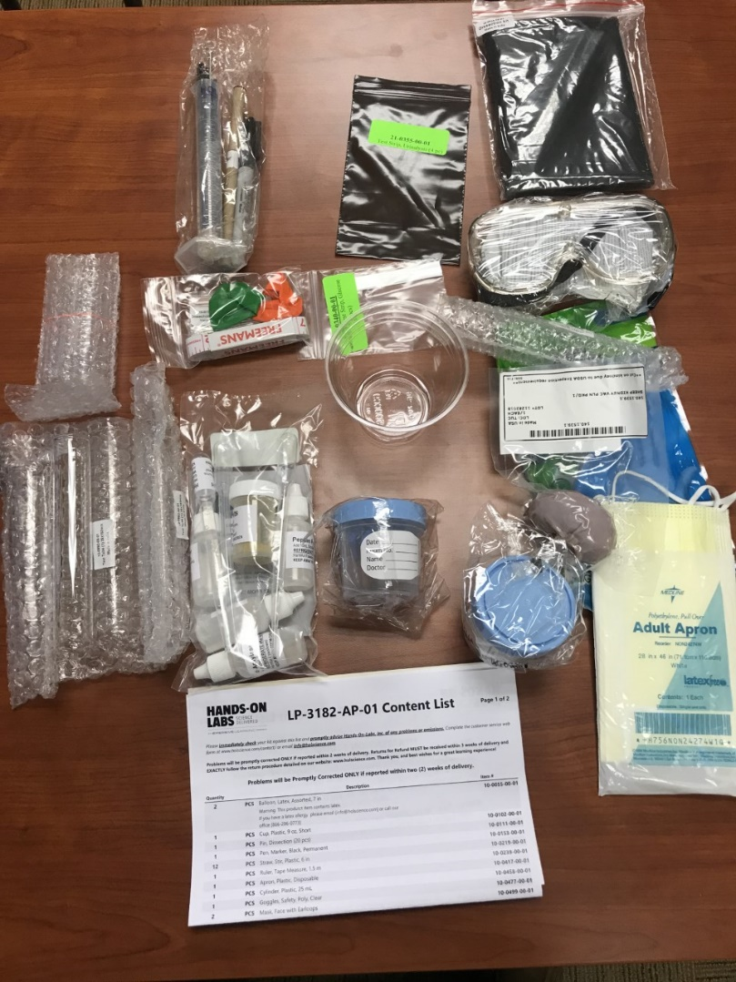
Hands On Labs

Slide 5
BIOL 1170: Anatomy and Physiology II Lab
61 kits were purchased for a total cost of $9394.00 ($154.00 a student)
The kits covered the Digestive system modules (1/6th of the course)
Urinalysis
Dissection of Sheep Kidney
Instructor recorded a video demonstration of her performing the lab
Uploaded to her canvas course

Slide 6
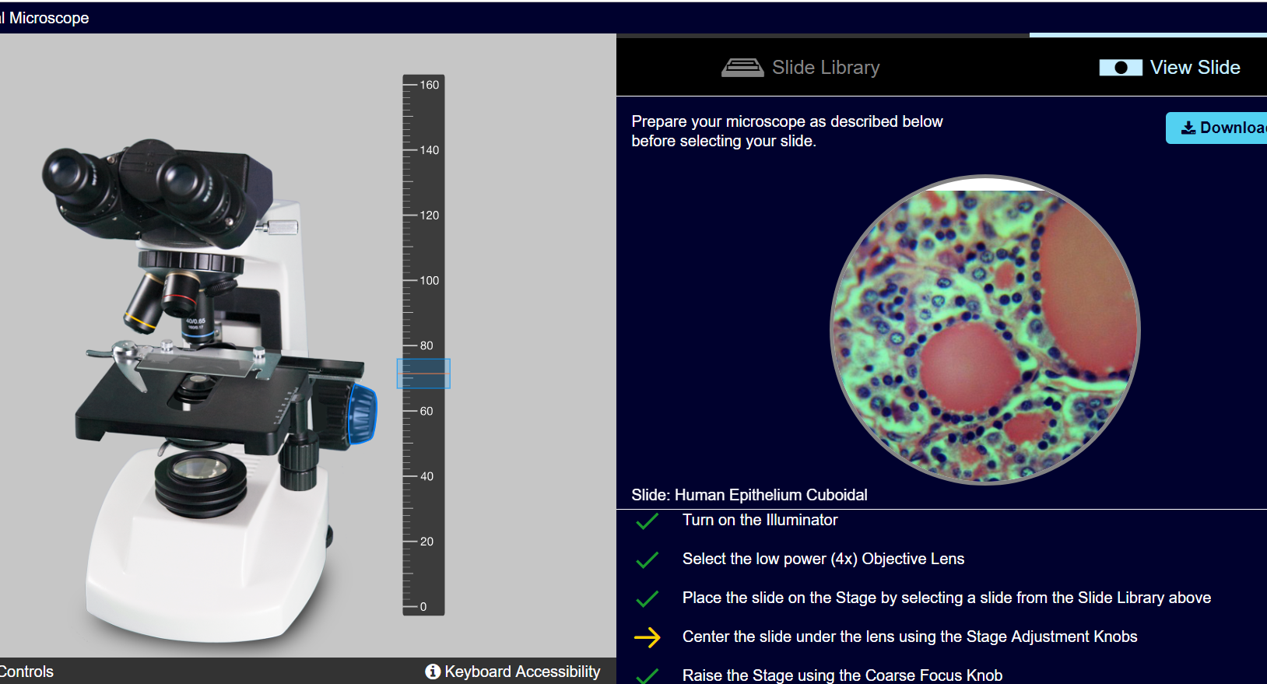
Results
Successes:
V-scope microscope:
Easy to use and images were very clear.
Digestive system activity (enzyme digestion assays for carbs, fats, and proteins):
The color changes worked out really well
the explanations were very straight forward,
materials were easy to use.
Pre-reading and follow up questions proved to be a useful resource

Slide 7
Results
Opportunities for improvement:
Very expensive
over $200 each semester per student to replicate face-to-face courses
Using only the online component (no at home experiments) in BIOL 1150 (A&P I Lab) was not optimal
The kits produce a lot of waste
plastic pipettes, dropper bottles, and test tubes are discarded after the lab is done.
In a face to face lab, we could minimize waste by recycling or reuse of some supplies.
Difficult for inexperienced hands
kits were very easy to understand for someone with laboratory experience, the students seemed to struggle with going through the experiment.

Slide 8
Future
Convenience of at home laboratory kits did not add value to the course
Cost of at home kits (without offset from grant) difficult to justify
Alternatives are being developed for online labs
Example: 3D simulation software being developed at FTCC for IPT competency testing
No currently available options can match the experience of face-to-face labs
Could potentially be a liability to a student wanting to explore Allied Health or applied science fields

