Slide 1
A Visual Guide for Higher Education Faculty, Staff, and Students: Using Free Internet Accounts as a Professional Workforce Resource
Mike Beutner, Ph.D., Instructional Technology University of Louisiana Monroe (ULM)
“eLearning: Innovation for Tomorrow’s Students” Louisiana Board of Regents Conference Pennington Biomedical Research Center Baton Rouge April 9, 2019

Slide 2
Google’s terse definition of eLearning is

Slide 3
Google’s terse definition of eLearning is “… learning conducted via electronic media

Slide 4
Google’s terse definition of eLearning is “… learning conducted via electronic media, typically on the Internet.”

Slide 5
Google’s terse definition of eLearning is “… learning conducted via electronic media, typically on the Internet.”

Slide 6
We Have Free Website Accounts!

Slide 7
We Have Free Website Accounts!
There’s no manual.

Slide 8
What’s Needed…
… A Friendly Visual Guide

Slide 9
The free online visual guide will

Slide 10
The free online visual guide will show faculty, staff, and students

Slide 11
The free online visual guide will show faculty, staff, and students how to use a free resource

Slide 12
The free online visual guide will show faculty, staff, and students how to use a free resource with free software

Slide 13
The free online visual guide will show faculty, staff, and students how to use a free resource with free software for eLearning

Slide 14
The free online visual guide will show faculty, staff, and students how to use a free resource with free software for eLearning and workforce development.

Slide 15
The free online visual guide will show faculty, staff, and students how to use a free resource with free software for eLearning and workforce development.

Slide 16
Productivity For Faculty
And Staff

Slide 17
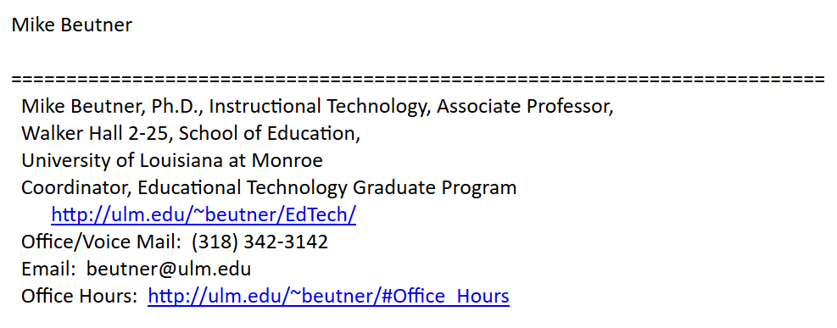

Slide 18
Email Signature

Slide 19
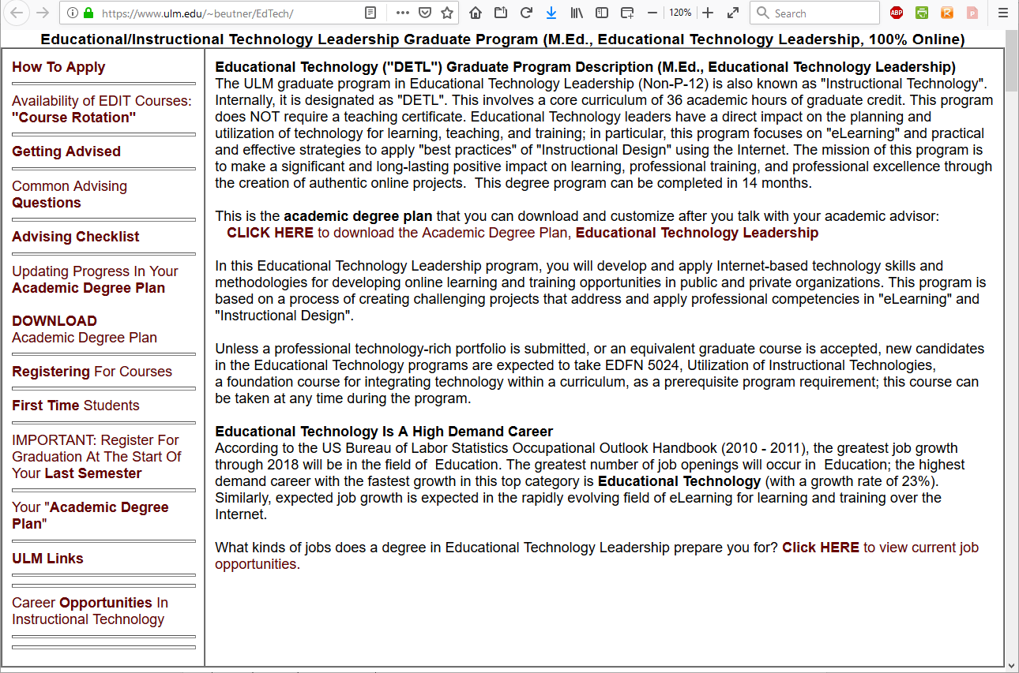

Slide 20
Documentation

Slide 22
Faculty Webpage

Slide 23
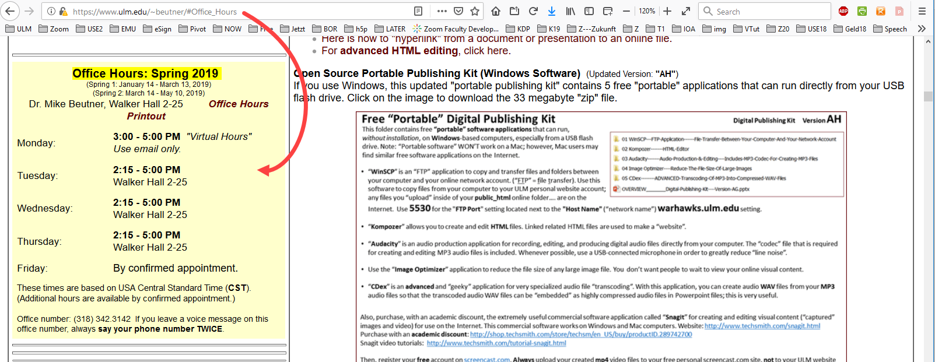

Slide 24
Office
Hours

Slide 25
A Workforce Development Tool For Students

Slide 26
Interviewers want

Slide 27
Interviewers want
evidence

Slide 28
Interviewers want
evidence of excellent work

Slide 29
Interviewers want
evidence of excellent work that’s on a website

Slide 30
Interviewers want
evidence of excellent work that’s on a website, an eFolio.

Slide 31
Interviewers want
evidence of excellent work that’s on a website, an eFolio.

Slide 32
Demonstration 1/3: “Hosting” an application.

Slide 33
https://ulm.edu/aceadventures/100

Slide 34
https://ulm.edu/aceadventures/ BOR2019

Slide 35
Demonstration 2/3: “A Student “eFolio”.

Slide 36
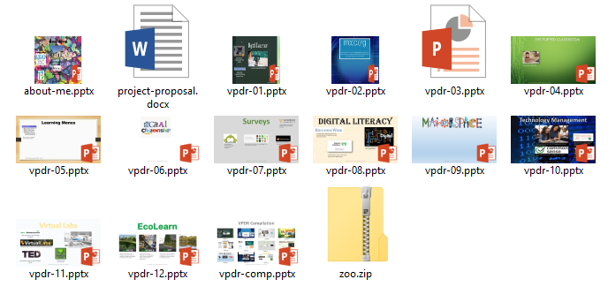
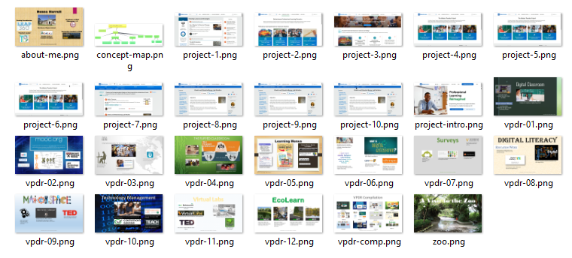
Sample eFolio

Slide 37
Demonstration 3/3: “Linked Visuals”.

Slide 38
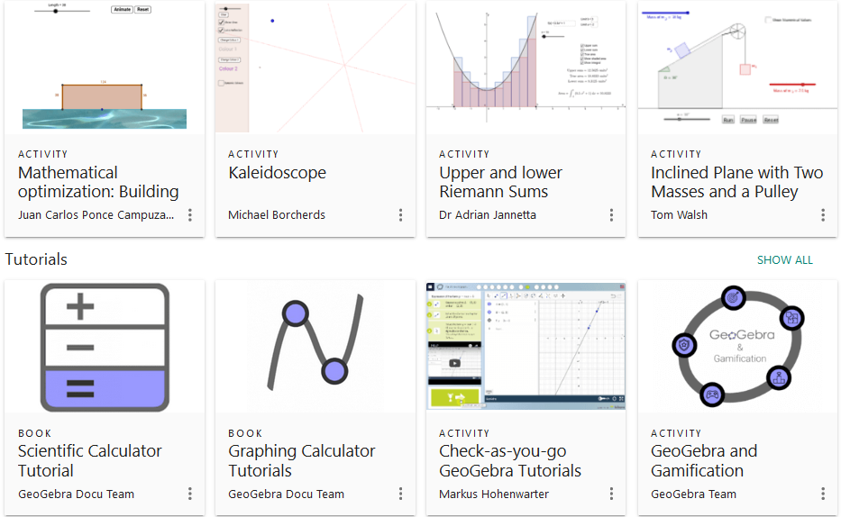
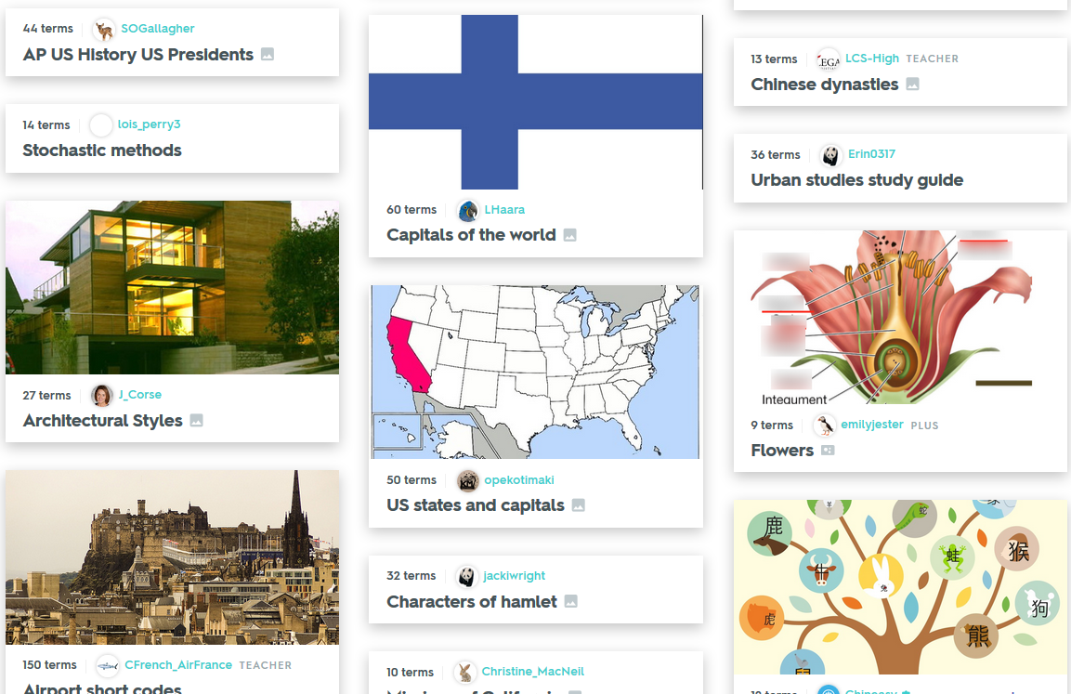
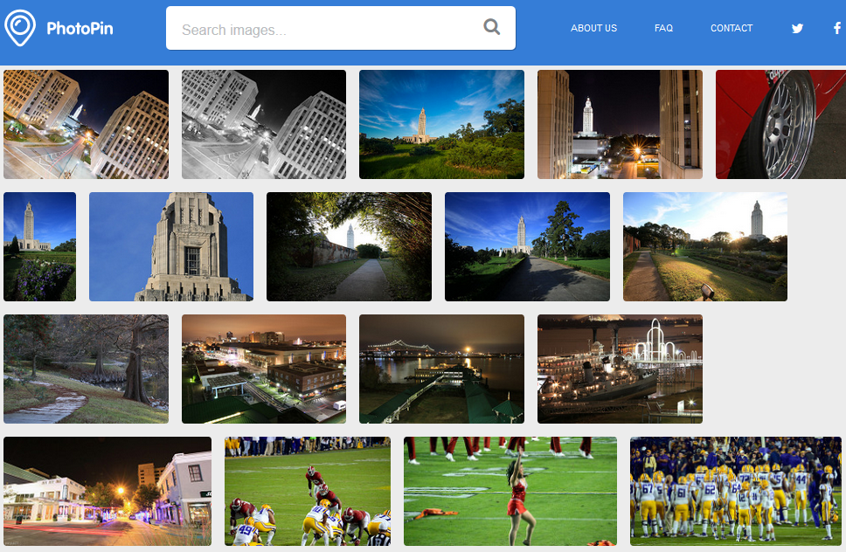
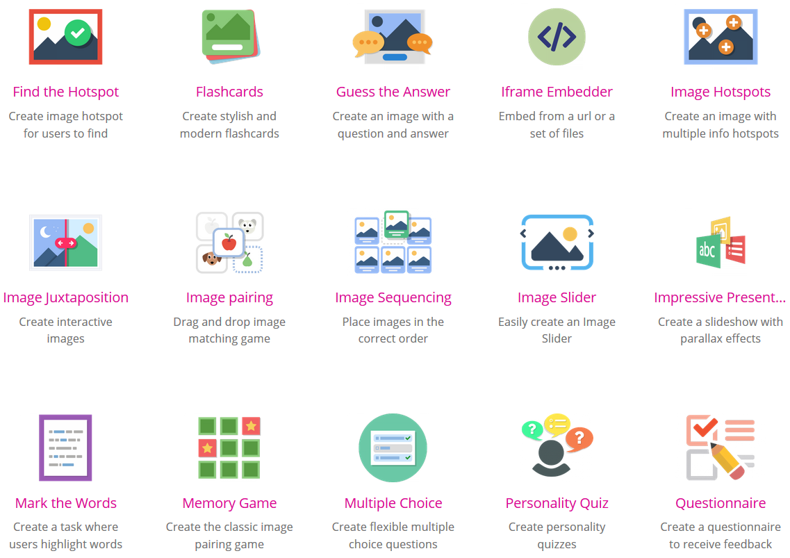
Recommended
Geogebra
Quizlet
https://geogebra.org/
https://quizlet.com/
https://lacue.org/
Photopin
H5P
http://photopin.com
https://h5p.org
https://www.khanacademy.org
https://h5p.org/content-types-and-applications

Slide 39
Find this Powerpoint file:
https://ulm.edu/aceadventures/BOR2019/webguide.pptx

Slide 40
A Visual Guide for Higher Education Faculty, Staff, and Students: Using Free Internet Accounts as a Professional Workforce Resource
https://ulm.edu/aceadventures/ BOR2019/webguide.pptx
Mike Beutner, Ph.D., Instructional Technology University of Louisiana Monroe (ULM)
Office: (318) 342-3142 Email: beutner@ulm.edu Faculty Webpage: https://ulm.edu/~beutner
“eLearning: Innovation for Tomorrow’s Students” Louisiana Board of Regents Conference Pennington Biomedical Research Center Baton Rouge April 9, 2019

