Slide 1
The Talent Gap: A Look at Partnerships
Add Date
Notes:
How many of you are into data? You love numbers and research? Good. Today, I’m going to share a few numbers and thoughts from some research we did last year. We conducted a research project called Closing the Skills Gap.
(1/3 of attendees of this conference)
Alright, on a serious note, for the next few minutes I want to have a conversation around the challenges organizations and corporations are facing across our nation and what we as educators might be able to do to help.
As learning leaders we are constantly working hard to stay ahead of the curve.
We are staying up on the latest trends in learning, the best technology, understanding the needs of our business clients so we can better support.
Then one day we are on a conference call with the boss and this happens…
(play video)

Slide 2

Notes:
In today’s competitive environments our work is never done and our focus and sometimes even our strategy shifts quickly.
We can find ourselves feeling like we just did all this work only to realize, now we have a different car to clean the snow off of.

Slide 3

Closing the Skills Gap
We set out to learn more about the growing skills gap in America. This is what we learned...
Notes:
On almost a weekly basis we speak with organizations ranging from Fortune 500 companies to regional healthcare systems and we hear about challenges they have around finding the right people, struggles with high turnover, college grads that come into the workforce that are far from “work-ready” and other similar challenges. Being that Learning House has made it our mission to improve peoples lives through education, we felt that these are challenges we should know more about and see how we might be part of a solution. Through our Learning House – Enterprise division we work closely with both educators and enterprise organizations in an effort to help produce better workforce outcomes. So we set out to learn more about the growing skills gap in America.

Slide 4




Who We Surveyed
Across
43%
75%
35%
12
600
with at least a
Bachelor’s
Millennials
HR leaders
C or VP
level leaders
sectors
96% with some college
We covered 5 major themes.
Notes:
Slide 5: Let’ talk about who we surveyed
We worked with a research and consulting firm called Future Workplace to conduct this research project. Together we conducted a survey with…
600 HR leaders in the US
Across 12+ sectors (Mfg, Retail/Hospitality, Healthcare, Education, Public Sector/Public Service, Financial Services, Logistics, Field Services/Contract Services/Customer Support, Non-profit, other)
43% C level or VP level leaders
35% Milennials
75% had at least a Bachelors (96% had at least some college)
And we covered 5 major themes

Slide 5

Notes:
Slide 7:
How many of you sit somewhere in HR? Everyone take note.
When you conduct research, you are often looking inside the minds of people to really get a sense for their thoughts on a subject.
I didn’t realize how complex HR leaders were.
Our research covered a large span of topics connected to the skills gap.

Slide 6

Notes:
Slide 8:
We looked at everything from the lifespan of a skill to inhibitors to solutions and L&D strategies being deployed to help address some of the gaps including Artificial Intelligence.
We don’t have time to cover all of these subjects and our findings in our brief session today,
But there are 2 specific stats that I think setup the broader landscape of some of the challenges around the skills gap as well as some interesting approaches to solving the gap.

Slide 7

Notes:
So let’s dive in and I’ll start by telling you a few stories about 2 tacos and coffee…
breakfast of champions…
Transition: Do you know what is keeping CEO’s up at night

Slide 8
What is Keeping Your CEO Up at Night?
Notes:
What’s the number one concern for CEO’s across this country?
According to annual research conducted by the Conference Board, “Attracting and Retaining talent is the number one concern for CEO’s both globally and in the US.”
There have been many shifts in the market due to extremely high employment rate,
the growing volume of open positions,
the baby boomer exodus,
the skills gap,
increasing expectations from employees on those they work for,
and the Gig economy.
All of these are making it very challenging to attract and retain talent.

Slide 9
Number of Unfilled Job Openings
70%
had up to 500 jobs go unfilled last year
Notes:
One of the many findings from our research was that 70% of organizations had up to 500 job openings go unfilled last year.
Companies are starting to talk about “ghosting interviews” where more interviewers are no showing for their interviews or just not showing up on the first day of work.
Figuring out how to attract the talent you need and keep that talent has become a bigger issue today than possibly any other time in our economy
Even front line workers can cost $2-$3K per headcount in vacancy costs. The average cost of front line workover turnover is $5K
Q: How many jobs went unfilled last year?
70% of respondents had up to 500 jobs go unfilled last year.
10% had over 500 jobs go unfilled last year
3% had over 1,000 jobs go unfilled last year
Contrast that to the fact that unemployment is still at 6.8M people even though it is the lowest its been in a very long time

Slide 10

A FRESH LOOK
AT AN OLD PROBLEM
Notes:
Back to the 2 tacos and coffee…
I want to share with you two examples of companies who have faced these talent challenges and have come up with breakthrough solutions with real measurable business impact
All of the companies I’m going to talk about today took a fresh look at their problem and came up with innovative ways of addressing their talent challenges.

Slide 11

Notes:
First, let’s talk about coffee. Specifically the Coffee giant of the world…. Starbucks.
What challenge was Starbucks facing?
Back in 2014 Starbucks was facing many challenges. One of their biggest challenge was finding talent, keeping talent, and incentivizing workers to take on more hours. They had around 100% annual turnover which is below average for their industry. The cost to replace a single worker is around $3,000 per employee. The biggest challenge was that most of their baristas were part-time working 15 hours or less per week and they wanted to incent their partners (baristas) to work more hours which could drive overall employee costs down and have a positive impact on customer satisfaction.
They decided to look at an old idea of tuition reimbursement benefits in a new way. They believed that by tweaking an standard tuition reimbursement program that they could drive some positive change. Their previous tuition reimbursement program was under utilized and not producing the type of attraction or retention impact that they were seeking. They decided to overhaul the program. They partnered with a single university to offer their education benefit and they changed the coverage to 100% of the tuition cost. They also modified who they offer it to. Now they offer it to all “benefits eligible” employees. In order to be a part-time benefits eligible employee you have to work a minimum of 20 hours a week (or average of 240 hours over 3 months).
What the results were
- A full 63% of new hires at Starbucks express interest in taking advantage of the benefit. According to Laurel Harper, Global Communications Manager at Starbucks, the College Achievement Plan is overwhelmingly cited by new applicants as one of the main reasons people apply to work there
- Overall, applications to work at Starbucks have increased by 600,000 from FY14 to FY15
In March of this year, Starbucks ceo Kevin Johnson unveiled the Innovation Strategy to Propel the Company’s Next Decade of Growth at Starbucks 2018 Annual Meeting of Shareholders. He shared 6 key drivers to propel the company for the next decade. Two of the six were focused on attracting and retaining talent.
Building a Strong, Purpose-Driven Pipeline of Talent
Once partners enrolled in Starbucks College Achievement Plan, those hires are one-and-a-half times more likely to stay with the company and are promoted at two times the rate of the rest of the U.S. barista population. The value this program brings to Starbucks is proving to be a model for others to follow.
Partners in Pursuit of a Higher Education: The Starbucks College Achievement Plan now has more than 10,000 participants and more than 1,200 graduates since its launch in 2014. Through the Starbucks College Achievement Plan, partners earn a bachelor’s degree with tuition costs covered, without a further commitment to Starbucks. The program’s goal is 25,000 graduates by 2025.
These types of solutions have been effectively leveraged across Financial Services companies, retailers, hotels, airlines, insurance companies, and healthcare, among others
Providing education benefits isn’t a new strategy…. But modernizing your plan to drive strategic and meaningful impact on how organizations attract talent and retain talent isn’t as common as it should be.
In this case ASU reported a 5% higher retention rate among Starbucks enrollees than amoung ASU’s core student body

Slide 12
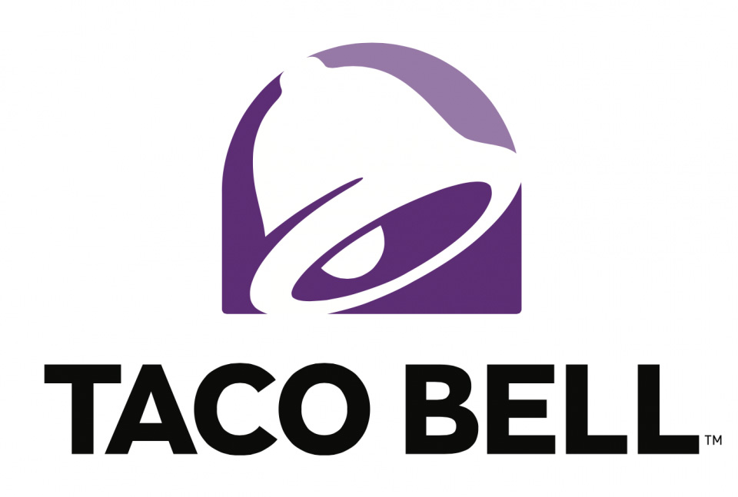
Notes:
Slide 14:
Now let’s talk about tacos. You might be wondering why I said two tacos rather than one? Because two tacos are always better than one.
Employee retention is a problem plaguing restaurant chains in every corner of the industry. With the U.S. employment rate a touch over 4 percent, minimum wage hikes, and the accelerating turnover rates for hourly employees it’s becoming increasingly difficult to find quality help, let alone retain those high performers.
With that in mind, it was hardly surprising that Taco Bell decided to “think outside the bun” and try to rethink their strategy. In 2017 they decide to launch a pilot to enhance their education benefits as part of their “Start With Us, Stay With Us” platform, which encourages employees to leverage the career-building and education programs that Taco Bell offers no matter how long they’ve been with, or plan to stay with, the company.
The YUM! Brands chain saw a 34% increase in employee retention for those enrolled over the first six months. This test was in about 700 corporate-owned restaurants and included more than 2,000 employees, who have since worked with a an education coach to go back to school. Employees enrolled in a course, program or degree through the program had a 98 percent retention rate in that six-month space, a 34 percent increase over those employees who were not enrolled.
This was exactly the type of impact that will support Taco Bell’s growth and hiring plans over the next five years.
Earlier this year, Taco Bell announced that it would be extending the program to provide education support for all 210,000 team members in its system of 7,000 restaurants in the U.S. Taco Bell team members will have access to personalized college advisors and tuition discounts for thousands of classes, certificates and degrees. The best part is Taco Bell doesn’t require employees to put in any time before signing up for these new benefits, so employees can take advantage of the education benefits on day one.
Frank Tucker, Global Chief People Officer at Taco Bell, said when they surveyed the employees, education support was one of the top three things they asked. The barriers to achieving their education goals were time, money and support. Their new program delivers on all of these needs for their employees through access to online classes, financial aid guidance, tuition assistance and a personal coaching to support each student in real time. Additionally, all employees can get college credit for on-the-job restaurant training, which could save an employee up to an additional $5,000, bringing their potential total savings to more than $10,000.
This added benefit will support Taco Bell’s plans to create 100,000 new jobs in the U.S. as part of the company’s 2022 growth goals.
https://www.tacobell.com/taco%20bell%20partners%20with%20guild
https://www.qsrmagazine.com/employee-management/taco-bell-extends-education-program-all-210000-employees

Slide 13

Notes:
Similar to the challenges that many organizations face in attracting middle-skill and front-line workers,
The nation is also struggling to find highly skilled workers in STEM fields such as software development, data scientist, and many others
Because of this there is extremely high demand for individuals with these skillsets which makes them very susceptible to being poached by competition
The average length of tenure for the big 10 IT firms in Silicon Valley is around 12 months.
Facebook had the longest tenure and on average their software developers stayed for 18 months before leaving for another job
The cost of hiring developers is easily $25,000 or more in recruiting fees
All of this combined creates a disaster for our so called “talent pipelines’. We have leaky pipes all over the place
But how might we do something different?

Slide 14
How Could You Create Your Own Talent Pipeline?
Notes:
I want to share 3 stories about companies who are doing something different.
Rather than just buying talent, they are building it.
Rather than viewing their Learning and Development strategy through traditional lens
They are looking at things differently and creating scenarios where L&D may be the companies best recruitment and retention strategy for top talent

Slide 15
High Performance Companies
80%
High Performance companies are investing up to 80% more on reskilling initiatives compared to low and average performing companies
Notes:
Our research looked at the investment companies are making into reskilling and upskilling initiatives to help solve some of the skills gap challenges through L&D initiatives (building vs buying)
We found that High performance companies are investing up to 80% more on reskilling initiatives compared to low and average performing companies.
That’s a significant difference and one worth taking note of, it doesn’t speak to causation vs. correlation, but if you want to be a high performing company and stay a high performing company it’s likely that you will need to invest more in reskilling and upskilling your employees compared to your competition.
So let’s take a look at a few companies who tackled upskilling and reskilling with a creative approach.

Slide 16

Notes:
Attracting the right talent while also offering sufficient salaries is a top concern for CIOs. Full-stack developers make about $111,540 annually, and job openings for the role have risen 198% from 2014 to 2017.
But training an existing workforce can be more beneficial when roles are specialized. Though more than half of developers identify as a full-stack developer, experts believe that can be too much of a "heavy lift."
Liberty Mutual CIO James McGlennon is responsible for conceiving the project called Go For Code. It’s a program designed to reskill and teach technology skills to internal employees who would have likely been displaced due to their current roles no longer being required by Liberty Mutual. James said it is easier to teach technology skills than it is to teach the knowledge of the company and insurance, which he believes to be much more difficult to learn. Once the employee is accepted into the program, they are assigned a new role in the company. They complete a 14 week training program to learn how to be a java developer. Once they complete the program they are integrated into their new team with their new manager.
Karin Conroy has been with Liberty for more than 30-years. She applied to the GoForCode program after her job as a was slated to be cut.
She was accepted to the Java bootcamp in early 2017. Liberty shifted her to a new team in the corporate IT group, where she completed the bootcamp program and then a month of assignments in areas such as front-end web development.
This year over 300 participants completed the Go For Code program. All of them were in previous roles within Liberty Mutual. Many of them from roles that were slated to be eliminated. The company found a way to keep the talent and reskill their talent to fit their growing need for developers. Around June 2017 Liberty Mutual was seeing such an impact from the program they decided to develop a deeper partnership with The Software Guild to build an onsite bootcamp at their Portsmouth New Hampshire headquarters so that they could be even more effective at reskilling their workforce.
The impact of retaining institutional knowledge and showing high commitment levels to employees is hard to measure, but sure to make an impact
However, being able to source talent internally vs. using external traditional means has saved the company several million in recruiting fees
Overall the total cost savings for the 300 employees this year is around $7.5 million

Slide 17

Notes:
Finding the right employee is one of the most important tasks in business (one might argue it is the most important thing managers do). Yet 61% of top executives surveyed in the Deloitte Human Capital Trends survey told us their companies do not do it well.
That’s why Google launched their Grow with Google program. To make it easier to find the talent that they need and so many others need.
The field of IT is growing quickly, with many companies looking to hire strong IT talent—there are 150,000 openings for IT Support jobs open in the U.S. alone. To help connect students with these job opportunities, they created a hiring consortium which includes Bank of America, Walmart, Sprint, GE Digital, PNC Bank, Infosys, TEKSystems, UPMC, Hulu, Cognizant, RICOH USA, MCPc, and 10 Walmart family companies and of course, Google.
Google's IT support certificate was launched in January using the Coursera platform
It takes about eight months to complete.
So far, nearly 40,000 people have enrolled in the online program..
For perspective of that impact, If Google was a university, this program would make it the 7th largest university in the nation in terms of colleges teaching undergraduates.
Recently they have partnered with more than 25 community colleges in California, Illinois, Michigan, New York, Ohio, Texas and Wisconsin to offer the certificate
This becomes a built in pool of talent for them to easily source from and even source to their clients
https://www.insidehighered.com/quicktakes/2018/06/26/google-launches-it-certificate-community-colleges
https://www.blog.google/outreach-initiatives/grow-with-google/it-cert-community-colleges/
*
https://www.educationdive.com/news/google-it-support-course-offered-at-25-community-colleges/526539/

Slide 18
What if…
…employee education and development became your company’s biggest recruiting and retention engine?
Notes:
I’ve shared just a few examples of how some organizations are thinking about current talent challenges slightly differently and producing some very impactful and interesting results. What could you do in your organization?
I want to leave you with a thought that I’ve been sharing with almost every learning leader I’ve spoken with this year.
“What if employee education and development became your company’s biggest recruiting and retention engine?”

Slide 19

Questions?
Jeremy Walsh
Vice President of Enterprise Learning Solutions
jcwalsh@wiley.com
954.205.7434
linkedin.com/in/jcwalsh
skills.learninghouse.com

Slide 20
Know Thy Students: Personalizing Experiences for The 3 Types of Adult Learners
Louisiana Board of Regents
Baton Rouge, LA

Slide 21
Google Insights
$8.5B
2x
> 50%
Increase in MOOC revenue by 2020
(increase of 5x)
Total number of digital activities a student performs post lead form capture.
Prospects take 1 + years
to decide to enroll
> 29,000
3,000 +
0%
The number of fully online degree programs in the US
(up 30% in just 5 years)
# of digital touchpoints while researching schools up to lead form
over 6 weeks
Growth in brand queries for non-profit public and private institutions Y/Y
Source: Google, Q1 2018 Education Insights Quarterly (EIQ)
Notes:
As a premiere partner with Google, Wiley routinely commission reports to monitor search trends within higher education. This enables us to maintain an accurate pulse of the market, its trends and themes, and in turns enables us better support the institutional needs of our partners.
Google’s Q1 2018 Education Insights Quarterly emphasized an increase marketplace competition and an increase in market disruption via non-traditional credentialing methods (MooCs, boot camps, etc.). The report also showed flat growth for public and private not-for-profit institutions. More than ever, students have more choices to help them attain their professional goals and address skills attainment.
The insights quarterly also surfaced interesting behavior related to the student journey. Today’s consumer of education spends upwards of a year+ researching institutions before engaging with an admissions manager, and only seriously considers three to four schools. Within their research process, they have over 3,000 digital touchpoints pre-lead form, and two times that amount post lead-capture. Today’s consumer is smarter than ever, and knows your brand and its offering.
So how you win in a market where traditional growth is flat, disruption is growing, and most programs are eliminated from consideration before standard marketing strategies even have time to start?

Slide 22
Google Insights
Market Disruption is Growing
Post-Lead Student Engagement Matter Even More
$8.5B
2x
Longer Research Process
> 50%
Increase in MOOC revenue by 2020
(increase of 5x)
Total number of digital activities a student performs post lead form capture.
Prospects take 1 + years
to decide to enroll
More Choices than Ever Before
> 29,000
Traditional Market Growth is Flat
More Thorough Research Process
3,000 +
0%
The number of fully online degree programs in the US
(up 30% in just 5 years)
# of digital touchpoints while researching schools up to lead form
over 6 weeks
Growth in brand queries for non-profit public and private institutions Y/Y
Source: Google, Q1 2018 Education Insights Quarterly (EIQ)
Notes:
As a premiere partner with Google, Wiley routinely commission reports to monitor search trends within higher education. This enables us to maintain an accurate pulse of the market, its trends and themes, and in turns enables us better support the institutional needs of our partners.
Google’s Q1 2018 Education Insights Quarterly emphasized an increase marketplace competition and an increase in market disruption via non-traditional credentialing methods (MooCs, boot camps, etc.). The report also showed flat growth for public and private not-for-profit institutions. More than ever, students have more choices to help them attain their professional goals and address skills attainment.
The insights quarterly also surfaced interesting behavior related to the student journey. Today’s consumer of education spends upwards of a year+ researching institutions before engaging with an admissions manager, and only seriously considers three to four schools. Within their research process, they have over 3,000 digital touchpoints pre-lead form, and two times that amount post lead-capture. Today’s consumer is smarter than ever, and knows your brand and its offering.
So how you win in a market where traditional growth is flat, disruption is growing, and most programs are eliminated from consideration before standard marketing strategies even have time to start?

Slide 23




Who Really Knows the Student?
The Faculty
The Administration
The Marketers
The Student
Notes:
We started to dig into Google’s insights around the student journey and consumer behavior. This surfaced a very simple but surprisingly complex question — who is the student?
Ask that question of various institutional stakeholders, and you’re likely to get differing opinions
Your faculty may describe the ideal student they want for the program.
The administration will cite
The marketing department will claim
As we asked this questions of our partner institutions, we got similar responses. It became very evident that the one person who knows the student best is the student.

Slide 24

Who Really Knows the Student?
The Student
The Faculty
The Administration
The Marketers
Notes:
We started to dig into Google’s insights around the student journey and consumer behavior. This surfaced a very simple but surprisingly complex question — who is the student?
Ask that question of various institutional stakeholders, and you’re likely to get differing opinions
Your faculty may describe the ideal student they want for the program.
The administration will cite
The marketing department will claim
As we asked this questions of our partner institutions, we got similar responses. It became very evident that the one person who knows the student best is the student.

Slide 25

Key Questions
What causes a prospect to consider higher education?
What traits and similarities do prospects share?
What motivates prospects to take action?
What barriers prevent prospects from progression?
How does prospect behavior differ by vertical of study?
What questions do our prospects want answered?
Notes:
We asked some questions.
…and here is how we did it.

Slide 26
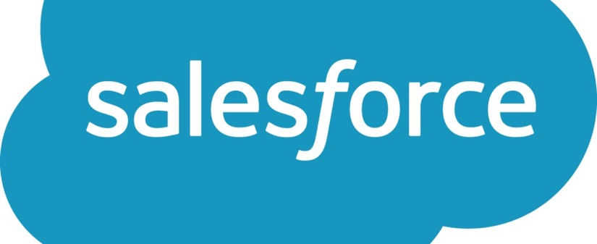



Methodology and Approach
CRM Student Data
Research Firm
Focus Groups and Round Tables
One-on-One Interviews
Notes:
So where did we start?
We first looked at our own student data. Wiley’s support of over 50000 students gives us the ability to really identify trends, themes and opportunities on multiple levels. We pulled a large diverse, cross-industry sample and began to conduct quantitative and qualitative research/outreach. However, we knew that limiting this study to our own data would not provide a true perspective of the market, just Wiley’s footprint. To ensure we had took a holistic approach, we partnered with an outside research firm to gain access to student data sets outside the Wiley ecosystem. Armed with the raw data, we began to identify correlations and similarities which lead us to three distinct audience segments.
We then conducted focus groups with each audience segment, dug deeper into the questions we sought answers too. We also facilitated round table discussions with our admissions advisors to document the most common questions students have related to the research and enrollment process. With that insight, we were able to pinpoint prospective and current students to conduct one-on-one interview with to help translate the segmentation groupings into student personas.

Slide 27



Three Distinct Audience Segments
The Advancer
The Launcher
The Altruist
Notes:
Here were the three segments uncovered by the research study.

Slide 28
The Advancer
Triggers and Motivations
Traits and Characteristics
Evaluation
Criteria
Workplace Event Occurs
Missed promotion
Colleague enrollment
Employer hosted career fair
Conversation w/Trusted Source
Work supervisor or co-worker
Family member
Mentor
Motivators
Higher salary
Job promotion
Competitiveness
Detail-oriented and direct
Needs trigger to prompt action
Cites a career, not a job.
Strong foundation to build on
Short list of “must haves”
Rushes through research
More likely to pay from savings
Influencer-driven
Unable to articulate goal
Views research and enrollment as stressful and cumbersome
Reluctant to engage one-to-one
Ease and fit into daily life
Proven ROI
Employer validation
Brand familiarity
“ Getting a master’s degree was always part of my plan. I really need a better understanding of the financials to land a senior leadership role.”
Notes:
First, the Advancer. As the name notes, this person wants to move ahead in his career. He’s motivated by a higher salary, a promotion and is very competitive. Advancers refer to their work as a career, not a job. They view the research process as cumbersome and stressful and so they create a short list of “must haves” that a program and university must meet. Ultimately when choosing a program, the Advancer needs it to fit into his life, see financial value in the degree and be familiar with the university they are attending.

Slide 29
The Launcher
Triggers and Motivations
Traits and Characteristics
Evaluation
Criteria
Motivators
Start a career
Change a career
Stability
Youngest of the segments
Aware of skills gap
Degree is best solution for barrier to entry
Goal-driven, but unware of best path for goal attainment
More likely to pay via loans and need reassurance of investment
Drawn to student outcomes
Strong desire to build confidence
Likely to have taken a MooC, seminar, or boot camp
Most common in STEM programs
Network opportunities
Job alignment and eligibility
Program reputation
Program specific differentiation
“I am returning to school so that I may launch a new career. It is a significant investment for me and I want to make the most out of it. That means meeting the most people and having the most options afterwards

Slide 30
The Altruist
Triggers and Motivations
Traits and Characteristics
Evaluation
Criteria
Life Stage Event Occurs
Empty nester
Retirement
Desire for Change
Motivators
Desire to learn
Aspirational
Sees a need or problem
Oldest of the three segments
Can have discovery paralysis that causes abandonment
Puts others first, especially family.
No clear path.
Desire flexibility as well as engagement within a program.
Drawn toward public service and the greater good.
They want to make difference.
Can lack clarity and often needs assistance. Lends to being fearful or having doubts.
Admissibility
Alignment to interests
Fit into daily life
Support
“ I want to make a difference, and have considered an advanced degree, but am not 100% sure. It’s exciting but the more I learn, the harder it is to make a decision.”

Slide 31
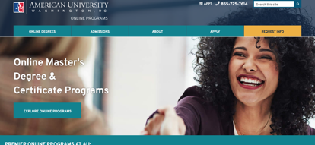
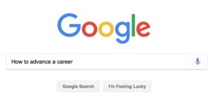


General Themes
Primary Research and Discovery Sources
89%
University Website
79%
Online Search
73%
Admissions Consult
51%
Trusted Referral
Prospects cited the university website as their primary source for programmatic research.
Recommendations
A/B test elements of current website
Optimize website architecture through student-driven UX labs
Define content strategy as it related to omnichannel approach
In aggregate, the sample cited online search as their second highest source of information when researching and evaluating a program.
Recommendations
Conduct keyword audit and competitor analysis
Conduct technical SEO audit
Outline quick and long-term content opportunities
It is important to note that our research also uncovered one bad interaction can jeopardize the outbound call model, and cause prospects to associate that experience to all lead capture forms.
Recommendations
Leverage admissions managers to assign audience segment
Provide narrative based on segment and behavioral style
While the Advancer places high emphasis on trusted endorsements, when viewed in aggregate, 51 percent of prospects cited this or direct referral was key in their final enrollment decision.
Recommendations
Activate on your alumni and current students
Explore influencer opportunities

Slide 32



General Themes
Primary Barriers to Enrollment
Cost
Time Investment
Lack of Confidence
Many students are still saddled with undergraduate loan debt which makes taking on an additional financial burden difficult.
Recommendations
Be transparent about tuition
Help simplify the FASFA process
Message ways to offset tuition in content marketing
Consider application waivers
Majority of graduate students are employed full-time and have family obligations. They don’t want success in one area come at the expense of another. Many also desire a faster path to in-market.
Recommendations
Assess program duration
Consider credit for work experience
Offer solutions via content marketing
Times passed since graduate-level prospects have been in an academic setting. Online learning may be foreign, and many can’t focus solely on academic studies. They doubt their ability to succeed.
Recommendations
Offer a teaser course (test-drive)
Explain the online student experience
Leverage current student testimonials

Slide 33



Operationalizing The Learns: Enrollment Services
Customize Engagement
Continue to Listen
Communicate Digitally
We identify the student persona early in the recruitment process and use that knowledge to customize the experience
61% of our students identified as Advancers
Advancers are more likely to move forward and apply
Education programs have a higher % of students identified as Altruists
We survey students who began their program of choice as well as those who fell out of the process
Students tell us the 4 primary factors in their decision are:
- Course availability
- University reputation
- Quality of the online experience
- Ability to advance career
60% of students who didn’t continue with their application cited concerns with cost and finances
Digitally native, adult learners are increasingly responding to non voice-to-voice engagement
Click-to-Chat is a meaningful lead generation channel
E-mail averages a 2-3% response rate; SMS averages 40%+
Ongoing SMS campaigns that address students personally have allowed us to achieve a 64% response rate and improve application completion rates
Notes:
We operationalized the research we did on student type and we identify which type of learner each inquiry is at the beginning of the student journey so that we can customize the experience. We also continue to listen to our students by doing survey research so that we understand what their primary motivations are and what’s important to them. Digital communication is key to reaching all types of online learners and we are seeing tremendous success with both click-to-chat and SMS. One of our key initiatives as a business is to continue building out our Omni-Channel Team.

Slide 34







Behavioral Analytics: Measuring Quality Engagement
3.5 million
& counting conversations have been recorded & analyzed
Performance Dashboard
Coaching Insights
Targeted Metrics
Predictive Insights
Likelihood
Models
Hitting Target Metrics increases conversion rate: on average 17.5%
35-40%
increase in
conversion post-implementation
Likelihood to Apply
Improved contact to application rate by 18%
Notes:
BA is key to ensuring that we are providing a quality experience based on what we know matters to students:
Our Program Managers (admissions representatives) use our proprietary Behavioral Analytics software platform, plus research from similar programs, to generate a student “persona” for each program. Being armed with these cutting-edge tools and insights helps us better understand your prospective students. We know who they are and where they are, along with their needs, wants, and motivations for choosing your programs over others’.
Using in-depth linguistic algorithms, the platform analyzes student speech and behavior during telephone interactions to reveal key measures of success, including the likelihood that a particular student will enroll. Over time, behavioral analytics allows us to learn the strengths, skills, and preferences of students. This allows us to have personalized student conversations and to customize communications to optimize student experiences and outcomes. Wiley Education Services has made a significant investment in behavioral analytics technology and maintains exclusivity with our vendor to offer this to our partner institutions.
Wiley has implemented behavioral analytics at scale, with more than 3.5 million conversations recorded and analyzed. This has enabled the establishment of benchmarks for targeted performance metrics and predictive modeling on a student’s likelihood to apply, enroll and persist. Coupled with directly informing coaching from Program Managers to prospective students, we’ve
realized tremendous results

Slide 35
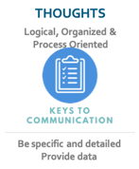
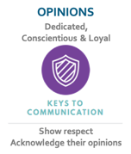
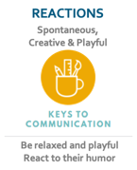
Operationalizing The Learns: Personalized Messaging
Producing content and creative that engages and resonates.
COMMUNICATION PREFERENCE
Behavioral Style
Top Converting Secondary Tertiary
Reactions Emotions Thoughts
Reactions Opinions Thoughts
Opinions Thoughts Reactions
Audience Segment
Advancer
Launcher
Altruist
Vertical of Study
Nursing
Cybersecurity
Social Work
Style Sheet
Omnichannel
Marketing Efforts
Student Persona
(quantitative + qualitative)
Content
Strategy
Media
Strategy
+
UNIVERSITY
EDITORIAL STANDARDS

Slide 36
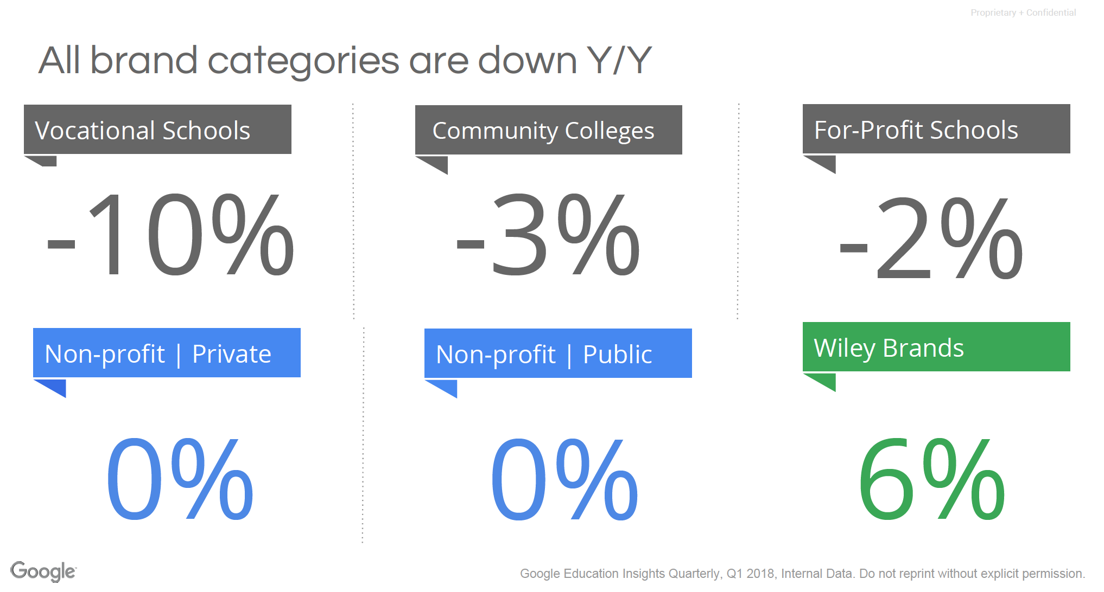
Results

Slide 37
Thank You

