Slide 1
Learning Mindsets in Corequisite Education
November 2023

Slide 2
Agenda
Topic | Time Duration
Introductions | 5 minutes
Our Work & Research | 10 minutes
Learning Mindsets in Meauxmentum | 5 minutes
Motivating Learners Course & Mindset Meauxtivators | 30 minutes
Q&A | 10 minutes

Slide 3
Introductions
Who we are

Slide 4
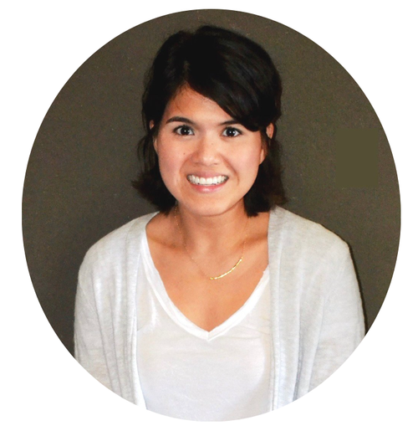
Our Motivate Lab Team
CHRIS HULLEMAN
Director
Associate Professor
University of Virginia
LADONNA YOUNG
Senior Director, Strategic Partnerships, Development & Equity
LINA GIN
Lead Product Manager
MARCUS KOLB
Project Manager

Slide 5
Our Work & Research
What we do

Slide 6
Motivate Lab Mission
To improve people’s lives through rigorous motivation research.

Slide 7
Motivate Lab Mission
To improve people’s lives through rigorous motivation research.

Slide 8
Motivate Lab Mission
To improve people’s lives through rigorous motivation research.

Slide 9
Motivate Lab Mission
To improve people’s lives through rigorous motivation research.
reduce systemic inequity

Slide 10
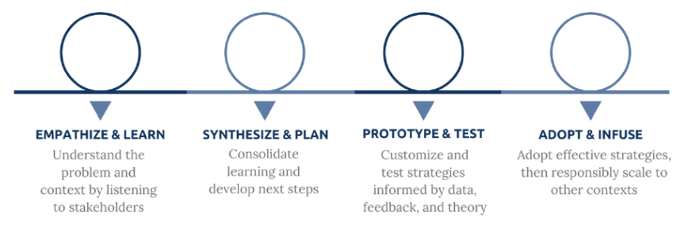
Our Research Process

Slide 11
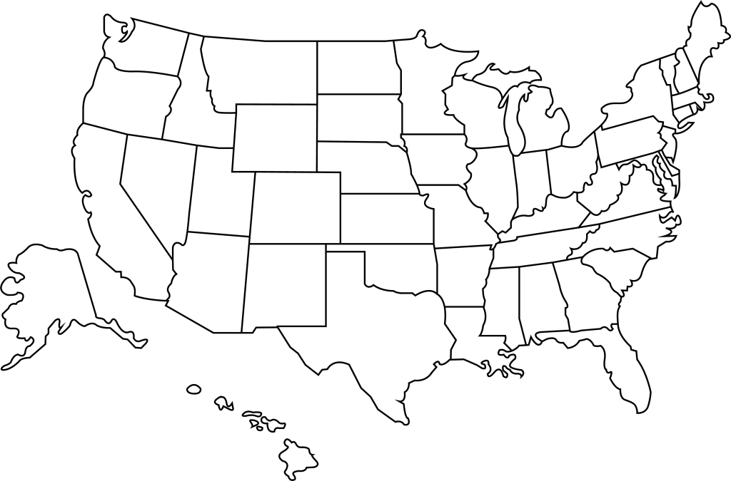
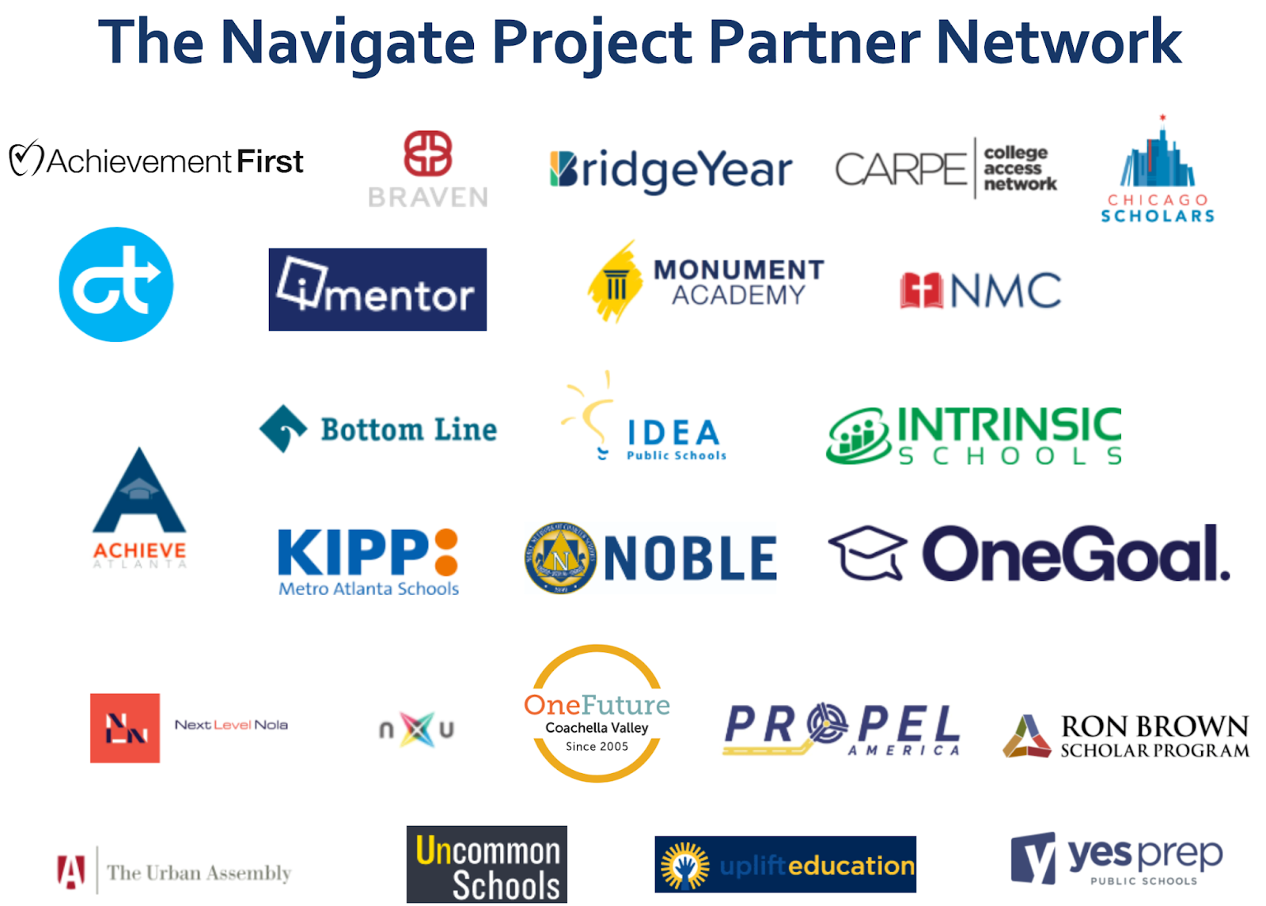
Motivate Lab Partners: 65 and Counting!
Notes:
63
https://docs.google.com/presentation/d/1pvUxn0yYMOb8dVTkiIZ3sNZN9vxK4UuzMm9qf2rsAsY/edit#slide=id.g162d95c7adb_0_292
COMs: 5 (AACOM + 4)
TNP: 25
TBR: 14
CUNY: 1 LA BoR: 1
USG: 7 (6 site visits + USG)
CFF: 5 (SDSU, Cal Poly, CPP, CSU-LA, CSU-LB)
OCCA: 1
The Post: 1
Strong Start to Finish: 1
AASCU: 1
Gardner: 1
UVA: 1
AACU: 1

Slide 12
Motivate Lab Partners: 65 and Counting!
Corequisite Education Partners
Notes:
63
https://docs.google.com/presentation/d/1pvUxn0yYMOb8dVTkiIZ3sNZN9vxK4UuzMm9qf2rsAsY/edit#slide=id.g162d95c7adb_0_292
COMs: 5 (AACOM + 4)
TNP: 25
TBR: 14
CUNY: 1 LA BoR: 1
USG: 7 (6 site visits + USG)
CFF: 5 (SDSU, Cal Poly, CPP, CSU-LA, CSU-LB)
OCCA: 1
The Post: 1
Strong Start to Finish: 1
AASCU: 1
Gardner: 1
UVA: 1
AACU: 1

Slide 13
Equitable System Change
Pre-Matriculation Activities
FYE Course Lesson Plans + Activities
Policymakers
Student Affairs
Instructors
Curriculum
Students
Classroom- Embedded Activities
Administration
Advisors
Professional Development
for Instructors and Staff
Researchers
Family & Friends
Parent Brochures & Website
Notes:
WE use our R&D process to help institutions and systems make meanginful system change by identifhing where they can pull learning mindset levers. As a part of this, we help people see the entire system when thinking about solutions.
We see the system in higher education as containing many stakeholders with overlapping opportunities for interaction and influence. This starts with students, and in fact we often ascribe a lot of responsibility to students for their personal outcomes. But that seems a bit short-sighted given all the other players in the system. This includes instructors, curriculum, advisors, students affairs, admin, family and friends, policy makers, and researchers, to name a few! In our work, we have developed and tested - using rigorous methods like randomized field experiments - supports at many levels of the system. Utility value interventions target students directly in classrooms. The Bulid Connections activity supports instructors. Parent information (brochures, website) helps parents think about how to help their children find value in education. Purpose lesson plans support first-year experience instructors and students. The MLC supports instructors and advisors directly, and curriculum and students indirectly.
KB: (1) make the administration box have solid white in the rectangle so it reads well and is like the others that overlap, (2) is there another word besides student affairs for a broader K-16 audience? This works for higher ed. Maybe it’s Co-Curriculum?
YT: COuld replace the blue-boxes with our recommended next steps (if our recommendations fit into this)

Slide 14
Learning Mindsets
Students’ beliefs about themselves as learners and their learning environment.
Growth Mindset
Belief that intelligence can be developed through hard work, the use of effective strategies, and help from others when needed
Purpose and Relevance
The belief that one’s schoolwork is valuable because it is connected to a larger purpose and/or relevant to one’s life.
Sense of Belonging
Belief that one is connected to and respected by peers, cared for by teachers and mentors, and fits in with the culture.

Slide 15
Learning Mindsets in Meauxmentum
Why it matters

Slide 16
3 Motivational Questions
Do I want to learn this?
Can I do this?
Do I belong here?

Slide 17
Rephrase with Mindset GPS
Purpose & Relevance
Growth Mindset
Yes, I want to learn this.
Sense of Belonging
Yes, I can do it.
Yes, I belong here.

Slide 18
Why Focus on Learning Mindsets?
Meaningful
Related to academic success and students’ well-being
Measurable
Can be assessed and tracked
Malleable
Can be altered through targeted activities and changes in the educational context
More Effective
Learning mindset interventions can be particularly powerful and improve outcomes for students from traditionally marginalized groups (e.g., Black, Latine, Indigenous, 1st generation)

Slide 19
Our Goal
We want to enhance the quality of psychological air in corequisite education.
Growth Mindset
Purpose & Relevance
Sense of Belonging
E
Equity

Slide 20
A Shared Goal

Slide 21
Motivating Learners Course &
Mindset Meauxtivators
How we plan to help

Slide 22
Motivating Learners Course
An online & asynchronous learning experience
This course equips faculty with motivationally-supportive tools and language to create a classrooms environments that supports students to develop adaptive beliefs about learning and school.

Slide 23
Course Outcomes
What you’ll be able to do by the end of the course
Know the principles for supporting student motivation through 3 key learning mindsets (Mindset GPS)
Identify both supportive and unsupportive learning mindset messages prevalent in corequisite education
Customize and implement learning mindset supportive activities and messages in corequisite education
Identify equity and opportunity gaps for key student groups and adopt learning mindset interventions to counteract them

Slide 24
Course Objectives
Guiding your learning towards course outcomes
Knowledge
Skill
Application
Understand Learning Mindset terminology, core principles, and strategies to identify equity and opportunity gaps
Identify and adopt Learning Mindset supportive instructional practice and messaging
Reflect and apply the concepts and instructional supports (i.e., key tasks) in practice

Slide 25
Course Structure
How the course is organized
Introduction to Key Concepts
Mindset Supportive Messaging
Revise Course Elements
Watch videos and read articles introducing key concepts, then hear the story of a student enrolled in a corequisite course who struggles to navigate the learning environment.
Practice identifying and creating learning mindset supportive
messages and consider their effects corequisite students. Create several projects to can be used in practice.
Learn how to structure learning experiences to support students' Learning Mindsets. Create several projects to be implemented as instructional routines.
Knowledge
Skill
Skill
Skill
Application
Application

Slide 26
Course Projects
Types of strategies to support what you already do
Leverage learning mindset supportive messaging in student-facing materials you leverage in corequisite education
Utilize Learning Mindset Messages
Cultivate Beliefs and Behaviors
Reinforce learning mindsets by planning opportunities to incorporate Mindset GPS in the corequisite context
Embed Mindset GPS into your already existing routines, such as how you assign work, review exams, or engage students in a corequisite environment
Create Environments
Notes:
Project Descriptions

Slide 27
Learning Mindset Messaging Project Example: Welcome Email
Dear Math101 students,
Let me officially welcome you back to JMU for the Fall semester and let you know I’m really looking forward to meeting each of you next week.
I also want to see if everyone had success getting our textbooks. Before our first class, I’d like you to read the preface of Jackson’s textbook (pgs. 1-4), so you appreciate why the author wrote it and the unique features she’s added to help learn our course material.
Then, please don’t hesitate to send email if you have any questions about our class that I can help with now (e.g., I can provide an alternative way to read the preface online if you’re still waiting on your textbook to come in the mail). Email is one of the best ways to always reach me.
Sincerely,
Dr. Barron
Legg and Wilson (2009)

Slide 28
Pause & Reflect
Can you identify where this email uses ?
Dear Math101 students,
Let me officially welcome you back to JMU for the Fall semester and let you know I’m really looking forward to meeting each of you next week.
I also want to see if everyone had success getting our textbooks. Before our first class, I’d like you to read the preface of Jackson’s textbook (pgs. 1-4), so you appreciate why the author wrote it and the unique features she’s added to help learn our course material.
Then, please don’t hesitate to send email if you have any questions about our class that I can help with now (e.g., I can provide an alternative way to read the preface online if you’re still waiting on your textbook to come in the mail). Email is one of the best ways to always reach me.
Sincerely,
Dr. Barron
Legg and Wilson (2009)

Slide 29
Mindset Meauxtivators
12 faculty members will serve as ambassadors across the Louisiana Regents system to share how to apply learning mindsets in corequisite education with colleagues.
Notes:
Opportunity to join after the course
Meet with system leaders
In person training opportunities
What are we training them on?
Intent for future courses?
Is this a collaborative effort to identify MM?
What are we building them up to? What is the goal?
Reinforce that MM are part of the Learning Mindset pillar in Meauxteum framework.? Are the MM also getting training in equity and resources?
Resource: creating people on the ground vs external folks is a huge resource boost

Slide 30
Mindset Meauxtivators
What will Louisiana Regents do for you?
Provide opportunities to:
Serve in a faculty leadership role
Develop a new role and expertise for yourself
Share your findings with your colleagues
Vocalize and influence at the state/system level
Letter for service to support promotion, tenure, etc.

Slide 31
Mindset Meauxtivators
What will Motivate Lab do for you?
Provide opportunities to:
Support learning and develop your knowledge and skill to advance learning mindset work across your assigned campuses
Connect you to other Mindest Meauxtivators for inspiration and motivation to advance learning mindset work in innovative ways

Slide 32
Mindset Meauxtivators
Meauxtivators will spread learnings and strategies to apply learning mindsets
Develop and share assets that could be useful for you and your assigned campuses
Spread your work and learnings to collaborate with others on innovative strategies to incorporate learning mindsets in practice
Guide and facilitate learnings across your assigned campuses to encourage and scale learning mindset supportive practices in corequisite education across the state
Notes:
Opportunity to join after the course
Meet with system leaders
In person training opportunities
What are we training them on?
Intent for future courses?
Is this a collaborative effort to identify MM?
What are we building them up to? What is the goal?
Reinforce that MM are part of the Learning Mindset pillar in Meauxteum framework.? Are the MM also getting training in equity and resources?
Resource: creating people on the ground vs external folks is a huge resource boost

Slide 33
Q&A

Slide 34
Q&A

Slide 35
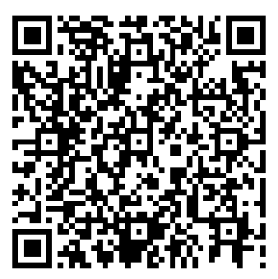
Thank You!
Please scan the QR code to provide feedback and share your interest in participating in a future Motivating Learners Course.
https://tinyurl.com/nhjtn4b4

