Slide 1
Co-Requisite Mathematics
SLCC’s Experience

Slide 2
Our Co-Requisite History
First offered in Fall 2015.
LFMA/MATH 0093 (Algebra Workshop) paired with MATH 1105 (College Algebra).
ACT 18 or equivalent.
One adopted text for both courses.

Slide 3
Our Approaches
Embedded in College Algebra
Separate instructors
Did not work well
Same instructor
Worked better, difficult to schedule, decreased flexibility
Cohort sections (same instructor)
Two traditional courses
Traditional college –level course, Hybrid co-requisite course
Two courses in same modality

Slide 4
Co-Requisite Content
Any background material necessary for College Algebra.
Activities to promote good habits and increase perseverance
In-class homework time
Review worksheets
Test reviews
Office conferences
Final Exam worksheets
Grade is largely based on participation in in-class activities.

Slide 5
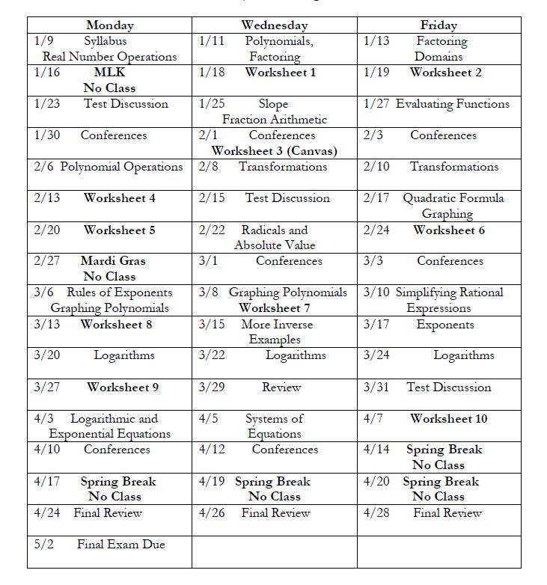

Slide 6
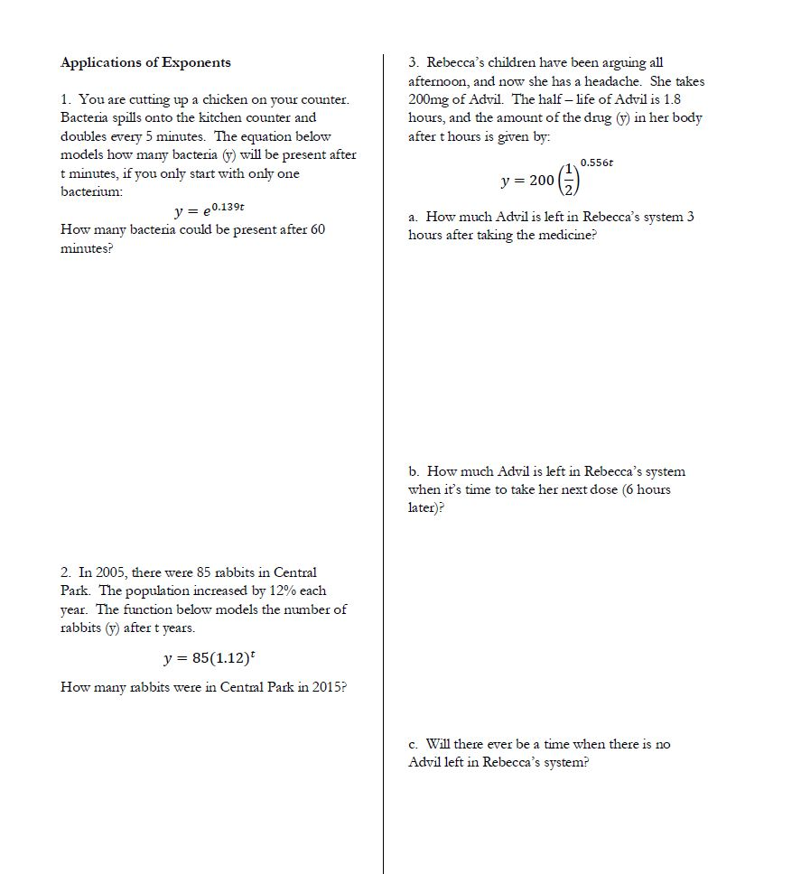
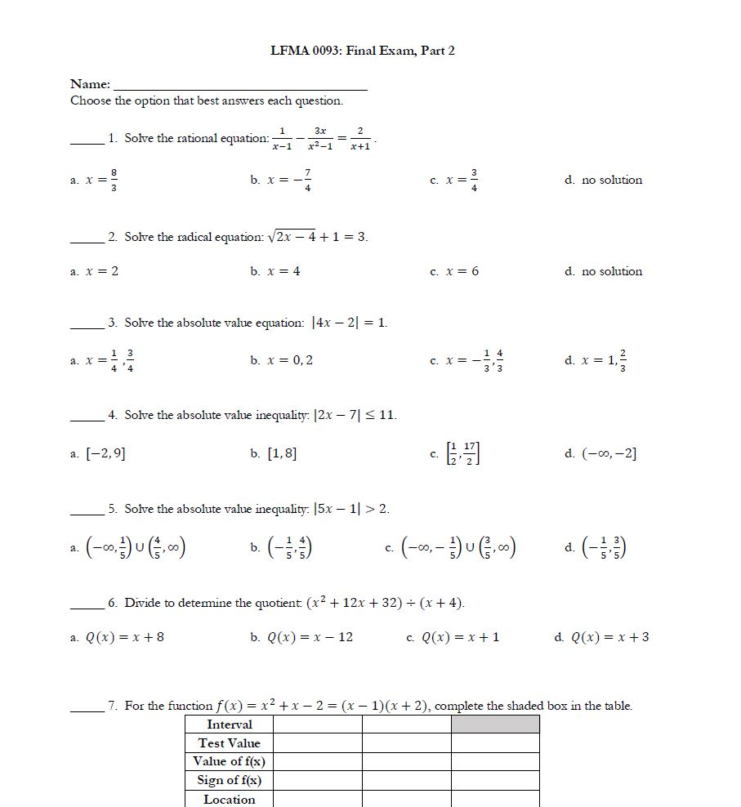

Slide 7
Co-Requisite Enrollment History
Academic Year | Co-Requisite Enrollment | Percentage of College Algebra Enrollment
2015 – 2016 | 50 | 2.2%
2016 – 2017 | 59 | 2.6%
2017 – 2018 | 57 | 2.9%
2018 – 2019 | 126 | 6.6%
2019 – 2020 | 151 | 7.8%
2020 – 2021 | 87 | 4.8%
2021 – 2022 | 115 | 8.1%
2022 – 2023 | 136 | 10.4%

Slide 8
Our Successes
Since Fall 2017, 81% of students who completed both co-requisite courses passed College Algebra.
Since Spring 2021, all but 1 assessed co-requisite sections have met the 80% "Meets or Exceeds Expectations" target in college-wide assessment.
Since Fall 2019, Student Rating of Instruction Data shows a 4.84/5 overall rating.

Slide 9
More Successes
SRI Comments on "What is the most valuable or useful thing you have learned in this class?"
"how to do algebra, I am so proud of myself for the things I learn from that math class."
"The more I practice my math the better I will become at it."
"that i can learn math"
"how to do algebra, I am so proud of myself for the things I learn from that math class."
"The most valuable thing I have learned from this course is repetition. Working the problems over and over until a firm grasp of the material is obtained has helped tremendously."

Slide 10
Our Challenges
Attendance and Participation
On average, 13% of students fail because they stopped attending.
Academic Integrity
Perseverance

Slide 11
Introducing MATH 0088
Using a 2 – tiered approach
Difference between ACT of 16 and 17
Same content and approach as MATH 0093
Hiring course lead
New Adjuncts
Scheduling
Back – to – back sections on the same days (2 or 3 days per week)
MWF, MW, TR
Offset days (4 or 5 days per week)
MW/TR, MWF/TR

Slide 12
What We’re Trying
Activities that worked well in MATH 0093
Review Worksheets
Class time for homework
New approaches
Reordering College Algebra material
Notebook checks
Exam reflections
Peer grading
Option to work ahead

Slide 13
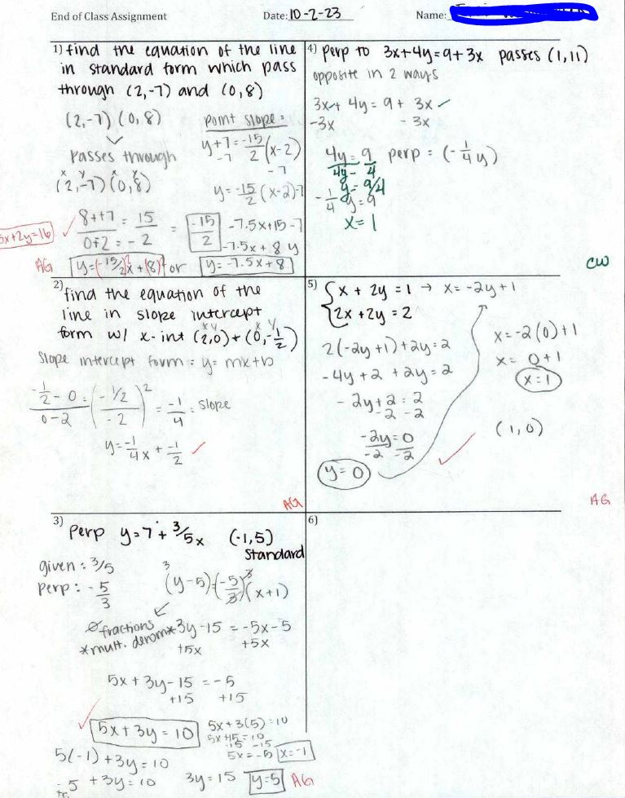
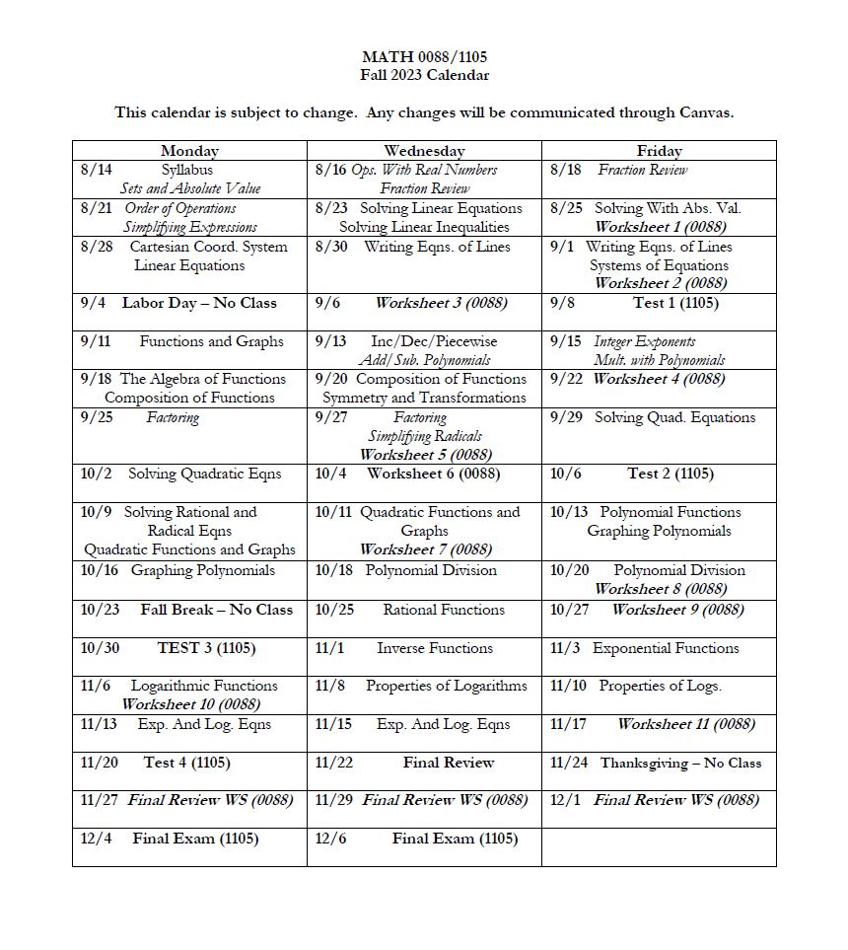

Slide 14
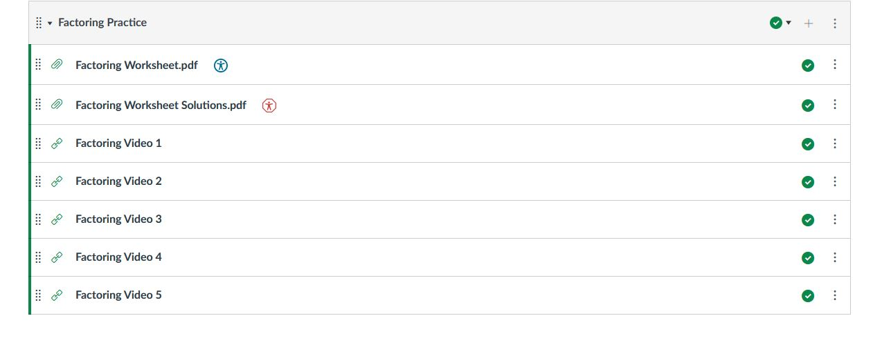
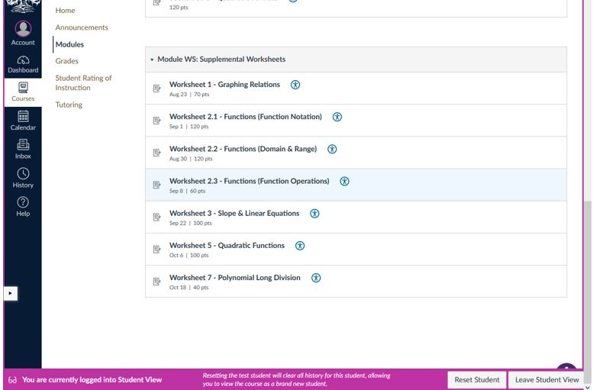
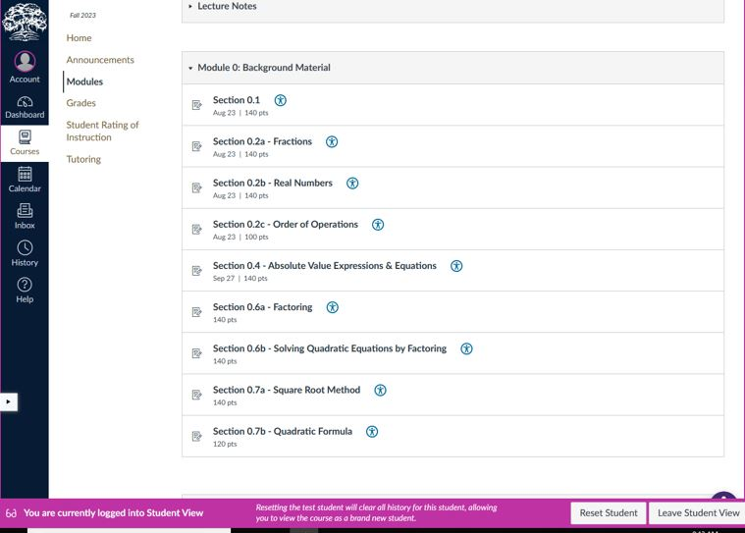

Slide 15
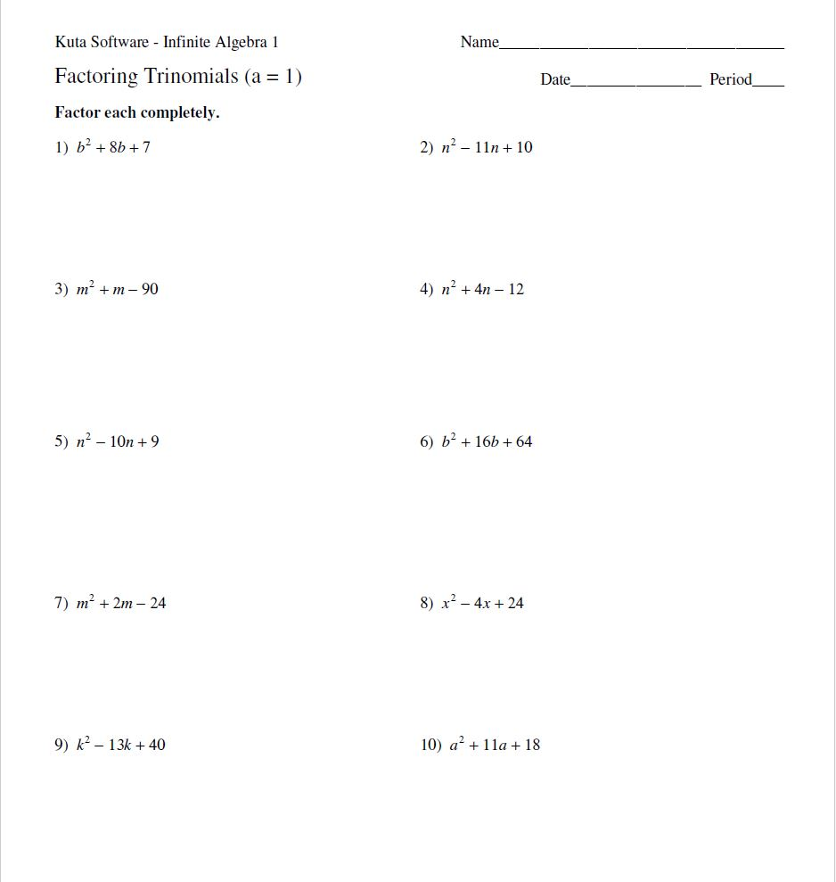
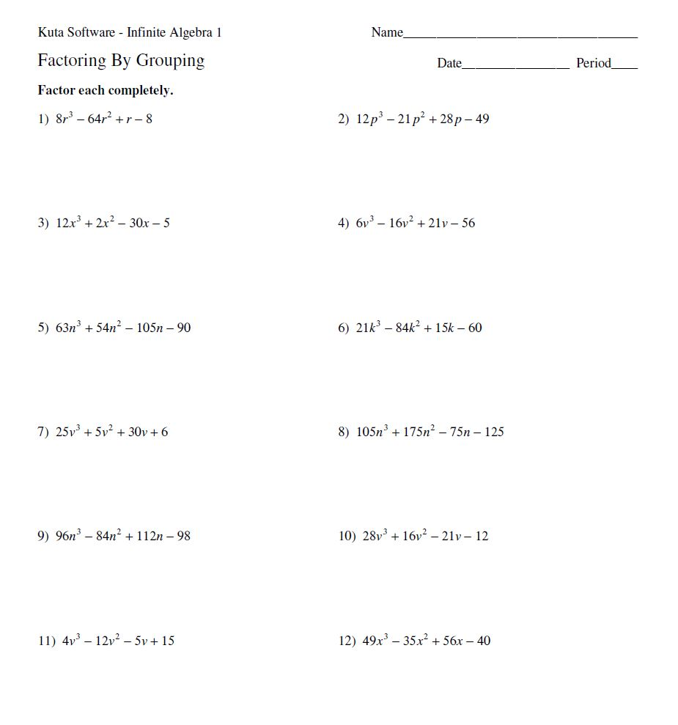
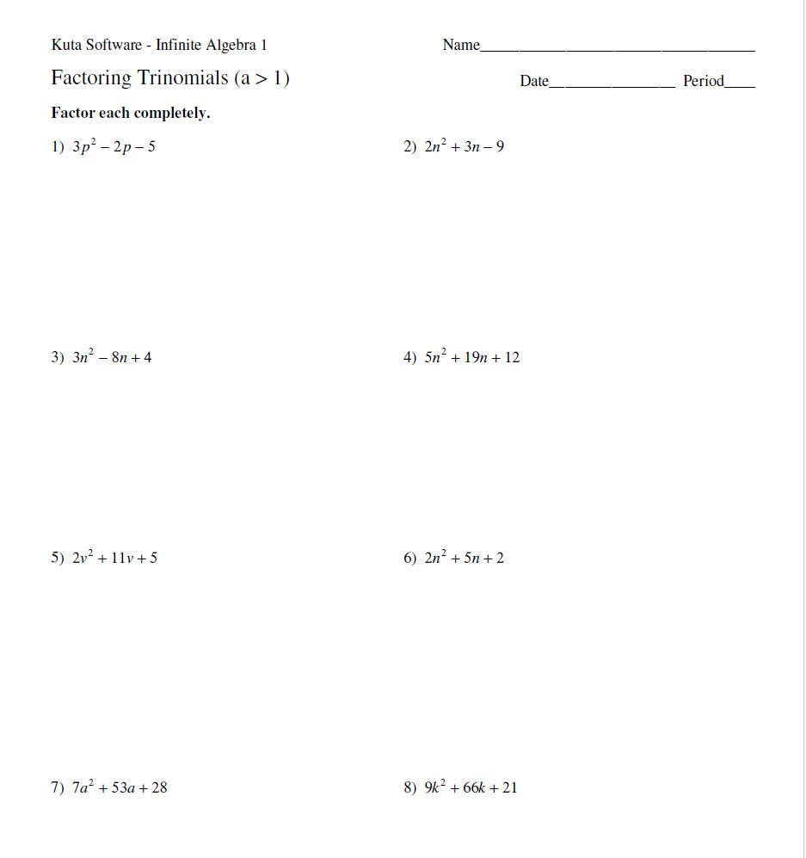

Slide 16
Anecdotes from Instructors
The 5 – day – per – week format works well.
“It seems like a majority of the coreq students lack study skills even more than math skills, and prioritizing frequency over duration is exactly what they need to apply to their own study habits.”
The extra practice time is helpful.
“One of the most obvious differences in the way I handle corequisite sections opposed to regular MATH 1105 sections is that in the corequisite sections I have more practice questions (hand outs) in class and I check for understanding by calling on students by handing them my iPad and having them demonstrate their work. (this is far less intimidating than asking them to come to the board).”

Slide 17
Successes
Extra time in class encourages homework completion.
Students who engage do well.
Challenges
Attendance and Participation
Academic Integrity
Perseverance

