Slide 1
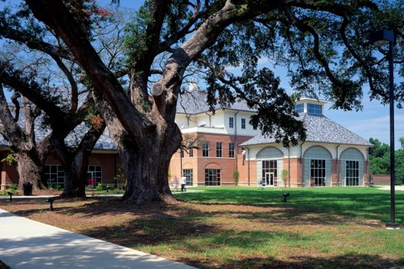
Supplement and Support for Students: SLCC's English Co-Req Model
Katherine Marsh, Department Chair
Aimee Rust, Course Lead
Dr. Adam Maillet, Instructor
Sami Richardson, Instructor
Notes:
Hello everyone, and welcome to our presentation on SLCC's English Co-Requisite Model as we discusses how the Workshop class has been adapted at our college to supplement and support our English 1010 students. It's a class about expanding on the fundementals of reading and writing, but also about making learning fun!

Slide 2
SLCC's History with Co-requisite
ENGL 0093: Introduced in Fall 2015 (as LFEN 0093)
Has undergone updates and initiatives over the semesters (new modalities, "triad" vs. fully cohorted models, expansion to other campuses)
Only available to students with ACT English 15-17 (or equivalent Accuplacer, SAT)
Lower or no test scores = ENGL 0083 (standalone developmental, last offered Summer 2023)
Fall 2023:
ENGL 0088 co-req: 468 students (38.7%)
ENGL 0093 co-req: 117 students (9.7%)
Total 1010 students: 1209 = 585 co-req (48.4%) = 624 non-co-req (51.6%)
Terms | Fa15- Sp16 | Fa16-Sp17 | Fa17-Sp18 | Fa18-Sp19 | Fa19-Sp20 | Fa20-Sp21 | Fa21-Sp22 | Fa22-Sp23 | Fall 2023
% of 1010 students in co-req | 2% | 3% | 3% | 13% | 17% | 10% | 11% | 11% | 48%

Slide 3
"English Workshop" Course Description
Fall 2023: launched the two-tier system
ENGL 88 Pre-Requisite: ACT English score of 14 or below, or Accuplacer NG Writing score of 224 or below
ENGL 93 Pre-Requisite: ACT English score of 15 - 17 or Accuplacer NG Writing Score of 225 - 249
This course is a supplement to ENGL 1010. It provides students with support, practice, and additional exposure to critical thinking, reading, writing, and rhetorical skills required in college level composition, with additional emphasis on foundational literacy and composition skills. Students will read and respond to a variety of texts, become familiar with strategies for building college-level essays, and regularize their application of English mechanics to communicate clearly with college and professional audiences. This is a supplemental course that cannot be used for certificate or degree programs.

Slide 4
Logistics
Why 2 levels/tiers?
Letter grade awarded for ENGL 1010 and co-req (not pass/fail)
Both levels/tiers carry 3 credit hours
Same instructor for both ENGL 1010 and co-req
Enrollment of 22 seats
Scheduling
Traditional lecture and HySync (virtual synchronous) courses only at this time – no asynchronous online options
15 and 12-week terms only (no 8-week for Fall or Spring – will pilot this during Summer 2024, along with 10-week)

Slide 5
Logistics
Staffing
Hiring: necessary to account for additional courses and loads for faculty
1 new fulltime faculty member
5 new adjunct faculty members
Course Offerings
Fall 2022:
ENGL 0083 (standalone developmental): 29 sections
ENGL 0093 + 1010: 5 paired sections
Fall 2023:
ENGL 0088 + 1010: 25 paired sections
ENGL 0093 + 1010: 6 paired sections

Slide 6
Training
Many new and returning faculty (full-time and adjunct) came into Fall 2023 with co-req and/or standalone developmental and college-level teaching experience.
However, some had not taught co-req or developmental in a few years, if at all (only college-level courses)
Departmental workshops and trainings coordinated with Department Chair and co-requisite Course Lead

Slide 7
Preparing to Implement: Trainings and Workshops
Workshop 1: "Best Practices in Corequisite Teaching"
Goals:
To onboard faculty unfamiliar with the corequisite/paired course model
To provide "why/how" understanding by incorporating theory and praxis. For example, when designing a coreq section, a best practice would be to anticipate "affective" or "hidden curriculum" student needs by deliberately designing assignments that address those needs

Slide 8
Slide 10 from "Best Practices in Corequisite Teaching"

Slide 9
Slide 27 from "Best Practices in Corequisite Teaching"

Slide 10
Preparing to Implement: Trainings and Workshops
Workshop 2: "Scaffolding Suggestions for Common ENGL Best Assignments"
Goals:
To assist faculty by providing specific scaffolding options they can build into their support courses for common 101-level essay and project assignments
2. To illustrate the diversity of successful approaches to assignment-building in paired courses

Slide 11
Slide 4 from "Scaffolding Suggestions"

Slide 12
Implementation: Resources
ENGL Co-Requisites Course Resources/Materials Sandbox – Canvas course, serves as repository for faculty to add materials, assignments, presentations for the classroom
Example co-requisite syllabi
Faculty-developed presentations and lesson support, sample assignments and prompts, free-use worksheets
Links to co-requisite professional development materials (webinars, recordings, etc.)

Slide 13
Sample Resources: Ready-to-Use Presentations and Lessons

Slide 14
Sample Resources: Assignments

Slide 15
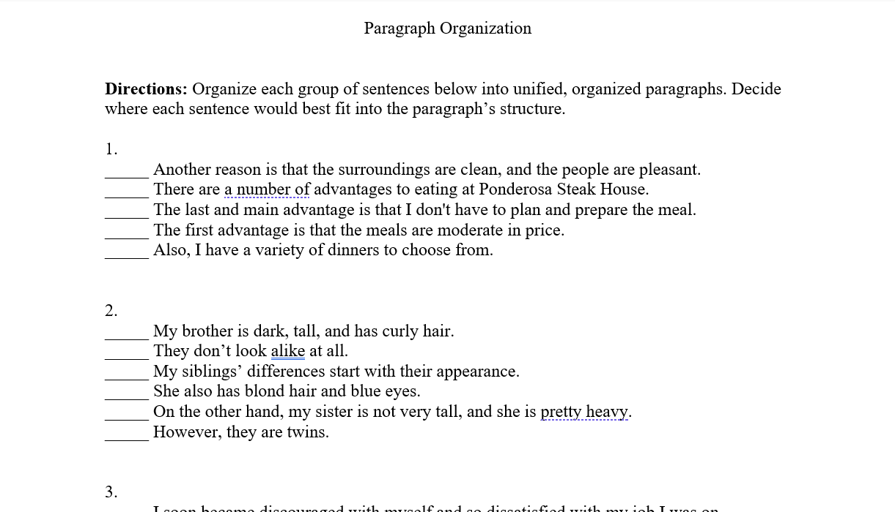
Aimee's Sample Assignment: Paragraph Organization Worksheet
Students complete as homework or in small groups
Graded Complete/Incomplete

Slide 16
Assessment
Students must be assessed with a minimum of 4 grading categories including, but not limited to:
quizzes, exams, participation, informal writing, outlines, journals, drafts, in-class timed essays, presentations, reading responses, grammar exercises, portfolios, and peer reviews.
The goal of the co-requisite is to supplement and support the work assigned in ENGL 1010.
Therefore, students should be engaged in activities that assist students in completing the work assigned in ENGL 1010. These activities, listed above, should allow students to practice skills needed in ENGL 1010 and should not include formal essays.

Slide 17
Assessment
Kate's | Aimee's | Adam's | Sami's
60% Writing Activities 10% Quizzes 20% Workshops & Conferences 10% Free-writes/ Journal Prompts | 30% In-Class Writing (Drafting) 30% Reading-Focused Responses 20% In-Class Activities 20% Quizzes | 25% Reading & Response 25% Writing Exercises 25% Interactive Fiction Project 25% Journals | 30% Peer-Review Participation 25% Open-Note Quizzes 20% Novel Project 35% Weekly Journal Entries

Slide 18
Sami's Slogan
Constantly reading outside of your minimal college requirements is imperative to develop your writing capability and make the writing process less intimidating.
Reading narratives should provide you with the following:
an appreciation for the conventions of narratives of other mediums (film, tv, video games),
a richer, more nuanced vocabulary,
a stronger understanding of grammar,
a more empathetic understanding of diversity,
a historical window into the past,
a mirror to reflect on your own growth,
and a powerful desire to create.

Slide 19
Sami's Sample Assignments
Major Assignment 2 in English 1010
You are a museum (or hall-of-fame or zoo) curator, and the director of the museum has asked you to prep the new wing of the museum. You will be required to research three related things
4 sources for each one (1 image, 3 articles), for 12+citations.
These sources should primarily come from the SOLACC library databases.
Each of the 3 things will become a body slide of your presentation,
You will summarize and cite your articles, like an annotated bibliography,
BUT you will read your informative summaries while your 3 images fill your slides.
Application in the English Workshop:
Peer Review
Open-Note Quizzes
Novel Project
Weekly Informal Journal

Slide 20
Sami's Sample Assignments
Application in the English Workshop:
Peer Review:
What was your rough draft rehearsal time (the final draft goal is 5-10 minutes)?
What is one positive thing a classmate said about your project 2?
What are the things from the rubric that you were told to work on?
Open-Note Quizzes
Novel Project
Weekly Informal Journal
Student feedback:
"It gives a second opinion that we might not have thought of, sharing ideas with each other about how to better our projects"
"Definitely helps you get a second point of view and allows you to fix things that may otherwise hurt your grade from being looked over."

Slide 21
Sami's Sample Assignments
Application in the English Workshop:
Peer Review
Open-Note Quizzes, Multiple Choice, Unlimited Timed Attempts:
What does MLA stand for?
Which is NOT an example of a secondary source?
Which is NOT a strategy if your search terms yield too few results?
We learned 10 steps for writing a summary. Which of these steps comes EARLIEST on that list?
What point-of view should you use in your informative summaries?
Novel Project
Weekly Informal Journal
Student feedback:
"It is pretty great, honestly. I mean, the more times you have to try, the more times u read through the info. Then you're actually learning it instead of failing and the class moving on."
"It helps significantly, it helps reduce test taking anxiety by allowing myself to not feel rushed, or pressured."

Slide 22
Sami's Sample Assignments
Application in the English Workshop:
Peer Review
Open-Note Quizzes, Multiple Choice:
Novel Project
Open your novel again & read for 45 minutes
Using what you learned about summaries, write a single sentence summary of what you read today.
Let’s pretend that they are making a new movie based on this book! Pick an actor to play a character. Find and cite an image of that actor.
Pick a set to use for a scene in the new movie adaptation. Find and cite and image of a place that could work for the scene.
Weekly Informal Journal
Student feedback:​
"I really like [in-class reading time], my life outside of class is hectic and I rarely have time to read so being able to read in class helps a lot."
"Great, I can read something that I personally find interesting and it helps ensure that I keep some sort of reading in my life, it also helps understand larger concepts."

Slide 23
Sami's Sample Assignments
Application in the English Workshop:
Peer Review
Open-Note Quizzes, Multiple Choice:
Novel Project
Weekly Informal Journal:
Skim through this 13-page, peer-reviewed academic journal article, Falk's "Understanding Museum Visitors’ Motivations and Learning" and respond. He lists the 5 types of visitors (Falk 117). Write 200+ words in your informal writing response, describing what you hope visitors, of different types, might gain from your imaginary museum. Have fun with it. What do you think your museum looks like? Who will it attract? What amenities might it have?
Student feedback:​
"I love being able to write freely without having to do a full paper, it allows me to explore my creativity, and even decrease my stress when I am able to write about issues I might be struggling with, without having to have a therapy session."
"it helps me recap everything that we went over and helps me feel motivated and excited to see what can be accomplished the next week."

Slide 24
Sami's Assignments
But not every day has to directly connect to their project...
the day they designed their presentations, with minimalism,
we read and discussed a 2023 article by Joseph Foley:
"Is the minimalist logo trend destroying brands?"
There was no writing for that day, but
they had fun discussing the reading.

Slide 25
Adam's Sample Assignments
Conceptualizing the co-req as the "deluxe edition" of 1010.
"Reading & Response"
Literary Character Dinner Party
Interactive Fiction
Journal: What's On Your Mind?

Slide 26
"Reading & Response"
•Supplemental readings for the co-req •Emphasis on contemporary publications
(sometimes published only days before class)
•Topics of interest to students (based upon their writing and conversation)
•Instructor reads the article
(explain words or concepts, ask questions, actively demonstrate the reading process)
•Student writes a response
(low-stakes homework, attending class prepares them to do this)
"I just found an interesting essay I think y'all would like: it was published
yesterday, so no one has ever done this in a college class before. We
might be the first, so let's read it and see what we think about it!"

Slide 27
"Reading & Response" Topics (Fall 2023)
•ChatGPT
•Shopping
•Digital Privacy
•Plato's Allegory of the Cave
•The Internet
•Social Media

Slide 28
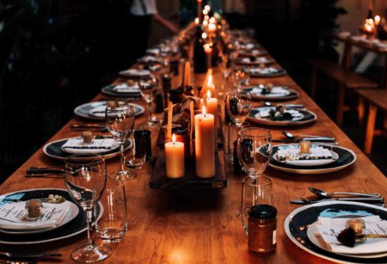
Literary Character Dinner Party
Students attend a mock dinner party in which they play one of the characters from the short stories that we read in 1010.
Encourages students to get inside the head of fictional characters.
One student acts as the "host" and the instructor acts as their assistant.

Slide 29
Literary Character Dinner Party
You, a famous literary character, have been invited to a fancy dinner party! Other luminaries such as yourself are going to be there as well. The conversation promises to be engaging; the food? Almost certainly divine.
A dinner party such as this is a formal affair; you don’t know most of the other guests, and you don’t want to embarrass yourself in conversation. It’s best to plan out some topics of talk: tidbits of insight, philosophy, or debate that the diverse group of guests might help to enrich. Interesting subjects of conversation: we’ve got to prepare a few before the party!

Slide 30
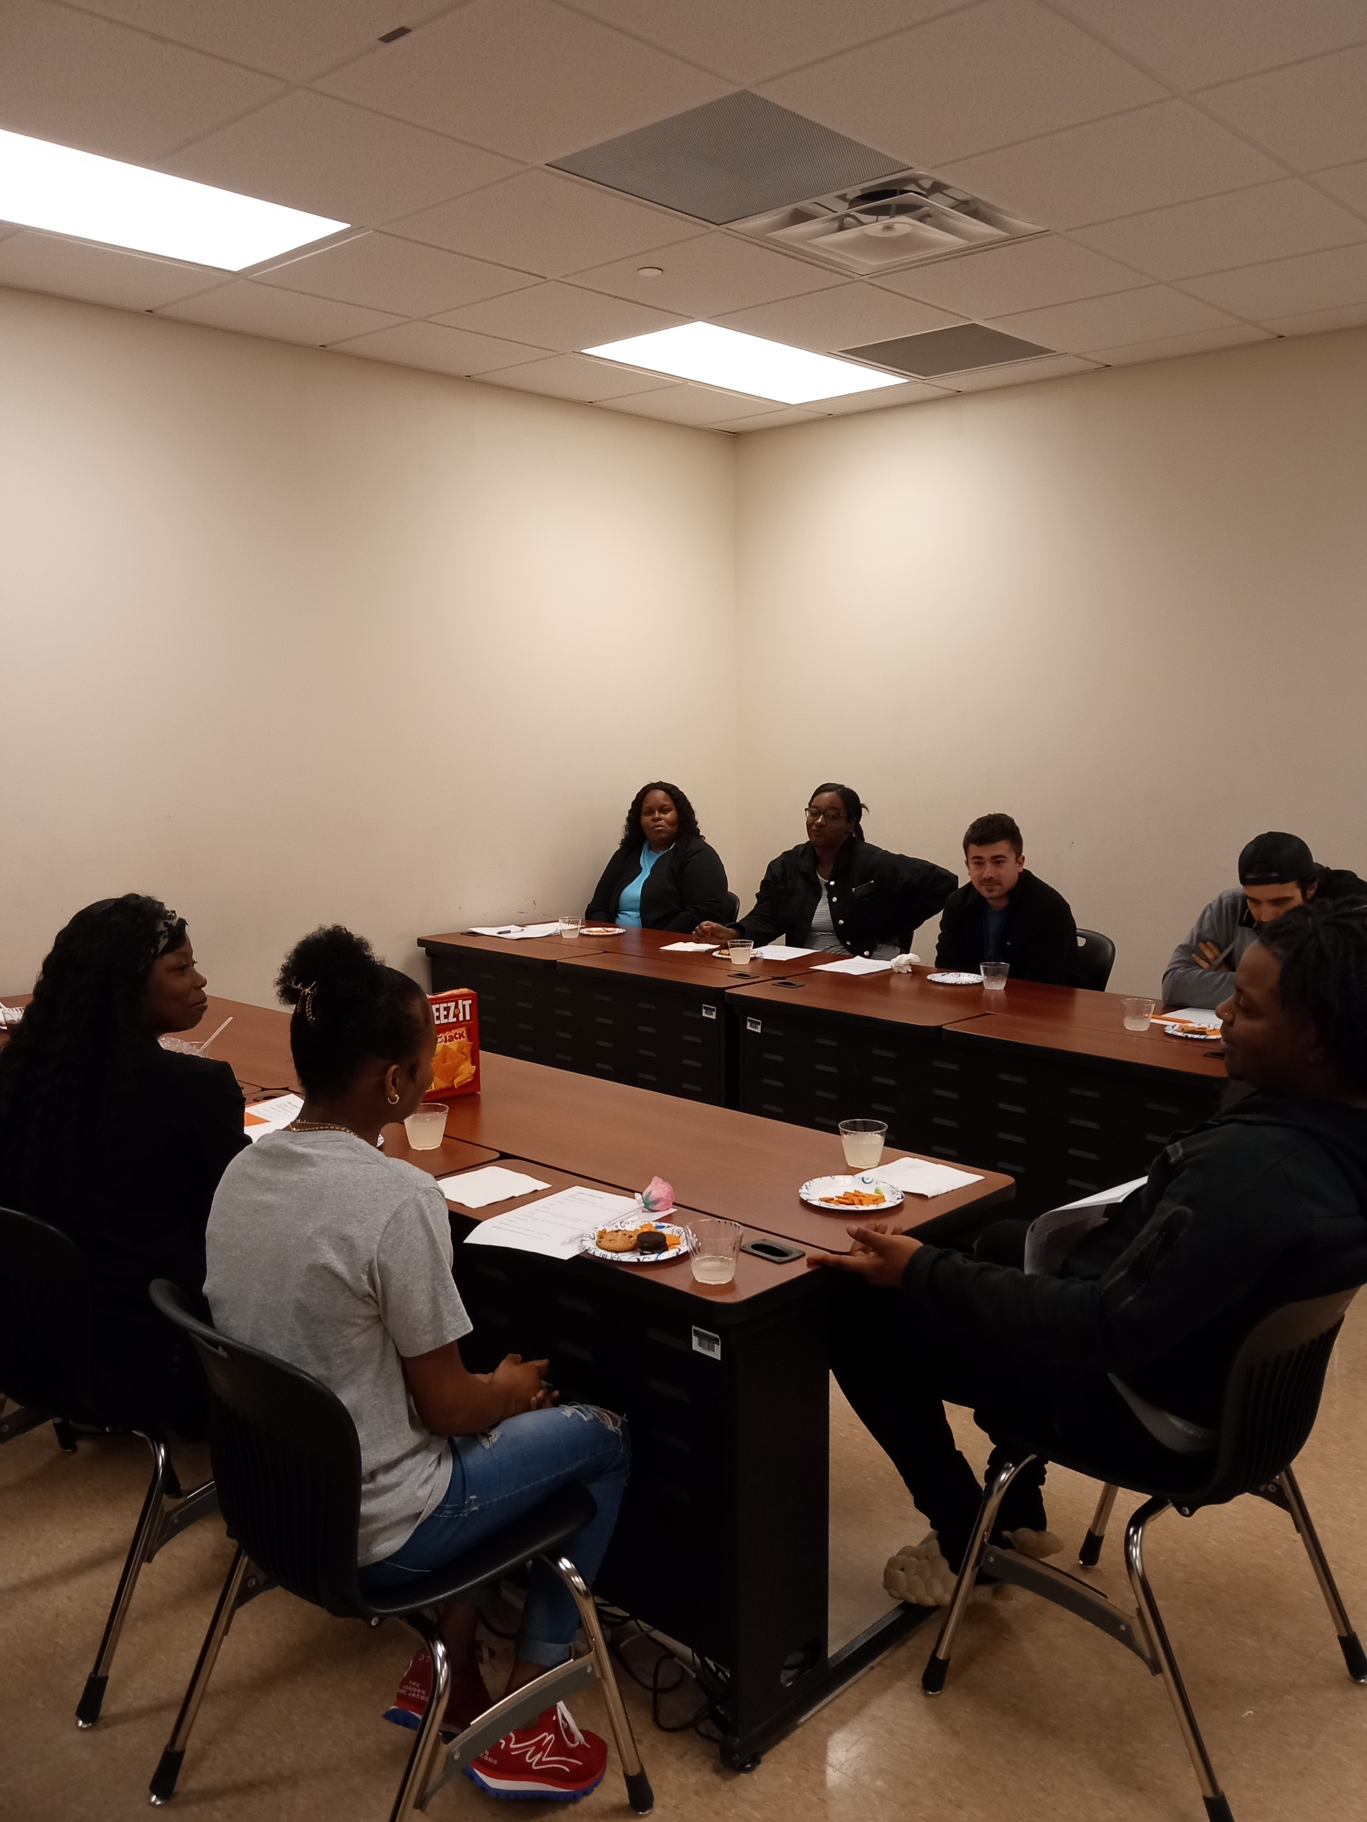
Literary Character Dinner Party Spring 2023

Slide 31
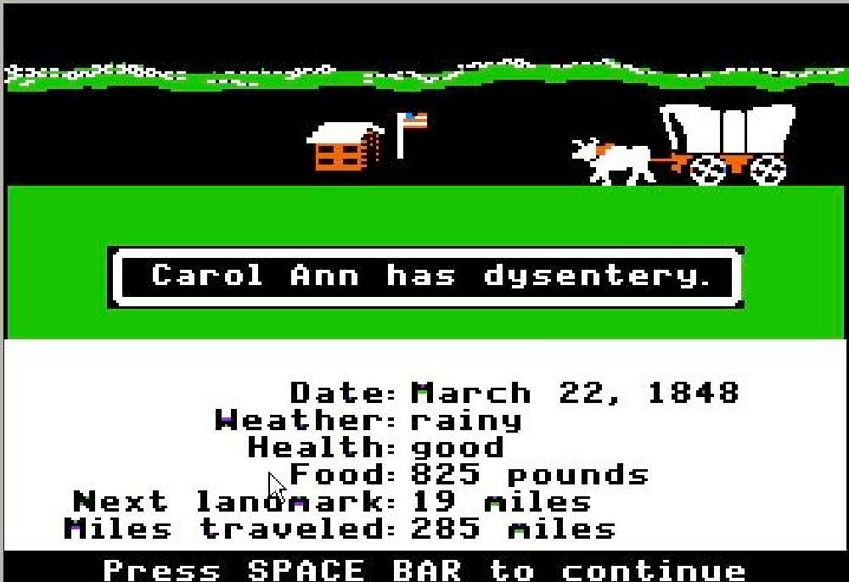
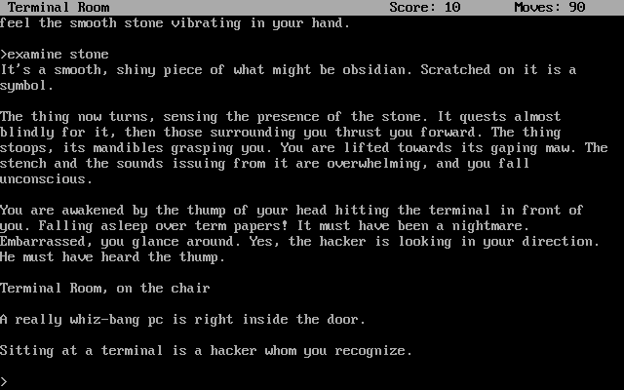
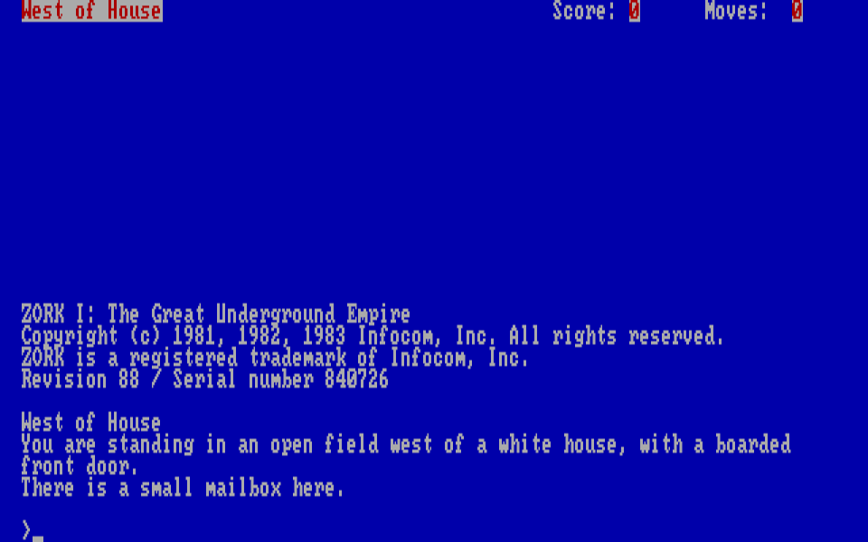
Interactive Fiction

Slide 32
Interactive Fiction
Students explore text-based, Interactive Fiction.
Assignments focus on different tasks: writing narratives, mapping, designing games, and reflecting on challenges.
Instruction combines context and history, as well as collaborative demonstration with the class.
"Serialized" throughout the semester; classroom texts increase in complexity.
Advanced texts require extreme patience, literary prowess, and problem solving.
Makes language fun, while working on fundamentals.

Slide 33
Student Responses to Interactive Fiction
What has been your favorite assignment in English 88?
"Playing interactive fiction, like Zork, has been a really enjoyable experience for me. I love immersive storytelling and the challenge of solving puzzles. It presents the challenge of using your imagination and thinking creatively to progress in the game."
"My favorite assignment in English 88 so far this semester was the Colossal Cave assignment. This was my favorite because it was really cool going on a journey, entering new rooms, collecting things, and being able to use the things you collect."

Slide 34
Student Response 1
What's On Your Mind?
"What’s on my mind is graduating from college with my associates. I dreamed about that moment for a long time. I want everyone to be there for me while crossing that stage. While traveling it, they are screaming my name, and people are clapping for me. At that moment, it felt like I had accomplished a significant milestone that nobody in my family had yet. That’s all I could think about right now."

Slide 35
Student Response 2
What's On Your Mind?
"Sometimes it feels like I have a million things to do. From school to two jobs, planning a wedding and being a mom, it's rough. I need to make a decision on which job to let go. Both come with their own pro's and con's. I definitely want to continue school, no if, ands, or buts. I want to let one of my jobs go, I just don't know which. It's easier to go to school when I work the bar, but I rely on tips. With my other job it's a little more inconvenient, during the day. A 9-5. [...] I'm just burnt out, I need to choose one, but I am not sure which. I wish there was a book for all of this. I always try to stay optimistic, so I know in the end I will always choose school, and that I am proud of myself. Anything can go but school."

Slide 36
Looking Forward
Continued challenges:
Student attrition and persistence
Staffing, training/onboarding strategies
Outcomes:
Fall data will be gathered Dec. 2023 – will use this along with faculty input and discussions for necessary updates, resources, etc. that may be needed
Departmental Placement Opportunities:
Began development in Spring 2023; currently working through logistics for implementation

Slide 37
Contact Us:
Katherine Marsh:
katherine.marsh@solacc.edu
Aimee Rust:
aimee.rust@solacc.edu
Dr. Adam Maillet:
adam.maillet@solacc.edu
Sami Richardson:
samantha.richardson@solacc.edu

