Slide 1
Best Practices: The CoRequisite Model for College Mathematics and PreCalculus I
Presented by Phyllis Okwan
and
Kimyata Dilworth
Southern University and A&M College
November 7, 2023

Slide 2
Presentation outline
01
How Did We Get Here?
02
Understanding The Journey
03
Course Content
04
Course Comparison
05
Data Presentation
06
How Do We Ensure Arrival?
07
Thank you

Slide 3
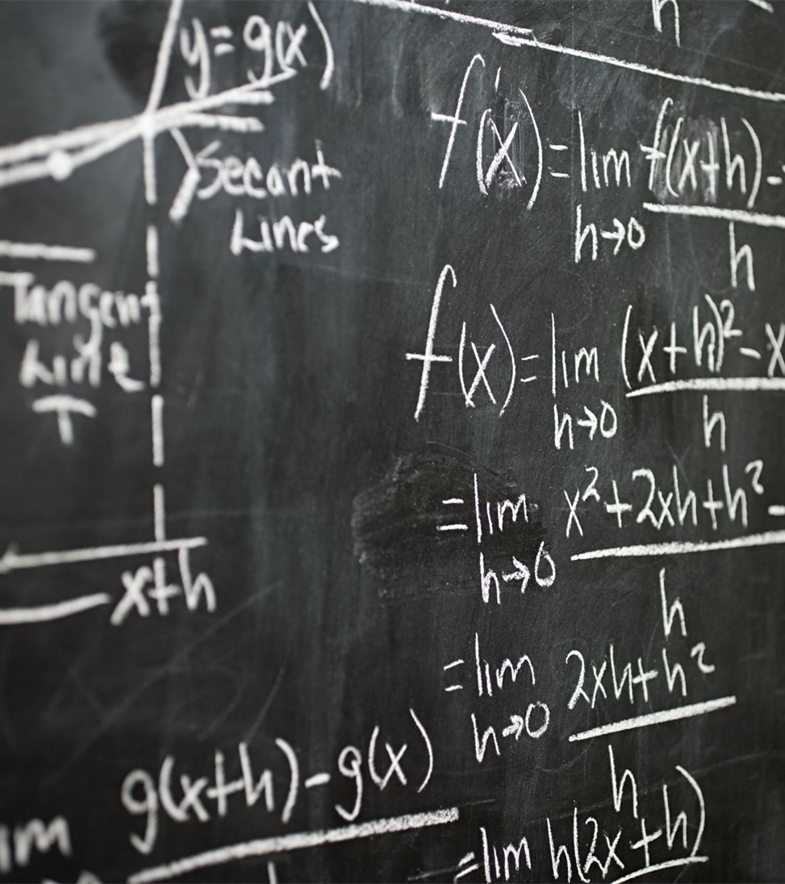
How Did We Get Here? Why were co-requisite courses created?
To support students needing help in some of the fundamental concepts that form the foundation of:
College Mathematics (Math 129)
PreCalculus I (Math 134).

Slide 4
Understand the student journey to and through the corequisite course
How do students enter the course?
What is the student experience?
What supports student experience?
Mathematics Pathways

Slide 5
College Mathematics: Sample course content
1
2
Module I
Module II
Real Numbers Operations [Introductory Algebra]
[1.1] Integers and Rational Numbers [Dev. Math]
1.2 Addition of Rational Numbers
1.3 Subtraction of Rational Numbers
1.4 Multiplication of Rational Numbers
[1.5] The Distributive Property [Dev. Math]
[1.6] Division of Rational Numbers [Dev. Math]
1.7 Square Roots and Real Numbers
Decimals and Percents
Expressions and Equations [Introductory Algebra]
[2.1] Variable Expressions [Dev. Math]
[2.2] Order of Operations [Dev. Math]
[2.3] One-Step Equations [Dev. Math]
2.4 Two-Step Equation
2.5 Multi-Step Equations
2.6 Equations with Variables on Both Sides
2.7 Ratio and Proportions
Linear Inequalities

Slide 6
Precalculus i: Sample course content
1
5
Module I
Module 5
Real Numbers and Equations and Inequalities
[1.3] Exponents, Order of Operations, and variable
Expressions
[1.4] Adding Real Numbers
[1.5] Subtracting Real Numbers
[1.6] Multiplying and Dividing Real Numbers
[1.8] Simplifying Expressions
[2.3] Further Solving Linear Equations
1.2 Linear Equations
1.7 Linear Inequalities
Quizzes and Test
Polynomial and Rational Functions
3.2 Polynomial Functions and Their Graphs
3.3 Dividing Polynomials; Remainder and Factor
Theorems
3.4 Zeros of Polynomial Functions
3.5 Rational Functions and Their Graphs
3.6 Polynomial and Rational Inequalities
Quizzes and Test

Slide 7
College Mathematics: Sample view

Slide 8
Precalculus i: Sample view

Slide 9
Course offerings comparison
 | College Mathematics I
 | Section
Semester | Corequisite | Regular
Fall 2021 | 9 | 12
Spring 2022 | 4 | 9
Fall 2022 | 15 | 10
Spring 2023 | 8 | 11
Fall 2023 | 13 | 9

Slide 10
Course offering comparison
 | PreCalculus I
 | Section
Semester | Corequisite | Regular
Fall 2021 | 15 | 18
Spring 2022 | 11 | 19
Fall 2022 | 21 | 19
Spring 2023 | 13 | 11
Fall 2023 | 22 | 22

Slide 11
Where are we now?
Empower your students to be agents of change.
Replace context with one that is engaging to your students.
Replace names with ones that are meaningful to your students.
4
Start with basic mathematical concepts.
3
2
1
www.mathedleadership.org

Slide 12
college mathematics COMPARISON: MATH 129 AND MATH 130 FROM Fall 2021 to spring 2023

Slide 13
Fall 2021 Comparison of Grades: Math 129 and Math 130

Slide 14
SPRING 2022 Comparison of Grades: Math 129 and Math 130

Slide 15
Year one Comparison of Grades: Math 129 and math 130

Slide 16
Fall 2022 Comparison of Grades: Math 129 and Math 130

Slide 17
SPRING 2023 Comparison of Grades: Math 129 and Math 130

Slide 18
Year TWO Comparison of Grades: Math 129 and math 130

Slide 19
PreCalculus I COMPARISON: MATH 134 AND sMAT 121 FROM Fall 2021 to spring 2023

Slide 20
Fall 2021 Comparison of Grades: Math 134 and sMat 121

Slide 21
Spring 2022 Comparison of Grades: Math 134 and sMat 121

Slide 22
Year one Comparison of Grades: Math 134 and sMat 121

Slide 23
Fall 2022 Comparison of Grades: Math 134 and sMat 121

Slide 24
Spring 2023 Comparison of Grades: Math 134 and sMat 121

Slide 25
Year TWO Comparison of Grades: Math 134 and sMat 121

Slide 26
Comparison of Passing Grades(Fall 21 to Spring 23): math 129, math 130, Math 134 and sMat 121

Slide 27
How do we ensure arrival?
MONITORING & CONTROL
ASSESSMENT
ASSESSMENT & MEASUREMENT
We use homework, small group participation, and class participation to make sure students understand the concept being taught, and also to reinforce those concepts that students are still struggling with
Students are assessed in these courses throughout the semester in the form of quizzes, tests, midterm exams, and comprehensive final exam
The coordinators of these courses meet with the instructors of these courses at the beginning of every semester and during the semester to discuss what works and what doesn’t work for students. Always finding ways to improve these courses

