Slide 1
From Classroom to Workplace: Using Learning Mindset Supportive Practices to Enhance Transfer of Skills and Knowledge
Dr. Chris Hulleman
Director and Professor
Motivate Lab and University of Virginia
Notes:
This workshop focuses on how to adopt learning-mindset supportive curricular strategies that help students to identify with their chosen program of study and transfer skills and knowledge from the classroom into the workplace.
https://www.laregents.edu/meauxmentum/
Session outline: https://docs.google.com/document/d/1TNhCD-5DzfCCPv4grYxEmpUcfo1b-IGP/edit

Slide 2


Learning Mindsets in Engagement
EVERYONE
ENGAGEMENT
CHOICE
MILESTONES
PATHWAYS
AFFORDABILITY
LEARNING MINDSETS
2

Slide 3
Agenda
Introduction
Think-Pair-Share
Theory and research on transfer
You Try It! Reflection activity
Pair-Share
Q&A

Slide 4
What is Transfer?
  Transfer occurs when “learning to participate in an activity in one situation [i.e., learning context] . . . influence[s] (positively or negatively) one’s ability to participate in another activity in a different situation [i.e., transfer context]” (Greeno, Smith, & Moore, 1993, p. 100).

Slide 5
Transfer has most often been studied like this….
From Perkins (2009) and Engle et al. (2012)
Notes:
From Perkins (2009) a case study of a high school physics classroom as reported in Engle, Lam, Meyer, & Nix. (2012). How does expansive faming promote transfer? Several proposed explanation and a research agenda for investigating them. Educational Psychologist.
Perkins,D. (2009). Making learningwhole: Howseven principles of teaching can transform education. San Francisco, CA: Jossey-Bass.

Slide 6
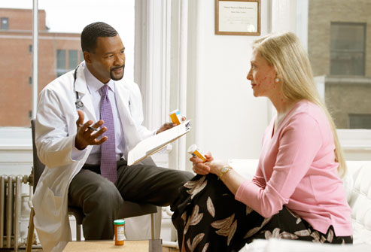
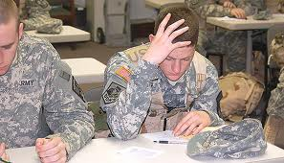
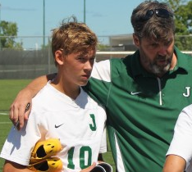



But we often think about transfer like this…

Slide 7
A Common (Fundamental) Assumption About Our Lives
We learn valuable skills, knowledge, and attitudes by participating in activities, whether it’s school, sports, clubs, volunteering.
What we learn by doing these activities changes how we approach other activities in our lives.
In other words, we can transfer the skills, knowledge, and attitudes from context to context.

Slide 8
Think-Pair-Share
What practices do your institutions engage in to facilitate transfer of knowledge and skills from the college setting to the workplace?
  3 minutes: Think on your own
  5 minutes: Talk with an elbow partner
  8 minutes: Share out with large group

Slide 9

mindset
curiosity
grit
self skills
motivation
personality
Economist!
character
conscientiousness
passion
non-cognitive skills
psychological assets
perseverance

Slide 10



Learning Mindsets
Students’ beliefs about themselves as learners and their learning environment.
Growth Mindset
Belief that intelligence can be developed through hard work, the use of effective strategies, and help from others when needed
Purpose and Relevance
The belief that one’s schoolwork is valuable because it is connected to a larger purpose and/or relevant to one’s life.
Sense of Belonging
Belief that one is connected to and respected by peers, cared for by teachers and mentors, and fits in with the culture.
Notes:
https://media2-production.mightynetworks.com/asset/27037112/Introduction_to_Mindset_GPS_Transcript.pdf

Slide 11
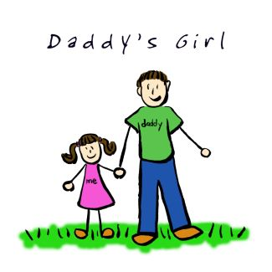


Is There Evidence That Mindsets and Other Non-Cognitive Skills Transfer?
Notes:
No!
My story
The wire clip
Physics class example
German/math study

Slide 12
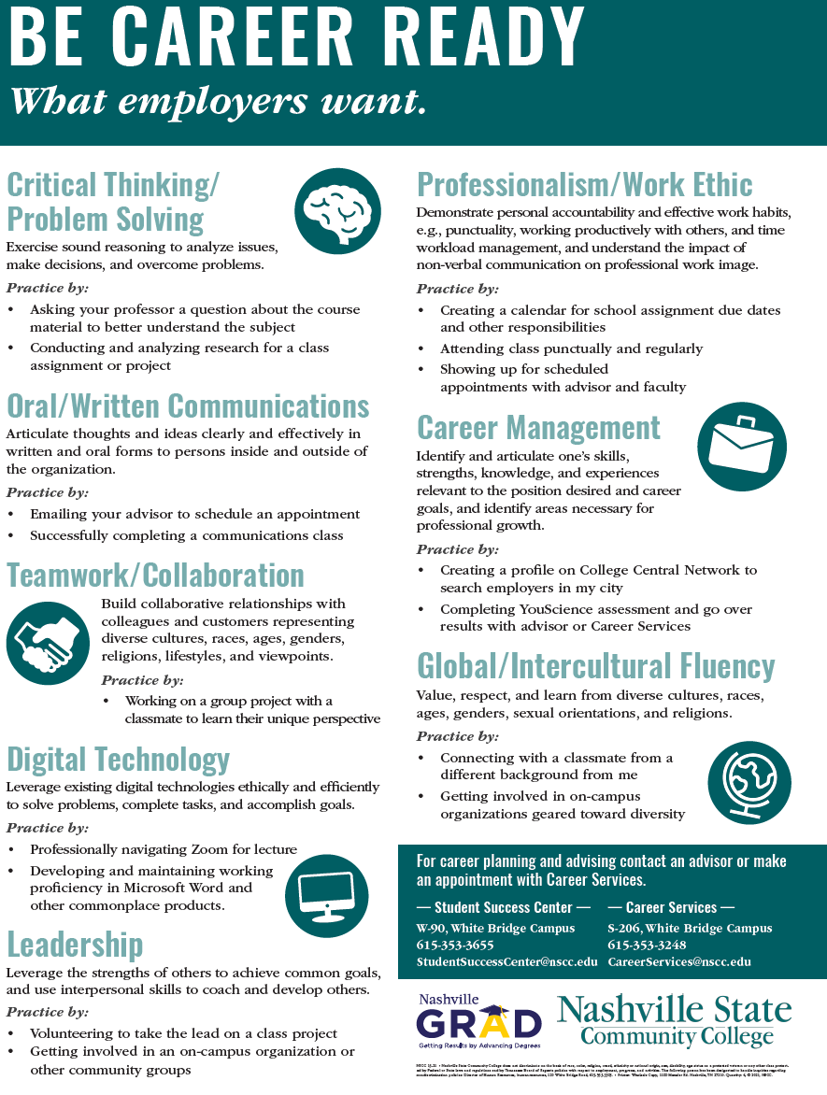
Notes:
From NSCC via Jessica Rabb

Slide 13
Correlations Between German and Math

Slide 14
How to Facilitate Transfer?
Learn the skill
Develop schemas about the skill that generate generalizations to a new context
Notice similarities between learning and transfer contexts
See relevance/value of skills learned in one context for another context
Cue/prime to similar features when transferring skills
Wormington & Hulleman (2017)

Slide 15
How to Facilitate Transfer?
Learn the skill
Develop schemas about the skill that generate generalizations to a new context
Notice similarities between learning and transfer contexts
See relevance/value of skills learned in one context for another context
Cue/prime to similar features when transferring skills
Wormington & Hulleman (2017)

Slide 16
Seeing Relevance for Learning
Utility Value
  Discovering that the material is related to your life in some way energizes learning
    Daily life
    Future career and life goals
    Hobbies and interests
Intervention
  Write an essay about how the class material is relevant to their life in some way
Hulleman & Harackiewicz (2009); Hulleman et al. (2010); Hulleman et al. (2014); Hulleman et al. (in prep.)

Slide 17
High School Science
(N = 262)
β = -.18, p = .03
Semester Grades
Note: Error bars represent +/- 2 SEM.
Hulleman & Harackiewicz, 2009, Science
Notes:
Error bars represent +/- 2SEM

Slide 18
How to Facilitate Transfer?
Learn the skill
Develop schemas about the skill that generate generalizations to a new context
Notice similarities between learning and transfer contexts
See relevance/value of skills learned in one context for another context
Cue/prime to similar features when transferring skills
Wormington & Hulleman (2017)

Slide 19
How to Facilitate Transfer?
Learn the skill
Develop schemas about the skill that generate generalizations to a new context
Notice similarities between learning and transfer contexts
See relevance/value of skills learned in one context for another context
Cue/prime to similar features when transferring skills
Wormington & Hulleman (2017)

Slide 20
Cueing Students Through Reflection: The Case of Service Learning
      “Generally, it is thought that community service places adolescents in novel situations and societal contexts in which they can learn, apply, and practice various behaviors and skills as well as confront societal issues and different perspectives, values, and behaviors. (p. 2115)”
Van Goethem et al. (2014). Child Development.

Slide 21
Meta-Analysis of Service Learning Programs
Outcomes:
Academic
Personal
Social
Civic
49 studies (N = 24,477, 12-20 year-olds)
Van Goethem et al. (2014). Child Development.
Notes:
van Goethem, van Hoof, Orobio de Castro, Van Aken, & Hart (2014). The role of reflection in the effects of ocmunity service on adolescent development: A meta-analysis. Child Development.
N=49 studies with control group, N = 24,497, ages 12-20
Positive benefit of service learning (also includes community service and volunteering) only if reflection included ES = .41 v. .05)
Classroom reflection had largest effect size
Quality of reflection had a small effect
# of hours served increased benefits of service-learning only if reflection is included
Older adolescents benefitted more only with reflection
Type of community service, type of reflection, and most student characteristics did not moderate the effect
Frequency of reflection increased benefits
Strongest effects when content of reflection matched content of outcomes (civic attitudes measured and reflectcion was on civic attitudes)

Slide 22
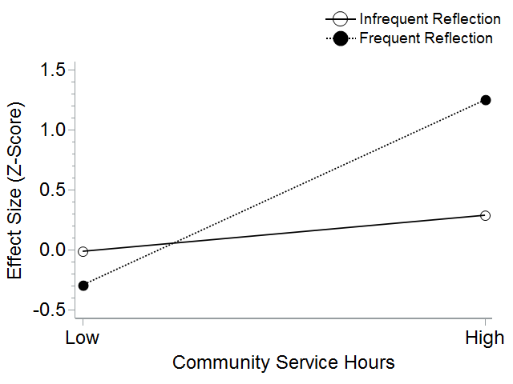
Meta-Analysis of Service Learning Programs
Van Goethem et al. (2014). Child Development.
Notes:
van Goethem, van Hoof, Orobio de Castro, Van Aken, & Hart (2014). The role of reflection in the effects of ocmunity service on adolescent development: A meta-analysis. Child Development.
N=49 studies with control group, N = 24,497, ages 12-20
Positive benefit of service learning (also includes community service and volunteering) only if reflection included ES = .41 v. .05)
Classroom reflection had largest effect size
Quality of reflection had a small effect
# of hours served increased benefits of service-learning only if reflection is included
Older adolescents benefitted more only with reflection
Type of community service, type of reflection, and most student characteristics did not moderate the effect
Frequency of reflection increased benefits
Strongest effects when content of reflection matched content of outcomes (civic attitudes measured and reflectcion was on civic attitudes)

Slide 23
How to Facilitate Transfer?
Learn the skill
Develop schemas about the skill that generate generalizations to a new context
Notice similarities between learning and transfer contexts
See relevance/value of skills learned in one context for another context
Cue/prime to similar features when transferring skills
Wormington & Hulleman (2017)

Slide 24
How to Facilitate Transfer?
Learn the skill
Develop schemas about the skill that generate generalizations to a new context
Notice similarities between learning and transfer contexts
See relevance/value of skills learned in one context for another context
Cue/prime to similar features when transferring skills
Wormington & Hulleman (2017)

Slide 25

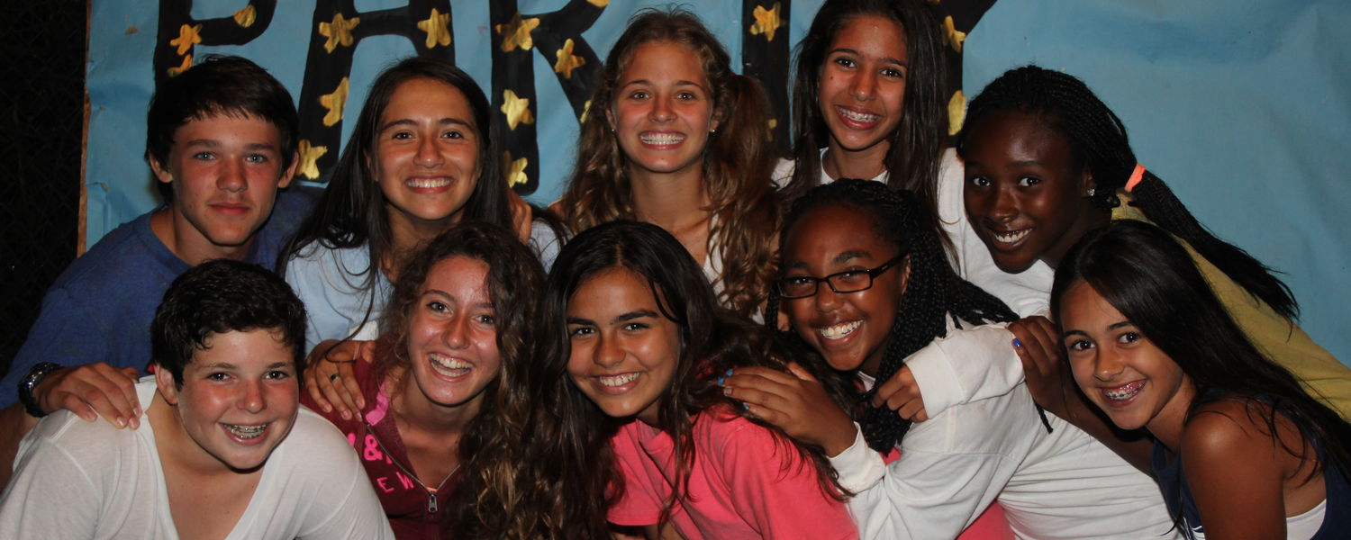
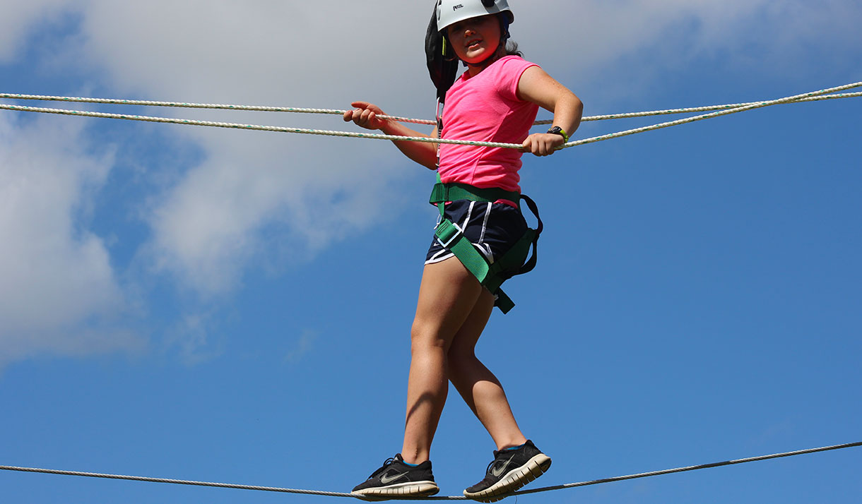
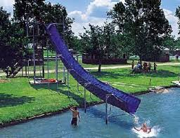
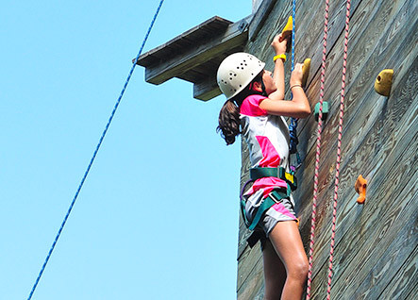

Cueing Connections Between Learning and Transfer Contexts
Hulleman, Yeager, et al. (in prep.)

Slide 26
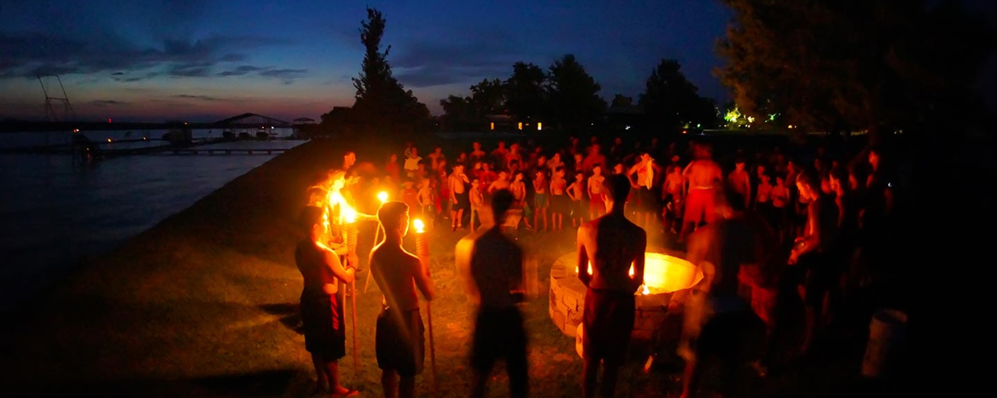
Tenacity and Purpose
Hulleman, Yeager, et al. (in prep.)

Slide 27
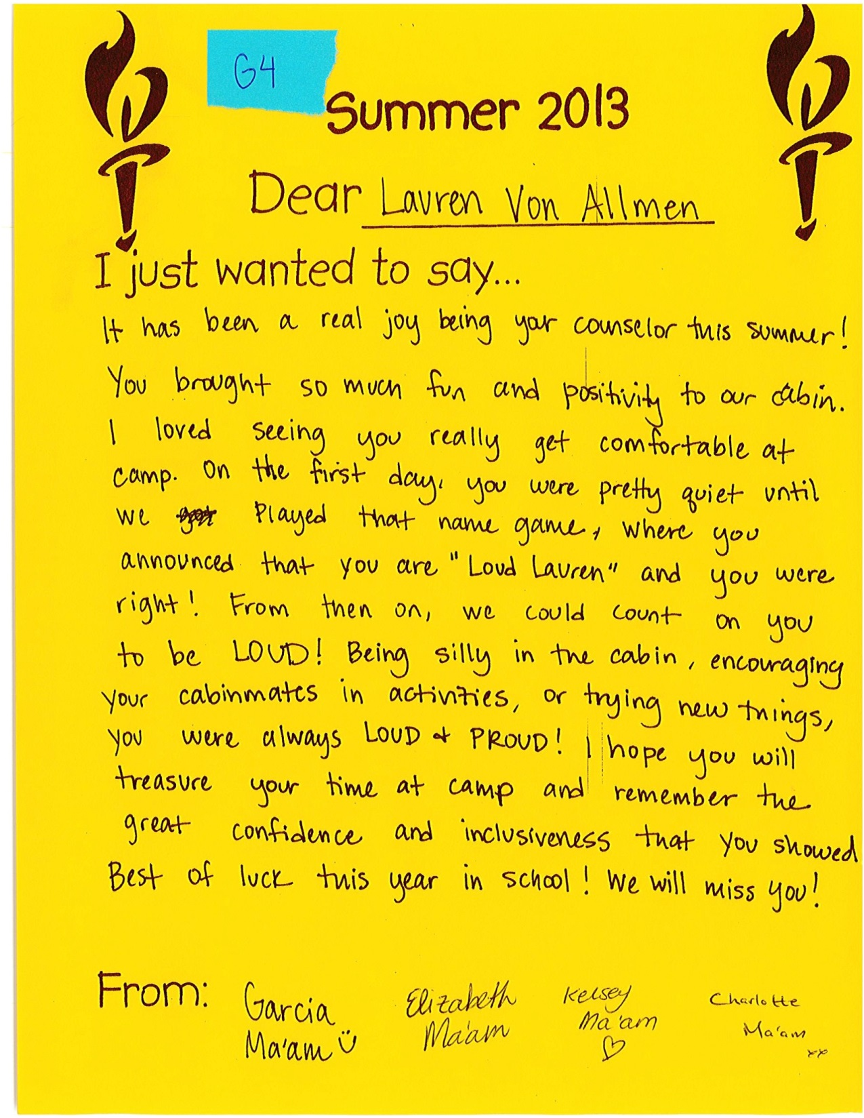

Slide 28
Reflection Activity #1 (August)
First, write about a memory from this week where you:
Had a lot of fun
Did something challenging at first but later got better
Second, pretend this thing happened to another new camper just like you next year. Imagine that this new camper feels really bad and doesn’t realize that things will get better. Write down what you could say to help a future understand that people usually make new friends when they go to new places like camp and people usually get better at activities when they keep trying hard at them?
Hulleman, Yeager, et al. (in prep.)

Slide 29
Reflection Activity #2 (October)
Part 1:
Many students have had experiences OUTSIDE OF SCHOOL DURING THE SUMMER OR FALL like the ones that are listed below. These are times when something in life was hard, and then they overcame it:
Learning to water ski
Climbing something that was really tall and made you scared, but doing it anyway
Making friends with new people, even when you don't know them
Adjusting to new rules and activities, even when they feel different
Hulleman, Yeager, et al. (in prep.)

Slide 30
Reflection Activity #2 (October)
Part 2:
Pick something from the list above that has lessons that could be related to school and answer these questions:
What hard thing did you do last summer?
How did it teach you to have tenacity and purpose, even when something was scary or hard or frustrating?
How can this help you do well in school, when school is hard or frustrating?
Hulleman, Yeager, et al. (in prep.)

Slide 31
Reflection Writing
Last year when i went to camp champions i learned how to use a sail boat. It was very hard because it was very windy that day. I didnt give up anyways and it taught me a lesson because in school i didnt give up when things got hard.
I went to a camp last summer. We went water skiing and it was hard for me to learn. After a few tries I did it. That moment helped me learn that with a little hard work, you can do anything.
I had to overcome an obstacle course that scared me and several of my friends. I started to climb and….as my fear subsided, I knew that if I beat this obstacle, I will be able to beat any obstacle that gets in my way. This will help me in school by reminding me of the obstacle I beat and will give me the strength to complete the challenge.
Hulleman, Yeager, et al. (in prep.)

Slide 32
Reflection Writing
Last year when i went to camp champions i learned how to use a sail boat. It was very hard because it was very windy that day. I didnt give up anyways and it taught me a lesson because in school i didnt give up when things got hard.
I went to a camp last summer. We went water skiing and it was hard for me to learn. After a few tries I did it. That moment helped me learn that with a little hard work, you can do anything.
I had to overcome an obstacle course that scared me and several of my friends. I started to climb and….as my fear subsided, I knew that if I beat this obstacle, I will be able to beat any obstacle that gets in my way. This will help me in school by reminding me of the obstacle I beat and will give me the strength to complete the challenge.
I didn't do anything only with my family. it was boring . I work so I can get money . it was worth it
Hulleman, Yeager, et al. (in prep.)

Slide 33
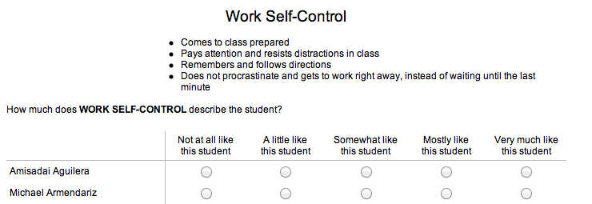
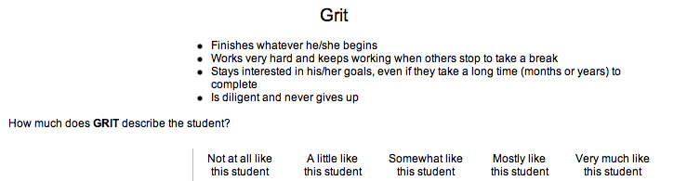
Teacher Ratings
Student #1
Student #2

Slide 34
Teacher ratings of students’ work habits and self-control
No reflection
Reflection
Hulleman, Yeager, et al. (in prep.)

Slide 35
How to Facilitate Transfer?
Learn the skill
Develop schemas about the skill that generate generalizations to a new context
Notice similarities between learning and transfer contexts
See relevance/value of skills learned in one context for another context
Cue/prime to similar features when transferring skills
Wormington & Hulleman (2017)

Slide 36
You Try It!

Slide 37
Pair-Share
Pick one of the practices you discussed (or that someone else mentioned). How could you improve it so that it increases the chances that students will transfer their knowledge, skills, and/or attitudes to the workplace?
  5 minutes: Elbow Partner
  10 minutes: Large Group Share Out

Slide 38
Questions?

