Slide 1
Removing Structural, Policy, and Pedagogy barriers that impact success in math and English courses
Understanding removing barriers is essential for understanding how to impact student success in Math and English courses.
Notes:
There are many different types of barriers that can influence success at our institutions, especially in high enrollment, high failure courses. As foundational principals of learning, numeracy and literacy can be considered two core principals of learning. To this end, Removing Structural, Policy, and Pedagogy Barriers That Impact Success In Math And English Courses Can have far reaching implications for institutions and communities. (GO TO NEXT SLIDE)
1 minute

Slide 2
Structural barriers to student success
Notes:
Structural Barriers can com in many forms, such as organizational, institutional culture, and many other impediments that are fixed into an institution’s foundation.
(GO TO NEXT SLIDE)
1 minute

Slide 3
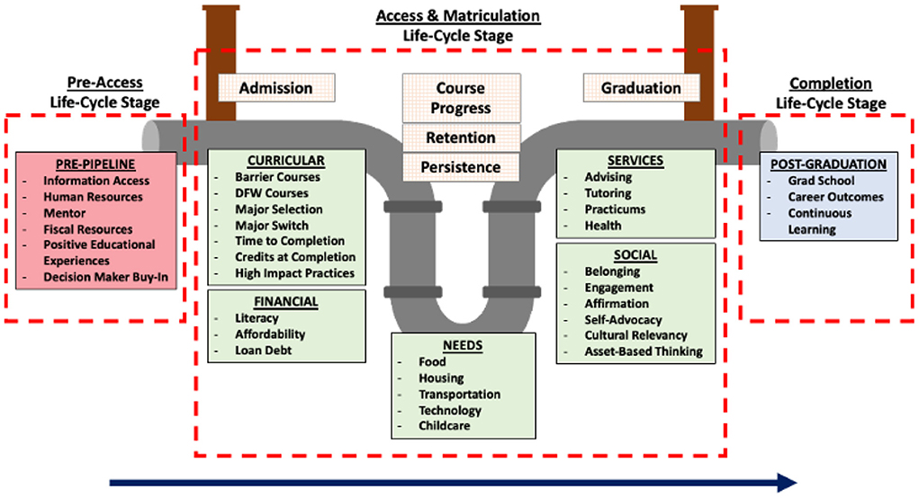
Policy barriers
Notes:
In addition to Structural Barriers, Policy Barriers also can create challenges for institutions. When thinking about the student life cycle ( Connecting with the Institution/ Entry into the Institution/ Progress and Completion throughout the Institution/ Advancement from the Institution) it becomes clear that there are many instances of inadvertent self-inflicted issues. (GO TO NEXT SLIDE)
1 minute

Slide 4
Pedagogy barriers
Notes:
And when you get to the crux of the real business of higher education institutions, Pedagogy Barriers too often lead to disconnects that end in stop outs, drop outs or failure. (GO TO NEXT SLIDE)
1 minute

Slide 5
So, where do we begin to remove these Structural, Policy, and Pedagogy barriers that impact success in math and English courses?
Notes:
But, we can achieve a better balance if our lessons engage students in a way that keeps them interacting with one another and involved in the learning process. (GO TO NEXT SLIDE)
1 minute

Slide 6
NG$B^{2}I$* Process: Barriers
Needs
Goals
Structural
Policy
Pedagogy
Barriers
*Source: Adapted from Dr. Allen Goben’s Trust & Empowerment: A Declaration of Interdependence (2016)
Notes:
When thinking about removing barriers, we must think about the desired outcomes – “The Why”. Here is a model that you may find to be useful as we go through today’s workshop. It is an adaptation of Allen Goben’s “Needs, Goals, Barriers, and Solutions” Framework for change. In this variation, Solutions is replaced by Big Ideas, of which you will be charged with developing deliverables following today’s workshop as you return to your respective institutions. (GO TO NEXT SLIDE)
1 minute

Slide 7
NG$B^{2}I$Process: Barriers
Identify:
1) What works regarding Math and English courses?
2) What doesn’t
work?
3) Who has the most success?
Needs
Structural
Policy
Pedagogy
2 minutes
Notes:
So, as we think about what targets for success our institutions have set for completion that are directly impacted by Math and English courses, I would as like for you to take 2 minutes and reflect on these three questions from what you have experienced. Write down a brief response for your own reference later in the session. (READ the QUESTION and Pause for 2 minutes, then GO TO NEXT SLIDE)
2 minutes

Slide 8
NG$B^{2}I$Process: Barriers
Goals
Address:
1) Positives?
2) Negatives?
Structural
Policy
Pedagogy
1 minute
Notes:
Now, look back at what you wrote about the Needs from the previous slide and think about the Positives and Negatives of those Needs. Are the Needs for students or the institution? Are the Needs remnants of bygone times that your institution just hasn’t updated? What can be changed to better meet your targeted Goals? Please take 1 minute and jot down whatever comes to mind. (Pause for 1 minute, then GO TO NEXT SLIDE)
1 minute

Slide 9
NG$B^{2}I$Process: Barriers
Barriers
Why (Challenges):
1) Positives?
2) Negatives?
1 minute
Notes:
Now that you have identified Needs and Goals, think about Why you have certain barriers in Math and English courses. Take a minute and write down the Barriers that you have identified that impact student success in Math and English courses. I will give you a minute to do so.
(Pause for 1 minute and GO TO NEXT SLIDE)
1 minute

Slide 10
Removing Structural, Policy, and Pedagogy barriers that impact success in math and English courses
Notes:
Let’s discuss the BIG IDEAS.
(GO TO NEXT SLIDE)

Slide 11
Outcomes
Develop a framework to address Structural, Policy, and Pedagogy barriers that impact success in math and English courses through targeted strategies with a 30/60/90 Day Plan
Notes:
The expected outcomes from your two Break Out Sessions that are forthcoming. READ aloud.
(GO TO NEXT SLIDE)
1 minute

Slide 12
Strategies
Structural Barriers
Access to Resources
Financial Support
Scheduling
Policy Barriers
Instructional Support Services
Data-Informed Decision Making
Pedagogy Barriers
Inclusive Curriculum Design
Adaptive Learning Technology
Assessment Strategies
Faculty-Student Interactions
Notes:
Here is a brief list of the strategies that we will focus on. Read aloud.
(GO TO NEXT SLIDE)
2 minute

Slide 13
Strategies
Structural Barriers
Access to Resources
Ensure equitable access to textbooks, online resources, and technology.
Establish a system for students to borrow or access required materials.
Financial Support
Provide financial assistance for course materials, especially for low-income students.
Create scholarship programs for students facing economic challenges.
Scheduling
Offer flexible scheduling options to accommodate diverse student needs.
Consider evening classes, weekend options, or online courses for greater accessibility.
Notes:
For Structural Barriers, let’s look at what specific strategies that I would like for you to think about as you take into consideration your institution’s challenges.
(GO TO NEXT SLIDE)
2 minute

Slide 14
Strategies
Policy Barriers
Instructional Support Services
Develop policies that support non-traditional students, such as parents or working
professionals, and students deemed not college ready through corequisite model
Data-Informed Decision Making
Regularly collect and analyze data on student outcomes.
Use data to identify and address disparities in achievement.
Notes:
For Policy Barriers, let’s look at what specific strategies that I would like for you to think about as you take into consideration your institution’s challenges.
(GO TO NEXT SLIDE)
2 minute

Slide 15
Strategies
Pedagogy Barriers
Inclusive Curriculum Design
Incorporate diverse perspectives in course content.
Use culturally responsive teaching practices to make the material relatable.
Adaptive Learning Technology (i.e. AI)
Implement interactive and hands-on learning activities.
Foster collaborative learning environments to engage students actively.
Assessment Strategies
Rethink assessment methods to ensure they align with learning objectives.
Consider alternative forms of assessment, such as project-based assessments.
Faculty-Student Interactions
Encourage regular office hours and open communication between faculty and students.
Foster a supportive environment where students feel comfortable seeking help.
Notes:
And finally, for Pedagogy Barriers, let’s look at what specific strategies that I would like for you to think about as you take into consideration your institution’s challenges.
(GO TO NEXT SLIDE)
2 minute

Slide 16
Breakout 1
Breakout 1 Reporter: Select a person to concisely respond to the question below for your Break Out group
Timekeeper 1: Select a person to monitor time, so that the Reporter is able to provide a response and all participants are able to contribute
Discuss existing Structural Barriers that can impact success in Math and English courses and document the strategy selected in “Activity Column” on the Meauxmentum Milestones Worksheet.
What strategy or strategies can you build from in developing a 30/60/90 day plan to remove the identified Structural Barriers ?
Notes:
(GO TO NEXT SLIDE)
THIS IS ONE IDEA BEING SHARED, THINK ABOUT HOW THIS CAN BE USED LATER
15 minutes

Slide 17
Shareout 1
Reporters:
What is one useful strategy that your group discussed?
Notes:
(GO TO NEXT SLIDE)
5 minutes

Slide 18
Breakout 2
Breakout 1 Reporter: Select a person to concisely respond to the question below for your Break Out group
Timekeeper 1: Select a person to monitor time, so that the Reporter is able to provide a response and all participants are able to contribute
Discuss existing Policy Barriers that can impact success in Math and English courses and document the strategy selected in “Activity Column” on the Meauxmentum Milestones Worksheet.
What strategy or strategies can you build from in developing a 30/60/90 day plan to remove the identified Policy Barriers ?
Notes:
(GO TO NEXT SLIDE)
THIS IS ONE IDEA BEING SHARED, THINK ABOUT HOW THIS CAN BE USED LATER
15 minutes

Slide 19
Shareout 2
Reporters:
What is one useful strategy that your group discussed?
Notes:
(GO TO NEXT SLIDE)
5 minutes

Slide 20
Breakout 3
Breakout 1 Reporter: Select a person to concisely respond to the question below for your Break Out group
Timekeeper 1: Select a person to monitor time, so that the Reporter is able to provide a response and all participants are able to contribute
Discuss existing Pedagogy Barriers that can impact success in Math and English courses and document the strategy selected in “Activity Column” on the Meauxmentum Milestones Worksheet.
What strategy or strategies can you build from in developing a 30/60/90 day plan to remove the identified Pedagogy Barriers ?
Notes:
(GO TO NEXT SLIDE)
THIS IS ONE IDEA BEING SHARED, THINK ABOUT HOW THIS CAN BE USED LATER
15 minutes

Slide 21
Shareout 3
Reporters:
What is one useful strategy that your group discussed?
Notes:
(GO TO NEXT SLIDE)
5 minutes

Slide 22
Institution Reflection
Based on today’s workshop, has the idea of Removing Structural, Policy, and Pedagogy barriers changed for you in terms of your thoughts about impact success in math and English courses ?
Notes:
(GO TO NEXT SLIDE)
10 minutes

Slide 23
References
Allen Goben. Author.
http://www.goben12.net/
Allan Carrington. Author.
https://cue.usc.edu/about/equity/equity-mindedness/
Notes:
3 minutes

