Slide 1
Learning Mindsets & Classroom Strategies for Success
Cuyamaca College
Tammi Marshall, Ed.D.
Notes:
Walk around greeting people and handing out the Ice Breaker. Have people work on this before the session starts.

Slide 2
Agenda
Introduction/Ice Breaker
Research
Cuyamaca Structure
Classroom Ideas
Continuous Quality Improvement
Questions
Notes:
2 minutes
Welcome everyone
Overview who I am
Who is in the room? Faculty? Administration? Advisors/Counseling? Research? Anyone else?
Great - let’s get started then.

Slide 3
Ice Breaker
Take 60 seconds to finish circling your values
Notes:
1 minute
Give 60 seconds to finish circling values

Slide 4
Ice Breaker - Speed Dating
Take 60 seconds to finish circling your values
Speed Dating
Get a Partner
Share - What values did you pick and why?
2 minutes per round
3 rounds
Notes:
8 minutes
Throughout this workshop we will utilize some of the classroom strategies we use at Cuyamaca College
Speed Dating (3 rounds)

Slide 5
Ice Breaker
Take 60 seconds to finish circling your values
Speed Dating
Kid President’s Pep Talk to Teachers and Students
Notes:
3 minutes
Show Video

Slide 6
Learning Mindset Research

Slide 7
Learning Mindset - Research
Think about a gateway course that you are or will be teaching that is open to all (or almost all) students (either through corequisite support or direct placement).
What are your expectations about students and their learning?
Write one of your expectations on a piece of paper …
snowball fight

Slide 8
Expectations are Powerful
The Power of Expectations:
Rats randomly assigned an “intelligent” label were almost 2x more likely to
successfully complete the maze
Rosenthal & Fode (1963)
Notes:
3 minutes
Show Video (https://www.youtube.com/watch?v=hbhwlRRW_3o)

Slide 9
Teacher Expectations are Powerful
Study of 150 STEM faculty with growth vs. fixed mindsets about intelligence. ​
​“To be honest, students have a certain amount of intelligence and they really can’t do much to change it.”​
When faculty who espoused a fixed-mindset view, students had lower course grades, and racial equity gaps were twice as large as in classes where faculty believe intelligence can be grown. Students also reported lower motivation in class.​
Faculty mindset was a more powerful predictor of student performance than any other faculty characteristic (gender, race/ethnicity, age, teaching experience, tenure status).​ Canning, Muenks, Green, Murphy (2019)​

Slide 10
Teacher Expectations are Powerful
Think-Pair-Share
What might growth mindset faculty be doing that fixed mindset faculty are not?

Slide 11
Attending to the Affective Domain
When students aren’t successful in their classes, the core issue is often not their ability to learn course content.
Why do some students disengage, withdraw effort, or disappear from class?
How we understand these issues and respond to them is what we mean by “attending to the affective domain.”

Slide 12
Attending to the Affective Domain
The work of Stanford educational psychologist Carol Dweck is helpful in understanding these dynamics.
Students who have what Dweck calls a “growth mindset” about intelligence are more likely to engage, challenge, invest effort, and learn more.
Students with a “fixed-mindset” see expending effort as a sign of lower intelligence, avoid challenges they fear may subject them to exposure, and ultimately learn less.

Slide 13
Attending to the Affective Domain
The College Fear Factor: How Students and Teachers Misunderstand Each Other by Rebecca Cox
“Fear is a dimension of student experience that has emerged in every study I have conducted, across community colleges in different regions of the country and with a highly diverse range of students.”
“Essentially, students were afraid that the professor would irrevocably confirm their academic inadequacy.”
Notes:
Citing an “underlying fear” that they would be “exposed” in front of their peers and professors “as too stupid for college classes,” many of the students “exhibited very low tolerance for feeling confused or making mistakes” and often did not seek extra assistance to understand new skills or information.
Others deliberately skipped assignments and exams. “Every assessment-related activity posed the risk of exposing to others (both professors and peers) what students already suspected: their overall unfitness for college.”
How often have we tried to get struggling students to come to class, do their homework, go to tutoring, visit our student hours? But they don’t. So what can we do?
Others dropped out: “quitting is the ultimate fear management strategy.”
This fear of being exposed as academically inadequate may play a significant role in explaining student behaviors that undermine learning.

Slide 14
Attending to the Affective Domain
What is our role in the complex dynamic that is the affective domain?
We may have a larger role than we realize.
Cox cautions us that “professors who underestimate the level of students’ anxiety tended to unintentionally exacerbate those fears.”
Notes:
These student behaviors are familiar to most teachers
How often have we tried to get struggling students to come to class, do their homework, go to tutoring, visit our student hours? But they don’t. So what can we do?

Slide 15
Attending to the Affective Domain
What is our role in the complex dynamic that is the affective domain?
We may have a larger role than we realize.
Cox cautions us that “professors who underestimate the level of students’ anxiety tended to unintentionally exacerbate those fears.”
Think-pair-share: What actions might a professor take that does this?
Notes:
These student behaviors are familiar to most teachers
How often have we tried to get struggling students to come to class, do their homework, go to tutoring, visit our student hours? But they don’t. So what can we do?

Slide 16
Attending to the Affective Domain
“If a person’s behavior doesn’t make sense to you, it is because you are missing a part of their context.” Dr. Devon Price
That context could be things like food insecurity or homelessness or depression or it could be fear, a sense that “I don’t belong here.”

Slide 17
Research
“Math faculty are the most important factor in determining a student’s successful completion of gateway math.”
Practices that can reduce racial disparities in gateway math.
Implementing growth-oriented & transparent grading practices
Offering accommodations equitably
Encouraging students to seek help & communicating support
Fostering belonging
Taking responsibility for addressing racial equity
Notes:
https://www.edequitysolutions.com/counting-on-math-faculty
See page 3 for an explanation of the practices
https://www.diverseeducation.com/reports-data/article/15635073/an-unexpected-key-to-performance-in-gateway-math-courses

Slide 18
More Research

Slide 19
Milestone Research
Florida Study:
Passing gateway English more than doubled a student’s chance of graduating
Passing gateway math strongly predicted a student’s chance of graduating

Slide 20
Milestone Research
Washington Study:
Passing gateway math and English was associated with substantially better completion rates for students.

Slide 21
Milestone Research
Tennessee Study:
48% of students who passed gateway math and English courses in their first year graduated within six years compared with 18% of those who did not pass these courses in their first year.
Notes:
Denley, T. (2016, October). Choice architecture, academic foci and guided pathways. Presentation to the AACC Pathways Institute, Denver, CO.

Slide 22
Cuyamaca College -
for context

Slide 23
Cuyamaca College Structure
English
Placement is based on GPA
Corequisite
Same teacher
Cohort model
Just-in-time review
No Dev Ed since 2018
Math
Placement is based on GPA, course taking history, and major
Corequisite
Same teacher
Cohort model
Just-in-time review
No Dev Ed since 2018
Notes:
Discuss the role of the corequisite as well as the math classes that have a corequisite

Slide 24
Learning Mindset in the Classroom

Slide 25
Learning Mindset in the Classroom
If we shift our understanding of student disengagement from a deficit-orientation to one routed in an understanding that
our expectations influence student performance;
laziness does not exist (content explains behavior); and
fear may be playing a big role in behaviors that are impeding learning.
How does our teaching practice, classroom policies, and grading practices change?
Groups of 3; share out

Slide 26
A Sample of Classroom Activities
Ice Breakers
Brainology
Broken Escalator
Let Learners Struggle
You Can Grow Your Intelligence
Box Activities

Slide 27
Making the Classroom Activity-Based and Student-Centered

Slide 28
Paradigm Shift in Teaching & Learning
The activity-based classroom:
Contextualized teaching and learning
Just-in-time review
Focus shifts from teacher to student
Productive struggle with brains-on activities
Teacher-guided discovery
Low stakes, collaborative practice
Intentional support for the affective domain
Notes:
CAP Design Principles are embedded within these

Slide 29
Cultural Shifts
Collaborative Work
Early referral
Intentional Support for the Affective Domain
Ongoing formative assessment
Faculty training
Notes:
Collaborative Work
Contributes to the formation of peer support groups
Early referral
Work closely with Counselors
Intentional Support for the Affective Domain
Goal setting, self-regulation, value of struggle
Making mistakes in class
Increases persistence
Ongoing formative assessment
Early intervention & increased success
Faculty Training
Workshops & conferences
Local Community of Practice
Job Shadowing

Slide 30
Troubleshooting
Two categories to consider:
Student Behaviors
Logistics
With a partner come up with two to five student behavior issues you might face when making the classroom more activity-based and student-centered.

Slide 31
Strategies
Motivating collaboration
Fortune 500 List
Discuss goals of college education
Article “When to Let Students Struggle” or “Brainology”
Random assignment
Group cards
Frequently change groups
Accountability
Establish expectation for board work & presentations
Ambassador exchange - see Toolbox

Slide 32
Troubleshooting continued
With your partner determine which strategy discussed will help overcome each issue you identified when making the classroom more activity based and student-centered.
Share out

Slide 33
Ideas from Cuyamaca
Calculus I - Covid project
Statistics - data & project based
Quantitative Reasoning - project based
Equitable grading strategies
Contract grading
Minimum grades
Revisions
No such thing as late work

Slide 34
Continuous Quality Improvement

Slide 35
Research & Change
Two stories
Pre-Statistics & Statistics with Corequisite Support
PreCalculus with Corequisite Support many semesters later
Throughput to Calculus I for STEM majors
Change is difficult, but we all must be open to it

Slide 36
Research & Change
Think-Pair-Share
Give an example of something you changed in your life based on experience or research.
How can you take this idea to help with the changing of structures and the classroom environment?

Slide 37
Research & Change
Think-Pair-Share
Give an example of something you changed in your life based on experience or research.
How can you take this idea to help with the changing of structures and the classroom environment?
Change is difficult, but we all must be open to it
Continuous Quality Improvement is the key

Slide 38
Questions?
For more information contact
Tammi Marshall
Tammi.Marshall@gcccd.edu

Slide 39
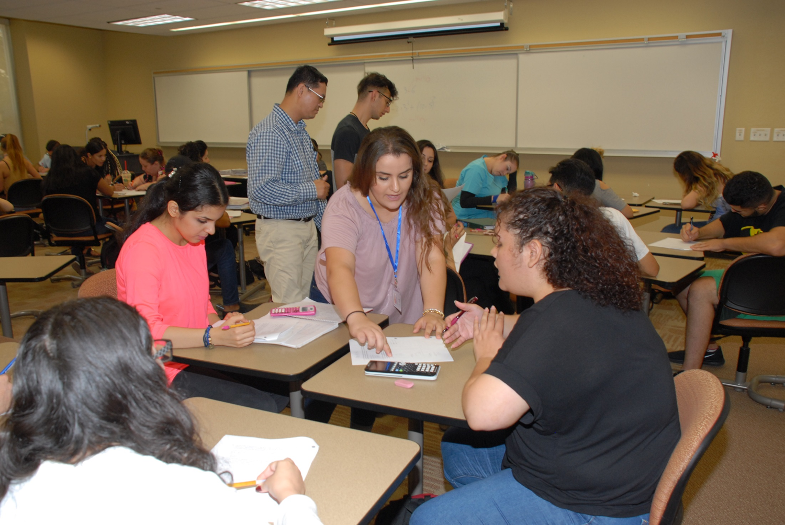

Slide 40
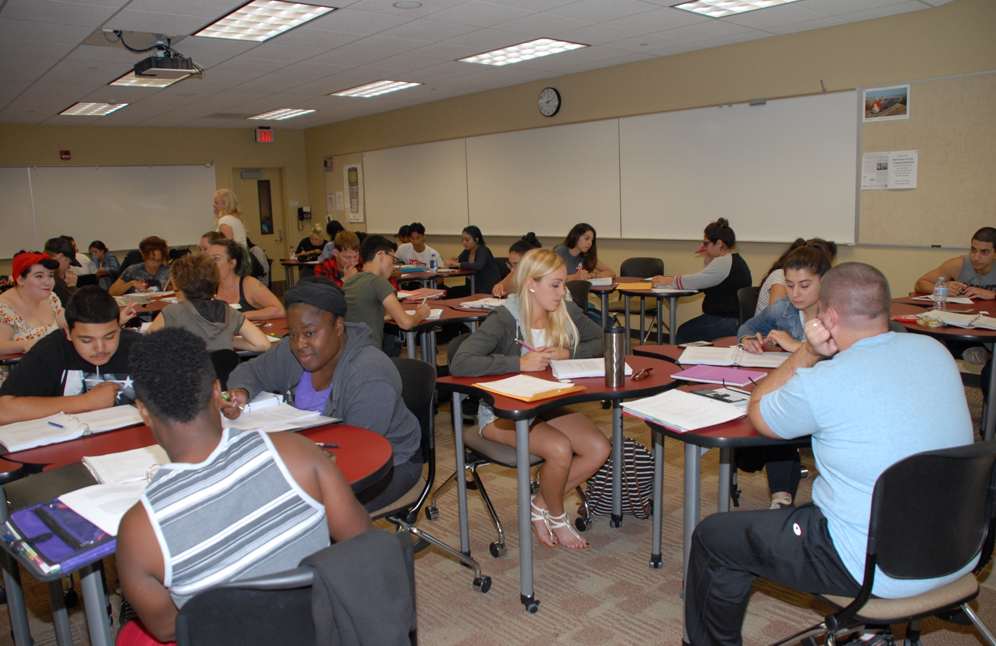

Slide 41
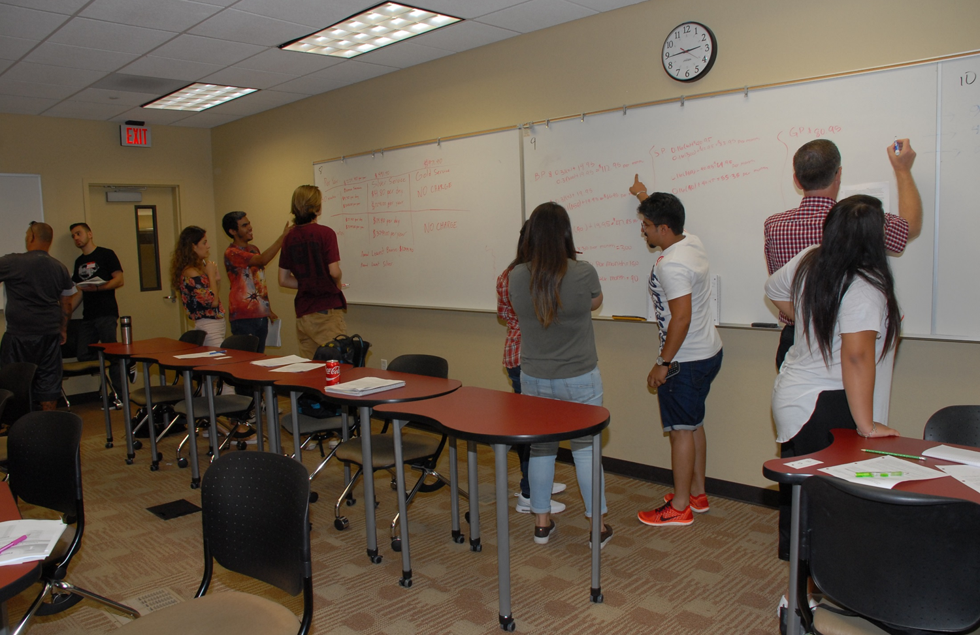

Slide 42
