Slide 1
Direction via Reflection
2024 Meauxmentum Summit
Jessica Rabb PhD
Biology, First Year Experience
Nashville State Community College

Slide 2
First Year Experience Class @ Nashville State
Academic and Career Pathway Planning Focus
Value of my Pathway
Degree/Major Value
Classes Value

Slide 3
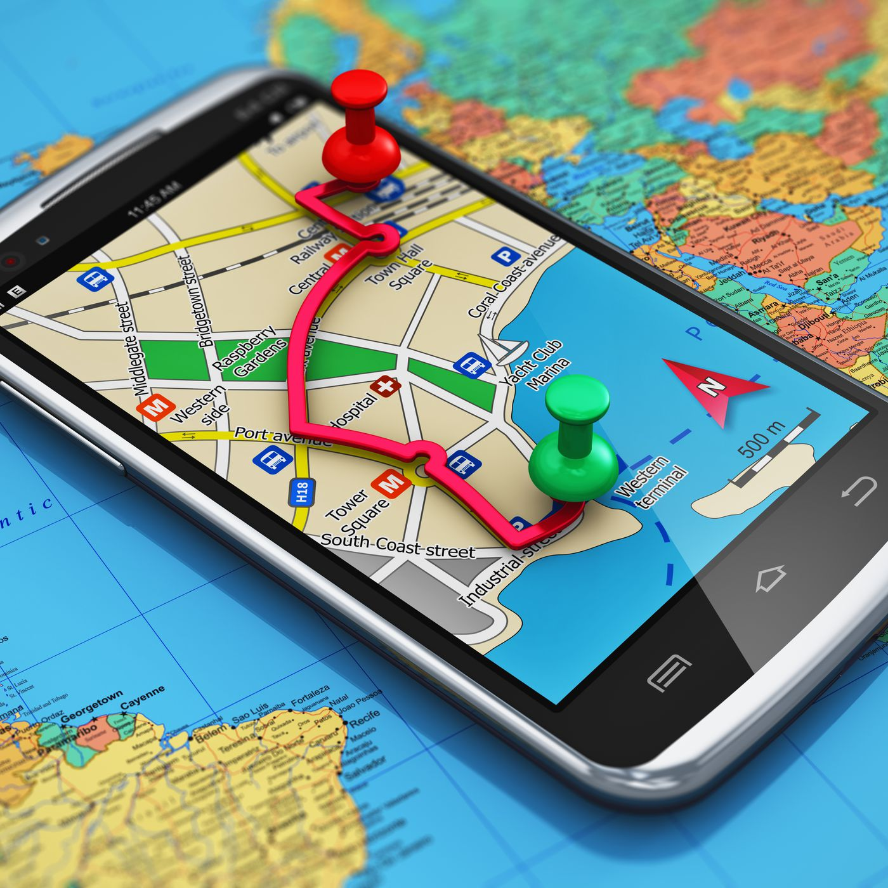
Learning Mindset GPS
Motivate Lab @ UVA @ Nashville State (2018)
Linked by College System of Tennessee
START
Growth
– I can learn this
Purpose
– I want to learn this
Sense of Belonging
– I belong in this learning community
FINISH

Slide 4
Mindset GPS in the FYE Class
START
Growth
– I can get better at college
Purpose
– I want to be in college
Sense of Belonging
– I belong in college
FINISH
COLLEGE
Value of My Pathway

Slide 5
Pathway GPS beyond an FYE Class
START
Value of My Pathway
FINISH

Slide 6
Pathway GPS
beyond an FYE course
START
First 30 Hours
Even focus area courses are less focused
FINISH
Major may be less focused – meta major

Slide 7
Direction via Reflection
Pathway GPS
Personal Connection to Pathway – Intrinsic Motivation

Slide 8
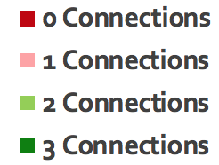
Reflection Only Fall 2018 n = 41
Discussion & Reflection Spring 2019
n = 40
12%
5%
20%
12%
32%
33%
44%
43%
Fall 2018 average wordcount: 89 words
Spring 2019 average wordcount: 160 words

Slide 9
Direction via Discussion and Reflection
GPS – Sense of Belonging

Slide 10
Try two short Pathway GPS discussions
Student reflections examples after each

Slide 11
Discussion 1 Goals
Make connection between what you value and this class
Make this class more meaningful to you
Help you become a more successful student

Slide 12
Think Pair Share
A time you valued school.
A time you did not value school.

Slide 13
One strategy when it is hard to find value in this class
connect what you personally value already to the value of this class

Slide 14
Some Personal Values of my Previous Students
Self-Improvement
Purpose in Life
Career
Helping Others
Independence
Relationships with friends and family
Supporting my family
Faith
Pursing my interests
Open mindedness
Hard work
What do you personally value?

Slide 15
Think Pair Share
How does this class reflect and reinforce what you personally value?
How does being at the Meauxmentum Summit reflect and reinforce what you personally value?

Slide 16
Written Reflection
How does this class reflect and reinforce what you personally value?
Your reflection should be...
Personal: This is your value. Pick a value meaningful to you.
Specific: Be specific how this class connects to your value.
You may make multiple connections.

Slide 17
Their Reflections -- excerpts
This class proves to myself how far I have come from the kid that struggled to care about himself.
I have a step daughter that I want to make proud and she is studying to be a nurse. She will take Biology and I want to share the experience.
This class allows me to become the first person in my family to obtain a college degree.
By being here and doing the work I am showing myself that I am capable of learning new things.

Slide 18
Discussion 2 ONLINE
Whether the class is online, hybrid, virtual, on-ground
Experience with online discussions
First online discussion – Introduction Discussion (something many classes have already)

Slide 19
Online Prompt 1
Pick two career readiness competencies you think will be most important to your academic and career success and explain why you picked each one. Be specific and personal.

Slide 20
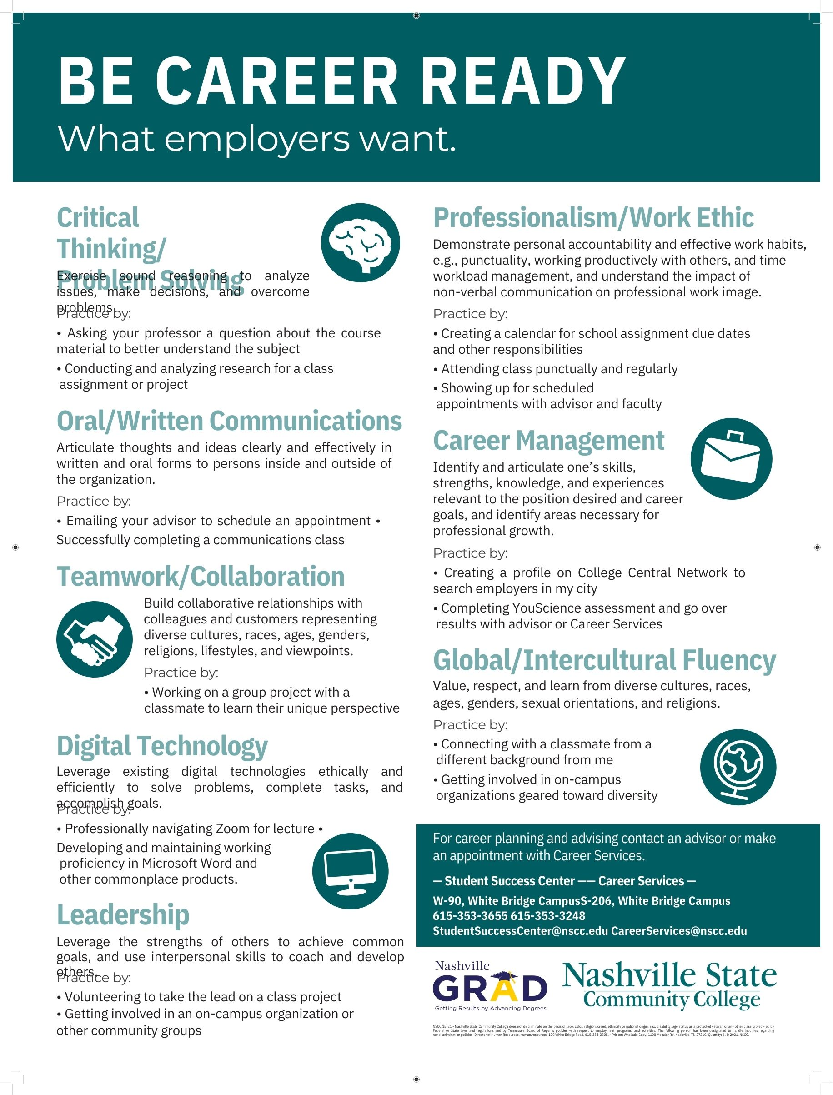
Career Competencies – National Association of Colleges and Employers (NACE)
How you can practice them @ Nashville State
Student Success Center
Career Services

Slide 21
Career Competencies
Think Pair Share
You can change
this list
Critical Thinking & Problem Solving
Communication
Teamwork
Technology -- use it effectively
Leadership
Professionalism & Work Ethic
Career Development & Self-improvement
Global & Intercultural Fluency
Which one is most important to your career? And why? (if time)

Slide 22
Think Pair Share
Explain how you can develop a career readiness competency as a student in this class. Be specific and personal.
Explain how you can develop a career readiness competency at Meauxmentum Summit. Be personal and specific.

Slide 23
Their posts – short examples
Working in the healthcare field it is very important to be able to take constructive criticism to grow and be better for the people you serve.
I do not get to take too many on-campus classes because of being a parent to a young child and working full-time, so I am privileged to be taking this class on campus that will perhaps allow me more experience to work in groups where I can exercise my communication skills by working in teams.
Since I am a computer science major often trying to debug programs, biology can cultivate enhanced problem-solving skills in diverse scenarios. Sometimes, all it takes is to look at things from a new angle.

Slide 24
Their replies – short examples
I’m also a Pre Med student here at Nashville State my major is Pre health. I also would like to become a Doctor.
I think it is very impressive that you have continued your education after receiving your degree. It is very inspiring that you have chosen to chase after what you want.
I admire how you openly admitted some of your weaknesses. I can relate to them, and I know they can be challenging to overcome.

Slide 25
My Feedback – short examples
Your replies help students to see that their classmates are supportive and caring. Great skills to have as a future doctor.
I am glad you selected this class as part of your Computer Science pathway when you had other options.
I help guide the student environmental club. I'll keep you posted on our activities.

Slide 26
Direction via Discussion and Reflection
Pathway
GPS
Growth
– My pathway helps me grow
Purpose
– My pathway reflects my purpose
Sense of Belonging
– I belong on this pathway
Value of My Pathway

Slide 27
Pathway Growth Ideas My pathway helps me grow
Pathway
GPS

Slide 28
Pathway Purpose Ideas My pathway reflects my purpose
Pathway
GPS

Slide 29
Pathway Belonging Ideas I belong on this pathway
Pathway
GPS

Slide 30
Materials
This presentation (ppt)
Value Discussion Guide (ppt)
Value Reflection Instructions (doc)
Stand alone instructions
First Day Engagement & Value Example (doc)
I use this document for attendance – complete first day
Career Competencies @ Nashville State Flyer (pdf)
Career Competencies Online Discussion (doc)

Slide 31
Direction via Reflection
2024 Meauxmentum Summit
Small time investment well spent like a GPS check-in along a complicated drive

Slide 32
Thank you
Jessica Rabb PhD
Biology, First Year Experience
Nashville State Community College

