Slide 1
Meauxmentum Through MS Learning Communities (A review & new resources)
Jeffery Galle, Ph.D.
Creative Engagement with Faculty
ellag55@gmail.com
https://Jgalle.com (website),
Spring 2025
Notes:
The MS program applies strategies within the three contexts where students engage with us.
GOALS: (1) Richer use of class minutes, (2) clearer/transparent assignments, and (3) experiencing the content of the course outside of class working within one or more High Impact Practices.
The Faculty Learning Community is the structure that enables small groups of faculty to go deep into their practice, identify changes, apply them, and seek counsel from colleagues as they go through the iterative process.
And with any choice of topic, there is a large set of resources—both open source and purchasable. While the financials are worked out in a first year program, MS can identify open source ones for the time being.

Slide 2
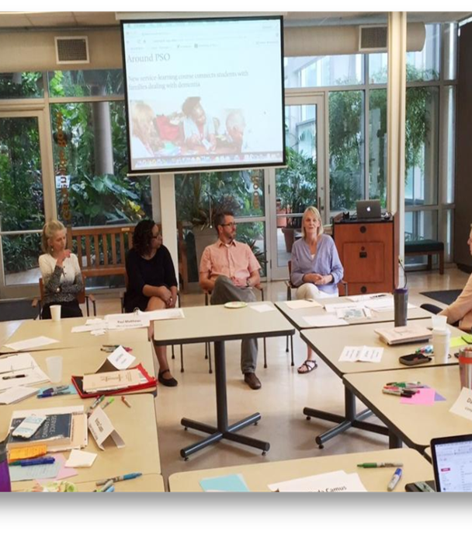
In group conversations, faculty . . .
Discover/apply strategies
Apply course changes
Support our colleagues’ efforts
Can be accountable to each other in a community
Collaborate on common goals in a specific project
Share reflections on course strategies
Notes:
FLC and other faculty learning/discussion groups as distinguished from conferences and large gatherings (which do have a good use) allow for individualized participation, hands-on, iterative practice for a longer time, hopefully one or two semesters or multiple years, ideally. The ideal of becoming the national expert is giving way to a value for broader, perhaps slower, but ultimately deeper expertise.
Analogy of one-off presentations or one-time workshops akin to setting off fireworks---a loud bang followed by smoke and ringing ears.
Better to learn in a small, supported group with clearly defined expectations and outcomes that improve courses, practices, and learning.

Slide 3
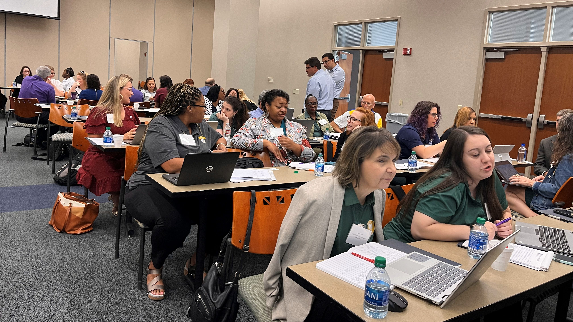
Scholar Responsibilities
August 12th kickoff
Selection of topic
Recruitment
Spring check-ins
Spring meetings
1 course application
Final reflection report
Notes:
Wherever you are along this list/timeline, success is within your reach. Simply put: Topic, Members, Meetings, Report
POST two links in chat and then review responsibilities
Your Toolkit contains other valuable info and examples from, previous learning communities. What we will do this spring is offer specifics at any point with the check-ins, by email or arranged zooms. August 12th kickoff and/or September 4th makeup: if you could not make either of these, you can catch up now.
Topic selection is discussed over upcoming slides now.
MEMBERS Recruitment: begin with colleagues serving on committees with you, your department meetings, your chair or dean. A department email often gathers new members. Joining your topic to other student learning efforts is another strategy. With the topic, you can describe the project to all.
Attend our check-ins.
Schedule a set of spring meetings, preferably 6 or more, to give opportunity for all members to learn materials, apply to classes, select course change and apply it.
At least ONE course application, small or large, discern impact and record it for your final reflection.
The final reflection/report: I have posted multiple examples of these and will analyze in depth with you all as we move forward this semester.
https://www.naesp.org/sites/default/files/resources/2/Leadership_Compass/2007/LC2007v5n2a4.pdf qualities of good FLC: focus on learning, collaboration, results-oriented
https://www.irisconnect.com/uk/blog/sharing-and-collaboration-in-schools/

Slide 4

Learning encounters: 3 Contexts
In the F2F classroom/online: Small Teaching approach: cognitive exercises, 1st and Last 5, Pauses
Transparent/clear assignments: TiLT-ing all student work
Experiential learning with HIPS and the 8 Elements; applying course content
Notes:
So, our topics stem from the three contexts we provide in which students engage with course/disciplinary materials: the classroom, student assignments, and application of course material in one or more High Impact Practices.
#1: The college classroom that engages students to think critically, not during lecture, but also in those little used segments of class, and also using specific cognitive activities praised by Bloom and others.
#2: Students assignments written clearly, transparently, as learning opportunities/not only tests for memorized facts.
#3: Experiential learning, application of course content, with structured reflection and other key elements, within one or more of the HIPS.

Slide 5
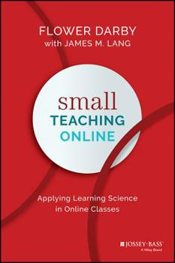
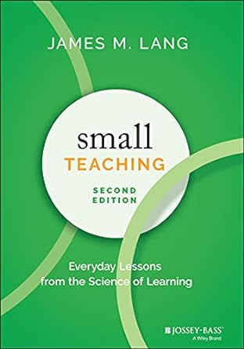
Notes:
Context 1: the classroom.
How can we use the classroom time to spark deeper learning? Active learning with learning science foundation: Lang addresses this question in this book and it’s conducive to use in all kinds of disciplines, classroom spaces, of a in a traditional lecture course.
Materials on the approach and the content of the book include August 12th kickoff slides, and recordings, as well as Sept 4th slides.
See the Regents’ website and jgalle.com for all covered materials.

Slide 6
Getting started with other available materials
https://teachinginhighered.com/podcast/small-teaching-reprised/ Inside Higher Ed interview with Jim Lang after 2nd ed of ST published.
https://crln.acrl.org/index.php/crlnews/article/view/24768/32616 good survey, types, analysis
https://gcci.uconn.edu/2019/08/19/applying-james-langs-small-teaching-in-stem-classrooms/ applying ST in STEM courses
https://www.ala.org/acrl/publications/keeping_up_with/small_teaching ST in Information Literacy, a course example
https://cei.bd.psu.edu/2021/08/09/small-teaching-tips-the-beginning-middle-and-end-of-class/ ST for first 5, last 5, and middle pause work.
Notes:
https://teachinginhighered.com/podcast/small-teaching-reprised/ Teaching in Higher Ed interview with Jim Lang after 2nd ed of ST published.
https://crln.acrl.org/index.php/crlnews/article/view/24768/32616 good survey, types, analysis
https://gcci.uconn.edu/2019/08/19/applying-james-langs-small-teaching-in-stem-classrooms/ applying ST in STEM courses
https://www.ala.org/acrl/publications/keeping_up_with/small_teaching ST in Information Literacy, a course example
https://cei.bd.psu.edu/2021/08/09/small-teaching-tips-the-beginning-middle-and-end-of-class/ ST for first 5, last 5, and middle pause work.
So rather than simply TELLING students the activities and exercises lead students to do the cognitive work WITHIN CLASS, create the mental framework, enhance retention of course material.

Slide 7
ST: Course examples
Knowledge activities: predicting, retrieving, interleaving
--1st five: daily quiz(can include at least 2 of cognitive activities)
--Last five: What have we covered summary; muddiest point; next lesson
--Pauses: recall a similar idea/fact/situation; summary
Understanding activities: connecting, practicing, self-explaining
--1st five: Connecting previous quiz(zes) to current pages or topic
--Last five: 5-minute prompt to connect current to previous info
--Pauses: Paired work (self-explaining choice/answers recent essays)
Inspiration activities:
--1st five: retaking particular quiz
--Last five: Sharing applications of course work in Service Learning project
--Pauses: sharing individual journal entries or key moment in essay
Notes:
In addition to TELLING students the content of the course and discipline, we can provide activities and exercises lead students to do the work, create the mental framework, enhance retention of course material.
Short exercises (at opportune moments) can require students to predict, retrieve, interleave; connect, practice, self-explain; and, recognize their belonging and adequacy.

Slide 8

PURPOSE | TASKS | CRITERIA
Uncovers relevance to students Connects to learning outcomes | Students know what to do Students know how to do it | Identifies specific expectations and criteria Provides examples & standards for success
Notes:
Context 2: student work, assignments.
You can find the full 1-hr workshop slides in the complete deck from August 12th. Here, we want to offer a summary to pique your interest in this approach to improving assignments.
PURPOSE: stated in terms of one or more of the stated outcomes, what student already have seen as the outcomes they re striving for.
TASKS: specific, clear steps, or work tasks for the given assignment. A research paper has stages, so multiple sets of tasks perhaps.
CRITERIA: make things challenging, tell them they can DO this, provide examples of first drafts through final drafts.
So let’s look at an example to see how the assignment revision process could take place.

Slide 9
MS materials: Kickoff slidedeck and recording as well as TiLT worksheet
Examples of Assignments, original and more transparent
Additional TiLT resources:
https://tilthighered.com/tiltexamplesandresources
[On the page, scroll down to ‘Example Assignments [more and less transparent]’
After reading several examples, consider how the TiLT framework of
Purpose, Task, and Criteria and revised language can apply to your assignments.
Notes:
https://tilthighered.com/tiltexamplesandresources
see many short videos, ~20 example assignments, and TiLT frameworks at the bottom of the page: This page is a gold mine; all free.

Slide 10
The High Impact Practices: Courses, Programs, & 8 Elements
1. Service Learning
2. Writing-Intensive courses
3. Collaborative assns/proj
4. Undergraduate Research
5. Global Learning
6. Internships
7. Capstone
8. Common Intellectual Experiences
9. Learning Communities
10. First Year Seminars
11. ePortfolio program
1. Rigor and challenge
2. Time and effort, extended period
3. Timely, meaningful feedback
4. Interactions w/ peers & faculty
5. Experiences of difference
6. Structured reflections
7. Real-world applications of content
8. Public demonstration of competence
Notes:
3rd context. Experience of Course and Disciplinary Content through ONE or MORE High Impact Practices.
These are the current 11 HIPS, with ePortfolio the most recent addition. I think the list is evolving and a twelfth High Impact Practice may one day soon be the TiLT which Denise’s workshop clearly demonstrated.
HIP materials available to MS:
--Slide decks from kickoff, Sept 4, and the recordings posted on Regents website
--Key worksheets HIPS, the 8 Elements, course examples

Slide 11
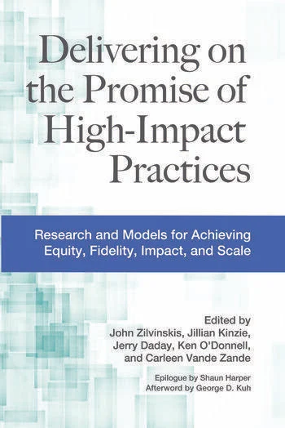


Key HIP books
Notes:
Great purchases after funding is available!

Slide 12
Getting started with other available materials
https://www.aacu.org/trending-topics/high-impact
AACU page
https://teaching.resources.osu.edu/teaching-topics/high-impact-practices-enhancing
The Ohio State University
https://www.tbr.edu/student-success/high-impact-practices Tennessee Bd Regents
Notes:
https://www.aacu.org/trending-topics/high-impact AACU page
https://teaching.resources.osu.edu/teaching-topics/high-impact-practices-enhancing
Ohio State University Teaching and Learning Resource Center
https://www.tbr.edu/student-success/high-impact-practices Tennessee Bd Regents
An individual FLC such as yours can enable your faculty to create a HIP within an individual course, or multiple courses, or even create a proposal for a HIP program like FYS or a common reading experience across an entering class. See what others have done.

Slide 13
MULTIPLE HIPS Enriching every Course
Service Learning: Writing Life (Lit); Water analysis (Bio); Languages immersion (Fr, Sp, German, etc);
Writing Intensive: All writing courses, but also Themed courses from art – zoology; Writing in the Discipline course; Special Topics courses
Collaborative assignment: course project in groups; panels for research project/presentation;
Notes:
Over the years, almost every course I offered at Oxford College came to possess three distinct HIPS—a service learning project, a writing intensive quality, and a collaborative assignment for students.

Slide 14
Selected FLC Resources by Topic
Lang, Jim (2021). Small Teaching, 2nd ed. Jossey-Bass.
Darby, Flower with Jim Lang (2019). Small Teaching Online: Applying Learning Science in Online Classes. Jossey-Bass.
Winkelmes, M. Boye, A. and Tapp, A. eds (2019). Transparent Design in Higher Education Teaching and Learning. Stylus.
Tilt in Higher Education. https://tilthighered.com/
Delivering on the Promise of High Impact Practices (2022). Edited By John Zilvinskis, Jillian Kinzie, Jerry Daday, Ken O'Donnell, Carleen Vande Zande. Routledge Press.
Kuh, George, et al (2008). High Impact Practices: What They Are, Who has Access to Them, and Why They are Important (AACU).
Kuh, George, et al (2013). Ensuring Quality and Taking High Impact Practices to Scale. (AACU).
Rogers, Satu and Jeff Galle (2015). How to Make Your Campus a ‘HIP’ Campus. Rowman and Littlefield.
Notes:
Small Teaching now in second edition (2021) also has an online focus (Flower Darby book 2019).
The TiLT work already possesses a rich presence in the website we’ve discussed; now there is an edited collection (2019)
HIPS work has burgeoned. The most recent book Delivering on the Promise (2022) adds to that rich collection.
Now, individual institutions are producing books on their HIPS efforts (Rogers and Galle, 2015)

Slide 15
Thank you and please contact me with any questions
Jeffery Galle, Ph.D.
Creative Engagement for Faculty
ellag55@gmail.com
https://Jgalle.com (website)
Notes:
Let’s apply a Just in Time approach by addressing specific challenges with targeted strategies. We only need your remarks and questions.

