Slide 1
Integrating Learning Science Principles to
Deepen Classroom Learning
The Cognitive Challenges of Effective Teaching
Stephen L. Chew, PhD
Samford University
slchew@samford.edu
Meauxmentum Summit
April 1-3, 2025
Notes:
Sloppy Joe Town Hall Deli

Slide 2
Goals for this Presentation
Describe the weakness of the current “best practices” approach to teaching
Discuss the contextual nature of teaching and learning
Describe a research-based framework of nine cognitive challenges that captures the contextual nature of learning
Discuss strategies that teachers can use for addressing each cognitive challenge.

Slide 3
Three Kinds of Knowledge for
Effective Teaching
Learning only occurs in one location, inside the brain of each student
Both teaching and learning strategies must mesh with the strengths and weaknesses of how the mind learns
Knowledge of
Your Field
Effective
Teaching
Knowledge
Of How Students
Learn
Knowledge of How
Students Learn
Your Area

Slide 4
The False Promise of
“Best Practices”
Traditional lecture | Active learning | Service learning | Problem-based learning | Calibrated peer review
Group learning | Mentoring | Cooperative learning | Discovery learning | Process Oriented Guided Inquiry Learning (POGIL)
Inductive learning | Learning by example | Inter-teaching | Project-based learning | Self-paced instruction
Flipped class | Curriculum Centered | On-line teaching | Clickers | Learning Communities
PowerPoint | Concept grids | Team-based learning | Teachable moments | Student teaching
Universal design of instruction | Competency-based | Multiple Intelligences | Kolb’s learning styles | MOOCs
Journaling | Reflective practice | Reciprocal teaching | Decoding the disciplines | Observation
Concept maps | Question generation | Peer-led team learning | Laboratory-based instruction | Immersion learning
Video clips | Role playing | Modeling | Programmed instruction | Undergraduate research
Mastery learning | Reacting to the past | Guided practice | Collaborative learning | Reaction papers
Apprenticeship | Situated learning | Authentic assessment | Formative assessment | Reflection papers
Classroom assessment techniques | High impact practices | Class discussion | Small group discussion | Brain-based education
Think-pair-share | Peer instruction | ConcepTests | Panel of experts | Writing Across the Curriculum
Brainstorming | Case-based learning | Worksheets | Guest speakers | Web enhanced
Structured controversy | Jeopardy | Portfolios | Personalized learning | Independent research
Flashcards | Research papers | Interviewing | Lecture with discussion | Independent study or tutorials
Oral reports | Study abroad | Mock convention | Textbook assignments | Socratic method
Just-in-time teaching | Jigsaw method | Wikis | Team teaching | Podcasts
Modules | Internships or practicums | Hybrid learning | Hyflex | Zoom
Implement the practice, and it
will work
Adapted from Chew, (2018)
Notes:
What teachers do.

Slide 5

Learning is Contextual
  Successful learning, and therefore successful teaching, depends on a complex interaction of multiple factors
  Any practice can be implemented well or poorly
  Every class has its own character
  There are no “best practices”
Notes:
Why Challenges?
Adobe Stock file #: 116667863

Slide 6

How We Study Learning and How We Teach
How We Study Teaching and Learning
How We Teach
Student Mental Mindset
Ineffective Learning Strategies
Metacognition and Self-regulation
Transfer of Learning
Student Fear and Mistrust
Constraints of Selective Attention
Lack of Prior Knowledge
Constraints of Mental Effort and Working Memory
Misconceptions
https://pxhere.com/en/photo/143255?utm_content=shareClip&utm_medium=referral&utm_source=pxhere
Notes:
https://pxhere.com/en/photo/143255?utm_content=shareClip&utm_medium=referral&utm_source=pxhere

Slide 7


What Teachers Know
Disciplinary knowledge, Pedagogical content knowledge, How people learn
All teachers have a mental model of how people learn best
  Select, implement, and adapt pedagogy
If the model is accurate, teaching will be effective, but if the model is flawed or incomplete, teaching will suffer
Students have a mental model of how they learn best
Notes:
Students base their study strategies on how they think they learn best
Part of teacher development is developing an accurate model of learning and part of teaching is teaching students how to learn your area.
https://upload.wikimedia.org/wikipedia/commons/b/ba/Student_in_Class%2C_Tulane_University%2C_September_2002.jpg
https://www.pexels.com/photo/black-teacher-thinking-while-working-5905840/
https://www.pexels.com/photo/focused-black-female-teacher-explaining-class-plan-to-pupils-5905444/
https://www.pexels.com/photo/black-woman-with-marker-near-whiteboard-5905625/
Instead of focusing on what teachers do, we need to focus on what teachers know.

Slide 8
Two Truths and a Lie
Two of the following statements are Truths about effective studying; one is a Lie. Pick the lie.
Highlighting text does NOT help you learn the material
Re-reading material multiple times is NOT an effective learning strategy
Effective learning is a combination of time, effort, and motivation.

Slide 9
Another One
Being raised with easy digital access to multiple sources of information and social media does NOT make you better at multi-tasking
A good way to study is to match the way you study to your personal learning style
The key to long-term learning is to learn, forget, then re-learn.

Slide 10
The Cognitive Challenges of Effective Teaching
What common challenges do all teachers have to solve?
How teachers solve a challenge depends on their teaching context
  Teaching is constant planning, assessment and adaptation
Notes:
A good teacher knows multiple strategies for solving a particular challenge and adapts to their situation
A good teacher knows the optimal way to implement a pedagogy to address specific challenges

Slide 11

The Cognitive Challenges to Teaching
(that we know about thus far)
Student Mental Mindset
Metacognition and Self-regulation
Student Fear and Mistrust
Lack of Prior Knowledge
Misconceptions
Ineffective Learning Strategies
Transfer of Learning
Constraints of Selective Attention
Constraints of Mental Effort and Working Memory
And they all interact with each other!
Notes:
All teaching and learning is contextual Increasing a factor that helps learning may also cause another factor to hurt learning.
Deep processing and cognitive load. Prior knowledge and cognitive load.

Slide 12




Four Types of Challenges
What Students Believe
What Students Know
Mental Mindset
Misconceptions
Fear and Mistrust
Prior Knowledge
Metacognition & Self-regulation
Transfer of Learning
What Students Can Do
Constraints of Selective Attention
How Students Learn
Ineffective Learning Strategies
Constraints of Mental Effort & Working Memory
Metacognition & Self-Regulation

Slide 13

What Students Believe:
Setting Expectations
I don’t like this stuff, I’m bad at it, and it’s pointless.
I already know all this stuff
Student Mental Mindset
Metacognition
This is where they weed out the people who don’t belong
Student Fear and Mistrust

Slide 14
Beliefs about Learning that
Make You Stupid
Learning is fast
Being good at a subject is a matter of inborn talent rather than hard work
Knowledge is composed of isolated facts
I’m really good at multi-tasking, especially during class or studying

Slide 15
Academic Mindset for Productive Persistence
(Farrington, 2013)
I belong in this academic community
  Belongingness
My ability and competence grow with my effort
  Growth Mindset
I can succeed at this
  Academic Self-efficacy
This work has value for me
  Curiosity
The Teacher’s Mindset Influences their Students’ Mindsets

Slide 16
Student Trust in the Teacher
Students’ willingness to risk vulnerability and pursue challenging work due to the belief that a teacher is competent, will demonstrate integrity, and will act in ways that are beneficial to students’ learning and development
  Competence: Has the knowledge and ability to fulfill teaching obligations
  Integrity: Is truthful, conscientious, and respectful of students
  Beneficence: Works to promote and enhance student learning and development

Slide 17

Wise Feedback
(Yeager et al., 2012)
Your paper contains a number of errors that are easily correctable. I can see that you are using some inefficient strategies to solve some of these problems. Please come by my office hours next week and let me go over this with you; I think I can really help you with this. (Anderman, 2016)
Please see me
I am holding the class to high standards
You have the ability to reach those standards
I will provide you with needed resources

Slide 18
Metacognition
A student’s awareness of their level of understanding of a topic
Metacognition distinguishes between stronger and weaker students
Struggling students tend to be highly overconfident

Slide 19
Self-Rating
What is your best, most accurate judgment of the percentage of questions that you answered correctly on this exam? Your answer may range from 0 to 100%
_____________________% correct

Slide 20
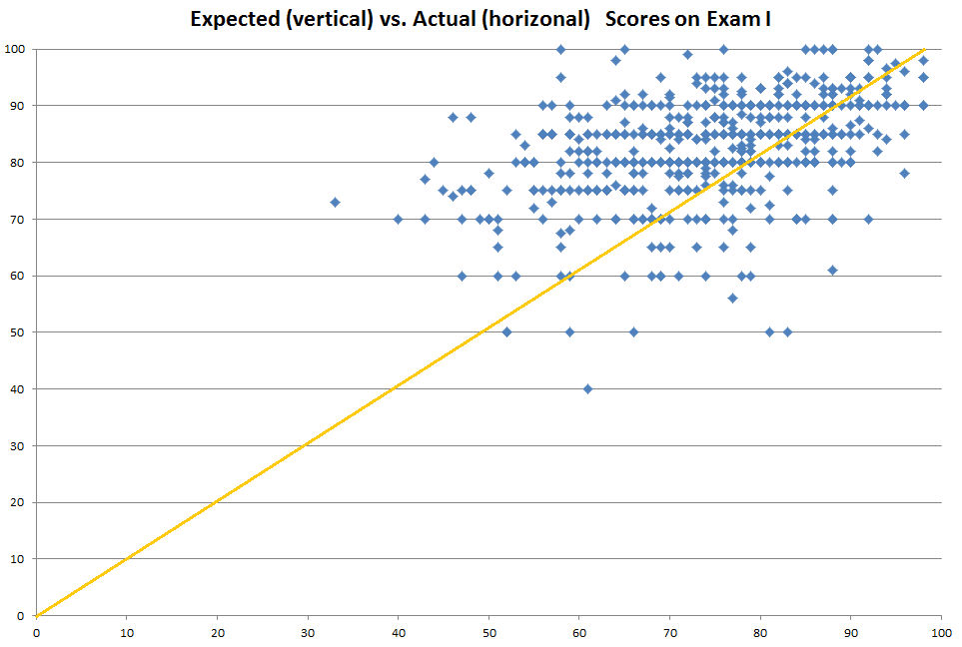
Estimated and Actual Grades for 800 Students: Econ 101
Consider these
two students

Slide 21
Improving Metacognition
Give students opportunities to test their knowledge and get feedback about their level of understanding
Teach them how to use the feedback
Build self-assessment skill

Slide 22
The Challenge of What Students Believe
The Challenge | Defined | Possible Solutions
Student Mental Mindset | Student beliefs about the value of a topic, how hard they expect to work, & how well they expect to do | Explain the purpose and value of work & what is involved in doing well; promote belonging and productive persistence
Fear and Mistrust | Student fears about teacher judgment and failure | Acknowledge fears & provide wise feedback
Metacognition | Student beliefs about their level of mastery of course content | Provide ample low-stakes opportunities for feedback about learning & instruct students how to use feedback

Slide 23

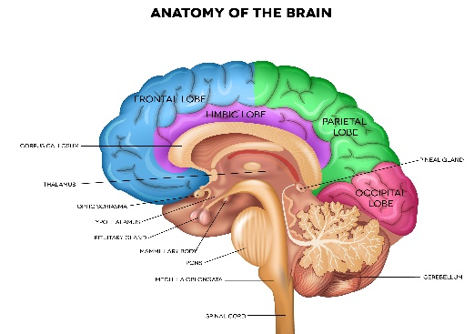
What Students Know:
Using Knowledge
Misconceptions
I remember this from AP Psych
I hope we learn about left-brained and right-brained people
Prior Knowledge
So that’s what a brain looks like.
That’s why my grandfather was paralyzed on his left side after his stroke damaged his right frontal lobe.
Transfer of Learning

Slide 24

Prior Knowledge Predicts Learning
“I’ve got King Five suited in the Big Blind. There’s a straddle on. The Button then raises to 40. I call for 30 more. The Under the Gun calls. We’re going three ways to the flop. Its Jack, Six, Four, rainbow.”
Brad Owen,
Professional Poker Player
VLOG 177: https://youtu.be/G9itw9IVm_s
Notes:
If you don’t know poker:
How easy is this to understand?
How easily could you learn it?

Slide 25
Common STEM Misconceptions
(Fizzics Education)
Rain comes from holes in clouds.
A giraffe’s neck got longer because it kept stretching to reach the trees.
Humans are responsible for the extinction of the dinosaurs.
The solar system contains only the sun, planets and the moon.
All the stars in a constellation are near each other.
Meteors are falling stars.
Atoms have electrons circling them like planets around a star
When white light passes through a colored filter, the filter adds color to the light.
An object at rest has no energy.
Objects float in water because they are lighter than water.
Notes:
https://www.fizzicseducation.com.au/articles/kids-perceptions-on-how-the-world-works-youd-be-amazed-how-they-think/
Color is a property of an object
Batteries have electricity inside them.
Clouds are made of cotton, wool, or smoke.
Atoms are like cells with a membrane and nucleus

Slide 26
Inert Knowledge
Students have relevant prior knowledge but fail to access it or apply it in novel situations
  Failure of transfer
All new learning is context dependent
Students often fail to see the relevance of what they learn beyond doing well on the exam

Slide 27
The Challenge of What Students Know
The Challenge | Defined | Possible Solutions
Insufficient Prior Knowledge | Students lack the prior knowledge needed to make sense of new information | Provide supplemental instruction to help students acquire relevant prior knowledge
Misconceptions | Students hold faulty or mistaken beliefs about the content that lead them to misinterpret or reject new information | Activate misconceptions then provide accurate versions of the concepts
Transfer of Learning | Students fail to apply their knowledge to new problems and situations | Provide opportunities for students to practice applying their knowledge to new problems and contexts

Slide 28

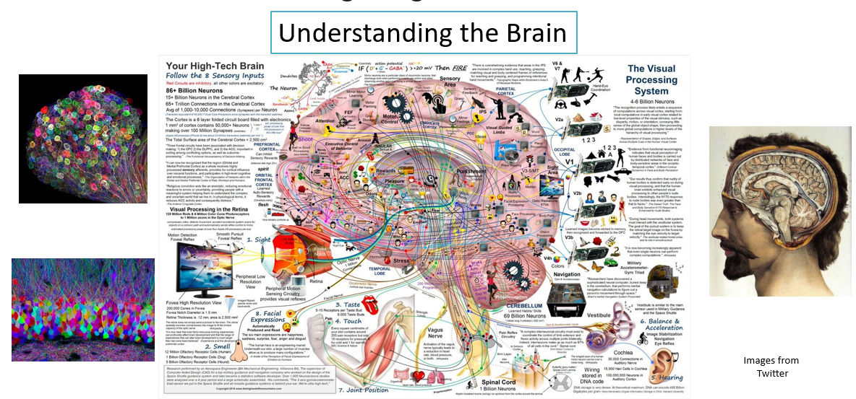
What Students Can Do:
Recognizing Constraints
Constraint of
Selective Attention
Constraint of Mental
Effort/Working Memory
I’m overwhelmed. I give up.
Where am I supposed to be looking?
I can’t keep up with everything he’s saying

Slide 29
Selective Attention
Attention is like a small spotlight in a darkened room.
Narrow focus
Anything that draws attention away from what we should be focusing on hurts learning
We miss anything outside our focus of awareness

Slide 30
The Cost of Multitasking
Partner up; you will need a stopwatch
Time each other doing the following:
  As quick as you can, count down from 10 to 0, then immediately say the alphabet out loud from A-K
  Now, alternate between the alphabet and counting down, 10-A, 9-B,…
Divide your second task time by your first task time

Slide 31
The Arithmetic of Distracted Studying
Assuming Distracted Study takes three times longer than
Focused Study to achieve the same level of learning
Focused Study
Takes 30 Minutes
Distracted Study
Takes 90 minutes
Focused Study gives you
60 Minutes (undistracted) free time
30
Minutes
Turns into
90 Minutes
30 Minutes
of Study
Which could
be
60 Minutes
Of Free Time

Slide 32
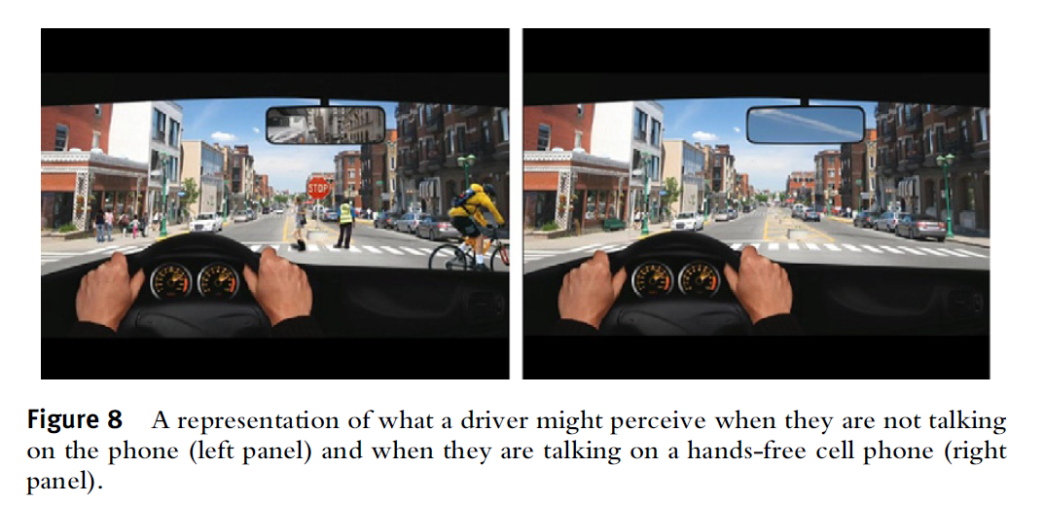
Inattentional Blindness
We miss most everything outside our focus of attention, and we are unaware that we missed anything
What the Distracted Driver Sees (or Misses)
(Strayer, et al., 2011)

Slide 33

The Importance of Undivided Attention
NO evidence that multi-tasking is as effective as concentrating on one task at a time
Even small distractions significantly reduce learning
  Resisting temptation is a distraction
There is no such thing as a momentary distraction
Remove distractions from your presence
Focused attention isn’t so much about willpower as it is about your environment

Slide 34



Beware Seductive Details
Highly interesting and entertaining information that is only tangentially related to the topic but is irrelevant to the author's intended theme
Much of teaching is attention management

Slide 35
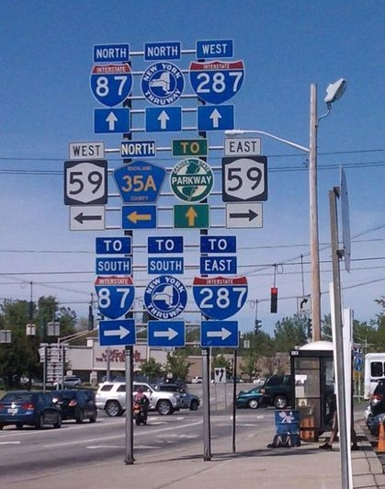
Cognitive Load Theory
(e.g., van Merrienboer & Sweller, 2005)
Mental effort: the amount of concentration a person has available
  Always a limited resource
Cognitive Load: the total amount of mental effort a task requires to complete it
A person can do multiple tasks as long as the total cognitive load does not exceed available mental effort
If cognitive load exceeds available mental effort, then performance suffers
https://d.justpo.st/media/images/2013/05/d95999dfb30299f0589edee03b906484.jpg
Notes:
https://www.justpo.st/post/11407

Slide 36
Student mental effort must meet the demands of instructional cognitive load
Available
Mental Effort
Cognitive Load
of Teaching
Teachers
design
instruction
Extraneous Load
Germane Load
Must be
less than
Limited
Resource
Intrinsic Load
Tasks and concepts
possess difficulty

Slide 37
Name the days of the week out loud and in order as fast as you can

Slide 38
About this Activity
Were you engaged?
Were you active?
Were you practicing retrieval?
Were you working hard and struggling?
What was the 4th day in the list?

Slide 39
The Days of the Week
(In Alphabetical Order)
Friday
Monday
Saturday
Sunday
Thursday
Tuesday
Wednesday
Notes:
How many people didn’t even try because it was too hard and you didn’t think it was worth the effort? What do you do when students tell you that?
Piece of advice: Study Harder! How useful is that? Not useful, but we tell students that all the time.

Slide 40
Implications of Cognitive Load Theory
If the cognitive load exceeds available mental effort, then learning will not occur
If the cognitive load takes up most or all of available cognitive effort, then there will not be enough mental effort available for learning or schema formation
Notes:
Can complete a task successfully but learn nothing from it if it took all of cognitive load. Schema formation is effortful.

Slide 41
The Challenge of What Students Can Do
The Challenge | Defined | Possible Solutions
Selective Attention | People have a narrow focus of awareness and miss anything outside that focus | Have only one clearly defined focus of attention during class
Mental Effort/Working Memory | People are limited in how hard they can concentrate and how much information they can store in conscious memory | Present information in manageable, coherent chunks and promote student reflection

Slide 42

How Students Develop:
Guiding Learning
You should all be thinking about getting ready for the next exam.
I’ll retype my lecture notes and read them over a few times.
Ineffective Learning Strategies
I’ll block out the day before the exam to study
I have three exams that day—what can I do? I’ll just study for all of them whenever I have time.
Poor Self-
Regulation

Slide 43
Effective Learning Depends on
Storage Strength: Encoding information in a way that optimizes meaningful associations and minimizes confusions
Retrieval Strength: Optimizing the likelihood that information will be recalled and applied accurately when appropriate

Slide 44
Improving Storage and Retrieval Strength
Storage Strength
Retrieval Strength
Elaboration: Making meaningful associations
Distinctiveness: Focus on key distinctions
Chunking: Building coherent, meaningful groups of information
Personalization: Making a personal connection
Overlearning: Going beyond bare mastery
Working through examples
Retrieval practice or self-testing
Spaced practice
Interleaving
Deliberate practice

Slide 45
What Doesn’t Lead to Effective Learning
Time spent studying
Effort
Repetition
Highlighting
Familiarity with material
Motivation to learn
Learning Styles
Memorization of isolated facts
Studying while distracted or Multi-tasking

Slide 46
Bad Study Strategies
Are usually easy to do, e.g., rote memorization of key terms, highlighting only key terms, reading only chapter summaries; “studying” with friends, studying with distractions
They promote familiarity, not learning
  Mindless re-reading or skimming
They lead to shallow processing
They build false confidence

Slide 47
The Challenge of How Students Learn
The Challenge | Defined | Possible Solutions
Ineffective Learning Strategies | Students use ineffective learning strategies that limit their learning | Incorporate effective strategies such as self-testing and self-explanation in the course
Self-Regulation | Students have difficulty planning, monitoring, evaluating and regulate their learning | Adopt assignments in which students plan how to study for exams and work on course projects

Slide 48
Our Challenges
What Students Believe
What Students Know
Mental Mindset
Misconceptions
Fear and Mistrust
Prior Knowledge
Metacognition & Self-regulation
Transfer of Learning
What Students Can Do
Constraints of Selective Attention
How Students Learn
Ineffective Learning Strategies
Constraints of Mental Effort & Working Memory
Metacognition & Self-Regulation

Slide 49
Effective teaching is more than just selecting the “best” practice, it is knowing how to get the best from the practices you select
Best Practices vs. Cognitive Challenges
Learning is contextual, therefore teaching is contextual
There is no such thing as best practices
The Cognitive Challenge Framework captures the complexity of teaching

Slide 50

Thank You
Stephen Chew (slchew@samford.edu)
Samford University

Slide 51

Choke Points and Pitfalls in Learning
Choke Points
Mental effort or concentration is a limited resource
Solution
Overlearning and practice to make knowledge automatic
Choke Points
WM has a limited capacity of about 4 chunks of information
Solution
Chunking: Organize information into large chunks
Pitfall
Students often prefer the least effective study strategies for long-term learning
Solution
Develop study strategies based on elaborative rehearsal and desirable difficulties
Pitfall
Students have mindsets (beliefs and attitudes) that undermine learning
Solution
Develop a productive persistence mindset
Attention
Senses
Learning
Material
Sensory
Memory
Working
Memory
Long-term
Memory
Elaborative
Rehearsal
Choke Points
Forgetting occurs in WM and LTM
Solution
Distinctive, overlearned
memories resist interference
Pitfall
People are often overconfident when judging their level of understanding (Metacognition)
Solution
Find ways to assess your understanding, use feedback to regulate your learning
Pitfall
Multitasking and distractions greatly reduce learning
Solution
Remove distractions in order to study with full focus
Choke Points
Narrow focus of attention limits learning
Solution
Avoid distractions
Selection
and Focus
Chew (2023)
Notes:
When drawing the IP model, have multiple arrows going from senses to SM and from SM to attention, showing attention is the first choke point
https://doi.org/10.1037/cap0000290

Slide 52


More on the Cognitive Challenges of Effective Teaching
Cognitive Challenges of Effective Teaching
Bill Cerbin
Psychology Teacher Network (2021)
https://tinyurl.com/yk9czv7x
We Can Do Better than “Best Practices”
Stephen L. Chew
The Teaching Professor (2023)
https://t.co/RZ4N1b3jhi
Stephen Chew (slchew@samford.edu)

Slide 53
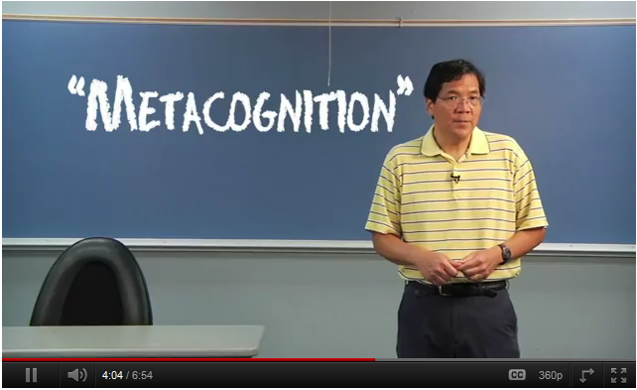

Video Series: How to Get the Most Out of Studying
Webpage: http://www.samford.edu/how-to-study/
(Optional) Introductory Video: Developing a Mindset for Successful Learning
Video 1: Beliefs That Make You Fail…Or Succeed
Video 2: What Students Should Understand About How People Learn
Video 3: Cognitive Principles for Optimizing Learning
Video 4: Putting the Principles for Optimizing Learning into Practice
Video 5: I Blew the Exam, Now What?
Notes:
Student preconceptions about college advice
Students expect to be lectured to about how hard college is going to be and how hard they will have to work.
“I’m a college professor and you better study hard because college is tough!”
“Look to your left…”
e.g. space out learning; serial position; study in same place you will be tested
Not a recipe for best way to study
Overcome student misconceptions about learning
Give students a coherent, research-based framework for effective learning strategies
More than disconnected study tips
Show them how to apply the framework to their study
Make the videos engaging, accessible, and memorable
Do it in six brief (7-8 minute) videos

Slide 54
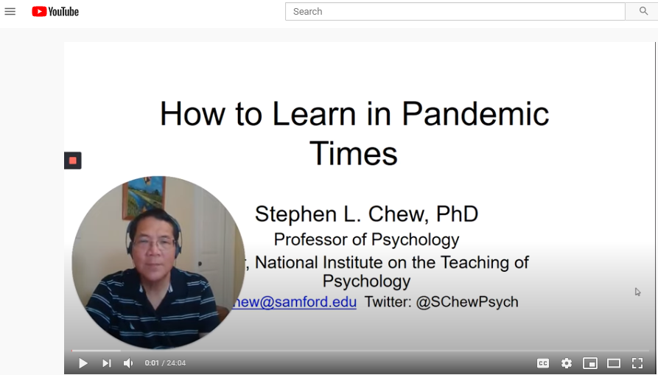

How to Learn in Pandemic Times
https://youtu.be/XOKG2LrnwYo

Slide 55
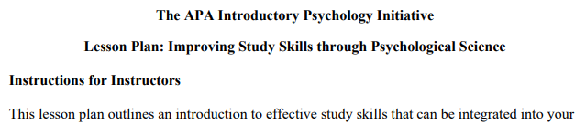
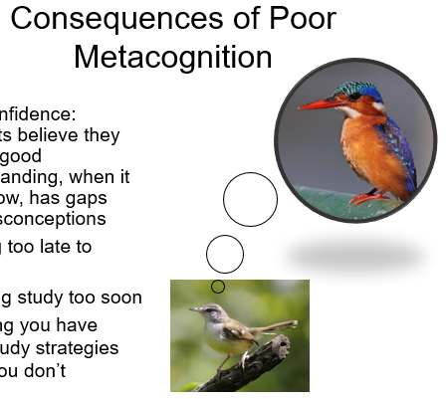
APA Study Skills Module
The APA IPI Study Skills Module: https://bit.ly/3epVPHO
  Complete lesson plan with lecture outline and slides
  Activities and Demonstrations
  Formative and summative assessments

Slide 56
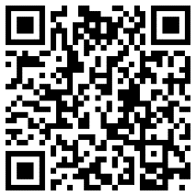
Video Series: The Cognitive Challenges of Effective Teaching
Playlist: https://tinyurl.com/yfgg8au3
Introduction and Overview https://youtu.be/tUdSxYlVAPM (13:23)
Student Mental Mindset and Student Fear and Mistrust https://youtu.be/BUhZZCg3KzA (15:36)
Ineffective Learning Strategies https://youtu.be/KfkX-IpG3sQ (14:43)
Metacognition and Self-Regulation https://youtu.be/4brOiCjMxp0 (8:52)
Prior Knowledge and Misconceptions https://youtu.be/lbXvQG5cNxQ (10:35)
Transfer of Learning https://youtu.be/UiPPxDFQM2E (12:21)
Constraints of Selective Attention https://youtu.be/ZKL8bNeLFLk (13:53)
Constraints of Mental Effort and Working Memory https://youtu.be/BeLuGzbyqus (16:02)
Implications of the Cognitive Challenges Framework https://youtu.be/QXgqJxKGsr4 (22:50)

