Slide 1


Skills-Based Learning in the Classroom
Angela M. Christie, Ph.D.
Sr. Director, Educational Programs
National Institute for Student Success
Georgia State University

Slide 2

66% of students felt they were not well prepared to succeed in a job search 75% said they did not know which positions were an appropriate fit 71% had visited their university’s career services center two times or fewer in their college career
Inside Higher Ed , “Why College Grads Can’t Find Jobs,” 1/17/2018

Slide 3
72% of students say higher education has appreciably improved their ability to secure a job 85% of seniors say college significantly helped them understand their career goals 60% of students say they feel pessimistic about finding meaningful employment after graduation
Handshake 2023 survey “What College Students Want”

Slide 4

Students are more likely to ask faculty about career advice.

Slide 5
78% of students either rarely or never visit or access resources provided by the career services office on their campuses 81% of students found career advice they received from faculty or departmental staff members to be helpful
2018 Strada-Gallup Alumni Survey

Slide 6

Employers are turning to more skills-based hiring practices.

Slide 7
65% of employers use skills-based hiring practices 75% of employers hire majors that are not exclusive to their industry. 88% of employers value problem-solving skills above all other attributes
NACE 2025 Job Outlook Report

Slide 8

Data Summary
While a high percentage of students feel their college education improved their chances of securing employment, more than half feel pessimistic about getting a job.
Almost ¾ of students visit their career services center fewer than two times during their academic pursuits, and the same percentage of students feel they do not know what jobs are a good fit for them.
A majority of students go to the faculty for career advice.
Employers focus on skills-based hiring and have a less favorable view of the job market prospects than they have had in five years.
A vast majority of employers hire candidates with demonstrable problem-solving and critical thinking skills, and ¾ hire candidates with majors not exclusive to the industry.

Slide 9
How do we bring more work-based learning experiences into the classroom?

Slide 10
WBLE in the Classroom
Major-Specific Career Explorer Data
Career-Readiness Curriculum
Skills Briefcase
Faculty Fellowships and Departmental Grants

Slide 11

Career-Readiness Curriculum
Integrated curriculum aligned with one of three outcomes.
Assessed annually
Developed in Learning Management System
Faculty training through online modules

Slide 12
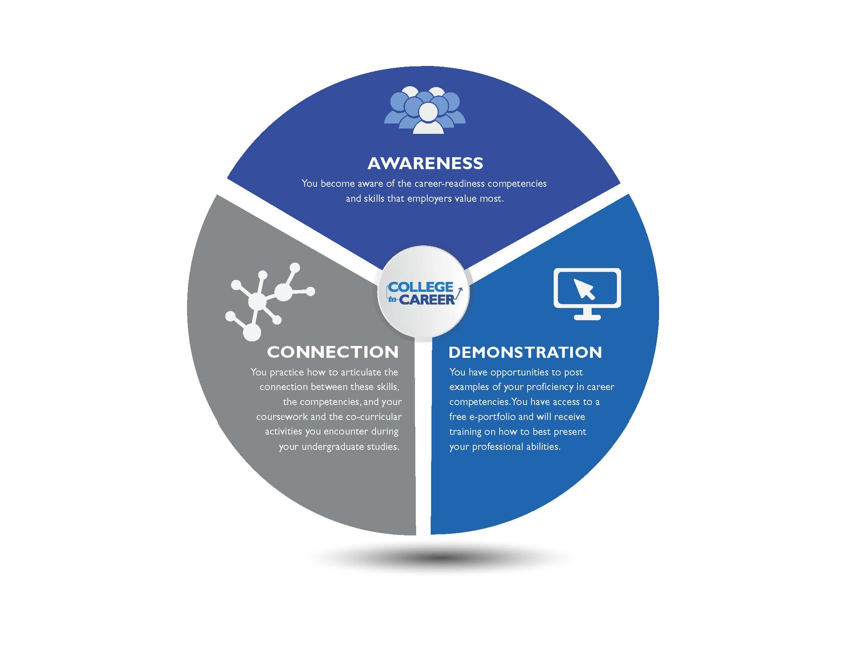
Learning Outcomes

Slide 13
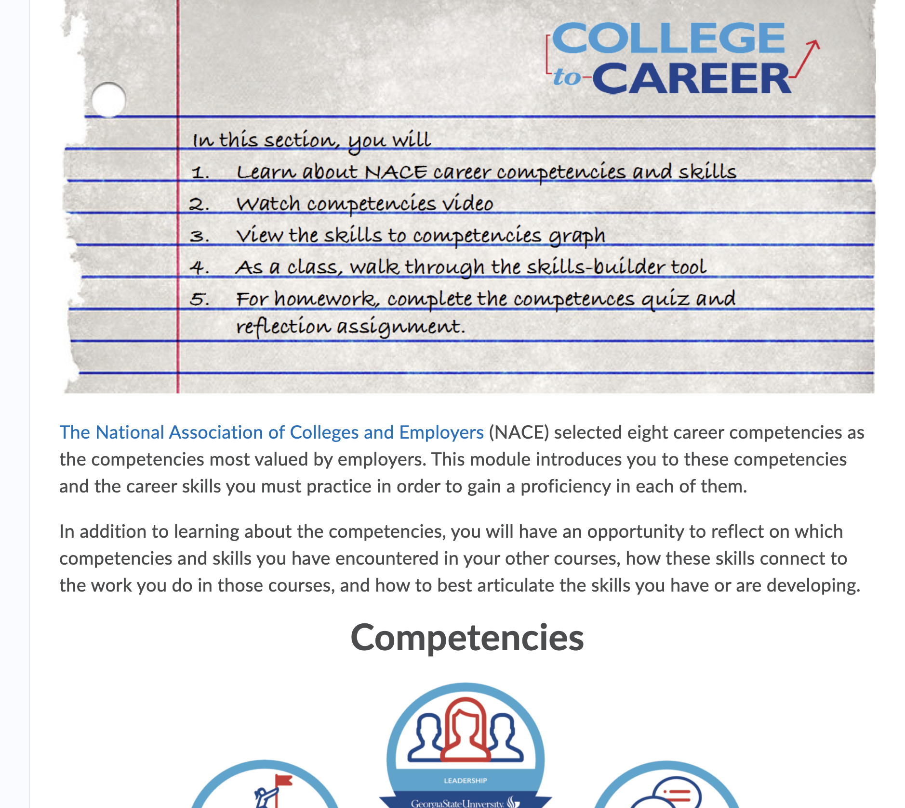
Career-readiness Modules: Orientation course, English 1101 and 1102, and Signature Experience courses
Notes:
Show the iCollege modules.

Slide 14
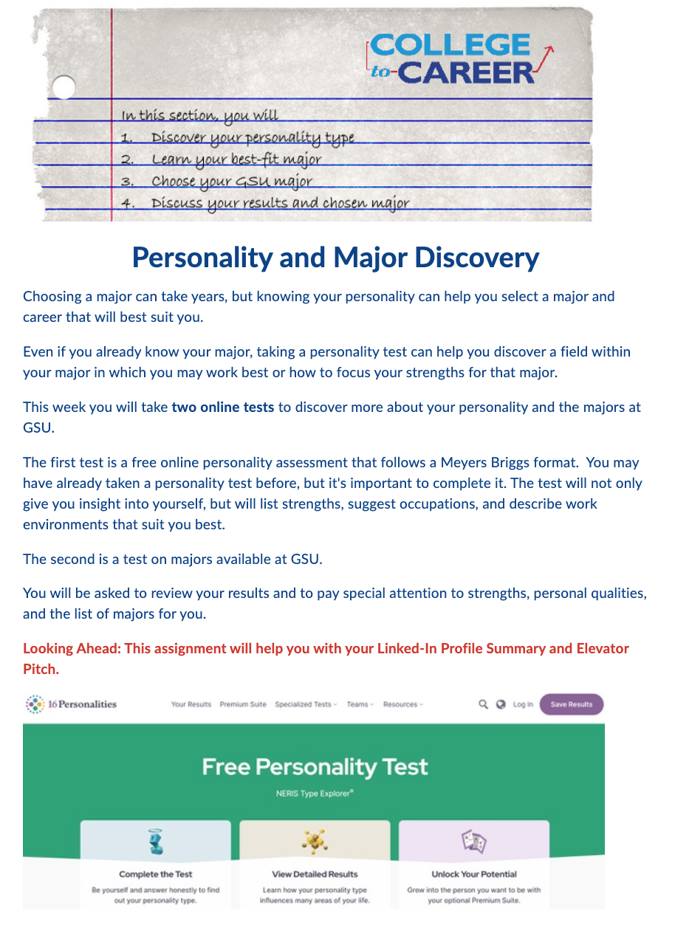
GSU 1010, a first-year orientation course, utilizes a set of College to Career modules in its course.
Modules introduce competencies and skills, have quizzes and short answer responses to questions about skills development, and direct students to Career Services to complete assignments.

Slide 15
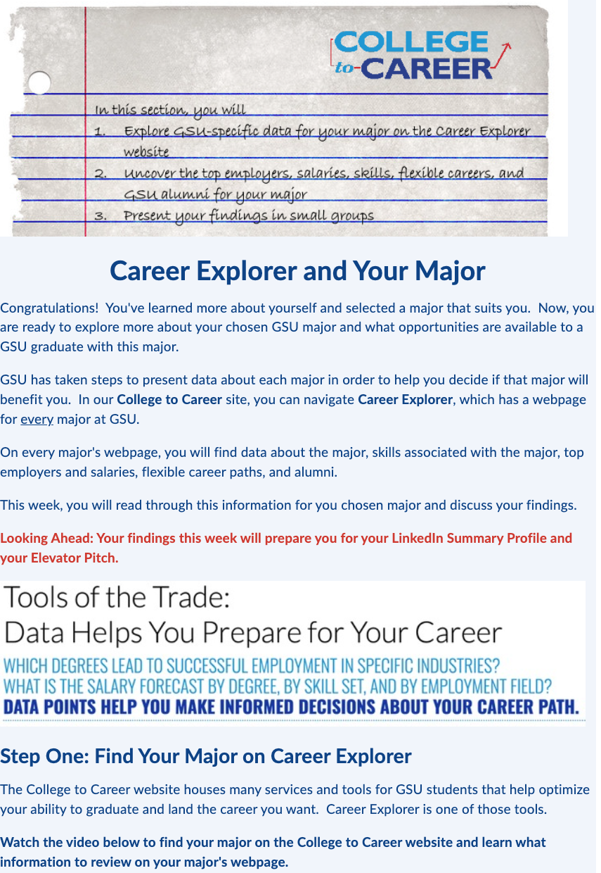
The orientation modules also introduce students to the Career Explorer and have them use it to explore major options and associated degree maps.

Slide 16
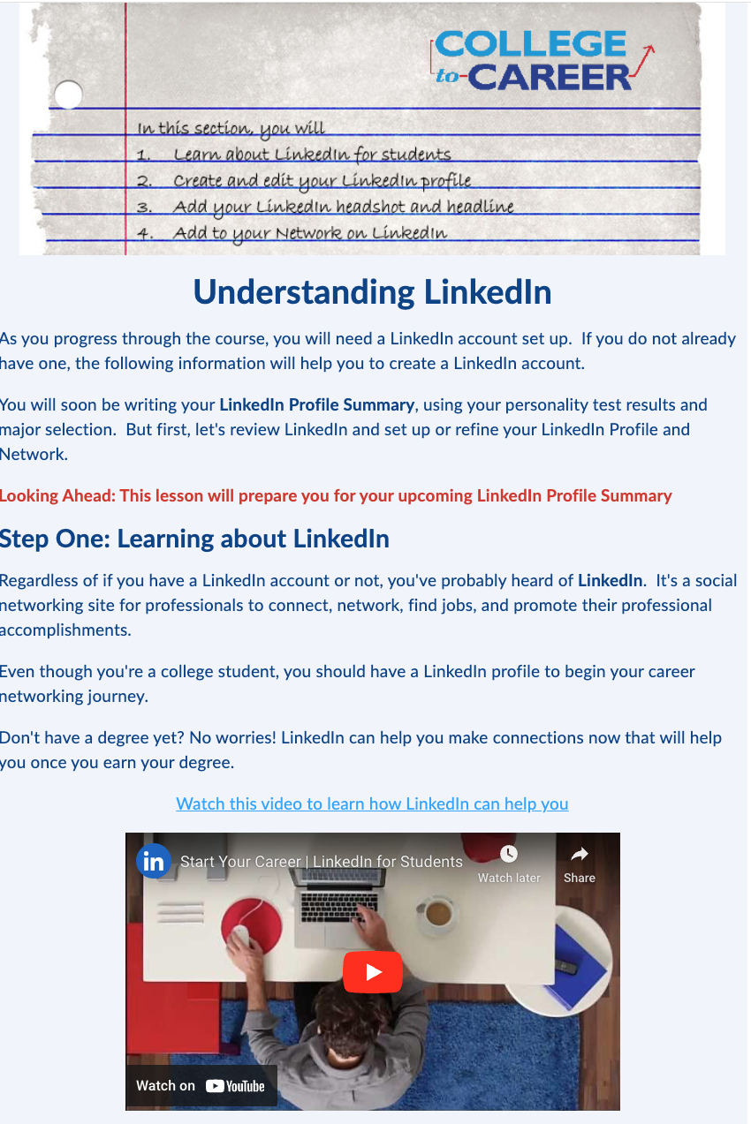
Students create their first LinkedIn account and present these account pages in class.
The assignment requires them to write a compelling bio, sit for a professional headshot (free at Career Services), and build a network of at least five contacts related to their career interests.

Slide 17
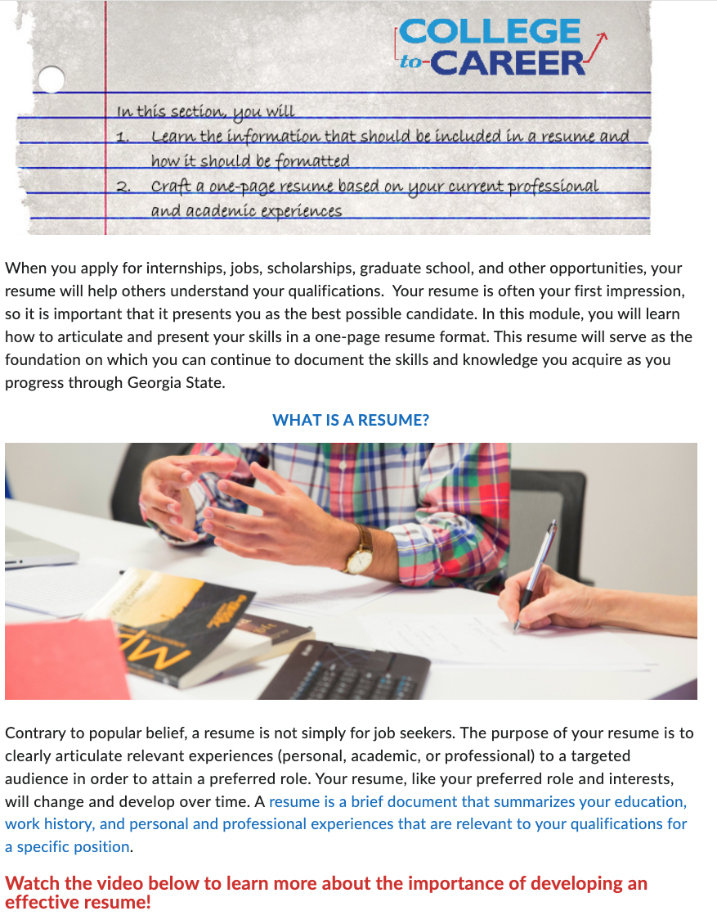
Students create their first resumes. This module contains a step-by-step video and student examples.
It also connects them to Handshake and requires them to open an account and upload their resume.

Slide 18
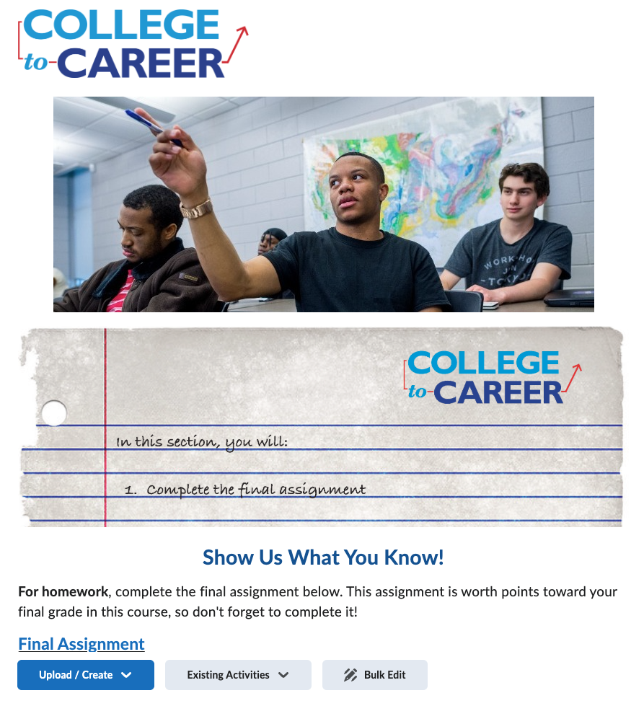
Automated data reporting takes the pressure off of faculty for grading and reporting.

Slide 19

Major-Specific Career Explorer Data
Includes real-time employment data for students
Faculty training is available through online video tutorials
Integrated into the curriculum for core and introduction courses

Slide 20
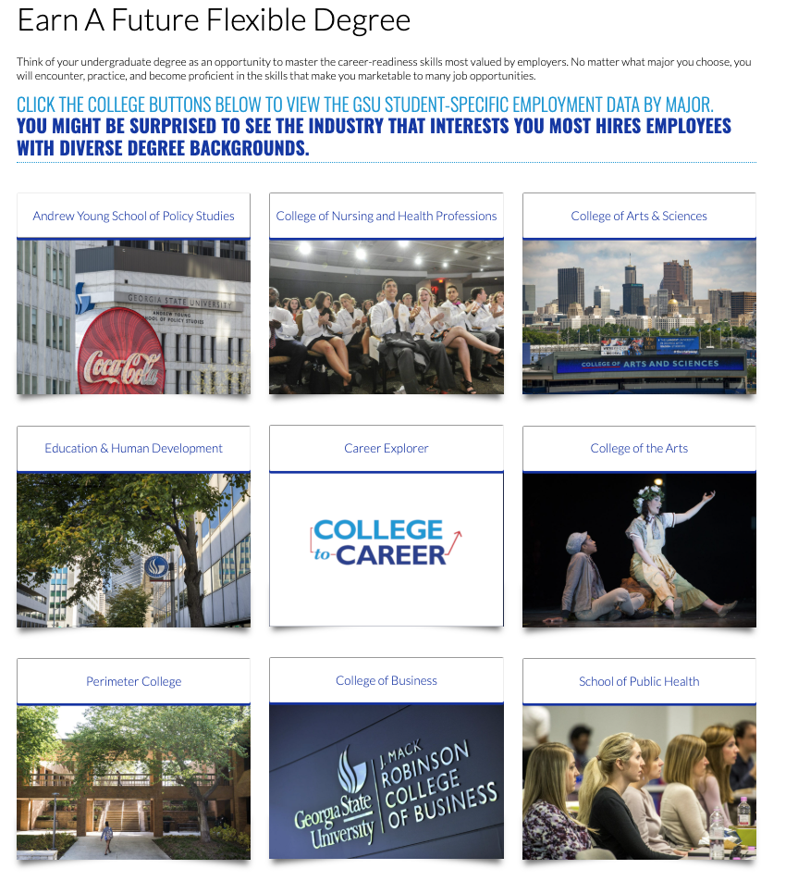
The Career Explorer uses Steppingblocks data to provide real-time employment outcomes for GSU graduates. Each major is mapped in the Career Explorer. Students can use the tool to explore possible majors, and faculty can use it to advise students on employment outcomes.

Slide 21
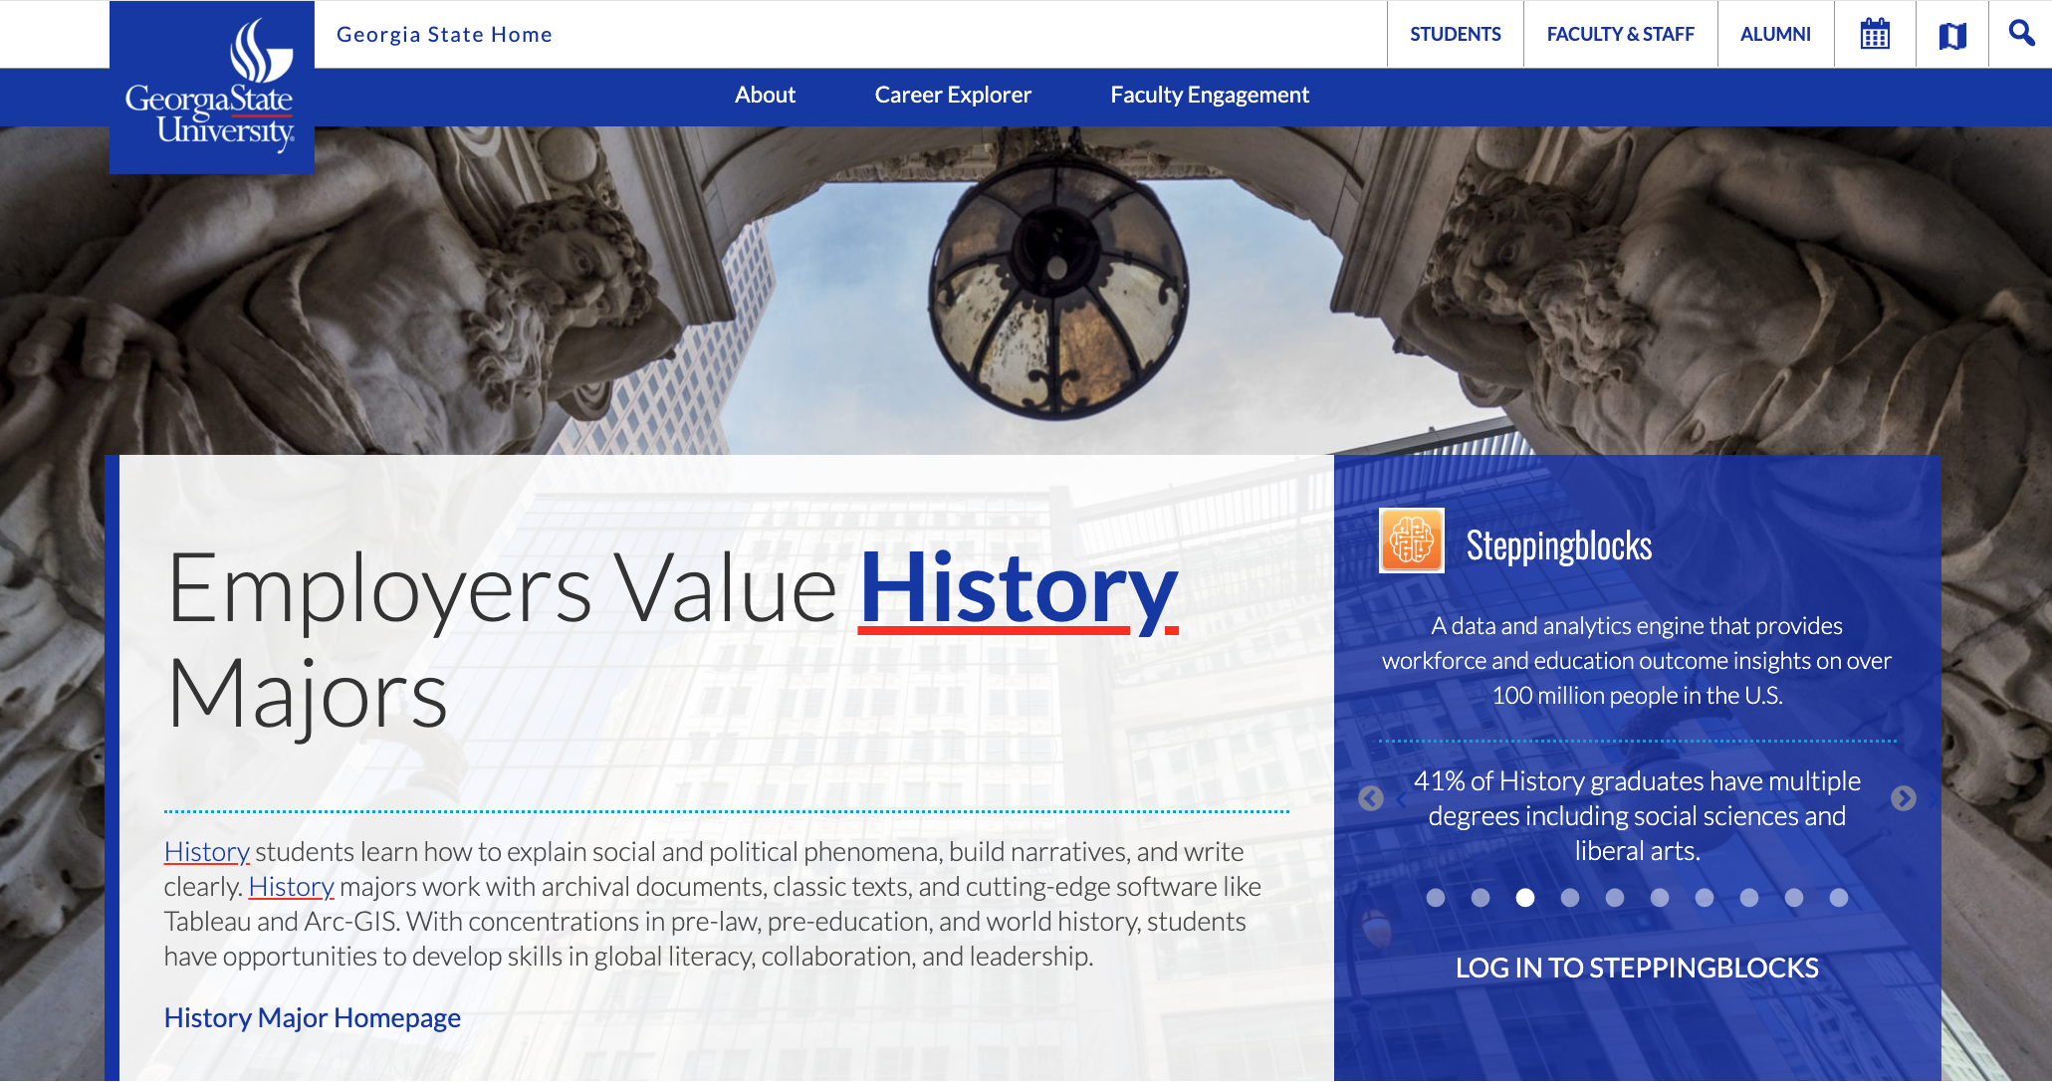
Each page contains a set of “wow facts” about the major and employment opportunities.

Slide 22
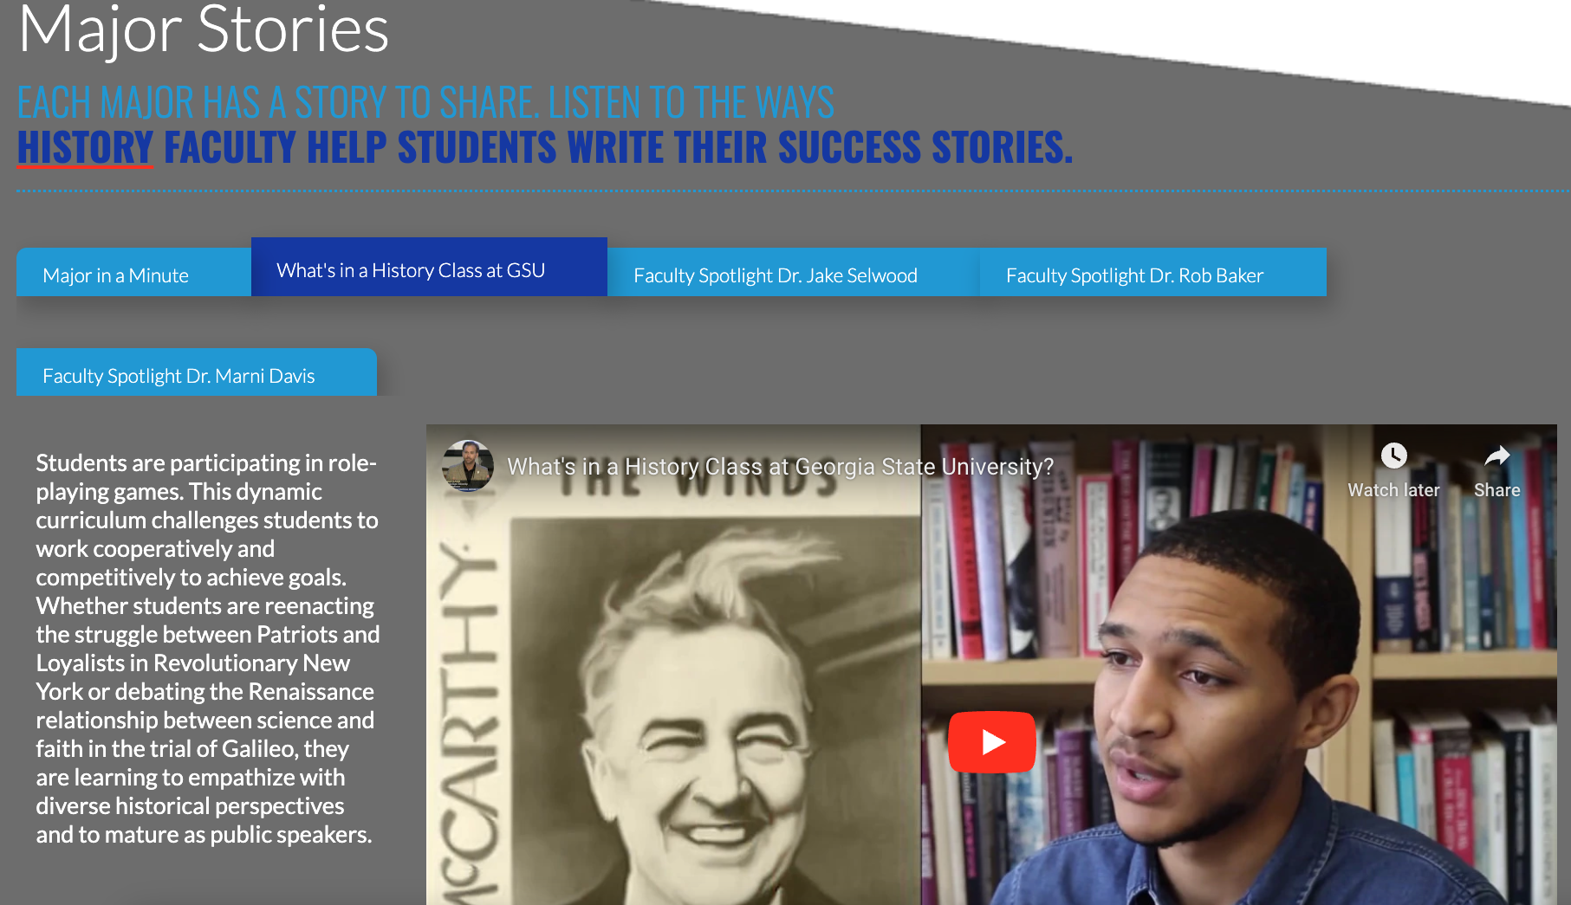
The pages also highlight student and faculty perspectives.

Slide 23
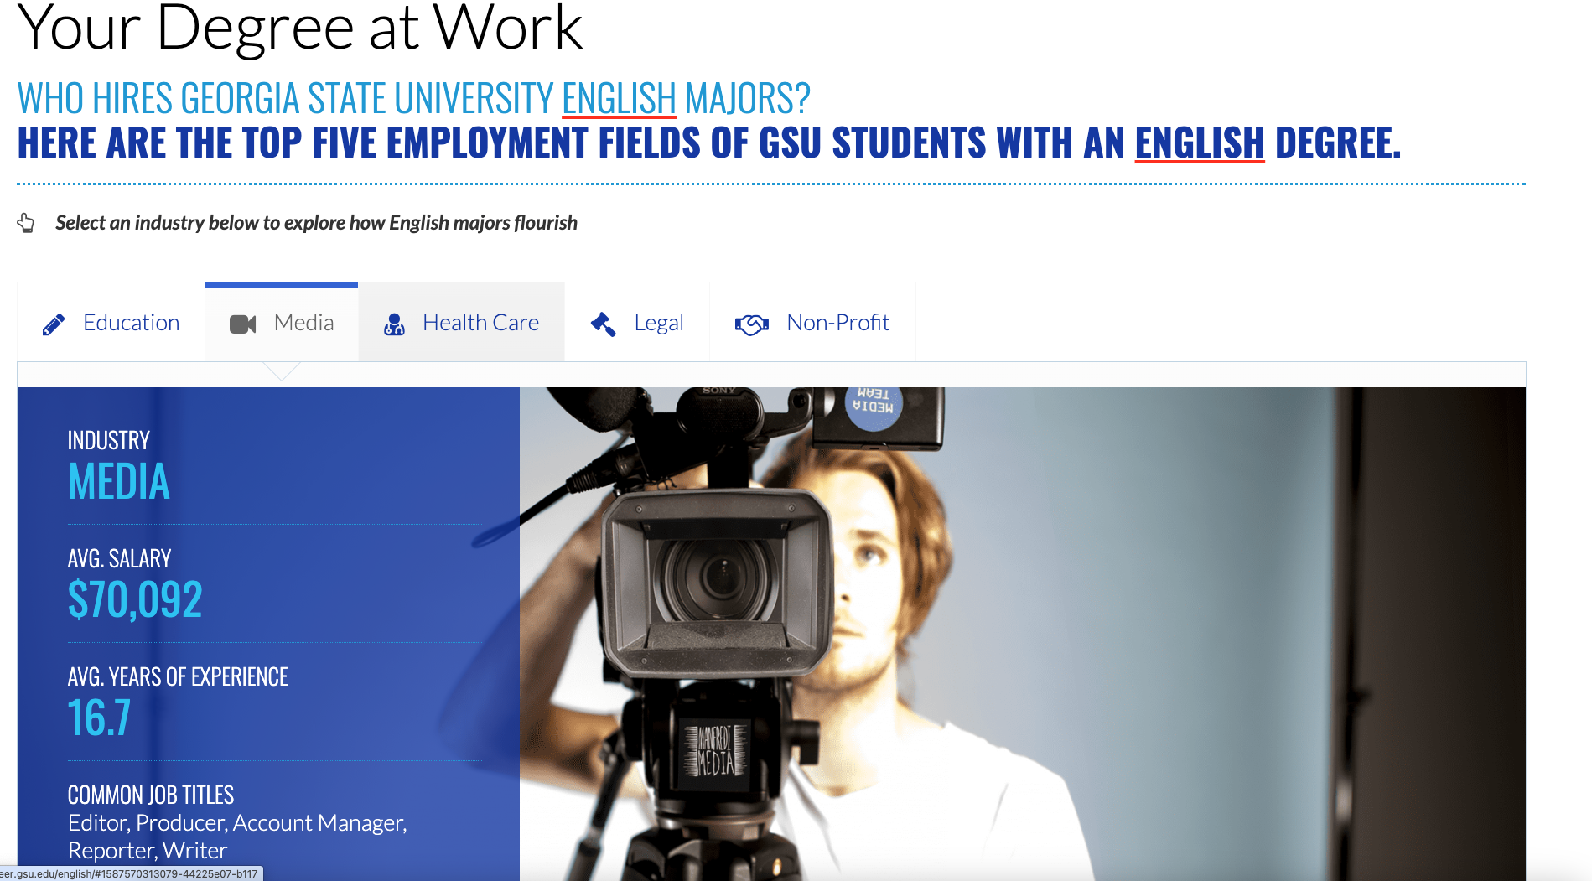
Each page contains a “Your Degree at Work” section that highlights the top five industries hiring GSU graduates with that degree.

Slide 24
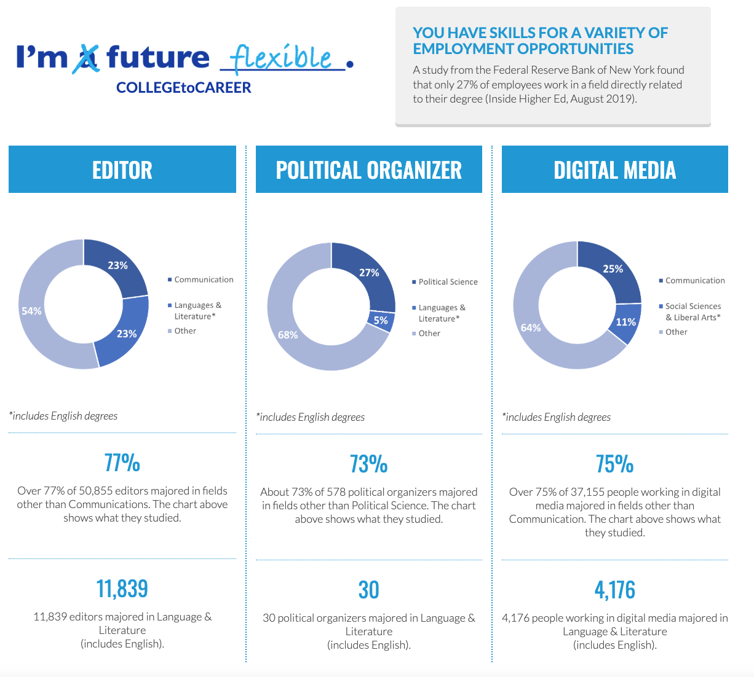
Employers hire candidates with degrees outside the industry. The “future flexible” section reminds students that finding a job after graduation has a lot to do with their ability to translate their skills.

Slide 25
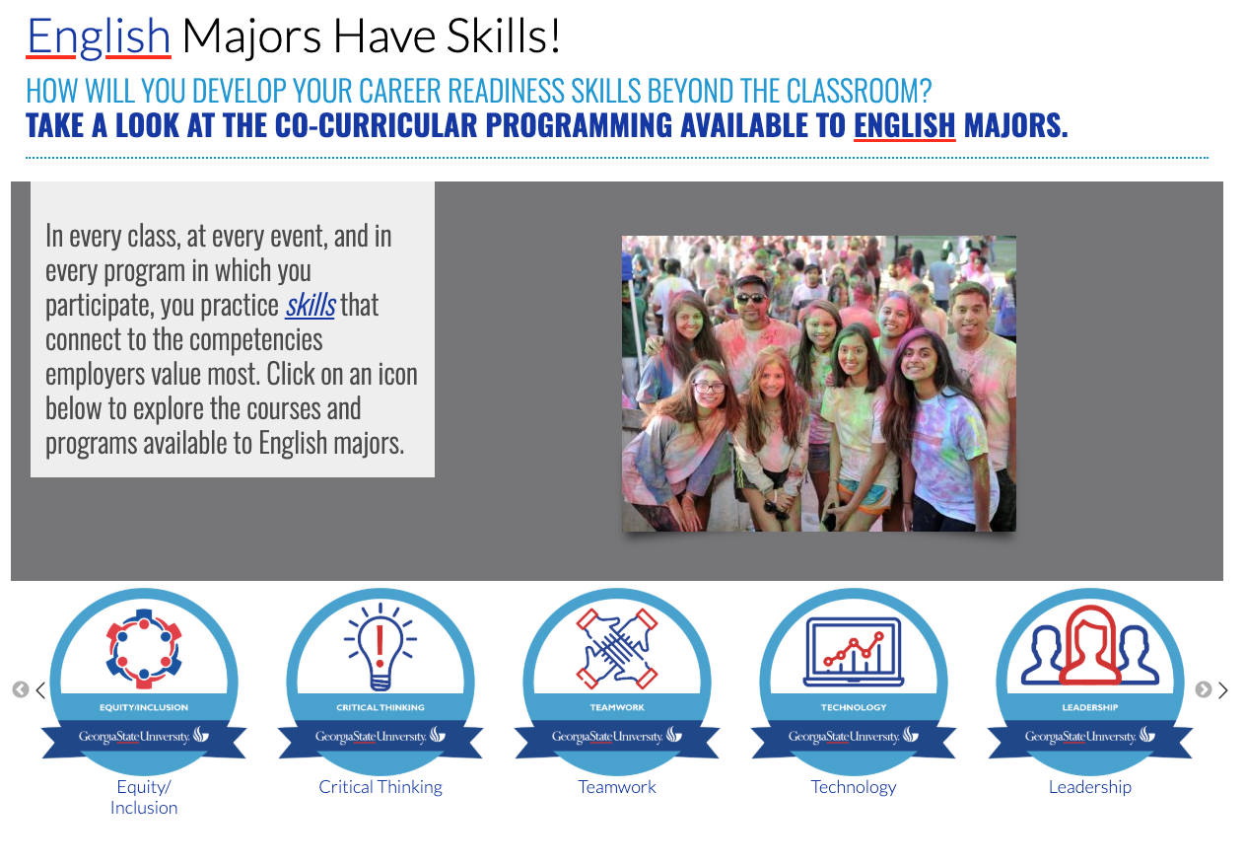
To highlight skills development, the Career Explorer allows departments to connect courses and activities to the NACE competencies.

Slide 26
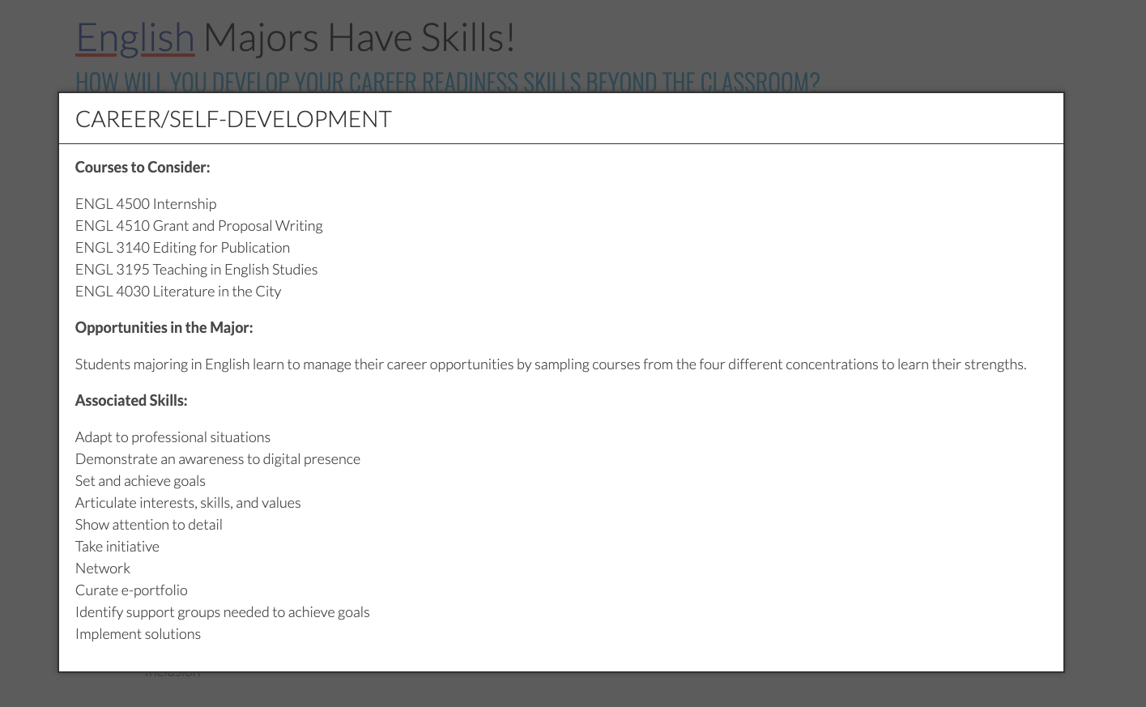

Slide 27
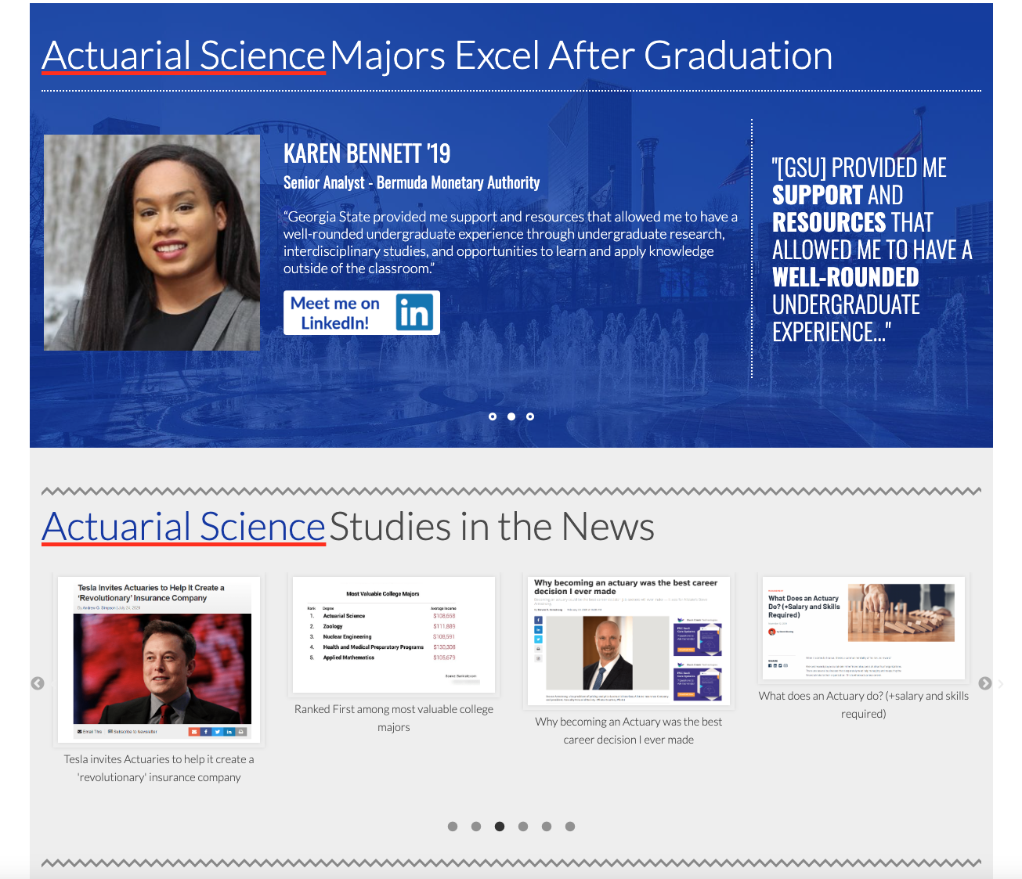
The pages also highlight recent graduates and invite students to connect with them on LinkedIn, which ties into their assignment in the GSU 1010 orientation course.

Slide 28

Skills Briefcase
Permits easy connection between the work students do in class and the skills needed to be competitive in the job market.
The briefcase serves as a portfolio of work that students can share with prospective employers.
Allows faculty to demonstrate how their coursework aligns with work-based learning outcomes.

Slide 29
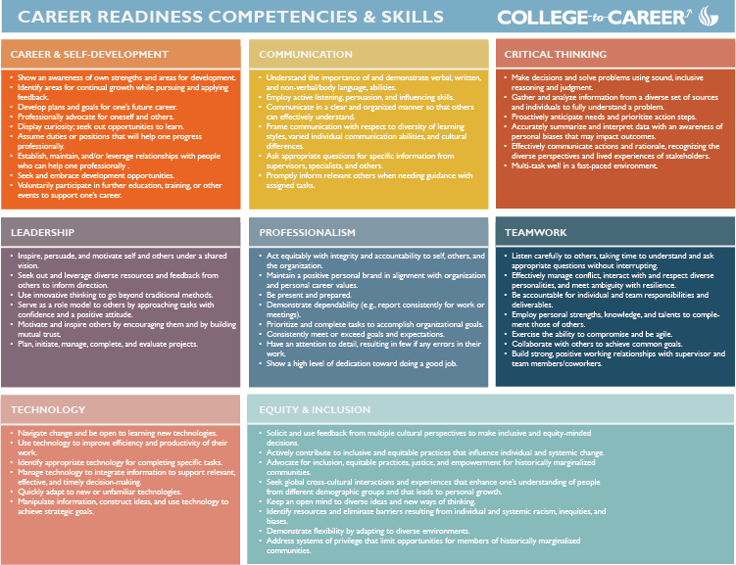
Notes:
Have the faculty toolkit up and ready to walk through

Slide 30
Competencies are automatically added to all Core IMPACTS courses Allows faculty to align Career-Ready Competencies with any assignment in iCollege Faculty use a simple assessment rubric to indicate student performance Competency assessments do NOT factor into the academic grade for the assignment Reporting features allow faculty to demonstrate their participation in Student Success and USG initiatives Empowers students to track their own skill development over time more easily

Slide 31
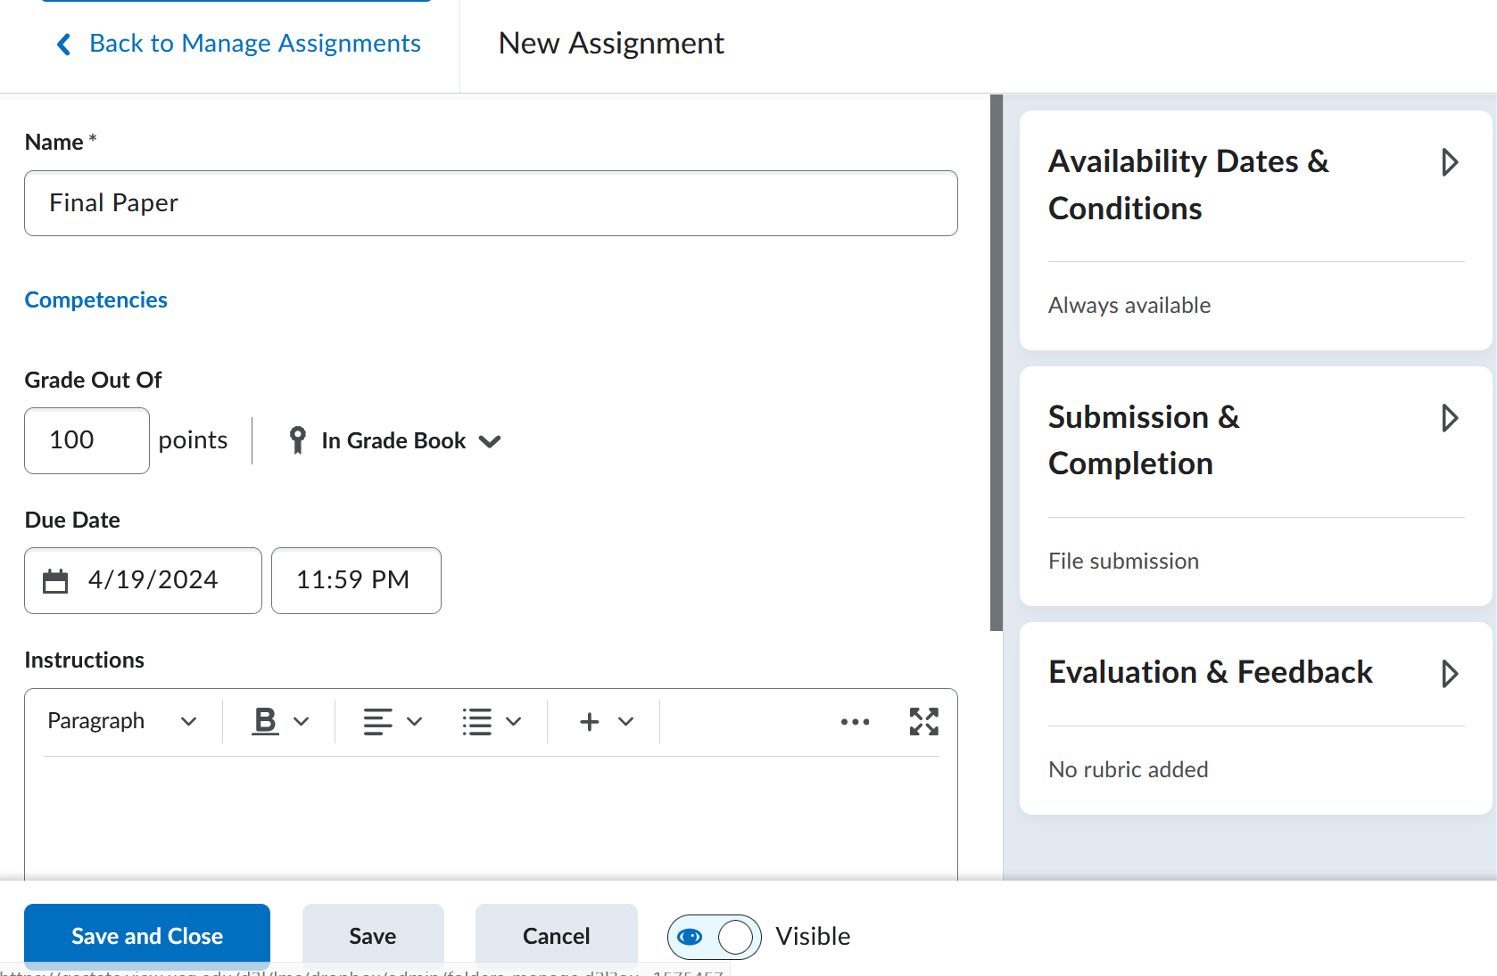
Adding Competencies to Assignments

Slide 32
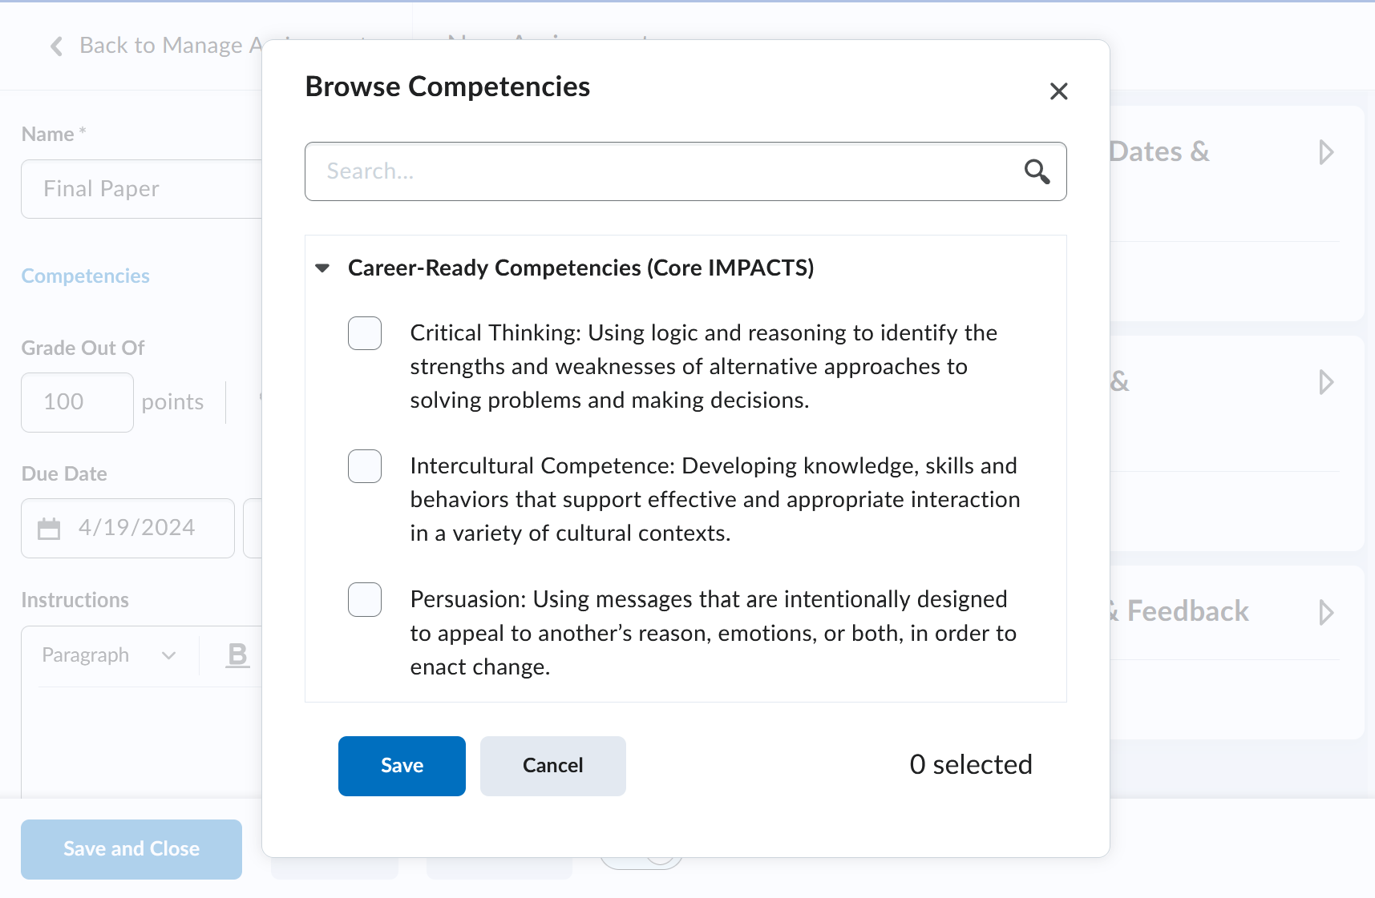
Adding Competencies to Assignments

Slide 33
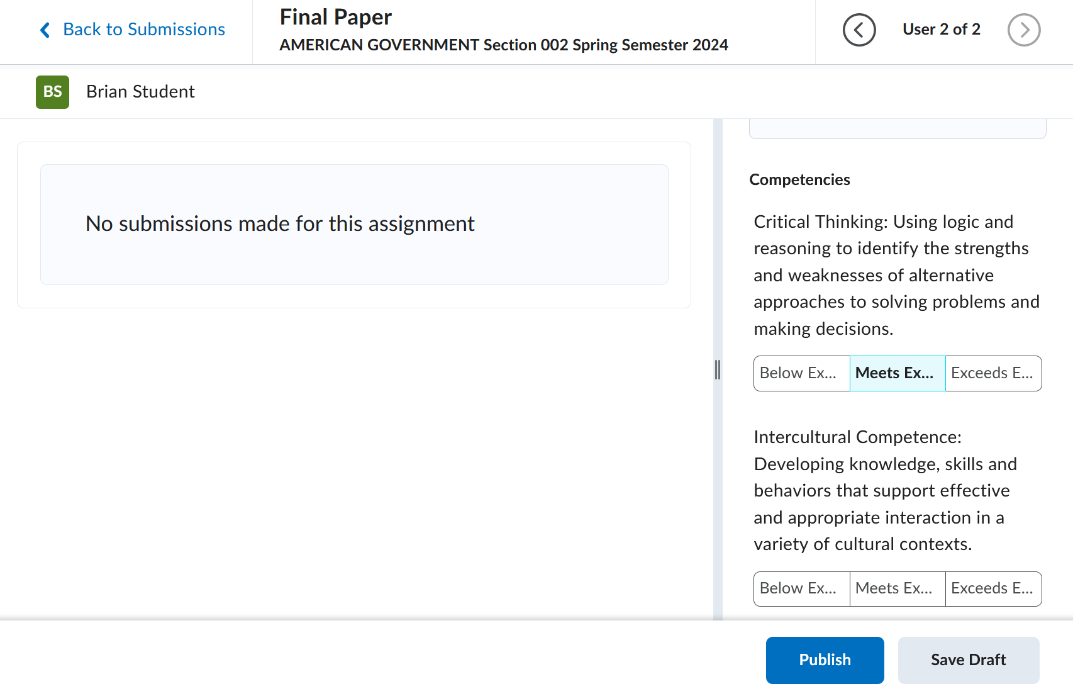
Scoring Competencies

Slide 34
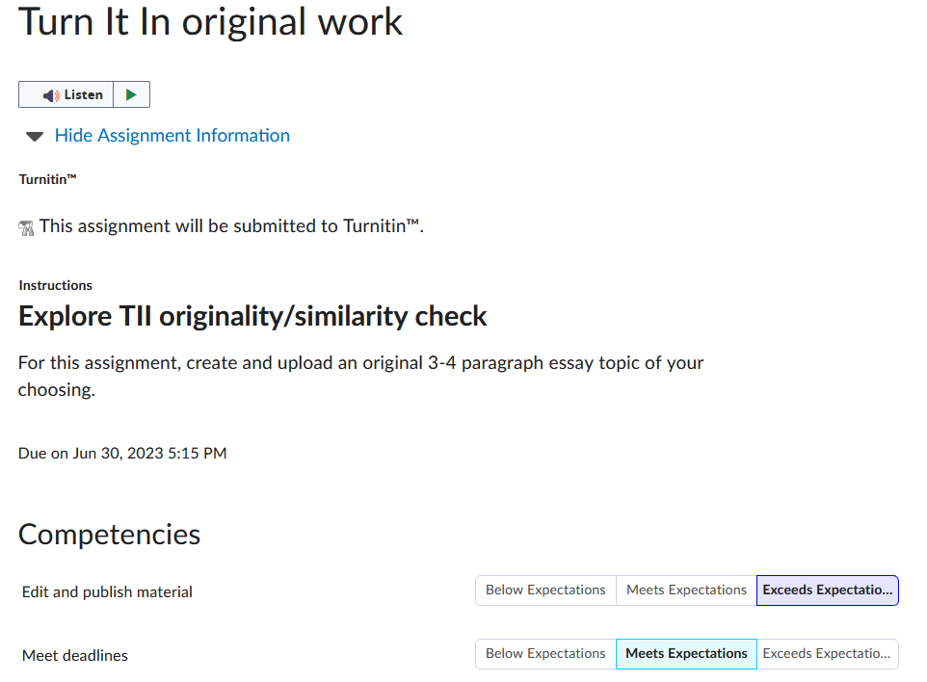
Student View of Competencies

Slide 35
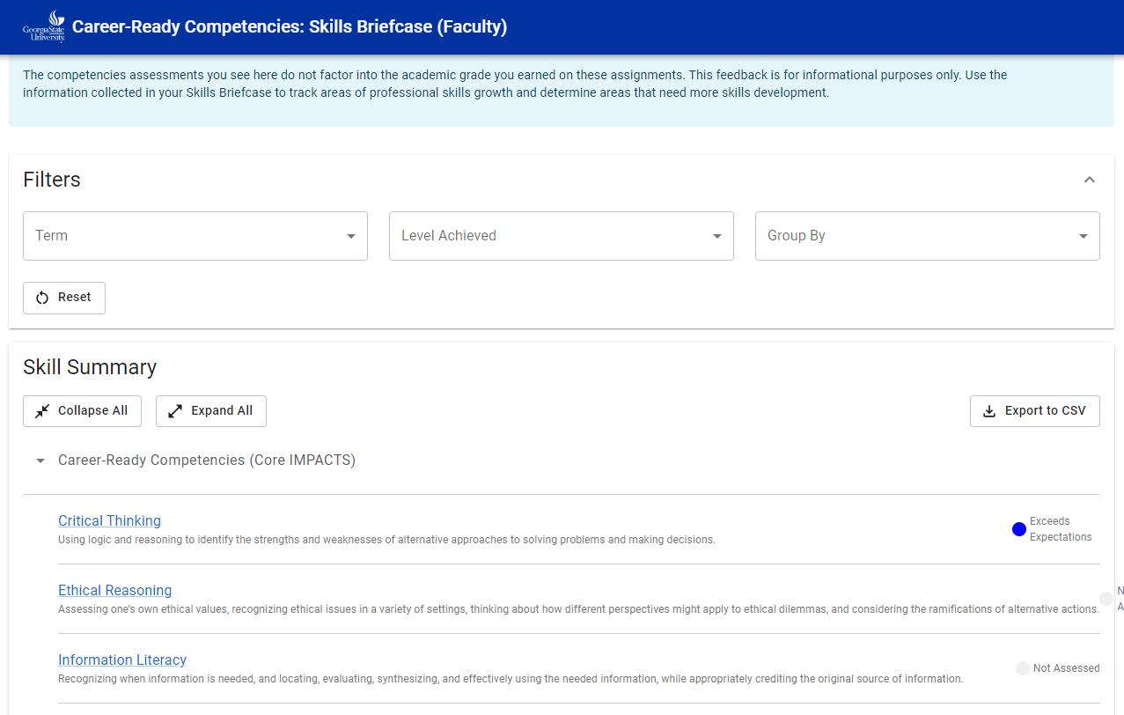
Faculty Dashboard
Notes:
Main faculty dashboard

Slide 36
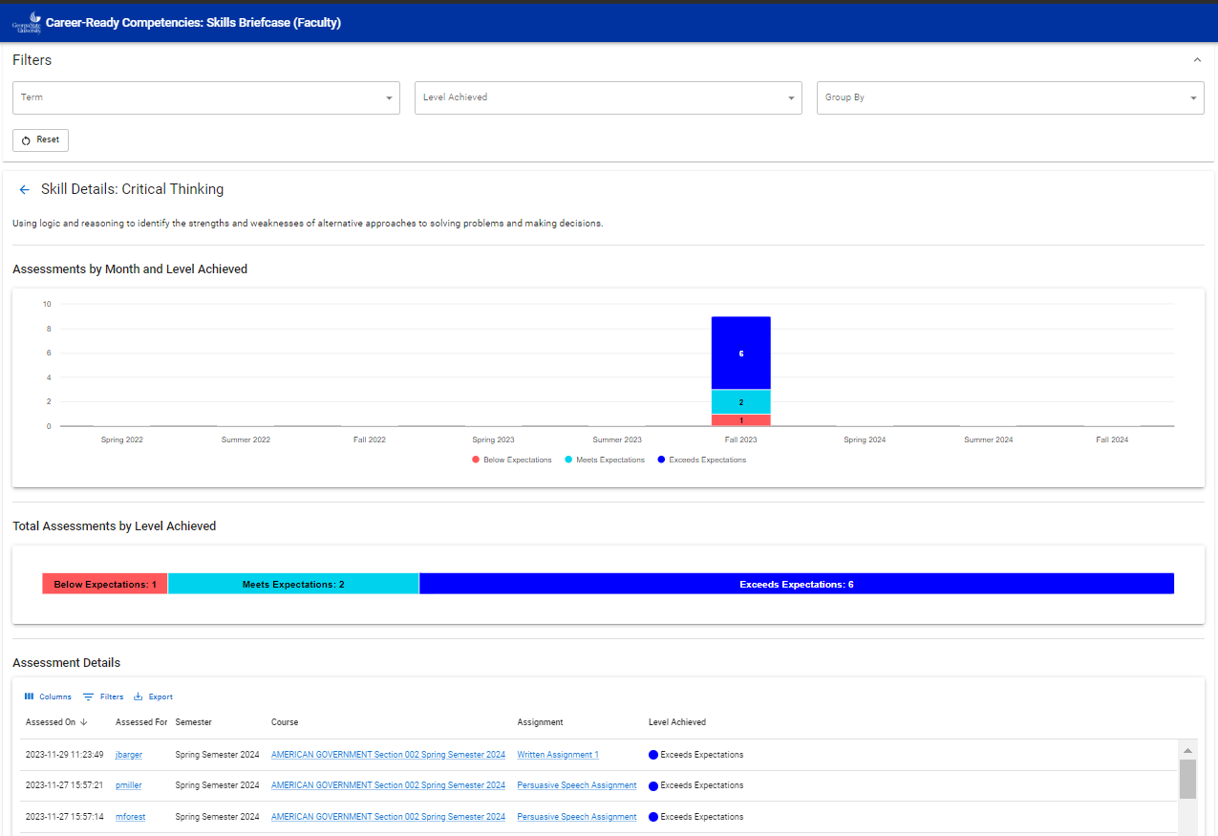
Faculty Details
Notes:
View when you click into one of the skills/competencies

Slide 37
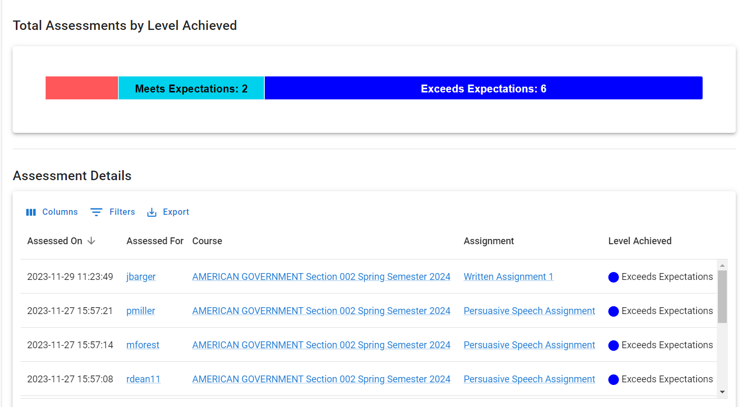
Faculty Details
Notes:
A close-up view of the total assessments for faculty & faculty details

Slide 38
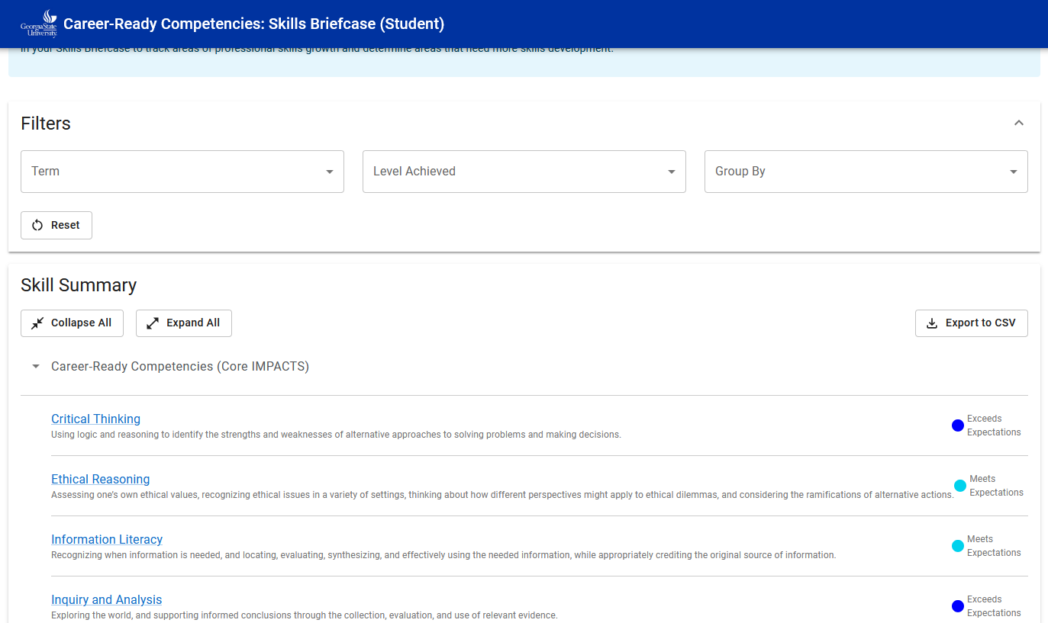
Student Dashboard
Notes:
A view of the student dashboard

Slide 39
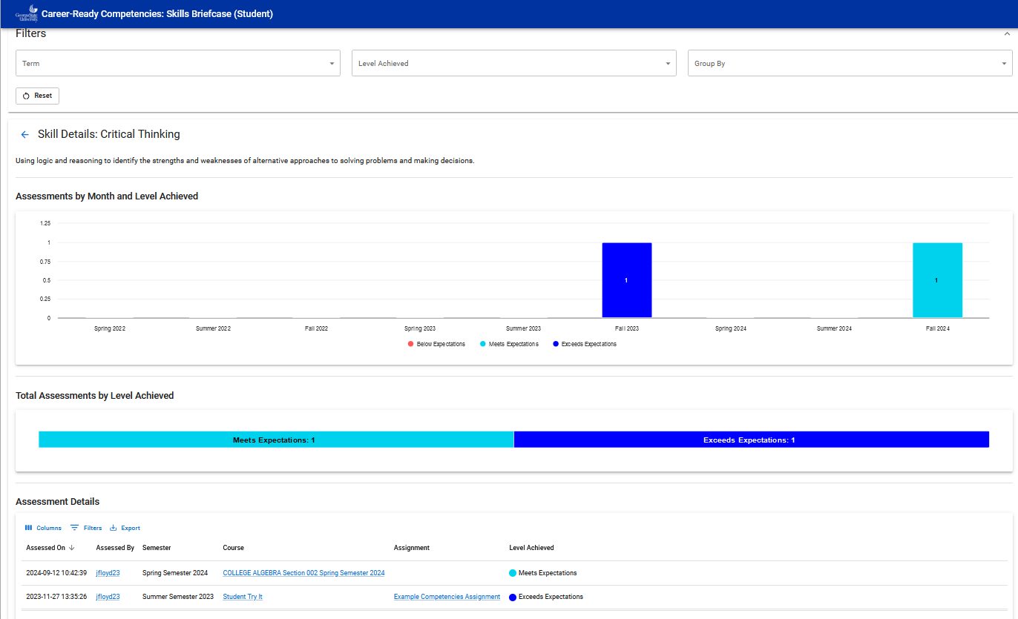
Student Details
Notes:
A view of the student details for a specific competency/skill

Slide 40
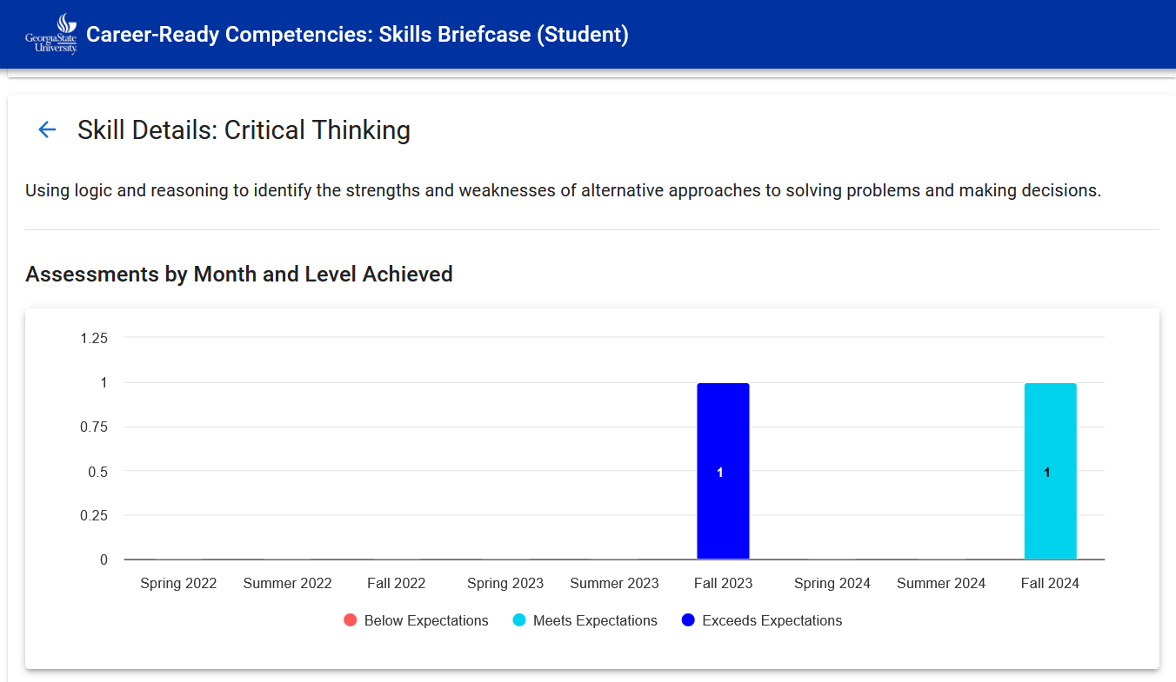
Student Details
Notes:
Student assessment over semesters

Slide 41
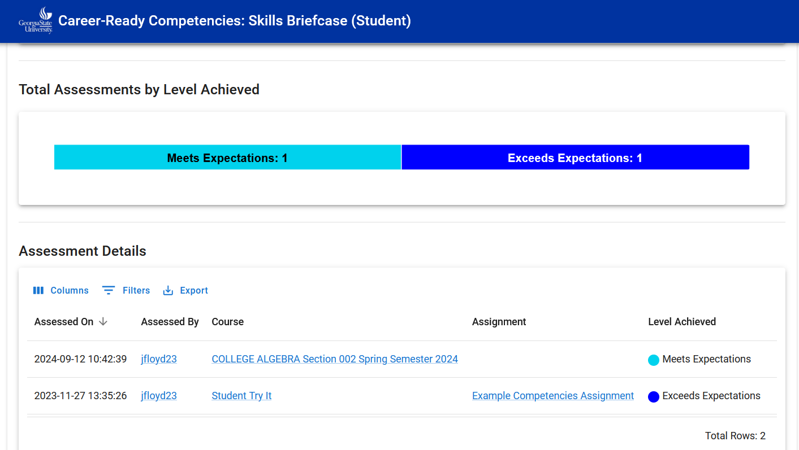
Student Details
Notes:
Student summary of assessments & details – links go to courses and assignments where available

Slide 42

Faculty Incentives
Projects include curriculum design, training, module design, and faculty outreach.
Departments receive funding to develop a career-readiness (or WBLE) pathway through the major.
Faculty receive training and support through the Center for Excellence in Teaching and Online Learning

Slide 43
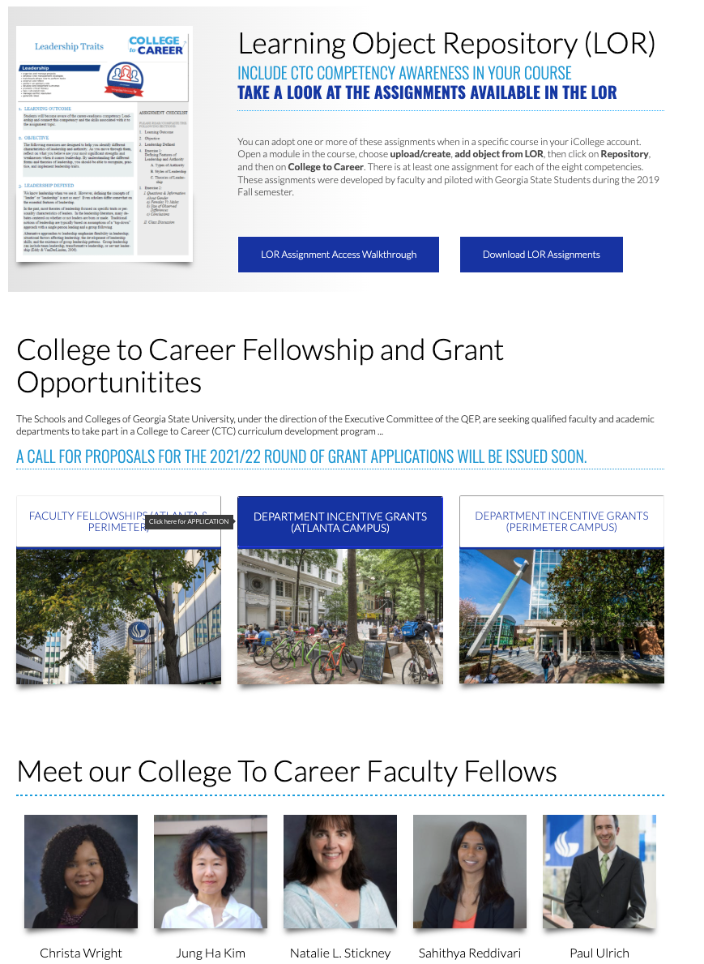
Faculty support included the LOR (in our LMS system), online training on all platforms (Steppingblocks, Career Explorer, and Skills Briefcase), and support through fellowships and departmental grants.

Slide 44
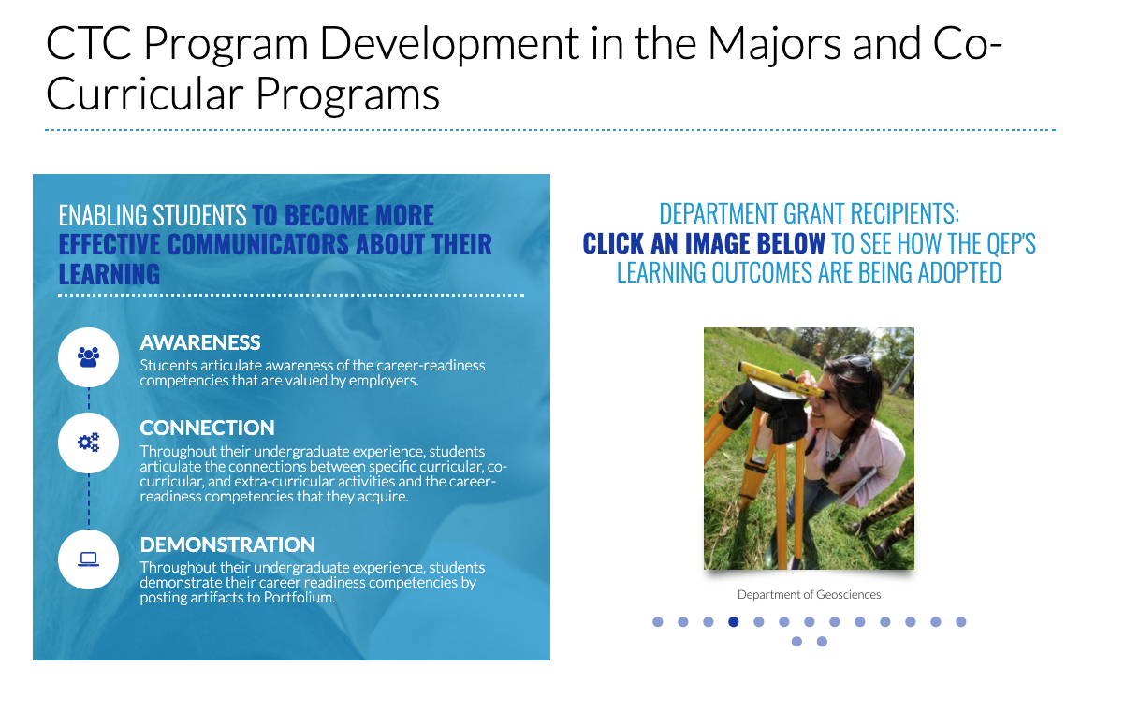
QEP funds supported 100% of GSU departments and awarded over 60 faculty fellowships.

Slide 45
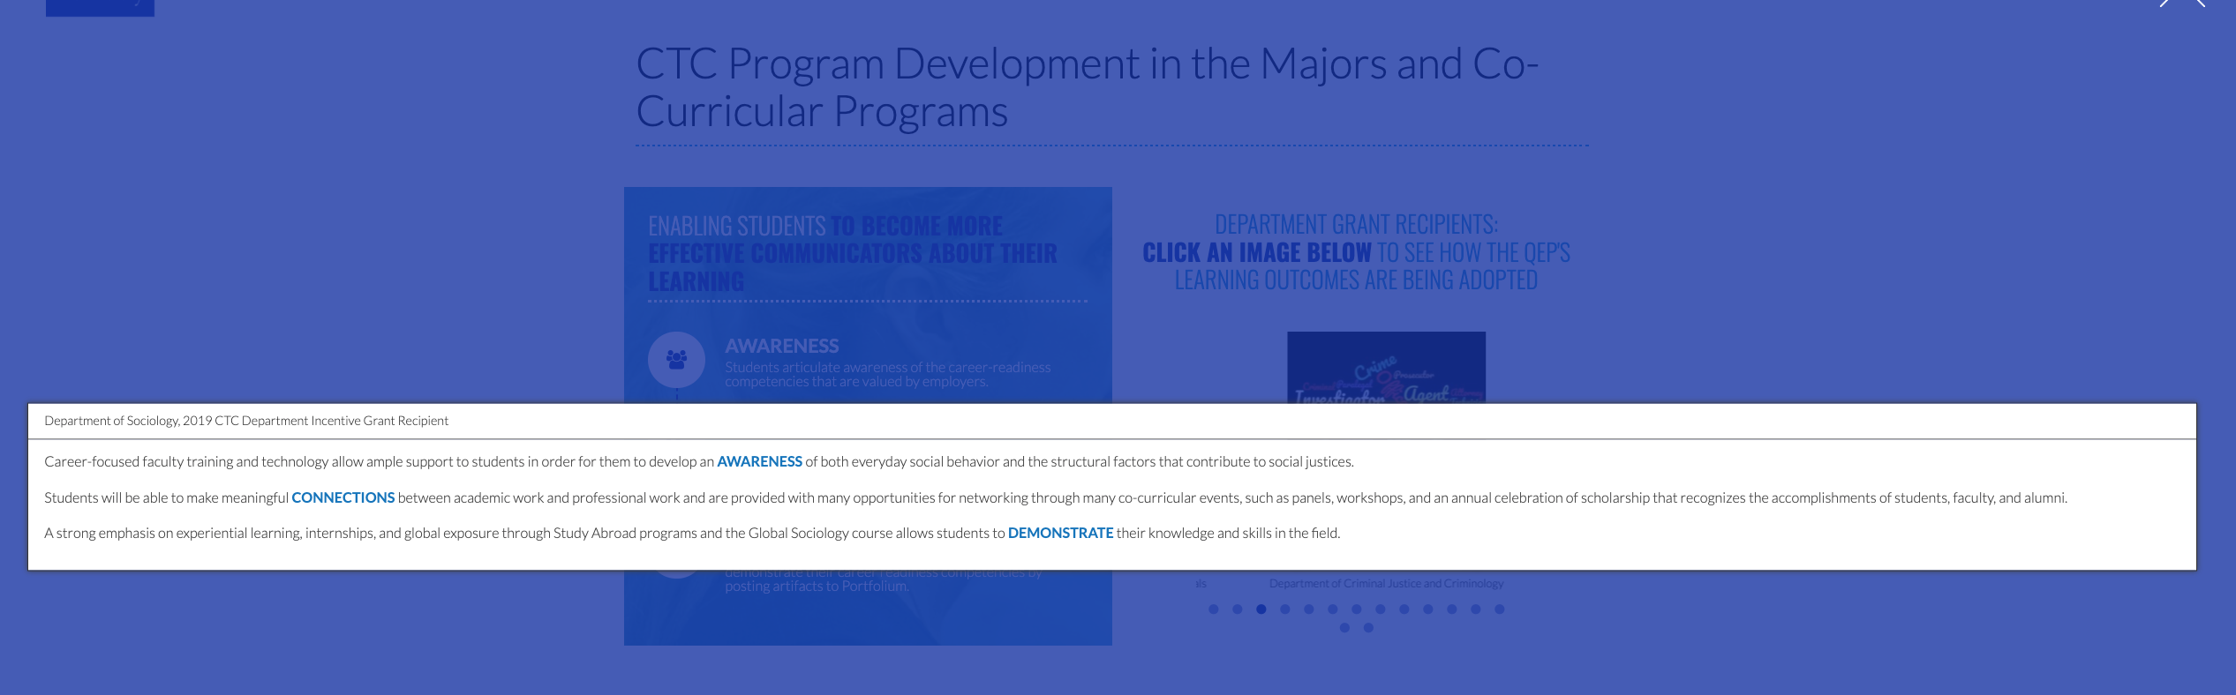
Faculty and departments highlighted their work on our CTC website and connected it to the learning outcomes: Awareness, Connection, and Demonstration.

Slide 46
Skills-Based Learning in the Classroom
Angela M. Christie, Ph.D.
Sr. Director, Educational Programs
National Institute for Student Success
Georgia State University

Slide 47
Questions?

