Slide 1
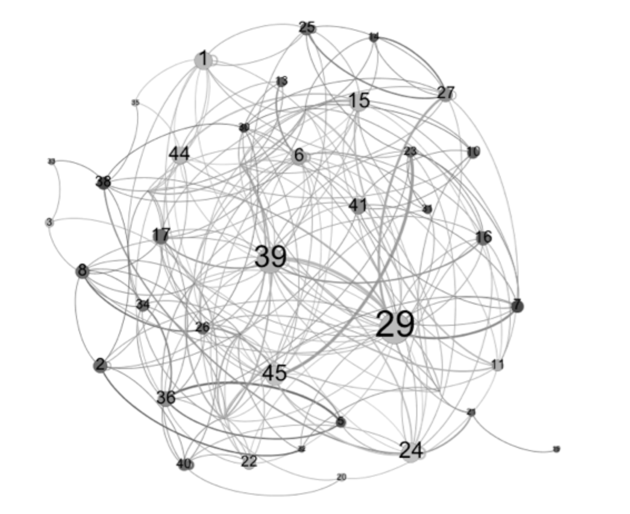
Strategic Planning for High-Impact Course Redesign
Small-World Networks in Course Design
Dr. Andrew Feldstein
Assistant Provost-Teaching Innovation and Learning Technologies at Fort Hays State University

Slide 2
About your presenter
Recovering Faculty Champion
Leads Instructional Design Team
Faculty Development Team
EdTech Ecosystem
Leads development and implementation of FHSU's Digital Master Plan
Co-Chair Student Success Pillar of Fort Hays State University’s Strategic Plan

Slide 3
Workshop Objectives
Guide administrators in developing a strategic plan for high-impact course redesign focusing on student engagement and agency
Reimagine the learning experience through a networked learning perspective
Establish priorities and resource allocation to maximize impact

Slide 4
The Digital Master Plan Journey: an uncontrolled experiment
The Pandemic Catalyst –
Spring 2020: Campus closure and transition to emergency remote teaching
Transitioned students reported feeling disconnected.
Online students shrugged

Slide 5
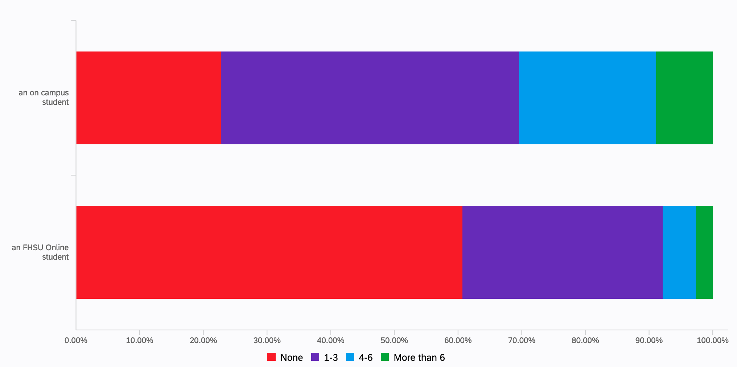
Follow-up Question (May 2021); During a typical semester, and outside of required course activities, how many classmates do you typically connect with to discuss course related subjects?
23%
61%

Slide 6
Discussion
Is this really a problem?
First, let’s talk about your students
Transformational vs. Transactional

Slide 7
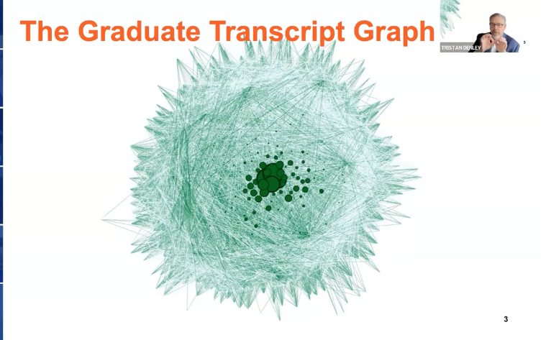
Small-World Network

Slide 8
Small World Network: Macro to Micro
Feldstein, A. P., Gower, K. (2015). Using Social Network Analysis to Explore Digital Student Interactions and Business Competency Learning in a Web-based Educational Platform. International Journal of Information Systems and Social Change, 6(1), 1-23, January-March 2015

Slide 9
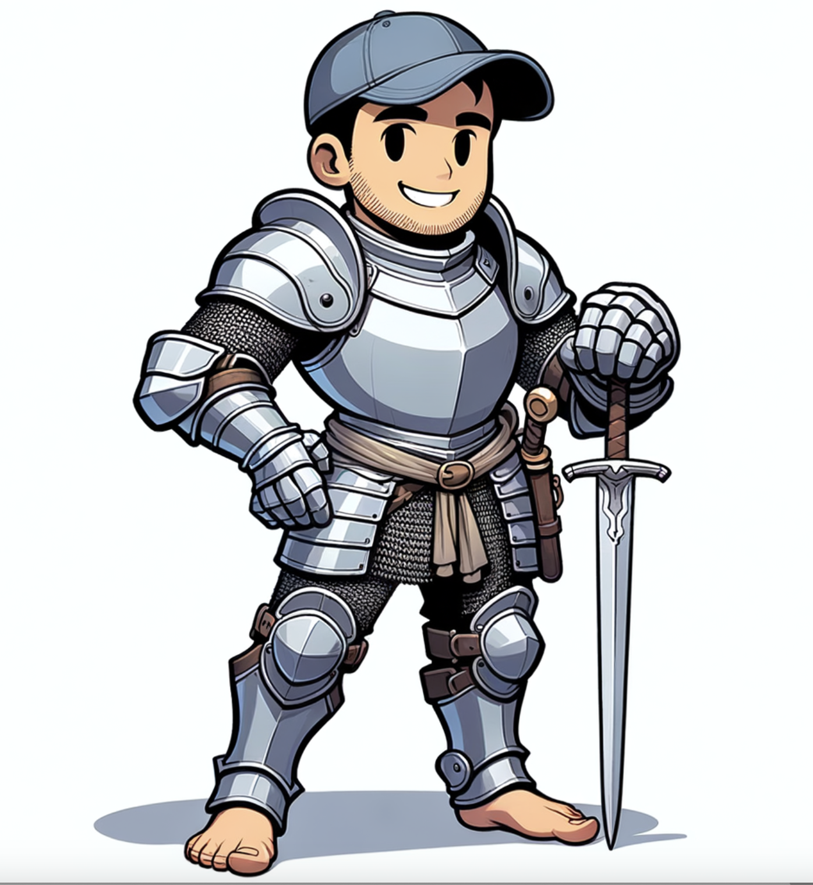
Confessions of a Former Faculty Champion

Slide 10
The Professor, the Blog, and the Stories They Tell
What do you see?
Project Interaction Network Rendered by Gephi: 44 Students in a 300-level Brand Management Course

Slide 11
Of Networks and Nodes: Looking at Network Measures
Eigenvector Centrality- health of a specific node
Clustering Coefficient- health of the network in which the node exists

Slide 12
Benefits of a High Clustering Coefficient
Enhanced Collaboration: High clustering allows for more effective collaboration and communication among learners, as they are more likely to be connected to each other.
Efficient Information Flow: Information can spread more quickly and efficiently in a network with high clustering, facilitating faster learning and knowledge sharing.
Robustness: Such networks are often more resilient to disruptions, as the interconnectedness provides multiple pathways for information flow.
Community Building: High clustering can foster a sense of community and belonging, which can enhance motivation and engagement in the learning process.
Innovation and Creativity: With more connections, learners are exposed to diverse perspectives and ideas, which can lead to greater innovation and creativity.

Slide 13
Networked Learning & Small-World Networks
Small-World Network Properties:
High clustering: Dense local connections
Short path lengths: Few steps between any two nodes
Weak ties: Bridge otherwise disconnected clusters
Efficient information flow: Balance between local structure and global reach
Networked Learning Alignment:
Collaborative knowledge creation requires both strong and weak ties
Trusting relationships develop in clustered network structures
Convivial technologies serve as infrastructure for small-world network formation

Slide 14
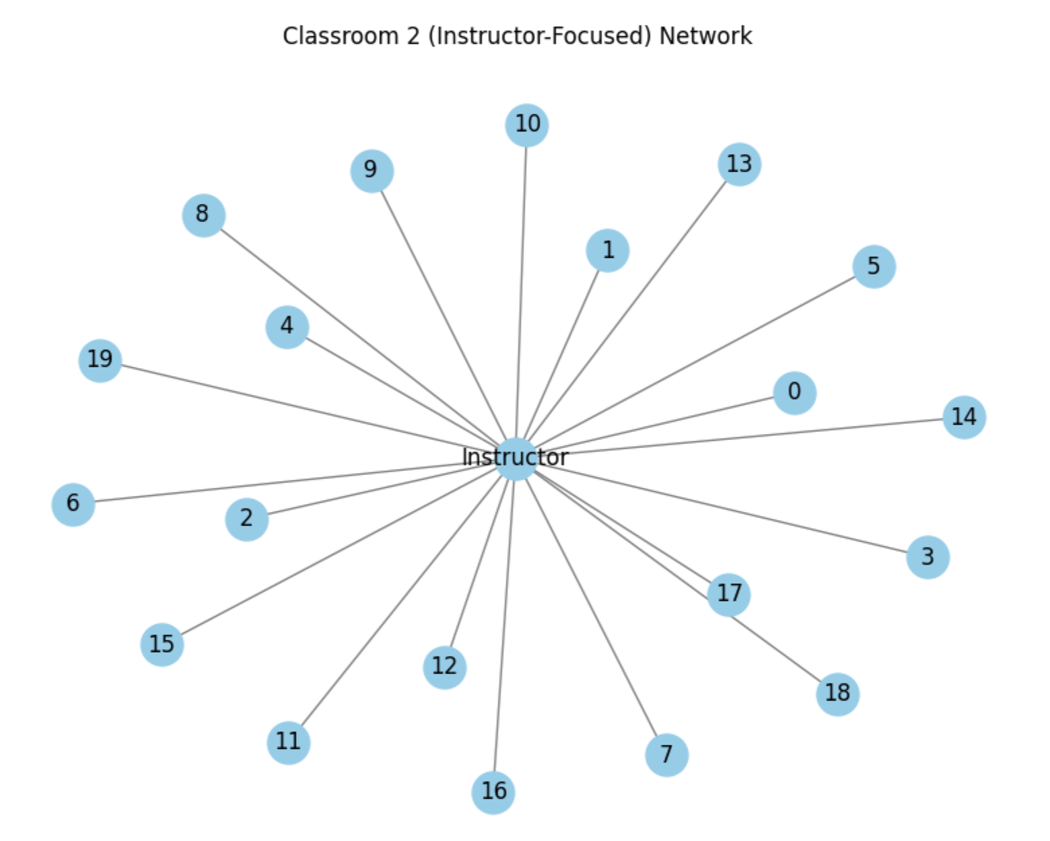
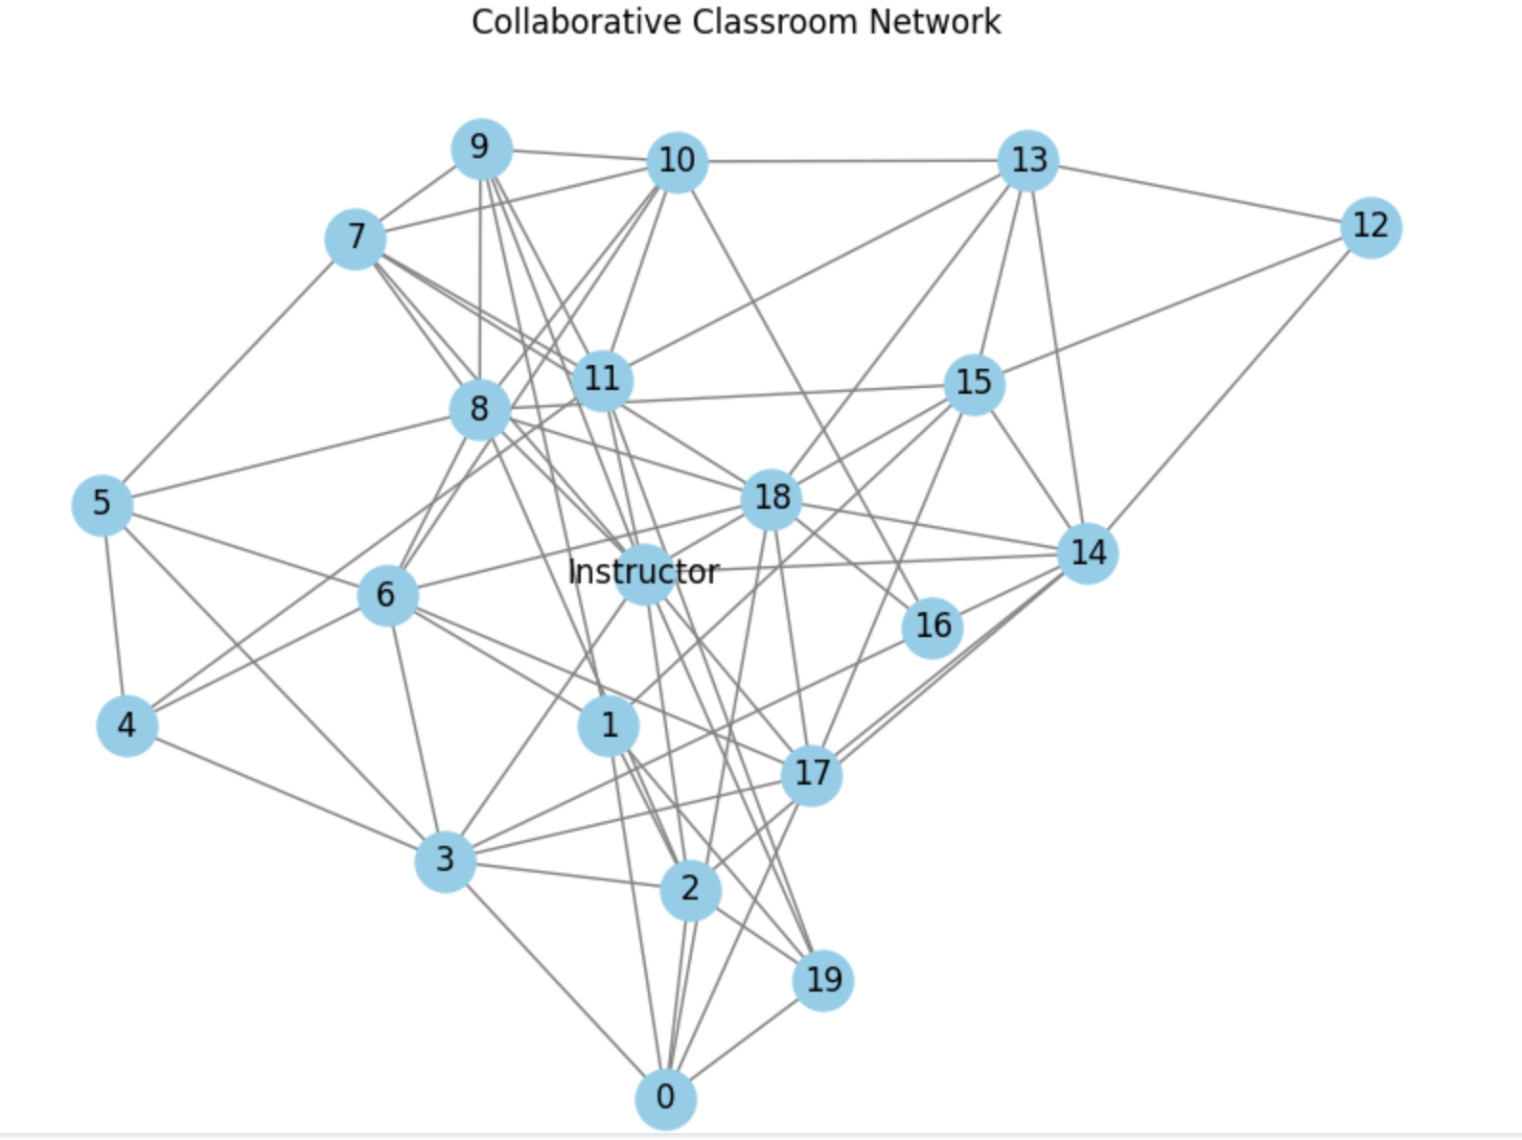
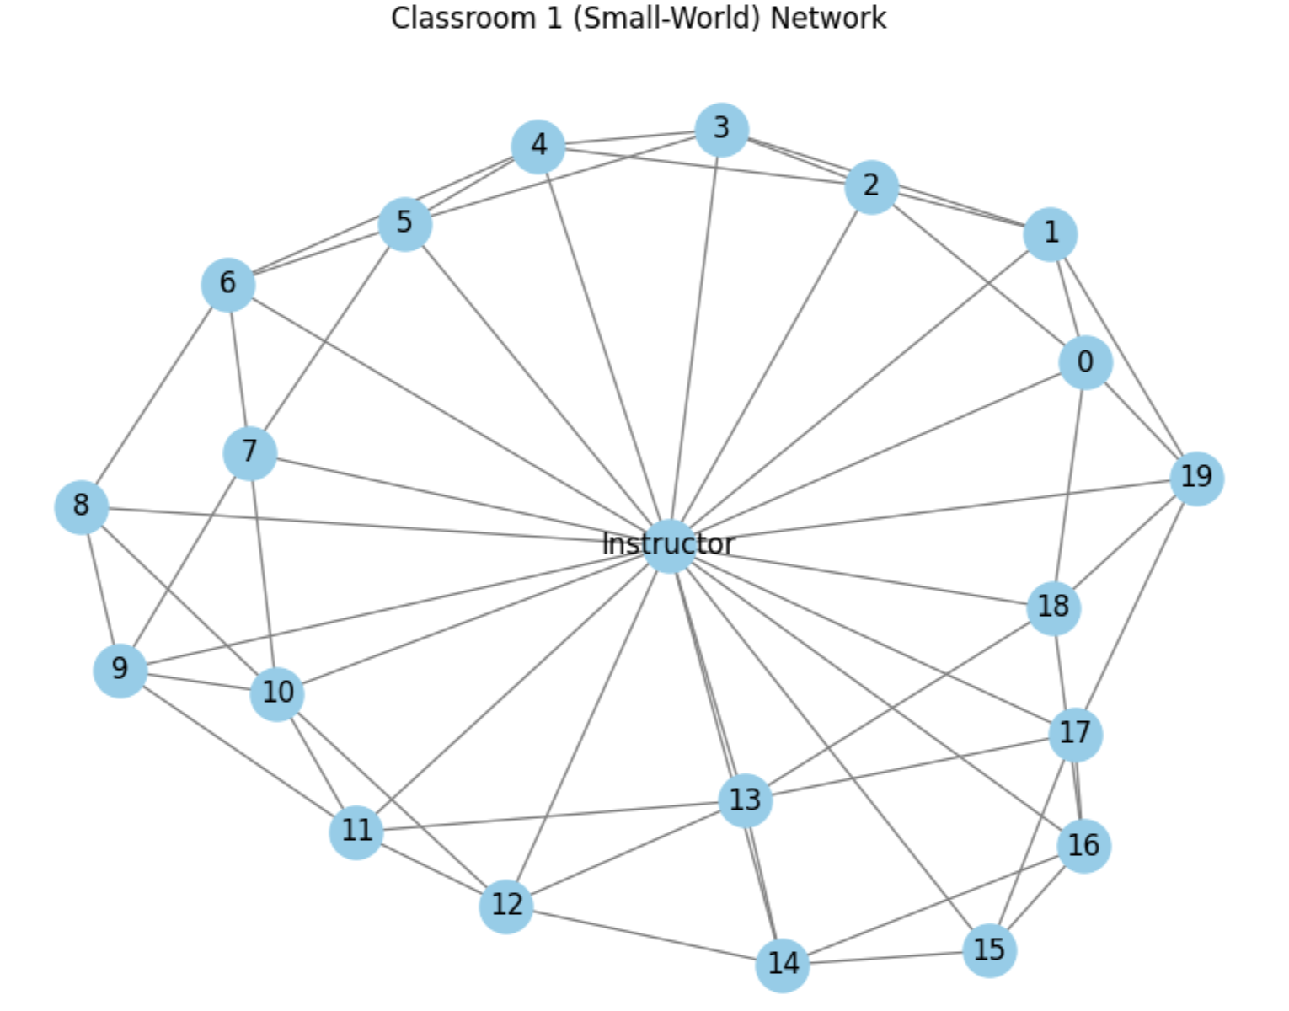
Classroom Interaction Patterns: Getting There From Here
Here
There

Slide 15
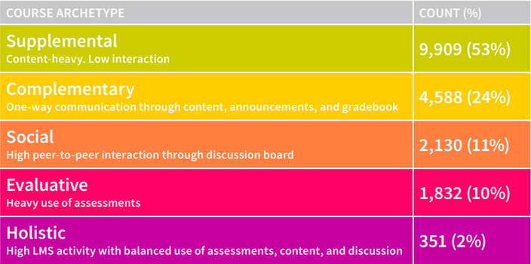
Course Design & Student Engagement
Pattens in Blackboard Learn Tool Use: Five Course Design Archetypes. J Whitmer, N Nunez, T Harfield, D Fortenza. Blackboard: Washington, DC, USA, 2016

Slide 16
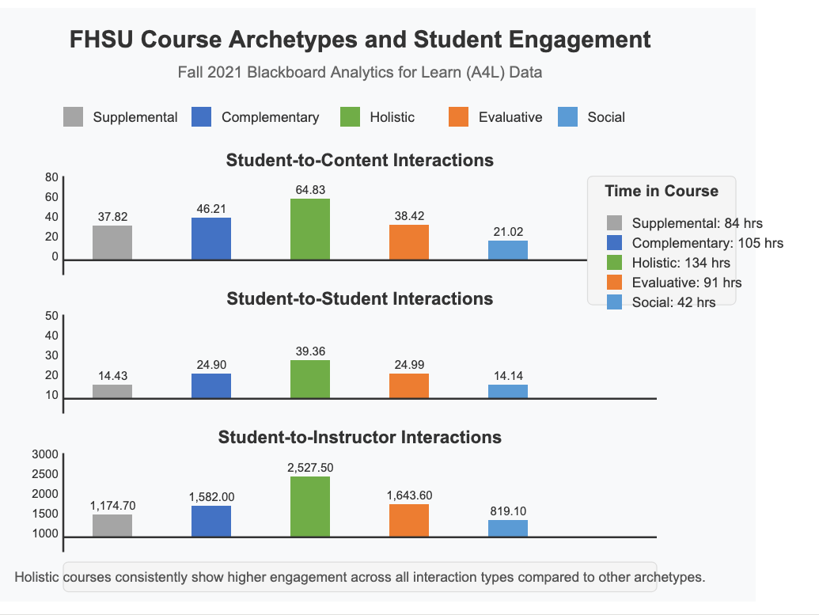
Course Archetypes: Course Design & Engagement

Slide 17
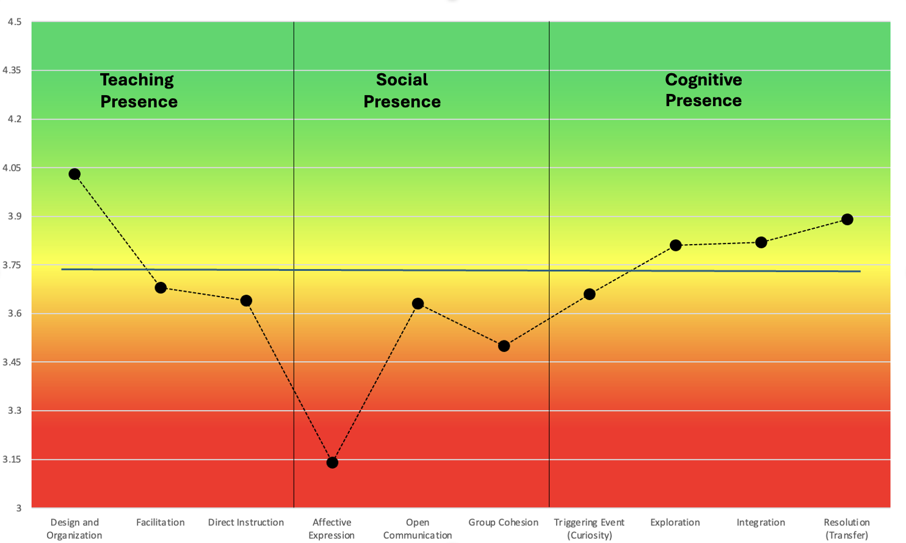
FHSU 2021 Community of Inquiry Survey Instrument
Focusing Above the Line
Course Structure & Design primarily focused on individual learning.
Perception of Teaching Presence
Students who perceived lack of social presence were more critical of instructor performance
(Arbaugh et al., 2010)

Slide 18
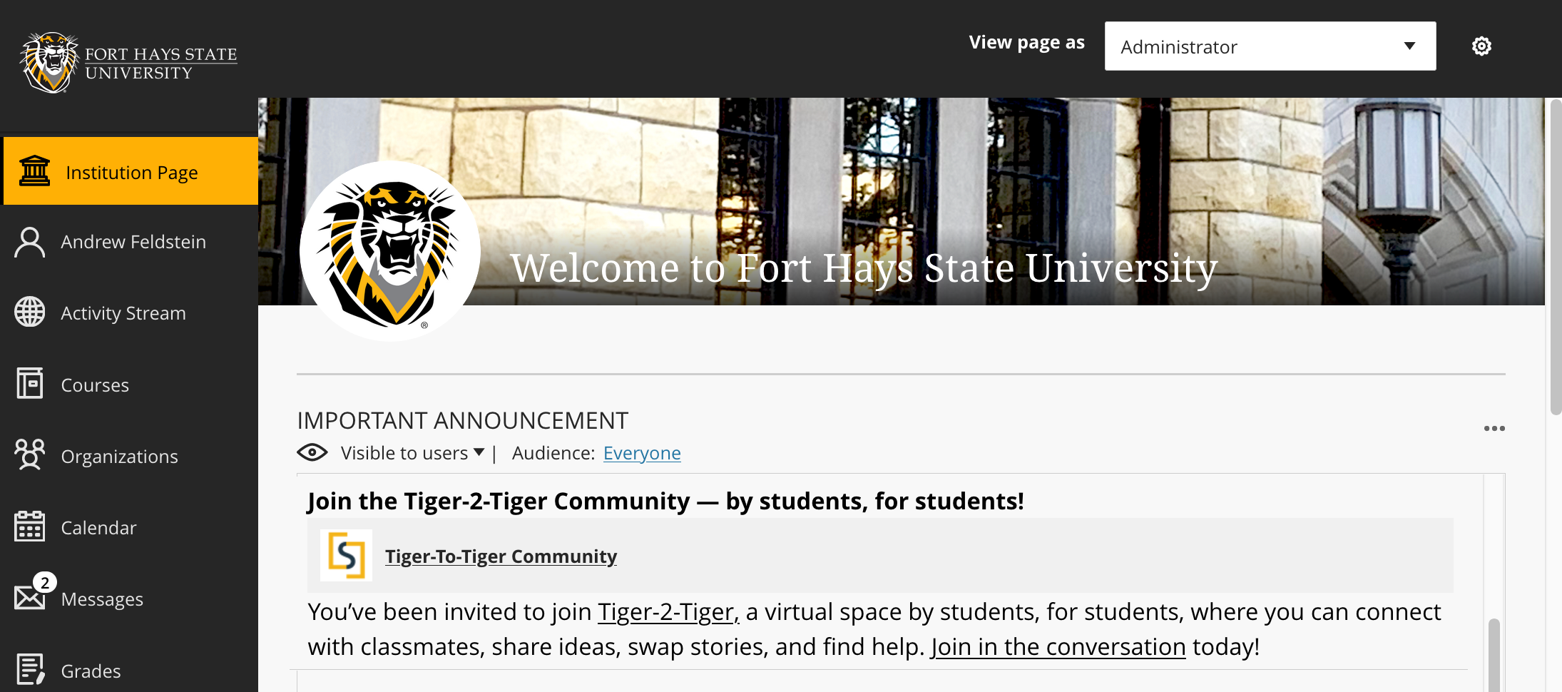


Covid Community Building: March 2021
Objectives
Create an inviting and intuitive social learning environment in which all community members can contribute, interact, and share ideas
encourage students to discover and share relevant content, exchange ideas, and, ultimately, teach and learn from one another in the social learning community
Currently 1500 plus active students monthly.

Slide 19
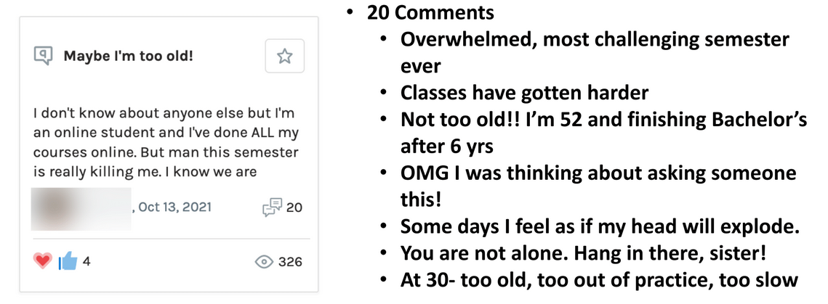
Student Engagement & Connection

Slide 20

We have work to do

Slide 21
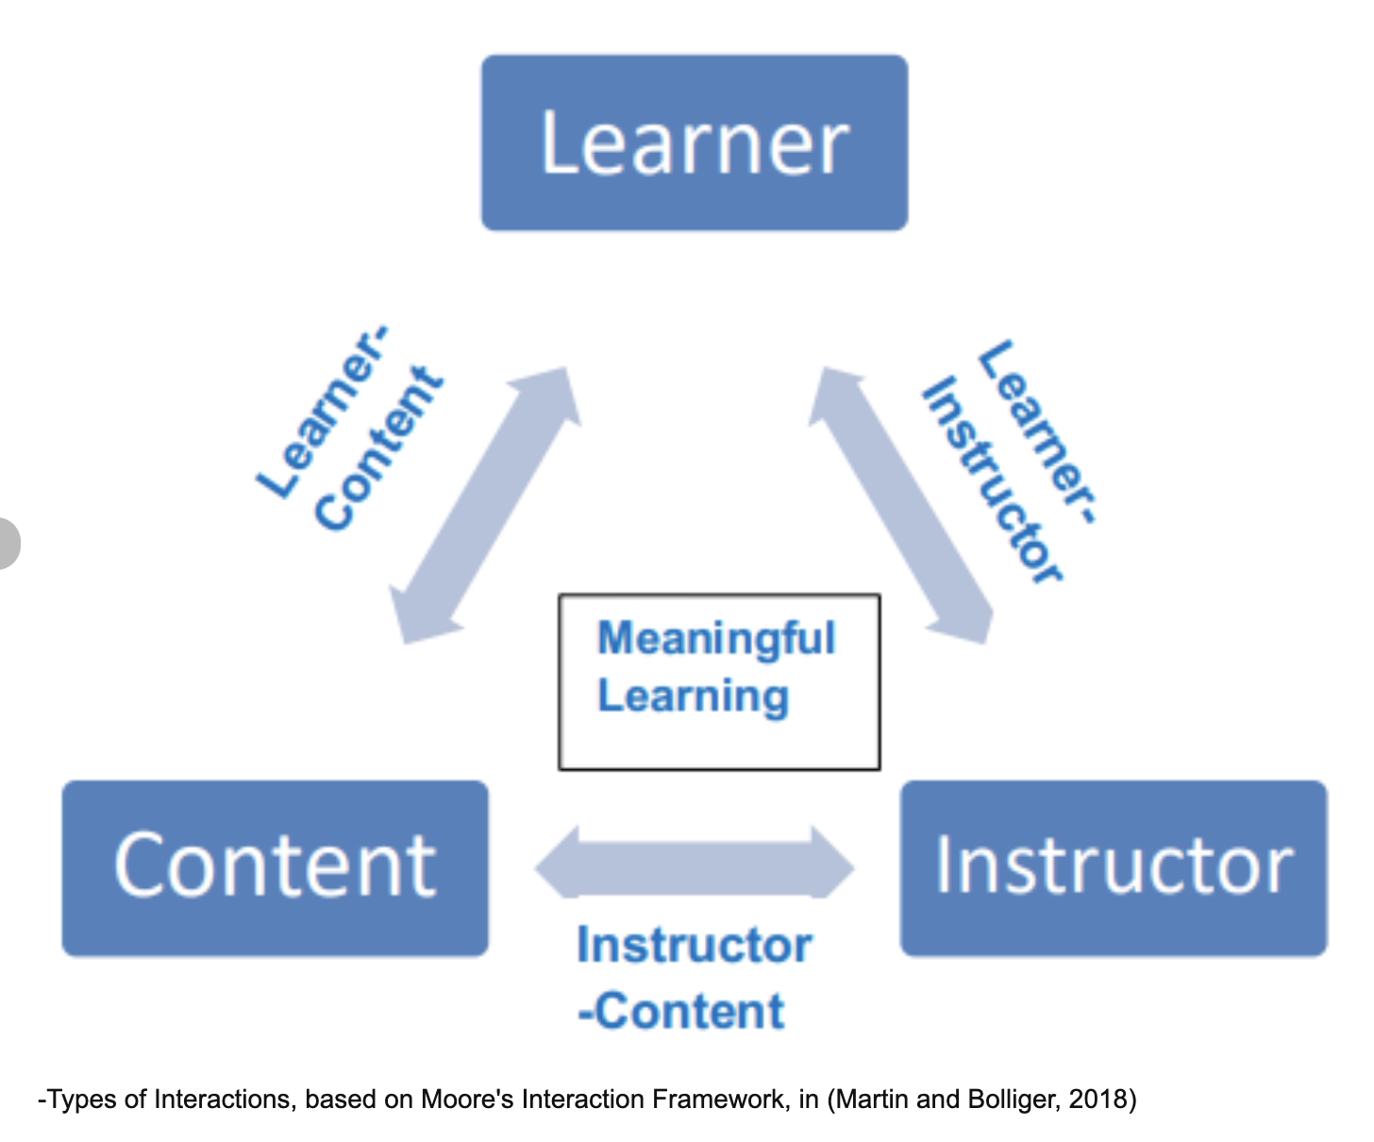
Part 2: The Digital Master Plan: From Content Delivery to Connected Learning
Let’s talk about interaction

Slide 22
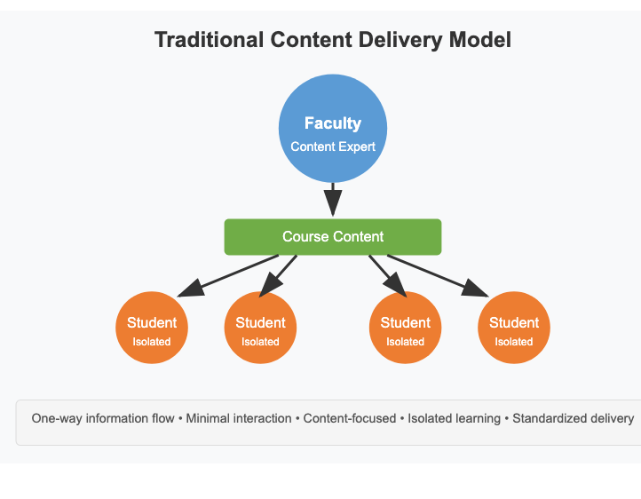
Traditional Paradigm: Content Delivery Model
This is what we support
Primary focus on transmitting disciplinary knowledge
Success measured by content coverage and recall
Student role: passive recipients of information
Online courses as isolated content repositories
Technology as one-way delivery mechanism
Learning as an individual, solitary activity

Slide 23
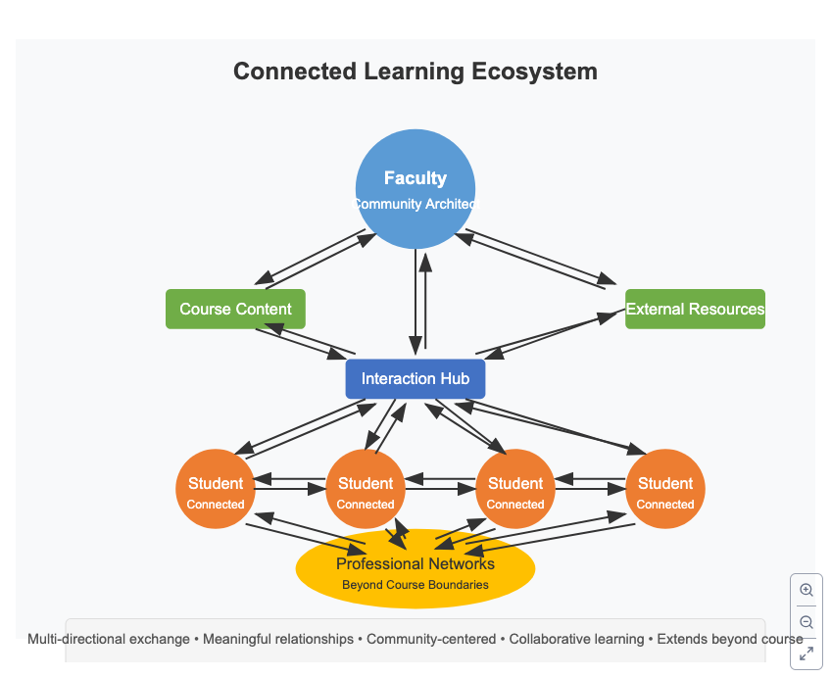
New Paradigm: Connected Learning Ecosystem
This is complicated
Primary focus on designing meaningful interactions and relationships
Success measured by engagement, connection, and collaborative knowledge building
Student role: active participants in an interconnected learning community
Online courses as nodes in a broader learning network - Technology as connection enabler and relationship facilitator
Learning as a social, collaborative, and interconnected experience

Slide 24
Paradigm Shift Barriers & Challenges
Faculty identity tied to content expertise rather than connection facilitation
Isolation of departments and lack of cross-disciplinary collaboration
Technology selected for content delivery rather than relationship building
Assessment systems that measure content recall rather than connection quality
Institutional structures that reinforce siloed learning
Other barriers?

Slide 25
The Role of the Faculty Champion
Empowerment alone ≠ successful implementation
Faculty innovation requires institutional infrastructure
Resistance thrives in the absence of systematic support
Individual champions burn out without broader buy-in
Discussion prompt: "What challenges have faculty champions faced at your institution?"

Slide 26

Creating a Digital Master Plan or a ‘digital master plan’
Vision Setting
Motivation & Strategies
Support Systems
Faculty Development

Slide 27
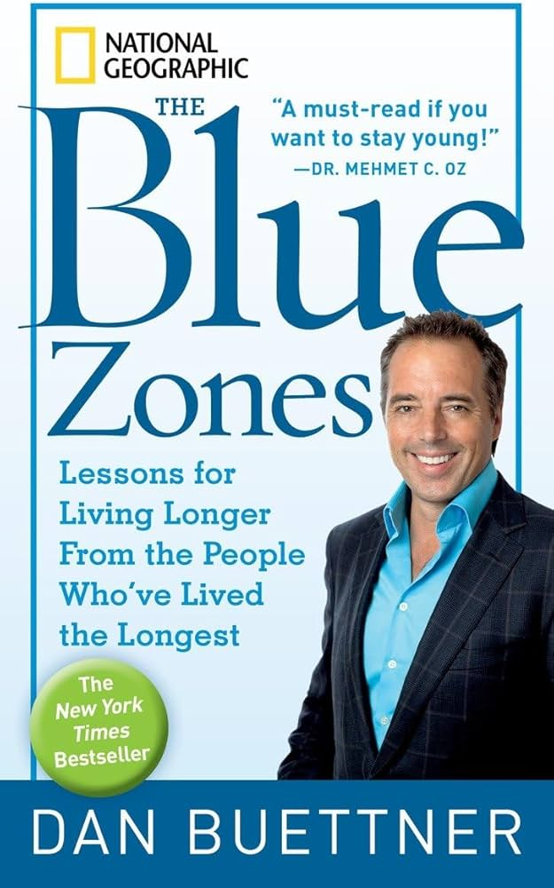
Vision Setting: Blue Zones and Digital Learning Environments
strategically designing the digital environment itself can naturally facilitate the behaviors we seek to encourage
Digital Master Plan creates an online ecosystem where meaningful interaction, collaboration, and knowledge construction become the path of least resistance
shift from focusing on individual responsibility to environmental design is particularly crucial for non-traditional online students, who often lack the time, resources, or confidence to forge connections without supportive structures in place.

Slide 28
Implementation Recommendations
Map your current learning ecosystem to identify connection gaps
Secure and support faculty champions who value relationship-building
Create connection infrastructure that spans course boundaries
Develop faculty as facilitators of meaningful relationships
Measure connection quality and its impact on success
Leverage the power of networks to amplify transformation
Build systems that sustain relationships beyond individual courses

Slide 29
Support Systems
Building the Infrastructure for Success
Technical infrastructure for interaction tools
Template designs faculty can easily adopt/adapt
Student preparation for new interaction models
Assessment tools that measure interaction quality
Administrative policies that allow for innovation

Slide 30
Resource Allocation Decisions
Faculty development and support
Technology infrastructure
Course redesign incentives
Learning analytics tools
Student support systems

Slide 31
Pitfalls to Avoid
Focusing on tools rather than pedagogical goals
Assuming faculty know how to design for interaction
Implementing without student preparation
Failing to align with reward structures
Expecting immediate, large-scale results

Slide 32
Key Takeaways
Systems thinking is essential - Course redesign is part of a larger ecosystem
Shift focus to connections and the learning process over content delivery
Learning is inherently social - Design for meaningful interactions at all levels
Faculty are community architects - Develop skills in fostering connections
Consistency in infrastructure enables diversity in relationships - Create reliable pathways for organic connections to flourish
Where will you start?

