Slide 1

Guiding Students through Meta-Majors
to Reduce Choice Paralysis
Justin Jernigan, Ph.D.
April 2-3, 2025

Slide 2
Guiding Students through Meta-Majors
Workshop Objectives
Equip faculty/advisors with strategies for helping undecided students select meta-majors based on interests and aptitudes.
Practice using structured conversation frameworks to guide students in making proactive academic choices.
Develop resources for consistent messaging on meta-majors to reduce choice paralysis and support persistence.

Slide 3
What is a Meta-Major?
At its core, an academic focus area
A collection of related majors, linked by common academic or career interests
Sometimes referred to as Focus Areas, Career Clusters, Communities of Interest or similar terms
Associated with related strategies and high-impact practices to encourage students to identify a major and persist in their studies
Designed to guide students toward the best-fit major for them – not an end in themselves (Waugh 2016)
Often associated with common courses (learning community blocks)
“Majors can be divided into categories - each with its own subcategories.” High School Guide to College (Center for Educational Partnerships, UC Regents, 2025)

Slide 4
Meta-Major Examples
Meta-Majors might include*:
Arts and Humanities
Business
Health and Medicine
Multi-Interdisciplinary Studies
Public and Social Services
Science, Technology, Engineering, and Math (STEM)
Social sciences
* Examples suggested by UC Berkeley’s (2025) High School Guide to College

Slide 5
Meta-Majors at GGC
Background Information*
GGC’s mission to "provide access to targeted baccalaureate level degrees that meet the economic development needs” of the region and to "produce contributing citizens and future leaders for Georgia and the nation."
GGC enrollment (Fall 2024): 12,245**
**Compare pre-COVID high Fall 2019: 12,831
First-year students (Fall 2024): 4,987
% of first-time freshmen passing college level English and Math in first 12 months (3-year avg.): 44.23
First-year Retention within USG (3-year avg.): 68%***
***Compare Fall 2017 cohort 1-year retention avg. 65.43%
* Source: GGC Institutional Research and Analytics

Slide 6
Meta-Majors at GGC with sample majors in each category*
Meta-Majors (Registration Code)
Business (BUSI) – Business Administration
Education (EDUC) – Elementary, Middle Grades Education, Special Education
Health professions (HEPR) – Nursing, Patient Navigation, Public Health
Humanities and arts (HUAR) – English, Cinema and Media Arts Production
Information technology (ITEC) – Information Technology
Social sciences (SOSC) – Criminal Justice, Human Services, Political Science, Psychology
Science, technology and math (STEM) – Biology, Chemistry, Environmental Science
* Integrative Studies (BSIS) is another option for students with multiple areas of interest
https://www.ggc.edu/academics/learning-communities

Slide 7
Guiding Students through
Meta-Major Choices
ACTIVITY BREAK
Orientation Task
Reflect on your own undergraduate experience
Share your responses using Nearpod on your phone or device: https://nearpod.com/student/

Slide 8
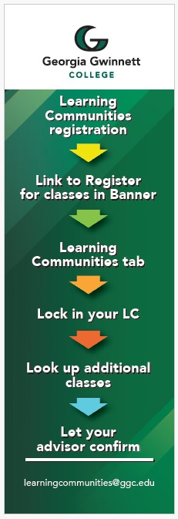
Guiding Students through
Meta-Major Choices
The Structured Conversation approach
Examples from Health Care and from around Higher Education, particularly academic advising (e.g., Shaffer & Zalewski, 2011; Paschke & Ditta, 2023; Rust & Willey, 2024)
Provides structure to guide prospective (high school) or new first-year students in selecting their Meta-Major.
Consider an adaptable form with baseline questions and prompts.
Include major and career examples for each Meta-Major. Early use of major and career choice tools can be helpful here – work with Academic Advising and Career Services.
Add explanatory definitions for key academic terms that may be unfamiliar to new students.

Slide 9
Guiding Students through
Meta-Major Choices
The Structured Conversation (cont.)*
◦ Can you describe your potential major, what you will learn, and the types of careers it will prepare you for?
◦ Do classes in your potential major (or meta-major) emphasize discussion? Lecture? Problem-solving?
◦ Do the typical course titles sound interesting?
◦ How much do you enjoy the high school courses recommended for students who plan to choose this major?
◦ How important to the major are skills in math? In reading? In writing? In research?
◦ How specialized is the major? Will you learn a lot about a little or a little about a lot?
◦ Is the major interdisciplinary (connecting many subject areas) or focused on one discipline/subject area?
◦ Is this a career-oriented major? Will it prepare you for a specific career or help you build general skills?
◦ Can you see yourself in one or more of the related careers for the meta-major you are considering?
*Suggested items adapted from Center for Educational Partnership, UC Regents (2025) High School Guide to College

Slide 10
Meta-Major Toolkit
Checklist for faculty and advisors
Guides and Tools, based on student's stage of progression:
  Degree guides, Academic Maps, Degree audit
  List of meta-major coursework that will work for all majors or groups of majors (see BoR USG, 2021).
Structured Conversation form
  Include recommended next steps for students
Support Resources for students
Key contacts to resolve questions
Data, predictive analytics where possible, for continuous refinement
Other tools for the toolkit?

Slide 11
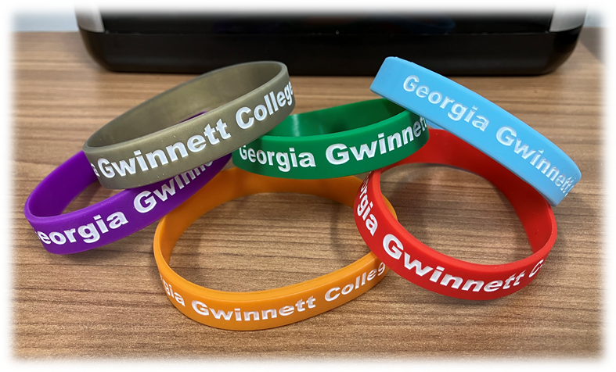
Meta-Majors and Belonging
Student belonging has been positively correlated to persistence in course study. (Allen, et al. 2021)
Researchers recommend institutions “offer a variety of platforms for engagement and connection” to enhance student belonging. (Pinto, Mjoen & Reed, 2024)
Consider establishing traditions that enhance student belonging.

Slide 12
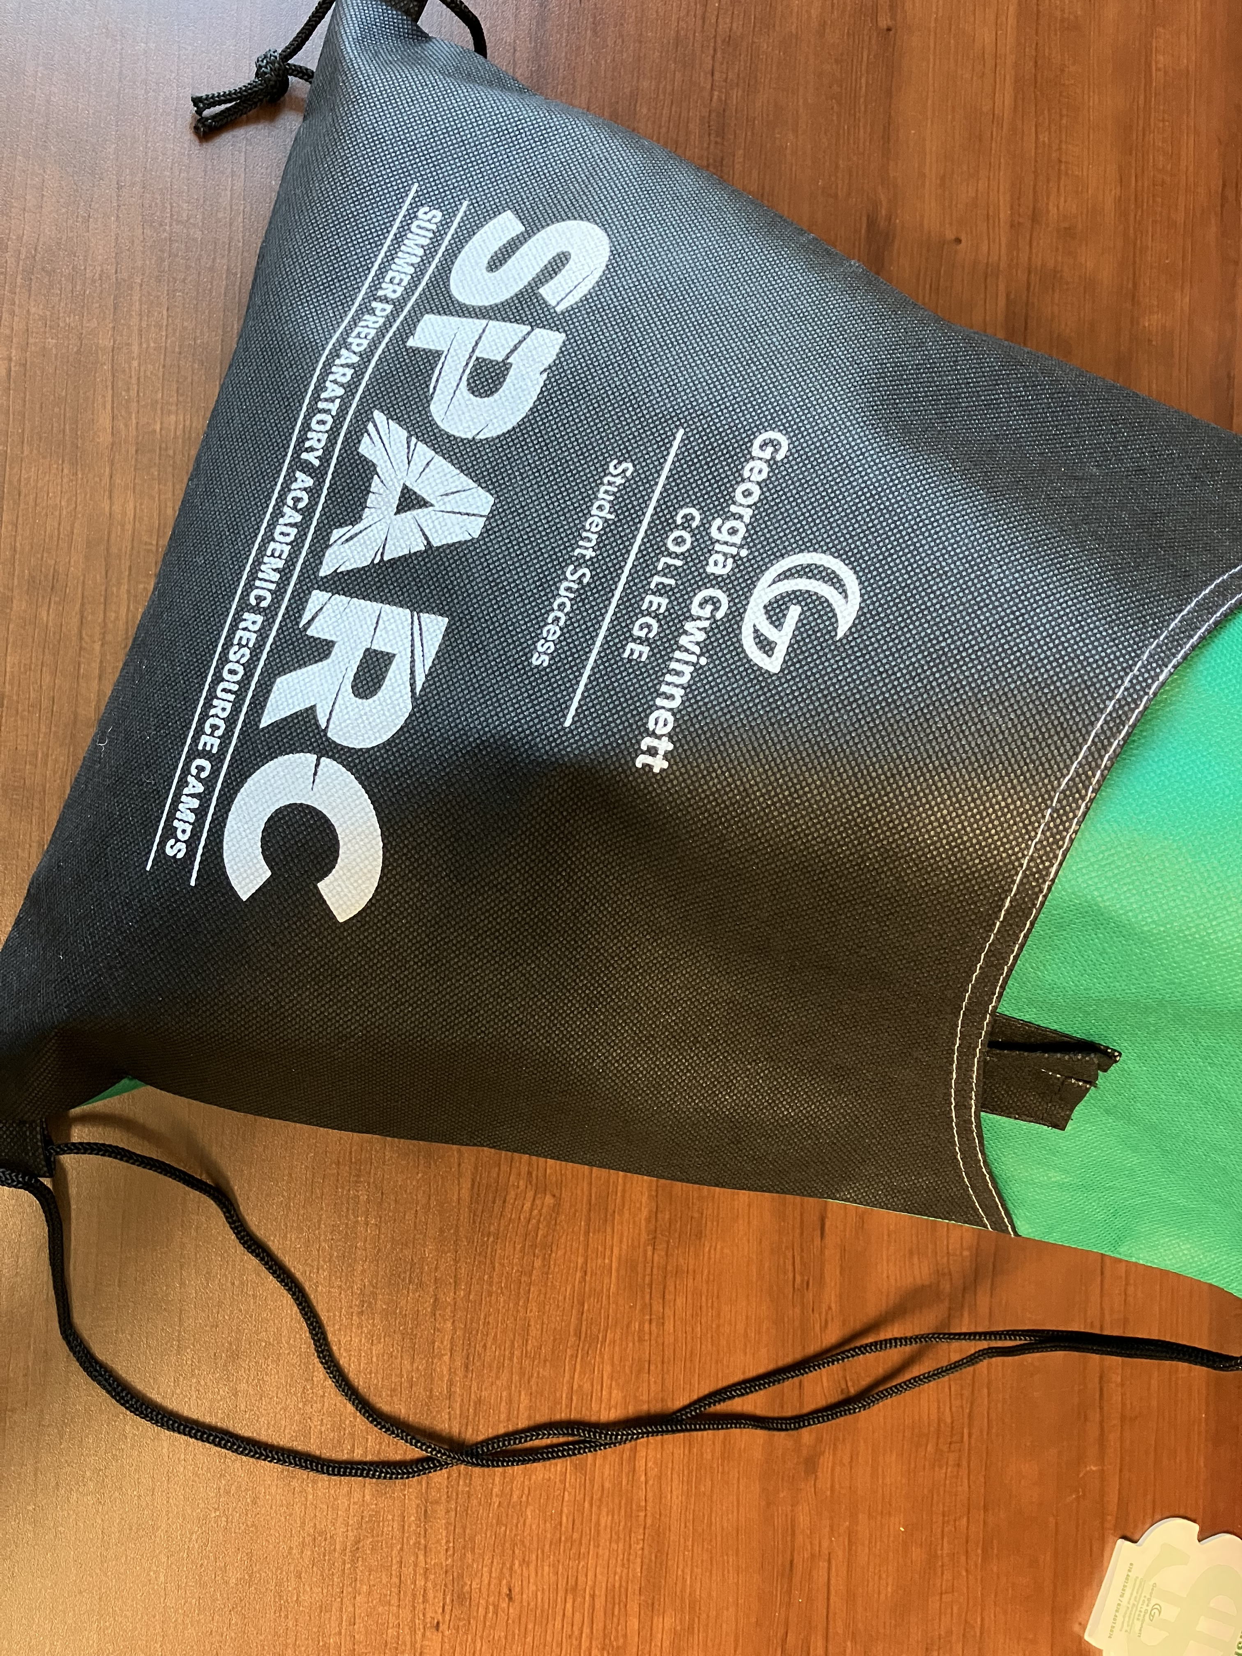
Program Example: SPARC
SPARC (Summer Preparatory Academic Resource Camps)
Connected with GGC’s Learning Communities strategy, aligned with College’s Strategic Plan.
Reinforces students’ Meta-Major choice and sense of belonging.
Collaborative program, including Student Success, Student Affairs, each Academic School, Career Services, and more.
Program features include:
  Meeting with the respective Dean for the Meta-Major and
  Meta-Major color-coded wristbands (associated with graduate discipline area hood colors).

Slide 13
Meta-Majors:
Related Success Strategies
First-Year Experience course (BoR USG, 2021)
First-Year learning communities (BoR USG, 2021)
  Living-learning communities (LLCs)
Advising structure – Proactive Advising design
Communications strategies
Continuous improvement, training, and development in the field (see, e.g., NACADA’s Research Center at https://nacada.ksu.edu/Resources/Research-Center.aspx)

Slide 14
Meta-Majors: Next Steps
Taking Meauxmentum to your Campus…
Advising structure: Proactive Advising
Assessment plan
Communication plan
Collaboration plan – Consider the range of stakeholders to include
Complementary programming:
  First-Year Experience course
  First-Year learning communities
    Living-learning communities (LLCs)
Task Force
Other strategies

Slide 15

Meta-Majors: Next Steps
Taking Meauxmentum to your Campus…

Slide 16
References
Allen, K. et al. (2021) . Belonging: a review of conceptual issues, an integrative framework, and directions for future research. Australian Journal of Psychology, 73, 87-102. https://doi.org/10.1080/00049530.2021.1883409
Board of Regents of the University System of Georgia (2021). Complete College Georgia Guided Pathways. Accessed at https://completegeorgia.org/content/guided-pathways-success
Georgia Gwinnett College (2025). GGC Data. Accessed at https://www.ggc.edu/about-ggc/institutional-research-and-analytics
NACADA (2025). NACADA Center for Research at Kansas State University. Accessed at https://nacada.ksu.edu/Resources/Research-Center.aspx
Paschke, J. & Ditta, A. (2024). Improving Flipped Academic Advising. NACADA Journal, 44:2, 110-122.
Pinto, A., Mjoen, O. & Reed, N. (2024). Beyond the first week: sustaining the feeling of social inclusion and sense of belonging for students. International Journal of Qualitative Studies on Health and Well-Being, 19, 1-11.
Rust, M. & Willey, E. (2024). Defining and Institutionalizing Proactive Advising. NACADA J., 44:2, 83-109.
Shaffer, L. & Zalewski, J. (2011). A Human Capital Approach to Career Advising. NACADA J., 31:1, 75-87.
UC Regents (2025) . Center for Educational Partnerships, High School Guide to College. Accessed at https://cep.berkeley.edu/cep-guide-college/high-school-guide-college.
Waugh, J. (2016) . Meta-Majors: An Essential First Step on the Path to College Completion. Boston: Jobs for the Future.

