Slide 1

Designing Meta-Majors to Streamline Pathways
Dr. Colleen Knight
Interim Assistant Vice President for Academic Student Engagement
College of Coastal Georgia
University System of Georgia

Slide 2
Objectives
Design a plan to develop meta-majors/focus areas that streamline purposeful choice, minimize excess credits, and support retention.
Establish a process for aligning meta-major core curricula and developing program maps.
Set benchmarks for measuring meta-major effectiveness.

Slide 3
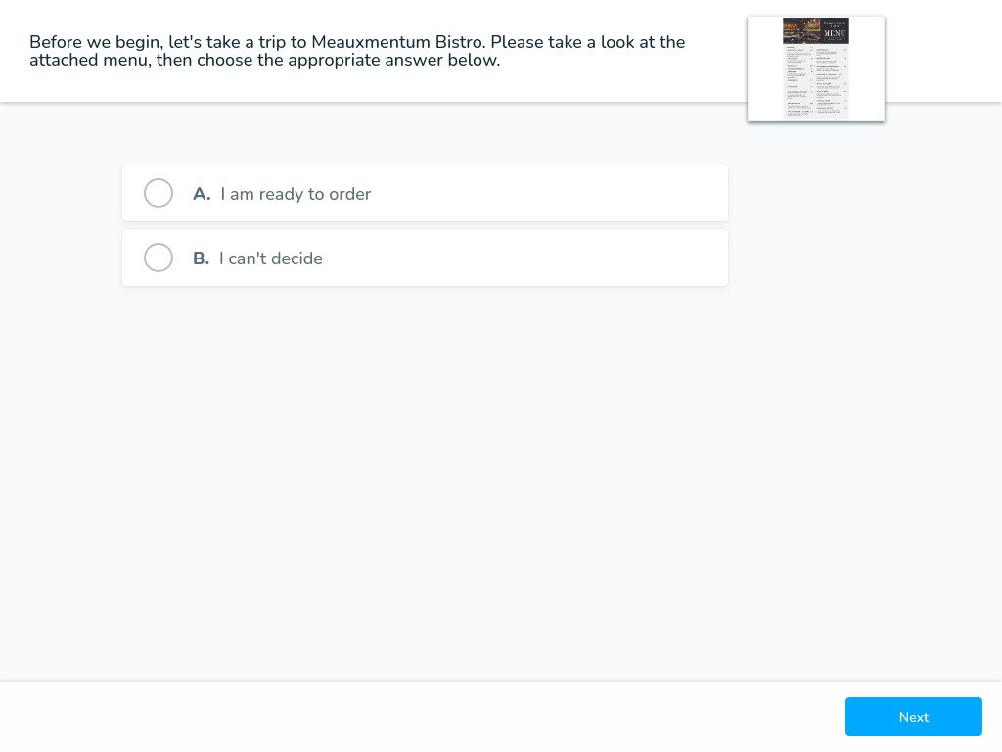
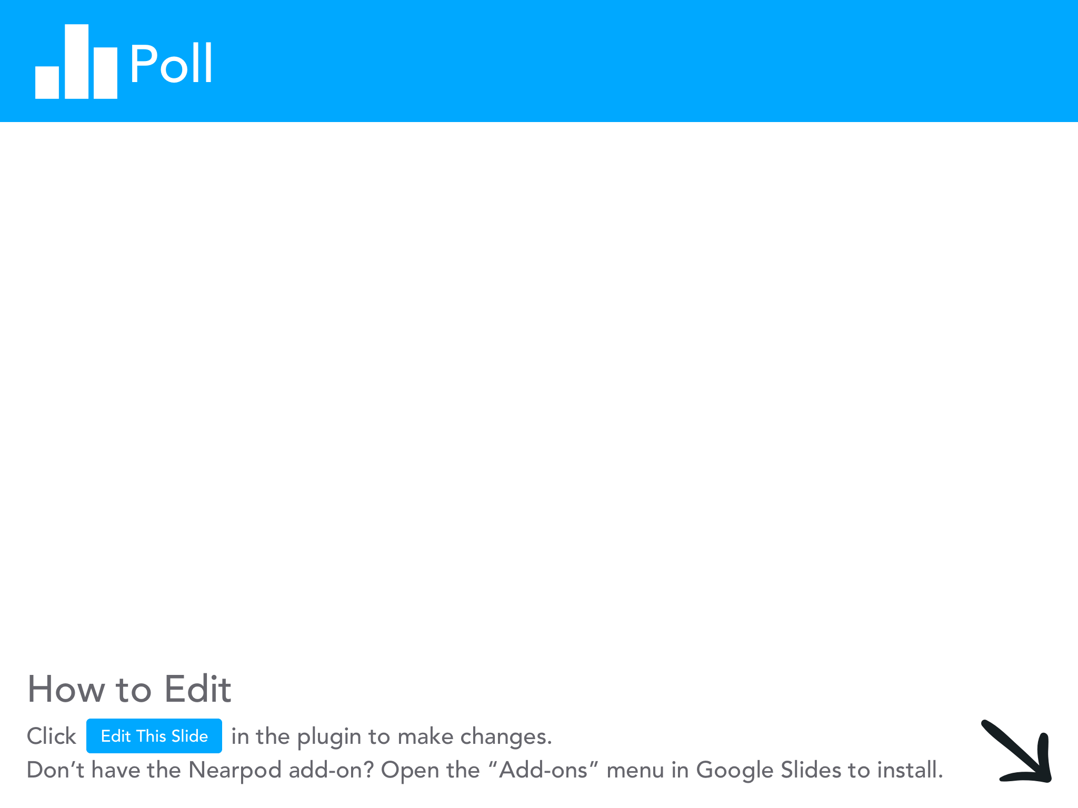

Slide 4
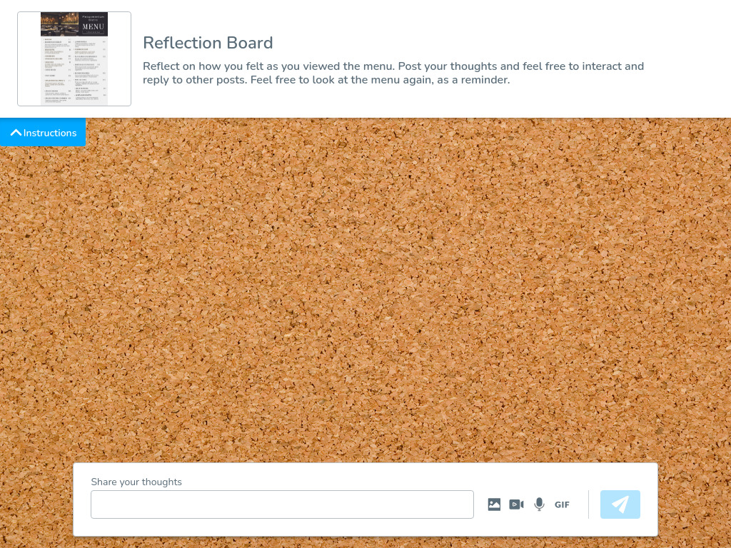
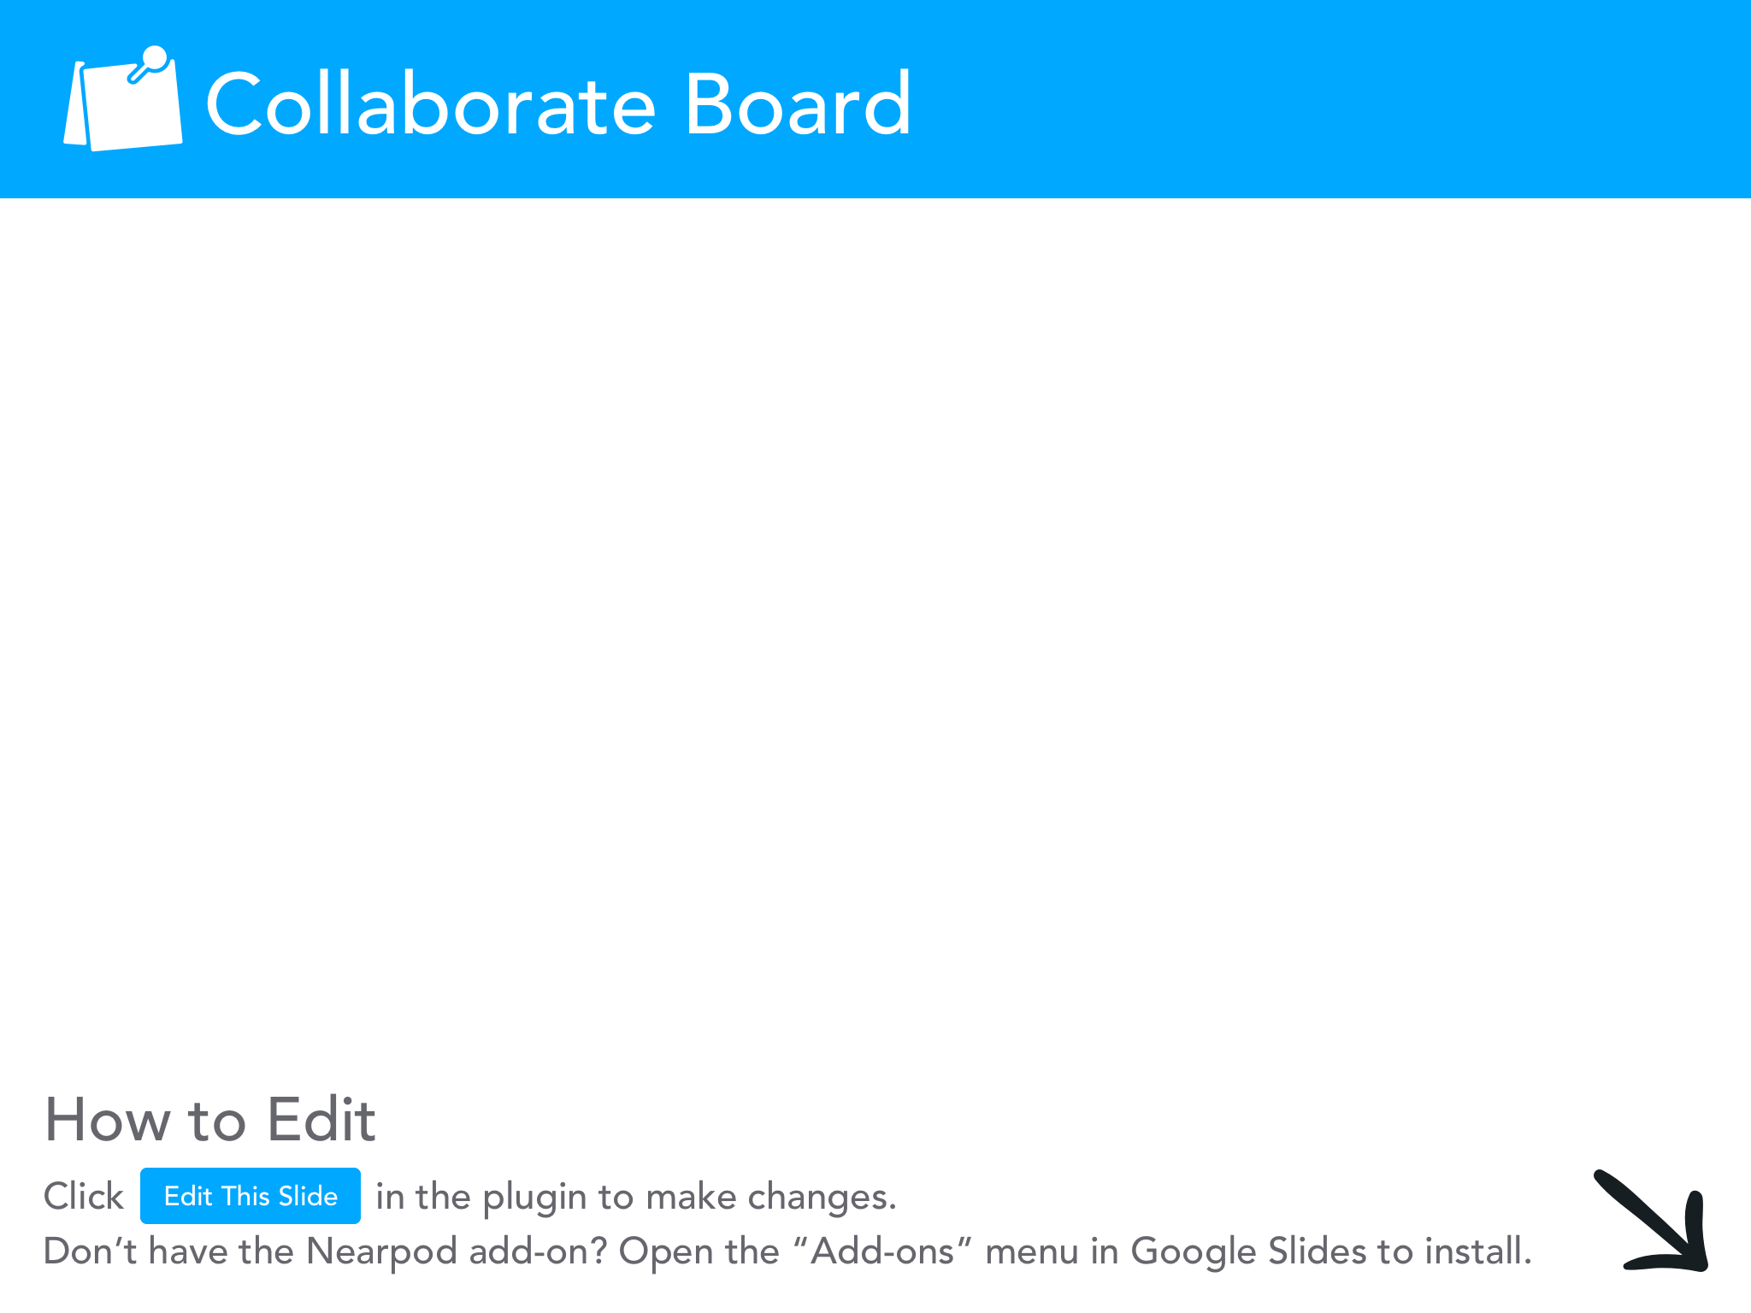

Slide 5
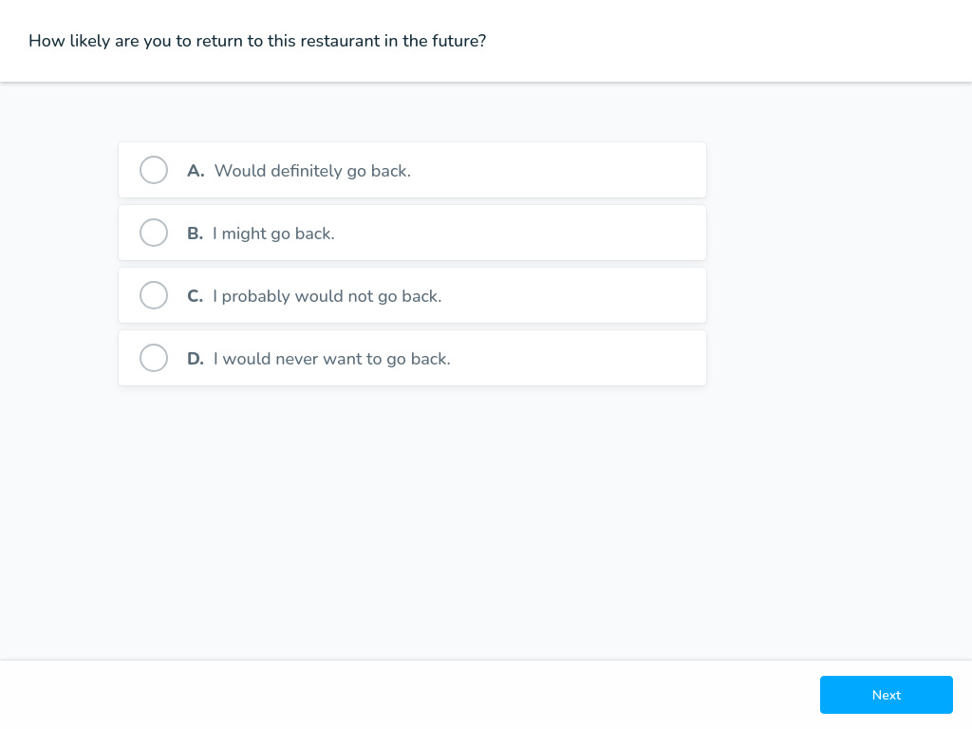

Slide 6
Reflections on our Bistro Visit
When you return to your institution, fill out an application. Understand the student experience.
Notes:
Food is at least familiar to us, but students may not know anything about your school
This is the first impression as they apply to your institution. Does this foster a sense of belonging?

Slide 7
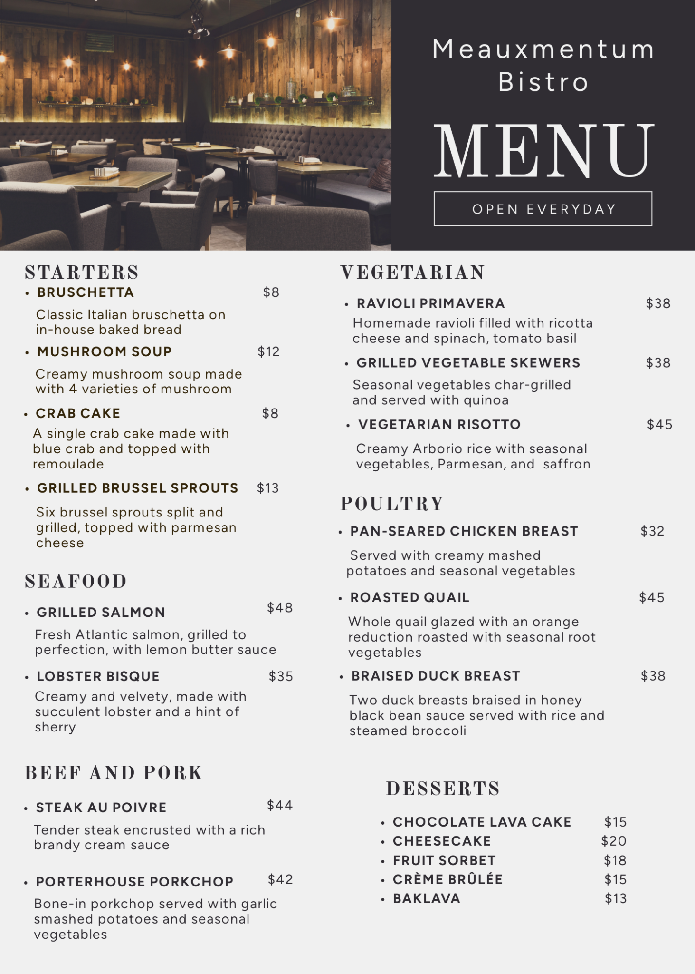
Organize your “menu” so that what you offer (and what they want) is easier to find.

Slide 8
Key Principles to Consider
Making it easier for students to find what they need.
Guiding students to make a purposeful choice.
Reflect on how majors are presented at your institution on the application and in the catalog. Share with us how they are currently organized.
Notes:
If degrees are organized by school, remind the attendees that most students do not understand the structure of an institution. It is likely not best practice to divide by schools/colleges.

Slide 9
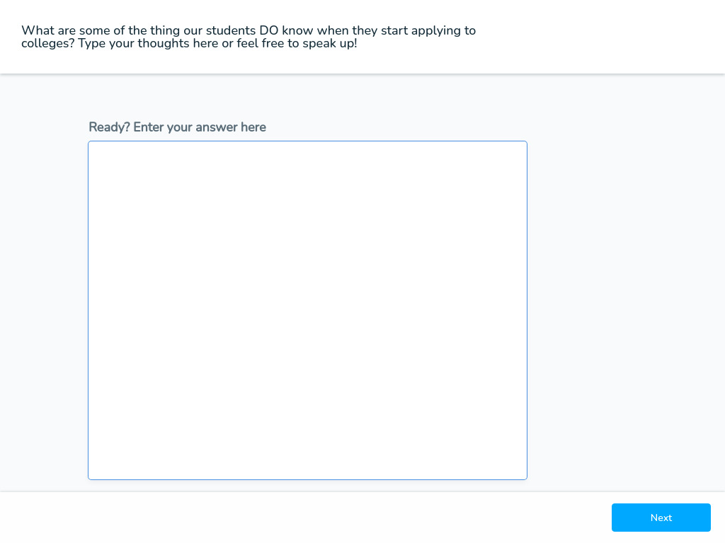
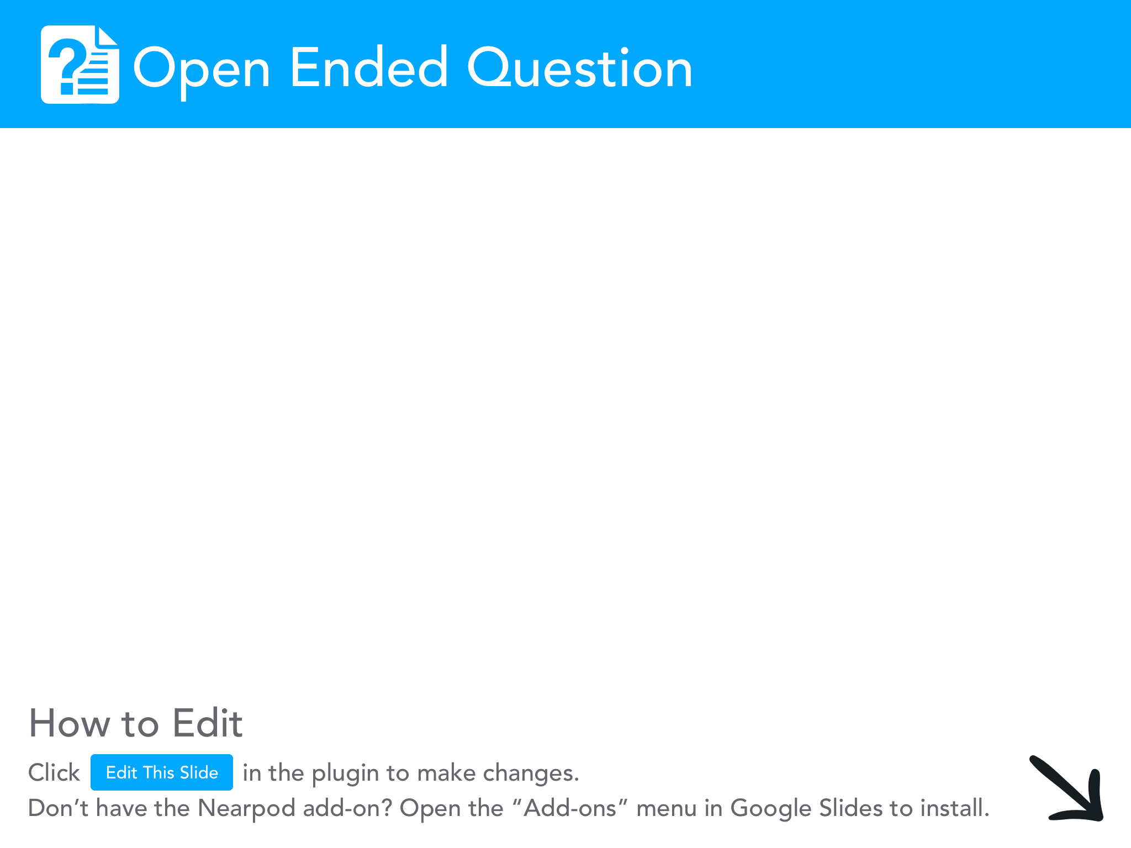

Slide 10
What are the steps you will need to take at your institution to reorganize your programs in a way that is student-focused and will guide purposeful choice?
Reach out to programs and determine what jobs/careers are the usual outcomes of their degrees.
Start with careers, then groups majors, then develop the meta-majors/focus areas.
Notes:
Note that seeing related majors in a meta major is also a learning opportunity. By seeing related programs they can see the connections between disciplines

Slide 11
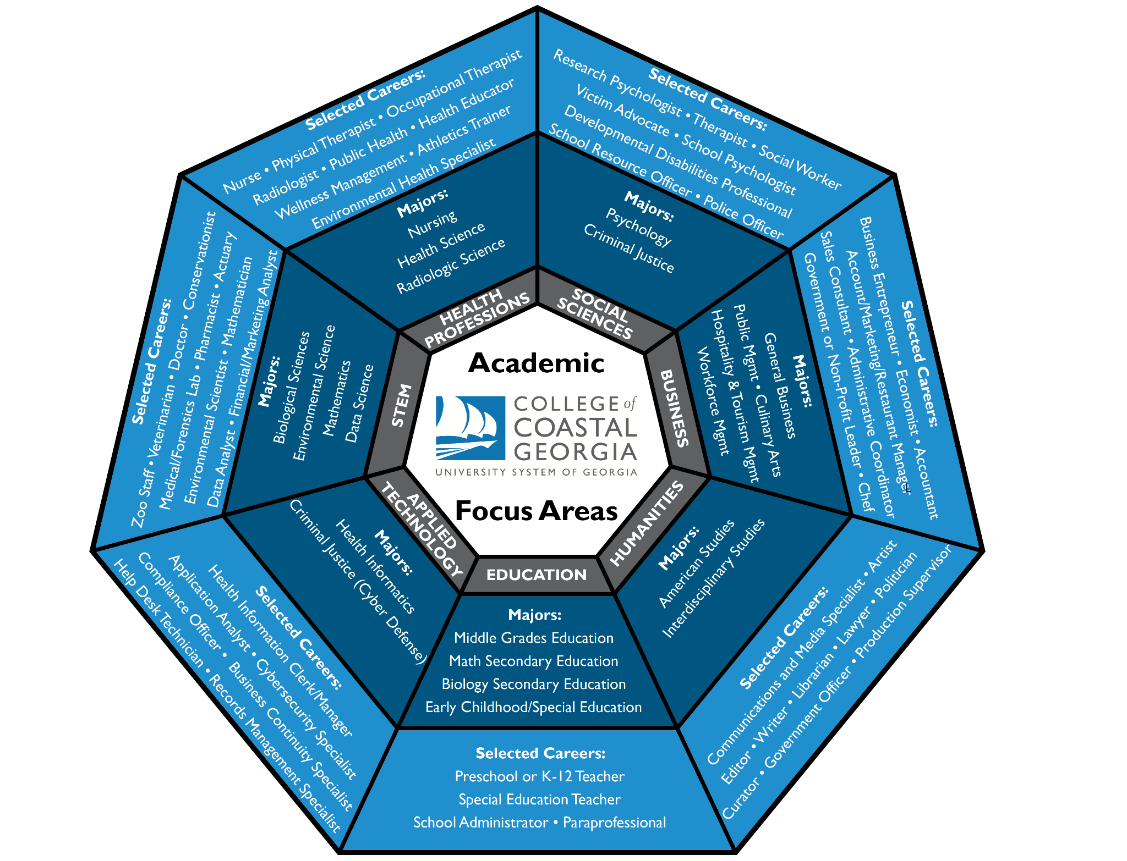
3 Schools
9 Departments
18 BS/BA Programs
3 Career AA/AS Programs
Notes:
Note that seeing related majors in a meta major is also a learning opportunity. By seeing related programs they can see the connections between disciplines

Slide 12
Who do you need to contact on your campus?
Start your list of who to contact and begin crafting your communication. Feel free to chat with others.

Slide 13
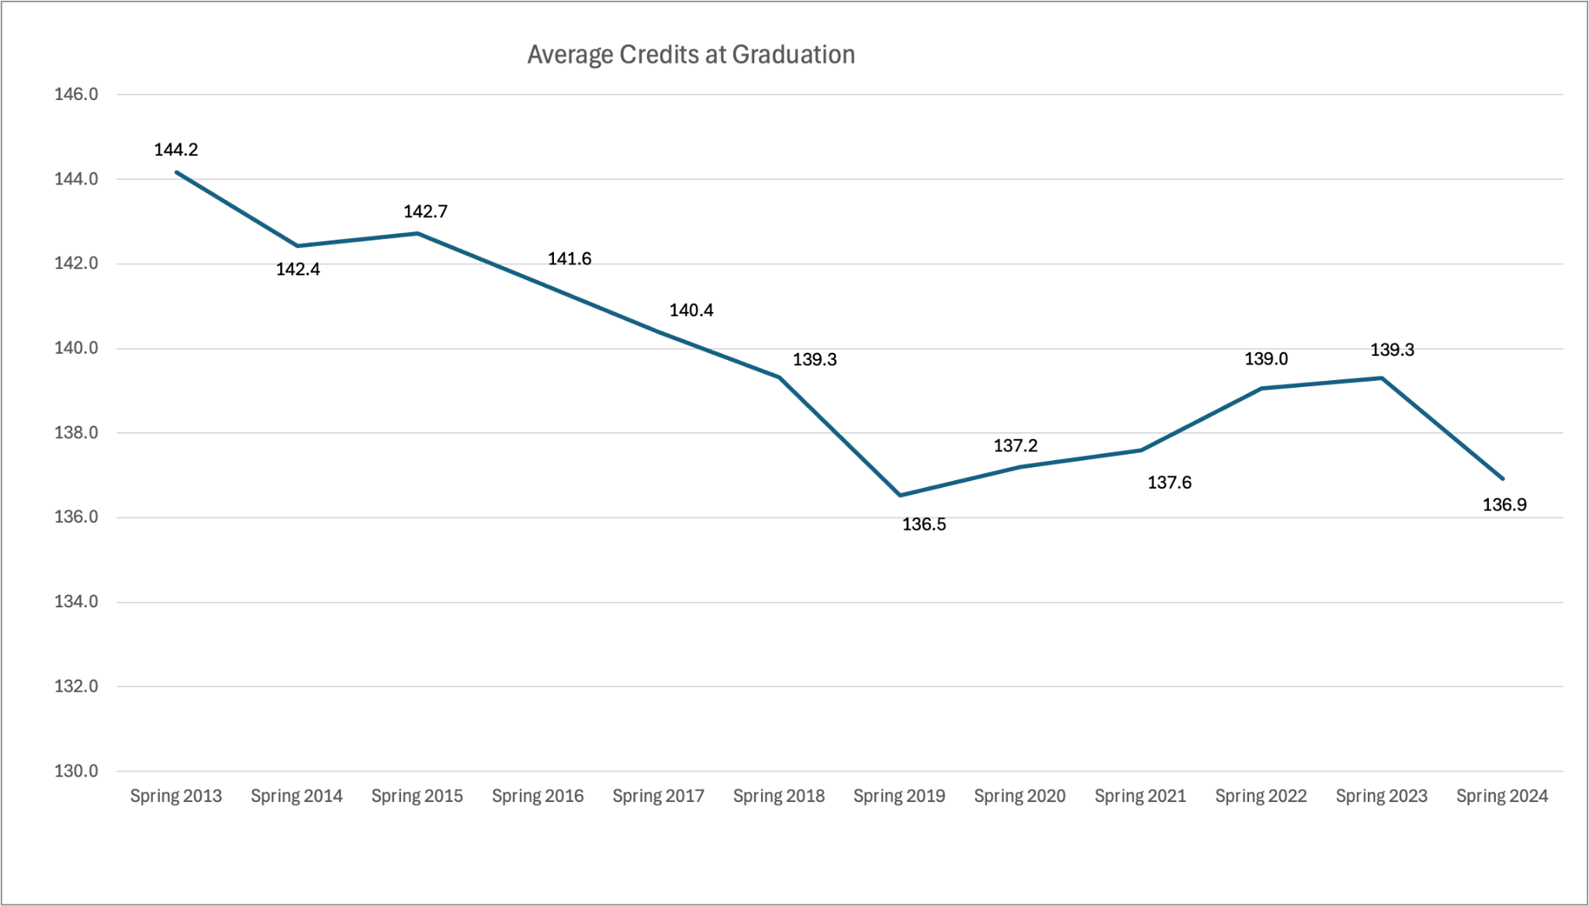

Outcomes of Implementing Focus Areas at Coastal GA
*Data excludes subsequent degrees.
Standard deviation ranges from 17 to 24 credits
Notes:
N = 106, 135, 162, 178, 176, 150, 183, 208, 200, 192, 158

Slide 14
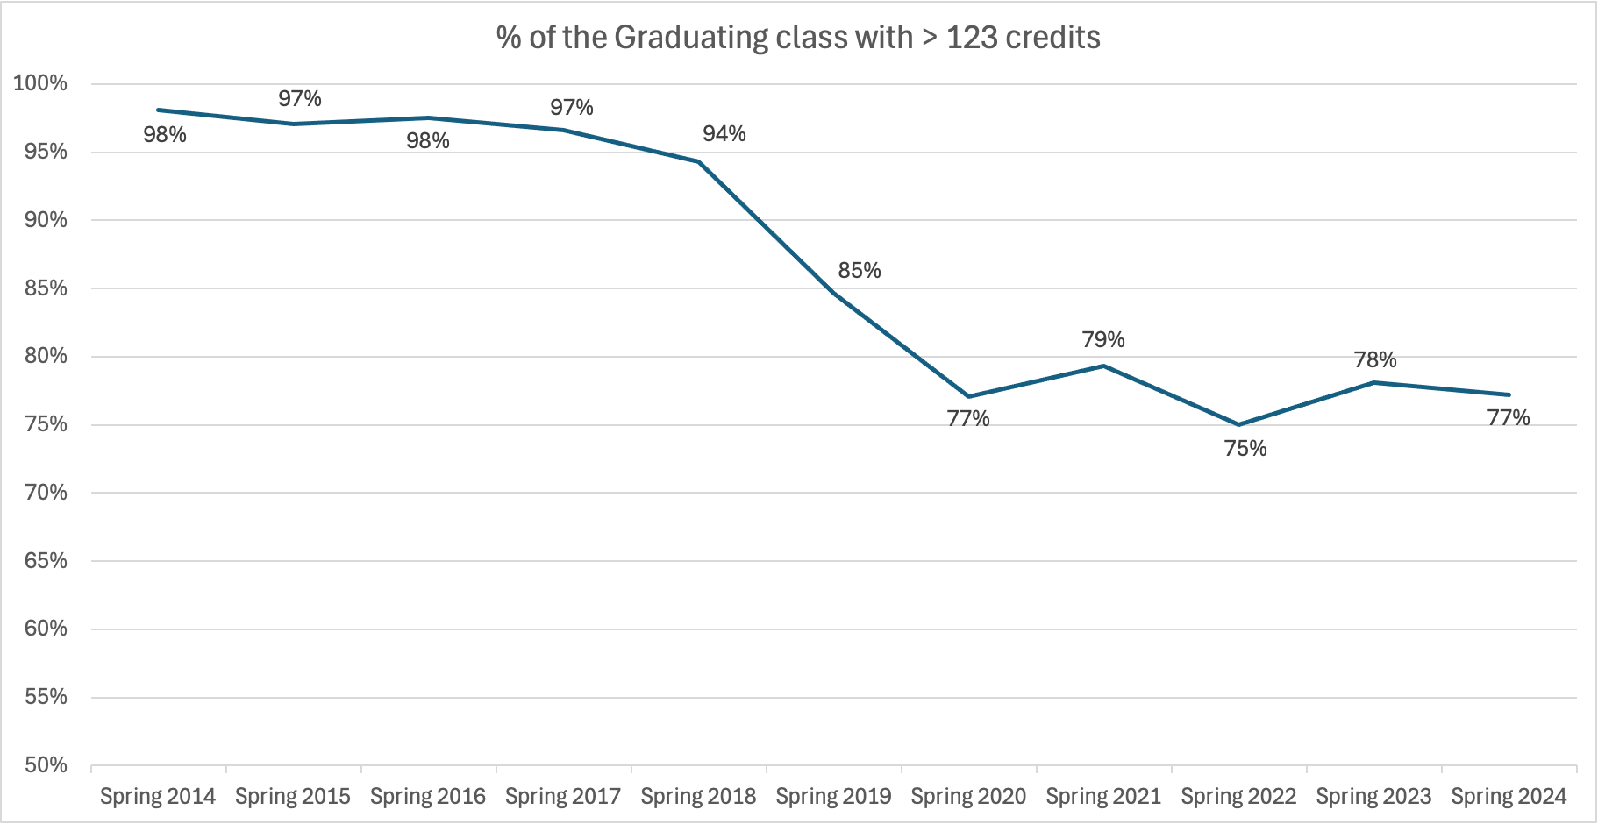
Outcomes of Implementing Focus Areas at Coastal GA
Implementation began Fall 2018

Slide 15
Objectives
Design a plan to develop meta-majors/focus areas that streamline purposeful choice, minimize excess credits, and support retention.
Establish a process for aligning meta-major core curricula and developing program maps.
Set benchmarks for measuring meta-major effectiveness.

Slide 16
Pause for Reflection
Any questions or concerns that come to mind?

Slide 17
Tools for the Undecided - Focused Exploration
College is a time for exploration, but remember that time is the enemy of completion and delayed graduation is potential earnings lost.
Intrusive Advising - Keeping them focused on a goal.
Discovering Aptitudes - Helping them explore where they will “fit”.
  Focus2Career (and Focus2Apply)
  SteppingBlocks
“Interest in” options
  Aligns with Associates Degrees in the Core for transfer
    Federal Aid - Course Program of Study (CPOS)

Slide 18
Objectives
Design a plan to develop meta-majors/focus areas that streamline purposeful choice, minimize excess credits, and support retention.
Establish a process for aligning meta-major core curricula and developing program maps.
Set benchmarks for measuring meta-major effectiveness.

Slide 19
We helped them choose: Now What?
Keeping on the path to completion with Program Maps

Slide 20
Program Maps
Benefits of Program Maps for Students:
Provides a clear path to graduation.
Ensures pre- and corequisites are taken at the appropriate time.
Provides checklists and milestones.
  Academic and non-academic guidance.
Benefits for the Institution:
Commitment and guarantee to and from programs that the degree can be completed as planned.
  Curriculum updates require an updated Program Map to ensure there are no unintended roadblocks.
Helps departments plan when to offer courses that may not be offered every semester.
Helps determine which departments need to be brought to the table when planning.
  Curricular changes
  Course/schedule needs

Slide 21
Next Steps: Aligning Curricula
Work across programs, departments, and schools/colleges to unify the Core Curriculum to minimize credit loss in the case of a major change within a focus area.
Generate buy-in: This is a long process and will have pain points.
  Paint the picture for members of your institution. Remember your menu experience.
Complete the “hours at graduation” analysis at your institution.
  Remind faculty and staff that this is time and money our students invested past what was necessary.

Slide 22
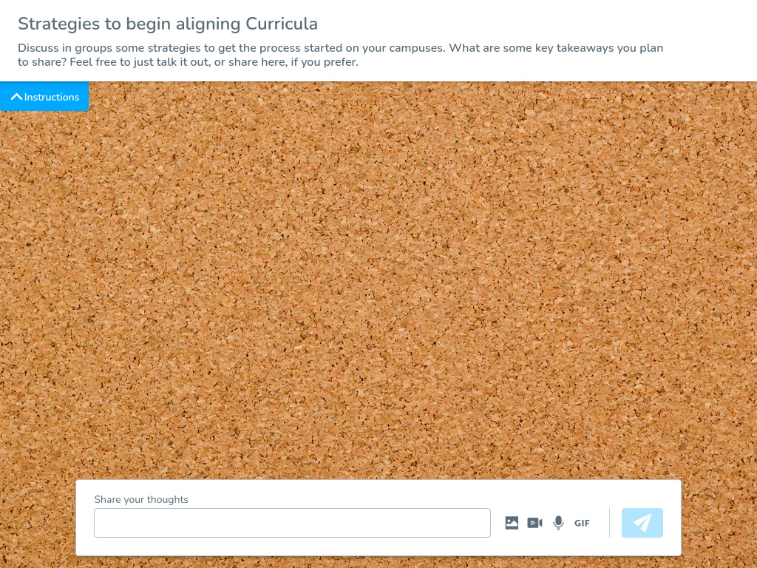

Slide 23
Objectives
Design a plan to develop meta-majors/focus areas that streamline purposeful choice, minimize excess credits, and support retention.
Establish a process for aligning meta-major core curricula and developing program maps.
Set benchmarks for measuring meta-major effectiveness.

Slide 24
Final Steps: Iterative Stress Tests
Use Program Maps to ensure completing degrees is possible in a timely manner. You can also monitor alignment within meta-majors/focus areas.
Continue to monitor data
  Determine your best benchmarks
    # of hours at graduation
    % of students graduating with X hours

Slide 26
Objectives
Design a plan to develop meta-majors/focus areas that streamline purposeful choice, minimize excess credits, and support retention.
Establish a process for aligning meta-major core curricula and developing program maps.
Set benchmarks for measuring meta-major effectiveness.

Slide 27
Action Items
Understand the student experience: Fill out an application
Restructure
  Collect career data from your programs
  Map careers to programs
  Categorize programs into meta-majors/focus areas
    Consider what students know and the guidance they need
Unify the curriculum
  Complete your list of stakeholders and craft your communication.
  Task programs to align the first year curriculum to minimize credit loss in case of a major change within a meta-major.
Perform regular stress tests
  Are transitions reasonably seamless?
  Are students completing with reasonable hours?

Slide 28
Questions/Comments?
Thank you for your time and engagement with me today!

Slide 29
