Slide 1
Creating Support Structures for Milestone Completion: Lessons from the Evidence-based ASAP|ACE Model
Donna Linderman, Ed.D.
Senior Vice Chancellor for Student Success
State University of New York (SUNY)
Meauxmentum Higher Education Summit: Gaining Meauxmentum
Lafayette, LA, April 2-3, 2025

Slide 2
AGENDA
Accelerated Study in Associate Programs + Accelerate Complete & Engage (ASAP|ACE) Program Model
Origins and Evidence Base
Replication across SUNY System
Program Components:
  Financial Resources
  Advisement Model
  Integrated Use of Data
  Considerations for Campus Adoption

Slide 3
ASAP|ACE Program Model, Origins and Evidence Base

Slide 4
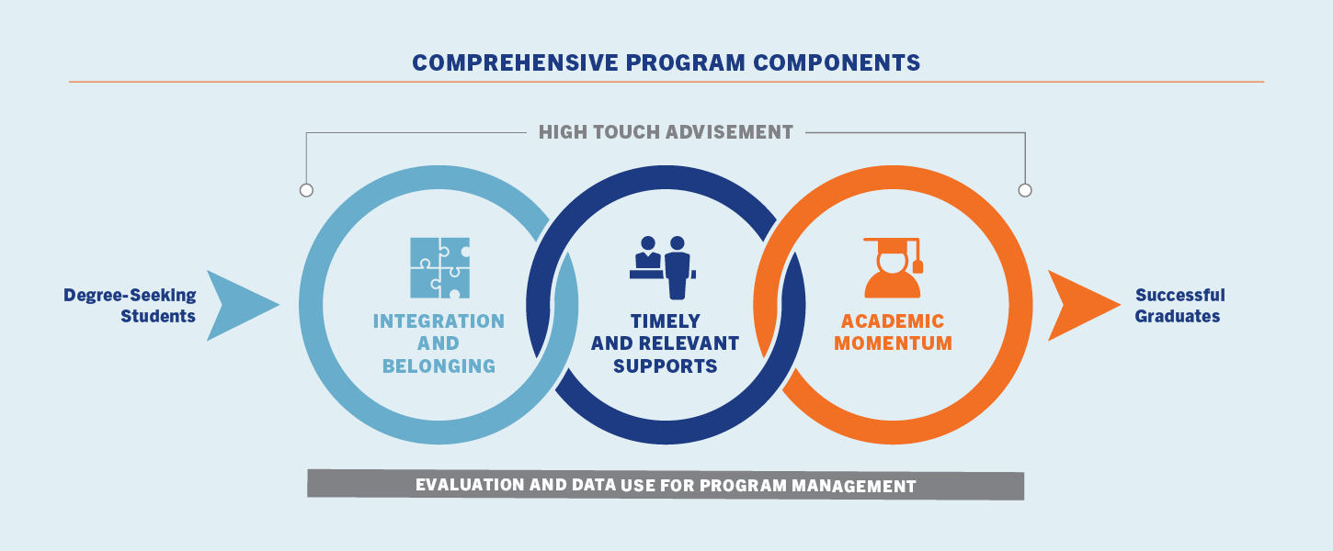
ASAP|ACE Program Model
Graduation Timelines
ASAP: Associate degree completion (within 3-years)
ACE: Bachelor's degree completion (4 years for freshmen + 2 years for transfer students w. associate degree)

Slide 5
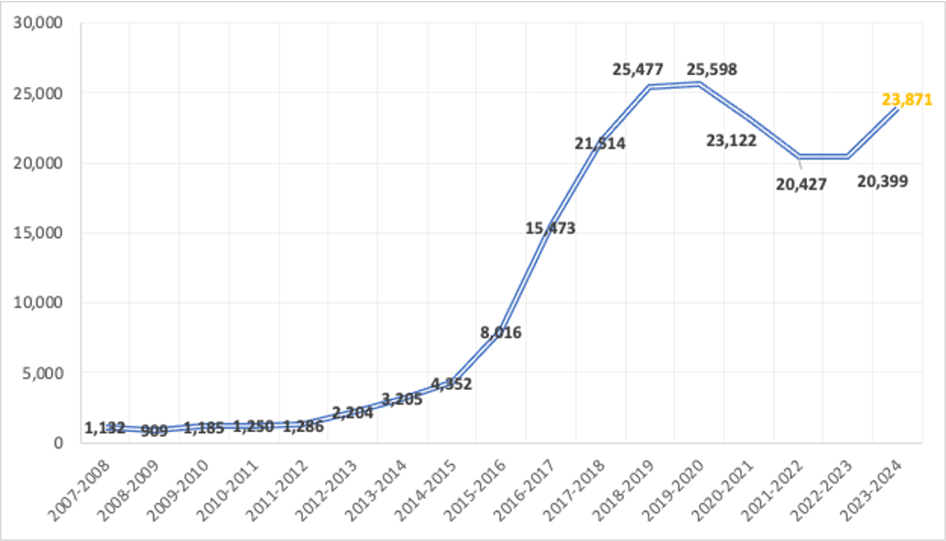
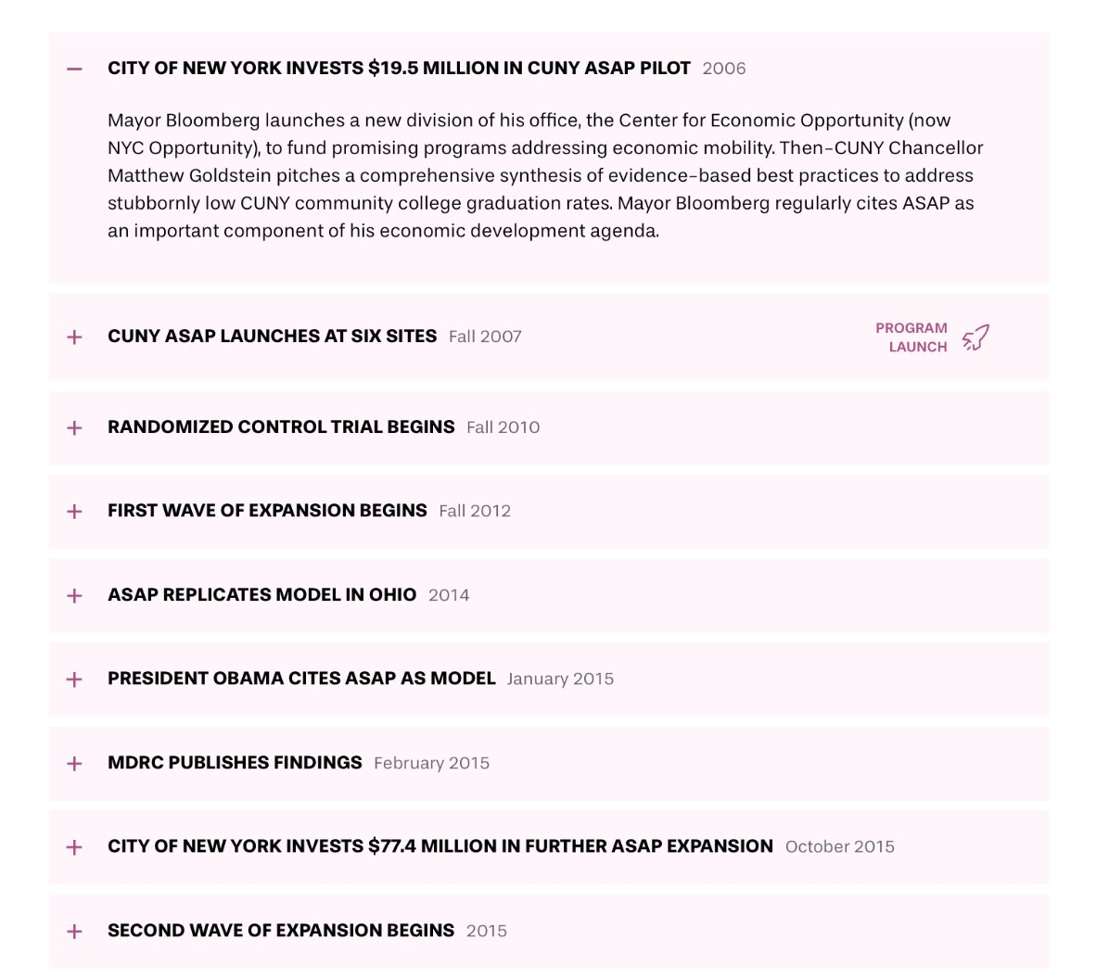
Cuny asap scaling story
ASAP launched at CUNY in 2007 and has served 110K students to date; currently 25K/year @ 9 campuses​
​
ACE launched in 2015 and has served 6.3K students to date; currently 3K/year at 8 campuses​
Source: CUNY ASAP, November 2023
Notes:
DL

Slide 6
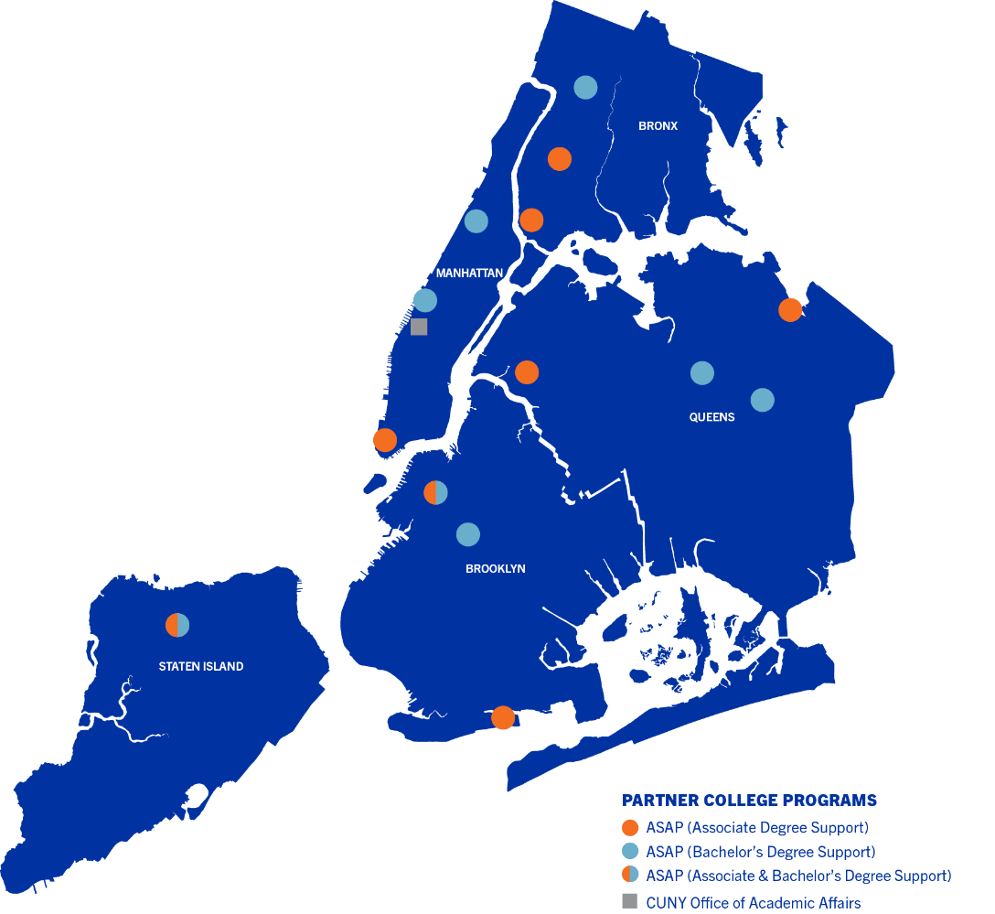
CUNY ASAP|ACe Consortia Structure
ASAP (est. 2007):
Has served 110K students to date
Current enrollment: 25K/year @ 9 campuses​
​
ACE (est. 2015):
Has served 6.3K students to date
Current enrollment: 3K/year at 8 campuses​
Consortia Structure
Partner Colleges
Local program management
Recruitment
Direct services to students
Monitoring student progress
Campus relationships and integration
System Office
Overall program administration
Program-wide resources
Evaluation/data management
External partnerships
Citywide outreach + Mar/Comms
Notes:
DL

Slide 7
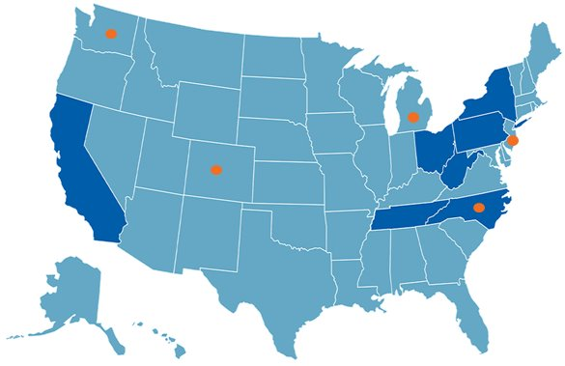
National Replication of ASAP|ACE (Beyond CUNY)
Replication and Expansion Across Eight States-*
CA (6 campuses)​
NY –SUNY (25 campuses)​
NC (3 campuses; expanding to 18--New)​
OH (3 campuses)​
PA (1 campus)​
TN (1 campus)​
WV (2 campuses)
CO (2 campuses--New)
*-Orange dots=SHEEO/CUNY ASAP|ACE National Replication Collaborative Learning Community Partner
Notes:
Constance

Slide 8

AsAP|ACE EVIDENCE BASE SNAPSHOT
ASAP has an average 3-year graduation rate of 53.4% vs. 24.6% for the historical matched comparison group | ASAP narrows equity gaps for Black and Hispanic males and has demonstrated all subgroups benefit from the program
An RCT of John Jay ACE demonstrated a 58.8% 4-year baccalaureate graduation rate (vs. 46.4% for the control group) | ACE Transfer has an average 2-year graduation rate of 68.4% (vs. 39% for comparable transfer students)
OHIO Replication Demonstration (2014-2018 + 202)
MDRC RCT found three-campus replications nearly doubled 3-year graduation rates and realized long-term positive gains on employment and earnings.
Cost Benefits of ASAP (2017) + ACE (2024)
For every $1 invested in ASAP by taxpayers, return = $3.50 (increased tax revenue + reduced use of public services)
Participation in ACE yields net social benefit of $43K/student + intergenerational benefits
NEW: SUNY Westchester Community College ASAP Replication (Viking ROADS) (2025)
MDRC RCT found VR increased 3-year graduation rates by 12 pp. and boosted FT enrollment and credit accumulation.

Slide 9
SUNY ASAP|ACE Replication

Slide 10

CAMPUS TRANSFORMATIONAL INITIATIVES FUND
All SUNY campuses received an allocation within the $60MSUNY Transformation Fund to choose from a menu of allowable uses to improve student success, support innovation, and help meet workforce needs.
SUNY Campus Transformation Fund (2023 – 24)
ASAP|ACE Replication ($20M)
Economic Mobility
Seamless Transfer
Operational Efficiency
Essential Student Supports
1
2
3
4
5
10

Slide 11

SUNY Partner Campuses
Plattsburgh
Potsdam
Clinton
Canton
Jefferson
Oswego
Consortia Model
25 partner campuses
SUNY Office of Student Success
University at Buffalo
Polytechnic Institute
Buffalo State
Finger Lakes
Cayuga
Herkimer
Erie
Morrisville
Schenectady
Hudson Valley
Fredonia
New Paltz
KEY
Orange
ASAP Campuses (13)
Rockland
Westchester
ACE Campuses (12)
Purchase
Suffolk
Nassau
Farmingdale
11

Slide 12

SUNY ASAP|ACE Program Components
Financial Resources to Remove Barriers to FT Attendance
  Cost of Attendance Award
  Transportation/Monthly Stipend
  Textbook/Materials
Wraparound Supports to Enhance Integration and Belonging
  High-Touch Advisement
  Career Development and Academic Support Activities
  Pre-semester Orientations
Structured Pathways to Build Academic Momentum
  Consolidated Course Schedules
  Blocked Courses for First-Year Students
  Winter and Summer Course Taking
12
Notes:
Get script from Pitch deck

Slide 13

ASAP|ACE Eligibility
U.S. citizen/eligible noncitizen (Dream Act and Dream.US eligible)
Eligible for in-state tuition
Enroll full-time (12 credits/semester ASAP; 15 credits/semester ACE)
Enroll in an approved major (most majors offered)
Apply for and accept any federal and state financial aid annually (must receive at least some Pell)
Not be enrolled in existing opportunity program
Participate in all required program activities
13

Slide 14
SUNY ASAP|ACE
Timeline and Key Milestones
May-June 2023: Campuses learn about ASAP|ACE via Transformation Fund planning process
August 2023:
25 campuses submit plans to replicate ASAP|ACE
SUNY OSS raises grant funds to build program capacity ($4.8M)
September 2023: 25 partner campuses announced w. target of 3,750 students + 450 students w. grant funding by Fall 2024
September 2023 – May 2024: Implementation planning and TA from CUNY ASAP|ACE National Replication Network + SUNY OSS
Spring 2024: Pilot programs launched at all campuses (N=1,100)
Fall 2024:
Full programs launched at all campuses (N=4,270)
Initiated PSM Study with Rockefeller Institute of Government
January 2025: Governor includes $12M allocation for SUNY ASAP|ACE in FY26 Exec. Budget
14
Notes:
Edit script

Slide 15
Early Impact: SUNY Student Success
+20%
higher credit completion rate for ASAP students in Spring 2024 compared to similar non-ASAP students
+9%
higher credit completion rate for ACE students in Spring 2024 compared to similar non-ACE students
80%
Spring-to-Fall persistence rate for ASAP students (vs. 72% for similar non-ASAP students)
88%
Spring-to-Fall persistence rate for ACE students (vs. 85% for similar non-ACE students)
15

Slide 16



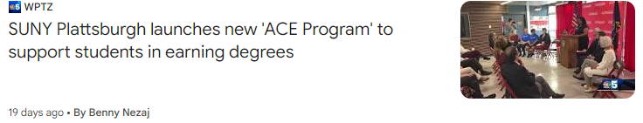
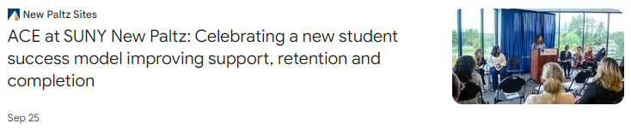
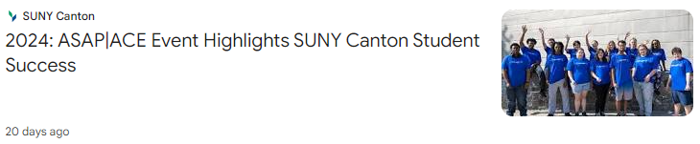



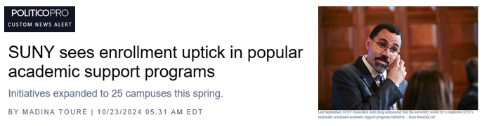
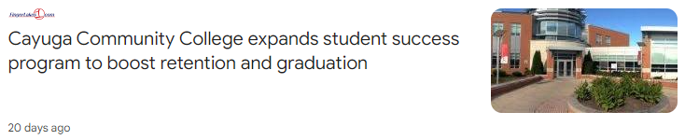
ASAP|ACE Fall 2024 Recognition
16

Slide 17
Awaiting FY26 NYS budget finalization (April)
Will allow expansion to 6K students this fall on pathway to 10K students over next two years
Except to add more partner campuses + more students at existing campuses
SUNY ASAP|ACE Next Steps
17
Notes:
Edit script

Slide 18
SUNY ASAP|ACE PROGRAM COMPONENTS

Slide 19
​
All students receive following resources to remove barriers to FT study
  Cost of Attendance Award:
    $400 for ASAP / $550 for ACE​
    Provided after FA for non-tuition/fee needs
  Textbook/Instructional Materials Award:
    $150 per semester
    Campus bookstore account OR direct disbursement to students through FA process
  Transportation/Monthly Stipend Award
    $50/month when enrolled
    Gas/grocery card OR applied to students' campus accounts
    Tied to meeting program requirements (ie: meeting w. advisor, group activities)
Critical Considerations to effective delivery:
    Strong relationship between program and FA and business offices to ensure resources are delivered in timely and consistent manner
    Clear communication to students on expectations
ASAP|ACE Program Components
Financial Resources

Slide 20
Core Elements
Dedicated trained advisor works w. students from entrance--graduation (1:150 caseload)
Developmental model with a focus on whole student academic and personal growth needs helping students establish and move towards goals
Rapport is built over time to heighten trust between student and advisor
Advisors carefully monitor students’ progress against set of program benchmarks; documented monthly
Frequency 2x/month in first semester then students sorted in Needs/Support levels each semester
Delivery modalities
1:1 meetings (in person, online, phone)
Group advisement sessions (in-person and online)
Select campuses: 1st year seminars
Widely considered the most important program component by
students and program staff
ASAP|ACE Program Components​
High-touch
Advisement Model

Slide 21
​
After first semester, advisors sort their students into "Support" levels to determine the frequency and modality of contact
Done each semester w. support levels coded in data submissions
High Support
Academic probation and/or regular course withdrawals
Difficulty articulating academic and personal goals
Consistently needs coaching to meet program requirements
Concern about personal circumstances and/or known challenges
Min Contact: 2x/mo with at least one being individual meeting w. advisor
Medium Support:
Midrange GPA and good academic standing
May need guidance to clarify academic and personal goals
Needs coaching to meet program requirements
Periodic concern @ personal circumstances that may impede progress
Min Contact: 1x/mo; modality determined w. advisor
Low Support:
High GPA and strong academic momentum
Clearly defined academic and personal goals
Meets program requirements without need for coaching,
Seeks opportunities to participate in campus opportunities
Min. Contact: 1x every other month w. some other form of program contact (ie: workshops) as agreed w. advisor
​
ASAP|ACE Program Components
Advisement Model –Triage Model

Slide 22
  All campuses work toward following Minimum Benchmarks:
  Retention (ASAP | ACE)
    Second semester: 90% | 95%
    Third semester: 80% | 90%
    Fourth semester: 70% | 87%
    Fifth semester (retained or graduated): 65% | 82%
  Cumulative Credits Earned
    ASAP: min. 10 per semester / 20 per year
    ACE: 15 per semester / 30 per year
  Developmental Education for Those w. Need (Enrollment | Fully Skills Proficient in One Year )
    ASAP: 100% | 90%
  Graduation
    Two-Year: ASAP 25% | ACE 50% (Transfer)
    Three-Year: ASAP 50% | N/A
    Four-Year ACE 50% (Freshmen)
    Student Engagement
    Monthly Advisor Contacts: 85% of students meet minimum engagement for their support level
    Semester Advisor Contacts: 95% meet minimum advisement contact and program engagement for their support level
ASAP Program Components​
Program Benchmarks

Slide 23
  ASAP|ACE uses data in a standardized manner for program management and evaluation purposes
  SUNY Student Success has created a standardized data management system with data definitions and collection schedules and protocols all partner campuses use
  Dedicated staff member provides training and support and manages a centralized database that allows for reports to be run for individual and program-wide analysis;
  Enrollment tracker used during recruitment cycles to monitor movement toward targets
  Engagement data is collected monthly from campuses, typically as exports from campus systems (ie: Starfish or Navigate)
  Data reports provided to campuses monthly and discussed at scheduled data meetings (all campuses receive their own data and program-wide averages); campuses not meeting benchmarks are contacted by SUNY System
  Academic data is collected from official IR data sources to run reports against benchmarks each semester
  Data also used for quasi-experimental study (just launched)
  New: Creating online database that will allow real-time entry/use of data w. recent grant funding
ASAP Program Components​
Integrated Use of Data

Slide 24
ASAP|ACE
Campus Considerations for Campus Adoption
Institutional Commitment & Alignment:
  Broad Leadership Support (not just the president)
  Understanding and commitment to replicate model w. fidelity
  Alignment w. campus strategic plans
Staffing & Infrastructure:
  Administrative capacity to support comprehensive model
  Leadership stability
  Ability to provide dedicated space + ongoing cross-functional support to program
Academic & Programmatic Fit
  Academic program mix that can accommodate timely completion
  Campus culture that would support ASAP|ACE advisement model and course availability needs for FT study
  Willingness to review policies that may impede students' academic momentum
Enrollment & Recruitment
  Assessment to ensure there is sufficient eligible student pool
  Admissions/Financial Aid Infrastructure to support continuous recruitment and FA review/packaging of prospective students to meet ambitious targets
Budget & Financial Considerations
  Ability to administer ASAP|ACE student financial resources
  Ability to quickly hire program staff
  Ability to offer sufficient intersession course offerings (or support cross registration)
24
Notes:
Edit script

Slide 25
For More Information: suny.edu/asap-ace
Contact: donna.linderman@suny.edu

