Slide 1

















Data-Driven Gateway Course Transformation
Angie Pellerin MA, MS, LPC-S
Associate Vice Chancellor for Student Success,
Louisiana State University Shreveport
Brandon Smith MFA, EdD
Associate Vice President, Gardner Institute
Felita T. Williams, PhD
Senior Vice President for Programs, Gardner Institute
Louisiana Meauxmentum Summit
April, 2025
Notes:
Felita

Slide 2
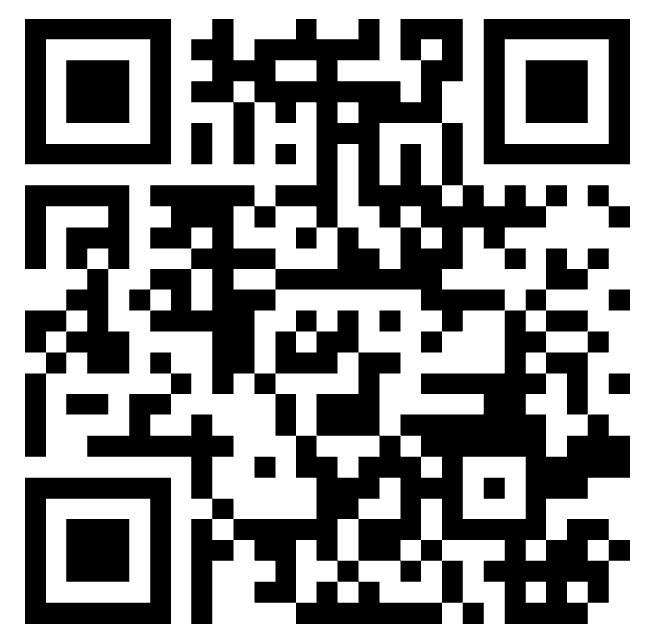

Welcome and Introductions via Mentimeter
Notes:
Felita: https://www.mentimeter.com/app/presentation/al199y5h8u7ft17z6trt412bday3pwtd/edit?question=165y7hryo5bs
DOWNLOAD AND RESET BETWEEN MEETINGS.

Slide 3
Approaches to Empowering Gateway/Catapult Course Redesign
Intros and Making Connections
Designing Leading Measures In Courses
Empowering Leadership to Use Data and Manage Large-Scale Redesign
Using Multiple Data Sources to Redesign a Critical Course–First-Year Experience
Working With Your Team to Plan
Data-Informed Redesign!
Agenda
gardnerinstitute.org
Notes:
Felita

Slide 4
Workshop
Objectives
Teach administrators to analyze institutional data to identify target courses for redesign and track success.
Implement data collection tools that monitor learning outcomes and gaps in redesigned courses.
Use data insights to refine redesign processes and make evidence-based improvements.
gardnerinstitute.org
Notes:
Felita

Slide 5
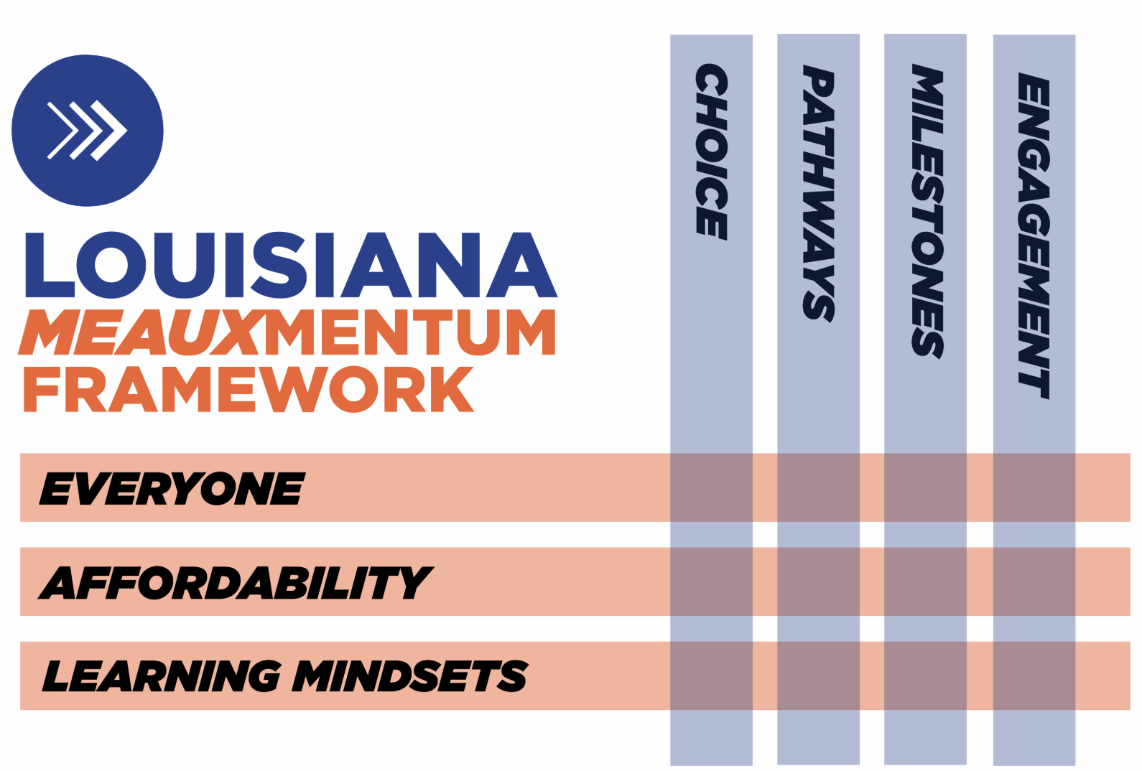
Gateway/Catapult Courses and Meauxmentum Strategy Alignment
Primary Impact. However, success in Gateways impacts all “Strands and Threads.”
Notes:
Angie :)

Slide 6
Located in Brevard, NC, the John N. Gardner Institute for Excellence in Higher Education is a 25-year-old, nonprofit organization.
Who we are:
The John N. Gardner Institute for Excellence in Higher Education is a non-profit organization dedicated to partnering with colleges, universities, philanthropic organizations, educators, and other entities to increase institutional responsibility for improving outcomes associated with teaching, learning, retention, and completion. The Institute supports postsecondary education’s efforts to ensure that every learner earns a credential that leads to a meaningful career and a highly fulfilling life. Through its work, the Institute will advance higher education’s broader mission of expanding opportunity and success for all students.
Notes:
Felita

Slide 7

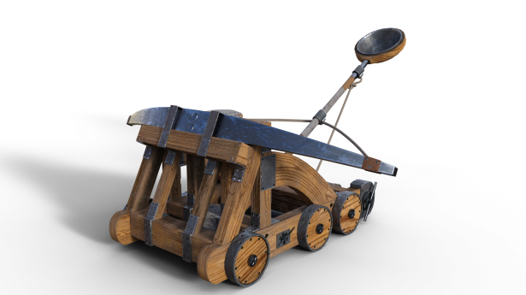
Where have our course redesign methods been used?
The Gardner Institute has been partnering with institutions for well over a decade to improve gateway course outcomes.
Notes:
Brandon

Slide 8
Research Universities
Georgia Institute of Technology Georgia State University
Kennesaw State University Mississippi State University Montana State University Billings New Jersey Institute of Technology
North Carolina Central University North Dakota State University-Main Campus
Oklahoma State University Oakland University
Purdue University Roosevelt University
Rutgers University-New Brunswick Rutgers University-Newark
Shaw University Texas Southern University
University of California-Santa Barbara University of Central Arkansas
University of Georgia University of Houston
University of Houston Downtown University of Illinois Chicago
University of Michigan University of Michigan-Dearborn
University of New Mexico-Main Campus University of North Georgia
University of Rhode Island University of Southern Mississippi
University of West Georgia Valdosta State University
Wayne State University Western Michigan University
Wingate University Xavier University of Louisiana
Notes:
Brandon

Slide 9
Universities
Albany State University Arkansas Tech University
Ashford University Augusta University Bemidji State University California State University-San Bernardino
Campbell University Capital University Chowan University Clayton State University Columbus State University East Central University
Eastern Michigan University Florida International University
Fort Valley State University Georgia College & State University
Georgia Southern University Georgia Southwestern State University Grand Valley State University Holy Family University
Kean University McMurry University Metropolitan State University of Denver Middle Georgia State University
Montana State University Billings Northern Vermont University
Qatar University Roosevelt University
Savannah State University Southern University
Southwestern Oklahoma State University and A&M College
Notes:
Brandon

Slide 10
Colleges
Abraham Baldwin Agricultural College Atlanta Metropolitan State College
Bergen Community College Brevard College
Catawba College Central Community College
Chaffey College College of Coastal Georgia
College of Micronesia-FSM Dalton State College
East Georgia State College Georgia Gwinnett College Georgia Highlands College Gordon State College Greensboro College Henry Ford College
Houston Community College Kalamazoo Valley Community College Lansing Community College Marist College
Nevada State College Newberry College
Northern Oklahoma College Saint John Fisher College South Georgia State College Southwestern College
St. Francis College Tulsa Community College
Washtenaw Community College Waubonsee Community College
Whittier College
Notes:
Brandon

Slide 11
Systems
American Public University System
Michigan System
Lone Star College System
University System of Georgia
eCore (University System of Georgia)
Notes:
Brandon

Slide 12
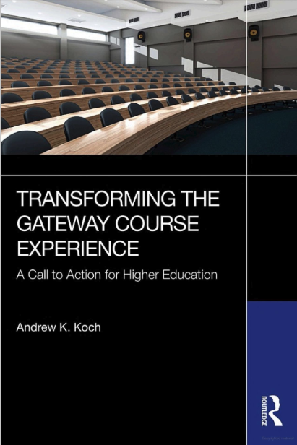
Author:
Dr. Drew Koch
Outlines the process
we use to guide redesign in a format that can be adopted by anyone.
Free copies shared today!
Notes:
Brandon-We have a book, and a process, we will give it away today. We will outline case studies of how this plays out at the system level and at institutions.

Slide 13
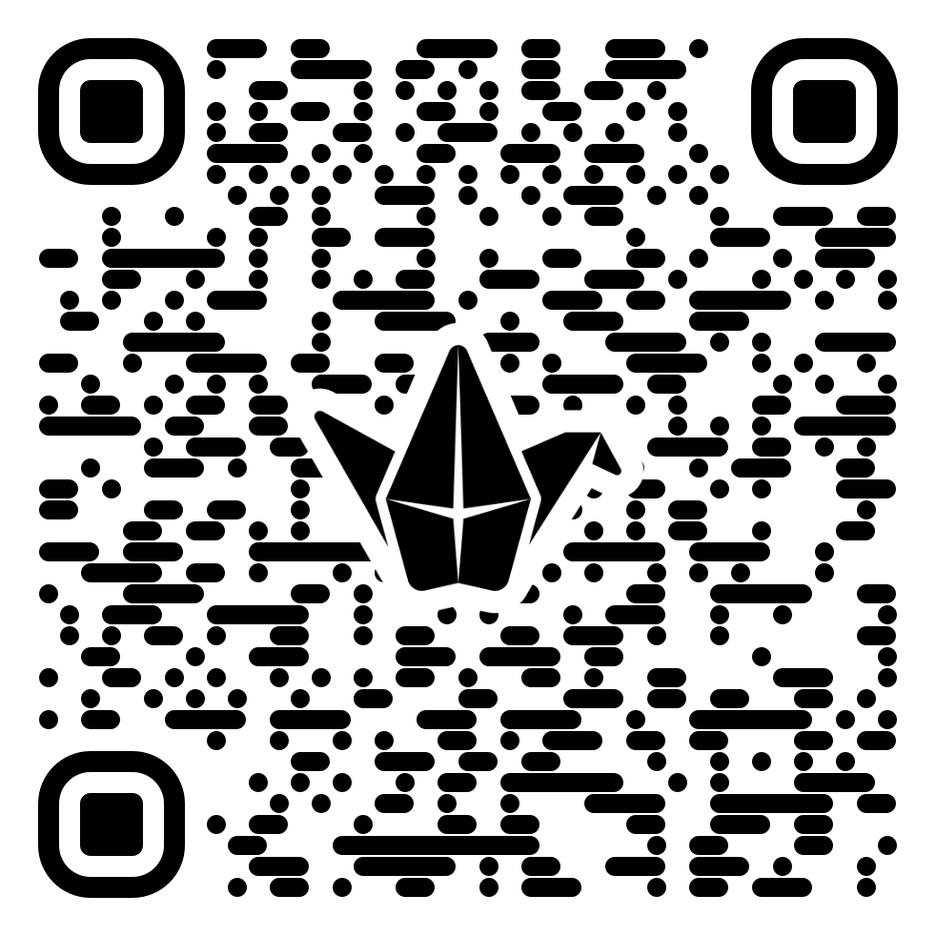
Accessing Resources for Today
Insights on how to lead an institutional course redesign project
Insight on the course design phases and what to expect at each phase
Resources and a framework to drive data driven course design to improve student learning and retention in gateway courses
https://padlet.com/GardnerInstitute/meauxmentum-workshop-april-2025-m28ua0kcnnxy3hon
gardnerinstitute.org
Notes:
Angie. https://padlet.com/GardnerInstitute/meauxmentum-workshop-april-2025-m28ua0kcnnxy3hon

Slide 14
Brevard College
The Case for Multiple Measures
Lagging measures that help you locate areas for potential improvement!
Note variation-desirable and undesirable.
Leading measures help you make real-time adjustments!

Slide 15
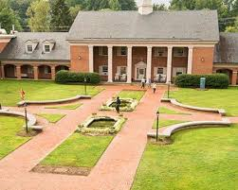

Brevard College: We Needed Partnership (2014-2015)
Historic four-year graduation rates hovered around 30%
Historic first-year retention rates around 50%
In 14-15 ⅔ of all classes had a 30% or higher rate of D,F,W,I
Enrollment was declining and we weren’t serving students well…
Notes:
Foundational, required for access to upper-level courses, DFWI, High-enrollment

Slide 16

We Needed to Redesign Gateway Courses
The Gateway Course Redesign process is a multi-year process for improving student learning and success in high-enrollment courses that have historically resulted in
high rates of Ds, Fs, Withdrawals, and Incompletes (DFWI).
Analyze and Plan
Phase 1
Act and Monitor
Phase 2
Act and Refine
Phase 3
Notes:
Brandon-Continuous improvement.

Slide 17
First Steps: Planning to Gather, Analyze and Plan
Gathering Evidence
  Student-level record data
    Disaggregated by
    demographics
  Student Surveys
  Faculty/Staff Surveys
  Other evidence
    Policies, Practices
Analyze and Plan
Phase 1
Question: Which student groups are we not effectively supporting? Where and why?
HOW DO WE KNOW?
gardnerinstitute.org

Slide 18

Planning to Gather, Analyze and Plan
Group Discussion:
What data do you currently use to inform Gateway Redesign?
What data might you want?
How do you make it easy for data to be understood and actionable?
Phase 1
Analyze and Plan
gardnerinstitute.org

Slide 19
Starting Gateway Redesign:
Initial Look at Aggregate Data
Course/Year | 14-15
ENG 111 | 59%
MAT 111 | 47%
BIO 110 | 70%
This year was an outlier that sparked a critical period for the institution.
Leadership recruited faculty participants and faculty engage in the Self-study process.
All changes were faculty designed and driven.
gardnerinstitute.org
Notes:
Why we chose to pilot G2C with these course.
High enrollment, foundational in nature, High DFWI rates,

Slide 20
Current DFWI Rates in the Initial G2C Pilot
Course/Year | 14-15 | 15-16 | 16-17 | 17-18 | 18-19
ENG 111 | 59% | 20% | 24% | 17% | 19%
MAT 111 | 47% | 25% | 32% | 19% | 20%
BIO 110 | 70% | 48% | 35% | 31% | 29%

Slide 21
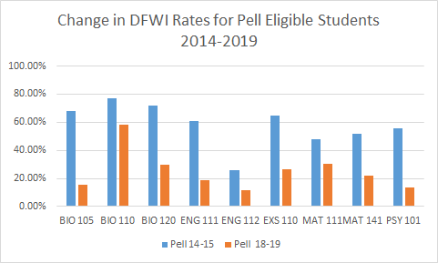

Slide 22
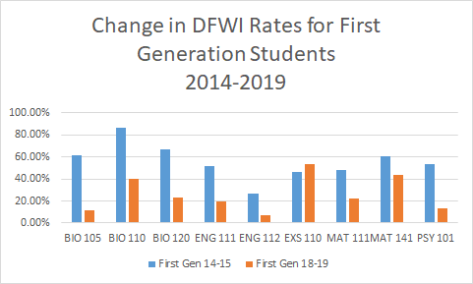
DFWI Rates by Population

Slide 23
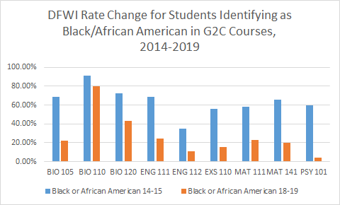
DFWI Rates by Population

Slide 24
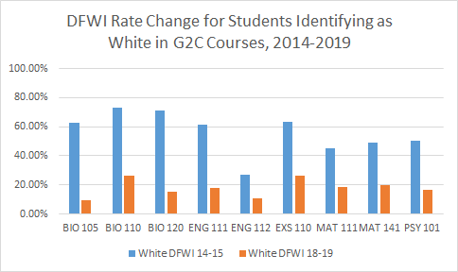
DFWI Rates by Population

Slide 25
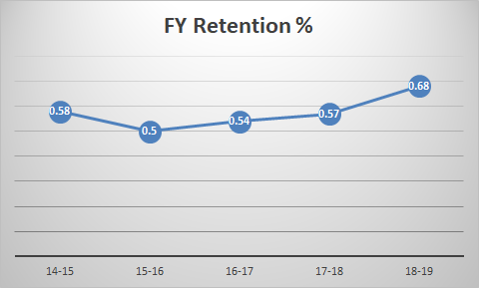
Corresponding Trends in Enrollment
FY retention up 11%
year over year
Overall enrollment up from 702 (F18) to 751 (F19) year-over-year
Overall enrollment increase of 7%-- based on retention

Slide 26
Gateway Redesign:
How We Used Leading Measures to Transform Outcomes
Identify the Challenging Milestones–assignments, events, pivotal moments in the learning process
  Data Deep Dive–Find Variation, Find Gaps, ask WHY the issues exist and WHAT you might do about it.
    Milestones Identified When…
      Faculty Completed the Principles and KPI
      Student Learning Gain Surveys (Dr. Elaine Seymour)
      Target changes using Redesign Framework (see padlet)
*NOTE--All redesign is faculty-driven. They designed changes, tested them, and shared results regularly across disciplines.
gardnerinstitute.org

Slide 27
“Milestones” as Leading Measures
“Milestone” assignments allow faculty to apply promising practices from literature, often learned in Gardner Institute Teaching and Learning Communities.
Most professors had 3-4 Milestones that they reported on via a spreadsheet (PDSA)--Document this is CRUCIAL.
Redesign Framework
Content Mastery Assignments when students weren’t successful on the first attempt.
gardnerinstitute.org

Slide 28
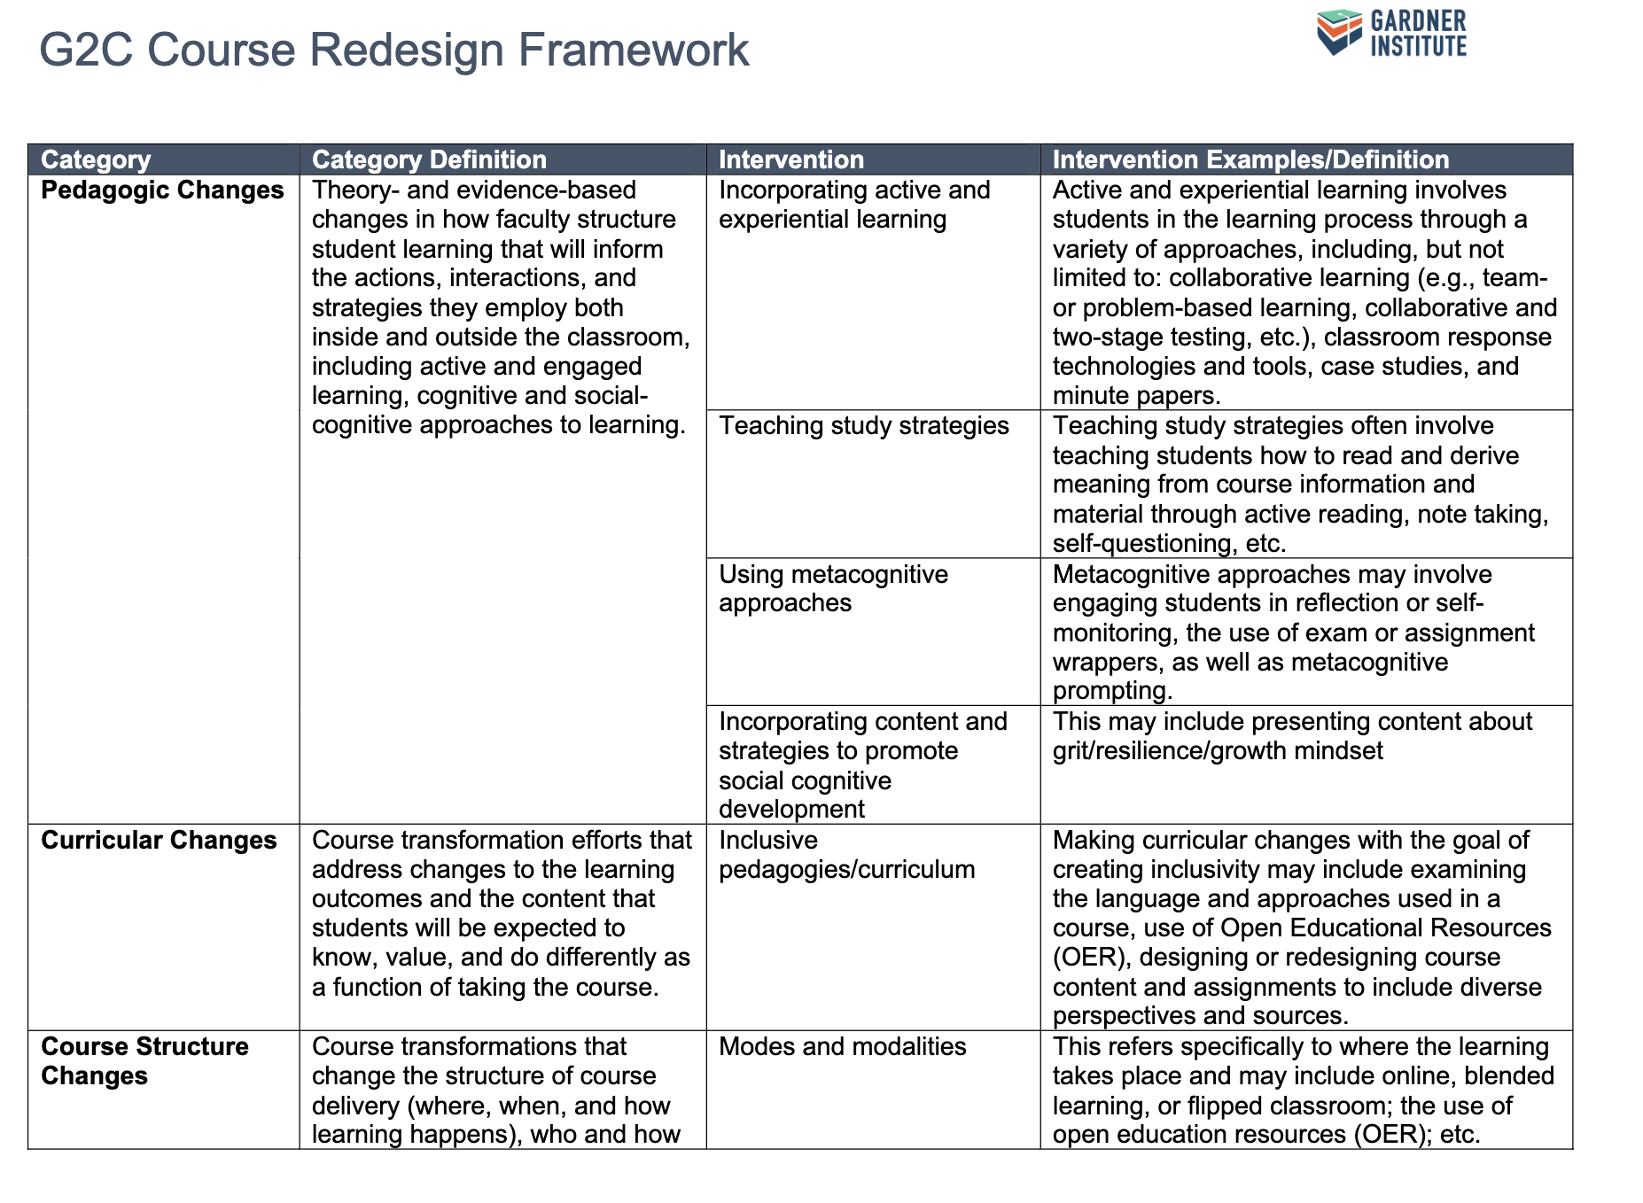
gardnerinstitute.org

Slide 29
Takeaway:
Targeting Interventions Based on Context and Student Needs Matters

Slide 30
Want to know more?
Visit Our Group Consultations

Slide 31

gardnerinstitute.org
Notes:
Felita

Slide 32

























25 institutions
Research 1
gardnerinstitute.org
Notes:
Felita: 25 0f 26 institutions, Access institutions,State Universities,
HBCUs, Research 1 Institutions, Located in urban, suburban and rural

Slide 33
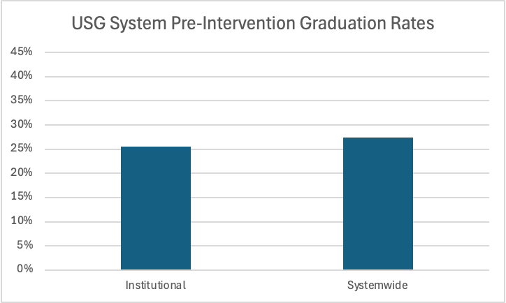
USG Grad Rates Pre Intervention, 2011
25 institutions
Research 1
gardnerinstitute.org
Notes:
Felita

Slide 34
Use data insights to determine the courses most likely to have a grade of D, F, W, I…
USG Course
Redesign
Project
College Algebra
English Composition 1
Departmental specific
gardnerinstitute.org
Notes:
Felita

Slide 35
Course Redesign as a System
Designed multi - level communications between institutions via level
Designed multi - level communications between faculty doing redesigns
Gardner Institute Teaching & Learning Community
Coordination
Communication
Course Redesign
Notes:
Felita

Slide 36

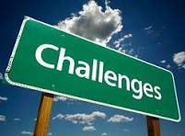
Faculty support
System problem solving
Coalition building
Improved retention Dean/Dept Chairs
Higher completion rates Faculty buy-in
Natural competitors
Organizing meetings
25 institutions
Research 1
gardnerinstitute.org
Notes:
Felita

Slide 37
If I had known then what I know now…
Three phased process
More focus on continuous improvement
How the System Office officially recognize the work
Phases
Continuous Improvement
Rewards
Notes:
Felita

Slide 38
USG Impact
25 institutions
Research 1
881 Faculty
33,352 class sections selected for analysis
764,089 students in the courses impacted
gardnerinstitute.org
Notes:
Felita

Slide 39
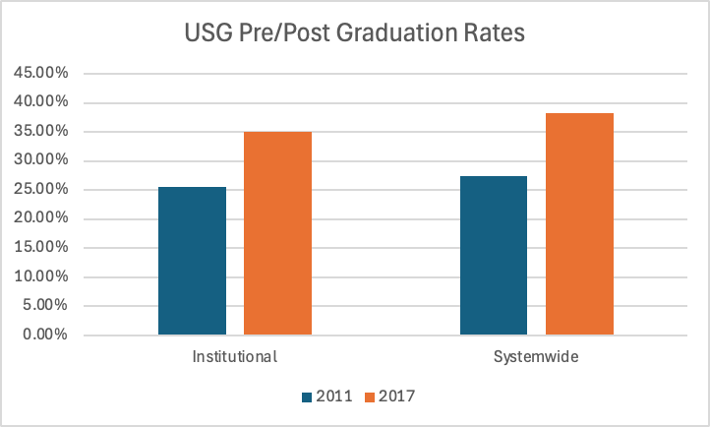
USG Grad Rates After Intervention
+9.5%
25 institutions
Research 1
+10.9%
gardnerinstitute.org
Notes:
Felita: 881 Faculty
33,352 class sections selected for analysis
764,089 students

Slide 40
Takeaway:
Institutional Leaders Can Work with
System Leaders to Leverage Data at Scale

Slide 41
Want to know more?
Visit Our Group Consultations

Slide 42
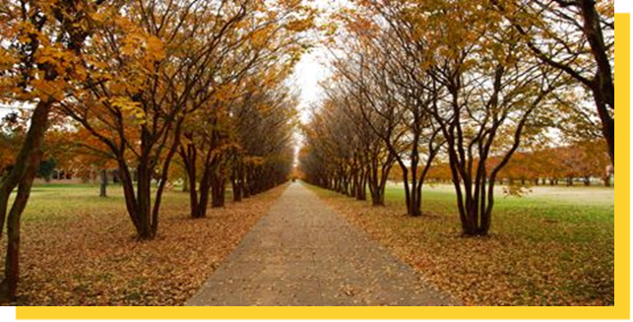
Louisiana State University Shreveport
First-Year Experience & First-Year Seminar
Redesign &
Continuous Improvement Process
2022-Present
Notes:
Angie P.: FYS didn’t happen in isolation.

Slide 43
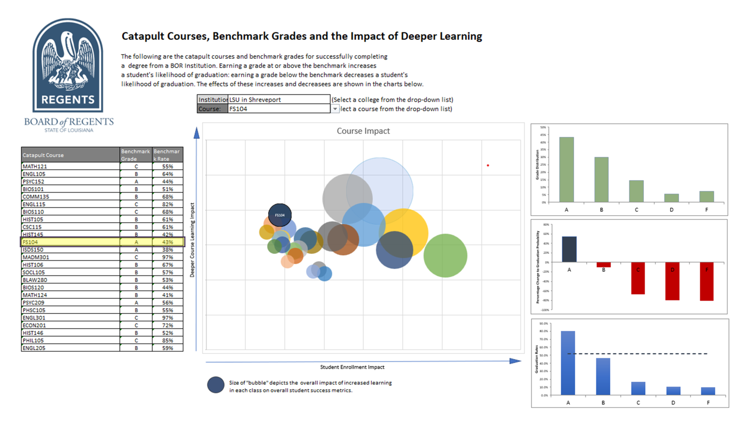
Notes:
Angie P.

Slide 44

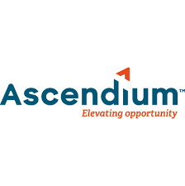





Innovating to Transform Institutions so Every Student Can Graduate: Support for Action
gardnerinstitute.org
Notes:
Brandon

Slide 45
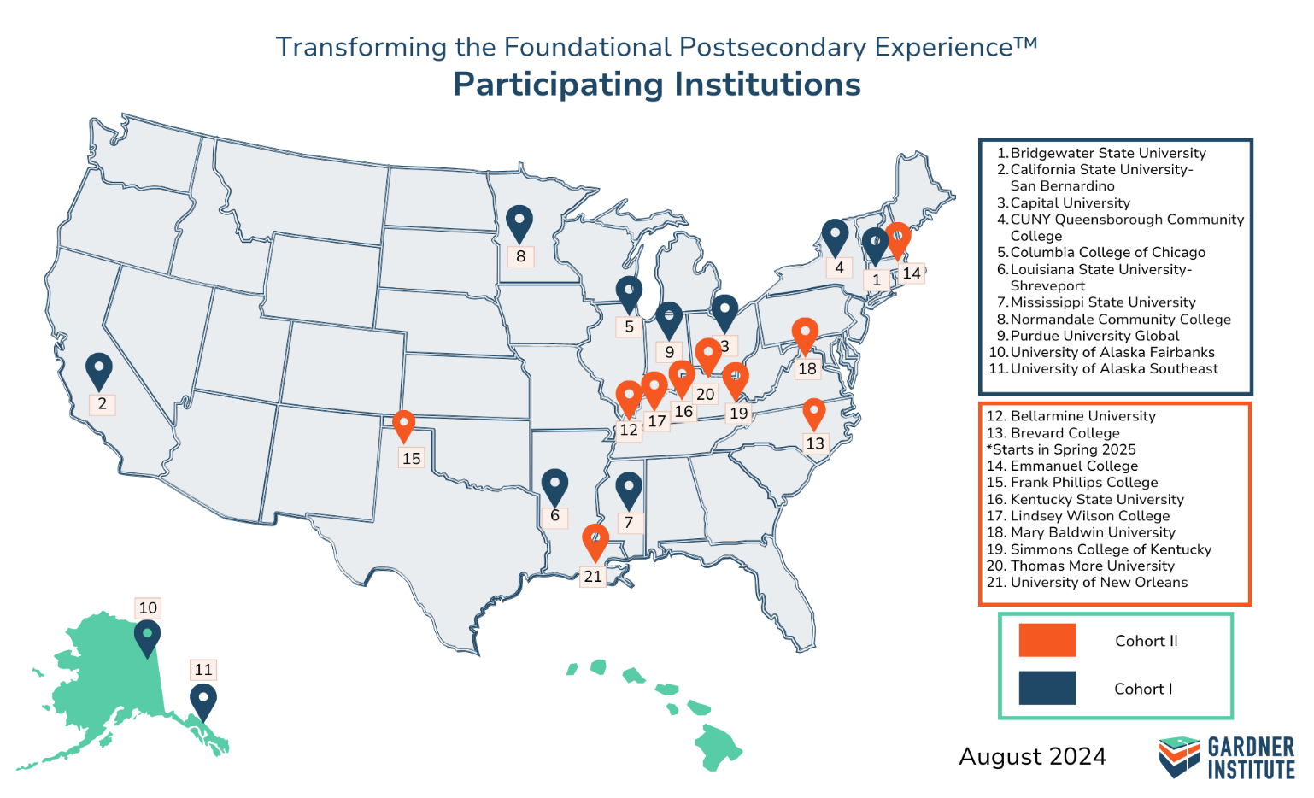





The Phase I Approach (Cohorts 1 & 2)
gardnerinstitute.org
Notes:
Brandon

Slide 46
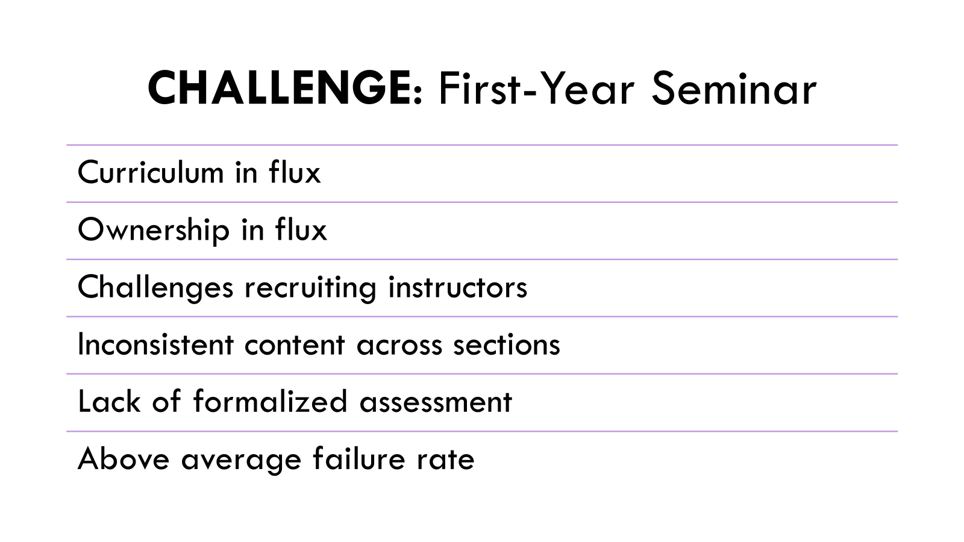
Notes:
Angie P.

Slide 47
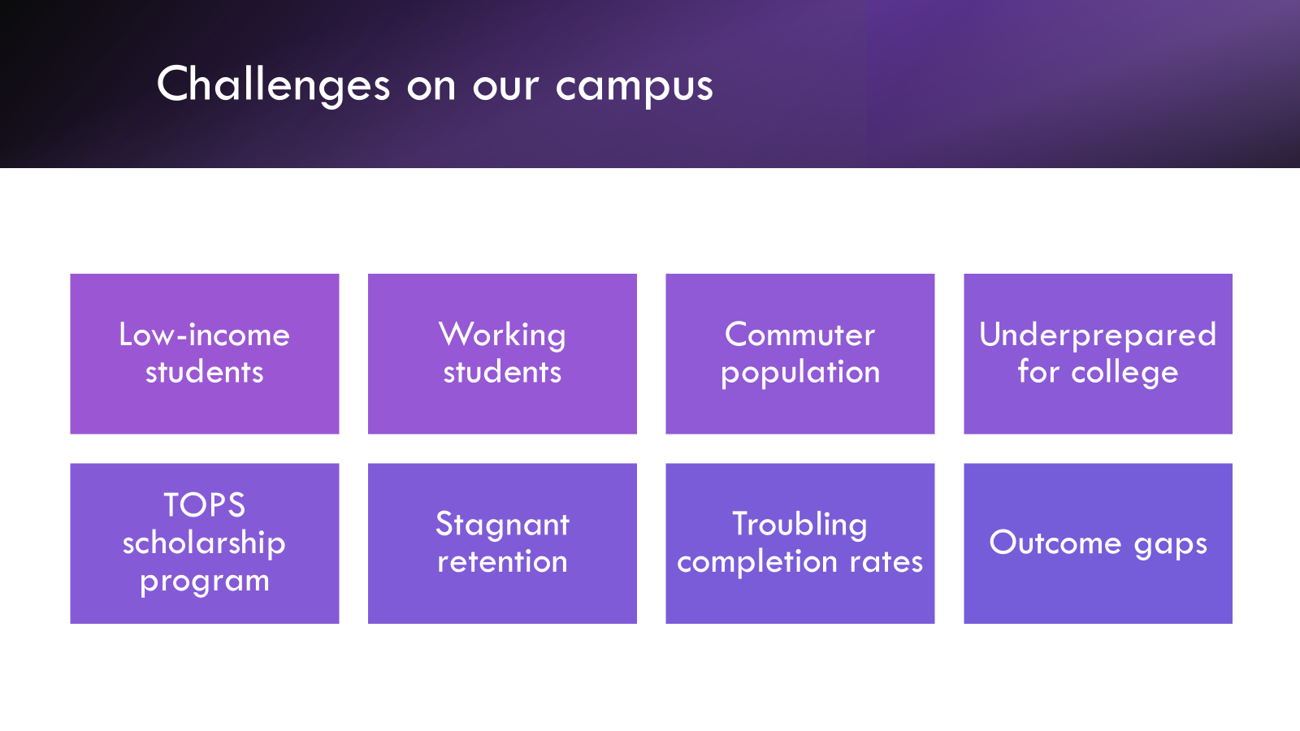
Important Data Consideration For Course Redesign
Notes:
Angie P.

Slide 48
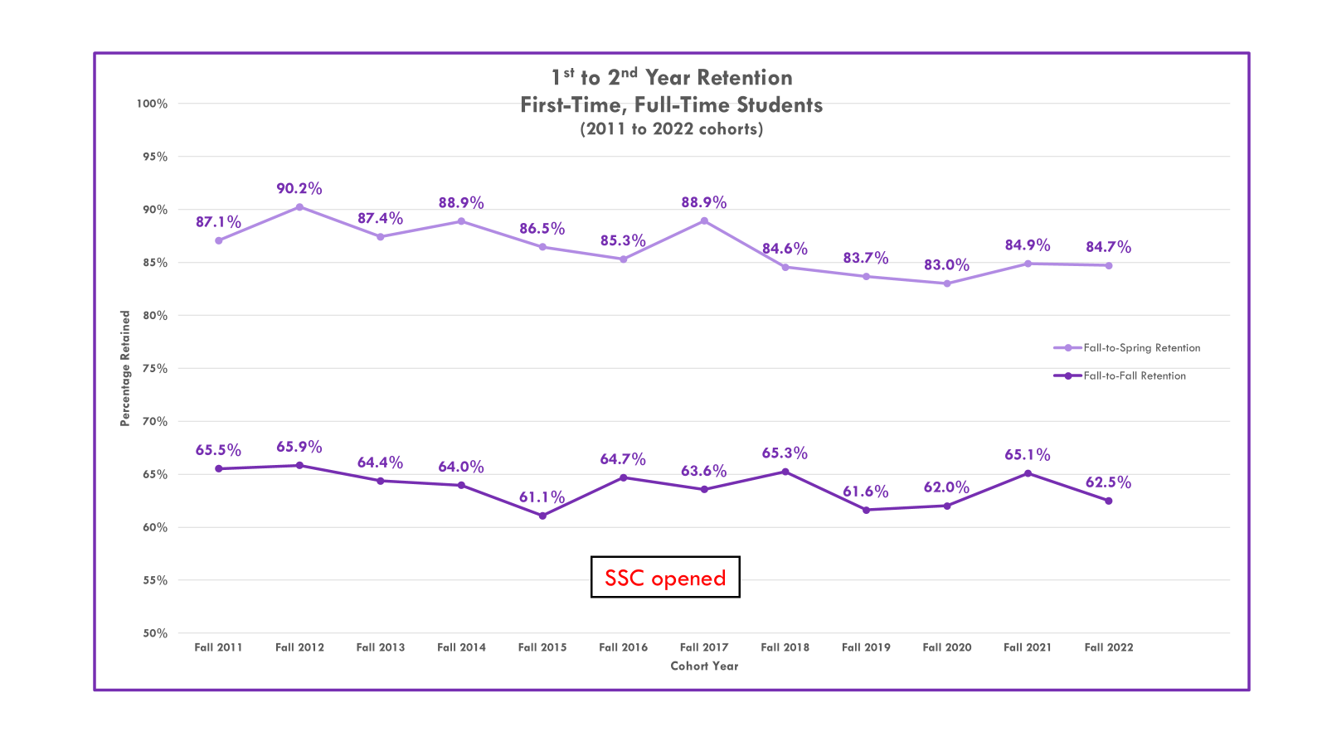
Notes:
Angie P.

Slide 49
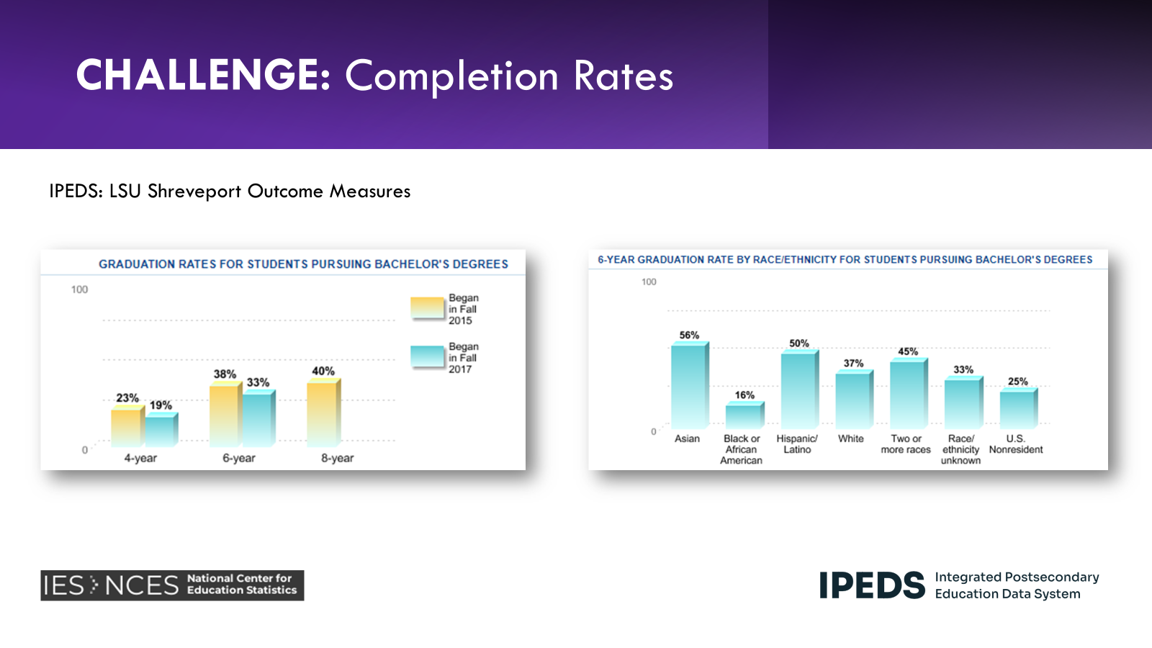
Notes:
Angie P.

Slide 50
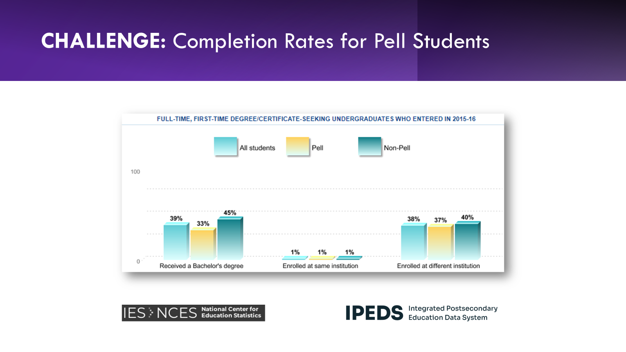
150% of Time
Notes:
Angie P.

Slide 51
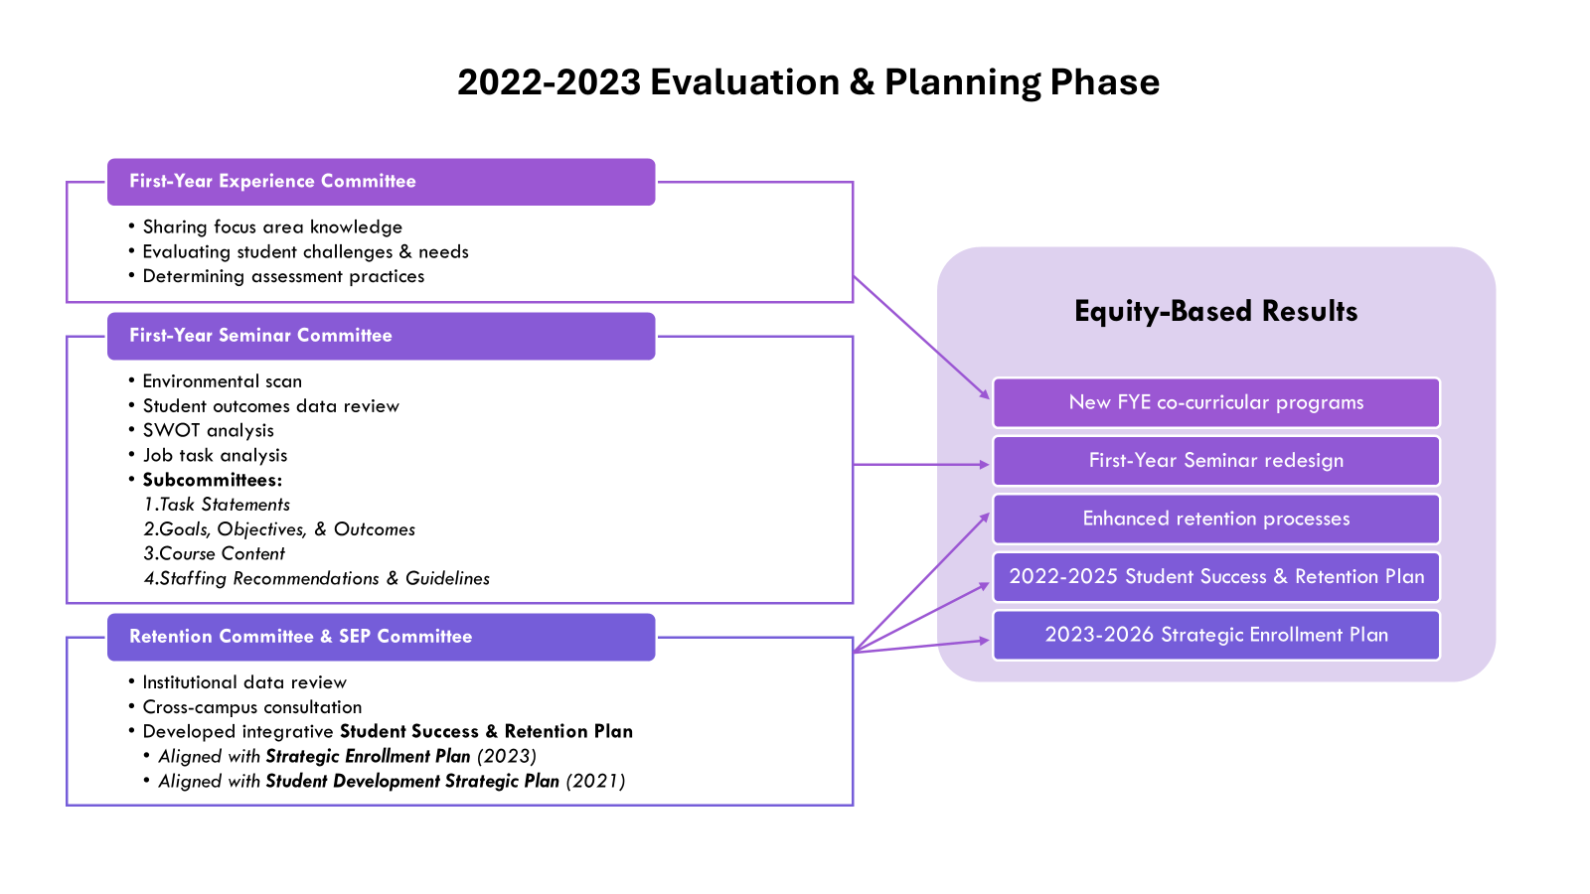
Putting the Data to Work

Slide 52
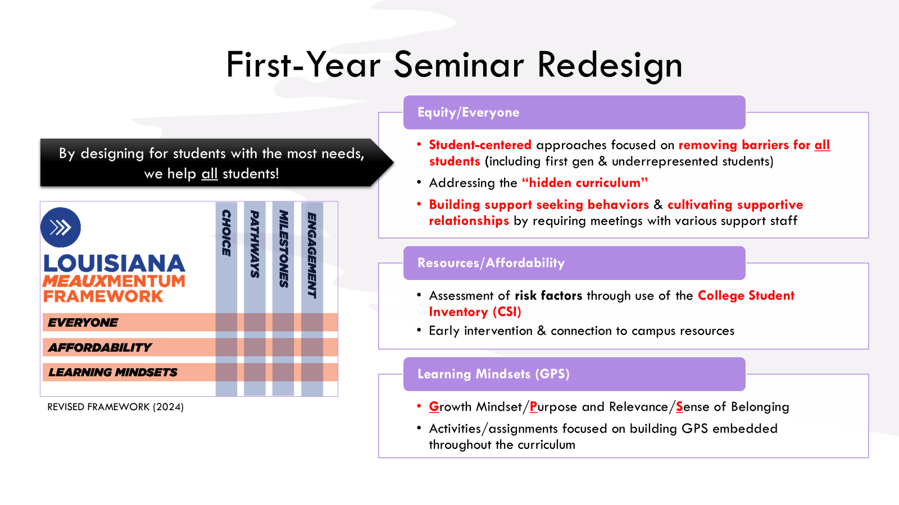
Notes:
Angie P.

Slide 53
Notes:
Angie P.

Slide 54
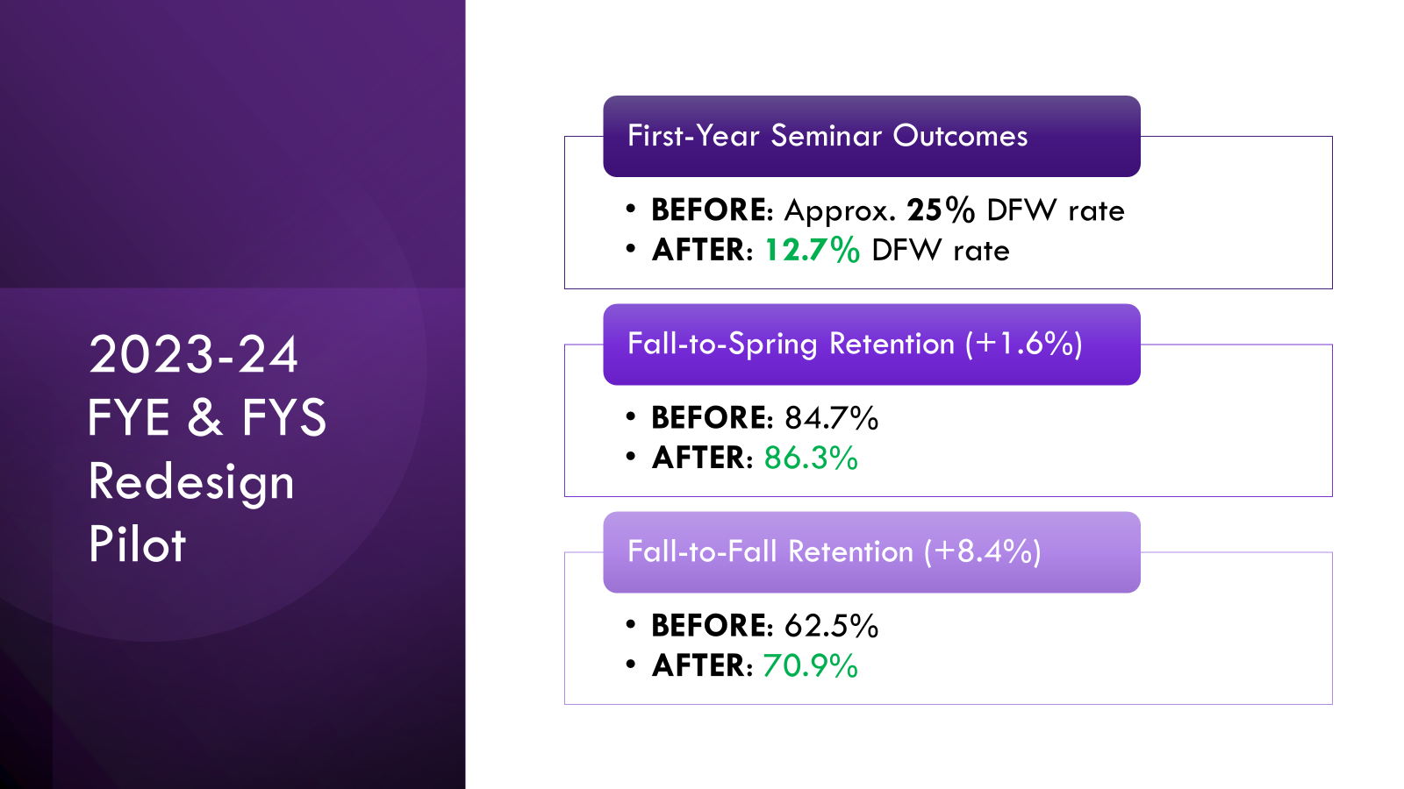
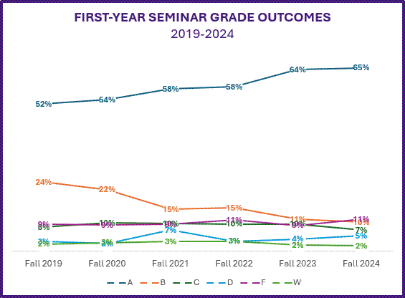
2023-24 FYE & FYS Redesign Pilot
First-Year Seminar Grade Outcomes
BEFORE: Approx. 25% DFW rate
AFTER: 12.7% DFW rate
Fall-to-Spring Retention (+1.6%)
BEFORE: 84.7%
AFTER: 86.3%
Fall-to-Fall Retention (+8.4%)
BEFORE: 62.5%
AFTER: 70.9%

Slide 55
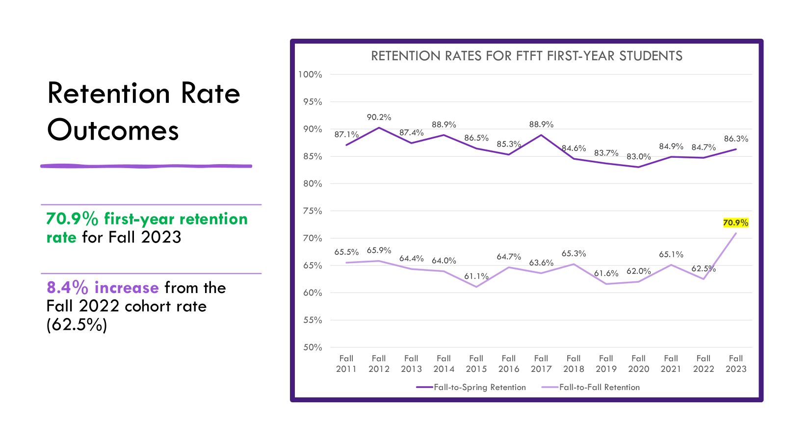

Slide 56
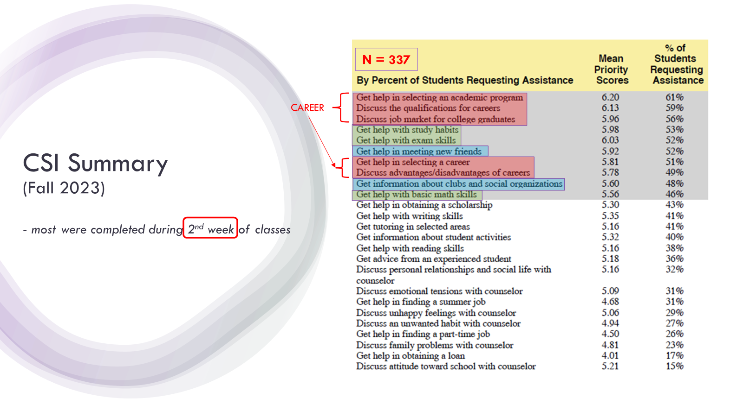
Notes:
Angie P.

Slide 57
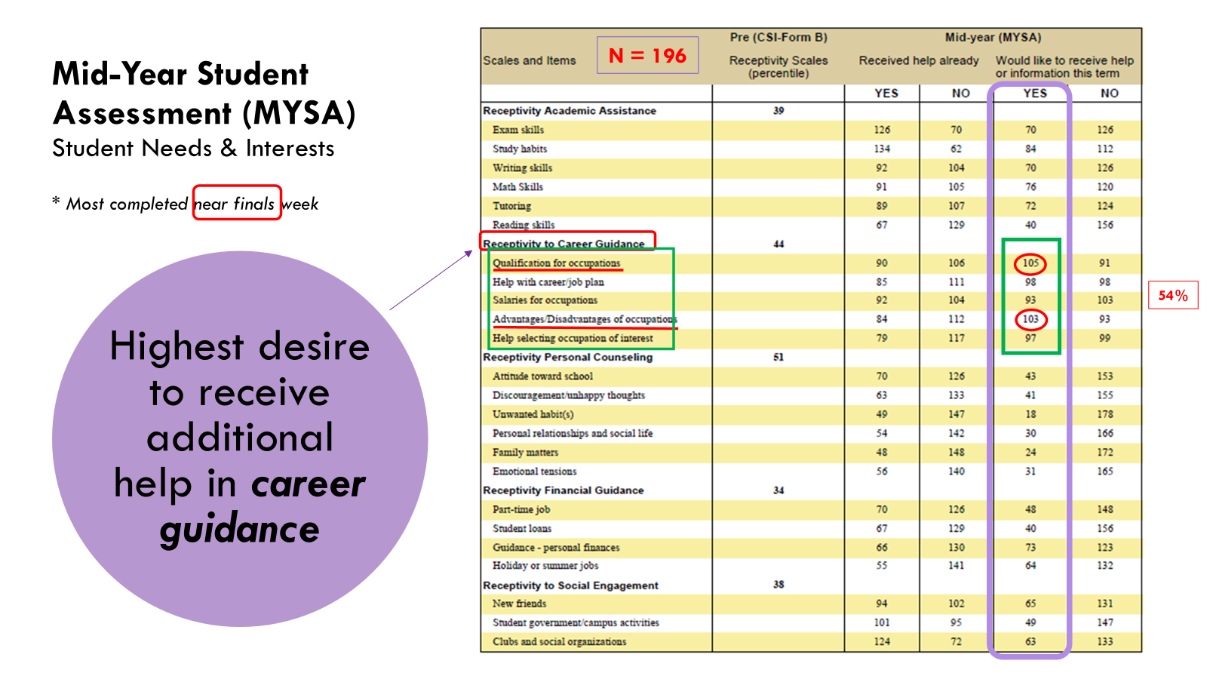

Slide 58
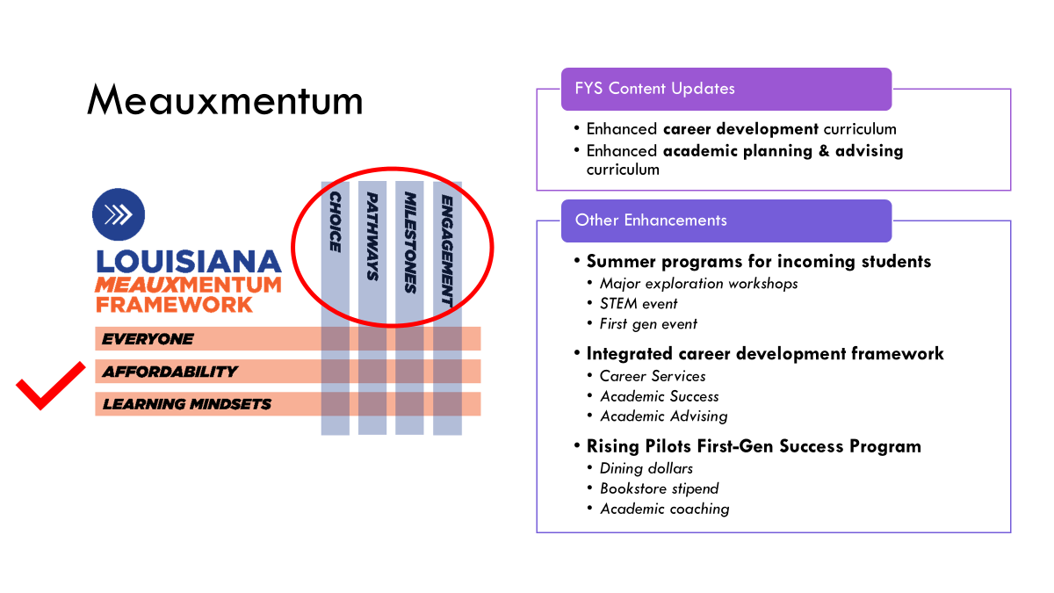
Notes:
Angie P.

Slide 59
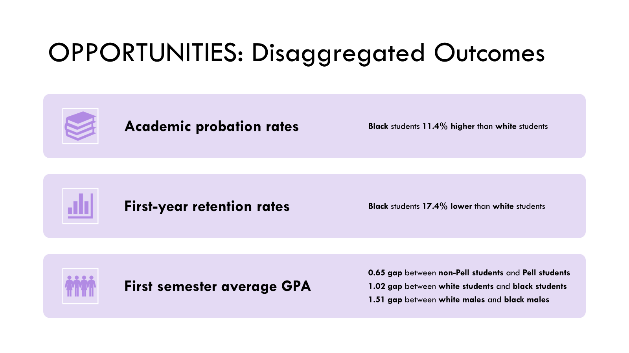
Notes:
Angie P.

Slide 60
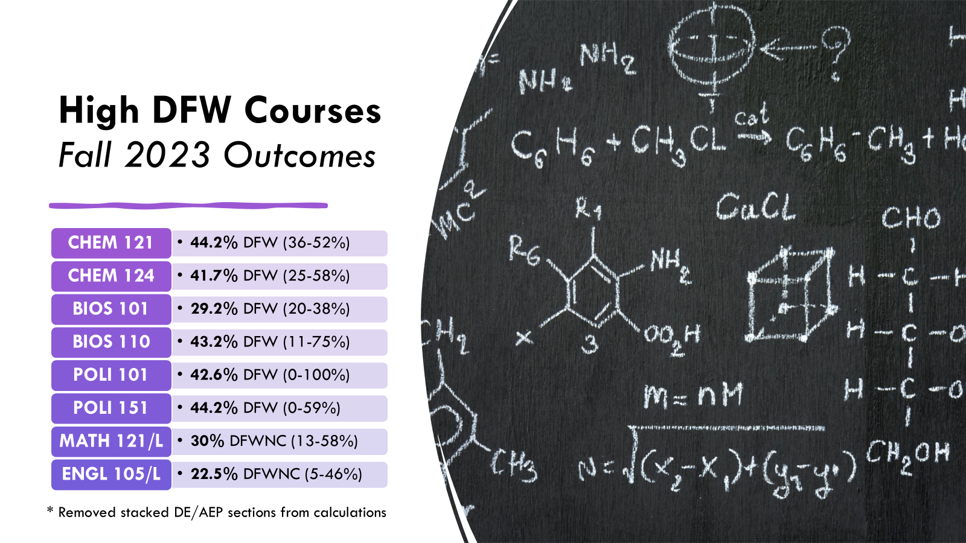
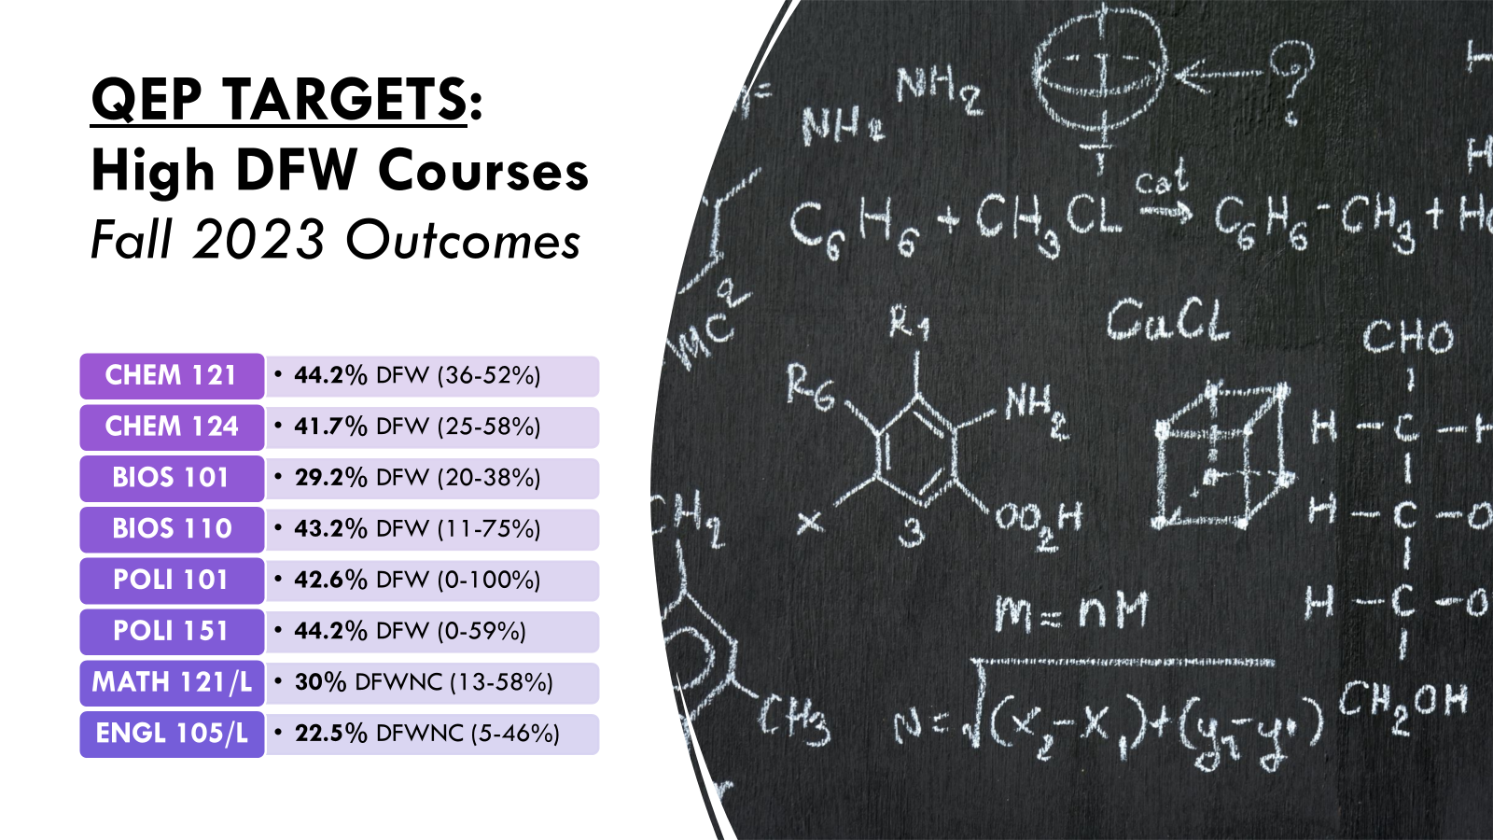
LSUS Transformation
Notes:
Angie P.

Slide 61
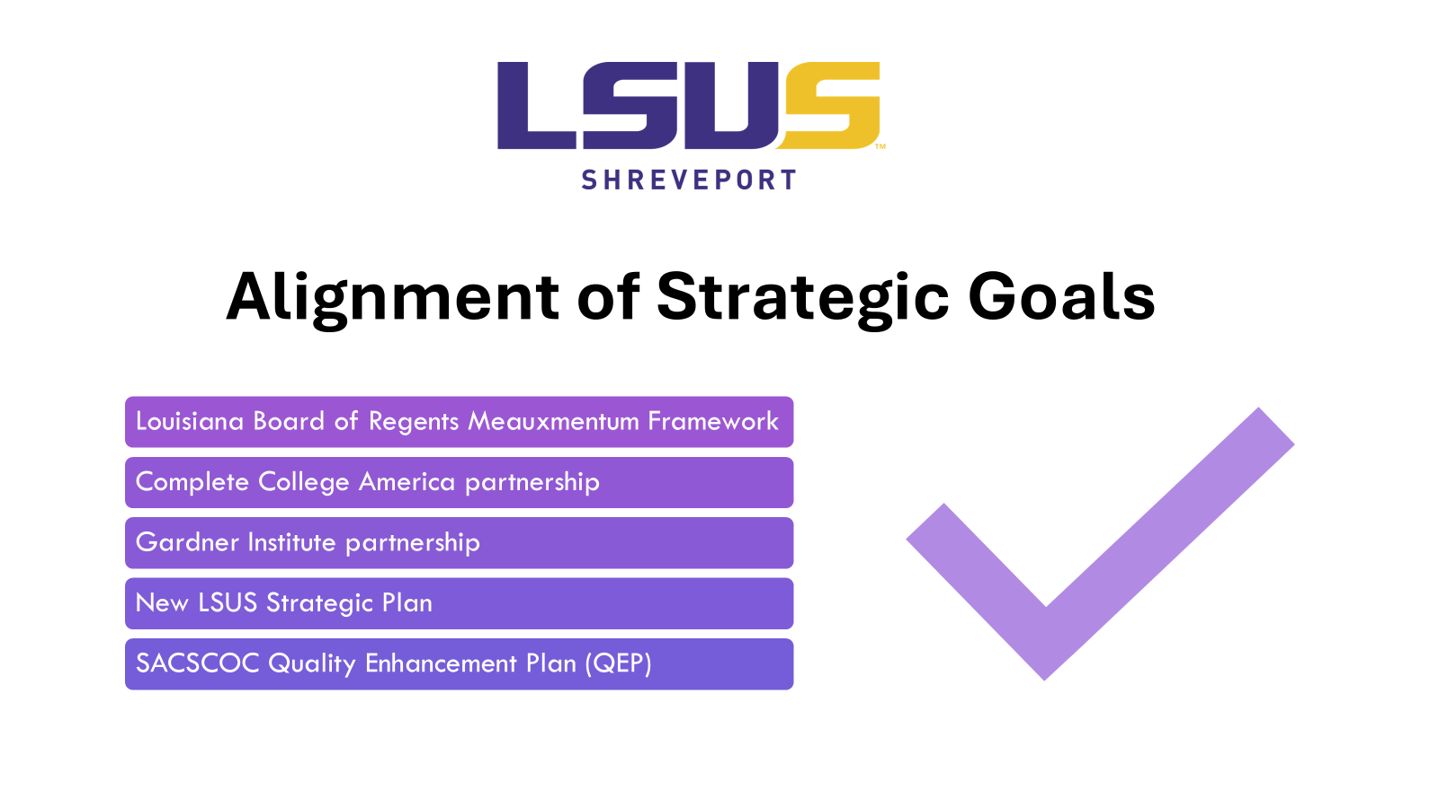

Slide 62
Takeaway:
Meauxmentum tools can be used along with new and existing data at the institution to drive decision making.

Slide 63
Synthesis: Breakouts to Apply Learning and Plan
Session 1
Hop into Padlet and respond to three
critical questions.
https://padlet.com/GardnerInstitute/meauxmentum-discussions-april-2025-1ock9gjjwdfj8uba
Share out with the group
(free books for participation).
SESSION 1
gardnerinstitute.org
Notes:
Angie

Slide 64

Synthesis: Breakouts to Apply Learning and Plan
Session 2
Hop into Padlet and respond to three
critical questions.
https://padlet.com/GardnerInstitute/remake-of-meauxmentum-discussions-session-2-april-2025-f9z4bhwmpt6uyixj
Share out with the group
(free books for participation).
SESSION 2
gardnerinstitute.org
Notes:
Angie

Slide 65
Want to know more?
Visit Our Group Consultations

Slide 66
Discussion & Questions

Slide 67
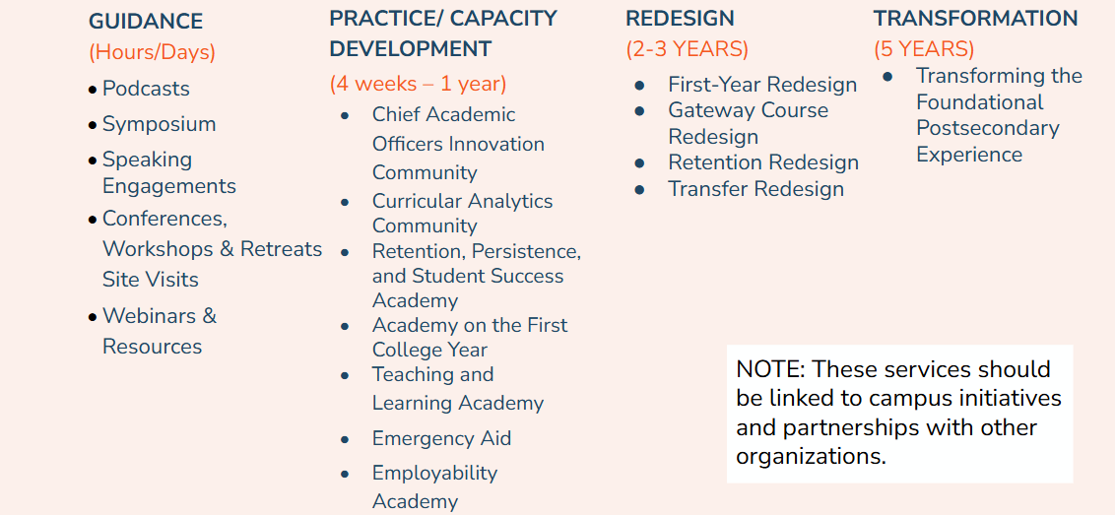
Contact Us

