Slide 1
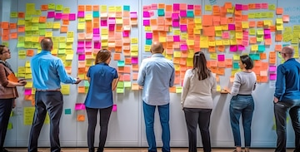
Supporting Faculty in Sustained Course Redesign Efforts
Dr. Jennifer E. Potter, Associate Director, Kirwan Center for Academic Innovation, University System of Maryland

Slide 2
Workshop Objectives
Support Structures
Create support structures, including professional development and mentorship programs, for faculty.
Incentives & Recognition
Develop incentives and recognition for faculty engaged in redesign work to encourage sustained improvement.
Feedback Mechanisms
Establish feedback mechanisms to continually assess and refine redesign efforts based on faculty input.

Slide 3
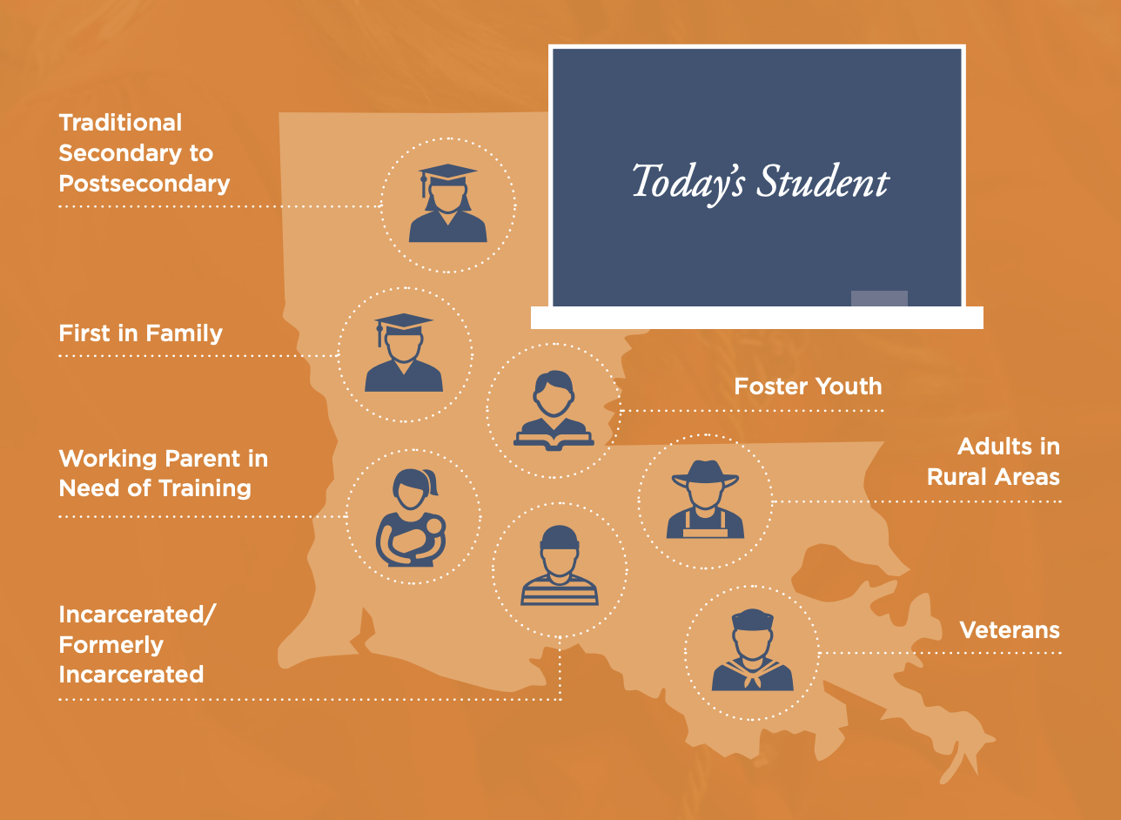

Slide 4
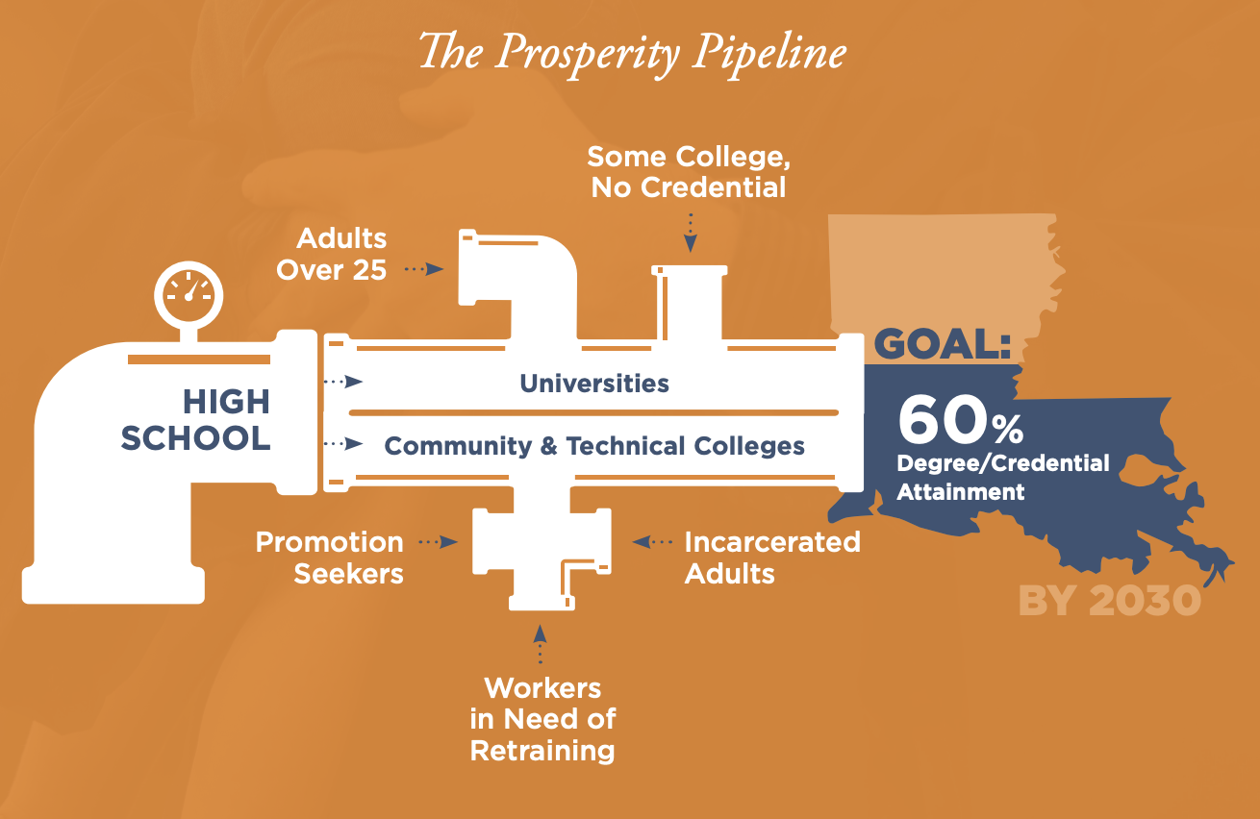

Slide 5
Importance of Course Redesign
Addresses student engagement
Improves student learning outcomes
Fosters a deeper understanding of material
Meets new pedagogical and technological demands

Slide 6
Steps of Course Redesign (Stanton & Bradley, 2013)
Identify issues and successes from the assessment results
1
Analyze issues to identify root-cause problems
2
Brainstorm solutions to root-cause problems
3
Select solution(s) to implement
4
Reorganize course from scratch or modify previous offering
5
Reassess course next offering
6

Slide 7

The Landscape of Course Redesign
Using the TILT framework in assignment design
Employing Universal Design for Learning principles
Active Learning Integration
Improving accessibility of course content
Using, adapting, or creating open educational resources
Integrating credentials, badges, and/or career-ready skills alignment

Slide 8
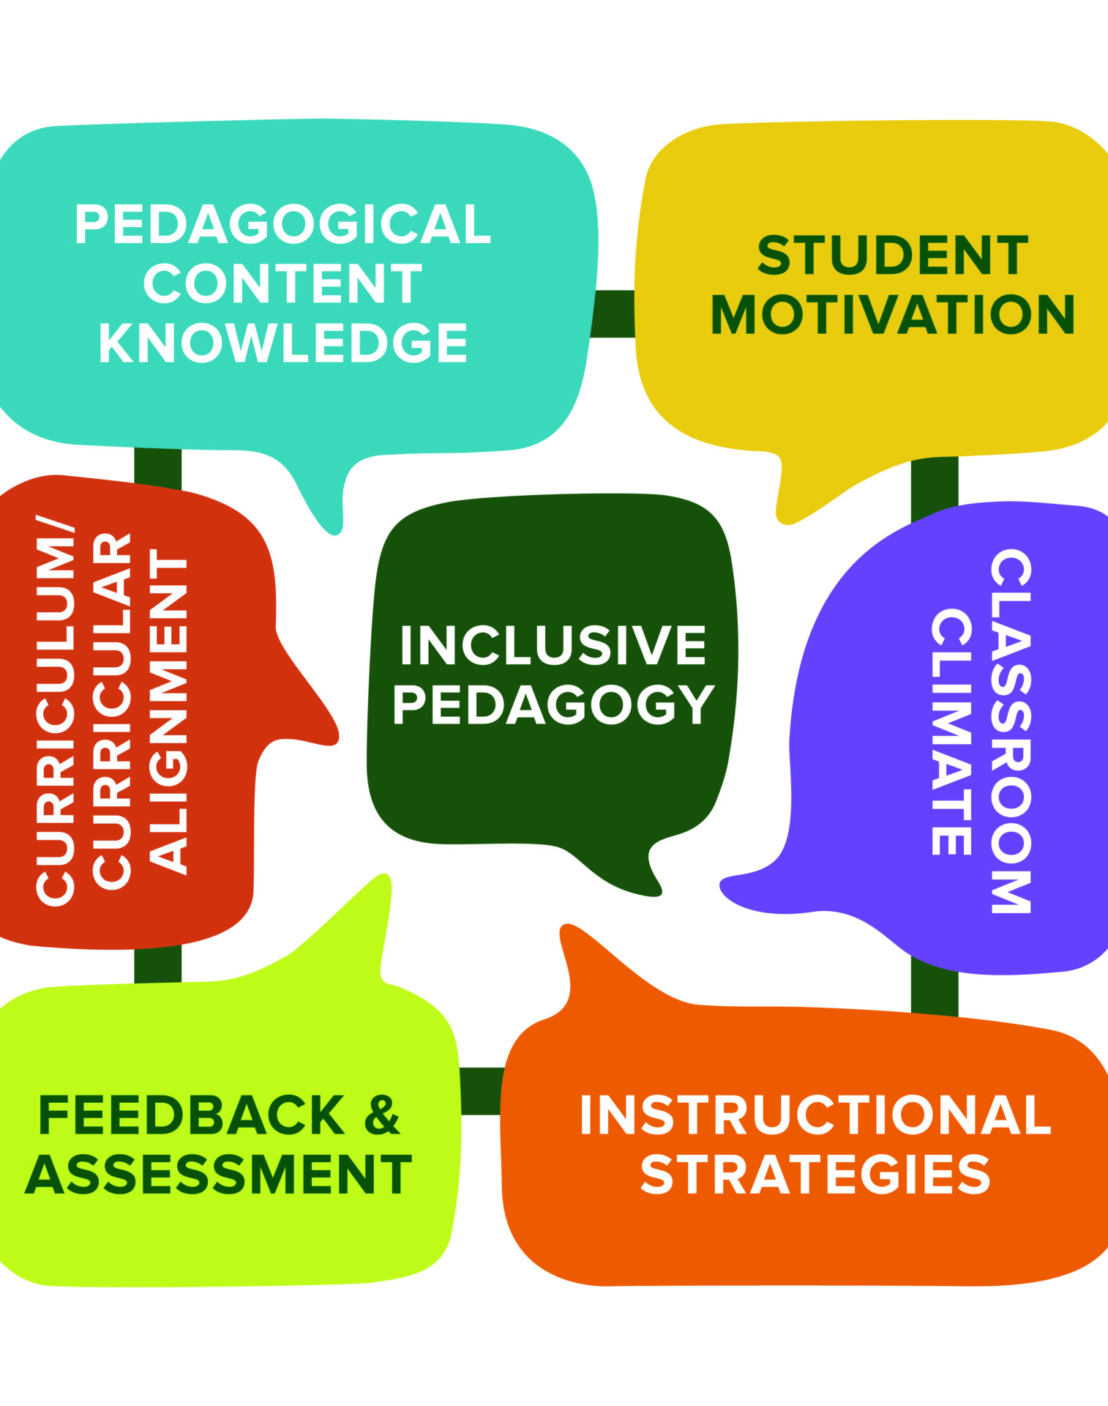
The TILT (Transparency in Learning and Teaching) Framework
Increases course completion rates by providing a clear purpose, task, and criteria, to help students understand how to succeed
Enhances student retention of knowledge by connecting assignments to broader learning goals
Reduces equity gaps for first-generation, underrepresented, and non-traditional students by demystifying “hidden curriculum” expectations
Promotes metacognitive skill development as students better understand the “why” behind assignments
Develops stronger transferable skills as students understand how tasks connect to real-world applications

Slide 9
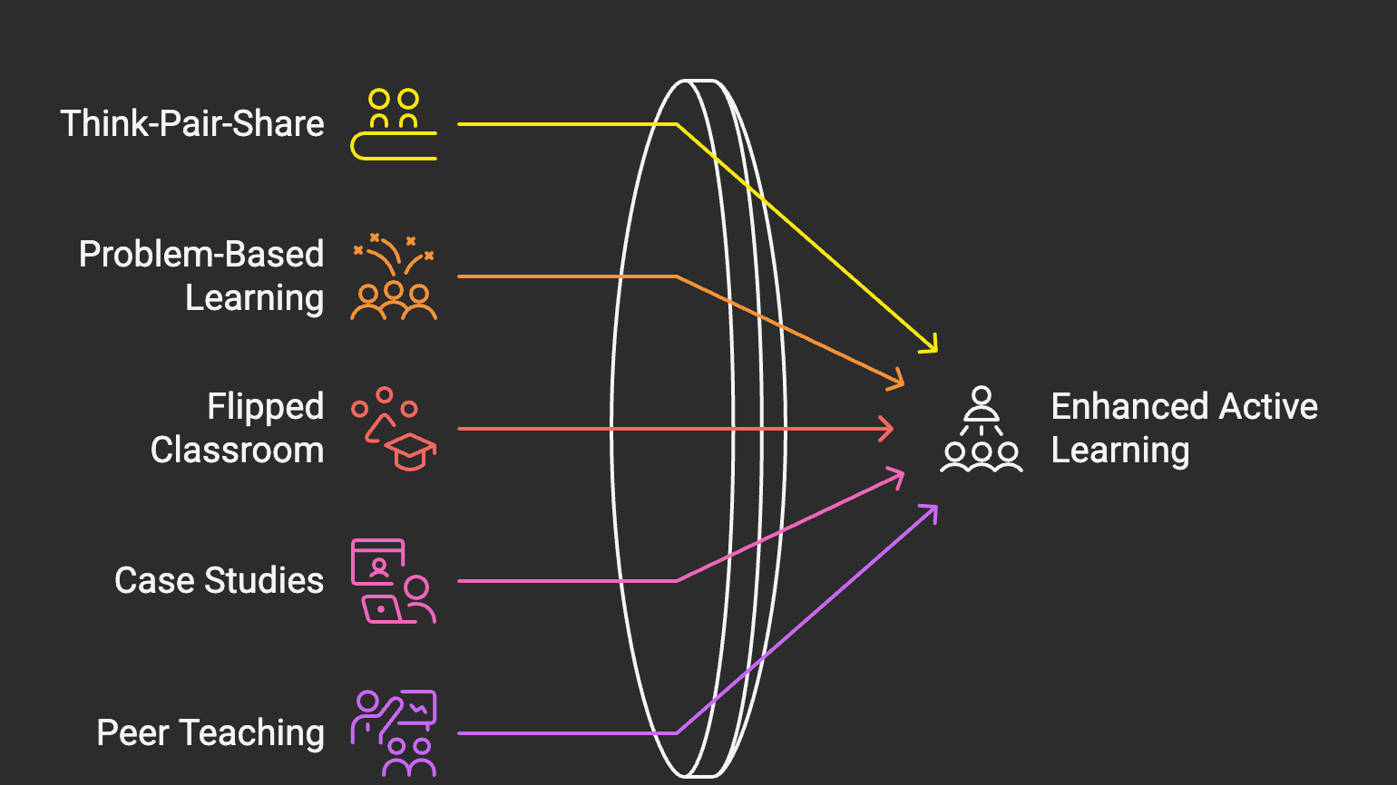

Slide 10
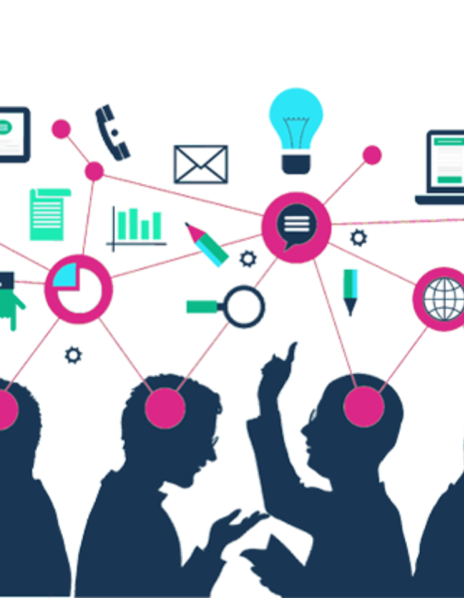
Active Learning Integration
Improves academic performance, with studies showing up to 10-15% higher exam scores compared to traditional lecture formats
Reduces achievement gaps for underrepresented students by providing multiple pathways to engage with content
Increases student motivation and engagement by making learning more relevant and interactive
Builds stronger peer relationships and classroom community through collaborative activities
Develops communication and teamwork skills that are highly valued by employers

Slide 11
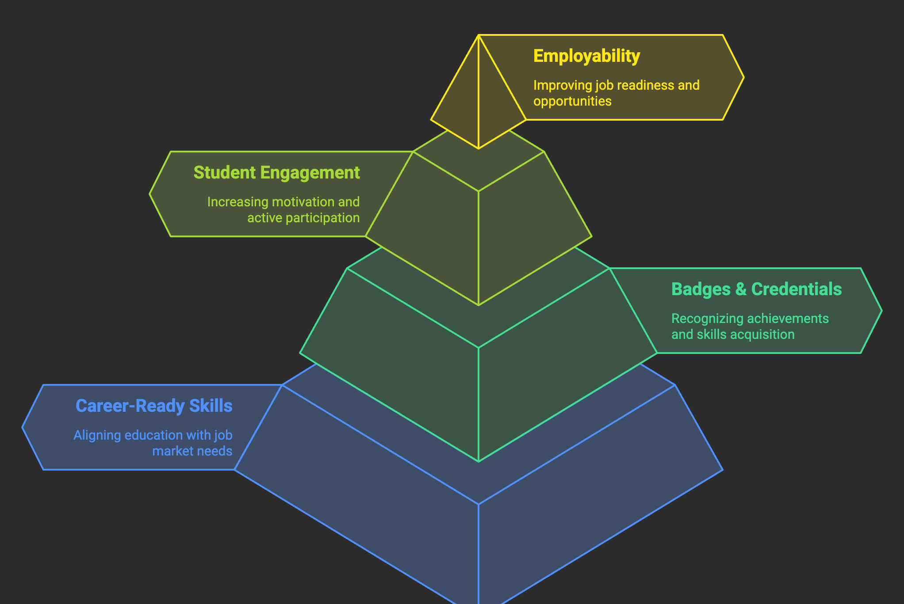

Slide 12
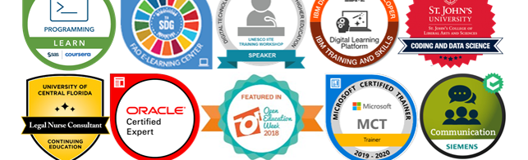
Integrating Credentials, Badges, Career-Ready Skills Alignment
Creates visible pathways between coursework and industry needs, helping students see direct relevance of their education
Provides tangible evidence of skill mastery beyond grades, giving students portfolio items to share with employers
Enables more personalized learning pathways as students can pursue badges aligned with their specific career goals
Helps close equity gaps by recognizing varied forms of learning and competency demonstration beyond traditional assessments
Supports lifelong learning by establishing a framework for continued skill development beyond graduation

Slide 13

Partnering with Faculty in Redesign Efforts

Slide 14
Frameworks for Supporting Faculty in Course Redesign
Communities of Practice (Wenger, 1998): faculty development is most effective when built around collaborative learning communities where knowledge is shared and co-constructed
Diffusion of Innovation Theory (Rogers, 2003): redesign adoption follows other innovation patterns, with faculty ranging from early adopters to laggards, each requiring different supports
Self-Determination Theory (Ryan & Deci, 2000): faculty motivation for redesign is enhanced when their needs for autonomy, competence, and relatedness are supported

Slide 15

Barriers to Faculty Engagement in Course Redesign
(Lack of) Time and (Too Much) Workload
Knowledge and Skill Gaps
Incentive and Recognition Deficits
Institutional and Cultural Obstacles
Sustainability and Impact Concerns

Slide 16

Barrier #1: Time and Workloads
Provide course release time
Create summer redesign institutes
Collaborate with student assistants
Define redesign project scopes
Implement incremental redesign over a defined period
Notes:
Course release time—agreed upon deliverables and timeline; focus on “model” courses that can benefit multiple sections of a course
Summer redesign institutes: Writing Center, Instructional Design team
Student Assistants: ULA programs, work study programs
Project Scopes: 1, 3, 5 years—what’s a reasonable timeline? What’s most important right now?

Slide 17
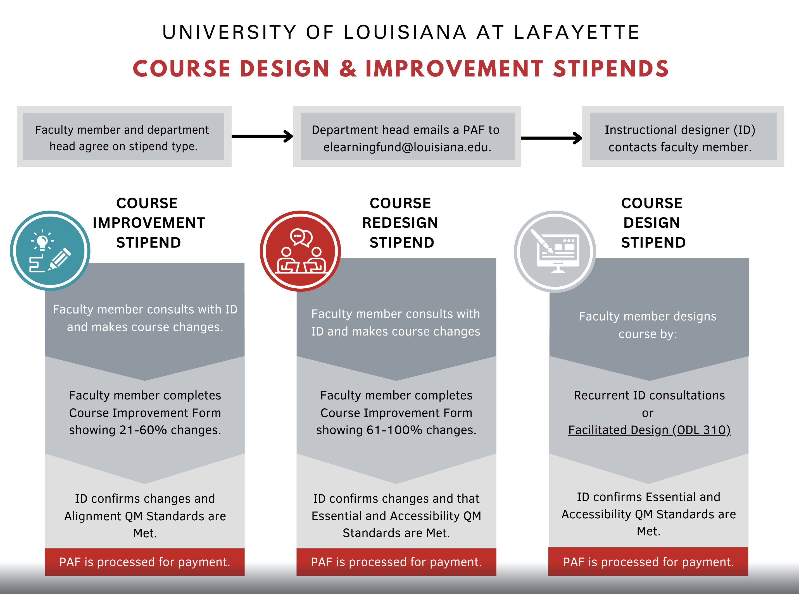
Case Study: Offer Course Redesign Stipends

Slide 18
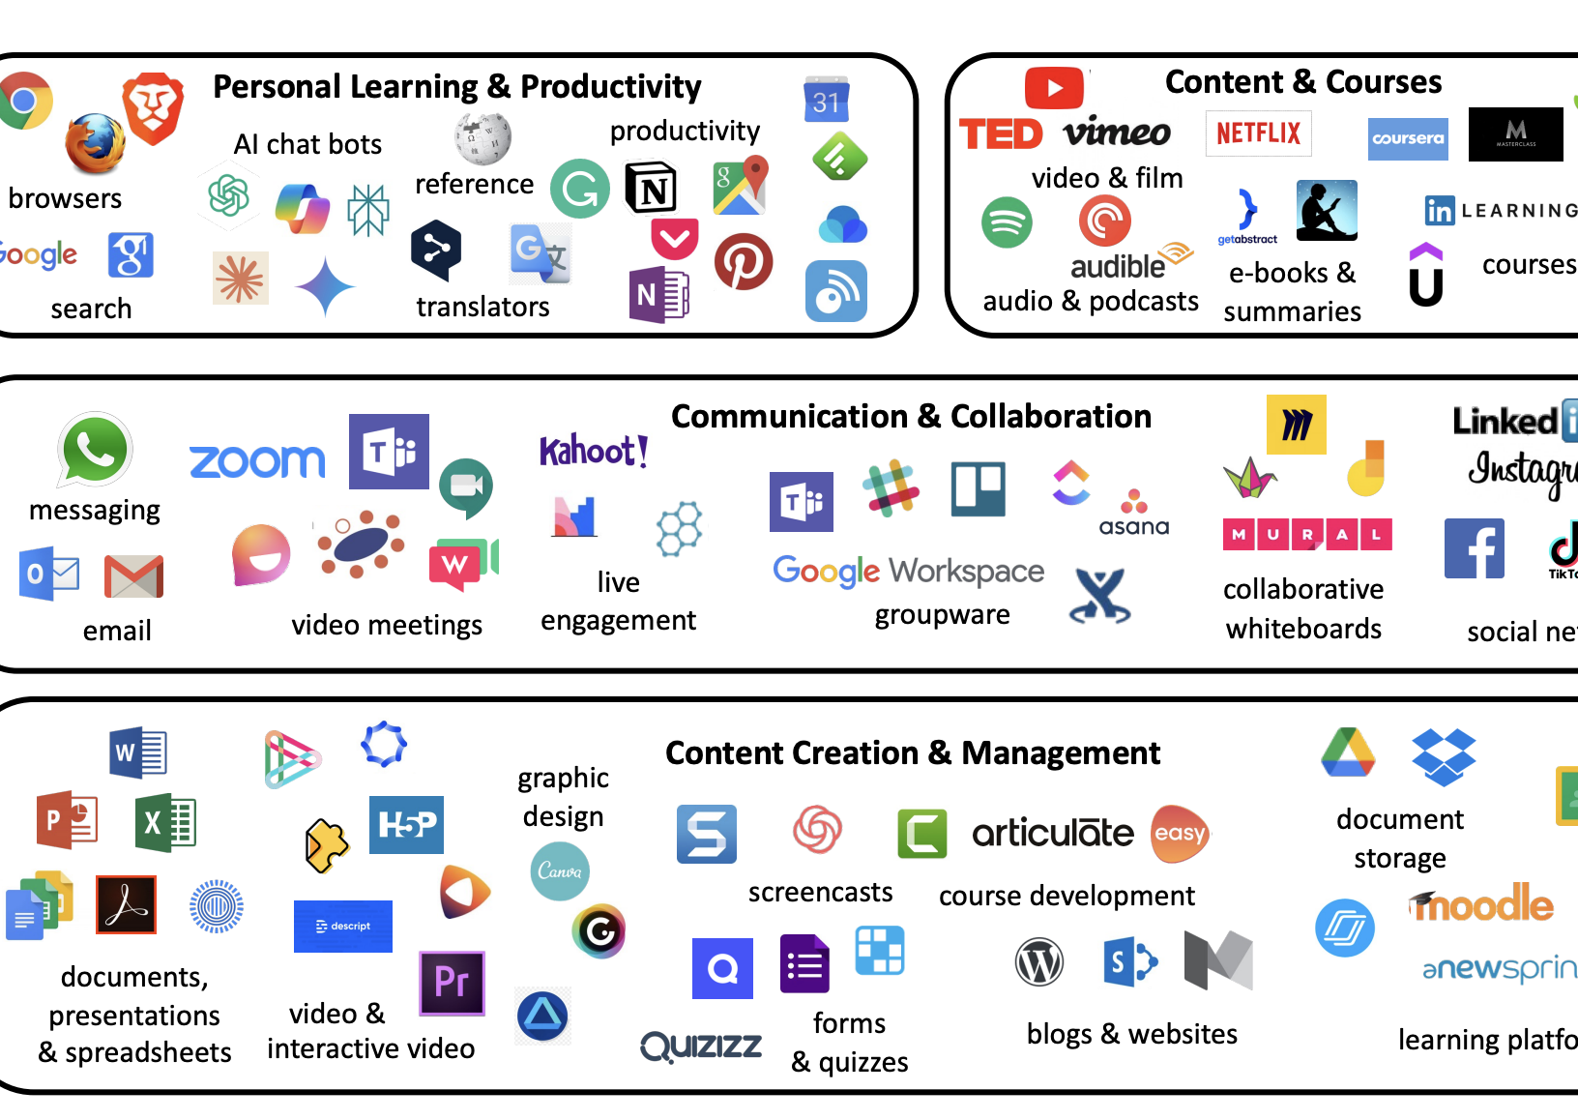
Barrier #2: Knowledge and Skill Gaps
Involve faculty in selection, adoption, and testing of new technologies
Develop tiered training programs
Establish instructional design partnerships
Create technology sandboxes
Implement peer mentoring
Develop just-in-time support materials
Notes:
Selection, adoption, and testing—faculty ed tech committees, focus groups, faculty-led pilots
Fellows/pilot faculty groups/community of practices—early adopters to 1) learn, 2) encourage/help, 3) formally train
Instructional design partnerships—async programming, ID consults; invest in ID
Tech Sandboxes—LMS, ChatGPT Team
Peer Mentoring—formal programs, mentor training, formalized at all ranks
Just-in-time support—YT videos for faculty!

Slide 19
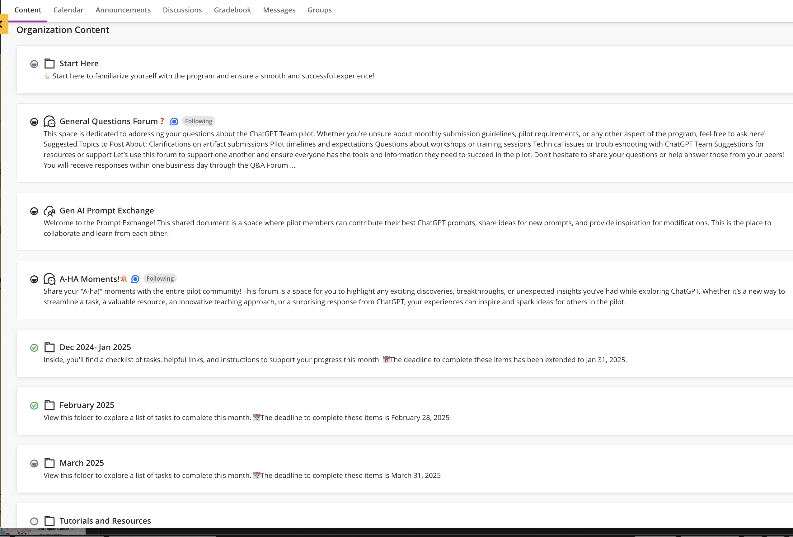
Case Study: Create Faculty Sandboxes

Slide 20

Barrier #3: Incentive and Recognition Deficits
Publicize success stories
Support Scholarship of Teaching and Learning (SoTL)
Provide financial incentives
Create/repurpose teaching excellence awards
Implement digital credentials/professional certifications for faculty development achievements
Revise P&T guidelines
Notes:
Publicize success—specific and consistent faculty success sharing—LinkedIn, stories, social, etc.
SoTL—fellowships, grants, publications toward tenure
Teaching awards for redesign with financial incentives (travel awards)
Digital credentials—Digital Accessibility, AI, trauma-informed teaching, QM, etc.
P&T—leadership in course design

Slide 21
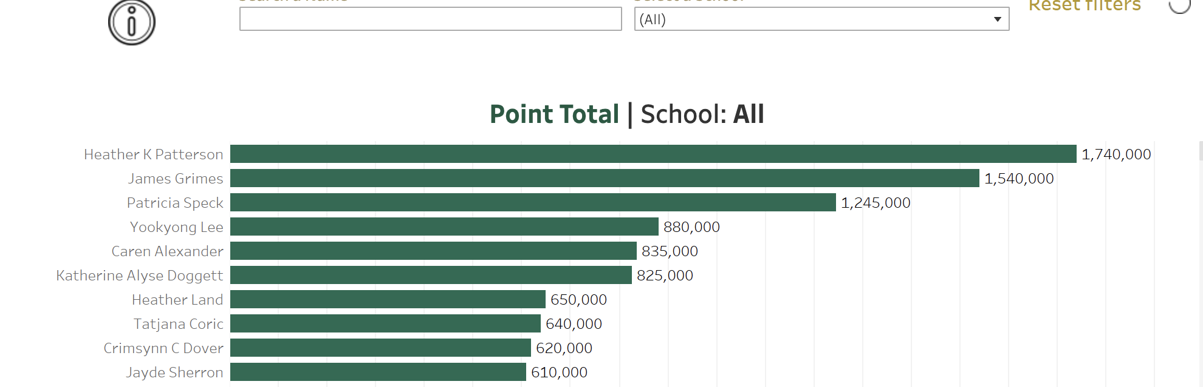
Case Study: UAB’s Faculty Competition

Slide 22
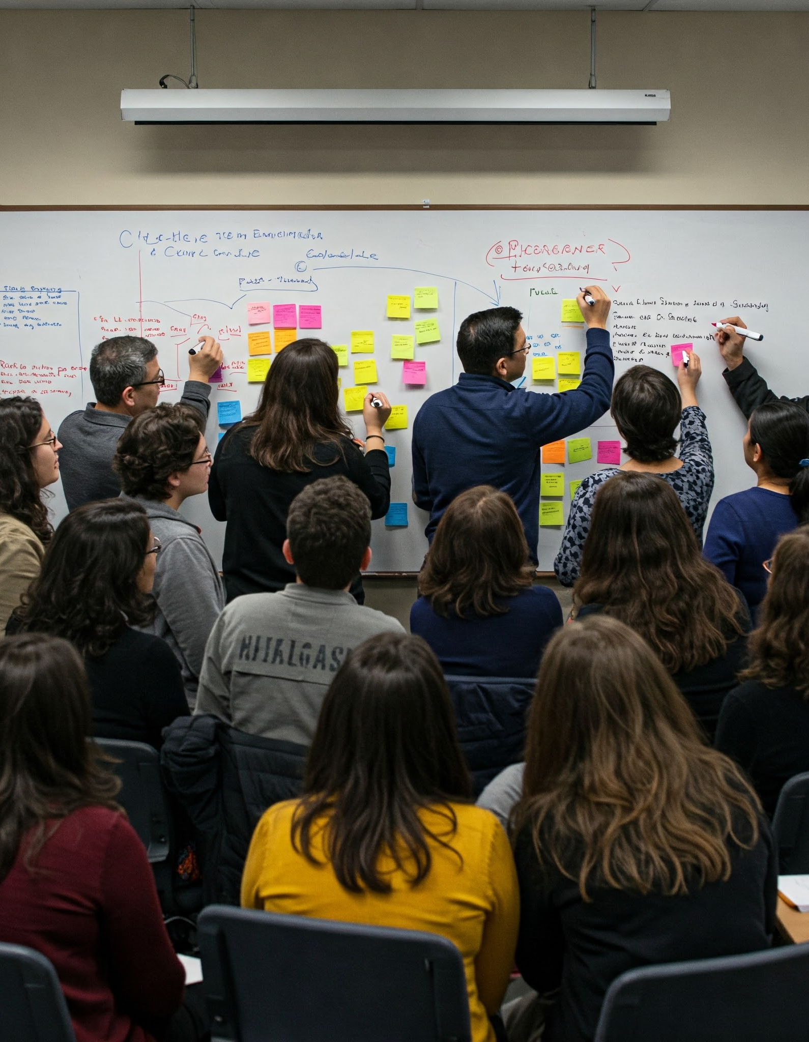
Barrier #4: Institutional and Cultural Obstacles
Identify faculty champions
Engage department chairs
Align redesign efforts with strategic priorities
Focus on catapult courses
Address student evaluations
Generate departmental buy-in
Promote interdepartmental collaboration
Notes:
Chairs are your best friends
Catapult courses—high enrollment OR high DFW
Student evals—focus on feedback, pair with peer observation that is focused on professional development
Department buy-in: both/and, yes…and…
Interdepartmental—opportunities to shine alongside other departments is a nice incentive

Slide 23
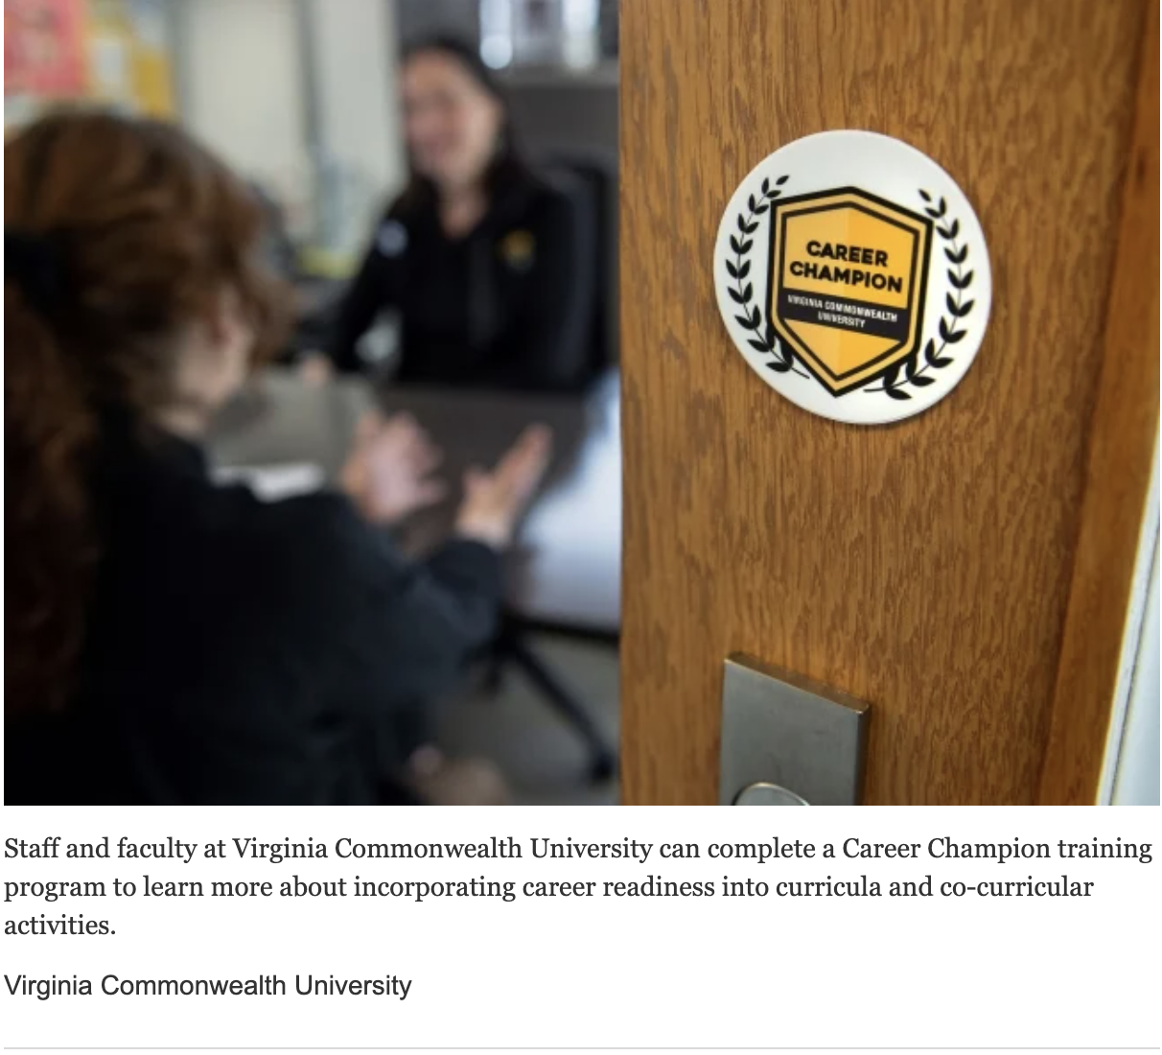
Case Study: Faculty Career Champions

Slide 24
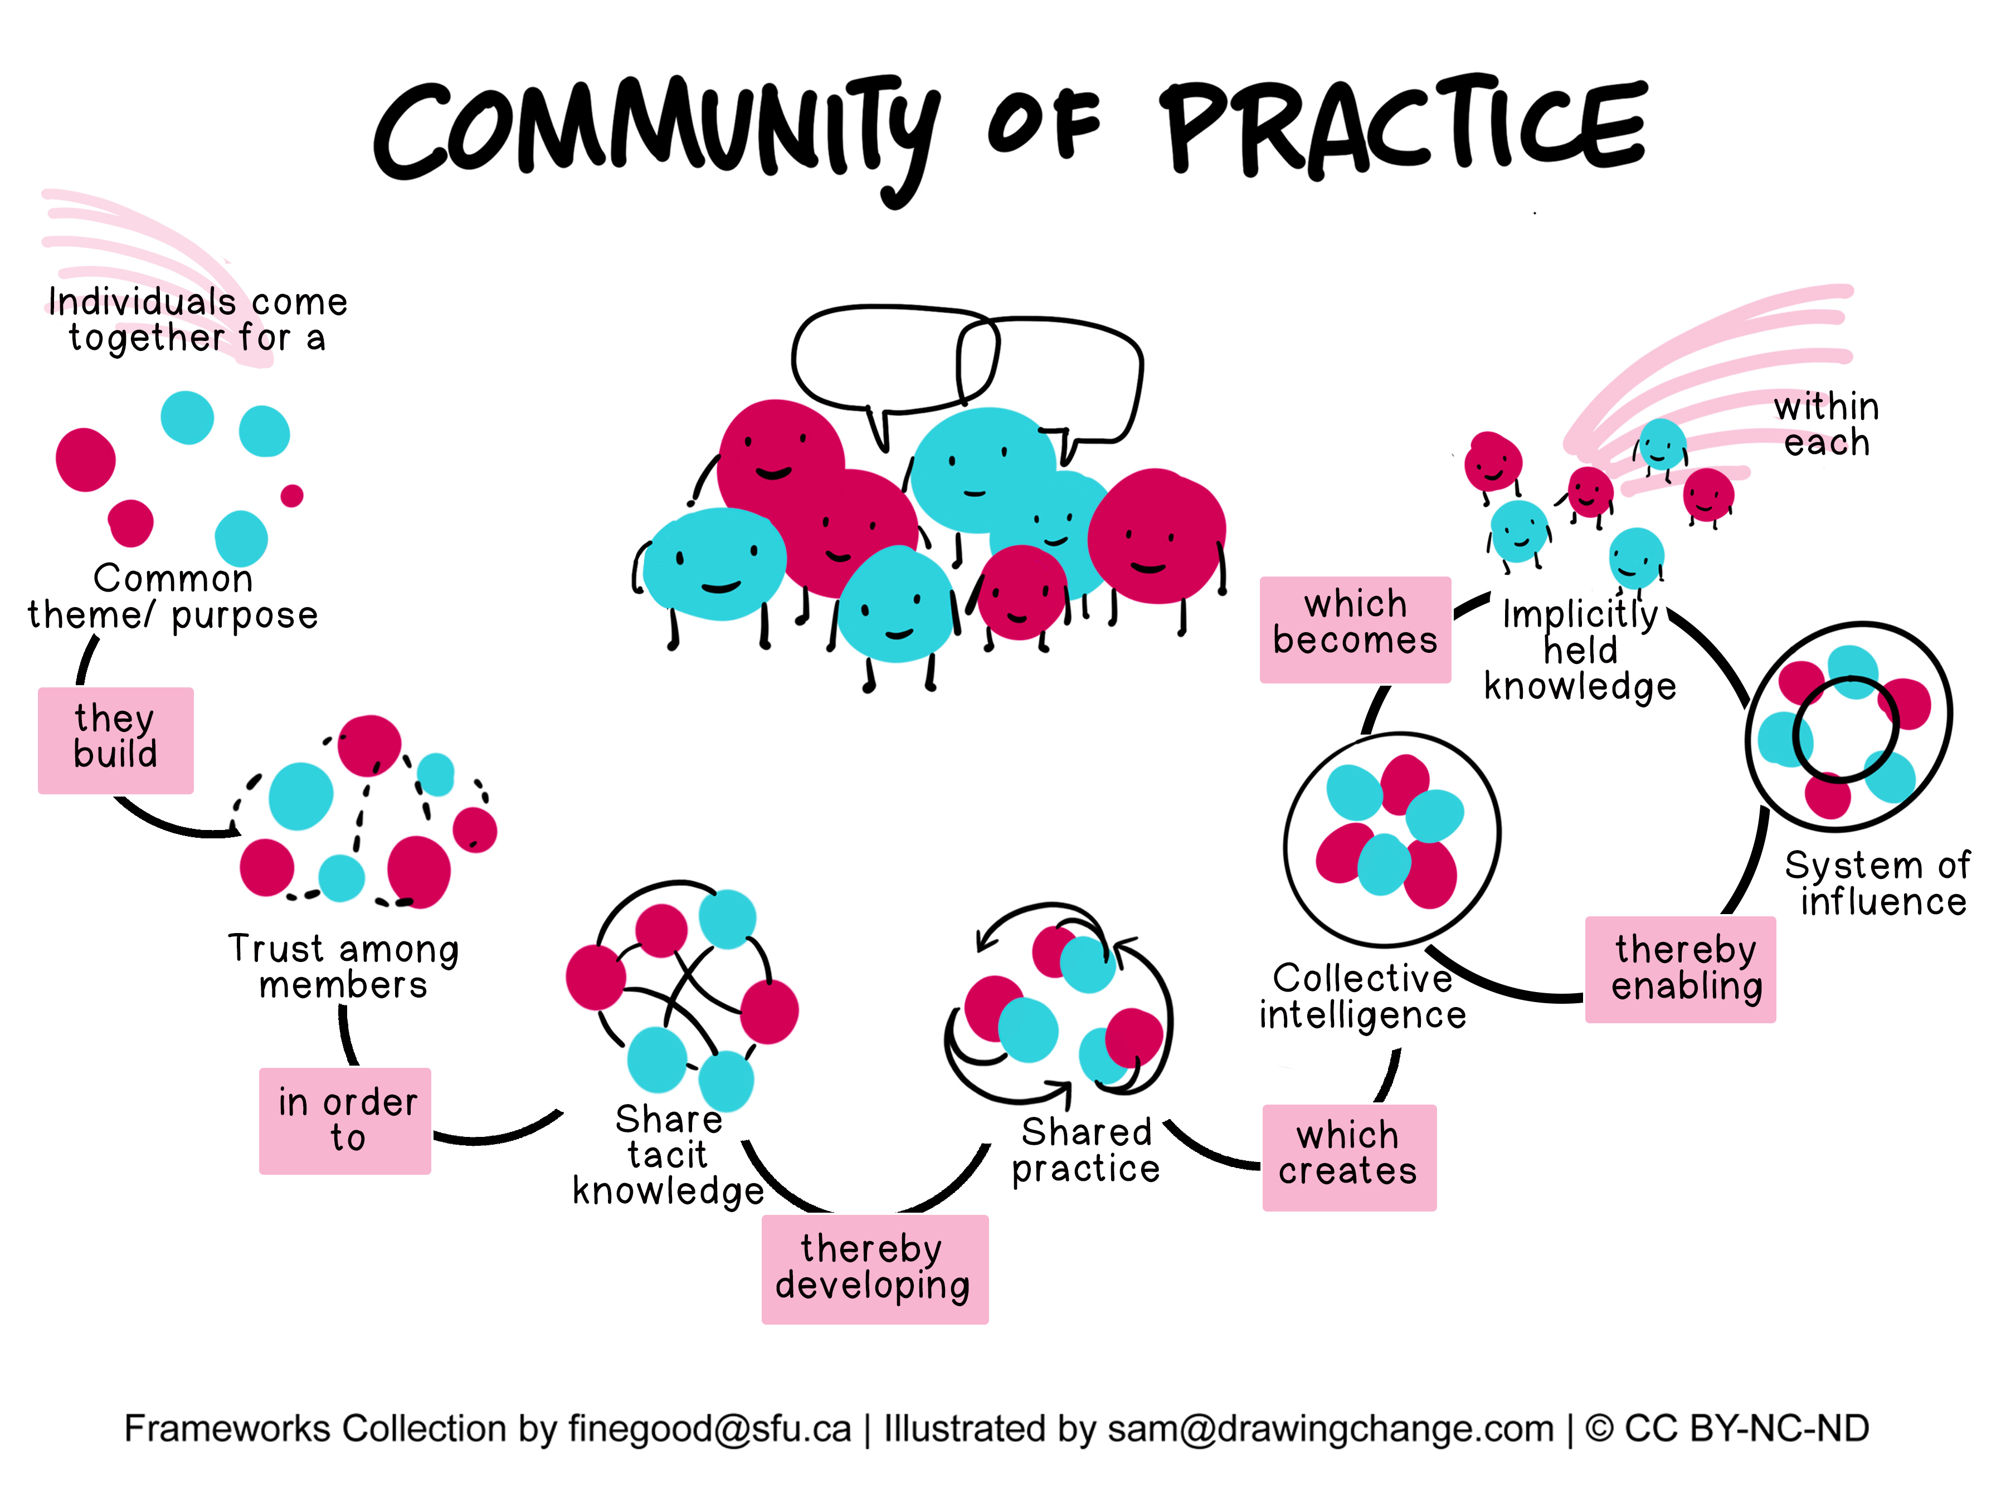
Barrier #5: Sustainability and Impact Concerns
Share evidence of impact
Build redesign communities of practice
Create ongoing support structures
Implement technology sustainability plans
Develop assessment frameworks to measure redesign efforts
Create redesign maintenance funding
Notes:
Communities of practice all day
Ongoing support structures—opportunities to continue the conversations
Tech Sustainability—no more new tools!
SoTL allows for ongoing
Assessment frameworks—not for box-checking but for exciting work on course redesign

Slide 25
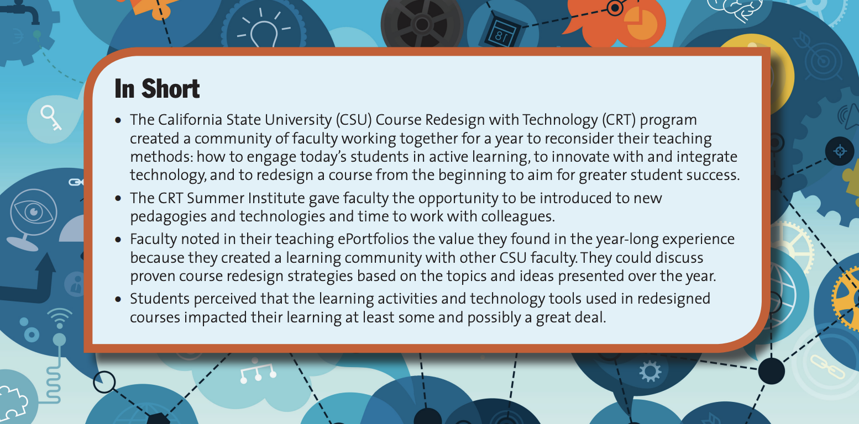
Case Study: Communities of Practice

Slide 26
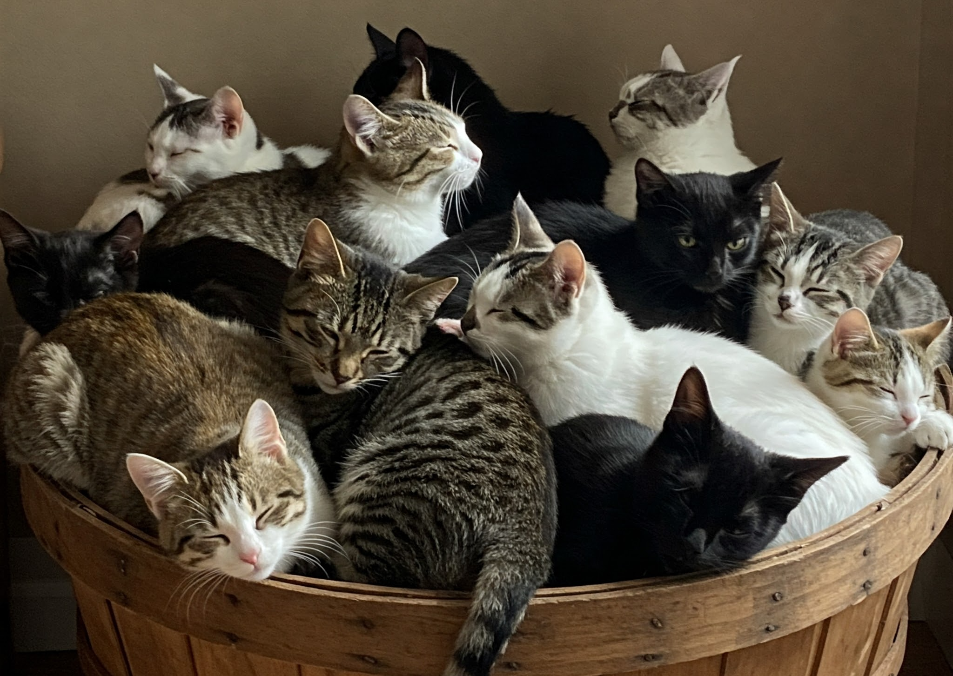
Building Long-Term Support Systems
Creating or adapting course design best practices and evaluative tools
Identifying effective support structures
Incorporating training and development programs
Building peer mentorship initiatives
Allocating resources strategies
Notes:
What can you do with what you have?
Training—cross-collab, faculty fellows, grant support
Peer mentorship—mentor training, mentoring constellations
Resource allocations—where can we find a bit?

Slide 27
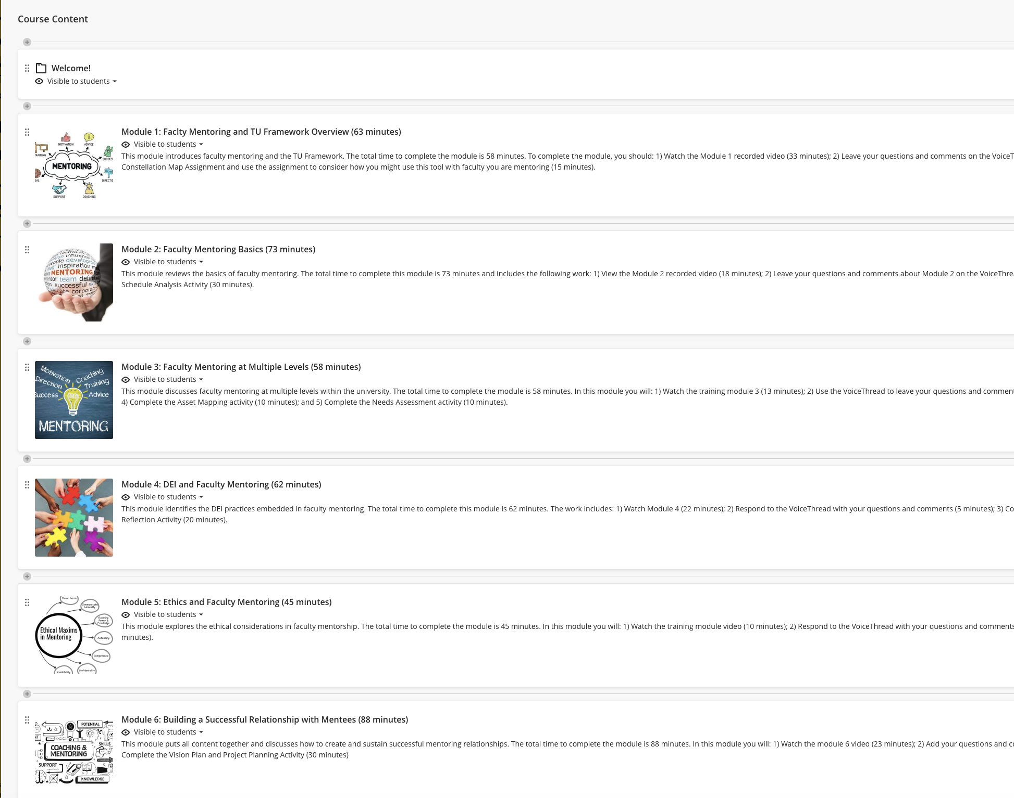
Case Study: Building a Faculty Mentoring Training Program

Slide 28
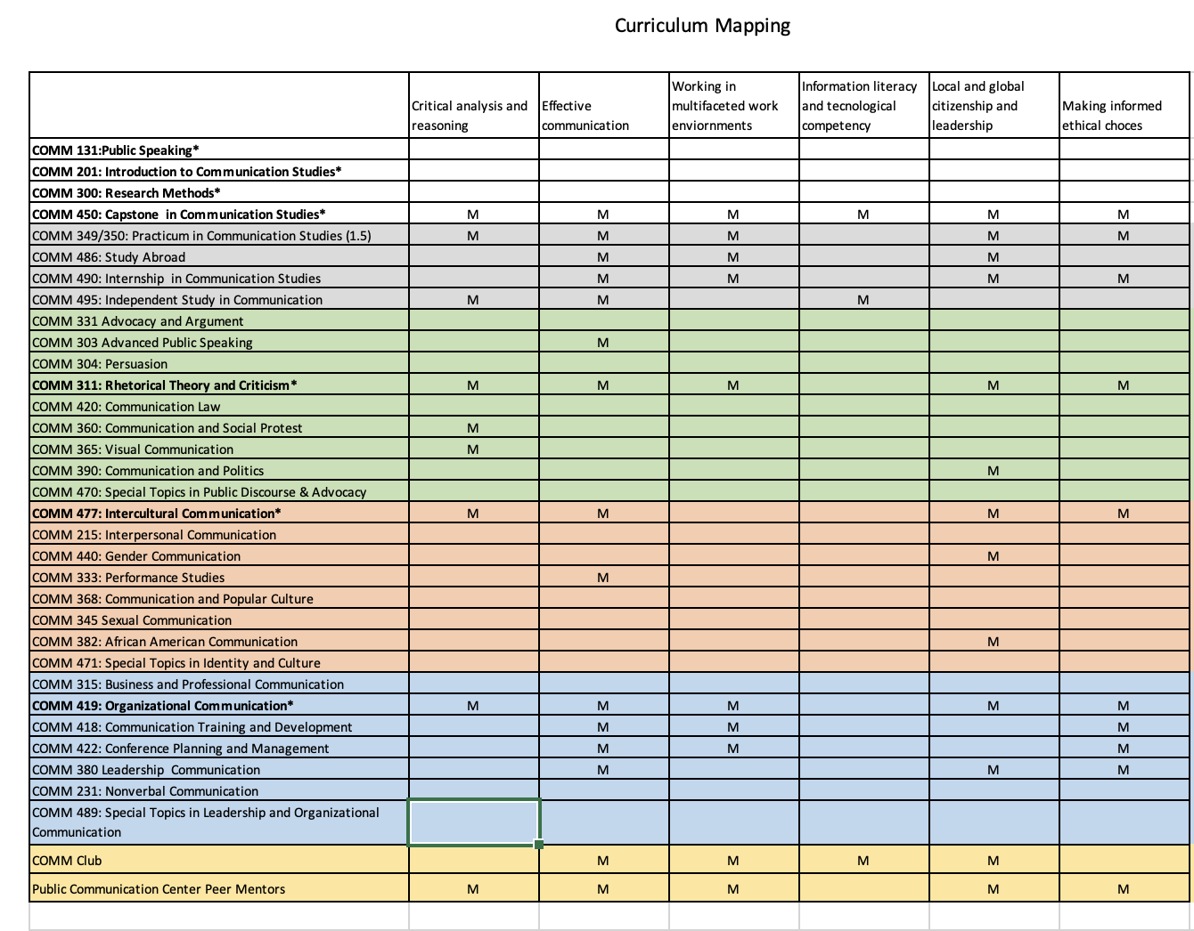
Implementation Strategies
Collaborative Mapping of Course Outcomes
Integrating Technology in Course Design
Assessment
Engaging students, faculty, and administrators
Notes:
Course/Program/University SLO mapping
Leverage QM
Assessment done right
Tech when it solves a problem
Play nicely together

Slide 29
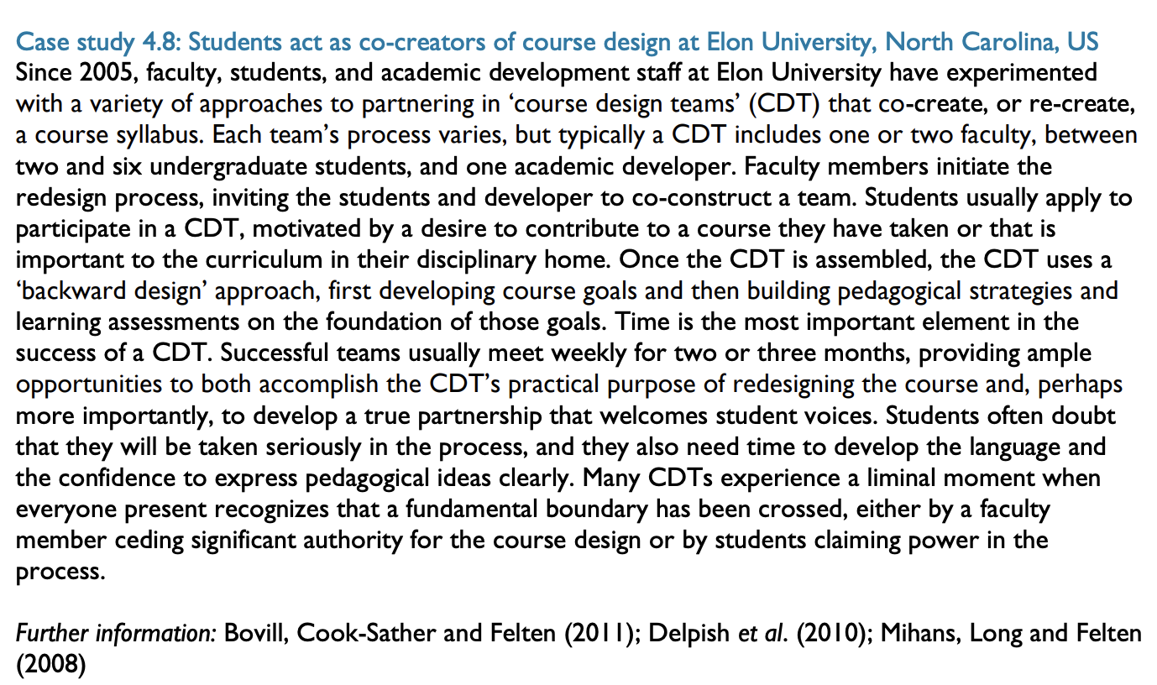
Implementation Case Study: Engage Students in Course Design

Slide 30
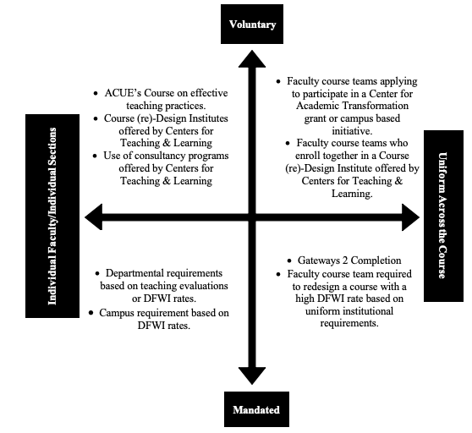
Considering Institutional Impact

Slide 31
Metrics for Success in Course Redesign
Institutional Outcomes
Student retention rates
Declining DFW rates
Persistence to degree completion
Student Outcomes
Learning outcomes and academic performance
Student engagement levels
Motivation and beliefs about the course or discipline
Skill development
Student satisfaction
Long-Term Outcomes
Employability of graduates
Performance in subsequent courses
Diversity and performance of disadvantaged students

Slide 32
Feedback Mechanisms
Post workshop/training surveys—built into workshop to increase completion rates
Peer and student feedback
Disciplinary/programmatic alignment
Assessment data—track progress and outcomes

Slide 33
References
Becker, J. K., Bishop Simmons, S., Fox, N., Back, A., & Reyes, B. M. (2022). Incentivizing information literacy integration: A case study on faculty–librarian collaboration. Communications in Information Literacy, 16 (2), 167–181. https://doi.org/10.15760/comminfolit.2022.16.2.5
Board of Regents of the University of Louisiana System. (2022, September). Louisiana prospers: Driving our talent imperative. https://www.laregents.edu/wp-content/uploads/2022/09/Full-Report-FINAL.pdf
Campbell, R., & Blankenship, B.B. (2020). Leveraging the power of course redesign for student success. To Improve the Academy: A Journal of Educational Development, 39(2), 51-74. http://dx.doi.org/10.3998/tia.17063888.0039.203
CAST (2024). Universal Design for Learning Guidelines version 3.0. Retrieved from https://udlguidelines.cast.org
Clarke, K., Gibbs, H., McDonald, A., Parsons, J., & White, M. (2024). Scaffolding trust to advance inclusive teaching through UDL: A model for academic development. International Journal for Academic Development, 30(1), 53-67. https://doi.org/10.1080/1360144X.2024.2441219
Demeter, E. (2021). Reflecting on course redesign: How faculty can measure the impact of instructional changes. AAC&U Liberal Education. https://www.aacu.org/liberaleducation/articles/reflecting-on-course-redesign-how-faculty-can-measure-the-impact-of-instructional-changes
Denoyelles, A. (n.d.) How to provide incentives for faculty participation. Teaching Online Preparation Toolkit. https://topkit.org/developing/tools-techniques-strategies/provide-incentives/

Slide 34
References, Continued
Fernandes, K., Christie, B., Bayard, J-P., Kennedy, L. (2019). Large-scale course redesign: Putting reflection into action. Change, 51(3), 34-43. https://doi.org/10.1080/00091383.2019.1606587
Finegood. (n.d.). Community of practice: Collaborative learners [Illustration]. Frameworks Collection. Illustrated by Sam/Drawing Change. CC BY-NC-ND.
Fotuhi, O. (2024, April 18). Why faculty should be part of technology decision making. [Blog Post]. Retrieved from https://edtechmagazine.com/higher/article/2024/04/why-faculty-should-be-part-technology-decision-making
Gazza, E.A. (2015). Continuously improving online course design using the plan-do-study-act cycle. MERLOT Journal of Online Learning and Teaching, 11(2), 291-296.
Grove, T. J., Wilfred, S. P., & Landau, J. (n.d.). Supporting faculty leaders in core course redesign: Overcoming challenges and increasing buy-in through faculty development retreats at Valdosta State University. Gardner Institute. https://gardnerinstitute.org/case-studies/supporting-faculty-leaders-in-core-course-redesign-overcoming-challenges-and-increasing-buy-in-through-faculty-development-retreats-at-valdosta-state-university/
Hart, J. (2024, September). Top tools for learning 2024: Results of the 18th annual survey: Tools by category. https://toptools4learning.com/wp-content/uploads/2024/09/tt4l2024.pdf

Slide 35
References, Continued
Healey, M., Flint, A., & Harrington, K. (2014, July). Engagement through partnership: Students as partners in learning and teaching in higher education. The Higher Education Academy.
Healey, M., Flint, A., & Harrington, K. (2014). Engagement through partnership: Students as partners in learning and teaching in higher education.
Keast, D. (2022, Summer). Using feedforward to improve the course redesign-relaunch process. Online Journal of Distance Learning Administration (OJDLA), 25(2). https://ojdla.com/articles/using-feedforward-to-improve-the-course-redesign-relaunch-process
Kupatadze, Ketevan. (2017, July 11). Course redesign with student-faculty partnership (Part 1). [Blog Post]. Retrieved from https://www.centerforengagedlearning.org/course-redesign-with-student-faculty-partnership-part-1/
Mowreader, A. (2024, February 22). Success program launch: Creating career champions on campus. Inside Higher Ed. https://www.insidehighered.com/news/student-success/life-after-college/2024/02/22/encouraging-career-development-across-university
Nagashima, T and Hrach, S. (2021). Motivating factors among University faculty for adopting Open Educational Resources: Incentives matter. Journal of Interactive Media in Education, 19(1), 1–10. https://doi.org/10.5334/jime.678
Rockwell, S. Kay; Schauer, Jolene; Fritz, Susan; and Marx, David B. (1999). Incentives and obstacles influencing higher education faculty and administrators to teach via distance. Faculty Publications: Agricultural Leadership, Education & Communication Department, 53. https://digitalcommons.unl.edu/aglecfacpub/53

Slide 36
References, Continued
Rogers, E.M. (2003). Diffusion of innovations (5th ed.). New York: Free Press.
Ryan, R. M., & Deci, E. L. (2000). Self-determination theory and the facilitation of intrinsic motivation, social development, and well-being. American Psychologist, 55(1), 68-78. https://doi.org/10.1037/0003-066X.55.1.68
Simon Fraser University Faculty of Science. (n.d.). Community of Practice. Retrieved from: https://www.sfu.ca/complex-systems-frameworks/frameworks/strategies/community-of-practice.html
Stanton, K.C., & Bradley, T.H. (2013). From course assessment to redesign: A hybrid-vehicle course as a case illustration. European Journal of Engineering Education, 38(6), 687-699. https://doi.org/10.1080/03043797.2013.826181
The University of Alabama at Birmingham. (n.d.) CTL Leaderboard. https://www.uab.edu/faculty/ctl/leaderboard
TILT Higher Ed. (n.d.). TILT Higher Ed examples and resources. Retrieved from: https://www.tilthighered.com/resources
Todorinova, L., & Wilkinson, Z.T. (2020). Incentivizing faculty for open educational resources (OER) adoption and open textbook authoring. Journal of academic librarianship, 46(6), 102220. https://doi.org/10.1016/j.acalib.2020.102220

Slide 37
References, Continued
University of Delaware Information Technologies. (2010, January 12). Course redesign and e-portfolios focus on Winter Faculty Institute. https://www1.udel.edu/it/news/course-redesign-and-e-portfolios-focus-winter-faculty-institute.html
University of Louisiana at Lafayette Distance Learning. (n.d.) Course certification. https://louisiana.edu/distancelearning/certifications/course-certification
Vaughan, N.D. (2010). A blended community of inquiry approach: Linking student engagement and course redesign. The Internet and Higher Education, 13, 60-65. https://doi.org/10.1016/j.iheduc.2009.10.007.
Wenger, E. (1998). Communities of practice: Learning, meaning, and identity. Cambridge: Cambridge University Press.

