Slide 1
Applying TILT (Transparency in Learning and Teaching)
To Catapult Courses

Slide 2
Links for Today
Slide Deck: https://bit.ly/MeauxmentumTILTSessionsSlideDeck
Agenda: https://bit.ly/MeauxmentumTILTSessionsAgenda
Mutant Worms (un-TILT-ed & TILT-ed): https://bit.ly/mutantwormsassignment
Un-TILT-ed & TILT-ed Humanities Assignment: https://bit.ly/EnvironmentalHistoryunTILTedTILTed
Introduction to Assignment Charrettes: https://bit.ly/2025AssignmentCharette
Sample Assignment Charette (F2F): https://bit.ly/4f8YFBk

Slide 3
Session Information
Title: Applying TILT (Transparency in Learning and Teaching) to Catapult Courses
Audience: Faculty
Summit Track: Catapult Courses
Topic: TiLT Strategies to Increase Student Engagement and Success

Slide 4
Session Objectives
Train faculty on using TiLT to clarify learning objectives, expectations, and success criteria in catapult courses.
Develop transparent assignment structures to improve student understanding and motivation.
Develop a methodology to evaluate the impact of TiLT on student performance and engagement in foundational courses.

Slide 5
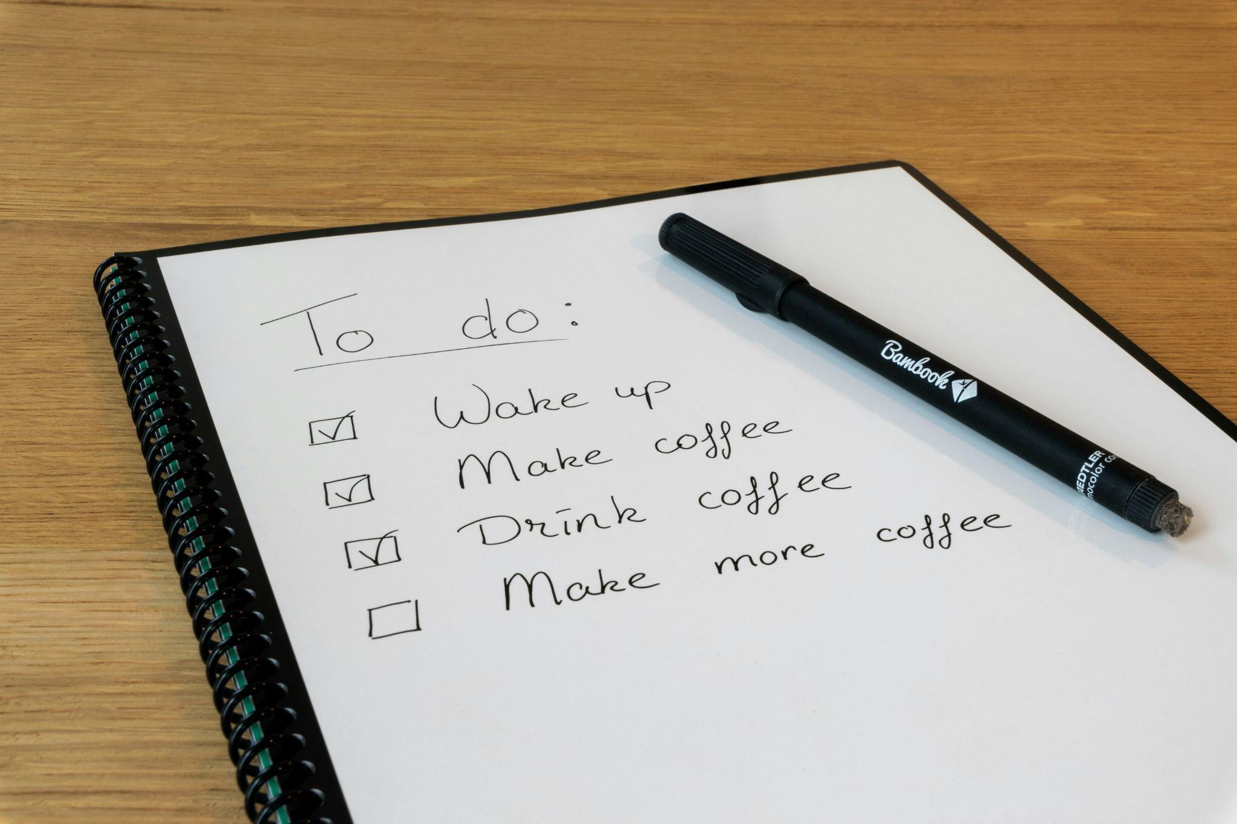
Agenda
Link: https://bit.ly/MeauxmentumTILTSessionsAgenda
Notes:
Photo by Thomas Bormans on Unsplash

Slide 6
Agenda
Remembering Assignments that Mattered (15 minutes)
A Research-Based Rationale: The TILT Study (10 minutes)
TILT in Practice: A Closer Look at Assignment Design (20 minutes)
Charettes: Making the Work Public and Collaborative (15 minutes)
Continuing the Conversation: Lessons from the Field (10 minutes)
Looking Ahead: What Might Your Next Step Be? (5 minutes)

Slide 7
Remembering Assignments that Mattered
Notes:
0:00 – 0:15 | Welcome and Opening Conversation: Remembering Assignments that Mattered
We’ll begin where so much good work begins: with our own experience. In small groups, recall an assignment that stayed with you—maybe because it helped you grow, maybe because it left you confused or discouraged. What was it about the design or delivery that made a difference? These stories, drawn from our lives as learners, can offer powerful insights into what students experience—and help us surface the questions that will guide our work today.
Speaker Notes: Emphasize that we all carry assignment experiences with us—both empowering and painful—and those stories shape how we design for others.
We’ll begin by drawing on the rich reservoir of our own learning experiences. In small groups, reflect on a memorable assignment from any point in your educational journey. What made it meaningful—its clarity, the challenge, the feedback, the surprise? Did it open a door—or close one? Create the conditions for a breakthrough … or a breakdown? We’ll use these shared reflections to surface some big questions about what assignments signal and why they matter.
Purpose: This activity invites us to reflect on our own experiences as learners to surface the implicit messages assignments carry and to recognize their power in shaping our educational journeys. By starting here, we center learning in our lived experiences and create shared insight into why assignment design matters.
Task: Individually, recall a memorable assignment from any point in your educational life. What made it meaningful—its clarity, its challenge, the feedback you received, the surprise it held? Did it open a door—or close one? Did it create the conditions for a breakthrough … or a breakdown? Jot down a few notes. Then, in your small group, share highlights or themes from your reflection—just one or two insights per person.
Criteria for Success: Not everyone may have time to share a full story, but each person has the opportunity to contribute a reflection. As a group, notice patterns or common threads—what made these assignments powerful (or painful)? These shared insights will set the stage for our exploration of assignment design.

Slide 8
Reflecting on a Memorable Assignment: Purpose
Purpose: This activity invites you to draw on your own learning experiences to reflect on what makes an assignment meaningful, confusing, or motivating.
By revisiting a memorable assignment from your past, you’ll surface insights that can help us better understand how assignment design shapes student learning and engagement.
These reflections will ground our work today in the real experiences of learners—starting with ourselves.

Slide 9
Reflecting on a Memorable Assignment: Task
Task: In “elbow partner” groups (ideally 3 people), take turns describing a memorable assignment from your educational journey. It could be one that inspired you—or one that frustrated or discouraged you.
As you share, consider the following questions to guide your reflection:
What made this assignment stand out?
Did it help you feel more confident in your learning? Did it open a door or close one?
Practice “deep listening” to your elbow partner(s)

Slide 10
Reflecting on a Memorable Assignment: Criteria for Success
You will know you are doing excellent work if you:
Share one meaningful assignment experience from your own education.
Reflect on how the assignment’s design and delivery shaped your engagement and learning.
Contribute to a collegial, curious, and reflective space by listening attentively and making space for others’ stories.
Note any questions or patterns that emerged in your group’s discussion to carry forward into our shared inquiry today.

Slide 11
A Research-Based Rationale: The TILT Study
Notes:
0:15 – 0:25 | A Research-Based Rationale: The TILT Study
We’ll turn briefly to the research—to what we’re learning from Mary-Ann Winkelmes, Tia McNair, and others about the connection between transparency in assignment design and student outcomes. Especially for students historically underserved by our institutions, clear purpose, clearly articulated tasks, and well-defined success criteria aren’t just helpful—they’re transformative. This is not about lowering standards; it’s about making learning more visible and more doable.

Slide 12
Individuals within a Collective
“But there has been little systematic study of the role that faculty can play collectively in improving learning outcomes and success for underserved students.”
Winkelmes et al., 2016: “A Teaching Intervention that Increases Underserved College Students’ Success”
Notes:
Slide Adapted from Winkelmes et al., 2016: “A Teaching Intervention that Increases Underserved College Students’ Success”:
Colleges and universities have of course made valuable efforts to address these skewed and inequitable outcomes, relying upon predictive analytics and resources including advising, scholarships, tutoring, and community-building programs.
But there has been little systematic study of the role that faculty can play collectively in improving learning outcomes and success for underserved students.
The Transparency and Problem-Centered Learning project aimed to complement existing student support efforts by training faculty and instructors to implement a teaching intervention that showed promise for increasing underserved students’ success, and to research the impact of the intervention on students’ learning experiences.

Slide 13

Faculty Development
Shifting away from an individual approach and towards a collective one
Notes:
Good teachers doing a good job in their own classrooms
Reinforcing silos

Slide 14
A Collective Approach That …
For Faculty
Preserves autonomy, choice, and academic freedom
Embeds multiple best practices in assessment in an elegant design that is simple (not easy) to use
Broadens and deepens an individual and collective functional assessment literacy
For Students
Provides a sense of stability and structure: while the content and the activities are new, the format remains constant across courses, departments
Progressively guides students in learning how to read and respond to assignments

Slide 15
Study Highlights
1,800 students, 35 faculty, 7 institutions
Intentionally varied (research 1, CTCs, small, large, etc.)
Faculty participated in assignment charrettes with “disciplinary strangers” to make two take-home assignments more transparent
Each faculty member taught 2 sections of the same course. One group of students received the intervention, the other group did not.
Faculty agreed to discuss with students in advance, twice in one term: Purpose, Task, Criteria for Success

Slide 16
What is Transparency?
“Engaging teachers and students in focusing together on how college students learn what they learn and why teachers structure learning experiences in particular ways”
“A Teaching Intervention that Increases Underserved College Students’ Success”
Winklemes, et al., 2016
Notes:
Citation: Winkelmes et al., 2016:“A Teaching Intervention that Increases Underserved College Students Success”
Intentionality: You need to be intentional. Don’t use TILT to “check the box.”
Transparency goes beyond TILT-ing your assignments. Transparency is a state of mind you employ as you design learning experiences for your students.
Using the framework versus the TILT-ing of the assignment: Putting a purpose, task, criteria on your assignment is just one way to be transparent. Transparent assignment design template (TAD) versus the entire framework
Transparency is WAYYYYYYYYYYY MORE THAN the template!!!!!!!!!

Slide 17
Assignments Matter
“TILT-ing” 2 assignments in 1 course 1 semester seems to have big results for ALL students:
Quantitative: the students who received transparent instruction had 13% to 15% higher retention rates … not just 1 year later . . . but 2 years later;
Qualitative: increases in those three most important predictors of student success
sense of academic confidence, sense of belonging, sense of gaining employer-valued skills

Slide 18
Learning = Student Success
In a parallel study of UNLV undergraduates
90.2% of students enrolled in “more transparent” introductory-level courses returned for the subsequent academic year—
a 16.1 percentage point increase
compared to the average retention rate of 74.1% for first-year full-time students.

Slide 19
Assignment Design Matters
TILT-ing 2 out of class assignments made a dramatic difference for students

Slide 20
TILT in Practice: A Closer Look at Assignment Design
Notes:
0:25 – 0:45 | TILT in Practice: A Closer Look at Assignment Design Here, we’ll dig into the framework itself. Using two versions of a real assignment—one typical, one revised with TILT principles—we’ll explore how attention to purpose, task, and criteria for success can make a significant difference. This is close-up work: small shifts in language or structure that carry real power. It’s also an invitation to slow down and reflect on how we signal our expectations—and what students take from those signals.

Slide 21
Setting Up Our First Activity
We are going to ask you to …
Imagine you are a student who is new to college and this is the first assignment you are attempting to complete. You are a novice learner and a novice to the discipline.
Read the “less transparent” version of this biology assignment for 2 minutes.
Reflect on the following questions
What do you think is the purpose of this assignment?
What knowledge or skills do you think you will you gain?
How does this assignment align with the learning outcomes of the course?
How or why will this be important to you 5 years from now?
Notes:
As you review this assignment, note that it is a less transparent assignment, so this activity is not as clear and you will naturally struggle with the clarity. Reflect on it and the context of this being your first experience with college, this professor, and your experience as compared to your classmates.

Slide 22
“Three Important Predictors of Success”
Academic confidence: I can learn this subject/discipline.
Sense of belonging: I’m supposed to be here. College is hard-- for everyone. My culture and values are reflected here.
Improved mastery of skills that employers value: What I’m learning will help me reach my long-term goals.
Notes:
9:22 AM to 9:23 AM (Jen Lead)
Research shows these are the three most important predictors of student success: academic confidence, sense of belonging, sense of gaining employer-valued skills.
Thanks to Martin Cockroft of Olympic college who came up with this great explanation of the three terms.
if you were a student with previous trepidation about the subject. What if you were a student who never took Bio or feels they are "bad at science”?

Slide 23
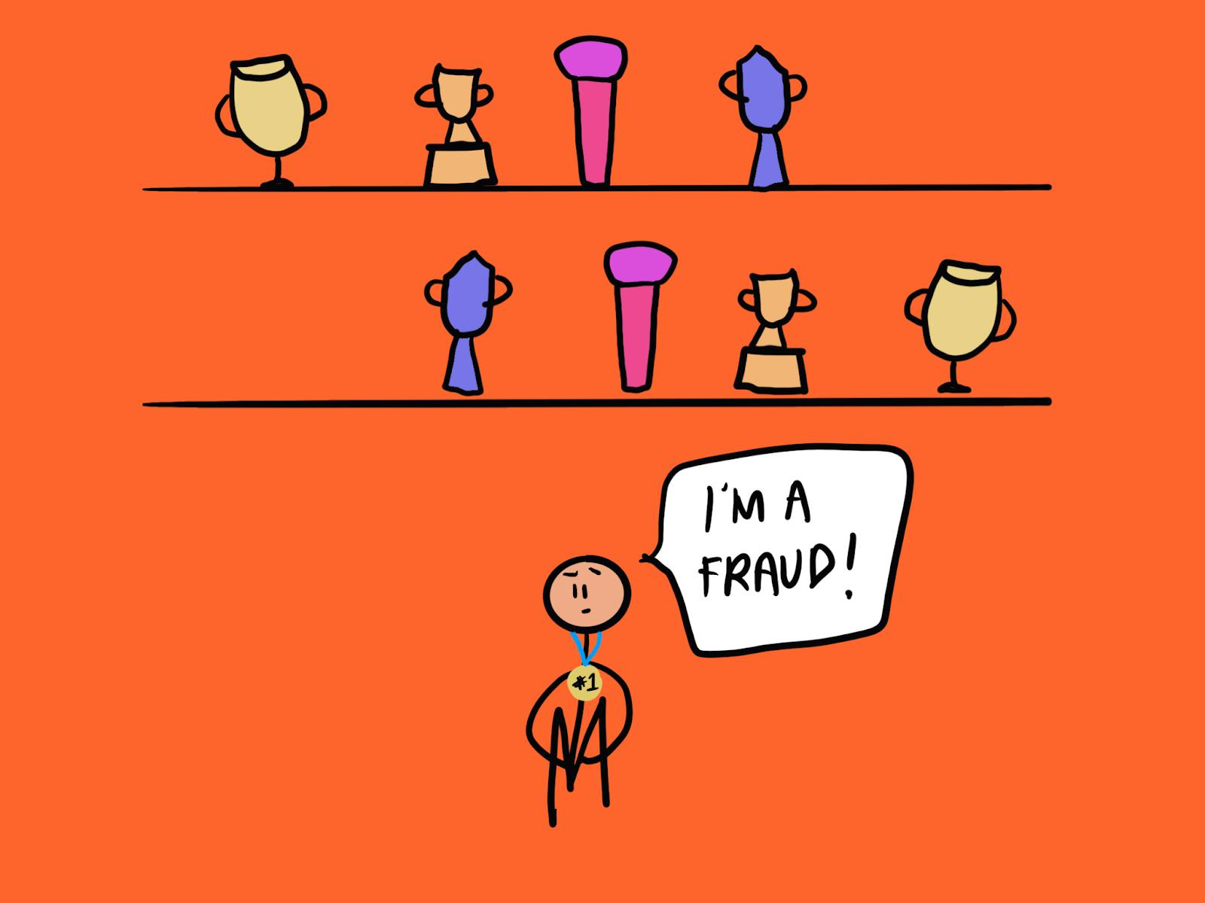
Imposter Syndrome
The enemy of academic confidence and sense of belonging
Notes:
https://thedecisionlab.com/reference-guide/organizational-behavior/impostor-syndrome
Key Terms
Imposter Syndrome: The psychological pattern in which one downplays their achievements and believes that they are secretly a fraud undeserving of their accolades.
Imposter Cycle: A cyclical pattern of thoughts and behaviors characteristic of people experiencing imposter syndrome.11 The imposter cycle is triggered when facing a new assignment or other task. Someone with imposter syndrome typically responds to new projects with either procrastination or over-preparation, both of which reinforce the belief that they are frauds. This reinforcement causes the cycle to repeat itself as feelings of inadequacy carry over into the next task.
Perfectionism: The tendency to strive for flawlessness in order to meet one’s own exceptionally high standards. People with imposter syndrome often self-imposed, impossible-to-reach goals which can exacerbate feelings of imposterism.11
Overachievement: A key component of imposter syndrome in which people work excessively hard to prove their worth and appear more than capable of completing the tasks given to them. In the context of imposter syndrome, striving for overachievement is sometimes called super-heroism.11
Comorbidity: This term describes the presence of one or more conditions co-occurring with another condition. For example, imposter syndrome is often comorbid with mental health disorders like anxiety and depression.1

Slide 24

The Hidden/Invisible Curriculum
Notes:
Invisible Curriculum
Definition: The invisible curriculum is often used to describe the knowledge, perspectives, and cultural capital that are assumed but not explicitly taught. These are concepts or skills that educators or institutions may assume all students inherently know, even though they may not.
Example: An invisible curriculum might be the assumption that students understand academic language, norms of professional communication, or unspoken rules around networking or self-advocacy.
Implication: This curriculum is “invisible” in that it often favors students from certain backgrounds who are already familiar with these unspoken expectations. It can disadvantage those who don’t come with this assumed knowledge, making success more difficult to attain.
invisible curriculum assumes prior knowledge or cultural capital that isn't explicitly provided.

Slide 25
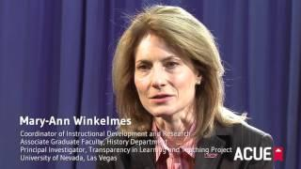
Hidden/
Invisible Curriculum
A very brief video from Dr. Mary-Ann Winkelmes, Principal Investigator for TILT Higher Ed
Notes:
9:21 AM to 9:22 AM Emily to lead (add graphic)

Slide 26
“Employer Valued Skills”
Learning effectively independently
Considering ethical implications of actions
Applying things learned to new problems and situations
Making connections between multiple sources of information
Breaking down theories, ideas, experiences into pieces for consideration
Collaboration
Communicating effectively
Written communication
Notes:
9:23 AM to 9:24 AM (Jen lead)

Slide 27
Now Let’s Do the Activity!
Now read the “less transparent” version of this Biology assignment. We will set a timer for 2 minutes.
As you read …
Put on your “student hat”: imagine you are a student who is new to college and this is the first assignment you are asked to complete.
Reflect on the following questions
What do you think is the purpose of this assignment?
What knowledge or skills do you think you will gain?
How does this assignment align with the course learning outcomes?
How or why will this be important to you 5 years from now? 10 years from now?
Notes:
9:24 AM to 9:27 AM Emily
1 minute to review the slide
2 minutes to read
As you review this assignment, note that it is a less transparent assignment, so this activity is not as clear and you will naturally struggle with the clarity. Reflect on it and the context of this being your first experience with college, this professor, and your experience as compared to your classmates.
How many of you had a little anxiety as you were thinking about your artifact selection? I couldn’t help but think about what was shared in our first reflection as it relates to challenges - knowing what to TILT, lack of confidence, and not knowing what I don’t know.
Total time 8 minutes
Set up: 2 minutes to explain what they are doing
Reading: 2 minutes to actually read (2 minutes padding)
Sharing Large Group: 4 minutes to discuss how this assignment is not transparent
REMOVE: Invite participants to either type their comments in chat OR unmute and share comments for 1 minute.
Will be in packets at their seats. REMOVE: Wendy put link into the chat: https://bit.ly/2qV7JXm

Slide 28
Large Group Discussion
If you were a first-generation student in this introductory Biology course, and you received this assignment … how might this impact your
Academic confidence: I can learn this subject/discipline.
Sense of belonging: I’m supposed to be here. College is hard-- for everyone. My culture and values are reflected here.
Improved mastery of skills that employers value: What I’m learning will help me reach my long-term goals.
Notes:
9:27 AM to 9:37 AM (Jodi facilitate the conversation)
Total time: 10 minutes
1 minutes to explain: Now that we have discussed transparency … With the same assignment, how would this impact the three most important indicators of student success.
Sharing: 9 minutes
Invite participants to share comments for 3 minutes for each question.
Jodi and Emily facilitate
We will record it
Jen will take notes
Notes
Academic Confidence: What the heck is a phenotype? First generation student who took– made me rethink my medical school goals. Peer reviewed study– oh my god I’ve never done this before. Short assignment, but feels overwhelming. I don’t even know where to stop. I would feel stupid: I don’t know anything. I don’t know where to go. Where do I get the resources to help me? Am I supposed to be here? I don’t even know if I should be there. Imagine if they give the “Gatekeeper” talk. Context of teaching online. “Cold” reaching out to the professor. With other students in the room … I felt less alone. You don’t make those connections. The other students are sometimes our saving grace. Peer reviewed study– I don’t allow my students to use academic journals. Those are the peer reviewed studies. Very statistical. Very specific audience. Presentation. Sometimes PhD study or Masters. I do not allow those because for them, trying to synthesize a case study. Zone of Proximal development. Classroom observations. Credit to our faculty. Study buddies– established. ASk that student first– did you understand this? Pros and cons– choose wisely kids. Shout out– these are happening. What does this mean to me 5 to 10 years. Strive and read accommodation– a Bio exam. Proctors were not familiar with the curriculum. Looking at each other. Specific career– “yes but no.” Add to the last part– first gen student– navigating this assignment. Domino effect. What do I want to do? Decreased my confidence, I don’t even know if I should be here. You almost visually think … Cascade effect. Thinking about the points the two of you just made … designing assignments/teaching … be intentional about tasks beyond the specific content. We might not use this exact knowledge– but hypothesis. That has value beyond the content. Yes, we are learning this content. A skill set. Hypothesis. STEM career or other careers. Poverty– a lot of our students. Long-term thinking. Hard to think long-term when you have faced resource scarcity. Hard for students to even think of. Not used to the luxury of thinking that far ahead. Not just first gen, but EVERY student who has experienced content. Cheating– why do I have to do this with literature. Or a class they desperately need. So focused on their future they make a bad decision (to cheat). It is important to say– I’m asking you to do this … being more explicit and transparent. Take for granted … increase your communication. Connection to lifelong learning. WHen you are experiencing a lot of different things in your life– part of my journey. Critically think for all of my life. Curriculums in college– end of the day– have to think at that level. Disadvantage. They come with all different kinds of strengths. Looking. TILT-ing is important for all of our students. Difference in backgrounds, size of high school, demographics, wealth. JuliA– research– the wealth of some students.

Slide 29
In Your Small Groups …
Now review the “More Transparent” (or “TILT-ed”) version of the “Mutant Worms” assignment:
What did the instructor change?
If you were a student in this introductory Biology course– a first generation college student– how might the changes to the assignment impact your
academic confidence
sense of belonging
sense of gaining employer-valued skills?
If you were the teacher of this course, how might these changes impact your teaching?
Notes:
9:42 AM to 10:00
1 minute to set up the small group conversation
8 minutes to actually discuss in the small group
1 minute to call them back
8 minutes for each group to share
Notes Broken down, I can go through step by step. Helps me allocate my time. Imagine my stress at 11:59 PM. Artifact Selection: How long your artifacts are … theme. I felt it appealed to multiple learning styles. The video. The model. The kinesthetic. The visual. Opportunity to formulate pointed questions I might ask. More confident going to a professor– relevant. Difference I noticed– sample answer. When I looked at this … I’m writing paragraphs in my head. What I’m envisioning. Hadn’t flipped it over. Oh! I would have psyched myself out … instead of three numerical bullet pointed answers. I would have mentally over complicated how to answer the question. 1) answer the question. 2) Answer the question. Much cleaner. My brain would not have formatted the responses in that way. How many of our students will over complicate. And then we say, “This is not what I asked for.” I would want to tell students what they had done in previous weeks to get ready. A lot of words. I didn’t try to LEARN– I just did rote activities. I did it to get it doen versus actual learning and retain. I don’t think that transferred. COnfirmed in these studies and that result. Having that purpose. Why are we doing this? To understand helps with that learning. For us with policies and staff and different things. Having that purpose. WHY do we have this policy? Not just to provide clarity– but break down the siloes. This impacts this department. So many that I see. Isn’t a larger conversation about the WHY. I have an assignment that is a case study. A real life thing. Pitch new software. Attending the TILT in August. I started adding more and more things. I know that sounds distressing. Someone’s lightbulb will go off. Adding videos. Set up computer rooms. Help them find artifacts. Still not perfect. Speak to students that it is not about getting it right– encouraged to make mistakes.

Slide 30
More and Less Transparent
Take a few minutes to review the Un-TILT-ed and TILT-ed versions of the “Mutant Worms”:
What did the instructor change?
If you were a student– a novice learner and a novice to the discipline– how might these changes impact your academic confidence, sense of belonging, sense of gaining employer-valued skills?
How does the TILT-ed assignment demystify the “invisible curriculum”?
If you were the teacher of this course, how might these changes impact your teaching? The quality of student work?

Slide 31
More and Less Transparent
Original and TILT-ed versions of Environmental History
What did the instructor change?
If you were a student– a novice learner and a novice to the discipline– how might these changes impact your academic confidence, sense of belonging, sense of gaining employer-valued skills?
How does the TILT-ed assignment demystify the “invisible curriculum”?
If you were the teacher of this course, how might these changes impact your teaching? The quality of student work?

Slide 32
Charettes: Making the Work Public and Collaborative
Notes:
0:45 – 1:00 | Charrettes: Making the Work Public and Collaborative
We won’t engage in a charrette today, but we’ll describe the process and its value. Charrettes create space for faculty to share works-in-progress, receive appreciative and constructive feedback, and see their own teaching through fresh eyes. This isn’t about perfecting a product—it’s about deepening a practice. Charrettes support both individual insight and the kind of collective sensemaking that fuels sustainable change.
Assignment Charrettes: Reflective Teaching in Action
What is a Charrette?
Adapted from architecture’s “little cart”—a design sprint with urgency and collaboration
Structured feedback on in-progress assignments
Encourages revision through fresh perspectives
Why It Works
Based on change management: silence, reflection, stepping into the student role
Encourages questions over quick fixes
Power in Giving Feedback
Sharpen assignment design instincts
Build empathy for student experience
Deepen metacognitive awareness
The Disciplinary Stranger
Offers “outsider” clarity
Models how students encounter unfamiliar tasks
Makes the invisible visible
Faculty Say…
“I left inspired, not overwhelmed.”
“Best feedback I’ve ever received.”
“I loved giving feedback even more than receiving it.”
More Benefits
Reveals horizontal learning outcomes across disciplines
Fosters asset-based, collegial learning culture
Centers teaching as a scholarly, collaborative craft

Slide 33
The Transparent Assignment Design Template
Purpose, Task, Criteria for Success

Slide 34
Purpose, Task, Criteria for Success
Purpose: Knowledge the student will gain, skills the student will practice … and why they will be important to the learner (learning outcomes for the course, major, non major, 5 years from now, 10 years from now)
Task: What steps should a novice learner new to the discipline do (and any anticipated mistakes they should avoid)?
Criteria for Success: How will the student know they are doing excellent work as they complete the assignment? How will their work be assessed and evaluated by the instructor?

Slide 35
Charette
Purpose: Provide meaningful feedback to help your partner TILT their assignment or artifact by clarifying its Purpose, Task, and Criteria for Success.
Task: One person shares their assignment or artifact. The other person reads it and provides feedback using the Transparent Artifact Template below. Switch roles and repeat.
Criteria for Success: You will have an idea for at least one change you can make to your artifact.
Notes:
10:31 Jen
Transparent Artifact Template: https://bit.ly/DCCCTAD

Slide 36
Before you go into your breakout room ...
Please copy the link to, or open, this slide deck: https://bit.ly/30aTkps
You’ll have 40 minutes to give each other feedback on the assignment you brought today.
You’ll have full audio, video, and screen share capabilities.
Use the Ask for Help option in your meeting controls to let us know your group needs something.
Watch for the countdown timer - that’s your signal to wrap up conversation and return to the main room.
Be prepared to report back when you return.

Slide 37
With your partner, please ...
Share the link to the slide deck in your breakout room chat and/or have someone screen the slides: https://bit.ly/30aTkps
Introduce yourselves to each other.
10 minutes to discuss the Purpose (slide 34)
10 minutes to discuss the Task (slide 35)
10 minutes to discuss the Criteria for Success (slide 36)
10 minutes for final thoughts (side 37)
Enjoy a rich and productive discussion!

Slide 38
First 10 Minutes: Give Each Other Feedback on the Purpose of the Assignment (5 minutes each)
Set a timer … Spend 5 minutes giving feedback to your partner:
Putting on your “student” hat …
What do you think is the purpose of this assignment?
What knowledge or skills do you think you will you gain?
How does this assignment align with the learning outcomes of the course?
How or why will this be important to you 5 years from now?
When the timer goes off … SWITCH!
Notes:
Send broadcast

Slide 39
Second 10 Minutes: Give Each Other Feedback on the TASK of the Assignment (5 minutes each)
Set a timer … spend 5 minutes giving feedback to your partner: putting on your “student hat” ...
Do you know what you are supposed to do? Are there clear steps to follow? Are they in a logical order?
Is there a step (or steps) missing?
Do you know how much time should you should allocate to complete this assignment?
Do you know how much time you should allocate to each step?
When the timer goes off … SWITCH!

Slide 40
Third 10 Minutes: Give Each Other Feedback on the Criteria for Success
Set a timer! You have 5 minutes to give feedback to your partner on criteria for success with your student hat on:
Do you know how this assignment will be graded? How much it is worth?
How will you know you are doing excellent work? Are there ...
Exemplars of high-quality student examples (preferably annotated) so students know WHY it is a good example
Checklists, rubrics
Peer review activities

Slide 41
Your TILT Partner
Pair Up with a “Disciplinary Stranger”
Work with someone who is new to your discipline or department.
Offer feedback on clarity and transparency
Act as an expert learner with a fresh perspective while also …
Putting on your “first generation student hat”
Notes:
10:31 to 10:32 Jen
Transparent Artifact Template: https://bit.ly/DCCCTAD

Slide 42
Charette Structure: Part 1
Part 1: Warming Up (4 min total, 2 min each)
Jodi/Emily will set a timer. Each person gets a chance to introduce their artifact and why they chose it.
Guiding Questions:
What artifact did you bring today? Why did you choose it?
How do students/staff currently engage with it?
What challenges or questions have come up in its use?
Switch partners after 2 minutes!
Notes:
10:32 to 10:36 AM - Jen
Transparent Artifact Template: https://bit.ly/DCCCTAD

Slide 43
Charette Structure: Part 2
Part 2: Feedback on Purpose (4 min each)
Jodi/Emily will set a timer. One person presents their artifact, and the other provides feedback.
As an Expert Learner with your first generation student hat on, offer your insights:
What do you think the purpose of this artifact is?
What knowledge or skills do you expect to gain?
How does this assignment/artifact align with learning outcomes or workplace goals?
Why will this be important 5 years from now?
Switch roles after 4 minutes!
Notes:
10:36 to 10:44 - Jen
Transparent Artifact Template: https://bit.ly/DCCCTAD

Slide 44
1 Minute Reflection
What came up for you as you talked about the PURPOSE of your assignment with your partner? Write down your thoughts:
Epiphanies/Ah-Has
Emotional Button/Concerns/Challenges
Questions
Notes:
10:44 AM to 10:45
15 minutes total
2 minute to set this up:
1 minute to transition in
10 minutes in the room
1 minute to transition back
1 minute to write
9 minutes total
8 minutes to talk about the criteria
1 minute to write

Slide 45
Charette Structure: Part 3
Part 3: Feedback on Task (4 min each)
Set a timer. One person shares, and the other provides feedback.
As a Student or First-Time User, Ask:
Do you clearly understand what to do?
Are the steps logical and easy to follow?
Is anything missing or confusing?
Do you know how much time to allocate?
Switch roles after 4 minutes!
Notes:
10:45 to 10:53
Transparent Artifact Template: https://bit.ly/3XwwTIb

Slide 46
1 Minute Reflection
What came up for you as you talked about the TASK of your assignment with your partner? Write down your thoughts:
Epiphanies/Ah-Has
Emotional Button/Concerns/Challenges
Questions
Notes:
10:53 to 10:54
15 minutes total
2 minute to set this up:
1 minute to transition in
10 minutes in the room
1 minute to transition back
1 minute to write
9 minutes total
8 minutes to talk about the criteria
1 minute to write

Slide 47
Charette Structure: Part 4
Part 4: Feedback on Criteria for Success (4 min each)
Set a timer. One person shares, and the other provides feedback.
As a Student or First-Time User, Ask:
Is it clear how success is measured?
Are there examples, rubrics, or checklists to clarify expectations?
Would peer review or exemplars help users assess their own work?
Switch roles after 4 minutes!
🔄 Switch roles after 5 minutes!
✍️ 1-Minute Reflection:
What revisions could make success more transparent?
Would a first-time user know when they are doing excellent work?
As a Student or First-Time User, Ask:
Do you clearly understand what to do?
Are the steps logical and easy to follow?
Is anything missing or confusing?
Do you know how much time to allocate?
Switch roles after 4 minutes!
Notes:
10:54 AM to 11:02 AM
Transparent Artifact Template: https://bit.ly/3XwwTIb

Slide 48
1 Minute Reflection
What came up for you as you talked about the CRITERIA FOR SUCCESS of your assignment with your partner? Write down your thoughts:
Epiphanies/Ah-Has
Emotional Button/Concerns/Challenges
Questions
Notes:
11:02 AM to 11:03 AM
15 minutes total
2 minute to set this up:
1 minute to transition in
10 minutes in the room
1 minute to transition back
1 minute to write
9 minutes total
8 minutes to talk about the criteria
1 minute to write

Slide 49
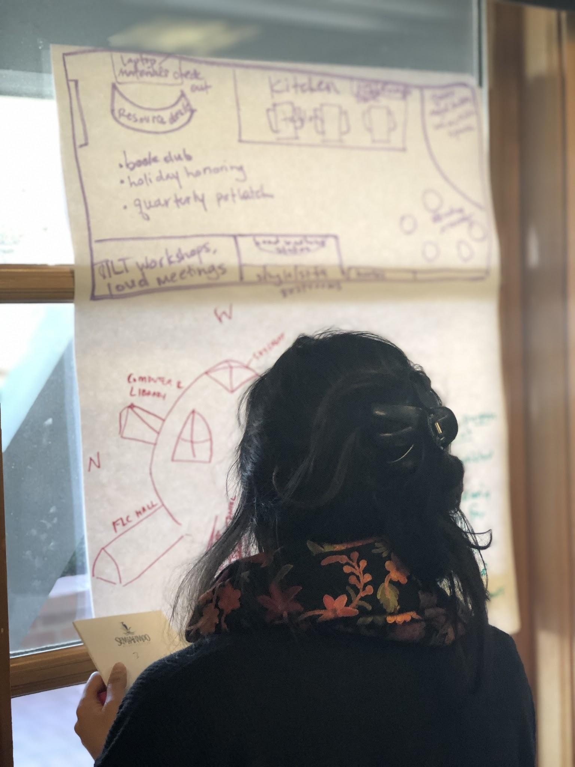
Charette
Practice Giving & Receiving Feedback
Notes:
10:30 Jen
Transparent Artifact Template: https://bit.ly/3XwwTIb
Clarifying Purpose, Task, and Criteria for Success to Support First-Generation Learners
When expectations are clear, all learners—students, colleagues, and staff—are better positioned to succeed. This charette provides a structured opportunity to analyze and refine an assignment or artifact by making its purpose, task, and criteria for success explicit. Through guided peer feedback, we ensure that our materials are transparent and accessible to first-generation students and other novice learners.

Slide 50
Purpose: Give & Receive Feedback
Set a timer and spend 10 minutes giving feedback to your partner on the PURPOSE of the assignment.
Each person gets 5 minutes. When the timer goes off … switch!
What do you think is the purpose of this assignment?
What knowledge or skills do you think you will you gain?
How does this assignment align with the learning outcomes of the course?
How or why will this be important to you 5 years from now?

Slide 51
Task: Give & Receive Feedback
Set a timer and spend 10 minutes giving feedback to your partner on the TASK of the assignment.
Each person gets 5 minutes. When the timer goes off … switch!
Do you know what you are supposed to do?
Are there clear steps to follow? Are they in a logical order?
Is there a step (or steps) missing?
Do you know how much time you should allocate to complete this assignment?
Do you know how much time you should allocate to each step?

Slide 52
Criteria: Give & Receive Feedback
Do you know how this assignment will be graded?
How much it is worth?
How will you know you are doing excellent work? Are there …
Exemplars of high-quality student examples (preferably annotated) so students know WHY it is a good example?
Checklists, rubrics?
Peer review activities?

Slide 53
Continuing the Conversation: Lessons from the Field
Notes:
1:00 – 1:10 | Continuing the Conversation: Lessons from the Field Across institutions and initiatives, educators are using TILT to support student success in high-stakes, foundational courses. We’ll share stories and strategies from colleagues in different contexts—what’s working, where they’ve encountered challenges, and how they’re measuring (and making sense of) impact. As always, these are works in progress—but ones animated by serious inquiry and a shared commitment to equity.

Slide 54
Collecting Evidence of Impact
Hot off the presses!
Harrisburg Area Community College (HACC) Faculty Learning Community (FLC)
Faculty with disciplinary expertise in quantitative and qualitative data created this “TILT Data Bank.”
We are current revising this survey

Slide 55
Looking Ahead: What Might Your Next Step Be?
Notes:
1:10 – 1:15 | Looking Ahead: What Might Your Next Step Be? To close, we’ll invite you to consider where this work might take you next. Is there an assignment you want to revisit? A conversation you want to start on your campus? A way to gather evidence about the effects of your changes? The TILT framework offers tools, yes—but more importantly, it offers a set of questions and commitments. And those are things we can carry forward, together.

Slide 56
Formative Assessment
Please use these “sentence seeds” to reflect:
I used to think …
Now I think …
Which makes me feel …
So now I can …
And now I will ...

Slide 57
Reflect & Take Action
Notes:
11:03 AM

Slide 58
Formative Assessment
I used to think …
Now I think …
Which makes me feel …
So now I can …
And now I will ...
Notes:
11:03 AM to 11:06 AM

Slide 59
Sample Reflection from a Previous Participant
I used to think that brevity was more important in formatting my assignments, and that they were more self-evident. Now I think that I need to outline more context and clarity for my assignments. Which makes me feel that I have another tool to improve my student's experience. Now I can refine my process. Now I will make a new outline for my assignments, exercises, and quizzes.
Notes:
11:03 AM to 11:06 AM

Slide 60
Links for Your Future Perusal
Transparent Assignment Design (TAD) Template:
Student Transparent Assignment Design Template:
How to select your two assignments to TILT (Faculty Verion): https://bit.ly/HowtoSelectYour2AssignmentstoTILT
How to select your two artifacts to TILT (Faculty & Staff Version)
Sample Assessments from the Seattle Colleges
Sample Asychronous Shell
Notes:
Short Link to the Slide Deck for this Presentation: https://bit.ly/30aTkps
Short URL to this Document: https://bit.ly/31jtBMl
Comments from Session #2: https://bit.ly/3eNjjrI

Slide 61
TILT-ing with Students
Share and discuss the student version of the transparent assignment design template
Solicit student input on how to make your assignment more transparent
Ask students to find exemplars
Three Strategies
Notes:
6:50-7:10 AM PST (9:50-10:10 AM EST)
TILT-ing with Students (Slides 30-42)
Explore strategies for involving students in the TILT process.
Introduce the Transparent Assignment Design Template.
Include interactive discussion about empowering students and using “The Unwritten Rules.”

Slide 62

Transparent Assignment Template
For Students
Short URL: https://bit.ly/TADStudentVersion
Notes:
Short URL: https://bit.ly/TADStudentVersion
Invisible Curriculum
Definition: The invisible curriculum is often used to describe the knowledge, perspectives, and cultural capital that are assumed but not explicitly taught. These are concepts or skills that educators or institutions may assume all students inherently know, even though they may not.
Example: An invisible curriculum might be the assumption that students understand academic language, norms of professional communication, or unspoken rules around networking or self-advocacy.
Implication: This curriculum is “invisible” in that it often favors students from certain backgrounds who are already familiar with these unspoken expectations. It can disadvantage those who don’t come with this assumed knowledge, making success more difficult to attain.
invisible curriculum assumes prior knowledge or cultural capital that isn't explicitly provided.
6:50-7:10 AM PST (9:50-10:10 AM EST)
TILT-ing with Students (Slides 30-42)
Explore strategies for involving students in the TILT process.
Introduce the Transparent Assignment Design Template.
Include interactive discussion about empowering students and using “The Unwritten Rules.”

Slide 63
Student Version of the Transparent Assignment Design Template
Share and discuss the student version of the transparent assignment design template
“The Unwritten Rules”
Student versions of
Purpose
Task
Criteria for success
Notes:
6:50-7:10 AM PST (9:50-10:10 AM EST)
TILT-ing with Students (Slides 30-42)
Explore strategies for involving students in the TILT process.
Introduce the Transparent Assignment Design Template.
Include interactive discussion about empowering students and using “The Unwritten Rules.”

Slide 64
“The Unwritten Rules”
Show students the student version of the transparent assignment design template
Have students read and discuss “The Unwritten Rules”
Share your commitment to becoming ever-more transparent in your teaching methods and your participation in this community of practice/faculty learning community
Notes:
6:50-7:10 AM PST (9:50-10:10 AM EST)
TILT-ing with Students (Slides 30-42)
Explore strategies for involving students in the TILT process.
Introduce the Transparent Assignment Design Template.
Include interactive discussion about empowering students and using “The Unwritten Rules.”

Slide 65
Empowering Students
Use the student version of the transparent assignment design template to discuss and share strategies for constructive and productive dialogue with faculty about assignments:
What is the most effective approach to get productive, supportive answers from faculty whose assignments might benefit from TILT-ing?
What language and/or phrases should students use?
What questions might they ask during office hours?
Notes:
6:50-7:10 AM PST (9:50-10:10 AM EST)
TILT-ing with Students (Slides 30-42)
Explore strategies for involving students in the TILT process.
Introduce the Transparent Assignment Design Template.
Include interactive discussion about empowering students and using “The Unwritten Rules.”

Slide 66
How to TILT Your Assignments with Your Students
Show your students a less transparent assignment (or your TILT-ed version)
Working in small groups, ask students to identify the purpose, task, and criteria for success using the student version of the transparent assignment design template
Facilitate a discussion: What is already present? What would they add?
Upload the class’s more transparent version to D2L
Notes:
6:50-7:10 AM PST (9:50-10:10 AM EST)
TILT-ing with Students (Slides 30-42)
Explore strategies for involving students in the TILT process.
Introduce the Transparent Assignment Design Template.
Include interactive discussion about empowering students and using “The Unwritten Rules.”

Slide 67
Ask Students to Select & Annotated Exemplars
Put students into small groups
Give them examples from previous student work
Have students refer to the student version of the Transparent Assignment Template (“The Unwritten Rules”)
Each group
Selects an exemplar from the previous student work and annotates it using “The Unwritten Rules”
Presents or shares the exemplar and annotations with the rest of the class
Notes:
6:50-7:10 AM PST (9:50-10:10 AM EST)
TILT-ing with Students (Slides 30-42)
Explore strategies for involving students in the TILT process.
Introduce the Transparent Assignment Design Template.
Include interactive discussion about empowering students and using “The Unwritten Rules.”

Slide 68
Small Group Discussion
“Engaging teachers and students in focusing together on how college students learn what they learn and why teachers structure learning experiences in particular ways”
Did any of the three strategies shared resonate for activities you might do spring semester 2025 with your students?
What other ideas do you have about how you might do this with your students?
Notes:
Break Out Session #3 Instructions: (10 minutes)
Discuss the following questions and be ready to share with the larger group if called on.
TILTing with Students: 3 Strategies
Share and discuss the student version of the transparent assignment design template
Solicit student input on how to make your assignment more transparent
Ask students to find exemplars
Which one of three strategies shared resonate for fall quarter 2021 with your students?
What other ideas do you have about how you might be transparent with your students in ways that are liberating?
6:50-7:10 AM PST (9:50-10:10 AM EST)
TILT-ing with Students (Slides 30-42)
Explore strategies for involving students in the TILT process.
Introduce the Transparent Assignment Design Template.
Include interactive discussion about empowering students and using “The Unwritten Rules.”

Slide 69
Collecting Evidence of Impact
Notes:
7:10-7:30 AM PST (10:10-10:30 AM EST)
Collecting Evidence of Impact (Slides 43-48)
Quantitative Data: Discuss metrics to track and LMS analytics (5 minutes).
Qualitative Data: Highlight methods for gathering student feedback (5 minutes).
Pre- and Post-Surveys: Explain how to measure changes in student experiences (5 minutes).

Slide 70
Assignments Matter
“TILT-ing” 2 assignments in 1 course 1 semester seems to have big results for ALL students:
Quantitative: the students who received transparent instruction had 13% to 15% higher retention rates … not just 1 year later . . . but 2 years later;
Qualitative: increases in those three most important predictors of student success
sense of academic confidence, sense of belonging, sense of gaining employer-valued skills

Slide 71
Learning = Student Success
In a parallel study of UNLV undergraduates
90.2% of students enrolled in “more transparent” introductory-level courses returned for the subsequent academic year—
a 16.1 percentage point increase
compared to the average retention rate of 74.1% for first-year full-time students.

Slide 72
Why Collect Evidence?
Assignments Matter
Understand how and why TILT-ed assignments influence student success
Identify areas for improvement in assignment design and teaching practice
Share insights with colleagues and contribute to institutional goals around student success
Notes:
7:10-7:30 AM PST (10:10-10:30 AM EST)
Collecting Evidence of Impact (Slides 43-48)
Quantitative Data: Discuss metrics to track and LMS analytics (5 minutes).
Qualitative Data: Highlight methods for gathering student feedback (5 minutes).
Pre- and Post-Surveys: Explain how to measure changes in student experiences (5 minutes).

Slide 73
Quantitative Data
Questions to Consider
What specific metrics will you track?
Example: Assignment completion rates, grades, number of late/missing submissions
How might analytics from your learning management system (LMS) help?
Example: Compare student performance with TILT-ed assignments this semester with student performance with non-TILT-ed assignments.
Notes:
Example: "I plan to track the percentage of students who submit the assignment on time and compare that to data from the same course in a previous semester when the assignment was not TILT-ed."
7:10-7:30 AM PST (10:10-10:30 AM EST)
Collecting Evidence of Impact (Slides 43-48)
Quantitative Data: Discuss metrics to track and LMS analytics (5 minutes).
Qualitative Data: Highlight methods for gathering student feedback (5 minutes).
Pre- and Post-Surveys: Explain how to measure changes in student experiences (5 minutes).

Slide 74
Qualitative Data
Gathering Student Feedback– Methods to Consider
End of assignment reflections
Short surveys or focus groups
Observing changes in student engagement, questions, and participation
Example: "I will ask students to complete a short reflection after the assignment, prompting them to share what they found most helpful about the clarified purpose, task, and criteria for success, and what they still found challenging."
Notes:
7:10-7:30 AM PST (10:10-10:30 AM EST)
Collecting Evidence of Impact (Slides 43-48)
Quantitative Data: Discuss metrics to track and LMS analytics (5 minutes).
Qualitative Data: Highlight methods for gathering student feedback (5 minutes).
Pre- and Post-Surveys: Explain how to measure changes in student experiences (5 minutes).

Slide 75
Pre and Post Surveys
Measuring Changes in Student Experience
Designing Surveys
Use a pre-survey to assess confidence, understanding, belonging, and perceptions of clarity
Follow up with a post-survey to assess changes and gather detailed feedback
Example: In a pre-survey, I will ask students to rate their confidence in completing the assignment on a scale of 1 to 5. In the post-survey, I will ask the same question, along with an open-ended prompt to describe what contributed to any changes."
Notes:
7:10-7:30 AM PST (10:10-10:30 AM EST)
Collecting Evidence of Impact (Slides 43-48)
Quantitative Data: Discuss metrics to track and LMS analytics (5 minutes).
Qualitative Data: Highlight methods for gathering student feedback (5 minutes).
Pre- and Post-Surveys: Explain how to measure changes in student experiences (5 minutes).

Slide 76
Practical Tips for Data Collection
Start with small, manageable goals for evidence collection
Use D2L to streamline your quantitative data tracking
Keep student surveys and reflections brief and focused
Document your own observations regularly during and after teaching (maybe a running google document labeled “Notes to Self.”)
Call to Action: Choose one quantitative and one qualitative method to try with your next TILT-ed assignment.
Notes:
7:10-7:30 AM PST (10:10-10:30 AM EST)
Collecting Evidence of Impact (Slides 43-48)
Quantitative Data: Discuss metrics to track and LMS analytics (5 minutes).
Qualitative Data: Highlight methods for gathering student feedback (5 minutes).
Pre- and Post-Surveys: Explain how to measure changes in student experiences (5 minutes).

Slide 77
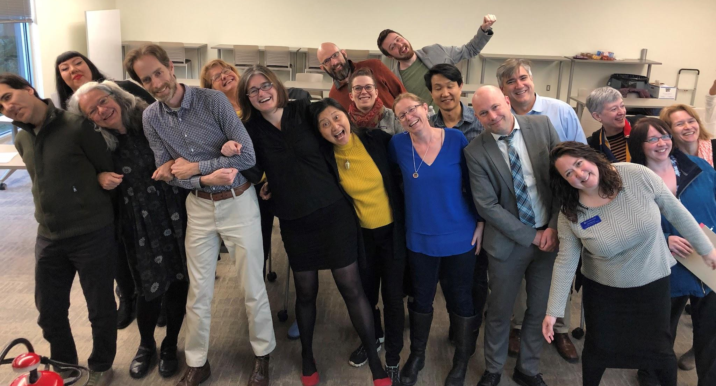
Transparent Assignments: The Terminology
Nouns
Transparency in Learning and Teaching
TILT Higher Ed
Transparency framework
Transparent assignment template
Verbs
TILT, TILT-ing, TILT-ed
Notes:
Laura

Slide 78
TILT Higher Ed’s Research Question
If teachers were to change one thing to benefit historically underserved students of color, what would be the one thing that would be of most benefit?
Notes:
Laura

Slide 79
TILT Higher Ed: The Study
1,800 students, 35 faculty, 7 institutions
Intentionally varied (research 1, CTCs, small, large, etc.)
Faculty participated in assignment charrettes with “disciplinary strangers” to make two take-home assignments more transparent.
Each faculty member taught 2 sections of the same course. One group of students received the intervention, the other group did not.
Notes:
Laura

Slide 80
What Do Students Need Most?
The Transparency Framework is a classroom-based intervention that addresses
Academic confidence: I can learn math.
Sense of belonging: I’m supposed to be here. College is hard-- for everyone. My culture and values are reflected here.
Improved mastery of skills that employers value: What I’m learning will help me reach my long-term goals.
Notes:
Laura
Research shows these are the three most important predictors of student success: academic confidence, sense of belonging, sense of gaining employer-valued skills.
Credit to Martin Cockroft for this great explanation of the three terms

Slide 81
The Answer is Assignments
Help students decode assignments by making them more transparent.
Notes:
Laura

Slide 82
What Do We Mean by “Transparent”?
A way of making plain to students
Purpose: Why THIS assignment (and not a different one); why the assignment matters in this course and life beyond the course; skills practiced; knowledge they should gain
Task: What steps they should take (and what mistakes they shouldn’t make) as they complete the assignment
Criteria for Success: What success looks like on this assignment; how they will know if they’ve been successful
Notes:
Laura
Jen Give credit to Martin Cockroft for this beautiful slide AND for the exciting work faculty have done at Olympic.

Slide 83
Transparent Assignments: The Template
Purpose
Skills practiced
Knowledge gained
Task
What to do
How to do it
Criteria
Checklist or rubric in advance so students can self-evaluate.
What excellence looks like (multiple annotated examples)
Relevance to students 5 years out
Connection to Learning Outcomes
Notes:
Laura
What do we mean by Transparency? What does a Transparent Assignment look like? It clarifies for students three things: the Purpose of the assignment, the Tasks (in order) for completing the assignment, and the Criteria for successful work.

Slide 84
Transparent Assignments: The Results
Transparent Assignments boosted students’
Academic Confidence
Larger effect for traditionally underserved students.
Sense of Belonging
Skills valued most by employers
Persistence rates, short-term & long-term completions
Winkelmes. Liberal Education 99, 2 (Spring 2013) Winkelmes et al. Peer Review 18, 1/2 (Winter/Spring 2016)
Notes:
Laura
*Confidence and belonging are predictors of increased persistence and higher grades.
**Skills such as writing, collaborating, applying concepts to new situations, evaluating reliability of information, learning independently
Note: The effect was larger for traditionally underserved students
Winkelmes. Liberal Education 99, 2 (Spring 2013) Winkelmes et al. Peer Review 18, 1/2 (Winter/Spring 2016)

Slide 85
2 Assignments, 1 Course, 1 Quarter
Just 2 TILT-ed Assignments in 1 Course Makes a Difference for Students
Notes:
Laura

Slide 86
First Part: Large Group Discussion of the “Less Transparent” Mutant Worms Assignment
Notes:
Yilin Sun will facilitate a two-part discussion
Pre-TILT Mutant Worms Assignment (12 minutes)
TILT-ed Mutant Worms Assignment (12 minutes)
15 minutes total review #16 before getting into the random breakout rooms - 4 groups of 5 each - make sure they have the questions handy.

Slide 87
“Less Transparent” Assignment: Biology
Review the “less transparent” version of this biology assignment for 2 minutes.
What do you think is the purpose of this assignment?
What knowledge or skills do you think you will you gain?
How does this assignment align with the learning outcomes of the course?
How or why will this be important to you 5 years from now?
Notes:
Yilin - please type your comments in Chat or on your notebook. if you’d like to share your comments for 1 minute, please raise your hand and unmute the mic. Remember the Ground Rule- “U” in GROUP; Use time wisely, be additive not repetitive, Try not to repeat what has been said but to add to the comments shared.

Slide 88
Reflection: Type into the Chat
If you were a student in this introductory Biology course, and you received this assignment … how might this impact your
academic confidence,
sense of belonging,
sense of gaining employer-valued skills?
Notes:
Yilin

Slide 89
Second Part: Breakout Room Discussion of the “More Transparent” Assignment
Notes:
Slide 20: Pamela as the host … will randomly generate 3 breakout rooms. Please assign Yilin, Laura, and Jen to each room. These will be randomly generated by the host. After the random generation, be sure that Yilin, Laura, and Jen are in different rooms.

Slide 90
More Transparent Assignment: Biology
Now review the “More Transparent” (or “TILT-ed”) version of the “Mutant Worms” assignment with a smaller group in a breakout room:
What changed?
If you were a student, how might these changes impact your academic confidence, sense of belonging, sense of gaining employer-valued skills?
If you were the teacher of this course, how might these changes impact your teaching?
Notes:
Yilin Sun will facilitate a two-part discussion
Pre-TILT Mutant Worms Assignment (12 minutes)
TILT-ed Mutant Worms Assignment (12 minutes)

Slide 91
What Are We Doing Next?
Purpose: Provide helpful feedback to your partner that will help them TILT their assignment for purpose, task, criteria for success.
Task: One person will screen share their assignment and the other will read it and give feedback using the transparent assignment template.
Criteria for Success: We will model what this looks like during the Virtual Fishbowl.
Notes:
Originally I was thinking 10 min for two rounds= 10x4 and then 5 minutes debrief among themselves. is that ok?

Slide 92
Virtual Fishbowl: Observe a Mini-Charrette
Notes:
Yilin will pair them by disciplinary strangers. Done, but pair format may work better for Activity 4. Alissa will create the CSV file and create the small groups.
Time: 15 minutes total

Slide 93
Model the Format to Give Feedback on PURPOSE
Jen and Laura Model the Process
Jen will screen share Laura’s assignment. Jen will read. Jen will set a timer for 5 minutes. Jen will give feedback to Laura to help her TILT the purpose of her assignment.
Switch.
Y will screen share their assignment. X will read. Y will set a timer for 5 minutes. X will give feedback to Y to help them TILT the purpose of their assignment.
Notes:
Yilin will identify people to participate in the charrette and invite them. Done and Got Laura -:)

Slide 94
Use the Template to Give Feedback
Purpose
Skills practiced
Knowledge gained
Task
What to do
How to do it
Criteria
Checklist or rubric in advance so students can self-evaluate.
What excellence looks like (multiple annotated examples)
Relevance to students 5 years out
Connection to Learning Outcomes
Notes:
What do we mean by Transparency? What does a Transparent Assignment look like? It clarifies for students three things: the Purpose of the assignment, the Tasks (in order) for completing the assignment, and the Criteria for successful work.

Slide 95
Your TILT Partner - Disciplinary Strangers
Joe Garcia and Victoria Hardy
Glenda Graham-Walton and Paul Kikuchi
Denise Grollmus and Doug Rupik
Jon Nackman and Laila Suidan
Julien Lee and Teresa Romaneschi
Mary Lockman and Ben Machado
Mark Murphy and Jill MCDONOUGH

Slide 96
First 10 Minutes: Give Each Other Feedback on the Purpose of the Assignment (5 minutes each)
Set a timer and spend 5 minutes giving feedback to your partner:
Putting on your “student” hat …
What do you think is the purpose of this assignment?
What knowledge or skills do you think you will you gain?
How does this assignment align with the learning outcomes of the course?
How or why will this be important to you 5 years from now?
When the timer goes off … switch!

Slide 97
Sample Reflection from a Previous Participant
I used to think that brevity was more important in formatting my assignments, and that they were more self-evident.
Now I think that I need to outline more context and clarity for my assignments.
Which makes me feel that I have another tool to improve my student's experience.
Now I can refine my process.
Now I will make a new outline for my assignments, exercises, and quizzes.
Notes:
Comments from Session #1: https://bit.ly/31jtBMl
Comments from Session #2: https://bit.ly/3eNjjrI

