Slide 1
Implementation Science & Continuous Improvement
Louisiana Board of Regents
2025 Meauxmentum Summit

Slide 2
Our Time Together
Hello & Welcome!
Meet Sova; Meet Sarah
Implementation Science
Continuous Improvement Framework
Driver Diagram Development
Moving Plan to Action
A Few Considerations
Let’s Connect!

Slide 3

At Sova, we partner with higher education systems and institutions, associations, and philanthropies to achieve large-scale change through careful attention to actionable strategy and practical implementation support.
We use problem solving as a pathway toward equitable outcomes and strengthened social and economic mobility for all.

Slide 4
Who here is….
a big idea thinker?
a details-orientation, implementation thinker?
both?

Slide 5
Implementation Science

Slide 6



Slide 7


Slide 8
Where have you seen examples of big ideas successfully implemented?

Slide 9
Implementation Science
Implementation science is the scientific study of methods and strategies that facilitate the uptake of evidence-based practice and research into regular use by practitioners and policymakers.

Slide 10
The Know-Do Gap
The field of implementation science seeks to systematically close the gap between what
we know and what we do
by
identifying and addressing the barriers that slow or halt the adoption of proven interventions and evidence-based practices.

Slide 11
Frameworks Driving Implementation Research
Consolidated Framework for Implementation Research (CFIR)
  Examines five domains that influence implementation
    intervention characteristics,
    outer setting
    inner setting
    individual characteristics
    implementation process.
Promoting Action on Research Implementation in Health Services (PARIHS)
  Suggests successful implementation depends on:
    evidence quality
    context receptivity
    facilitation
RE-AIM Framework
  Evaluates interventions based on:
    Reach
    Effectiveness
    Adoption
    Implementation
    Maintenance

Slide 12
Continuous Improvement Framework

Slide 13
Dynamic Sustainability
Emphasizes ongoing adaptation and improvement rather than maintaining rigid fidelity to original interventions.
Data-Driven Decision Making
Adaptability
Sustainability Focus
Learning Systems: knowledge generation is embedded in daily practice
The healthcare industry - a learning system - paved the path for the convergence
of implementation science and continuous improvement and the subsequent
adoption in higher education.

Slide 14
Strategic Need
Implementation Dilemma
Continuous Improvement Framework
Leaders across the higher education landscape are constantly identifying key strategic needs to meet a host of demands: finance, service provision, mission alignment, emerging legislation, etc.
The ability to move from strategy to implementation remains challenging across higher education - from strategic priorities to basic programming.
The implementation dilemma is costing higher education time, money, resources, capacity, etc. and, ultimately, outcomes.
Because change and implementation needs to happen at the organizational level but is led by those across the organization with varying skill sets and priorities, progress is often stymied.
Employing continuous improvement as a framework provides structure for identifying key goals, barriers to success, and clear and concise plans for making progress within a timeline that prioritizes intended outcomes.

Slide 15
Continuous Improvement Framework
Continuous improvement is the ongoing process of analyzing performance, identifying opportunities, and making incremental and breakthrough changes to processes, products, and personnel.
By analyzing and fine-tuning processes, organizations can create efficiencies, build capacity, meet goals, and improve decision-making.

Slide 16
Continuous Improvement Benefits
Makes overwhelming and complicated scenarios more manageable.
Forces acknowledgement of key challenges thwarting success
Allows competing priorities to be managed with focus on organizational needs & health
Creates structures for progress and accountability
Provides intentional space for reflection and mid-course changes to drive innovation

Slide 17




Learn Fast, Fail Fast, Improve Quickly
Elements of Continuous Improvement Cycles
For 30, 60, and 90 day intervals and evaluated every 30 days
WHAT?
What are your
near-term goals?
What are the activities
to reach your goals?
WHO?
Who is accountable for each goal and activity?
HOW?
How will you know when you have met your goal?
WHEN?
When will you complete each goal
and activity?
New cycles begin every 90 days, with time in between for reflection & reset

Slide 18
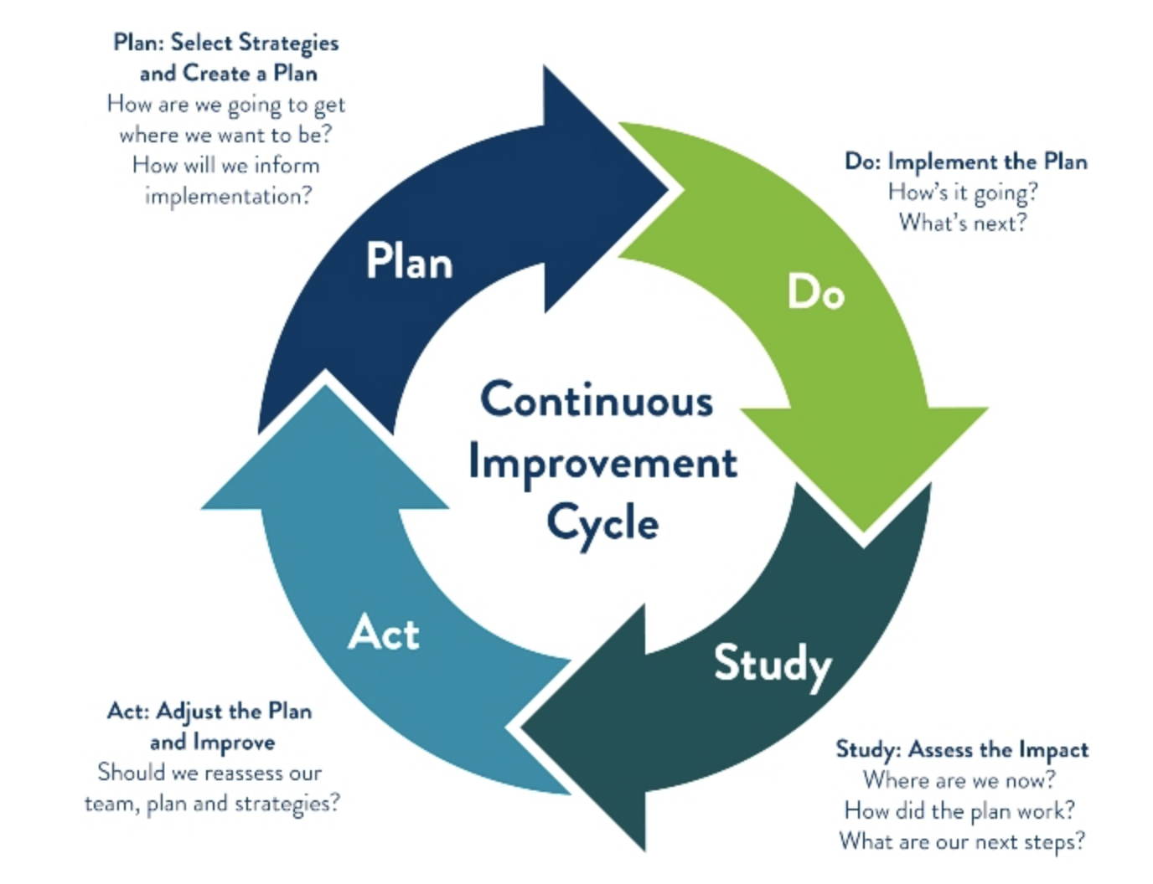

Slide 19
Driver Diagram Development

Slide 20
Driver Diagram Creation
Often, implementation approaches become so focused on tactics that the strategic goals of the project are lost and key metrics are not considered.
Through development of a driver diagram - a foundational component of continuous improvement - leaders:
state strategic goals
identify intended outcomes
select metrics to measure progress and success
examine key barriers to progress
determine tactical projects.
This provides useful guardrails in collaborative work where many competing priorities exist and decision-making can become challenging.

Slide 21
What is a big challenge you are hoping to solve?

Slide 22
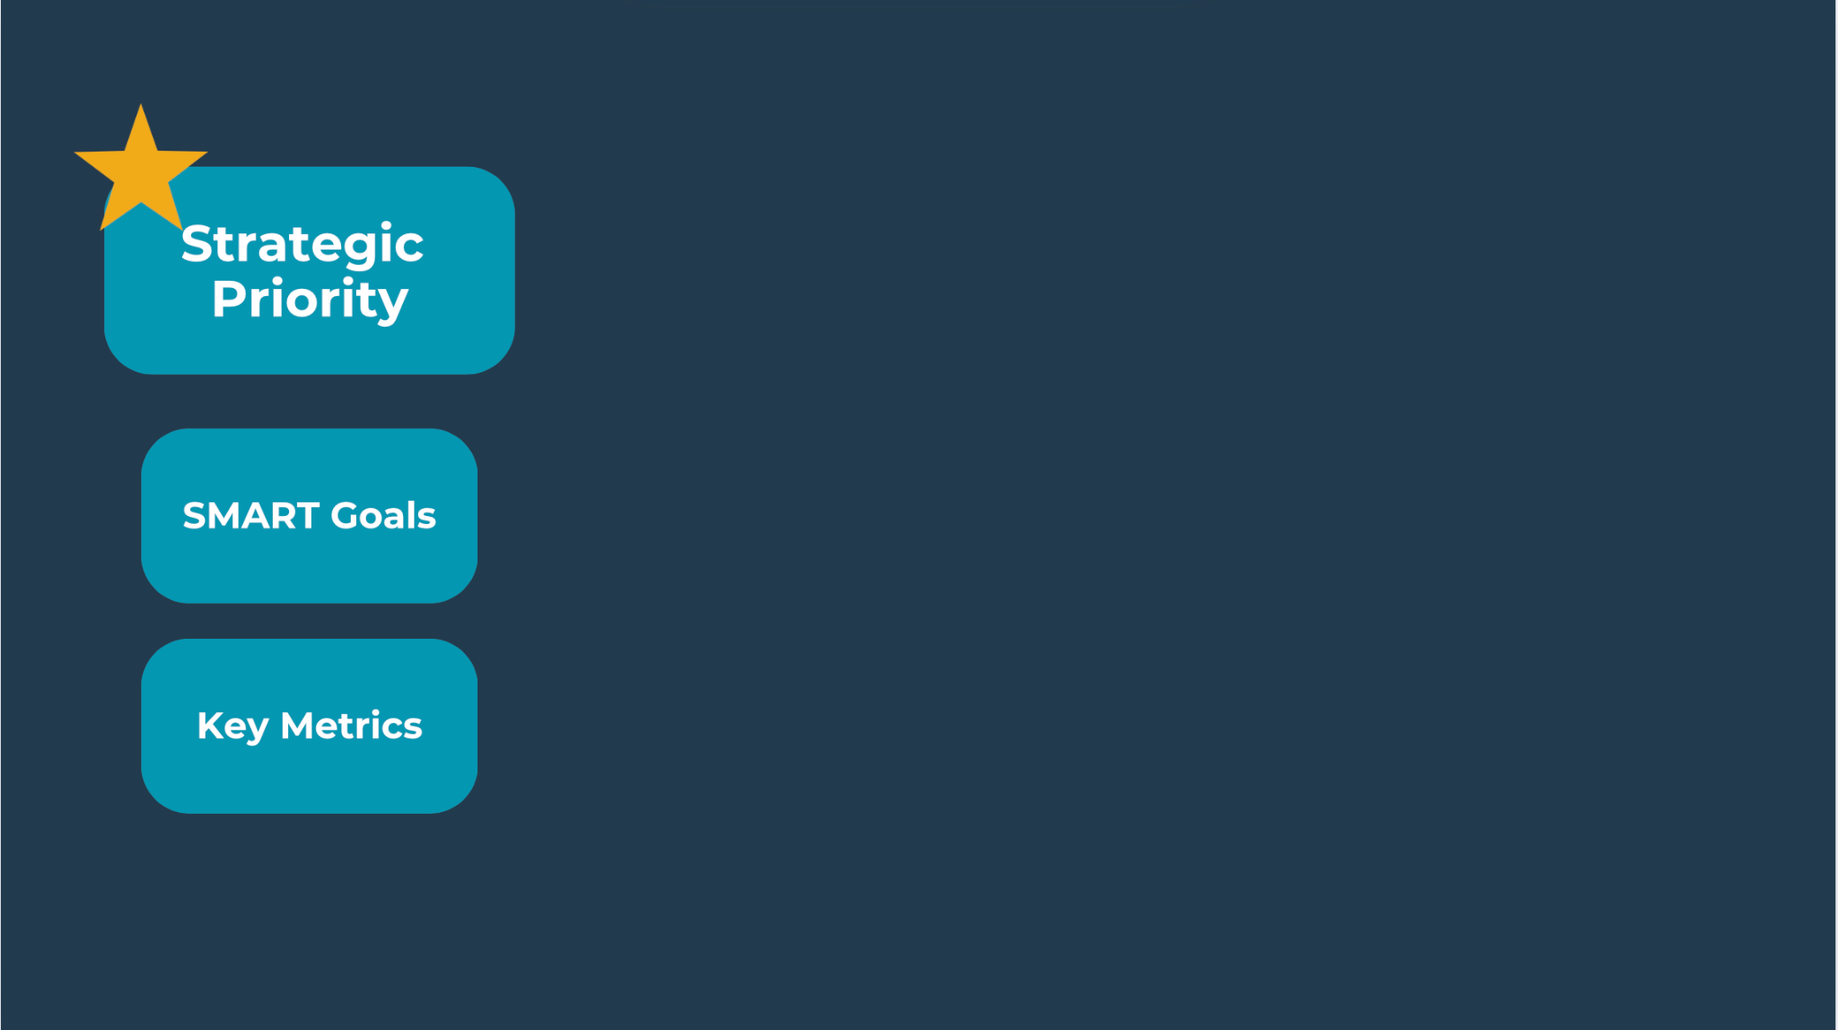

Slide 23
How does finding a solution for your challenge align with an institutional strategic priority?

Slide 24
Notes:
SMART: strategic/specific, measurable, achievable, relevant, time-bound

Slide 25
How will you know you are successful?
What metrics are available to you?
What do you need to know?

Slide 26
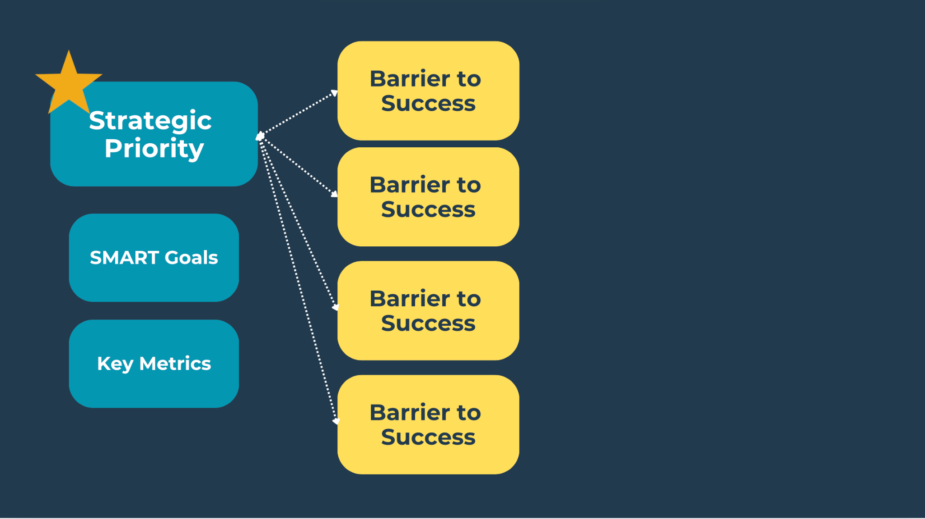

Slide 27
What are your greatest barriers or challenges
to solving or challenge or achieving your desired goals?

Slide 28
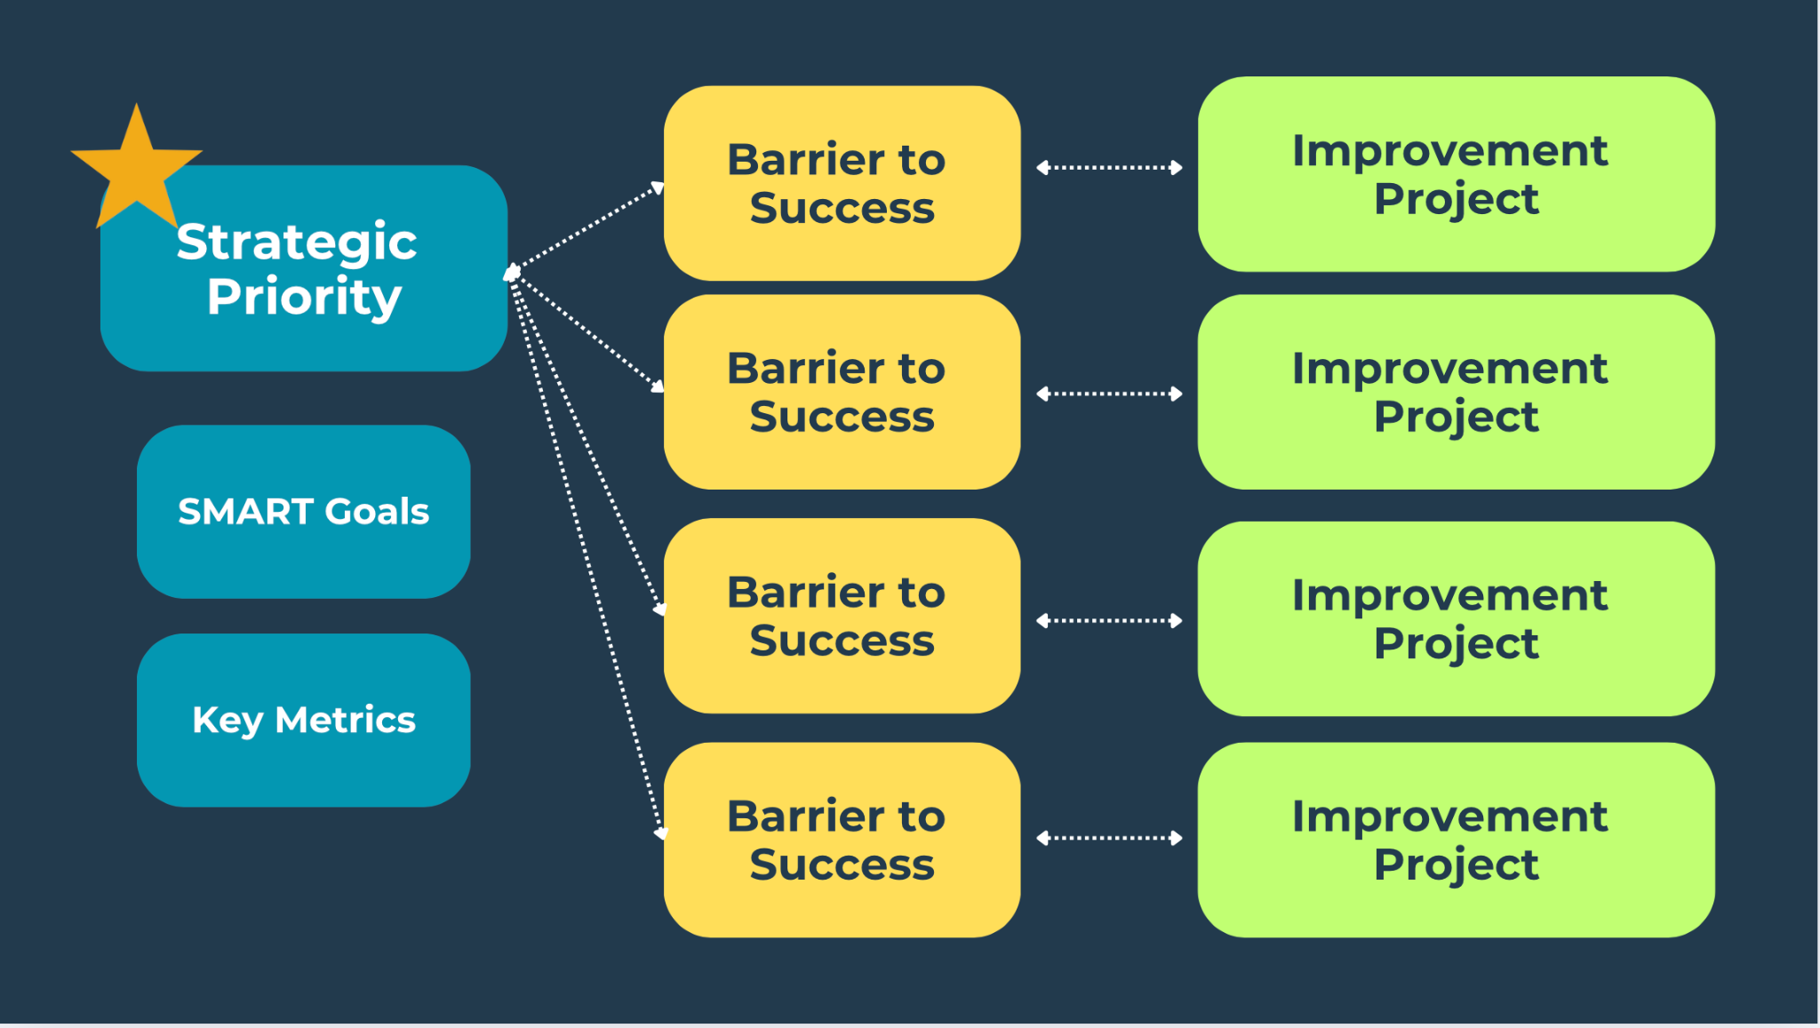

Slide 29
What are the improvement projects that directly solve your challenges or barriers?

Slide 30


Slide 31
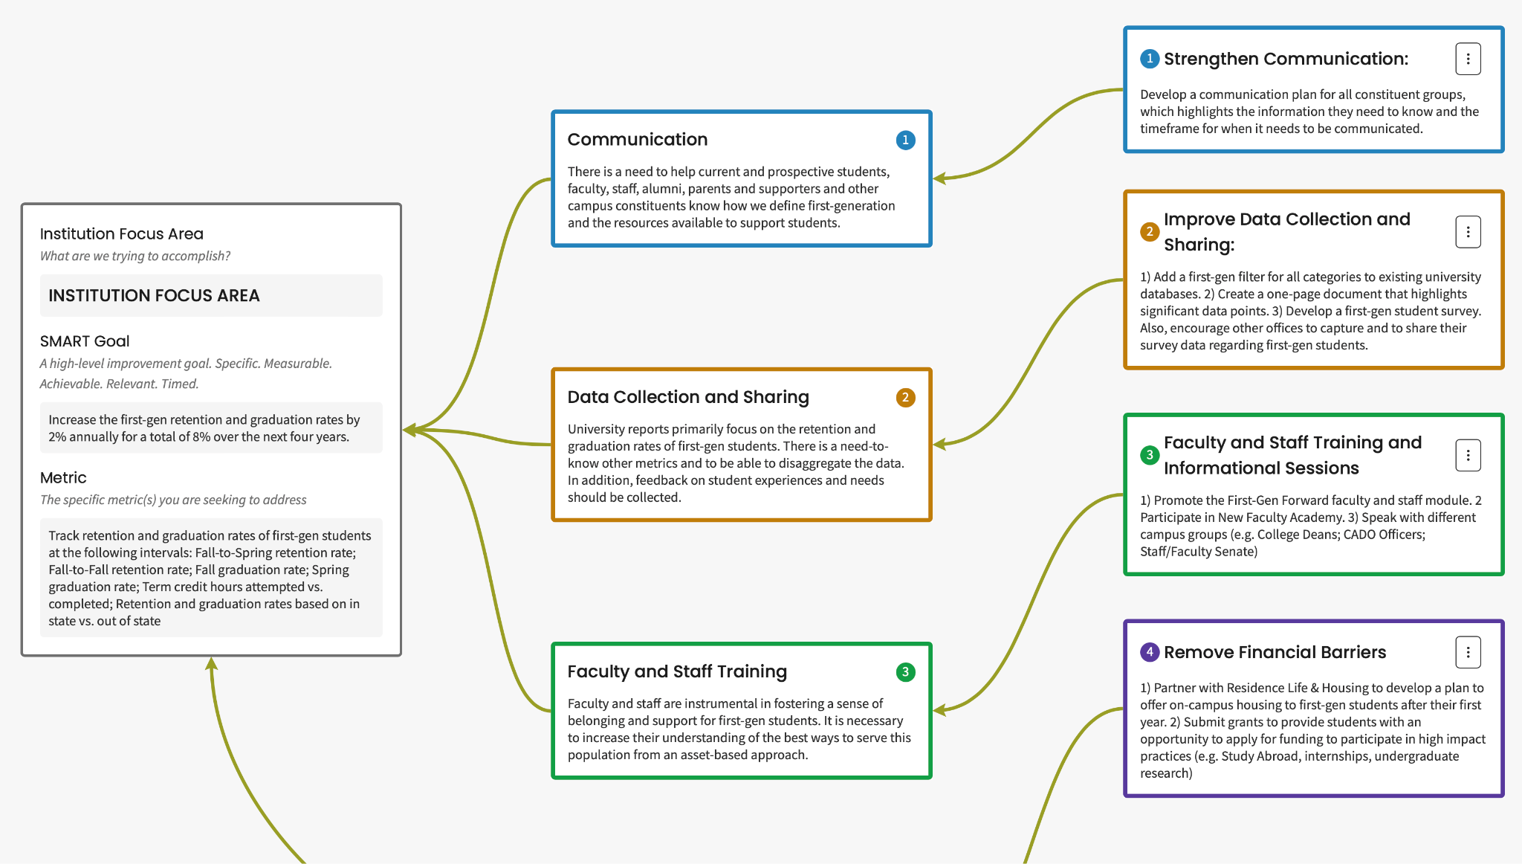
Sample Institution/Entity
Driver Diagram

Slide 32
Moving Plan to Action

Slide 33
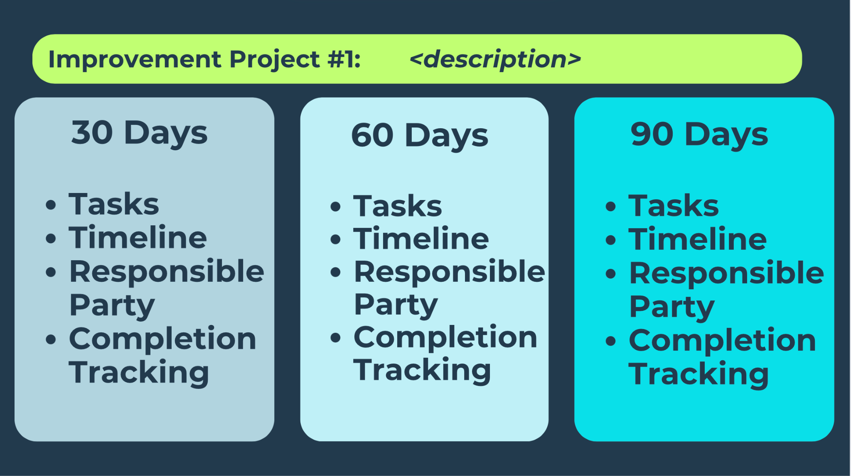

Slide 34
At 90 Days...
EDIT
PAUSE
SEEK COUNSEL
FORGE AHEAD
REFLECT
DISCUSS
CELEBRATE

Slide 35
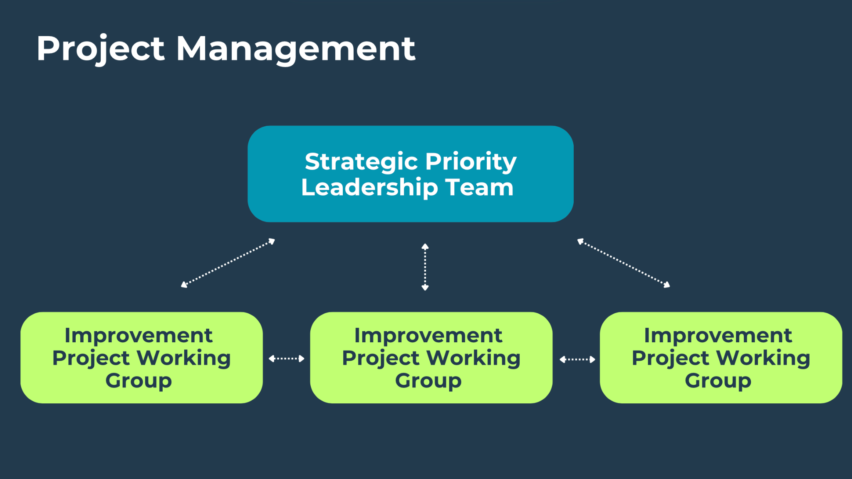

Slide 36
Who are the key people you need on your team?

Slide 37
A Few Considerations

Slide 38
Continuous Improvement Requires
Change Management
Adopting Proven Strategies Can Help
Integrated Implementation Process
Pre-implementation Phase
Change management: Stakeholder analysis, readiness assessment, coalition building
Continuous improvement: Baseline measurement, gap analysis, process mapping
Practical Integration Strategies
Hybrid Leadership Teams: Include change managers and improvement specialists
Consolidated Implementation Plans: Merge change management and QI plans
Unified Metrics: Develop measurement systems that track both technical and adaptive changes
Shared Learning Systems: Create feedback mechanisms that inform both processes
Joint Training: Cross-train teams in both methodologies
Notes:
Integrated Implementation Process
Pre-implementation Phase
Change management: Stakeholder analysis, readiness assessment, coalition building
Continuous improvement: Baseline measurement, gap analysis, process mapping
Implementation Phase
Change management: Communication planning, addressing resistance, supporting adopters
Continuous improvement: PDSA cycles, rapid tests of change, measurement systems
Sustainment Phase
Change management: Institutionalizing new approaches, addressing culture
Continuous improvement: Ongoing monitoring, standardization, spread strategies
Practical Integration Strategies
Hybrid Leadership Teams: Include change managers and improvement specialists
Consolidated Implementation Plans: Merge change management and QI plans
Unified Metrics: Develop measurement systems that track both technical and adaptive changes
Shared Learning Systems: Create feedback mechanisms that inform both processes
Joint Training: Cross-train teams in both methodologies

Slide 39
Driver Diagrams & Action Plans are
TOOLS for YOU,
not a homework assignment for leadership.

Slide 40
Consider Proven Implementation Strategy Research
Successful implementation occurs when explicit attention to the culture, history, values, assets, and needs of the community are integrated into the principles, strategies, frameworks, and tools of implementation science.
Cultural Adaptation
Trusting Relationships
Critical Perspectives
Community-Defined Evidence
Dismantling Power Structures
Audience-Informed Investments and Decision-Making
Stanford Social Innovation Review: Implementation at Work

Slide 41
Space
&
Grace

Slide 42
Let’s Connect
Sarah E. Whitley, Ph.D.
sarah.whitley@sova.org
LinkedIn

