Slide 1

Embedding Peer Learning & Collaboration to Support WBLE+ Integration
Susan Guerrero, Fletcher Technical Community College
Dr. Anna-Bradley Schoenfeld, Riipen
Dr. Mara Woody, Riipen

Slide 2
Objectives for this Workshop
Train faculty to design and implement project-based learning experiences using the Riipen platform.
Explore strategies for aligning course objectives with real-world projects, fostering student engagement and career readiness.
Use Riipen’s tools to facilitate collaboration between students and industry partners, ensuring meaningful experiential learning outcomes.

Slide 3
Definitions:
High Impact Practice (HIPs):
Achievement of deep learning, significant engagement gains, and positive differential impact on historically underserved student populations*.
(Kuh & O’Donnell, 2013); AAC&U.
Project-Based Learning/ Work-Based Learning/ Experiential Learning/ Work- Integrated Learning:
A teaching method in which students learn by actively engaging in real-world and personally meaningful projects**.
PBL Works
(For our purposes, interchangeable.)
Work-Based Learning Ecosystem:
Successful WBL models use research-based structures to build scalable, systematic and sustainable systems that include all ecosystem partners. These partners consist of employers, education providers and community organizations***.
AdvanceCTE
Curriculum-Embedded Project-Based Learning:
A project-based curriculum is built around project work, where students—guided by faculty—gain responsibility for their own learning by tackling tangible, open-ended problems faced by real people****.
Center for Project-Based Learning, WPI
*https://wwwcp.umes.edu/teachingexcellence/high-impact-practices/
**https://www.pblworks.org/what-is-pbl
***https://careertech.org/wp-content/uploads/2023/01/Work-basedLearning_Ecosystems_WhitePaper_GettingSmartandGPSEd_1121.pdf
****https://wp.wpi.edu/projectbasedlearning/pbl-in-higher-education-faqs/#:~:text=A%20project%2Dbased%20curriculum%20is,problems%20faced%20by%20real%20people.
Notes:
Mara and Susan tag team.

Slide 4
Louisiana Prospers & Meauxmentum Framework: Create Milestones and Engage All Learners
Why WBL Matters
Everyone deserves opportunity for education to lead to meaningful employment and personal and community prosperity.
Students need support in finding the right path to meaningful work and opportunities to develop technical and soft skills needed in today’s world.
This may be done by connecting theory to practice so students may learn by doing and connect their learning to their future endeavors.
“It allows students to try out new things, gain a sense of what they enjoy, and put skills they learn in the classroom into practice. Experiential learning also provides a crucial real-world perspective to learning that helps students understand how what they learn in college impacts their career trajectory after graduation”*.
Main takeaways regarding experiential learning
Education moves innovation into society and industry.
*Lake Forest College. Experiential learning: What it is and why it makes a difference for college students. https://www.lakeforest.edu/news-and-events/experiential-learning-what-it-is-and-why-it-makes-a-difference-for-college-students
Notes:
Mara and Susan. How Fletcher learned of the need for Cybersecurity employees in the Maritime Industry and how we built the program. Speed of cyber.

Slide 5
Curriculum-embedded project-based learning serves all learners and is impactful.
Project-based learning models can scale and access all learners through:
Projects embedded within courses, especially milestones such as foundation and catapult courses, career service programming, or other co-curricular programs, that ensure active learning strategies and support learner success.
Curriculum-embedded projects are built-in experiential learning opportunities, learners do not need additional resources to seek-out these experiences.
Faculty are able to guide and mentor learners throughout projects.
Group-based projects develop soft and durable skills, social capital and professional networks, and confidence, among many other benefits.
Flexibility in design to meet learners where they are and not create additional barriers to completing experiential learning opportunities.
Notes:
Mara: There is in fact a full spectrum of work-based learning experiences that can be offered to students. Susan: how companies build real-world projects with Riipen that match what they learn in the classroom making the connection between skills learned and reinforcing them with practice.

Slide 6
1.
Define experiential learning objectives
2.
Outline what the experience should look like to meet objectives
Steps to Create Experiential Learning Programs
3.
Scope a project that would meet the experience
4.
Build relationships with corporate partners/employers
5.
Define timelines to implement and complete projects
6.
Within semester/course, have learners work on projects
7.
Assess the experience and whether learners met the learning objectives
8.
Measure impact (examples: course grades, change of major, retention, success, workforce outcomes)
Notes:
This is a workshop where we will walk through these steps in teams - so that everyone gains experience in how to build project-based learning programs. To simplify the process today, we are utilizing the tools we have at Riipen to assist.With a mission to eliminate underemployment, Riipen takes very seriously our work with education providers to ensure learners receive quality experiential learning opportunities that enhance the student learning experience.

Slide 7
Demonstration:
Define experiential learning objectives
Outline what the experience should look like to meet objectives

Slide 8
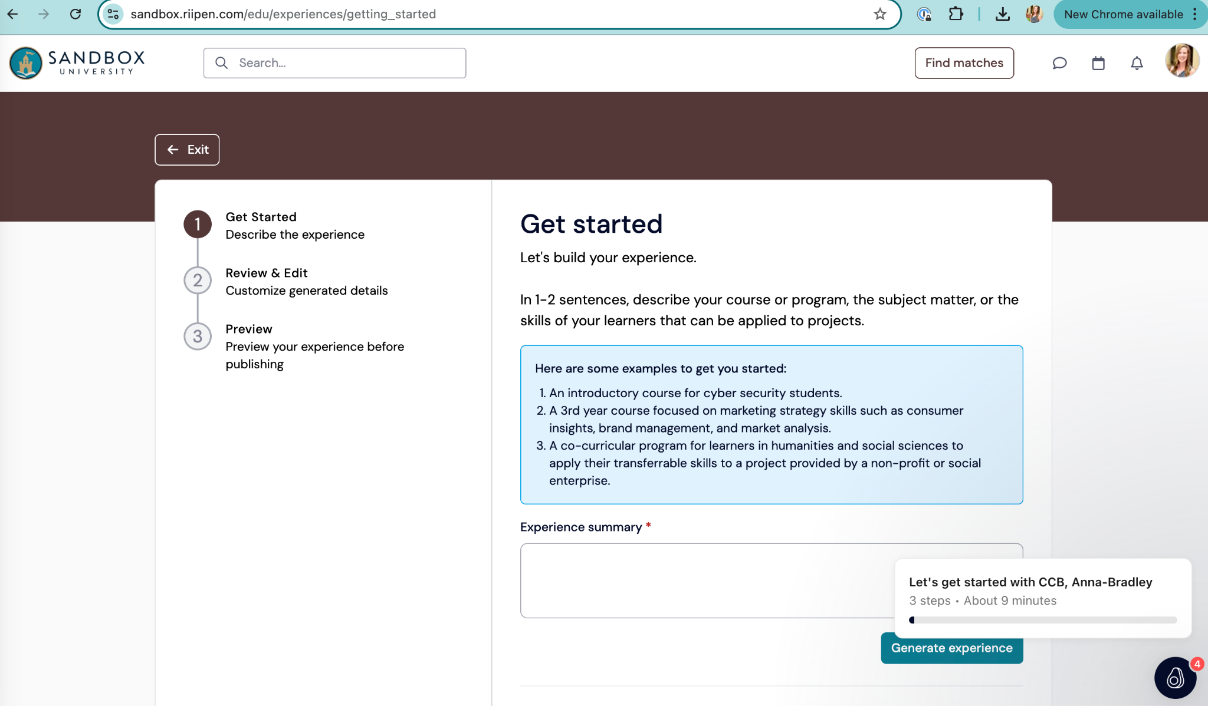

Slide 9
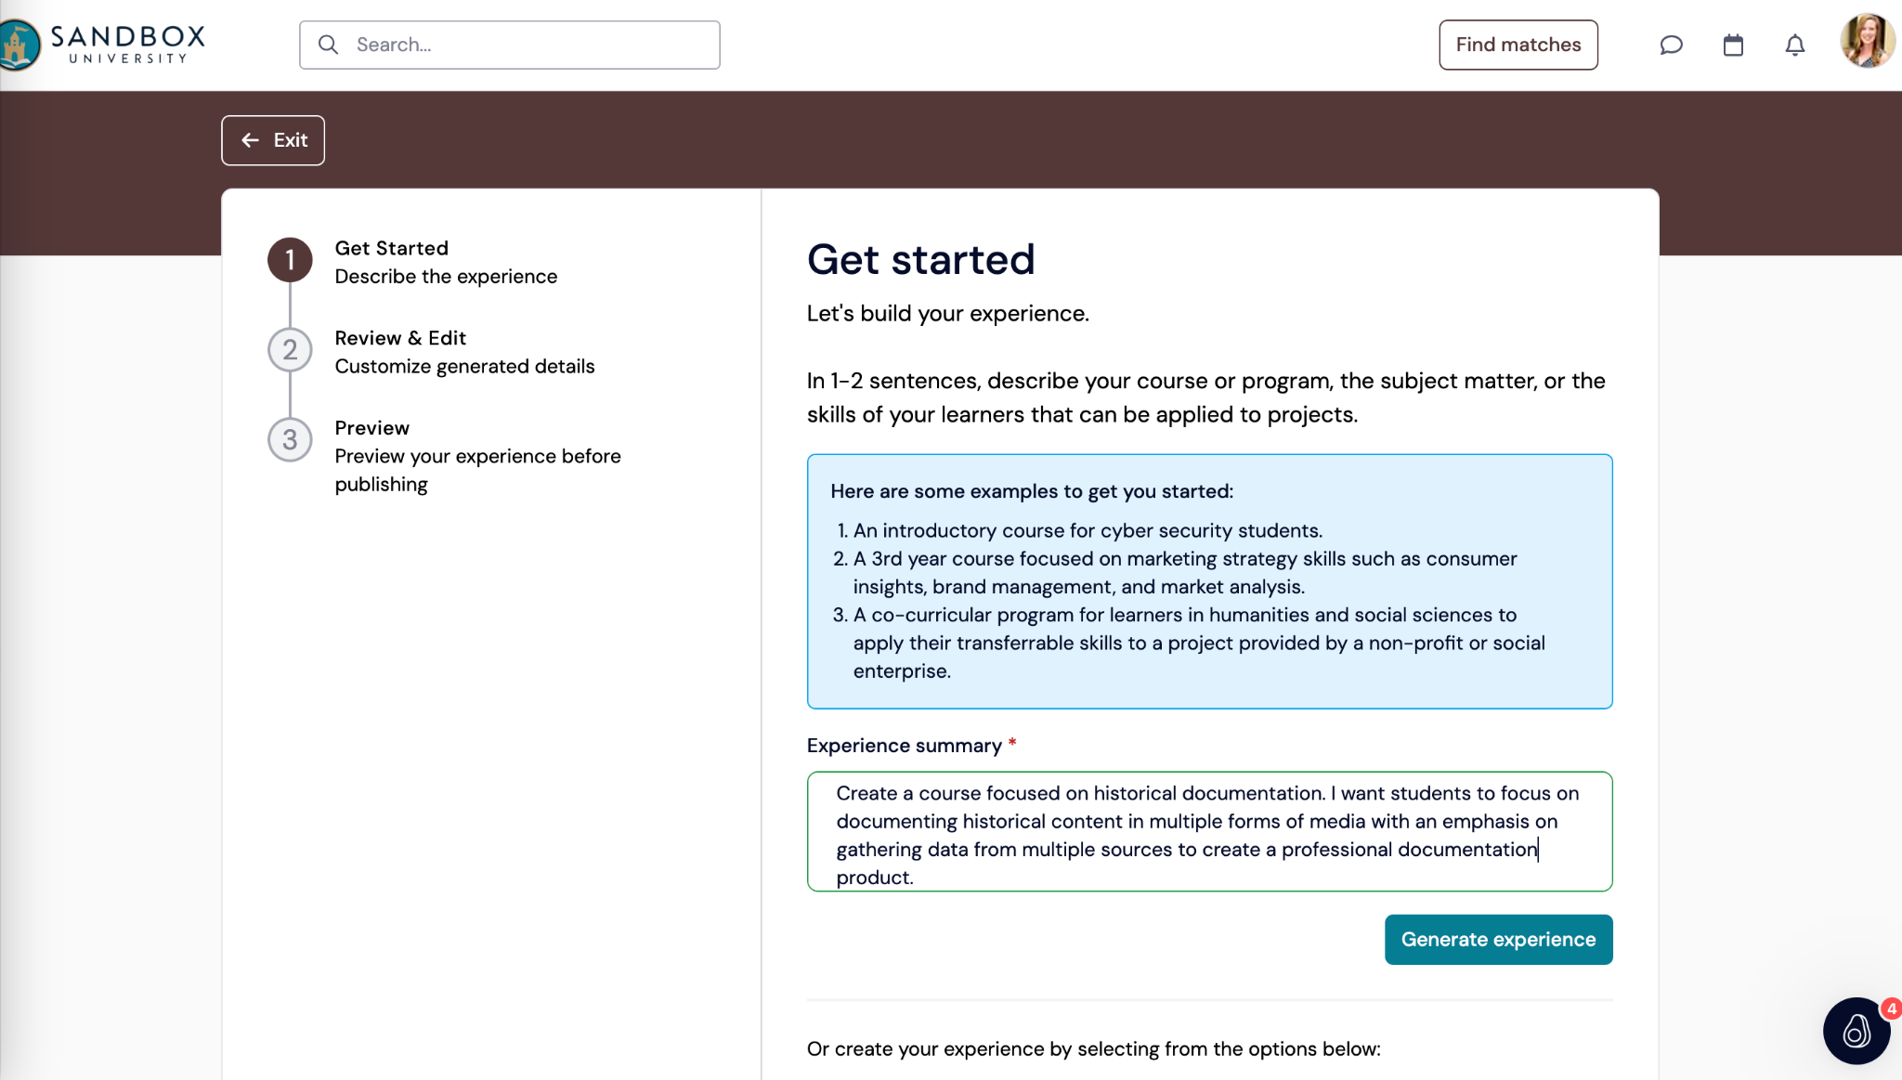

Slide 10
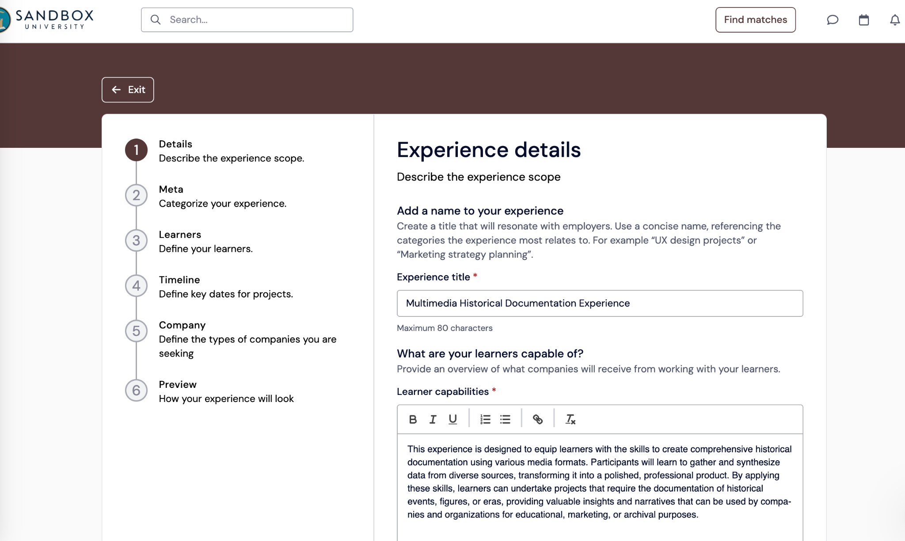

Slide 11
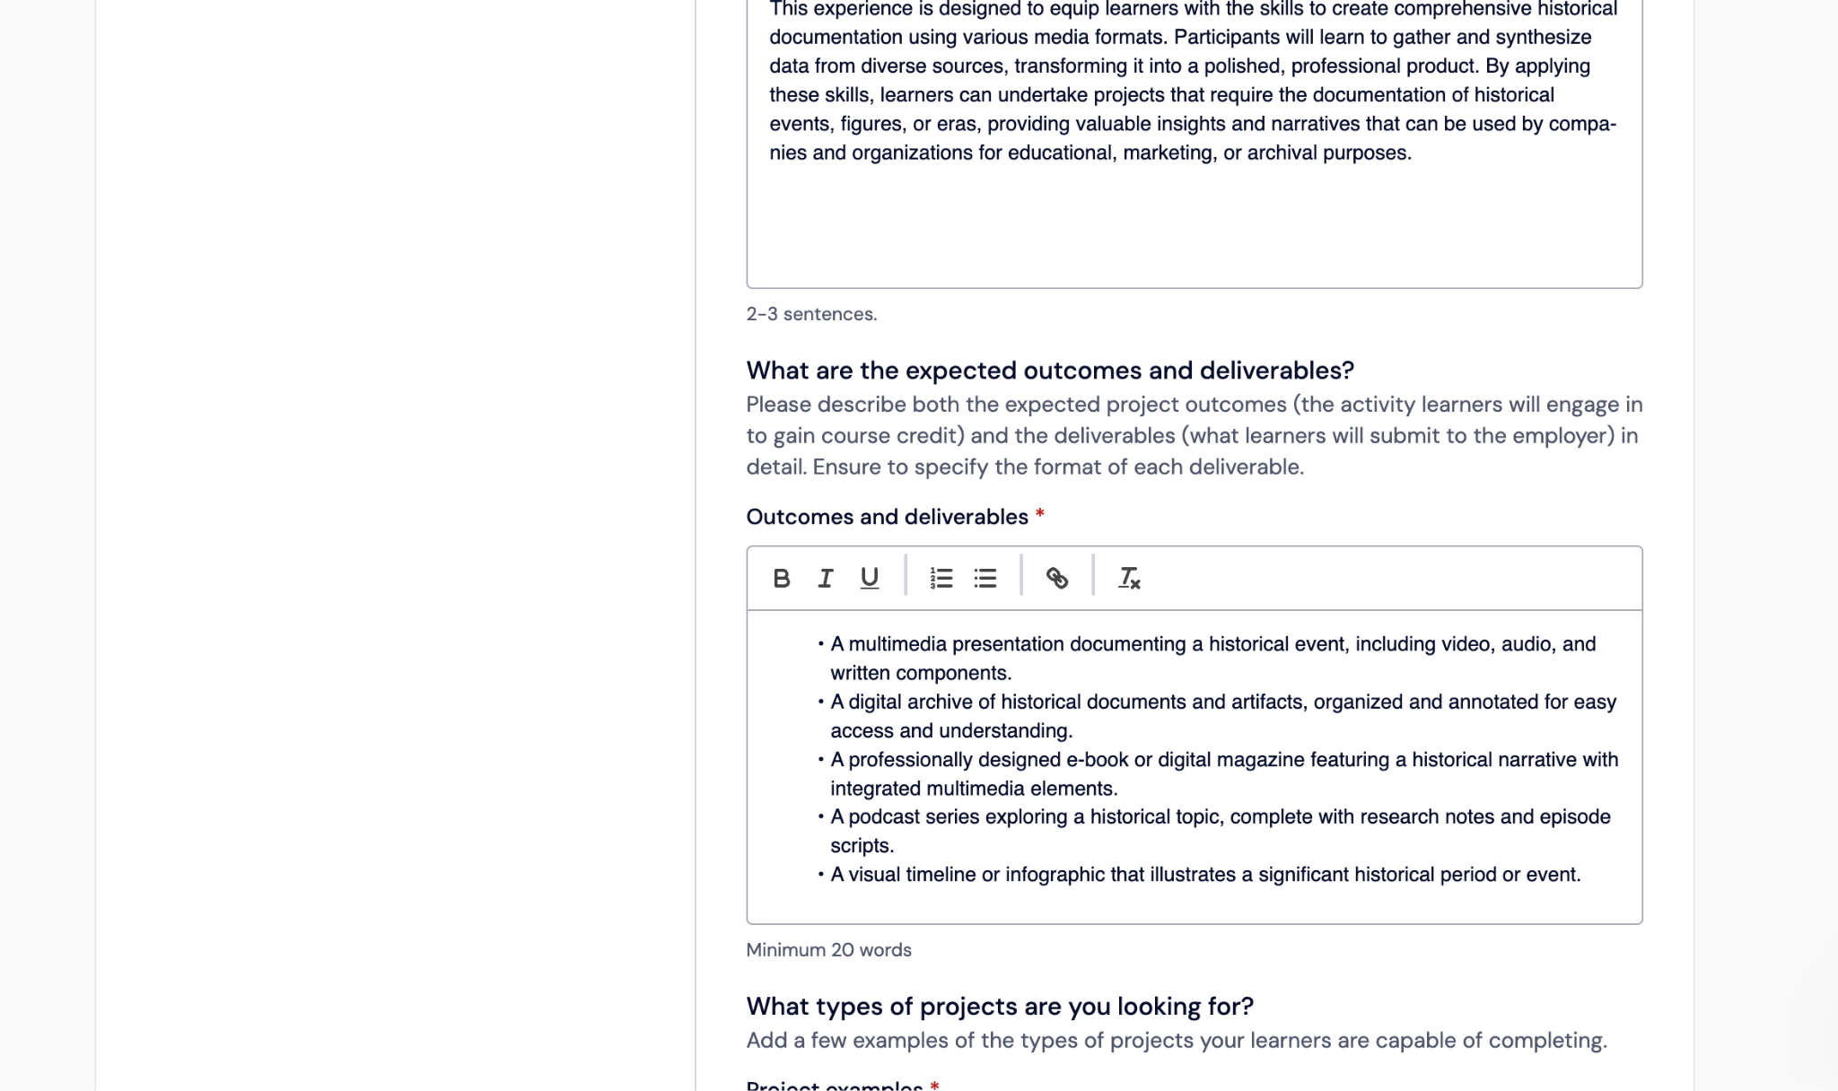

Slide 12
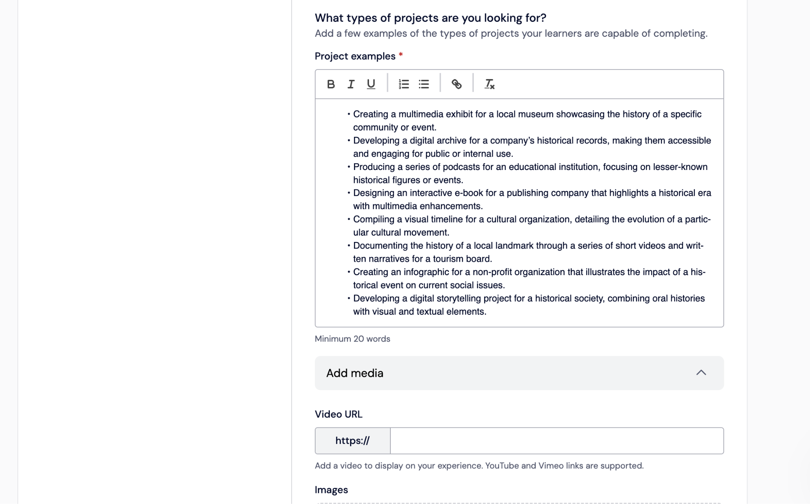

Slide 13
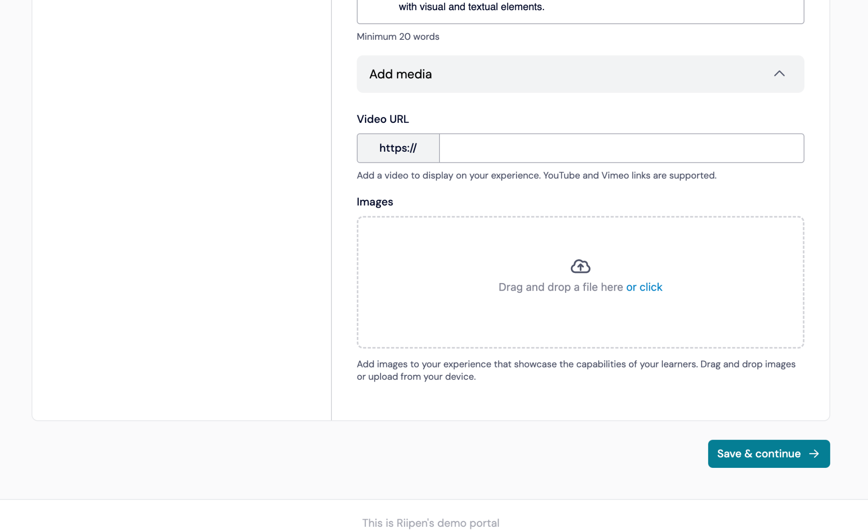

Slide 14
Group Activity:
At your tables, come up with five courses that are good candidates for WBL
Short present to group

Slide 15
Demonstration:
Define project scope
Considerations before working with a corporate partner/ employer

Slide 16
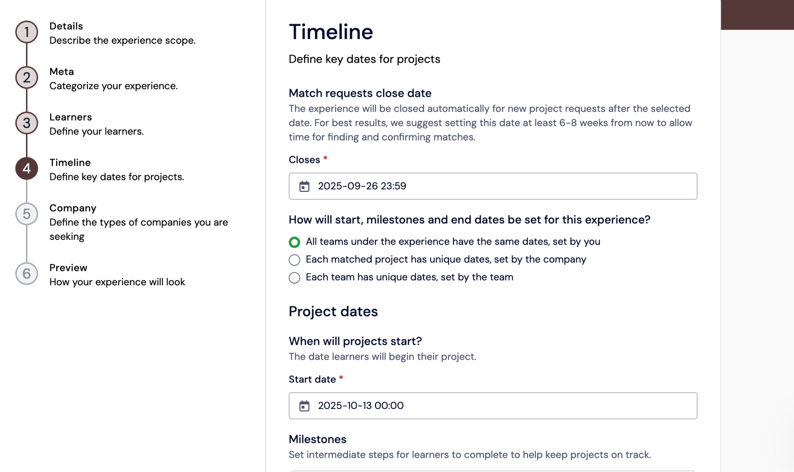

Slide 17
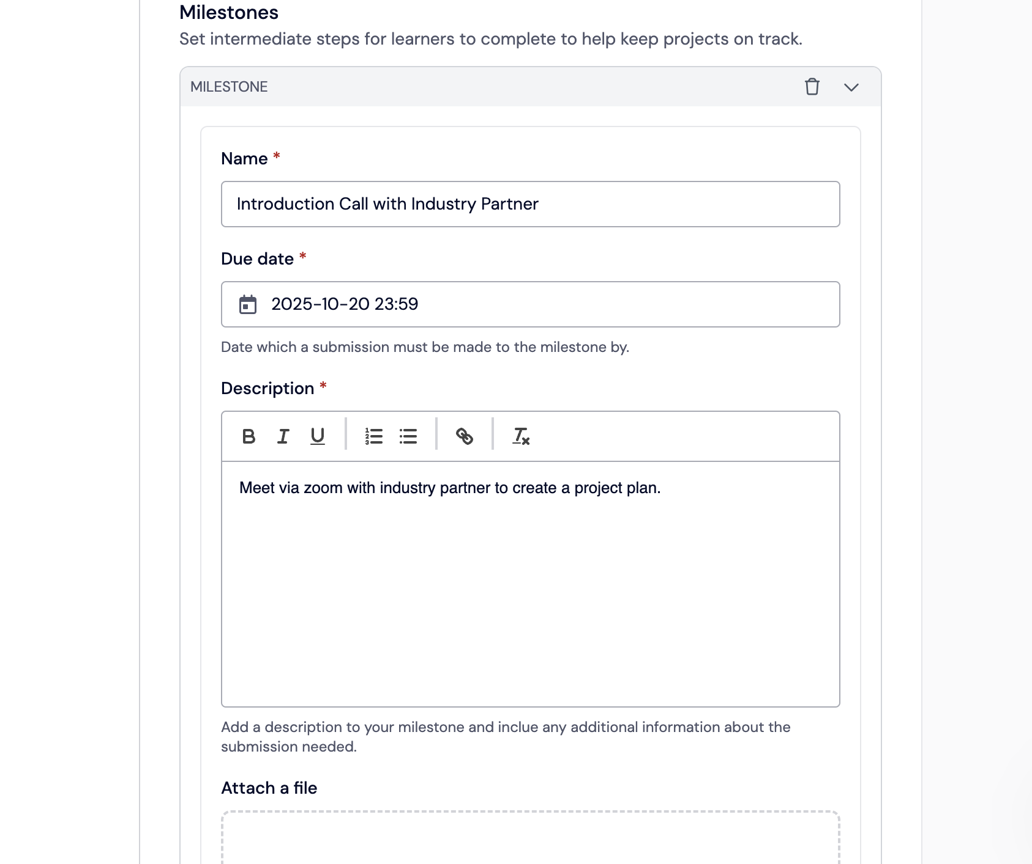

Slide 18
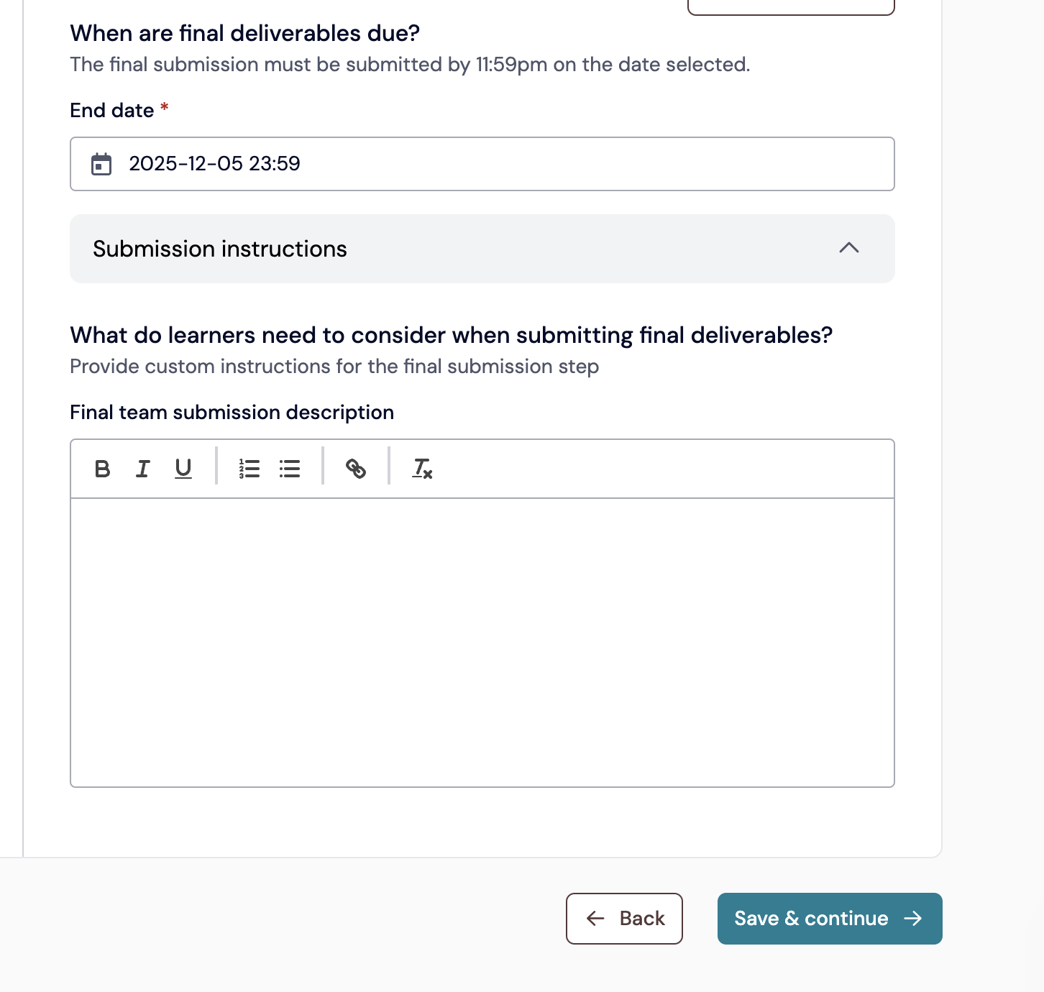

Slide 19
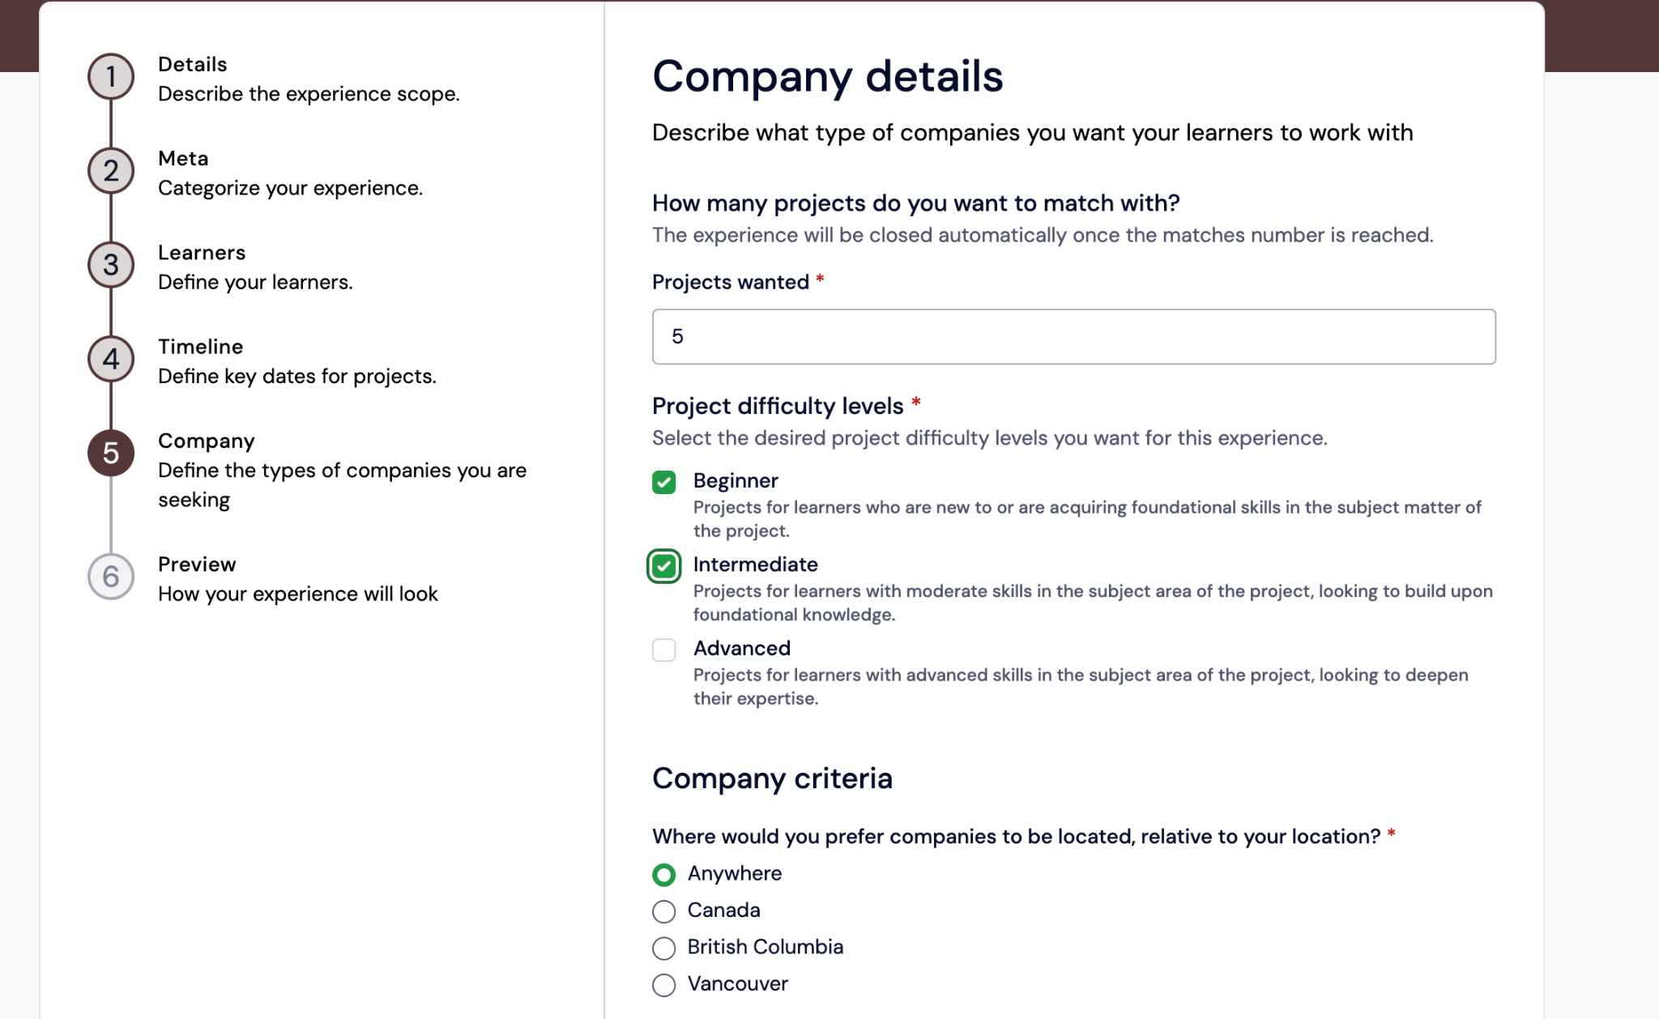

Slide 20
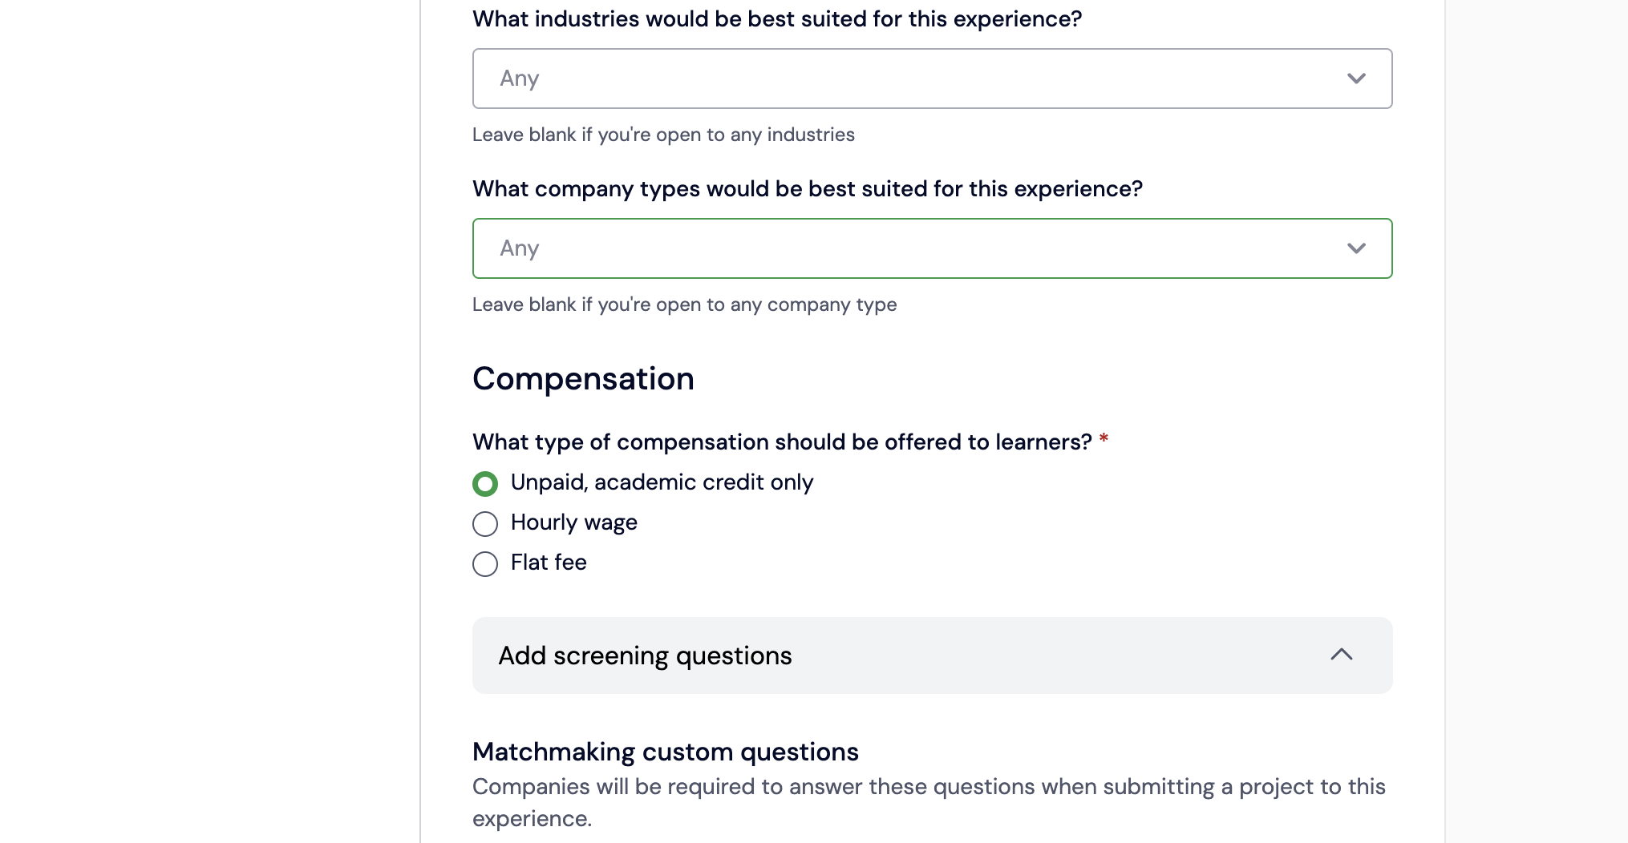

Slide 21
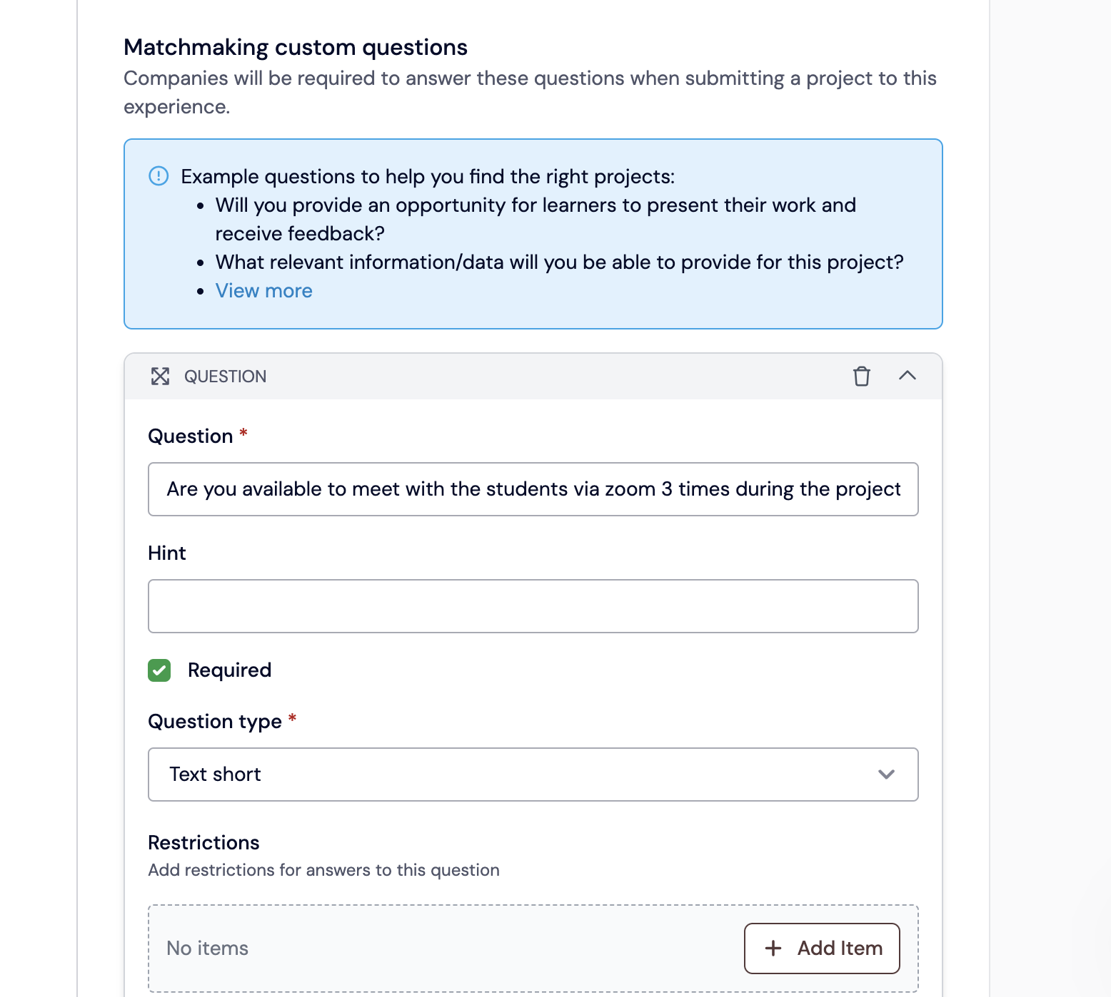

Slide 22
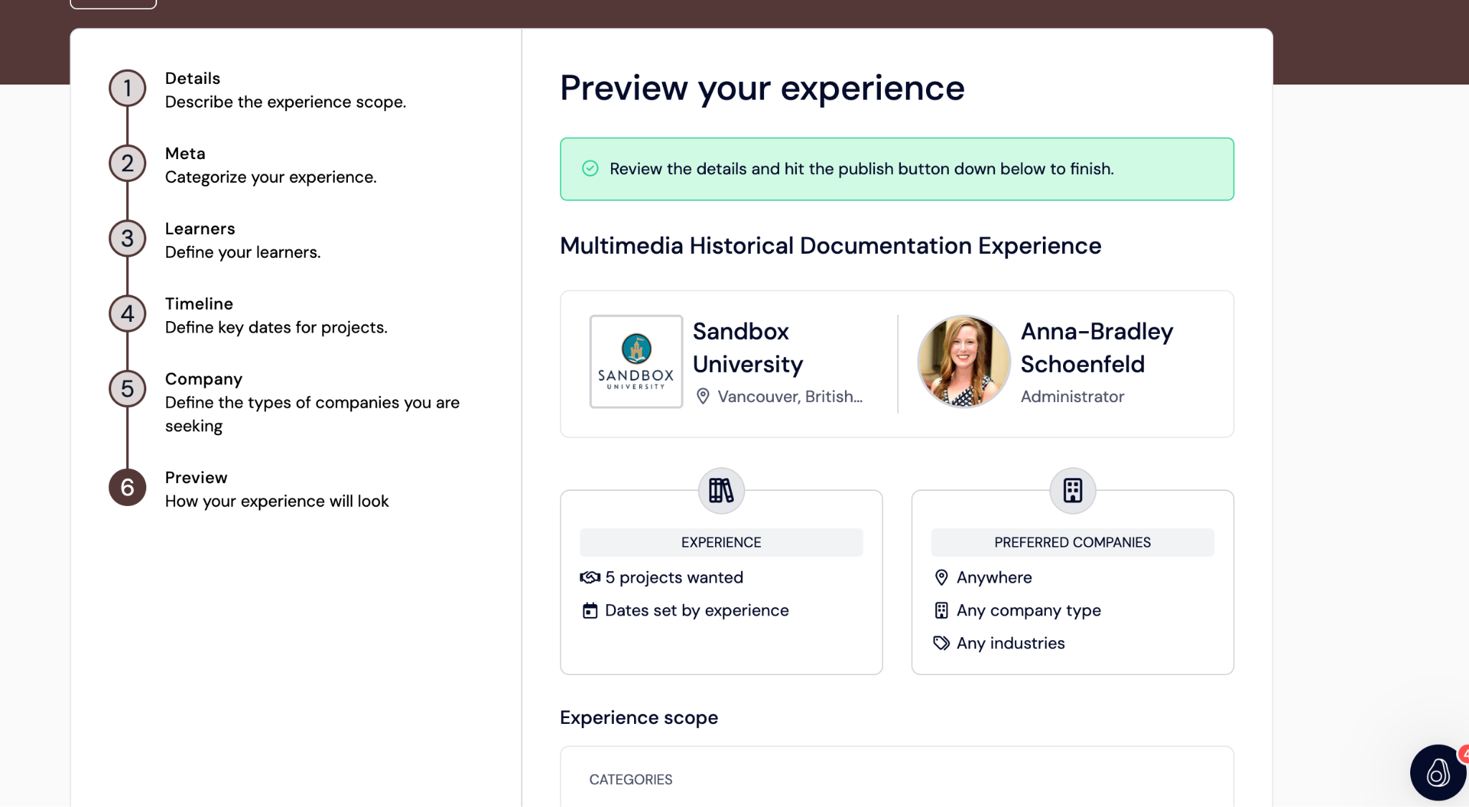

Slide 23
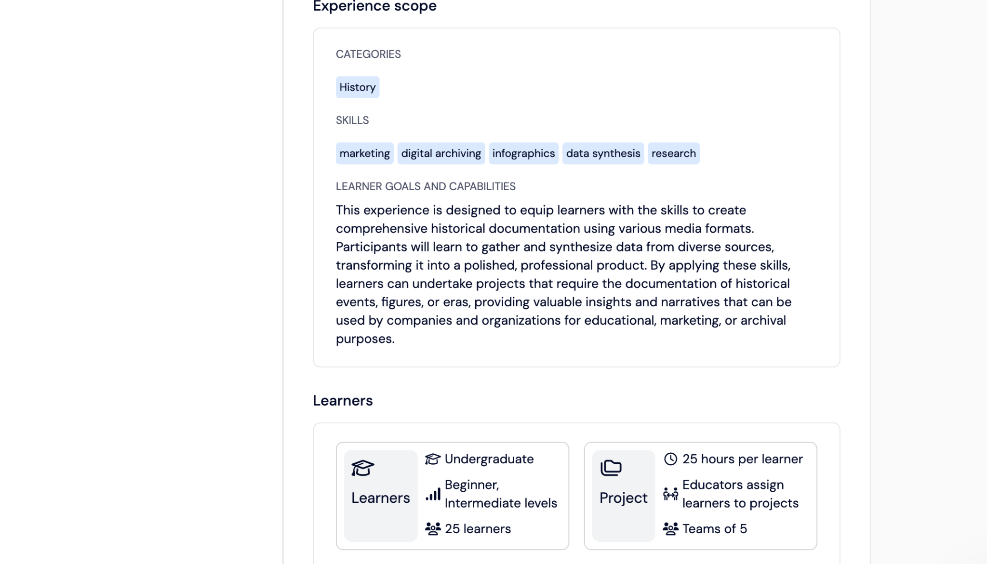

Slide 24
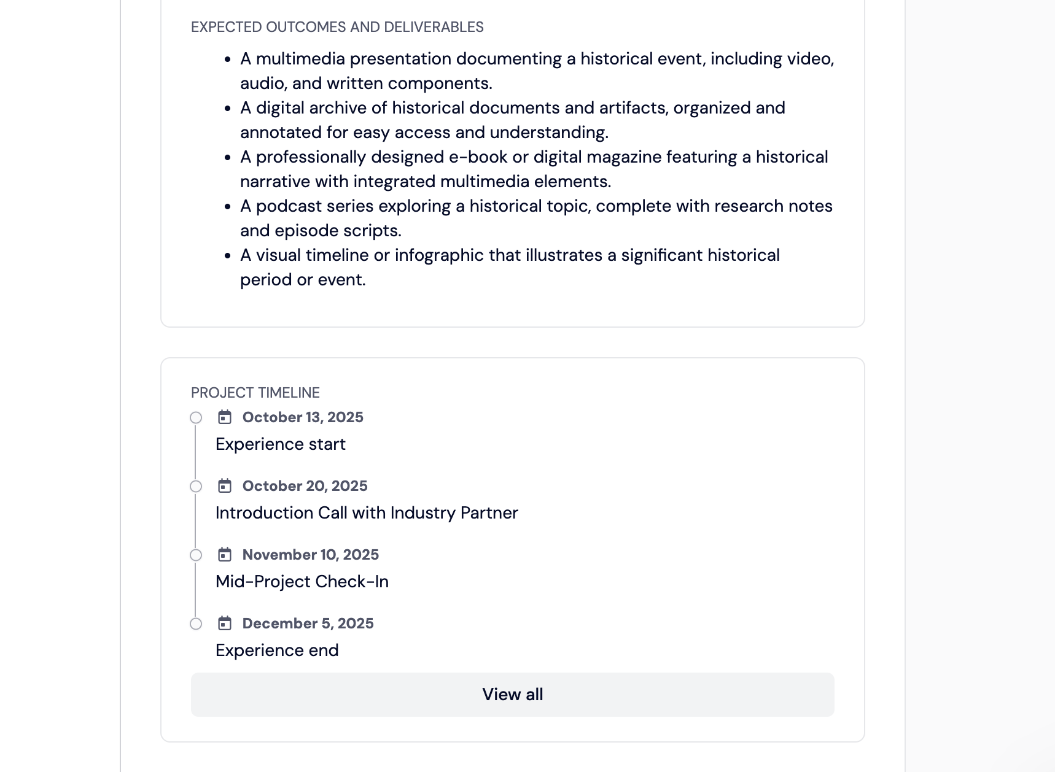

Slide 25
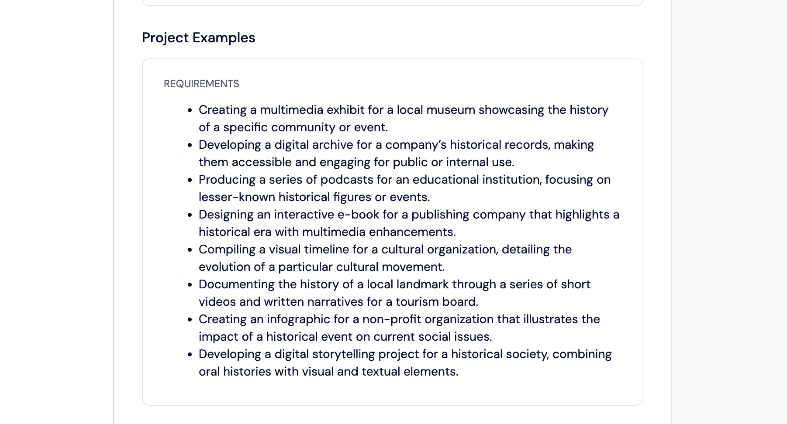

Slide 26
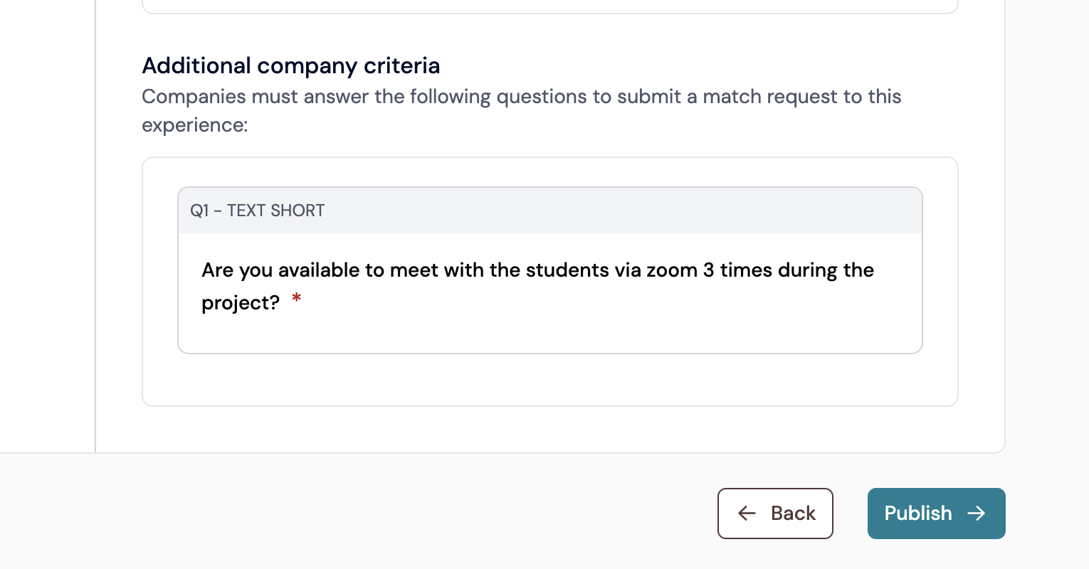

Slide 27
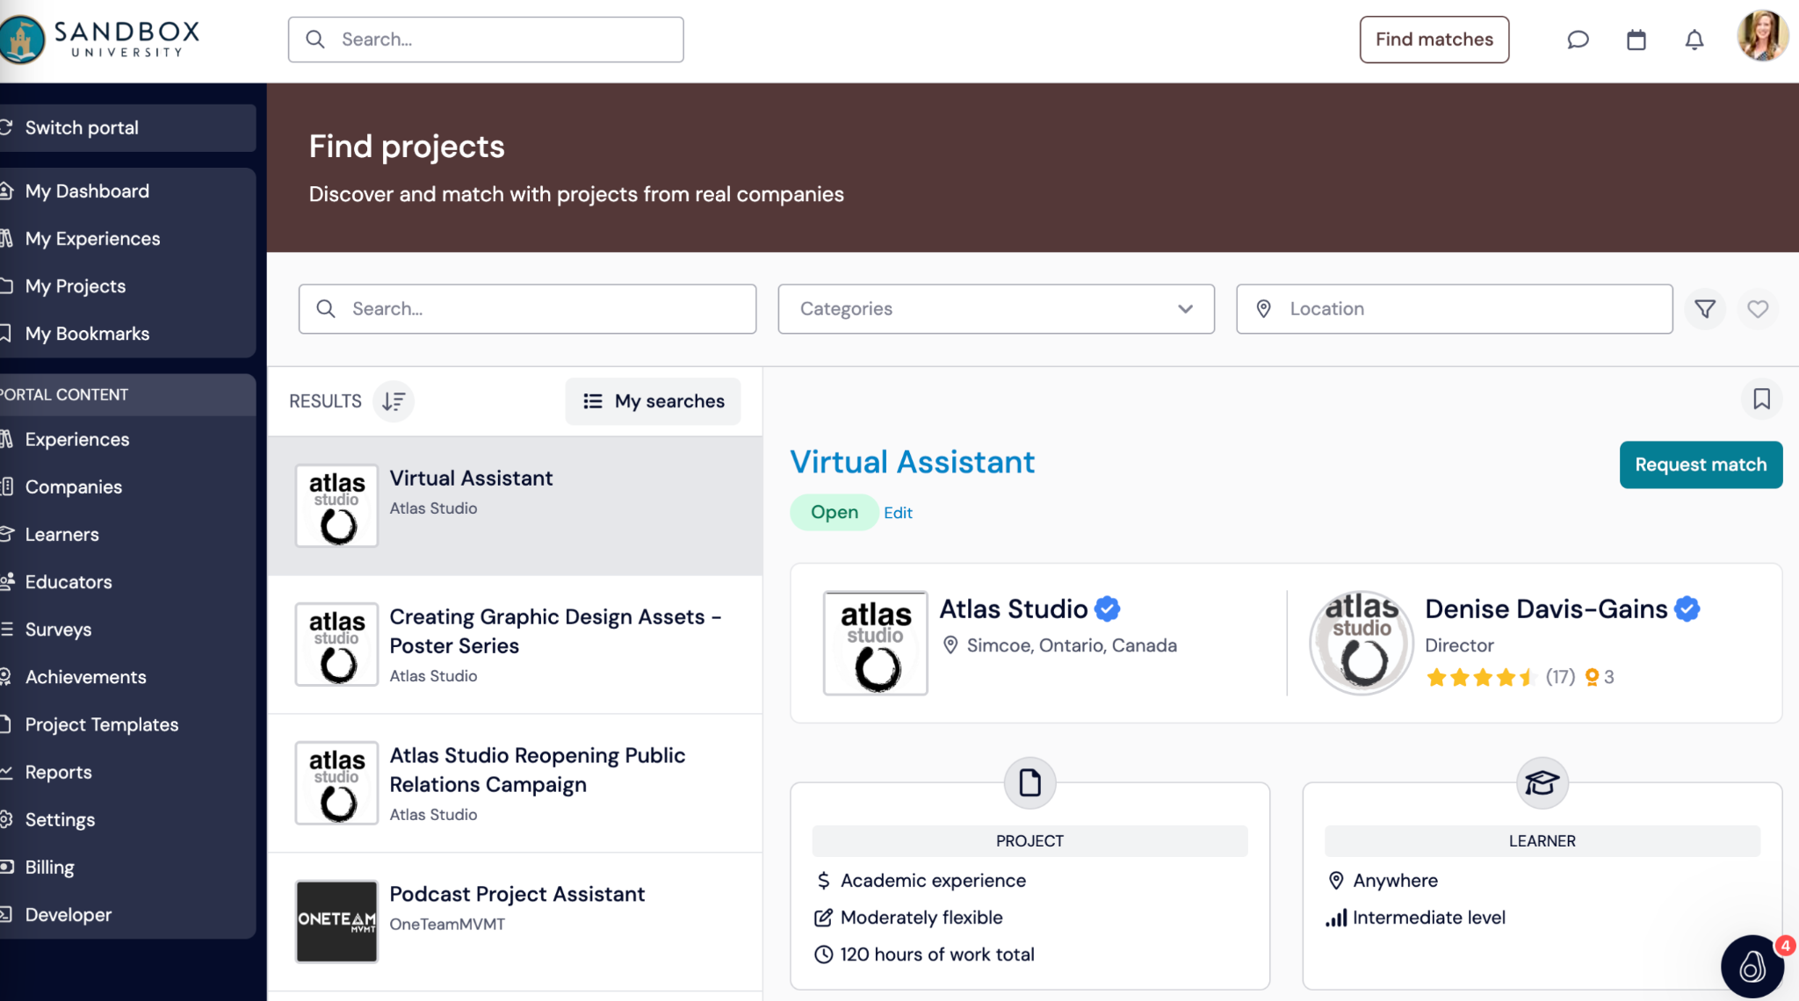

Slide 28
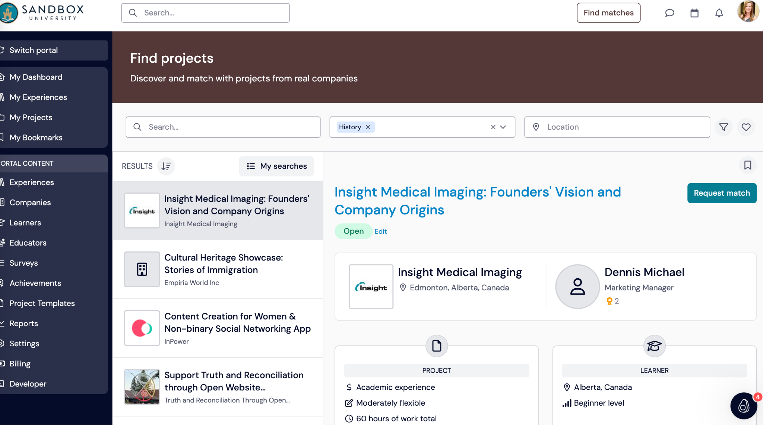

Slide 29
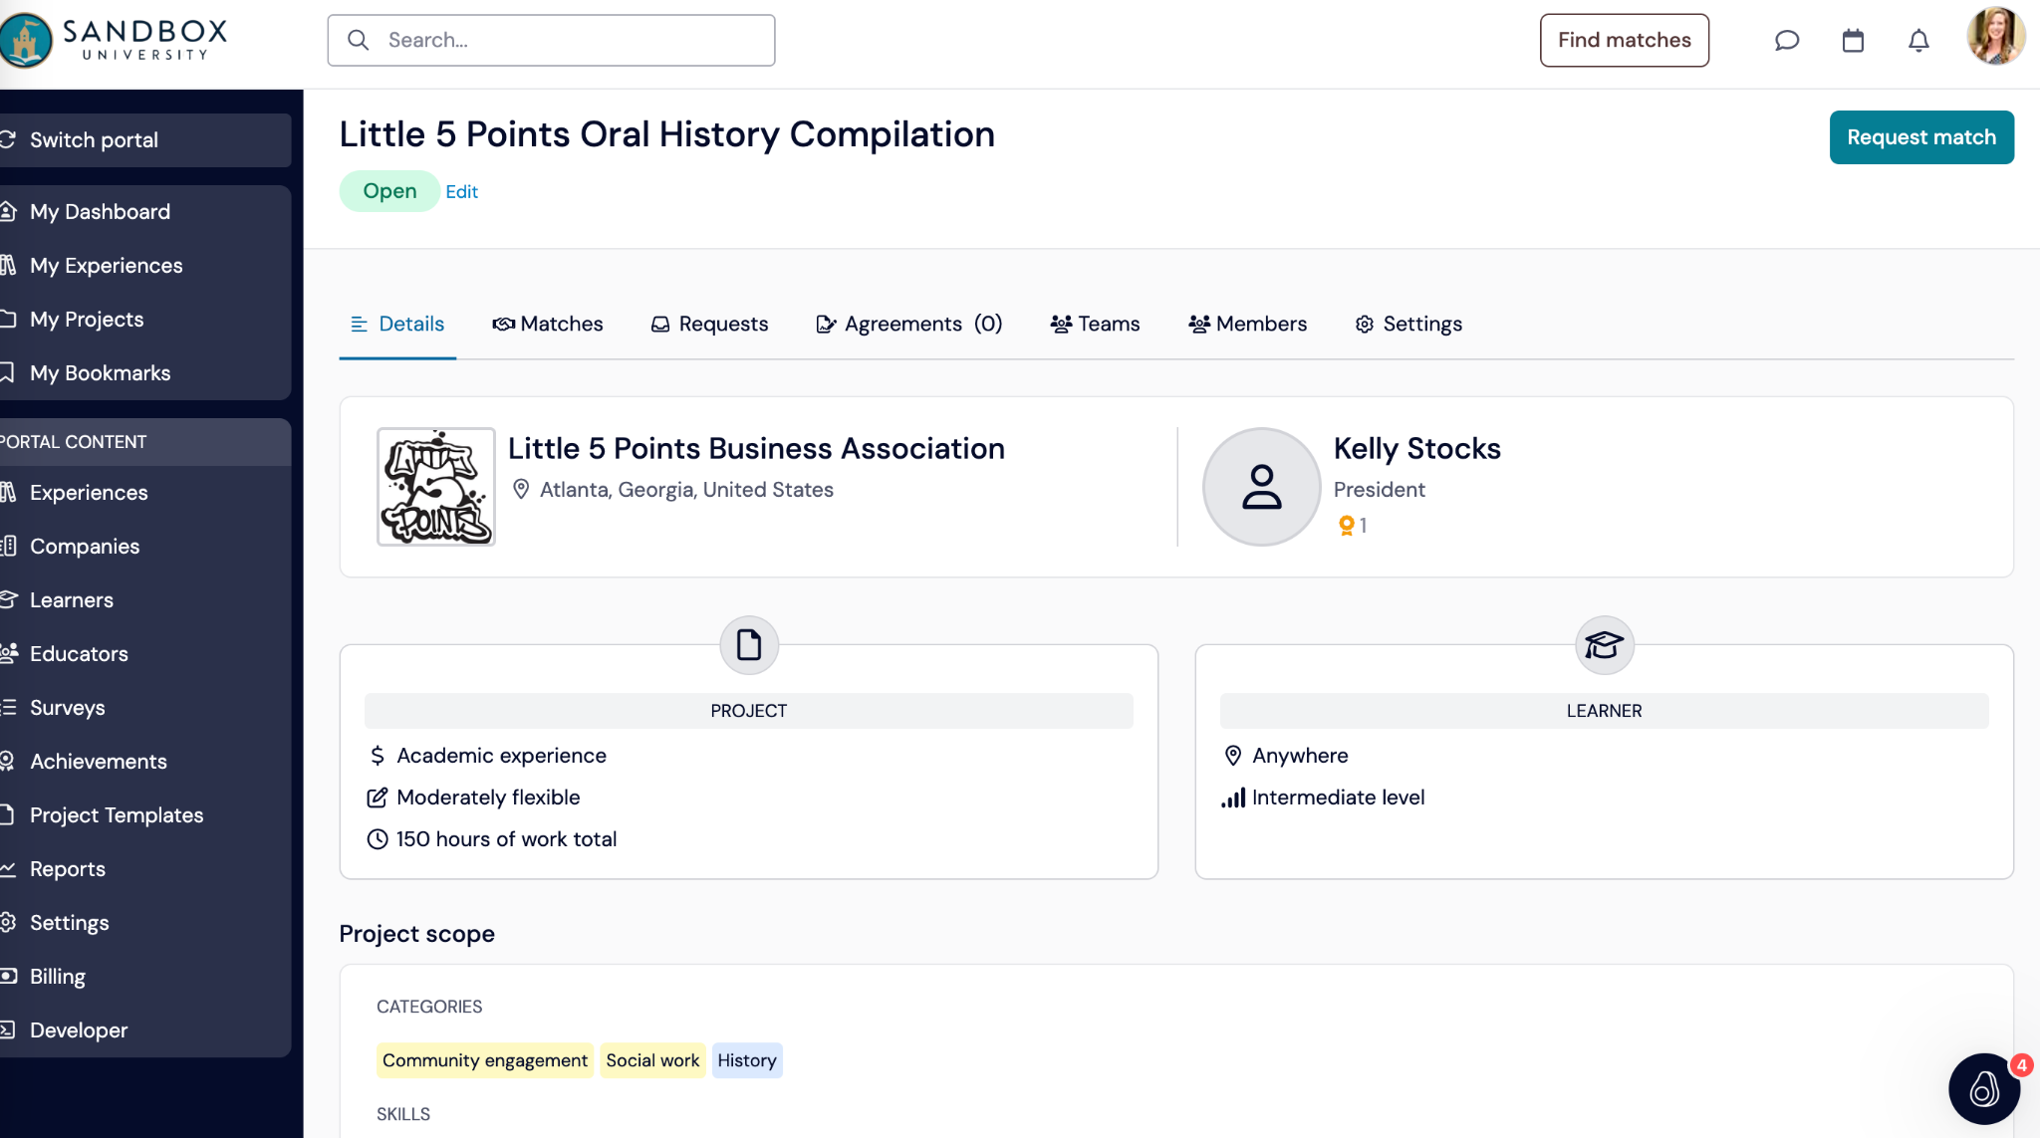

Slide 30
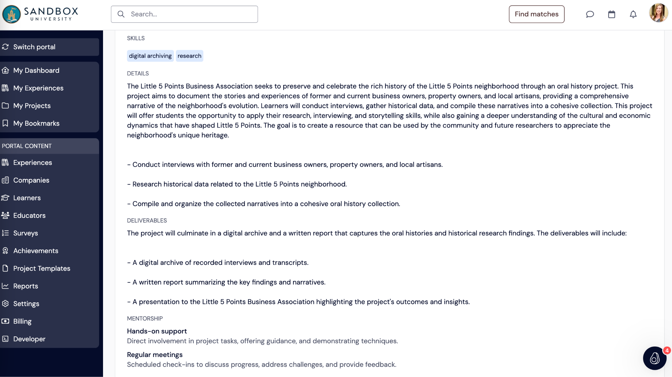

Slide 31
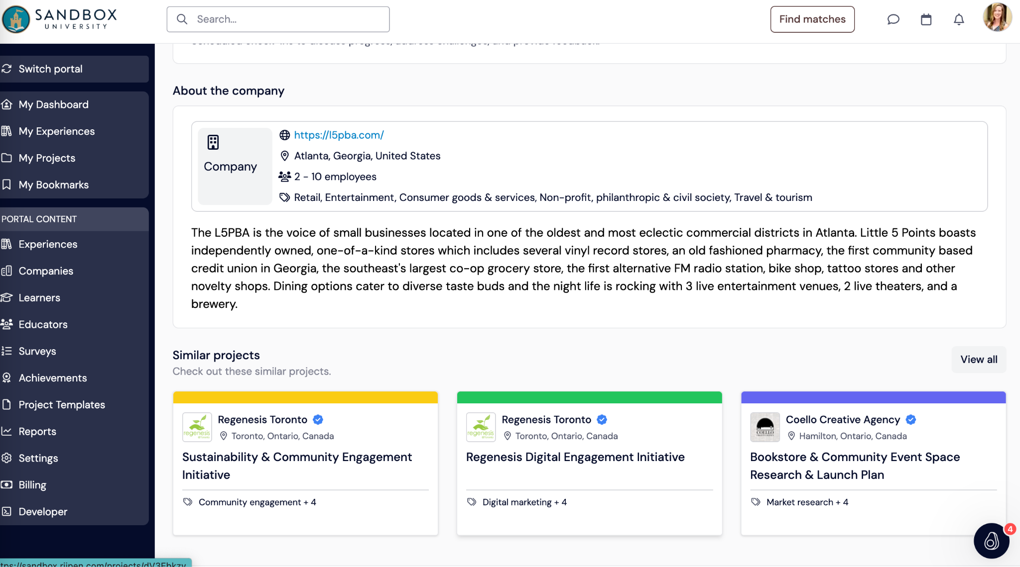

Slide 32
Group Activity:
At your tables, search the Riipen marketplace projects/courses and find/create a high-level idea of project for one of your courses
Short present to group

Slide 33
Demonstration:
How to update/revise projects to meet needs
Faculty review learner progress
Importance of recognized skill development
Impact reporting and measurements

Slide 34
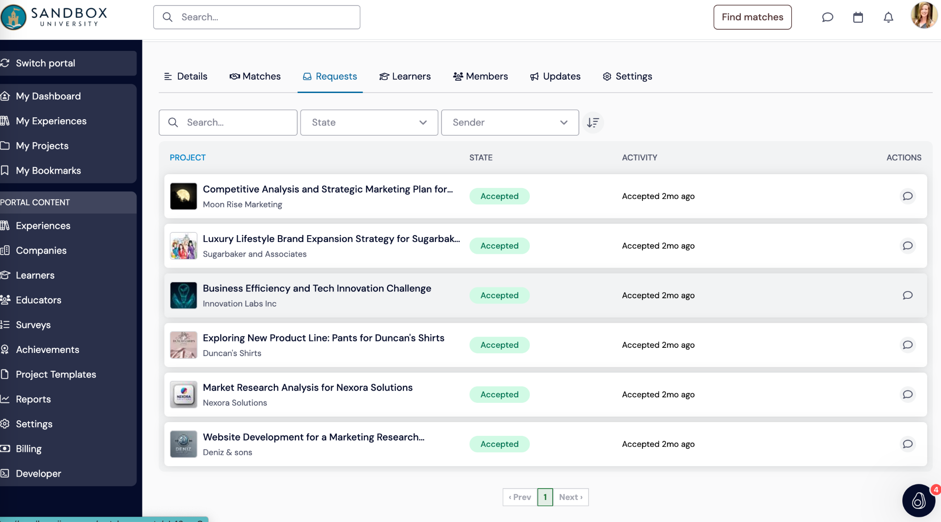

Slide 35
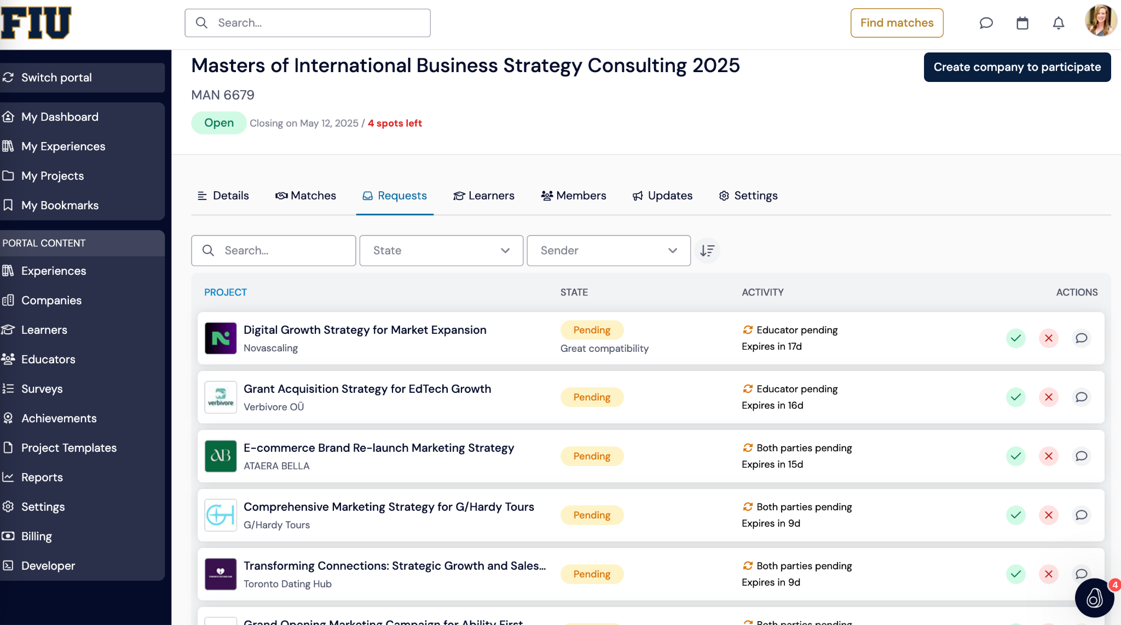

Slide 36
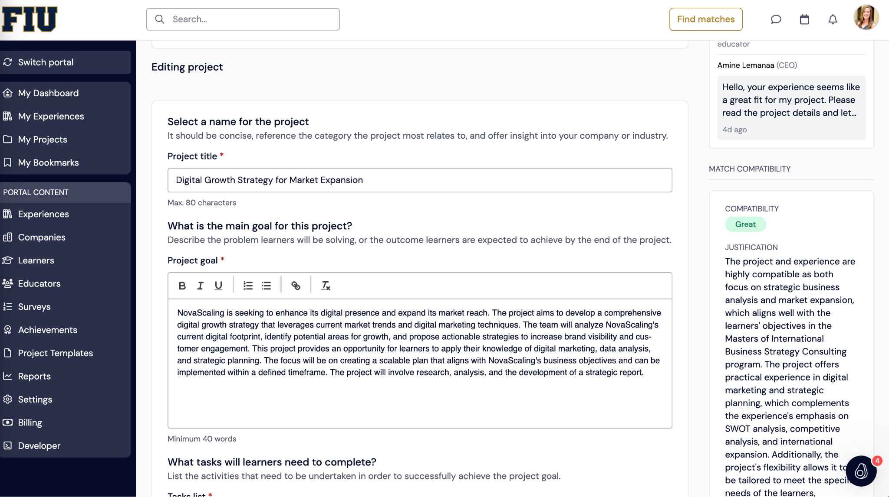

Slide 37
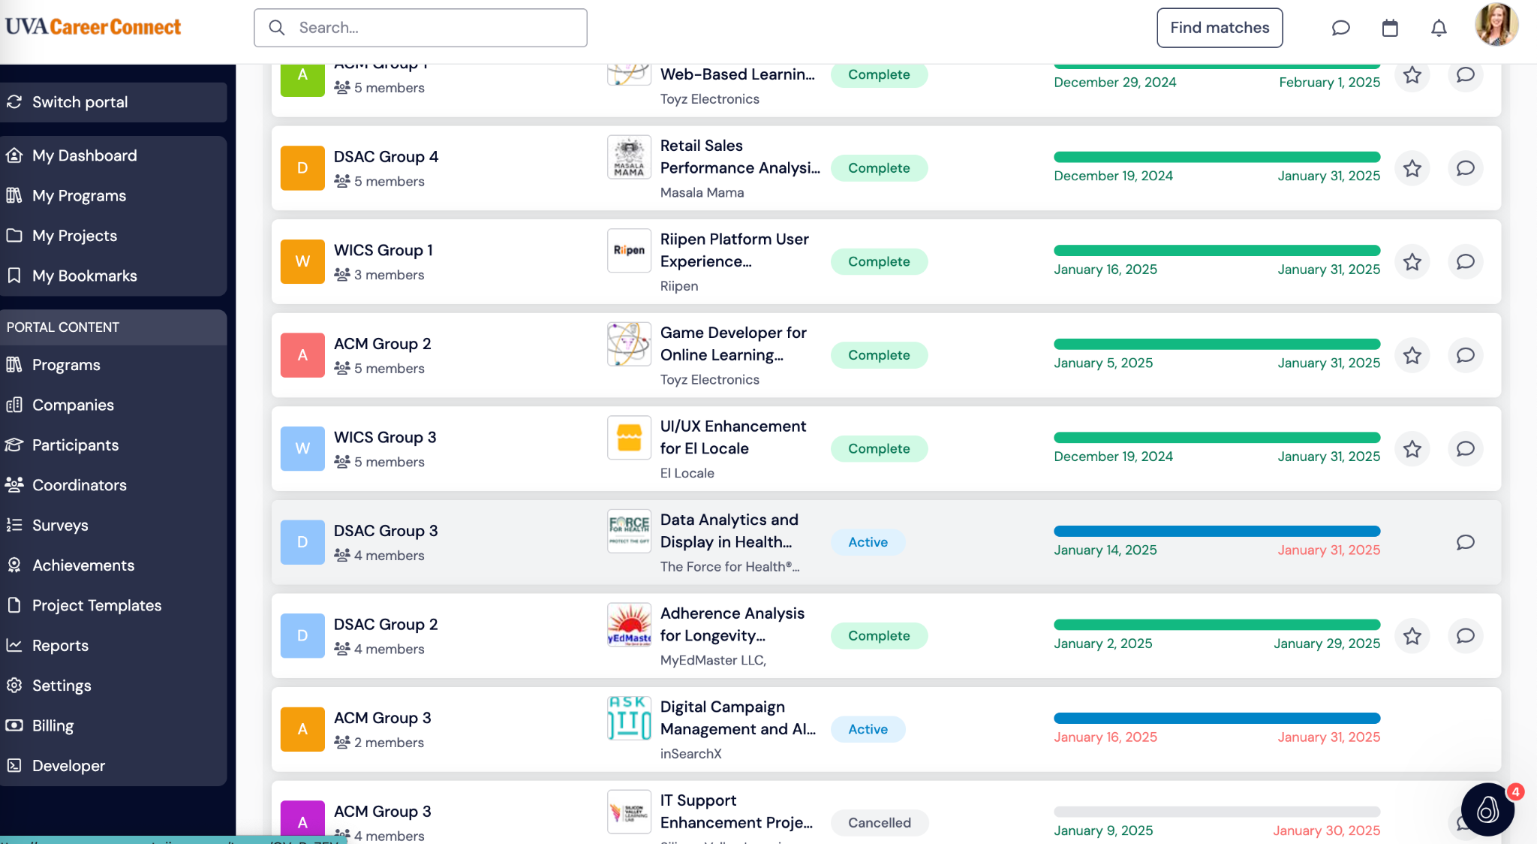

Slide 38
Demonstration:
Impact for learners

Slide 39
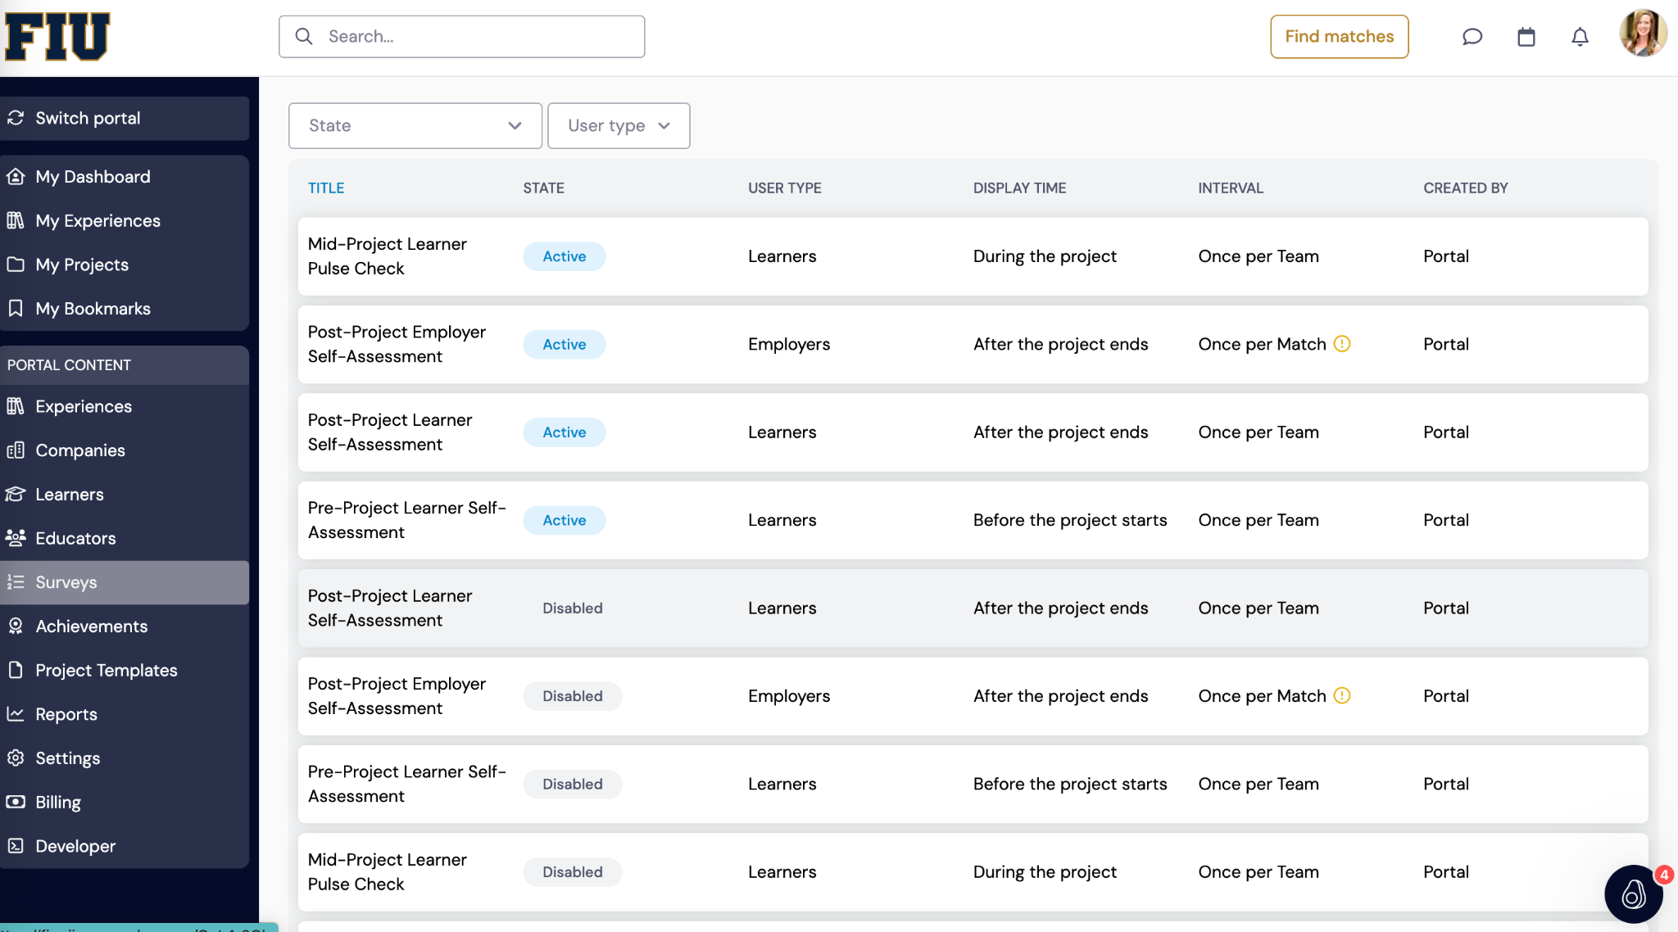

Slide 40
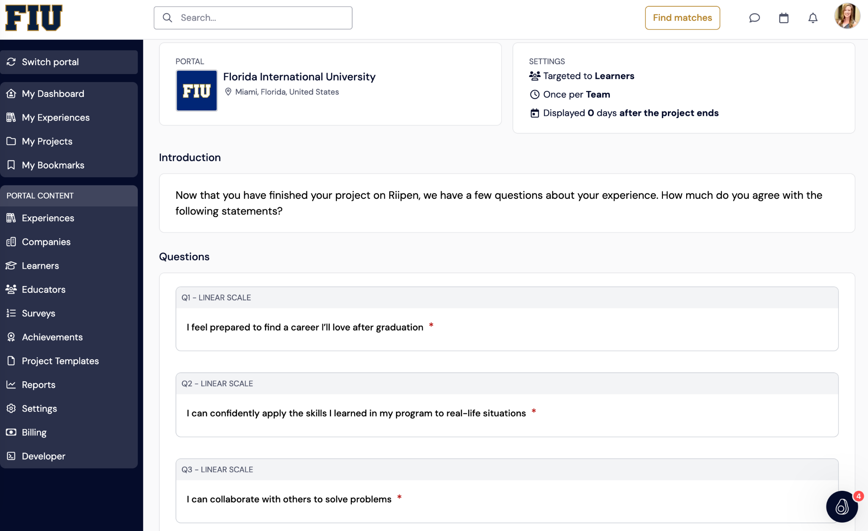

Slide 41
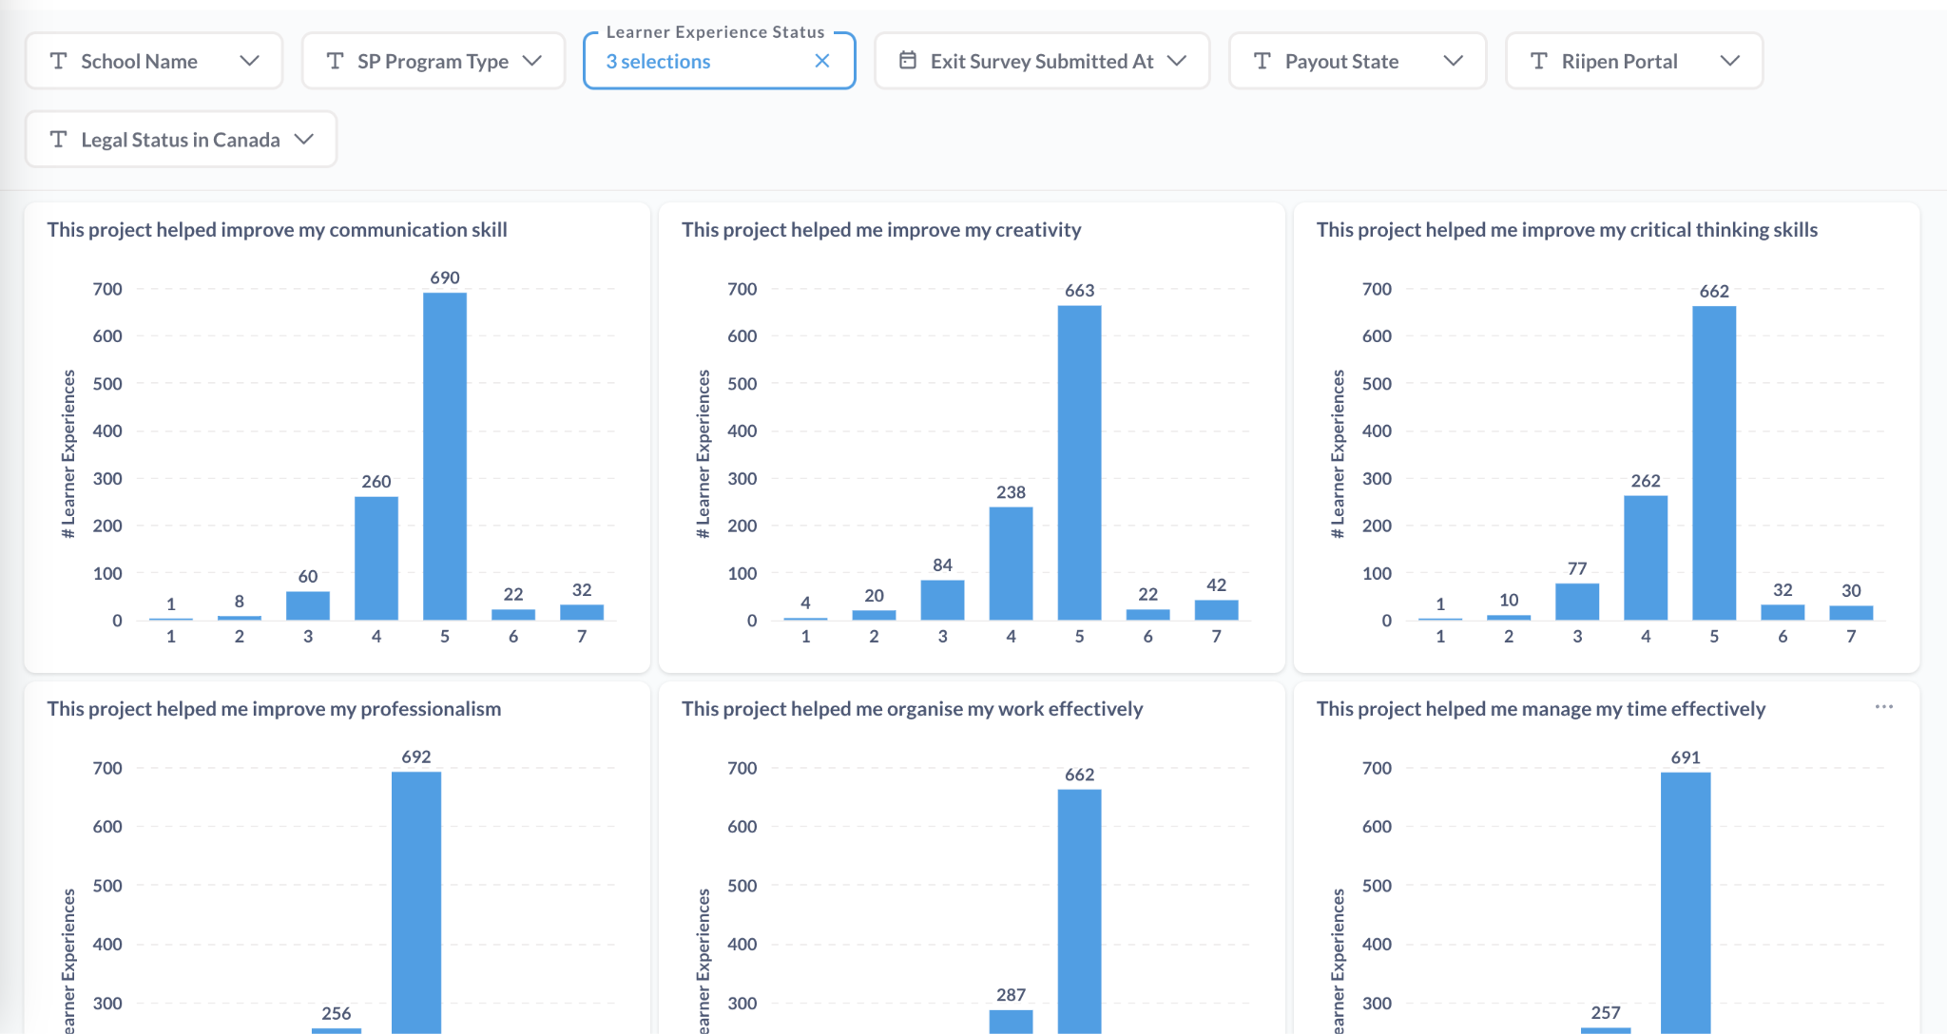

Slide 42
Group Activity:
At your tables, develop assessment questions or measures based on learning objectives, outcomes and strategic goals
Short present to group
Notes:
Don’t forget these metrics: peer collaboration on WBLE outcomes, including networking, skill-building, and career confidence.

Slide 43
Work–based learning value to learners
When developed well, allows learners opportunities to build skills to navigate a complex world, solve the problems of tomorrow, and help shape the world we will all live in.
Assessment and success measures provide opportunities to continuously improve work-based learning - and keep programming focused on strategic goals and purpose.
We are developing the leaders of tomorrow.
Fletcher Technical Community College:
  Future of the program
  Lessons Learned
  Challenges/opportunities
  Impact

Slide 44
Discussion
Reflection
What Barriers to Student Success does WBL Address?
What Infrastructure Barriers Need to be Addressed to Implement WBL?
What’s Next?

Slide 45
Thank you.

